Slide 1
Prehistoric Cultures
Major Characteristics of Modern Physical Anthropology
#9 - #10

Slide 2
Modern Physical Anthropology
Work on Biocultural Evolution

Slide 3
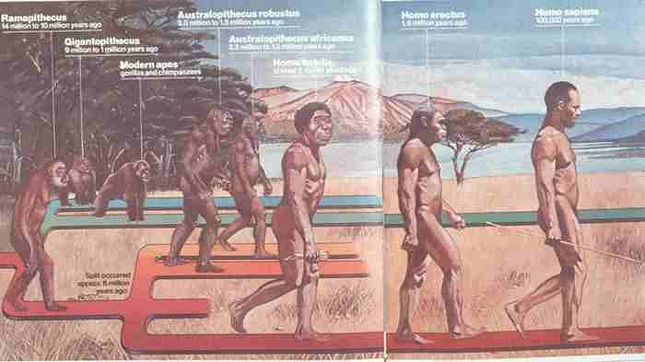

Slide 4
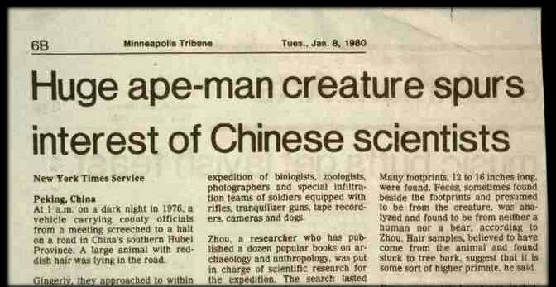

Slide 5
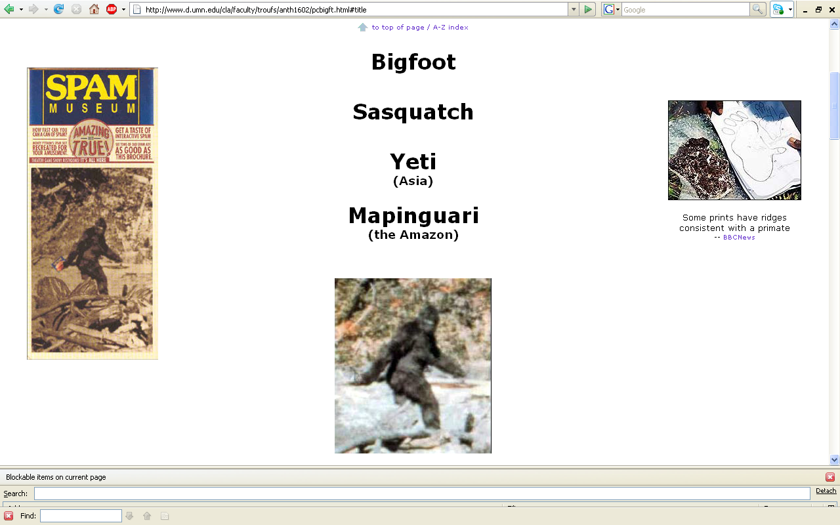
] 6
www.d.umn.edu/cla/faculty/troufs/anth1602/pcbigft.html#title

Slide 6
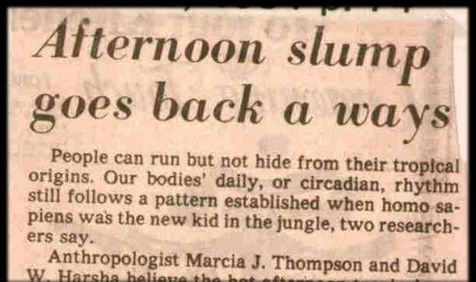

Slide 7
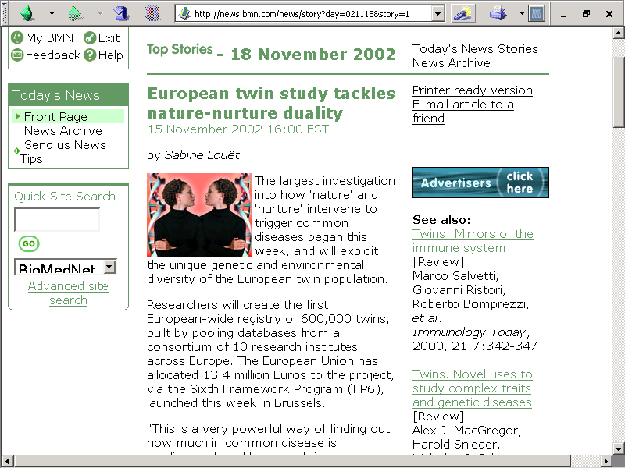
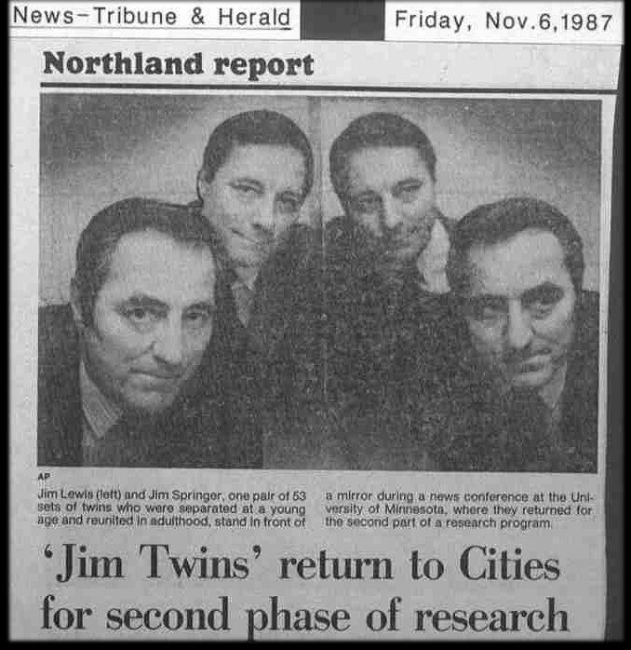

Slide 8
Modern Physical Anthropology
Sociobiology

Slide 9
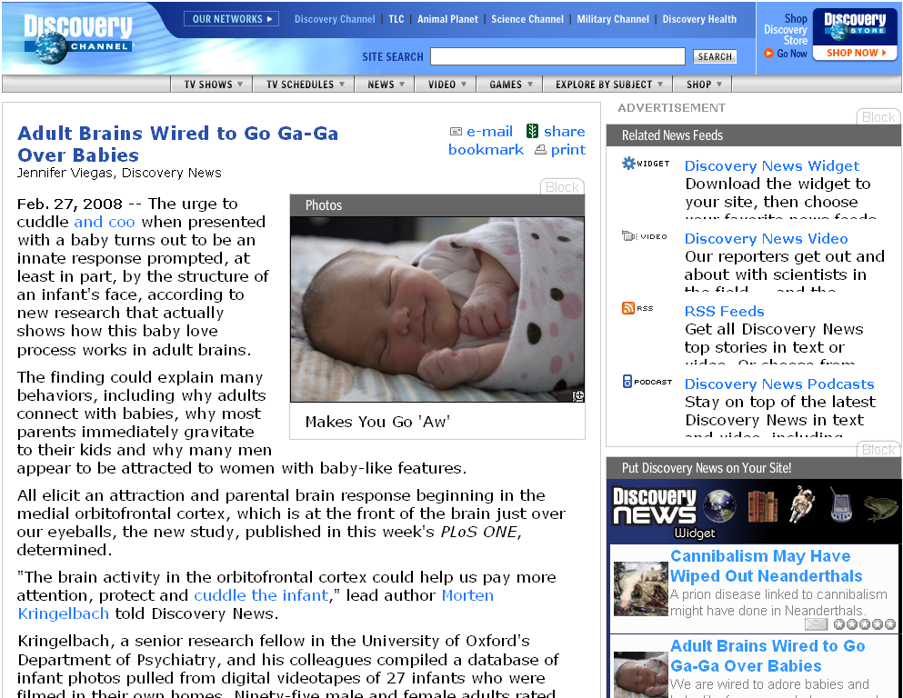
http://dsc.discovery.com/news/2008/02/27/babies-human-brain.html
Notes:
9

Slide 10
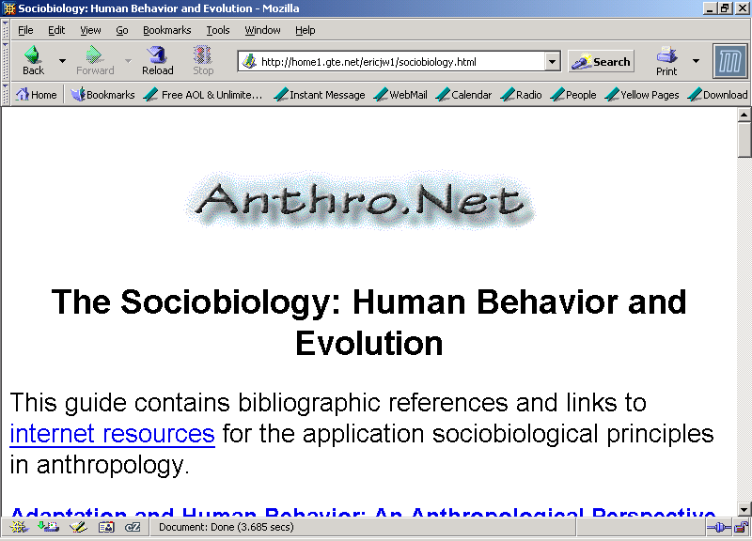

Slide 11
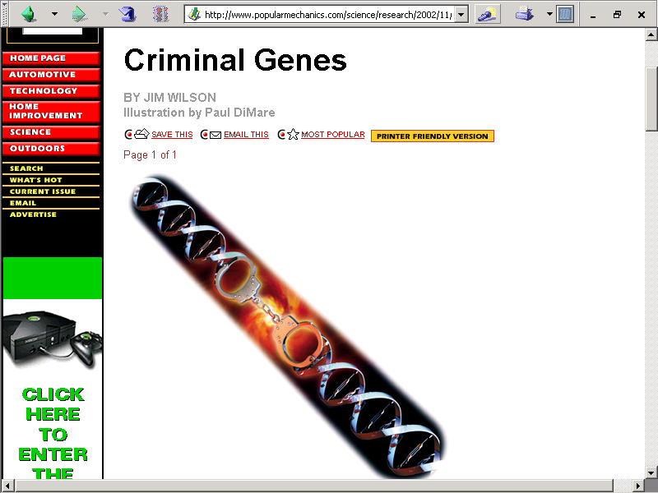

Slide 12
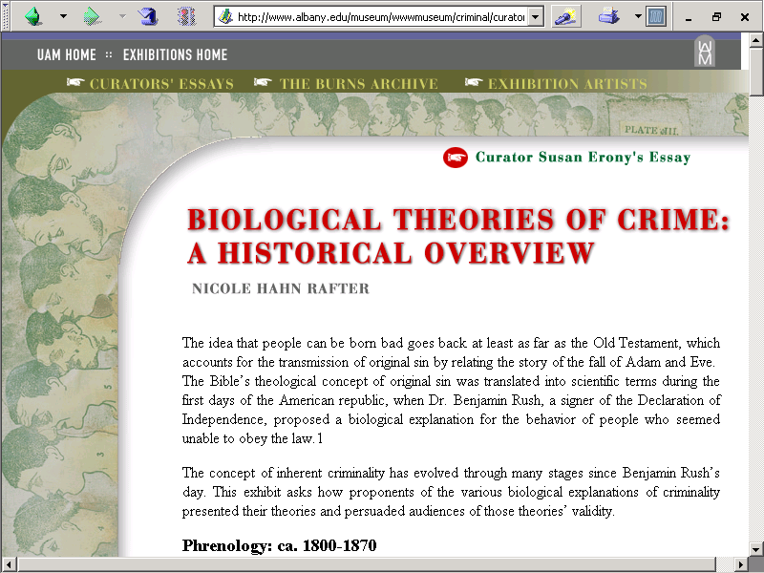
Cesare Lombroso
Earnest A. Hooton
William Sheldon

Slide 13
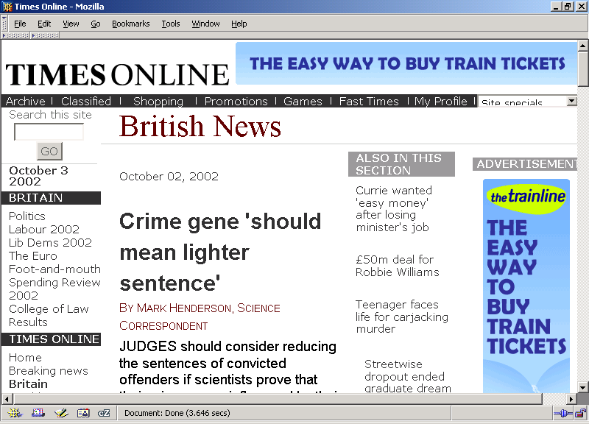

Slide 14
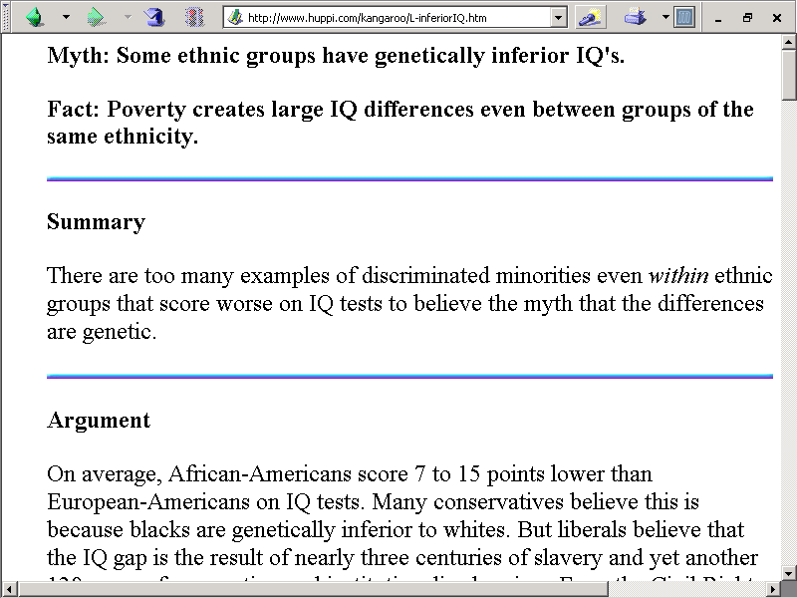

Slide 15


