Slide 1
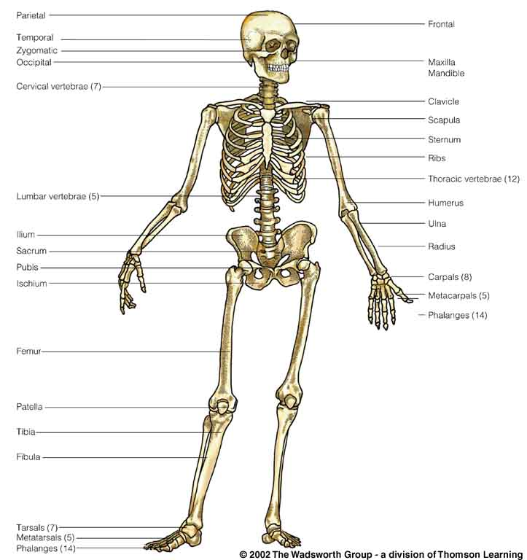
Class Slides Set 15A
Bipedalism
Legs/Feet and Pelvis

Slide 2
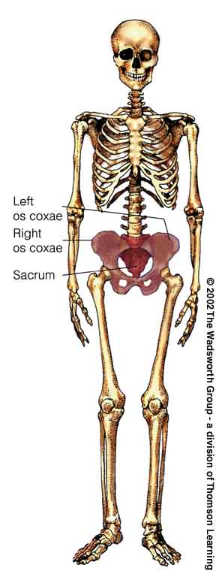
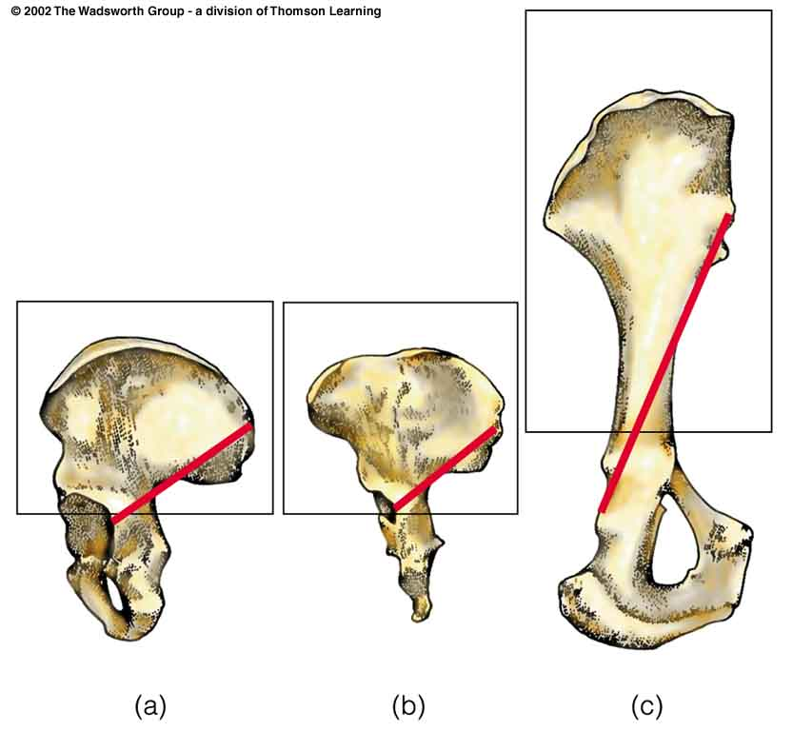
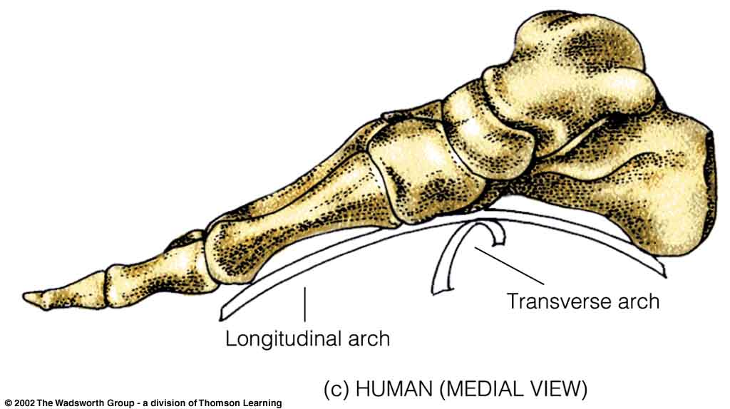
Bipedalism
Legs/Feet and Pelvis

Slide 3
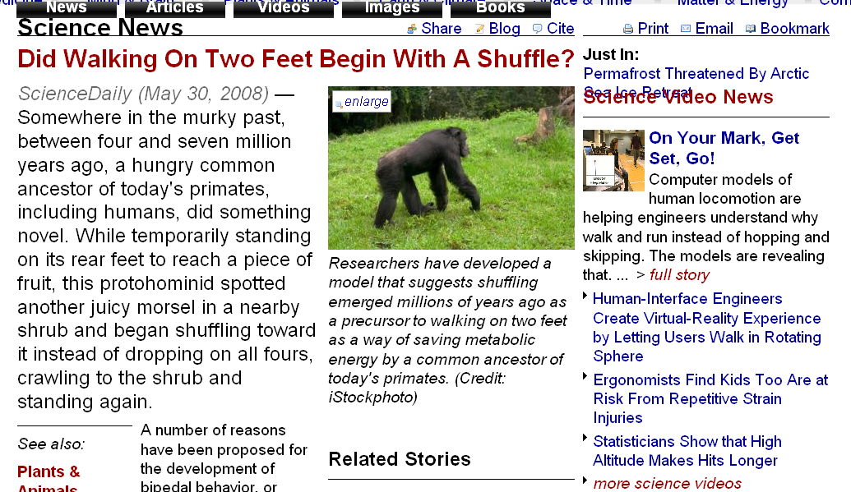
www.sciencedaily.com/releases/2008/05/080529140042.htm
Notes:
3

Slide 4
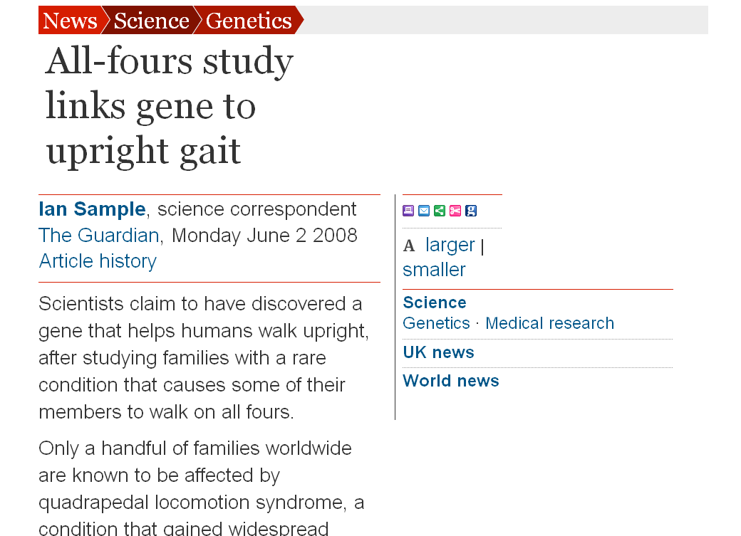
www.guardian.co.uk/science/2008/jun/02/genetics.medicalresearch
Notes:
4

Slide 5
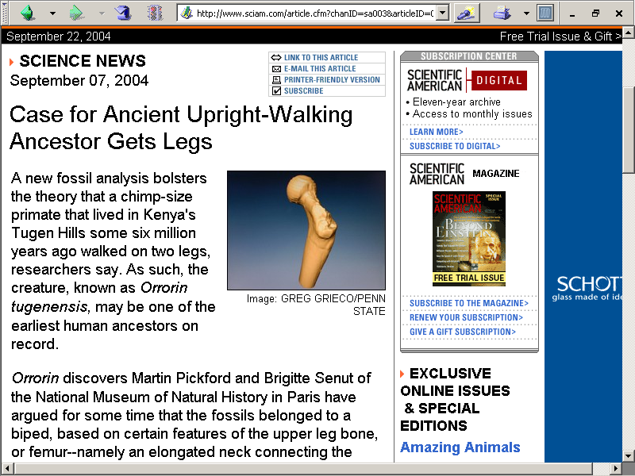
http://www.sciam.com/article.cfm?chanID=sa003&articleID=0008EB7D-BC26-1138-BC2683414B7F0000

Slide 6
Arm swinging
and
erect (bipedal)
or
semi-erect walking
resulted in a number of postcranial changes

Slide 7
Postcranial =
below the head
(with bipeds)
behind the head
(with quadrupeds)

Slide 8
Postcrania
New World monkey
Modern human
Understanding Physical Anthropology and Archaeology, 9th ed., pp. 200, 429, 121

Slide 9
Apes
The ability to assume a fairly erect posture produced important changes

Slide 10
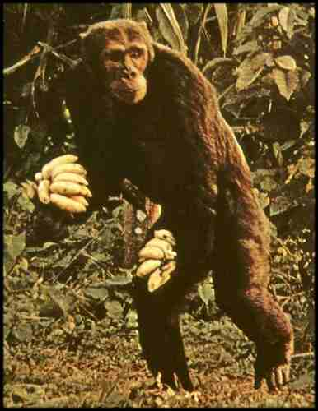
Chimpanzee
The Primates, Time-Life (1974) p. 71

Slide 11
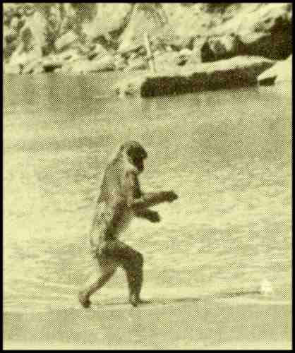

Slide 12
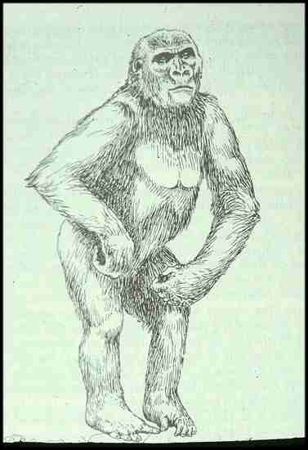

Slide 13
Bipedal Locomotion
Why bipedalism?

Slide 14
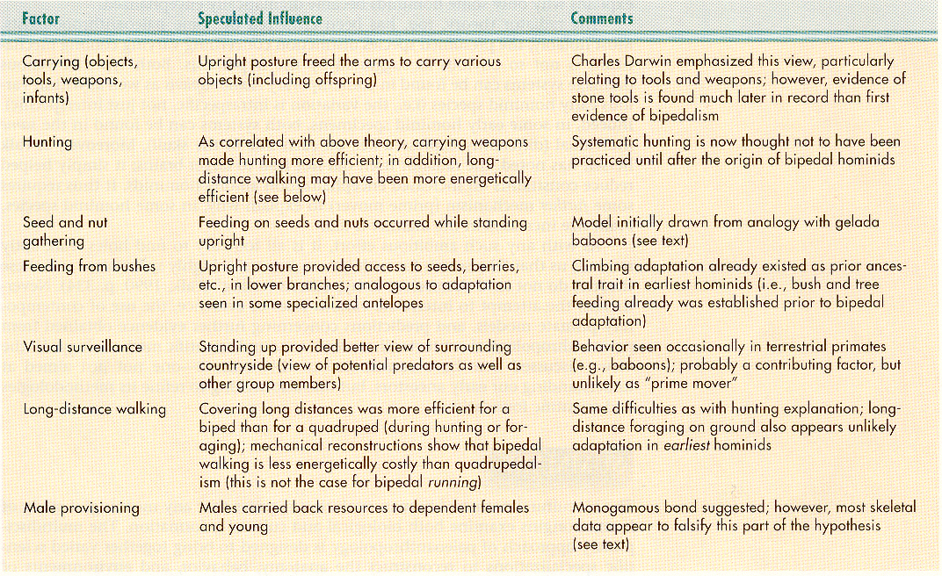
Possible Factors Influencing the
Initial Evolution of Bipedal Locomotion in Hominids.
Understanding Physical Anthropology and Archaeology, 8th ed., p. 217

Slide 15
Bipedalism
Bipedalism is related to tool use

Slide 16
Possible Factors Influencing the
Initial Evolution of Bipedal Locomotion in Hominids.
Understanding Physical Anthropology and Archaeology, 8th ed., p. 217

Slide 17
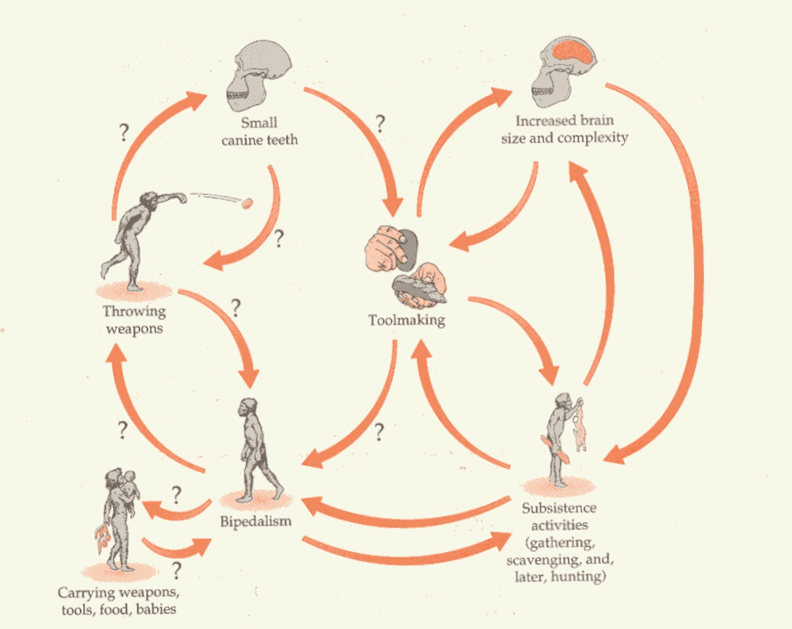
Positive Feedback Systems.
Humankind Emerging, 7th ed., p. 275

Slide 18
Acheulian biface (“hand axe”)
Understanding Physical Anthropology and Archaeology, 9th ed., p. 239

Slide 19
Bipedalism
more about bipedalism
and to tool use later

Slide 20
Bipedalism
Bipedalism also makes hunting
more energy efficient

Slide 21
Possible Factors Influencing the
Initial Evolution of Bipedal Locomotion in Hominids.
Understanding Physical Anthropology and Archaeology, 8th ed., p. 217

Slide 22
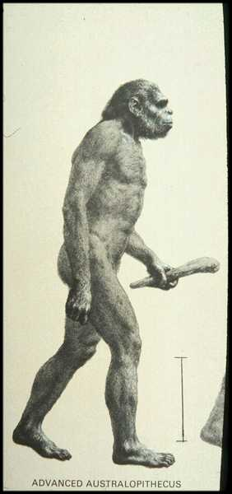
The Primates, Time-Life (1974) p. 44

Slide 23
Bipedalism
Seed and nut gathering
and
Feeding from bushes

Slide 24
Possible Factors Influencing the
Initial Evolution of Bipedal Locomotion in Hominids.
Understanding Physical Anthropology and Archaeology, 8th ed., p. 217

Slide 25
Bipedalism
Bipedalism and vision
(visual surveillance)

Slide 26
Possible Factors Influencing the
Initial Evolution of Bipedal Locomotion in Hominids.
Understanding Physical Anthropology and Archaeology, 8th ed., p. 217

Slide 27
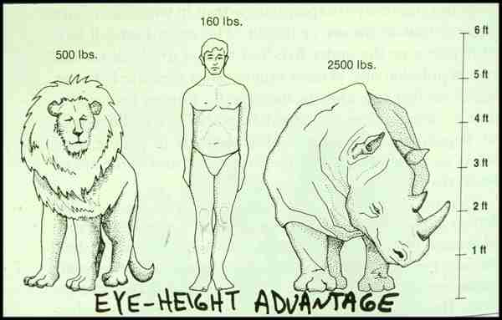

Slide 28
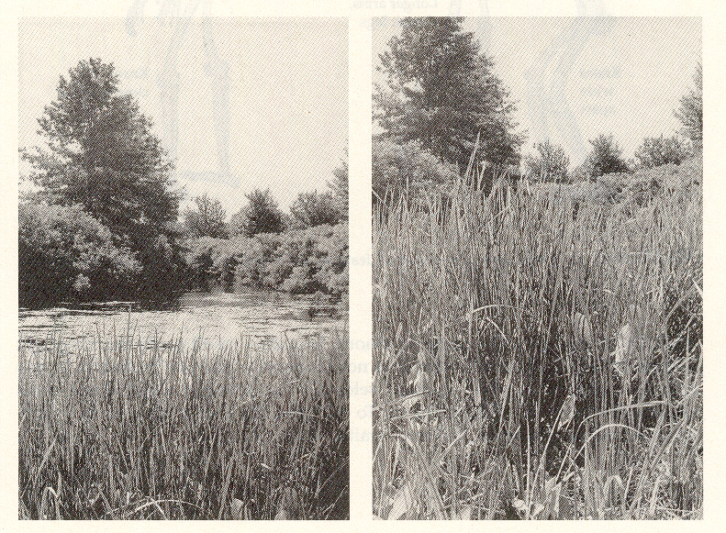

Slide 29
Eye Level and Sight.
Humankind Emerging, 7th ed., p. 114

Slide 30
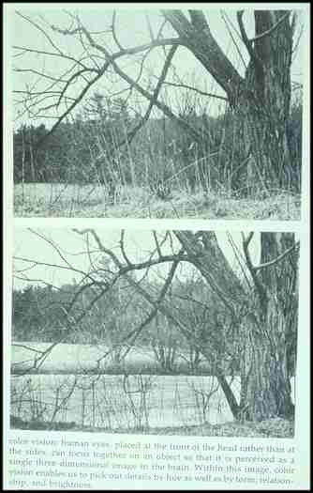

Slide 31
Bipedalism
Bipedalism and
Long-distance walking

Slide 32
Possible Factors Influencing the
Initial Evolution of Bipedal Locomotion in Hominids.
Understanding Physical Anthropology and Archaeology, 8th ed., p. 217

Slide 33
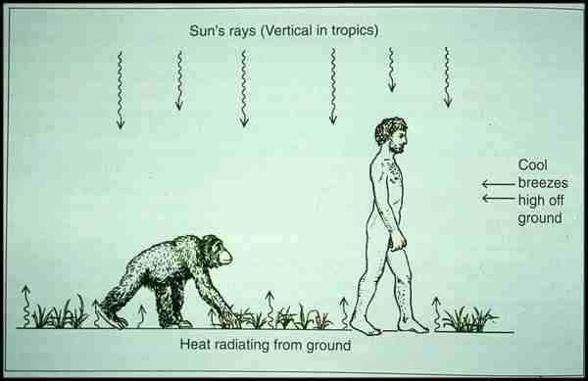

Slide 34
Bipedalism
Male help
in
“provisioning”
Owen Lovejoy “provisioning hypothesis”

Slide 35
Possible Factors Influencing the
Initial Evolution of Bipedal Locomotion in Hominids.
Understanding Physical Anthropology and Archaeology, 8th ed., p. 217

Slide 36
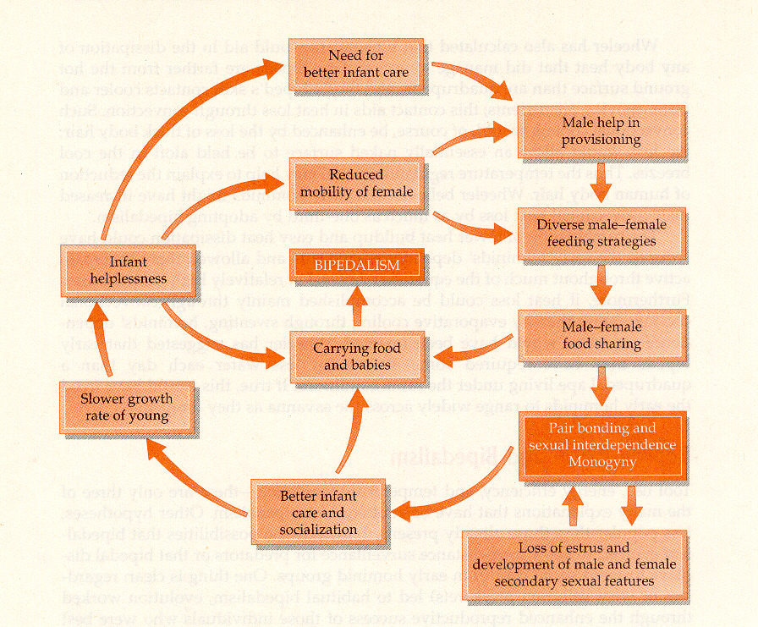
Pliocene Adaptations. (Lovejoy)
Humankind Emerging, 7th ed., p. 270

Slide 37
Bipedalism
Bipedalism
and
other hominid traits

Slide 38
Not on the chart
Possible Factors Influencing the
Initial Evolution of Bipedal Locomotion in Hominids.
Understanding Physical Anthropology and Archaeology, 8th ed., p. 217

Slide 39
Bipedalism
body temperature

Slide 40

http://news.bbc.co.uk/sport1/hi/other_sports/1468591.stm

Slide 41

http://www.sunspot.net/sports/baseball/bal-te.sp.orioles18feb18,0,360173.story?coll=bal-utility-baseball

Slide 42
Bipedalism
R. Falk (1989) suggested that bipedalism resulted in the development of a cooling mechanism for the brain.
CA 31:2:187

Slide 43
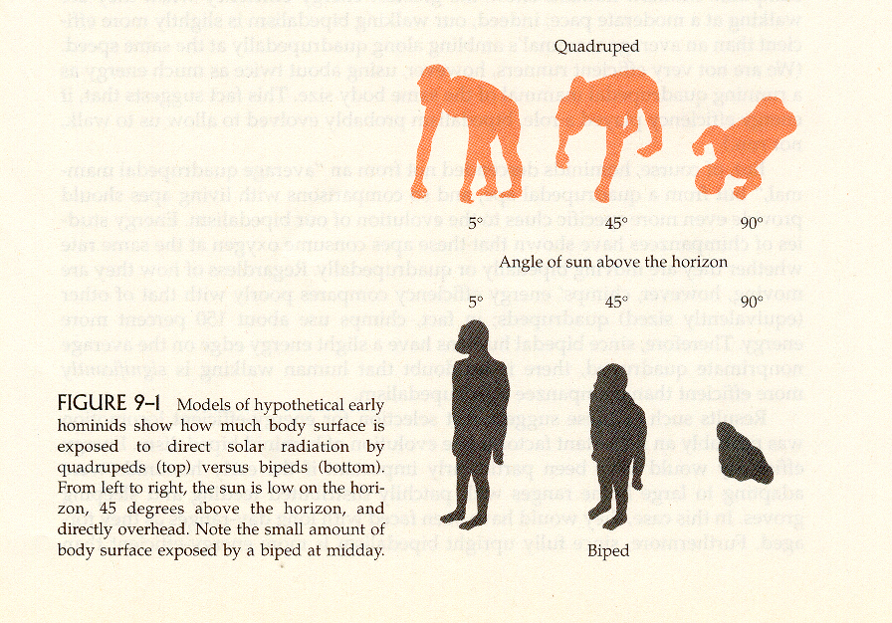
Body Surface and Solar Radiation.
Humankind Emerging, 7th ed., p. 268

Slide 45
Not on the chart
Possible Factors Influencing the
Initial Evolution of Bipedal Locomotion in Hominids.
Understanding Physical Anthropology and Archaeology, 8th ed., p. 217

Slide 46
Bipedalism
may have been
an arboreal forest adaptation

Slide 47
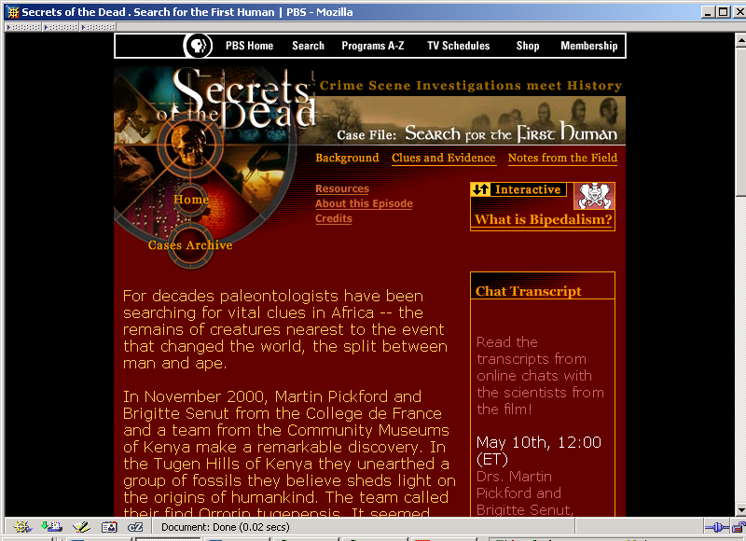
Week 07
Video: Search for the First Human -- A Secrets of the Dead Special

Slide 48
Not on the chart
Possible Factors Influencing the
Initial Evolution of Bipedal Locomotion in Hominids.
Understanding Physical Anthropology and Archaeology, 8th ed., p. 217

Slide 49
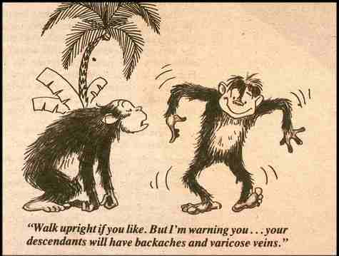

Slide 50
Bipedal walking
resulted in a number of postcranial changes in the legs and feet . . .

Slide 51
The legs and feet . . .
feet become more foot-like

Slide 52
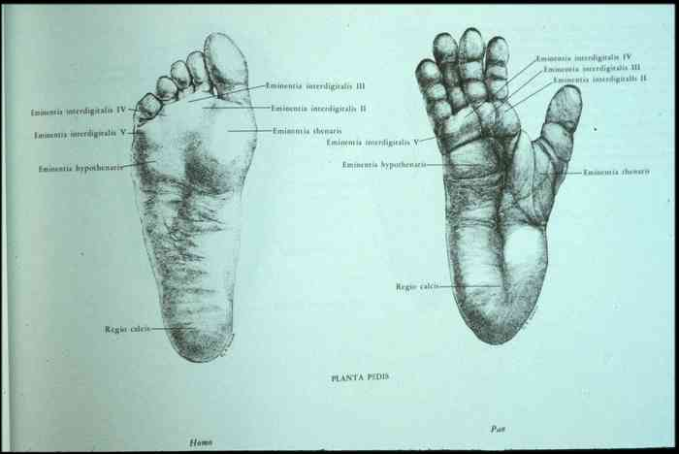

Slide 53
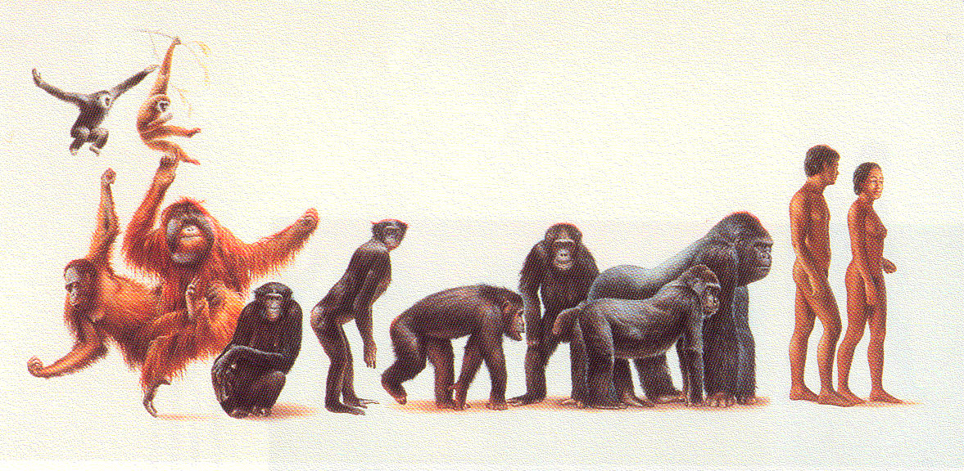
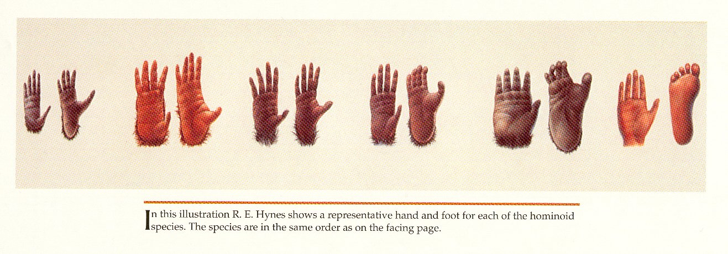
^{gibbons}
^{humans}
^{gorillas}
^{bonobos}
^{chimps}
^{orangutans}
^{orangutans}
^{bonobos}
^{chimps}
^{gorillas}
^{humans}
^{gibbons}
Campbell and Loy, Humankind Emerging, 8th ed, p. 138f

Slide 54
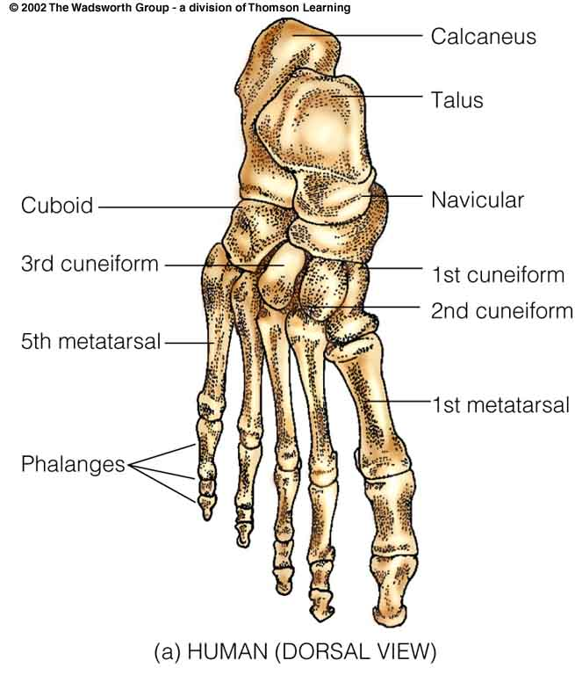
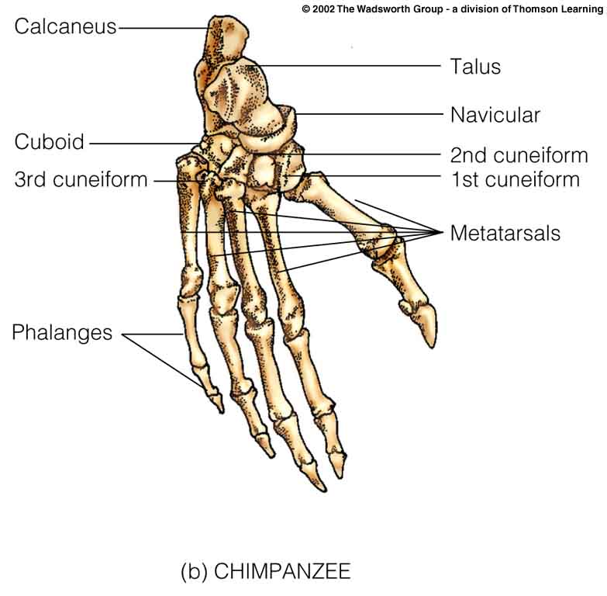
Foot (pedal) anatomy.
Understanding Physical Anthropology and Archaeology, 9th ed., p. 435

Slide 55
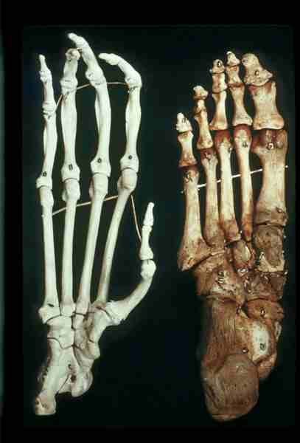

Slide 56
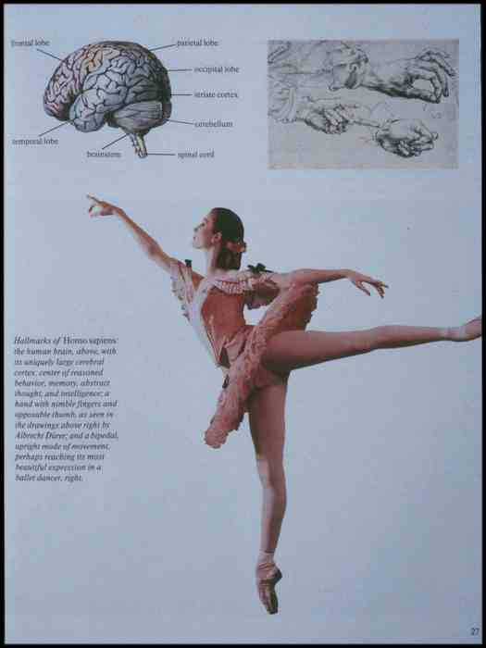

Slide 57
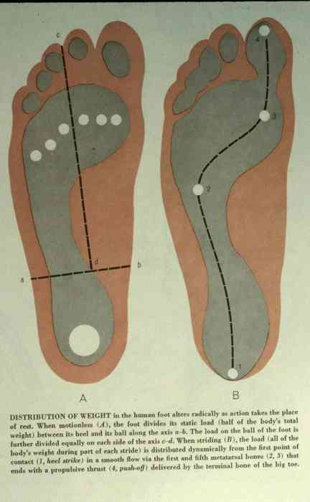

Slide 58
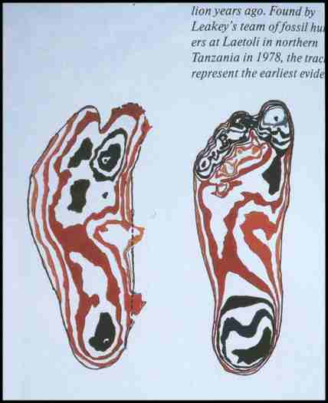

Slide 59
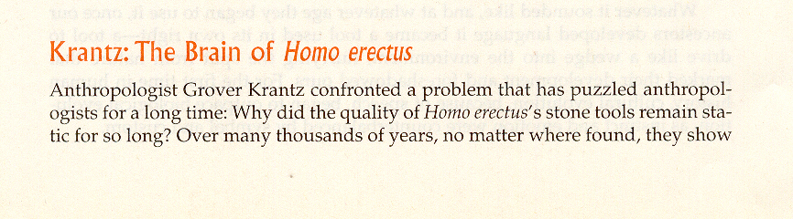
Grover Krantz.
Humankind Emerging, 7th ed., p. 383

Slide 60
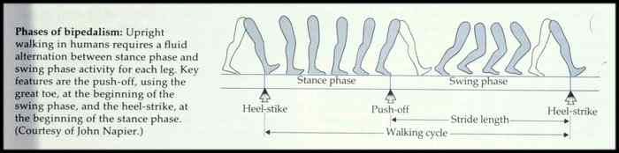

Slide 61
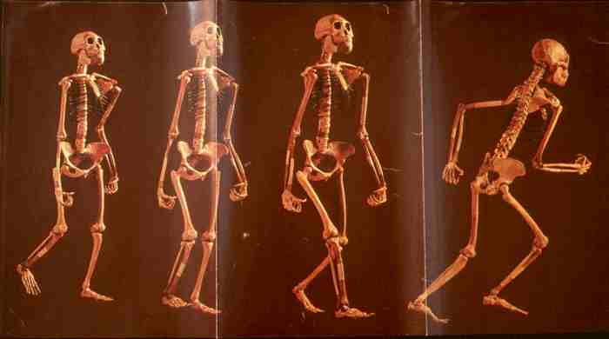

Slide 62
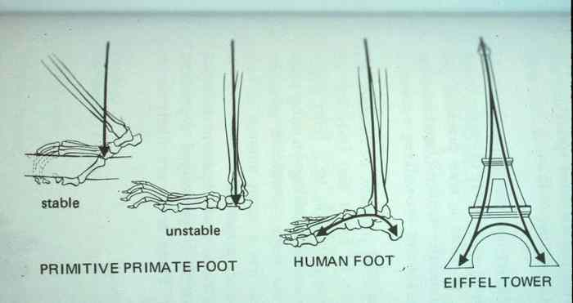
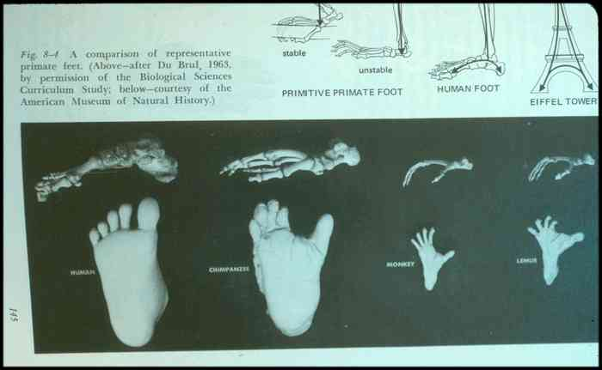

Slide 63
Foot (pedal) anatomy.
Understanding Physical Anthropology and Archaeology, 9th ed., p. 436

Slide 64
Leg bones are much stouter
and
have more pronounced
dorsal ridges
(on the back)

Slide 65
Leg muscle structures change

Slide 66
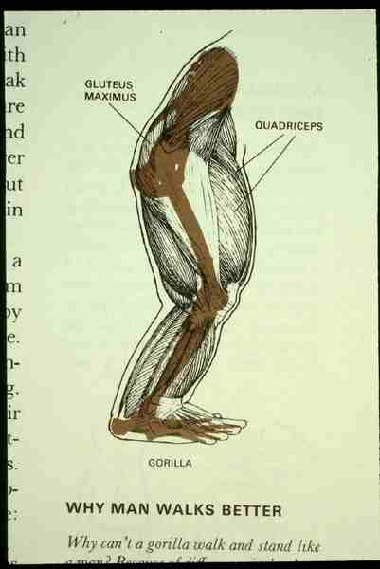

Slide 67
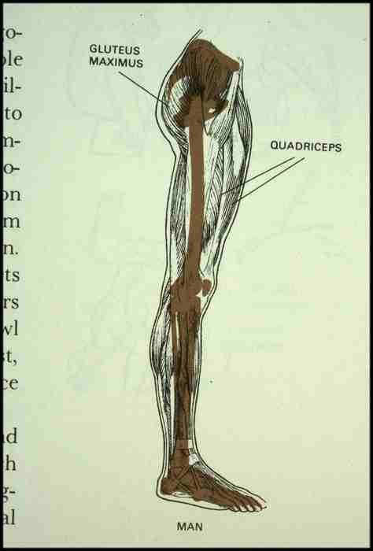

Slide 68
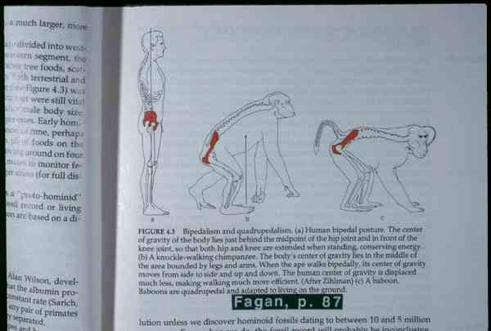

Slide 69
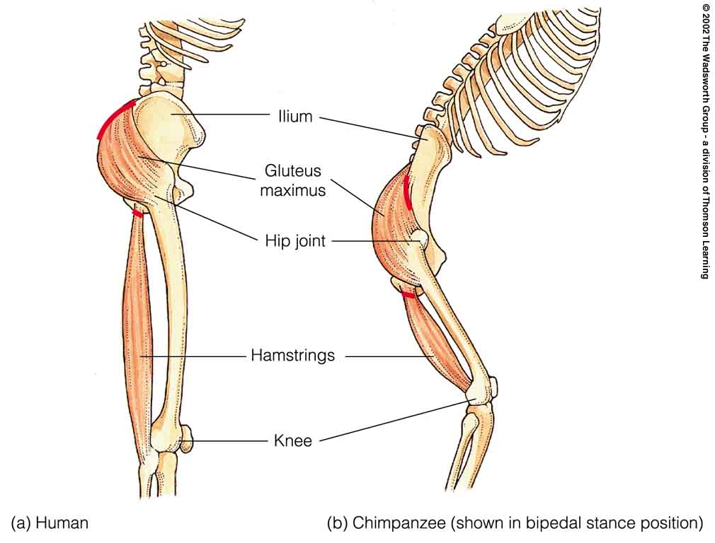
Comparison of muscles that act to extend the hip.
Understanding Physical Anthropology and Archaeology, 8th ed., p. 224

Slide 70
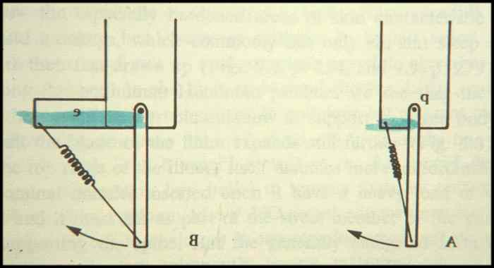

Slide 71
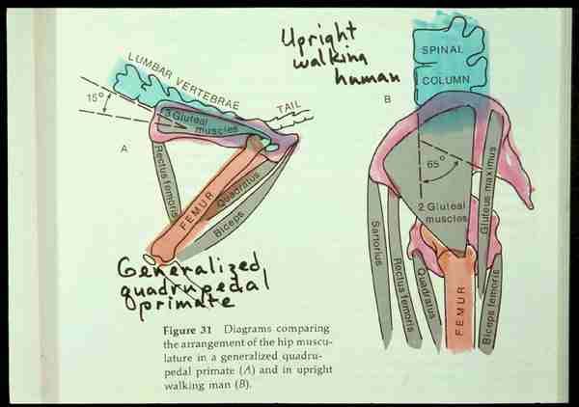

Slide 72
Humans have developed a “closed-knee stance”

Slide 73
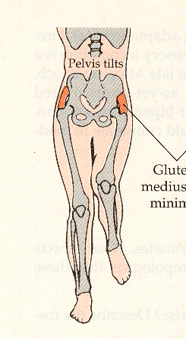
Closed-Knee Stance.
Humankind Emerging, 7th ed., p. 193

Slide 74
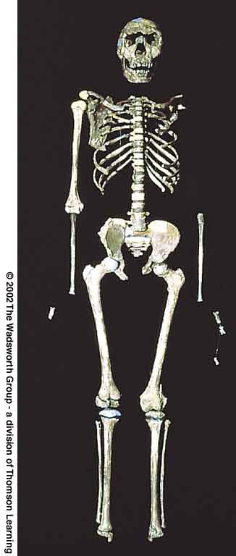
WT 15000 from Nariokotome, Kenya:
the most complete Homo erectus specimen yet found
Understanding Physical Anthropology and Archaeology, 9th ed., p. 235

Slide 75
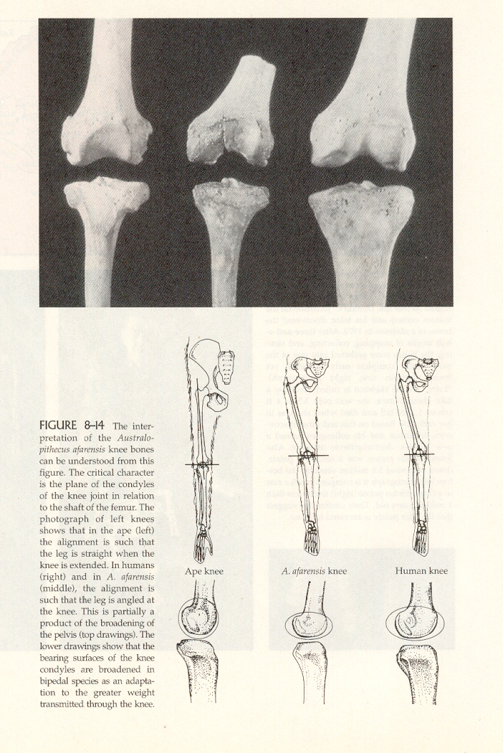
Humankind Emerging, 7th ed., p. 242

Slide 76
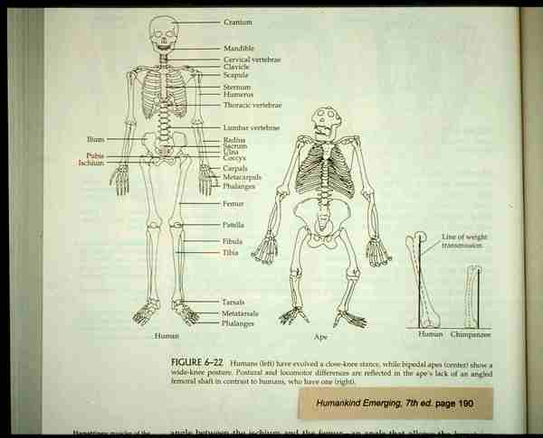

Slide 77
There is a loss of some mobility
and
“prehensility”
in feet

Slide 78
Prehensility =
the ability to grasp

Slide 79
White-handed gibbon
Understanding Physical Anthropology and Archaeology, 9th ed., p. 131

Slide 80
A number of changes take place in the pelvis . . .

Slide 81
The Pelvis
becomes shorter and wider . . .
has a “distinct pelvic bowl” . . .
and the muscle attachment ridges become heavier . . .

Slide 82
The Pelvis
becomes shorter and wider . . .
has a “distinct pelvic bowl” . . .
and the muscle attachment ridges become heavier . . .

Slide 83
xx
Ossa coxae. (a) Homo sapiens.
(b) Australopithecus. (c) Chimpanzee
Understanding Physical Anthropology and Archaeology, 9th ed., p. 199

Slide 84
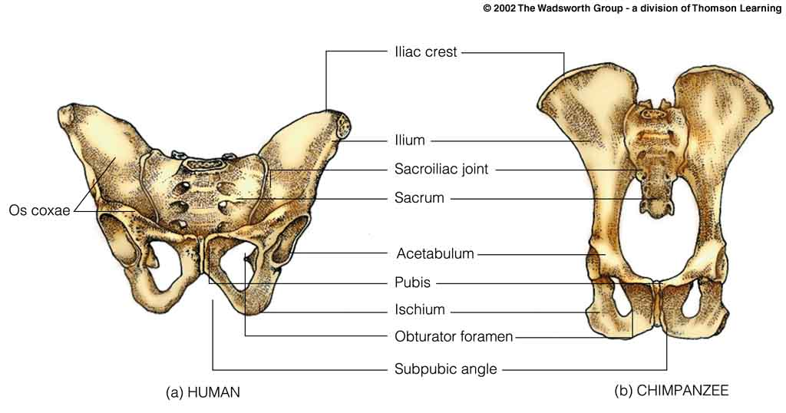
Pelvic girdles.
Understanding Physical Anthropology and Archaeology, 9th ed., p. 435

Slide 85
The Pelvis
becomes shorter and wider . . .
has a “distinct pelvic bowl” . . .
and the muscle attachment ridges become heavier . . .

Slide 86
Pelvic girdles.
Understanding Physical Anthropology and Archaeology, 9th ed., p. 435

Slide 87
And the muscle attachment ridges one the pelvis become heavier . . .

Slide 88
xx
Ossa coxae. (a) Homo sapiens.
(b) Australopithecus. (c) Chimpanzee
Understanding Physical Anthropology and Archaeology, 9th ed., p. 199

Slide 89
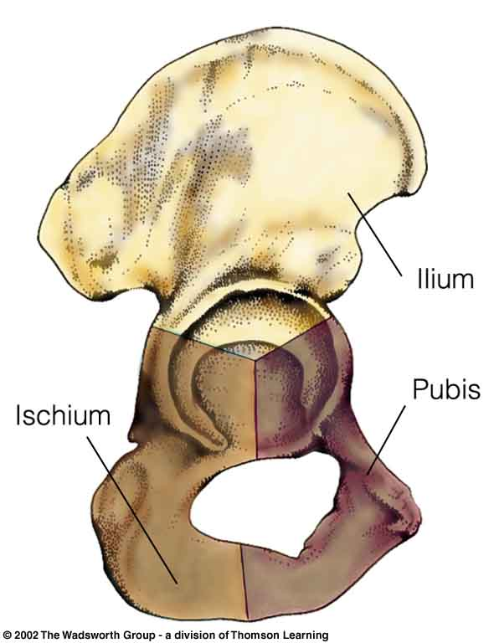
The human os coxae, composed of three bones. (R)
Understanding Physical Anthropology and Archaeology, 9th ed., p. 199

Slide 90
More on pelvic changes later, with the discussion of Australopithecus
(“southern ape”)

Slide 91
External tails are lost

Slide 92
Skeleton of a brachiator (gibbon)
Understanding Physical Anthropology and Archaeology, 9th ed., p. 121

Slide 93
Continue on to Set #15B
The Upper Body
Modern human skeleton
Understanding Physical Anthropology and Archaeology, 8th ed., p. 223

