Slide 1
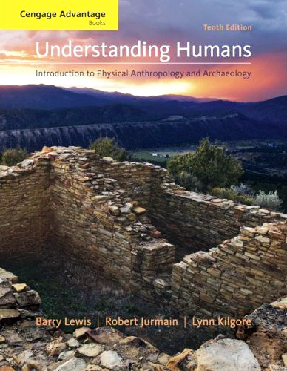
Class Slides Set 17A
Early Hominins
. . . or how to make sense
out of
Chs. 9 and 11 of the text . . .
Prehistoric Cultures
Tim Roufs’ section ©2009

Slide 2
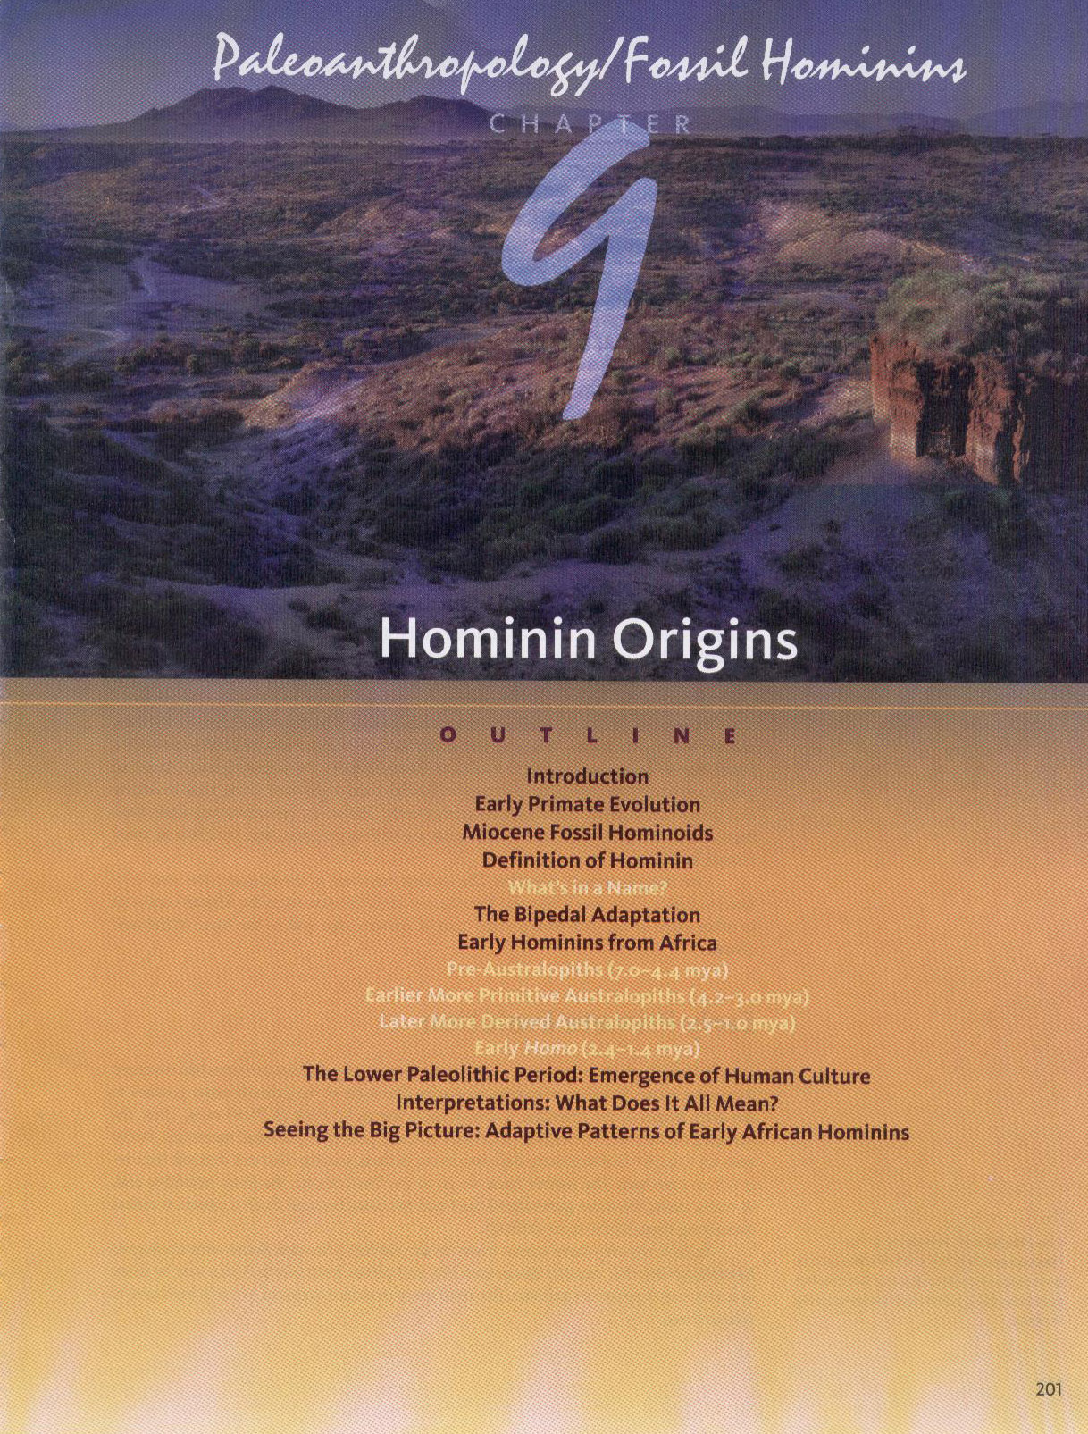
Introduction
to Early Hominins

Slide 3
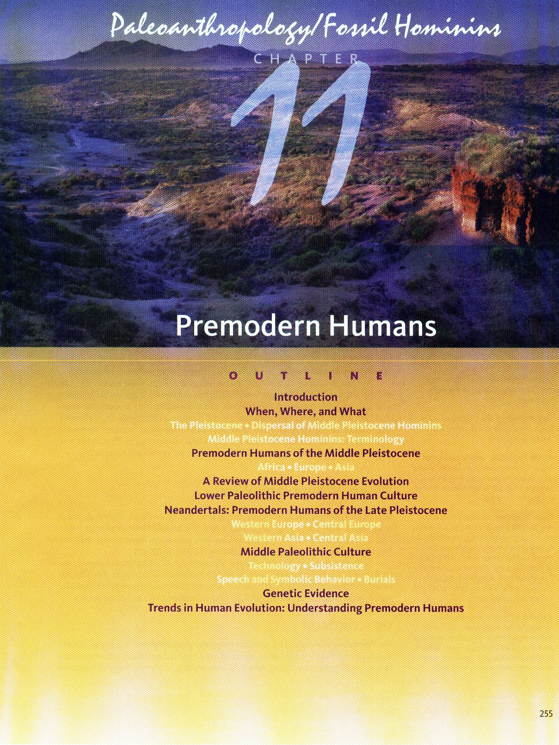

Slide 4
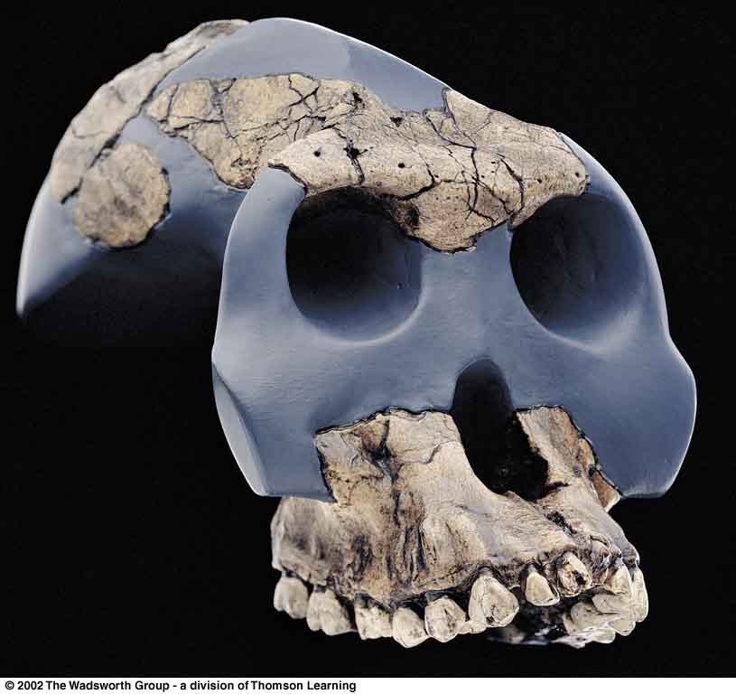
Introduction
to
Early
Hominins
Australopithecus garhi, 2.5 m.y.a., Ethiopia
Turnbaugh, Jurmain, Kilgore, and Nelson, 8th ed., p. 235

Slide 5
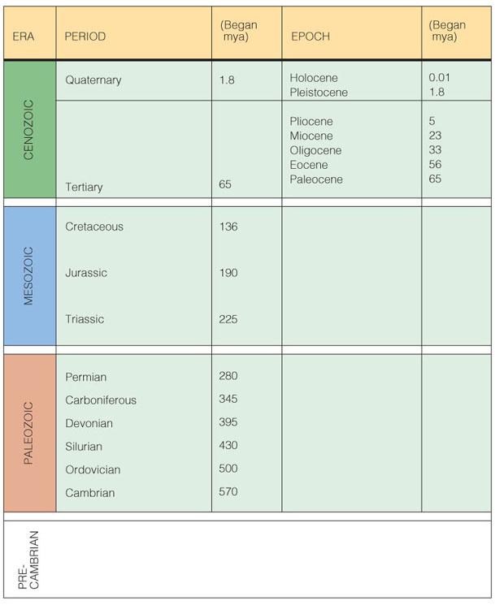
Understanding Humans, 10th Ed., p. 110.

Slide 6
Began (mya)
Understanding Humans, 10th Ed., p. 110.

Slide 7
note climactic change
including the “Ice Age”

Slide 8
The Pleistocene is
frequently referred
to as
the “Ice Age”

Slide 9
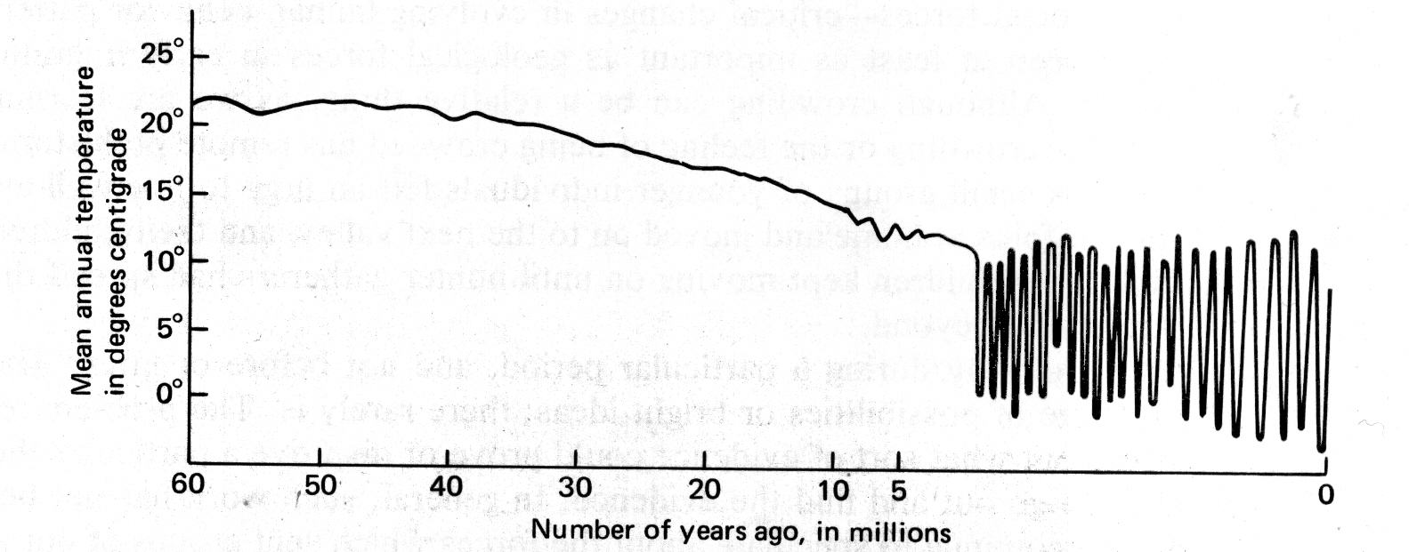
Miocene
Pleistocene
Plocene
John E. Pfeiffer, The Emergence of Man, 4th ed.
(NY: Harper and Row, 1985), p. 101.

Slide 10
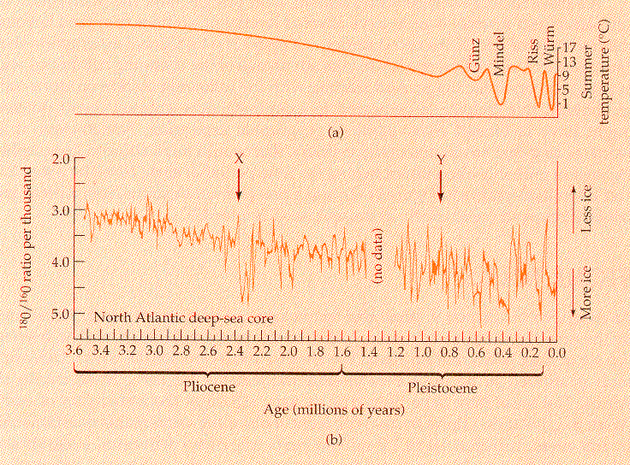
Campbell-Loy, Humankind Emerging, 7th ed., p. 327

Slide 11
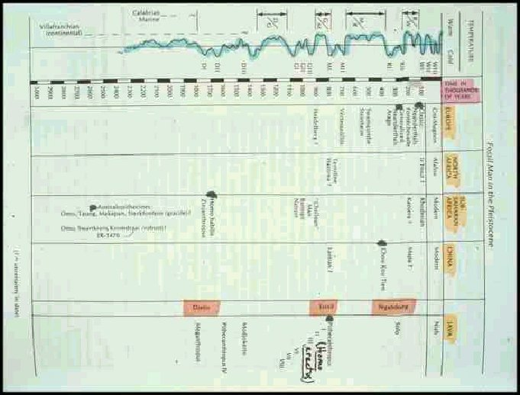

Slide 12
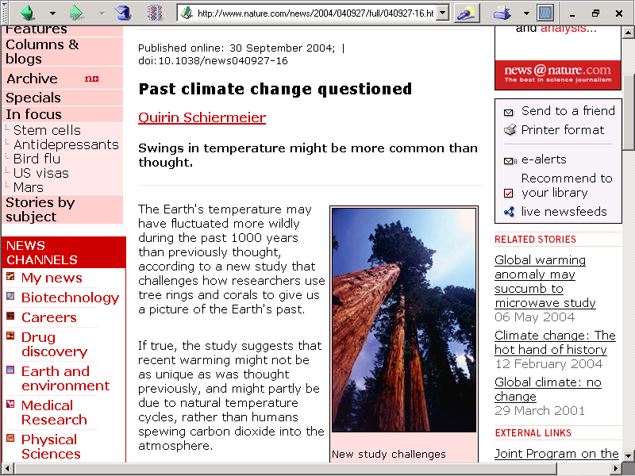
http://www.nature.com/news/2004/040927/full/040927-16.html

Slide 13
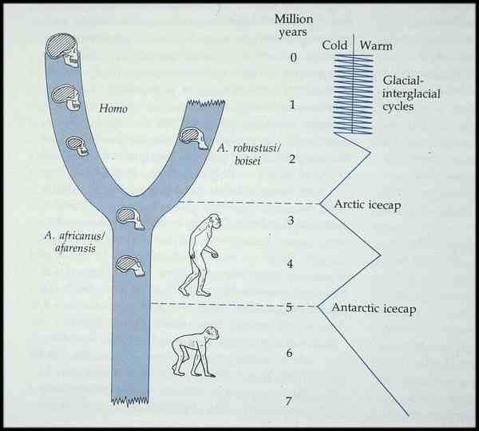

Slide 14
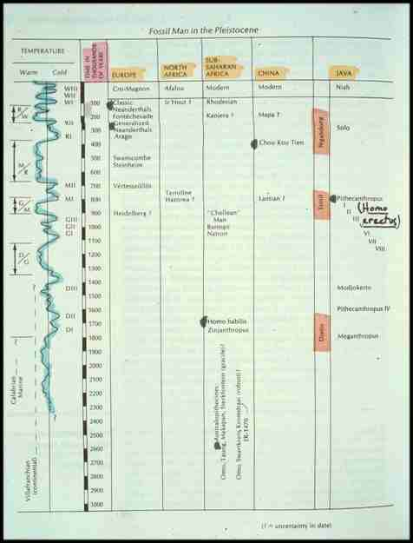

Slide 15
3 million yrs

Slide 16
2 million yrs

Slide 17
1 million yrs

Slide 18
Pleistocene

Slide 19
Holocene

Slide 21
“Taung Child”
“Zinj”

Slide 22
Homo
habilis

Slide 24
Australopithecines

Slide 25
Australopithecines . . .
  including Paranthropus . . .
(aka Australopithecus robustus)
are also known as
“Plio-Pleistocene hominids”

Slide 26
Began (mya)
Plio-Pleistocene hominid = Australopithecus
Understanding Humans, 10th Ed., p. 110.

Slide 27
Homo
habilis
Australopithecus

Slide 28
Homo erectus
Homo
habilis
Australopithecus

Slide 29
Homo sapiens
Homo erectus
Homo
habilis
Australopithecus

Slide 30
Homo sapiens
Homo erectus
Homo
habilis
Australopithecus

Slide 31
“Moderns”
Homo sapiens
Homo erectus
Homo
habilis
Australopithecus

Slide 32
“Moderns”
Neandertals
Homo sapiens
Homo erectus
Homo
habilis
Australopithecus

Slide 33
Homo sapiens
Homo erectus
Pleistocene
Homo
habilis
Australopithecus

Slide 34
sea levels rise and fall
with global warming and cooling

Slide 35

MARILYN VOS SAVANT
Sunday's Column - May 31, 2009
I'd like some perspective on global warming. Have sea levels ever been as high as they are now? —J. Kolasinski, Columbus, Ohio
Yes, roughly 35,000 years ago. A few thousand years later, sea levels began to drop. By about 15,000 years ago, the oceans had declined by almost 500 feet. Then they started to rise, and sea levels have been going up ever since.
www.duluthnewstribune.com/event/article/id/107842/

Slide 36
MARILYN VOS SAVANT
Sunday's Column - May 31, 2009
I'd like some perspective on global warming. Have sea levels ever been as high as they are now? —J. Kolasinski, Columbus, Ohio
Yes, roughly 35,000 years ago. A few thousand years later, sea levels began to drop. By about 15,000 years ago, the oceans had declined by almost 500 feet. Then they started to rise, and sea levels have been going up ever since.
www.duluthnewstribune.com/event/article/id/107842/

Slide 37
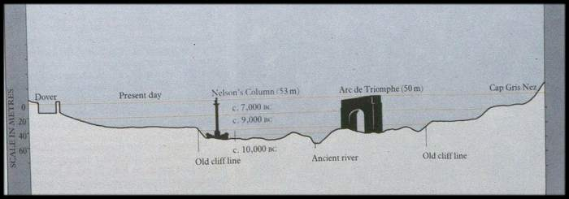

Slide 42
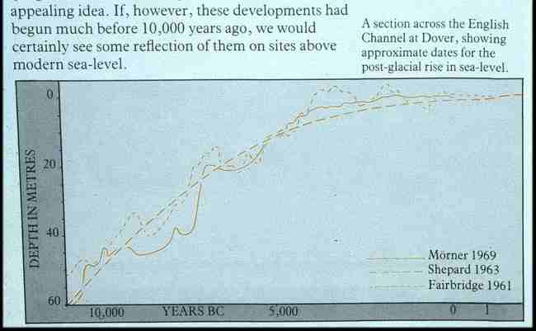

Slide 43
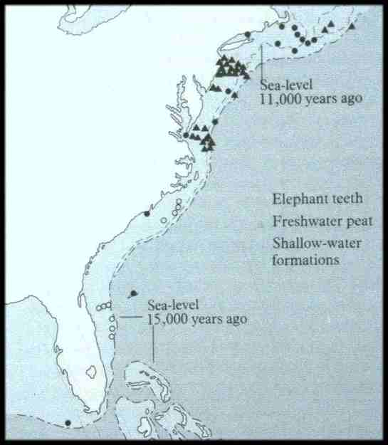

Slide 44
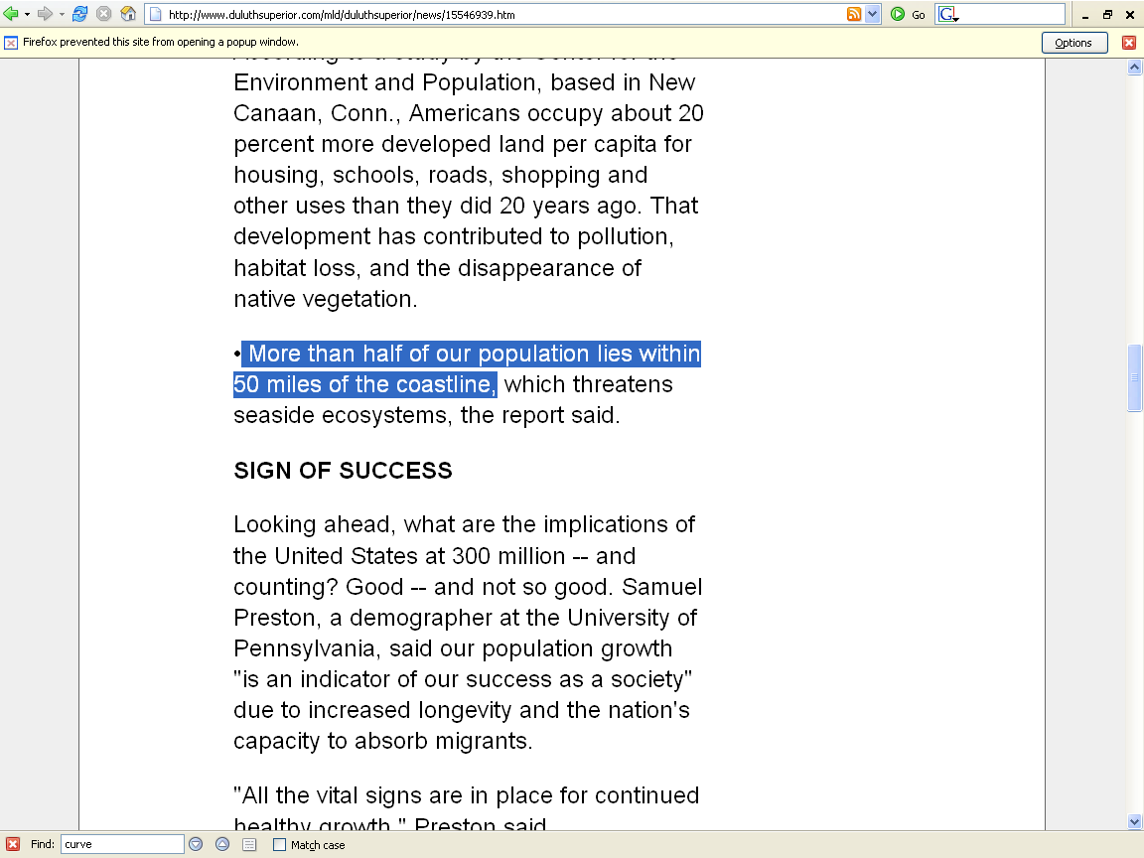
http://www.duluthsuperior.com/mld/duluthsuperior/news/15546939.htm

Slide 45
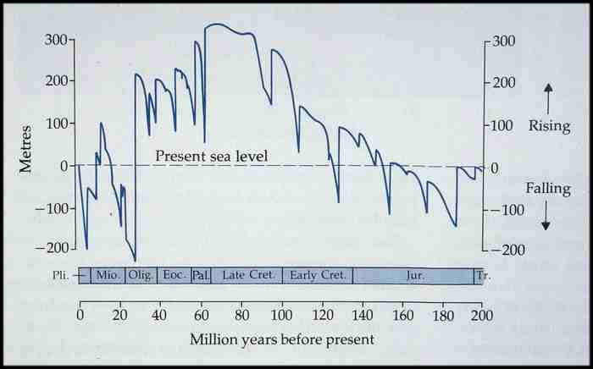

Slide 46
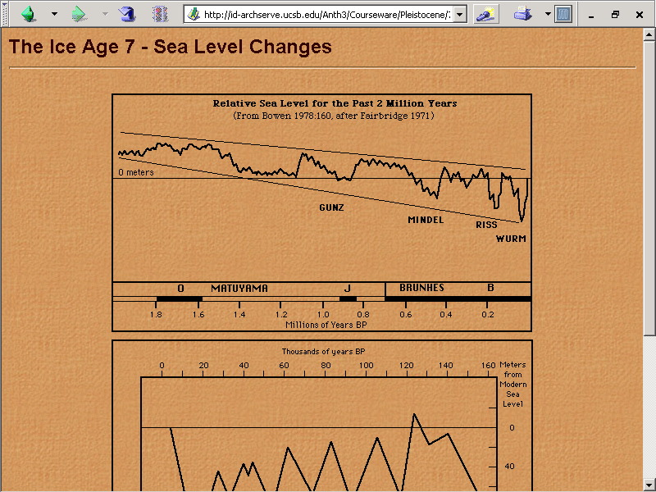

Slide 47
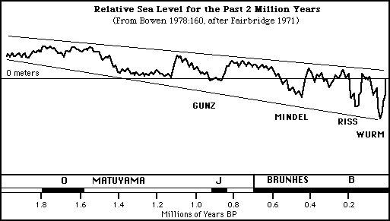

Slide 48
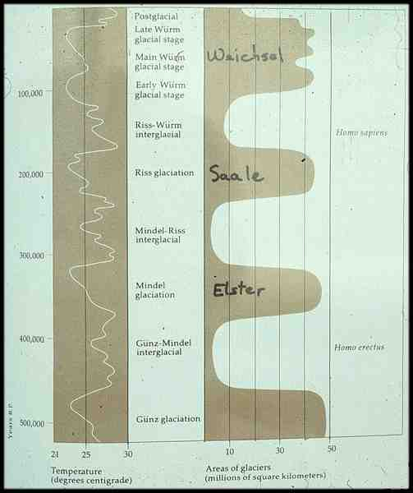

Slide 49
Wűrm glacial
Riss glacial
Mindel glacial
Gűnz glacial

Slide 50
North American Terms
Wisconsin glacial
Illinoian glacial
Kansan glacial
Nebraskan glacial

Slide 51
Weischel glacial
Saale glacial
Elster glacial

Slide 52
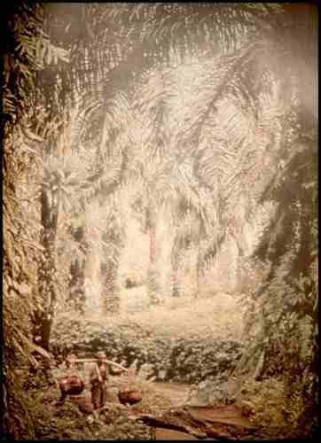

Slide 53
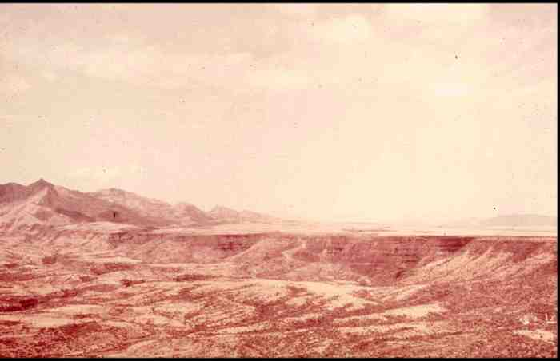

Slide 59
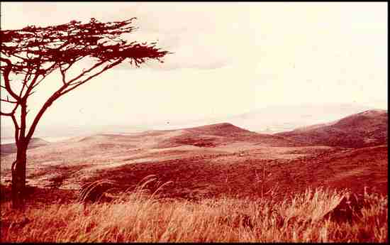

Slide 60
Began (mya)
Understanding Humans, 10th Ed., p. 110.

Slide 61
Understanding Physical Anthropology and Archaeology, 9th ed., p. 103

Slide 62
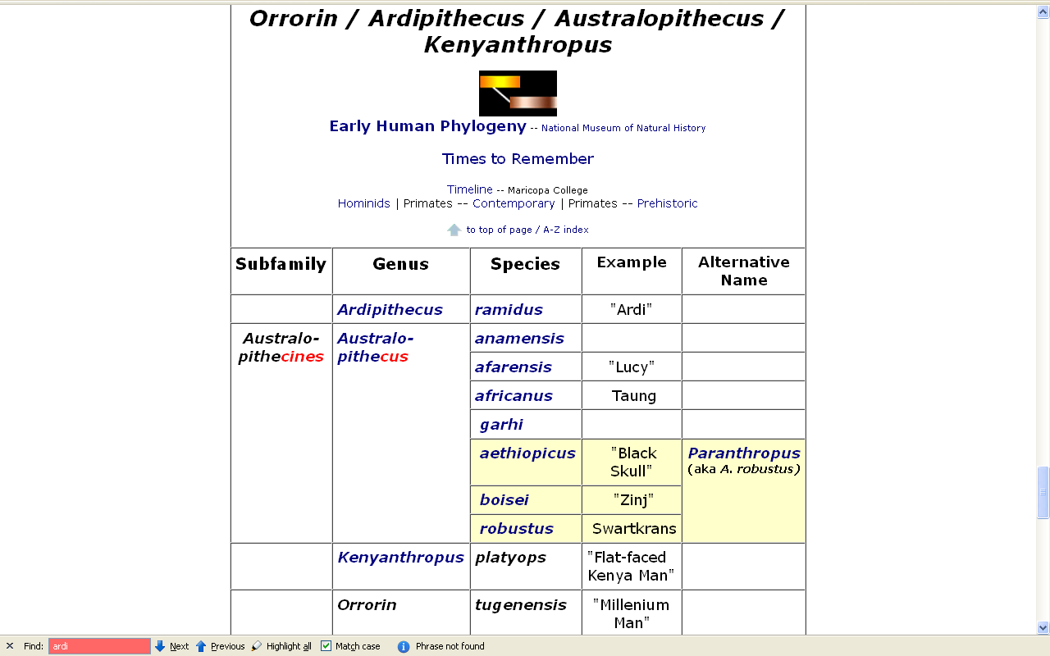

Slide 63
Early Hominids
Genus Species
Orrorin
Ardipithecus
Australopithecus
Paranthropus
tugenensis
ramidus
anamensis
afarensis
africanus
garhi
aethiopicus
boisei
robustus

Slide 64
Early Hominins
Genus Species
Orrorin
Ardipithecus
Australopithecus
Paranthropus
tugenensis
ramidus
anamensis
afarensis
africanus
garhi
aethiopicus
boisei
robustus

Slide 65
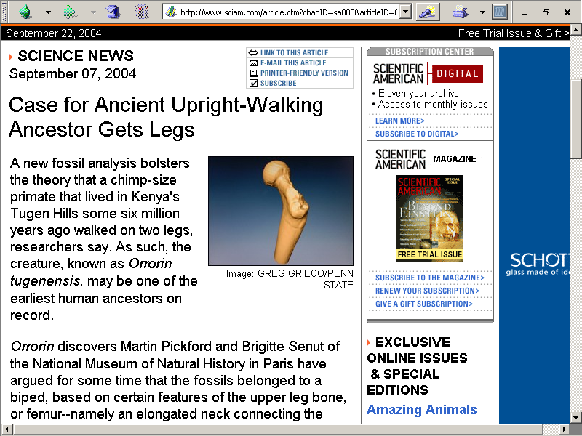
http://www.sciam.com/article.cfm?chanID=sa003&articleID=0008EB7D-BC26-1138-BC2683414B7F0000

Slide 66

Week 07
Video: Search for the First Human

Slide 67
Began (mya)
Orrorin
Plio-Pleistocene hominid= Australopithecus
Understanding Humans, 10th Ed., p. 110.

Slide 68
Began (mya)
Orrorin
Mio-Plio-Pleistocene hominin
Plio-Pleistocene hominid = Australopithecus
Understanding Humans, 10th Ed., p. 110.

