Slide 1
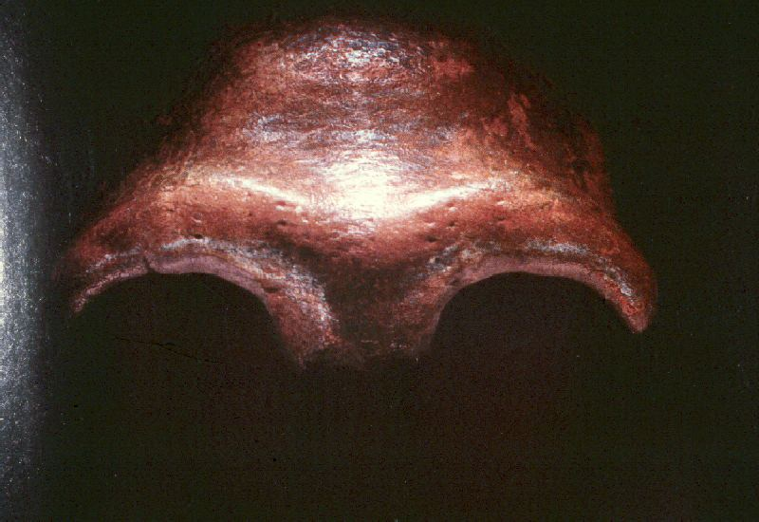
Neandertals
and other
“Premodern Humans”
(aka “Archaics”)
Lewin, In the Age of Mankind. Washington, D.C., Smithsonian, 1988.
Notes:
1

Slide 2
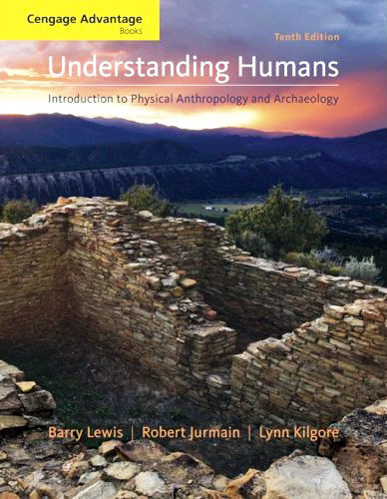
. . . or how to make sense
out of
Ch. 11 of the text . . .

Slide 3
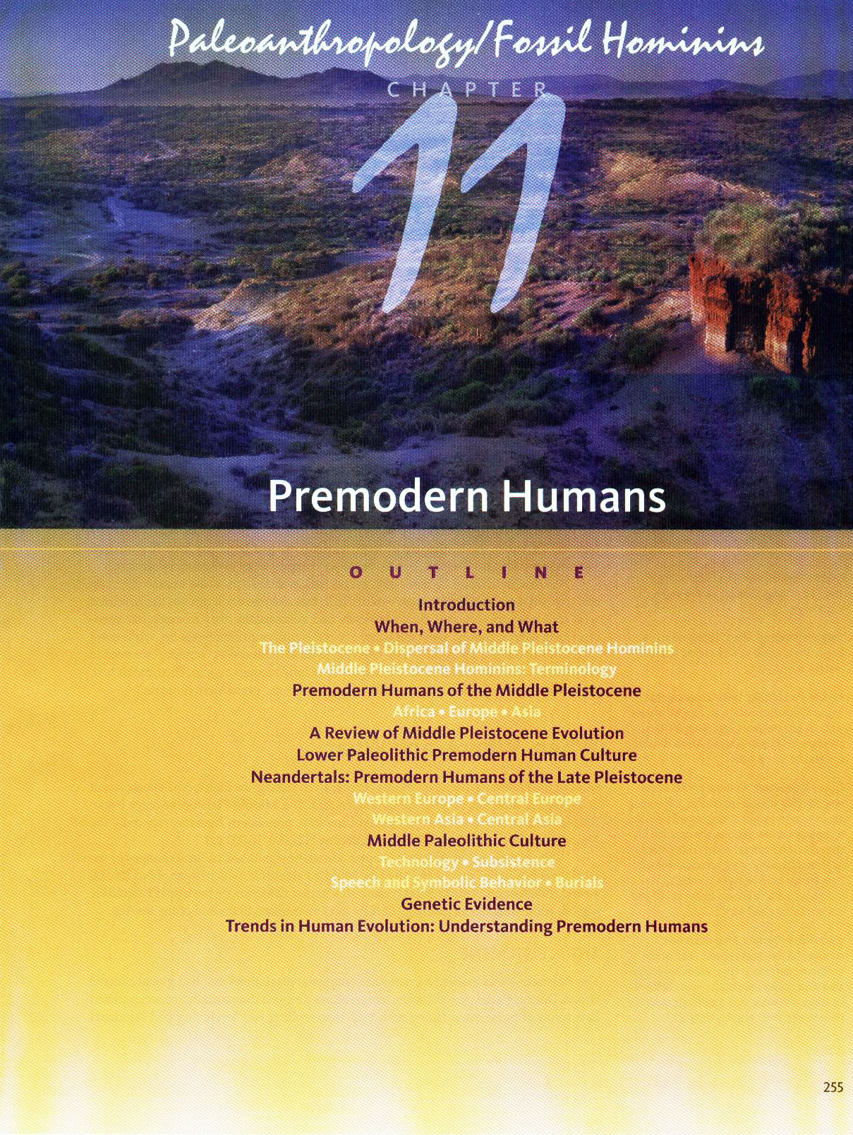
Neandertals
and
Others
(aka “Archaics”)

Slide 4
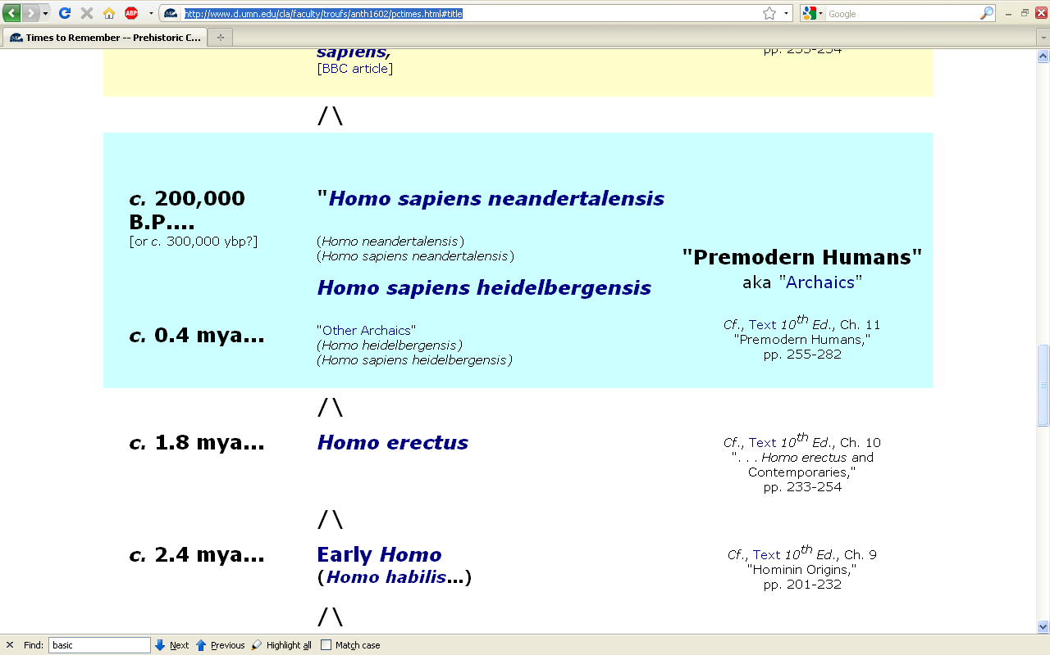
http://www.d.umn.edu/cla/faculty/troufs/anth1602/pctimes.html

Slide 5
Recent News
Lewin, In the Age of Mankind. Washington, D.C., Smithsonian, 1988.
Notes:
5

Slide 6
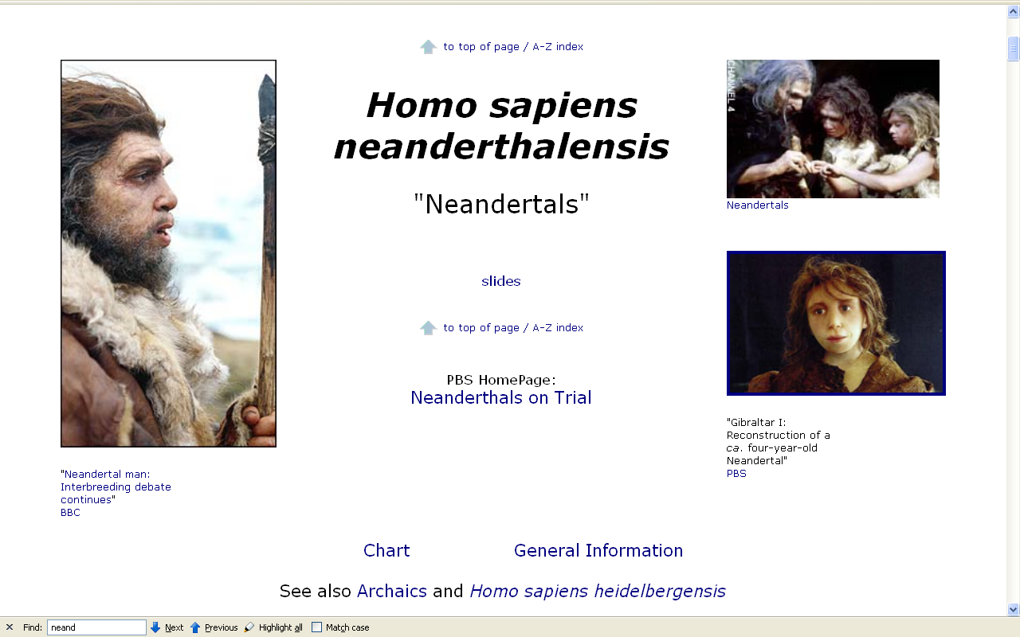
www.d.umn.edu/cla/faculty/troufs/anth1602/pcneand.html#title

Slide 7
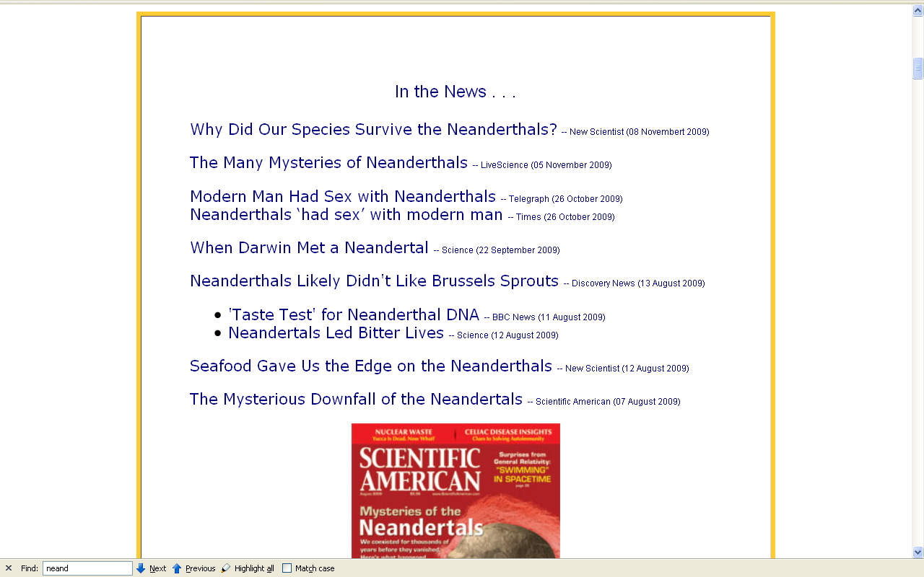
http://www.d.umn.edu/cla/faculty/troufs/anth1602/pcneand.html#title

Slide 8
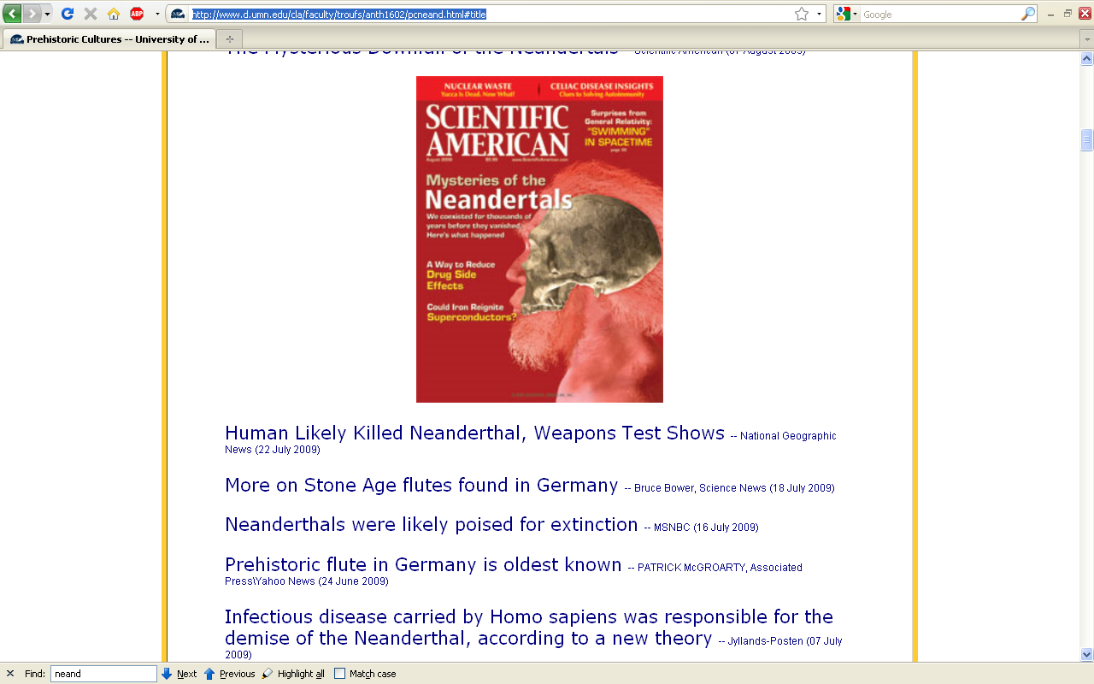
http://www.d.umn.edu/cla/faculty/troufs/anth1602/pcneand.html#title

Slide 9
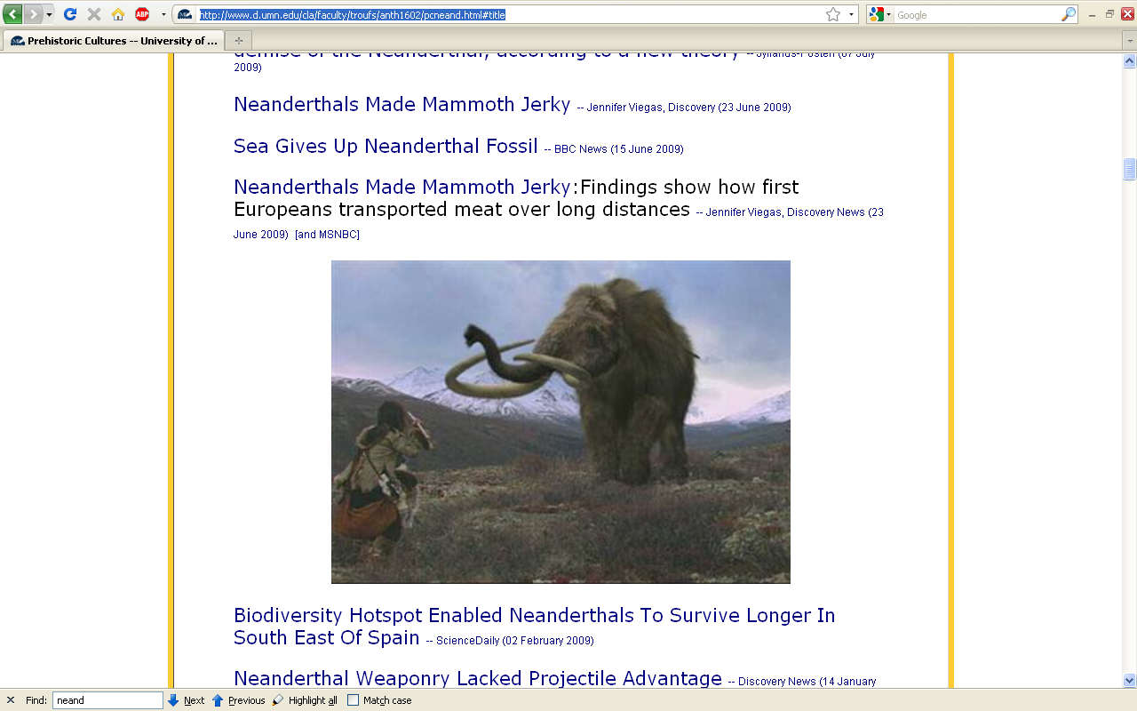
http://www.d.umn.edu/cla/faculty/troufs/anth1602/pcneand.html#title

Slide 10
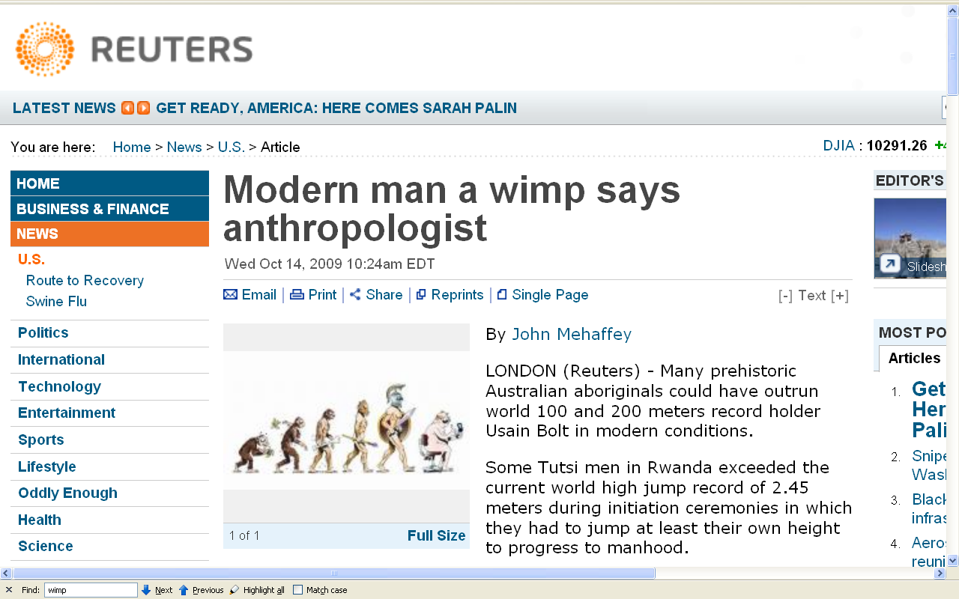
http://www.reuters.com/article/newsOne/idUSTRE59D0BR20091014?pageNumber=1&virtualBrandChannel=11604&sp=true
Notes:
10

Slide 11
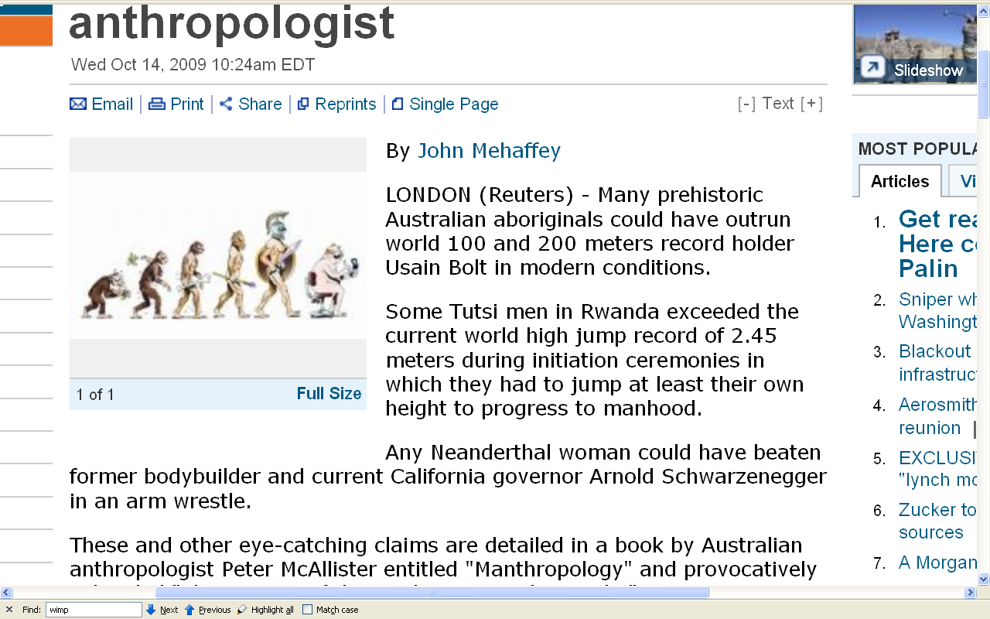
http://www.reuters.com/article/newsOne/idUSTRE59D0BR20091014?pageNumber=1&virtualBrandChannel=11604&sp=true
Notes:
11

Slide 12
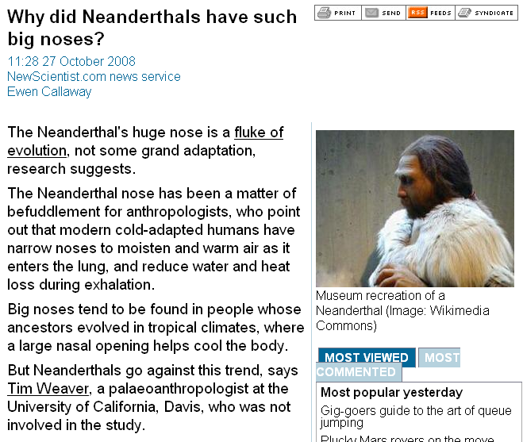
www.newscientist.com/channel/life/dn15042-why-did-neanderthals-have-such-big-noses.html?feedId=online-news_rss20

Slide 13
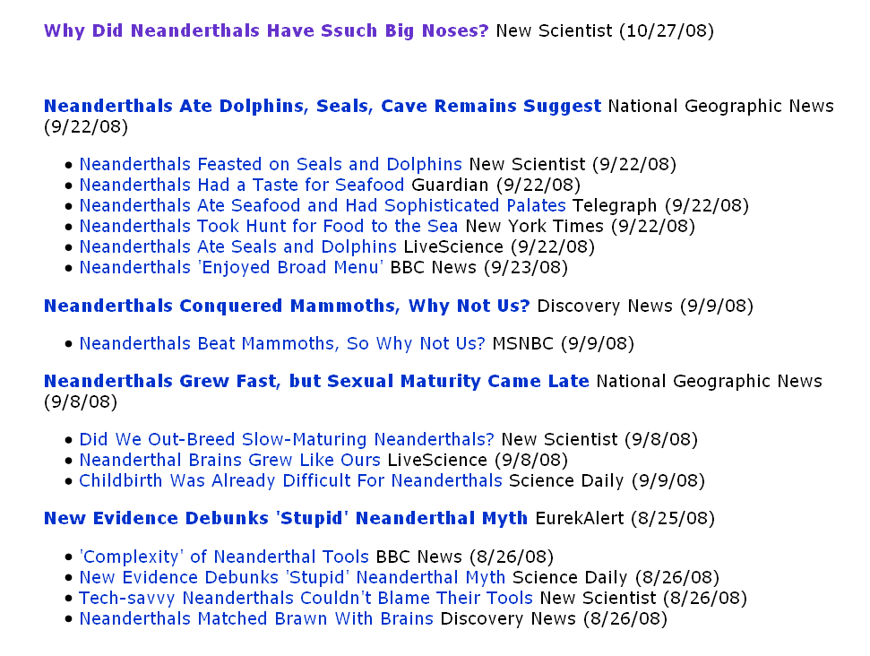
http://www.d.umn.edu/cla/faculty/troufs/anth1602/pcneand.html#title

Slide 14
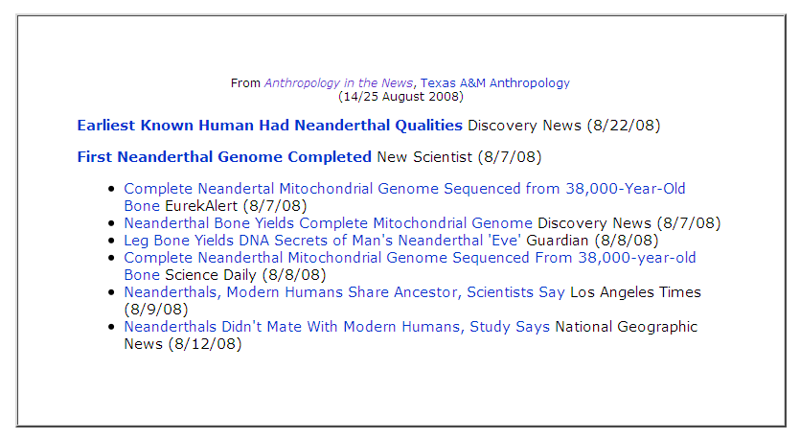
http://www.d.umn.edu/cla/faculty/troufs/anth1602/pcneand.html#title

Slide 15
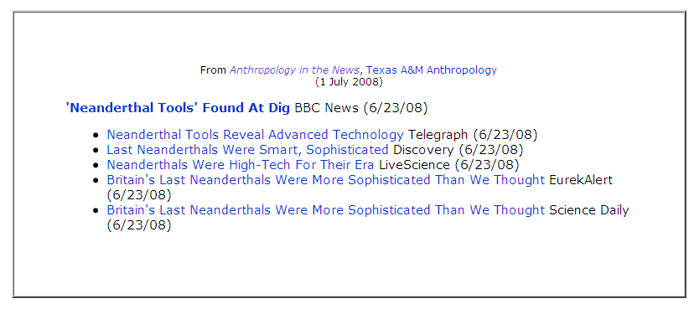
http://www.d.umn.edu/cla/faculty/troufs/anth1602/pcneand.html#title

Slide 16
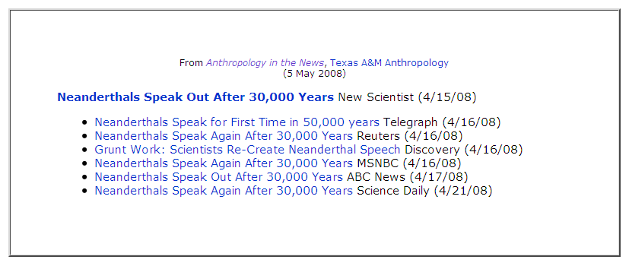
http://www.d.umn.edu/cla/faculty/troufs/anth1602/pcneand.html#title

Slide 17
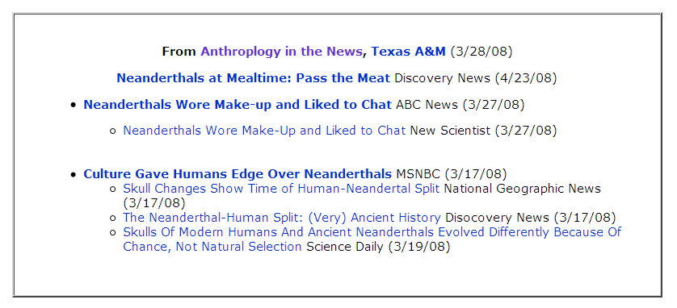
http://www.d.umn.edu/cla/faculty/troufs/anth1602/pcneand.html#title

Slide 18
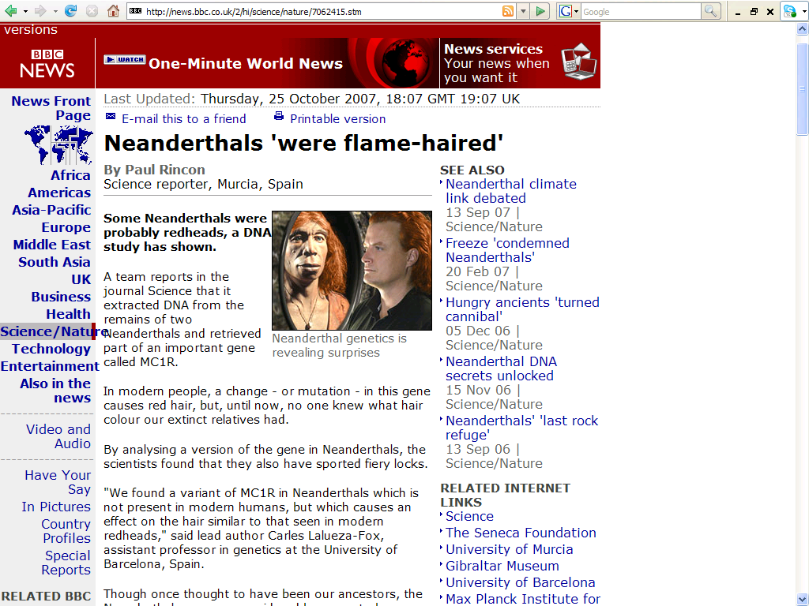
http://news.bbc.co.uk/2/hi/science/nature/7062415.stm

Slide 19
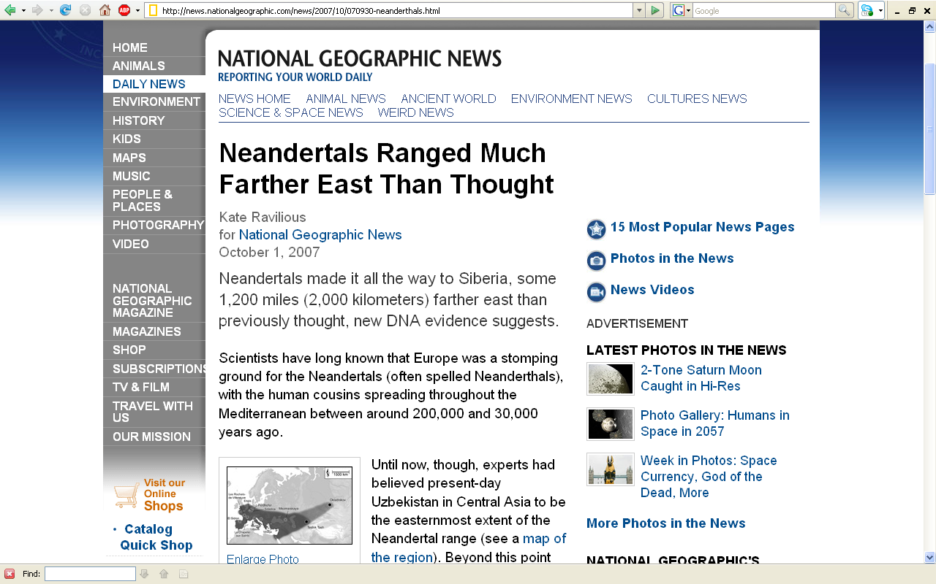
http://news.nationalgeographic.com/news/2007/10/070930-neanderthals.html

Slide 20
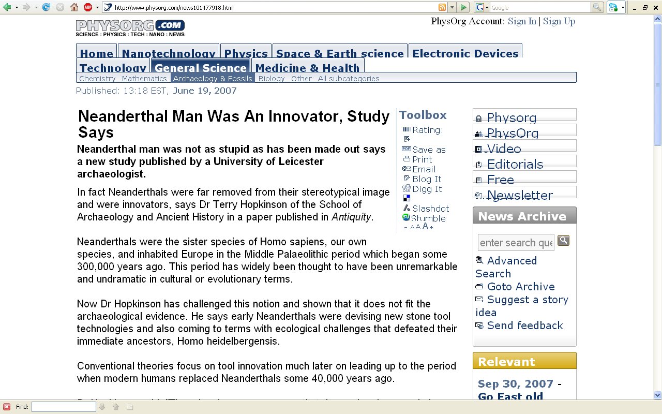
www.physorg.com/news101477918.html

Slide 21
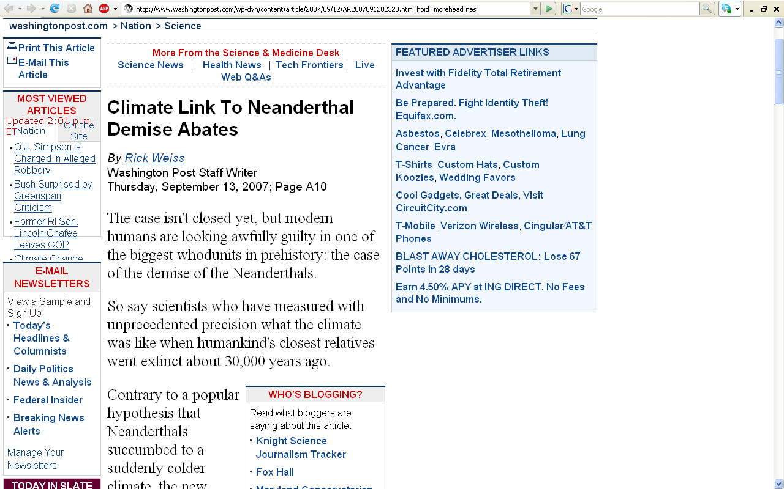
www.washingtonpost.com/wp-dyn/content/article/2007/09/12/AR2007091202323.html?hpid=moreheadlines

Slide 22
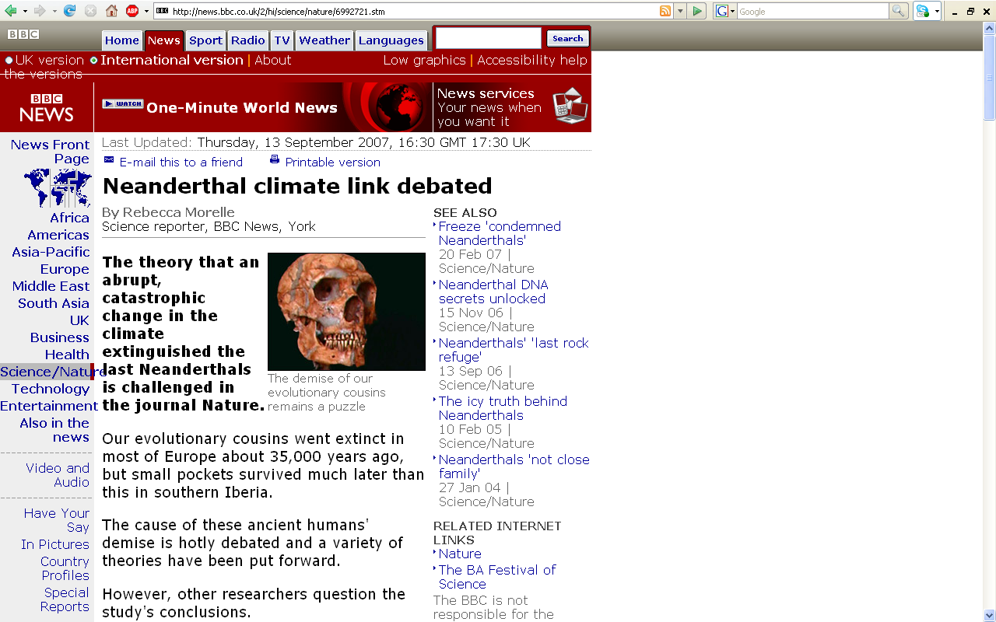
www.washingtonpost.com/wp-dyn/content/article/2007/09/12/AR2007091202323.html?hpid=moreheadlines

Slide 23
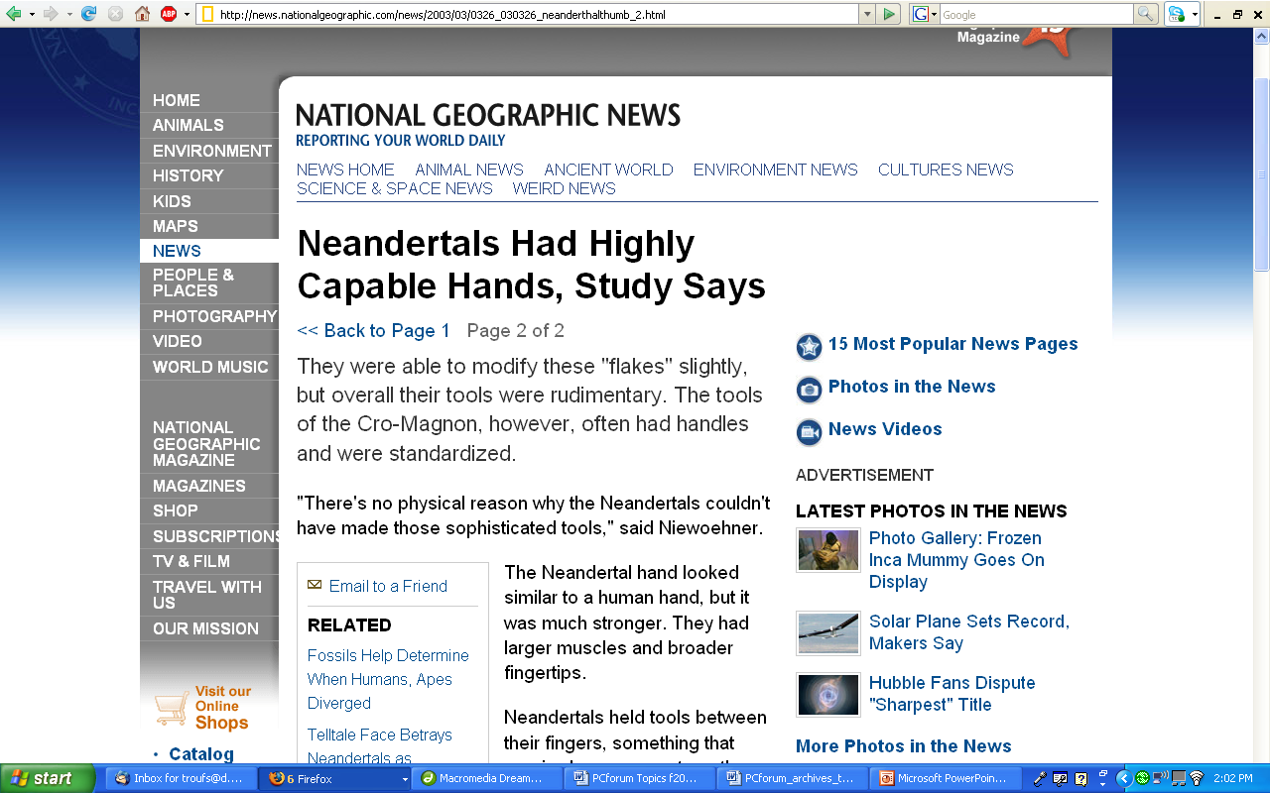
http://news.nationalgeographic.com/news/2003/03/0326_030326_neanderthalthumb_2.html

Slide 24
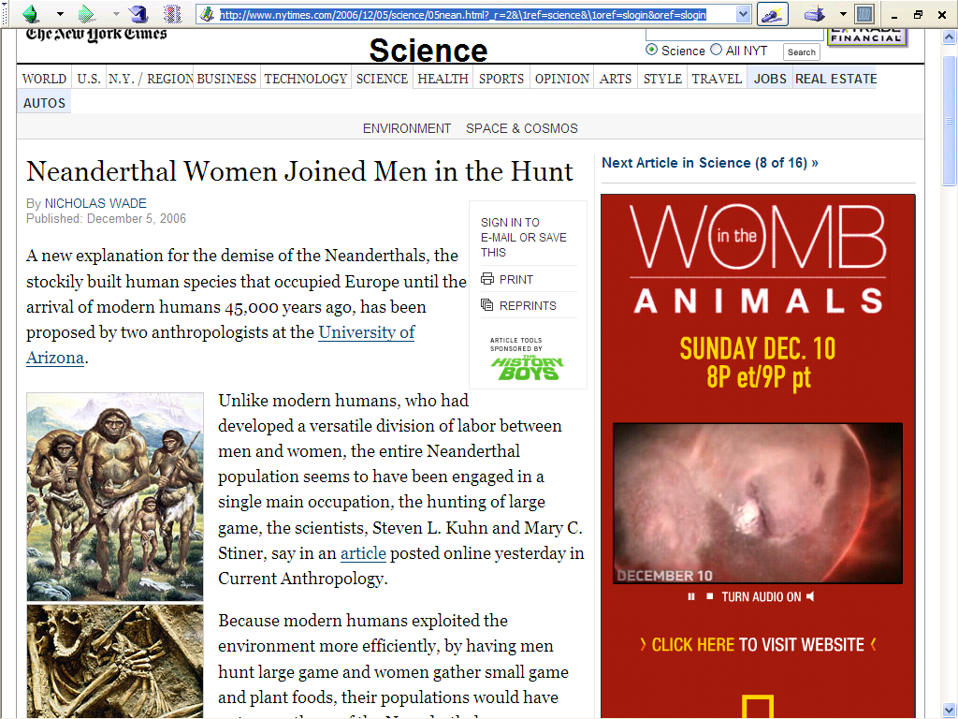
http://www.nytimes.com/2006/12/05/science/05nean.html?_r=2&\1ref=science&\1oref=slogin&oref=slogin

Slide 25
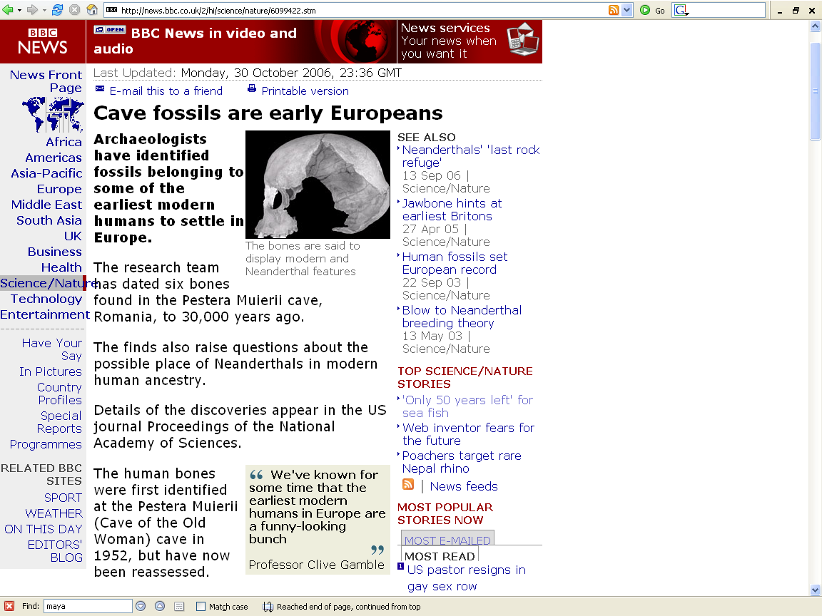
http://news.bbc.co.uk/2/hi/science/nature/6099422.stm

Slide 26
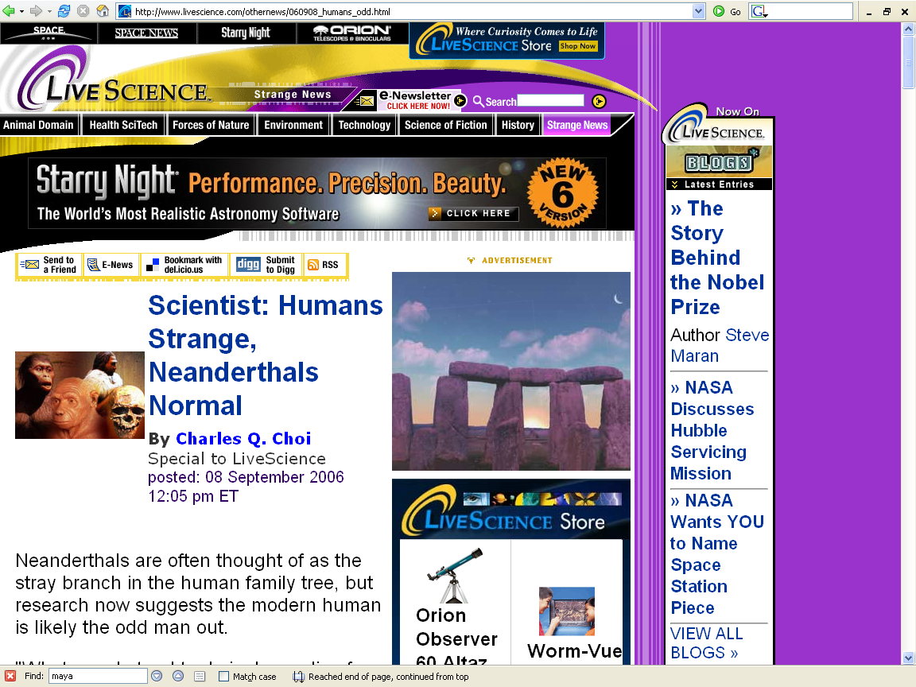
http://www.livescience.com/othernews/060908_humans_odd.html
Notes:
26

Slide 27
Neandertals
and other
“Premodern Humans”
(aka “Archaics”)
Lewin, In the Age of Mankind. Washington, D.C., Smithsonian, 1988.
Notes:
27

Slide 28
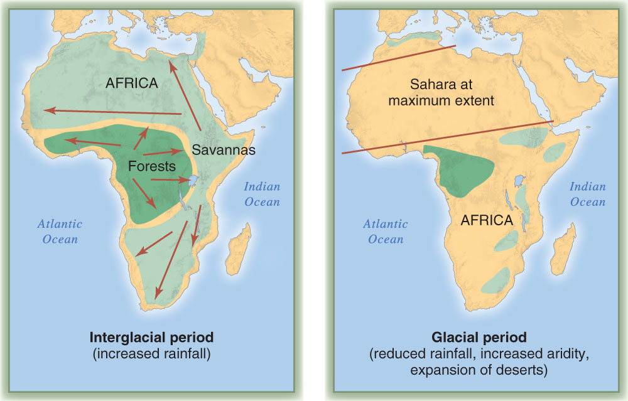
Changing Pleistocene environments in Africa.
Understanding Humans, 10th ed., p. 257

Slide 29
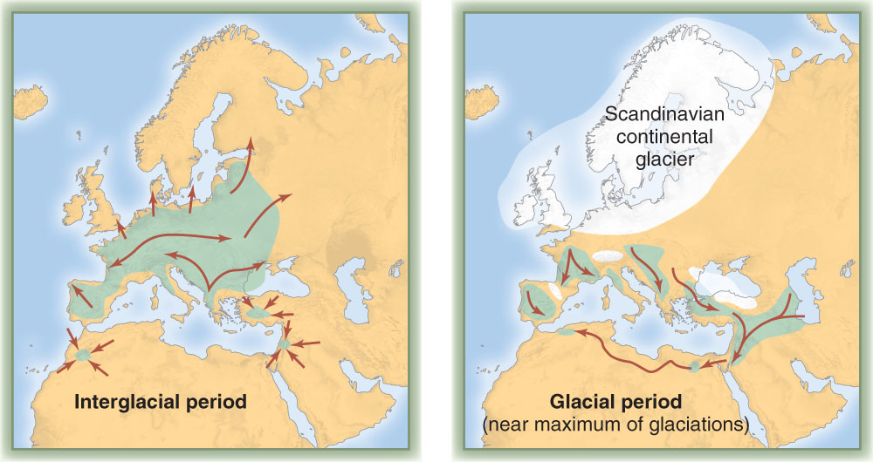
Changing Pleistocene environments in Eurasia.
Purple areas show regions of likely hominid occupation.
Orange areas are major glaciers.
Arrows indicate likely migration routes.
Understanding Humans, 10th ed., p. 258

Slide 30
Neandertals and Other Archaics
What’s the difference between
“Early” Homo
and
“Archaic” Homo?
(“Premodern Humans”)

Slide 31
Neandertals and Other Archaics
What’s the difference between
“Early” Homo
and
“Premodern Humans”
(“Archaics”)

Slide 32
Neandertals and Other Archaics
“Early” Homo
2.4 mya . . .
  Homo habilis
  Homo rudolfensis

Slide 33
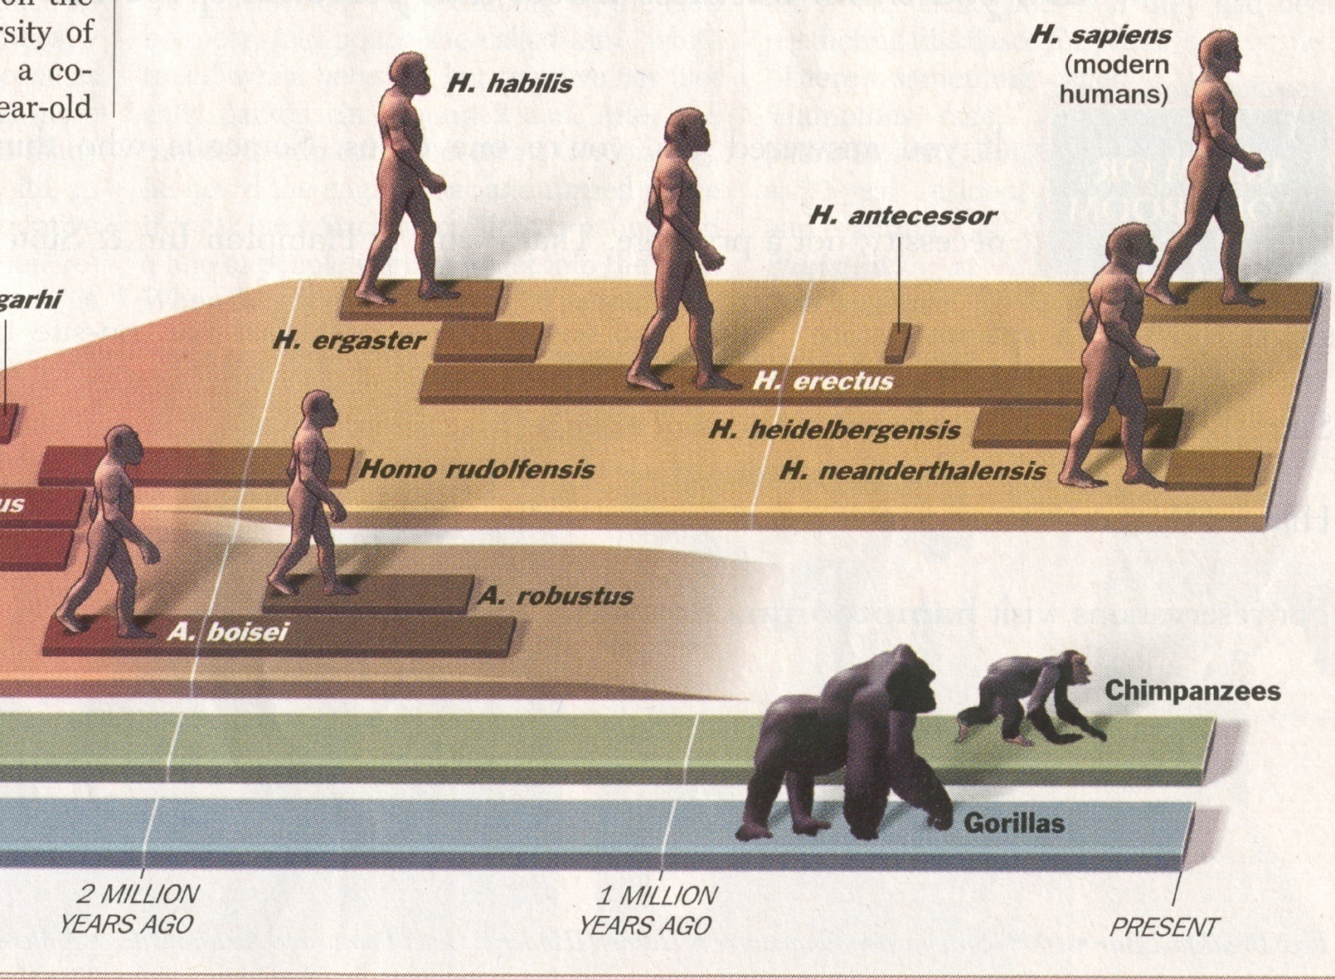
“Early Homo”
“Premodern Humans”
(aka “Archaics”)
Time, 23 July 2001.
Notes:
33

Slide 34
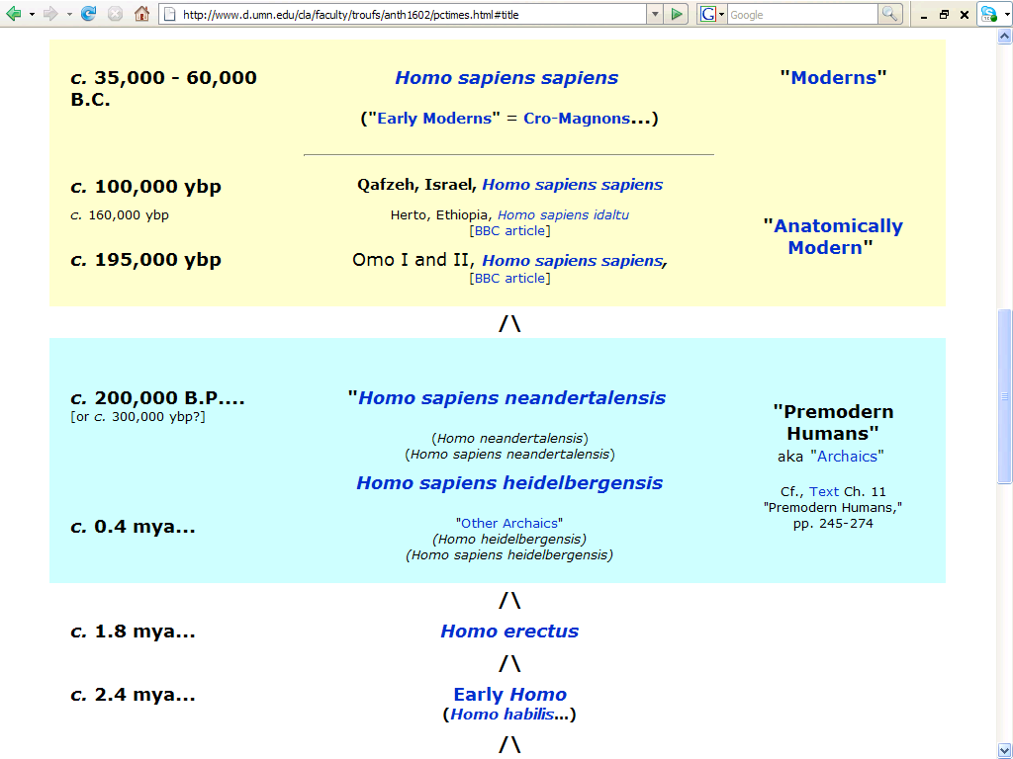
http://www.d.umn.edu/cla/faculty/troufs/anth1602/pctimes.html#title
Notes:
34

Slide 35

“Early Homo”
“Premodern Humans”
(aka “Archaics”)
Time, 23 July 2001.

Slide 36
Neandertals and Other Archaics
What’s the difference between
“Early” Homo
and
“Premodern Humans”
(“Archaics”)

Slide 37
http://www.d.umn.edu/cla/faculty/troufs/anth1602/pctimes.html#title
Notes:
37

Slide 38
Neandertals and Other Archaics
“Premodern Humans”
“Archaics”
are members of the species Homo sapiens
  including Neandertals?
preceded “anatomically modern Homo sapiens” (“moderns”)
  Qafzeh
  Cro-Magnon . . .

Slide 39
Neandertals and Other Archaics
“Premodern Humans”
“Archaics”
are different from Homo erectus . . .
but lack the full set of characteristics diagnostic of modern Homo sapiens . . .

Slide 40
“Modern Humans”
“Homo erectus”
“Premodern Humans”
(aka “Archaics”)
Time, 23 July 2001.

Slide 41
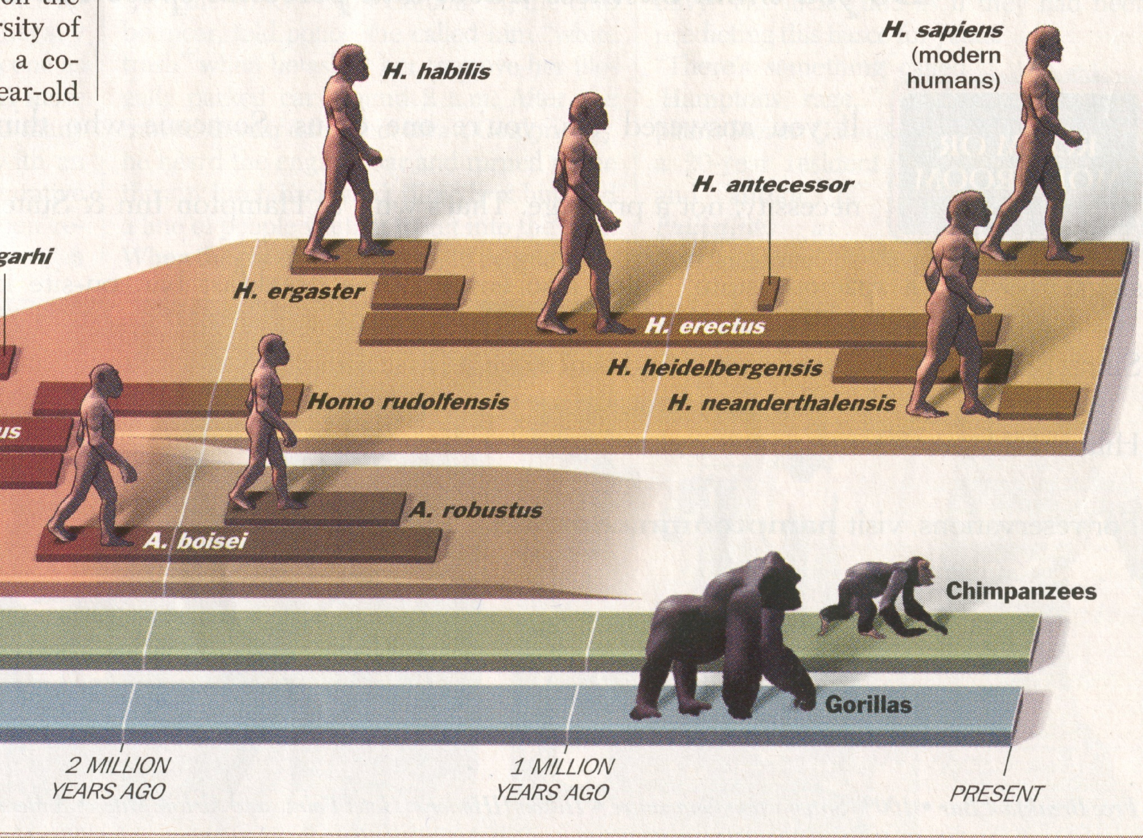
“Modern Humans”
(aka “Archaics”)
“Premodern Humans”
(aka “Archaics”)
“Early Homo”
Time, 23 July 2001.

Slide 42
“Premodern Humans”
(aka “Archaics”)
Time, 23 July 2001.

Slide 43
Neandertals and Other Archaics
“Premodern Humans”
“Archaics”
early members of the species Homo sapiens who preceded anatomically modern humans . . .

Slide 44
Neandertals and Other Archaics
“Premodern Humans”
“Archaics”
400,000 - ca. 130,000 ybp

Slide 45
Neandertals and Other Archaics
“Premodern Humans”
“Archaics”
post - Erectus humans in
  Africa
  Asia (India and China)
  Europe

Slide 46
Neandertals and Other Archaics
“Premodern Humans” include
(European “Archaics”)
    Steinheim
    Swanscombe
    Vértesszöllös
    Atapuerca
    Arago . . .
    and Neandertal

Slide 47
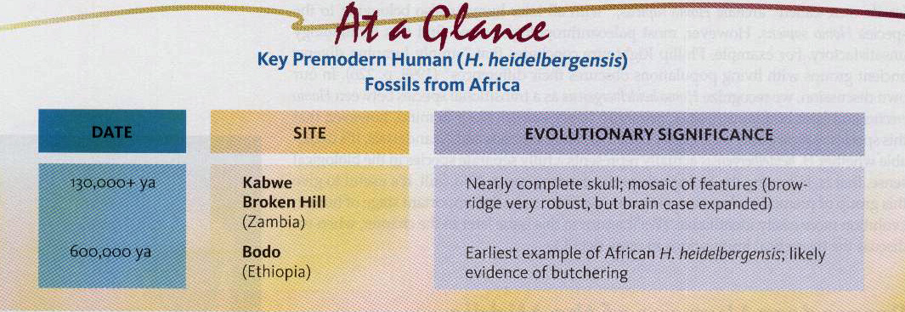
Understanding Humans, 10th ed., p. 260

Slide 48
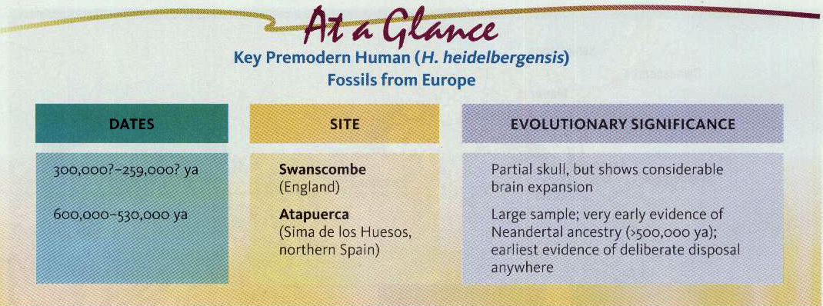
Understanding Humans, 10th ed., p. 261

Slide 49
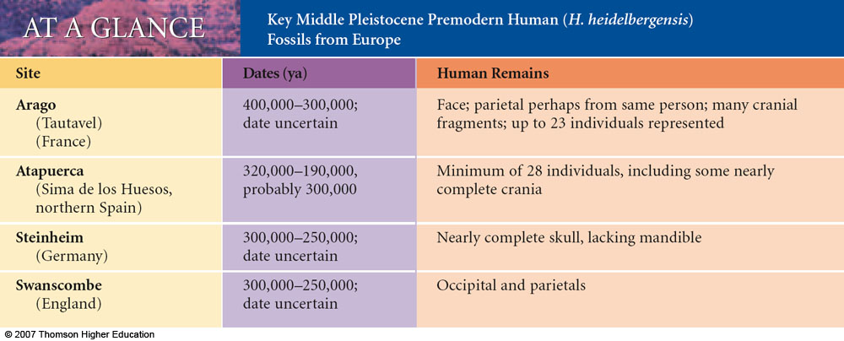
Understanding Physical Anthropology and Archaeology, 9th ed., p. 252

Slide 50
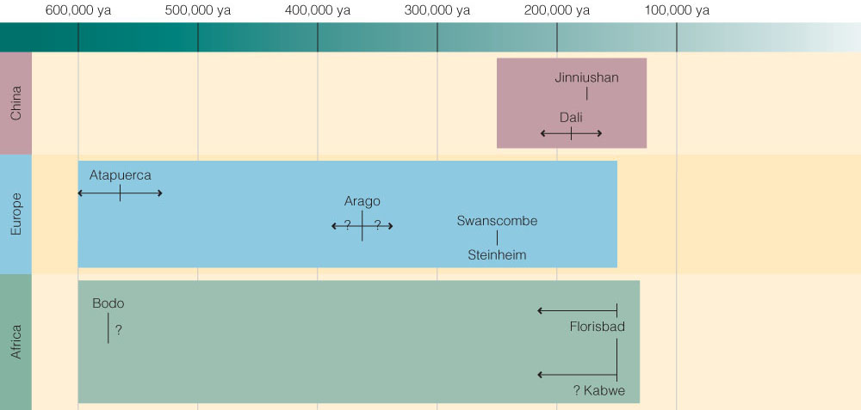
“Premodern Humans”
(European “Archaics”)
Understanding Humans, 10th ed., p. 265

Slide 51
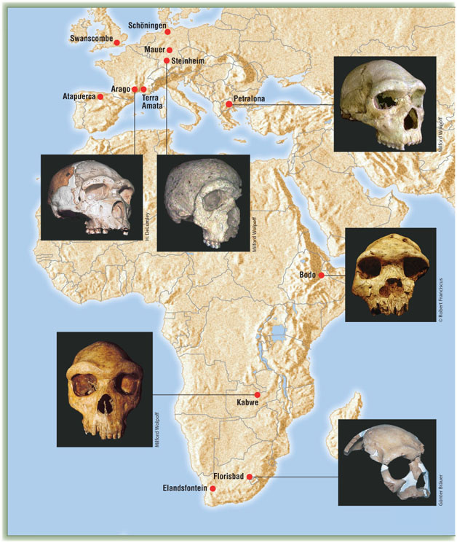
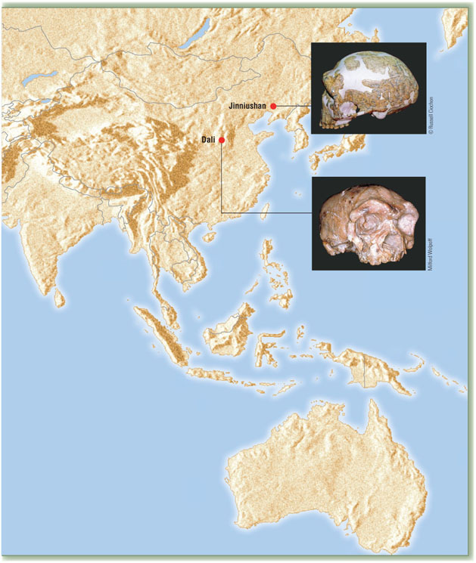
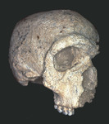
Fossil Discoveries and Localities of Middle Pleistocene premodern hominins.
Understanding Humans, 10th ed., pp. 262-263

Slide 52
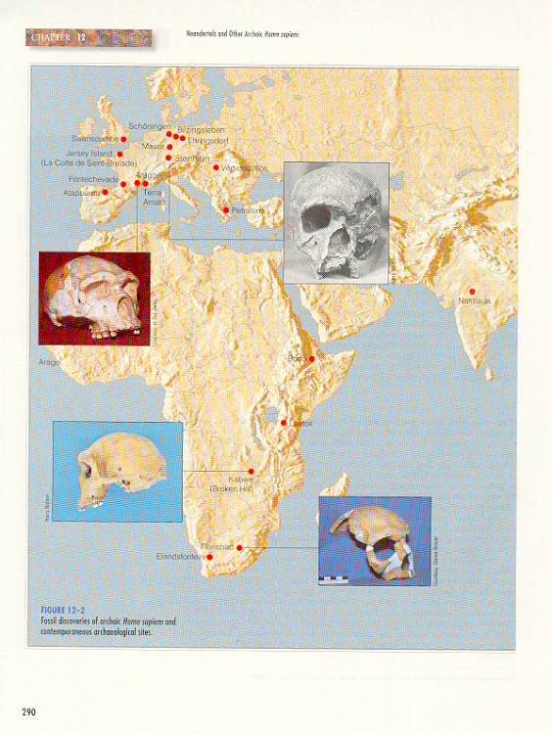
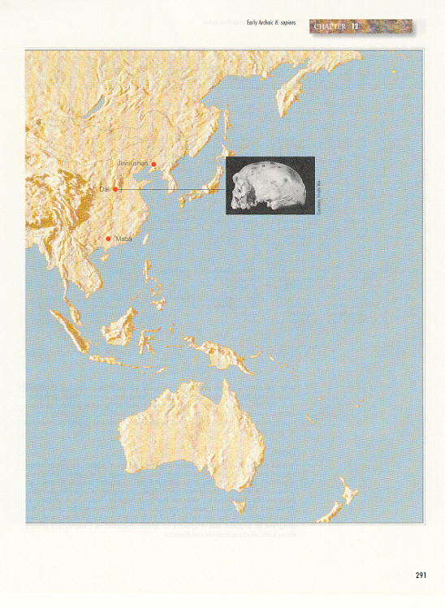
X
Steinheim, 10th Ed, p. 260 ff.
Understanding Humans, 10th ed., p. 262-263

Slide 53
Changing Pleistocene environments in Africa.
Understanding Humans, 10th ed., p. 257

Slide 54
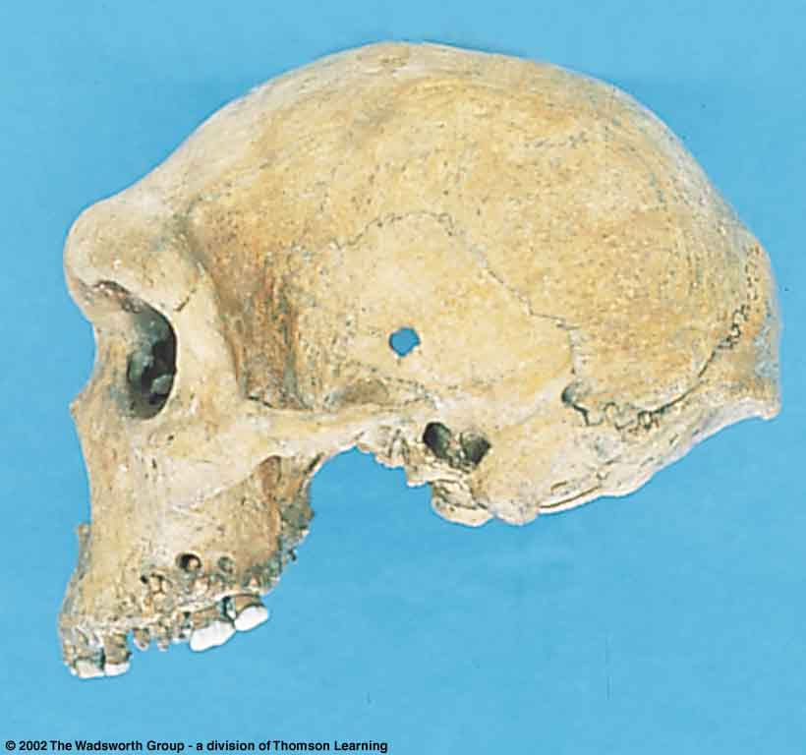
X
Understanding Physical Anthropology and Archaeology, 9th Ed., pp. 250-251.

Slide 55
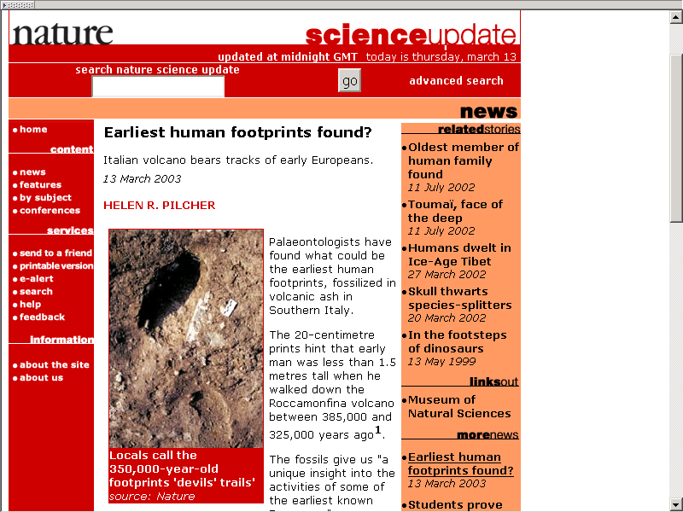
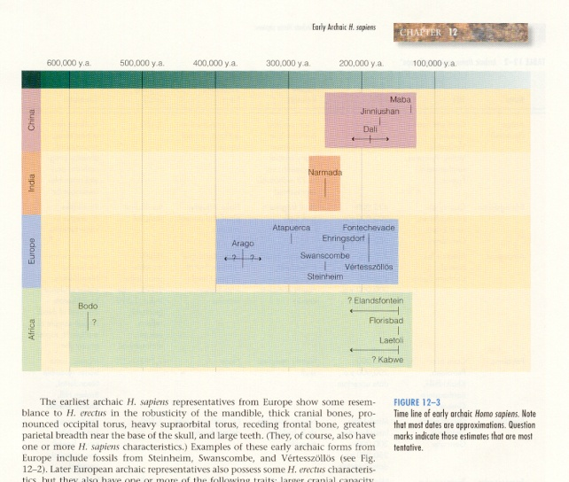
http://www.nature.com/nsu/030310/030310-9.html

Slide 56
Neandertals and Other Archaics
“Premodern Humans” include
(European “Archaics”)
400,000 - ca. 130,000 ybp
but
Neandertals are a special case Archaic

Slide 57
Neandertals
Four important Neandertal questions
  Is Neandertal a separate species than Homo sapiens?
  Why did the Neandertals disappear so rapidly?
    The “Neandertal Problem”
  Did Neandertals have speech like we know it?
  Did Neandertals interbreed with Homo sapiens sapiens ? (Are we part Neandertal?)

Slide 58
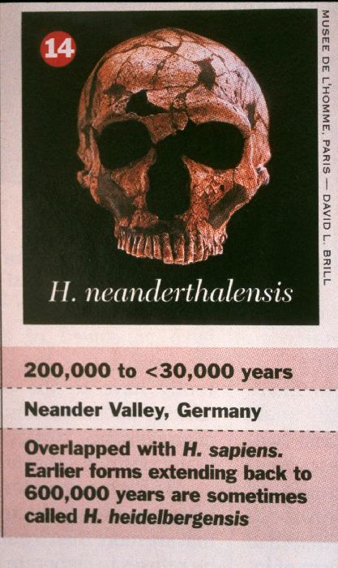

Slide 59
www.newscientist.com/channel/life/dn15042-why-did-neanderthals-have-such-big-noses.html?feedId=online-news_rss20

Slide 60
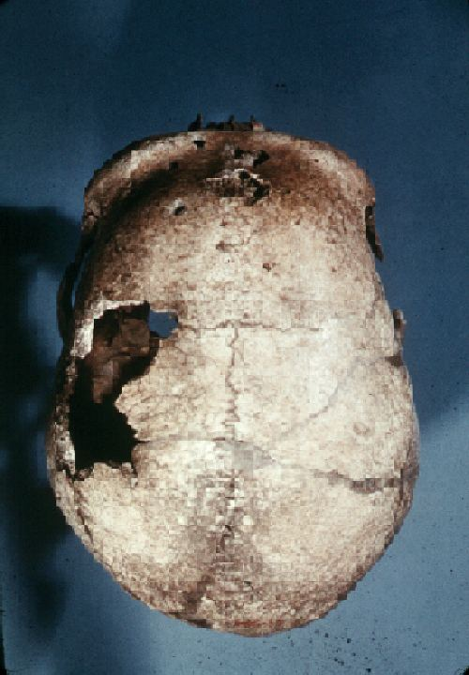
“The Old Man” of La Chapelle-aux-Saints, France.
1600 cc. cranial capacity.

Slide 61
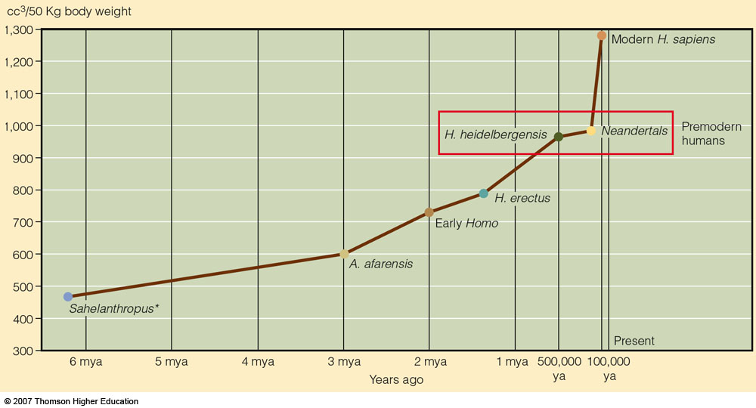
Hominin brain size / body weight ratio
Premodern humans
have a more than 20%
increase in relative brain size
compared to Homo erectus,
but modern humans show
another 30% expansion
beyond that in
premodern humans.
brain size as cc³ per 50 kg of body weight
Understanding Physical Anthropology and Archaeology, 9th ed., p. 269

Slide 62
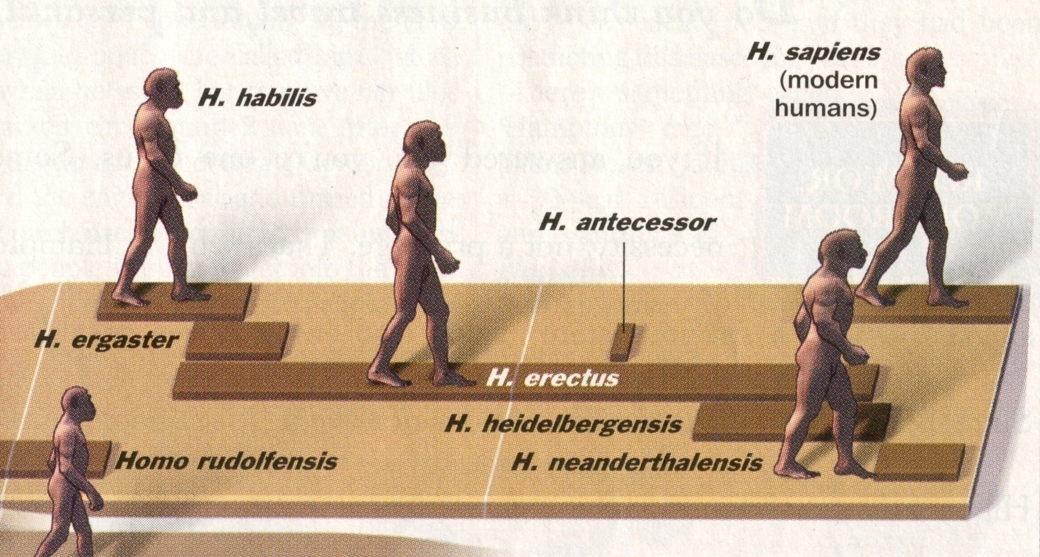
Neandertal
Time, 23 July 2001.

Slide 63
Fossil Discoveries and Localities of Neandertal
Understanding Humans, 10th ed., pp. 262-263

Slide 64
Neandertals
Four important Neandertal questions
  Is Neandertal a separate species than Homo sapiens ?

Slide 65
Neandertals and Other Archaics
“Until recently the Neanderthals have been considered by just about all researchers to be an archaic subspecies of Homo sapiens, specifically Homo sapiens neanderthalensis.”
- - Feder / Park, 1993, p. 256

Slide 66
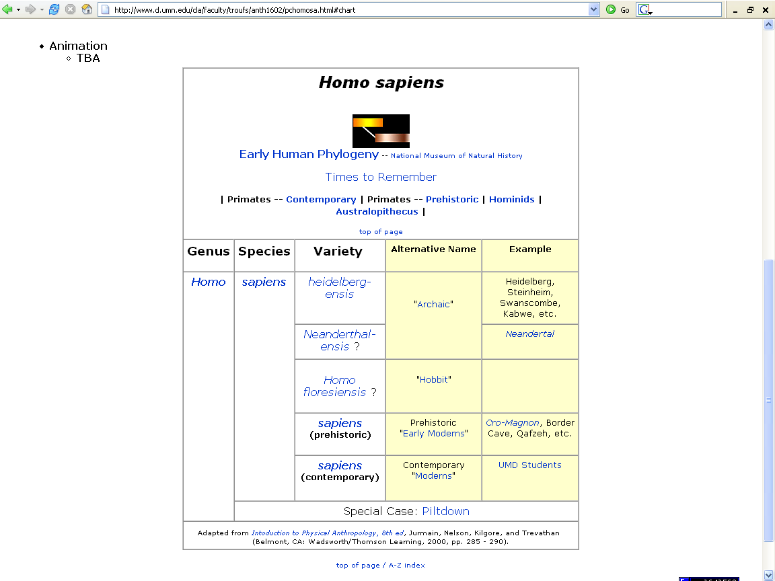
http://www.d.umn.edu/cla/faculty/troufs/anth1602/pcneand.html#chart

Slide 67
Neandertals and Other Archaics
Neandertal
Homo sapiens neanderthalensis
but some think they are
Homo neanderthalensis
(a separate species)

Slide 68
Neandertals and Other Archaics
Homo sapiens types
Homo sapiens sapiens
Homo sapiens neandertalensis?
Homo sapiens heidelbergensis?

Slide 69
http://www.d.umn.edu/cla/faculty/troufs/anth1602/pctimes.html#title
Notes:
69

Slide 70
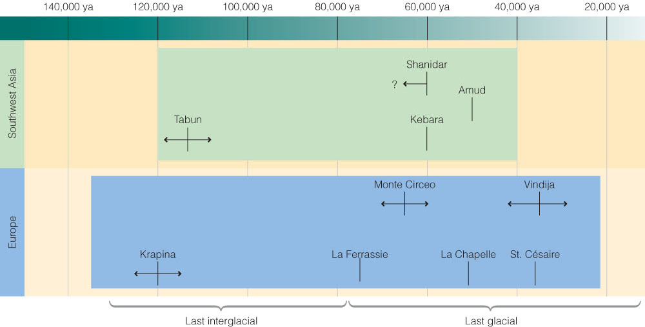
Time line for Neandertal fossil discoveries..
Understanding Humans, 10th ed., p. 271

Slide 71
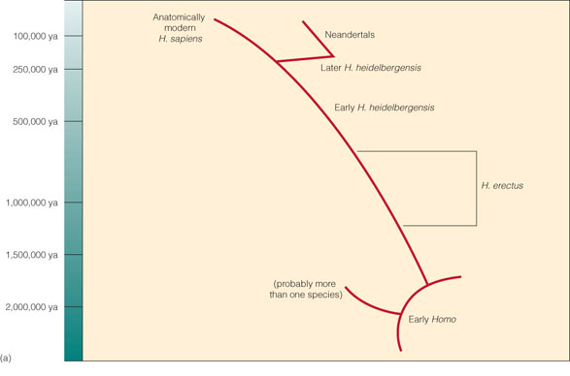
Premoderns
Phylogeny (a) of genus Homo
with only very moderate species diversity is implied.
Understanding Humans, 10th ed., p. 279

Slide 72
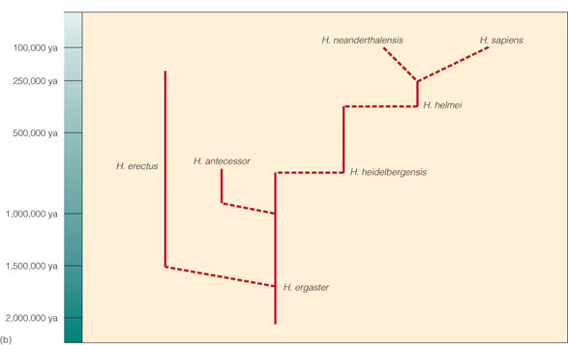
Premoderns
Phylogeny (b) of genus Homo
showing considerable species diversity.
Understanding Humans, 10th ed., p. 279

Slide 73

Possible evolutionary relationships of
Middle and Upper Pleistocene hominins.
Understanding Physical Anthropology and Archaeology, 9th ed., p. 271

Slide 74
Neandertals and Other Archaics
“As a result of [studies in the early 1990s] the idea has been resurrected that the Neanderthals do not belong in the sapiens sapiens at all, but deserve the status of a separate species, Homo neanderthalensis.”
- - Feder / Park, 1993, p. 256

Slide 75
Neandertals and Other Archaics
Neandertal
Homo sapiens neanderthalensis
but some think they are
Homo neanderthalensis
(a separate species)

Slide 76

A
B
C
N
X
Z
Humankind Emerging, 7th edition, p. 418.

Slide 77
Neandertals and Other Archaics
Neandertal types
“Classic”
“Progressive”
  (aka “Generalized”)

Slide 78

^{Homo sapiens}
^{Homo erectus}
^{Homo}
^{habilis}
^{Australopithecus}

Slide 79

Morphology and Variation in Neandertal Crania.
Understanding Humans, 10th ed., p. 268

Slide 80

Fossil Discoveries of Neandertal.
Understanding Humans, 10th ed., p. 257

Slide 81
Fossil Discoveries of Neandertal.
Understanding Humans, 10th ed., p. 257

Slide 82



Fossil Discoveries of Neandertal.
Understanding Physical Anthropology and Archaeology, 9th Ed., pp. 260-261.

Slide 83

Kurdish shepherds helping with excavations at Shanidar, Iraq.
Campbell-Loy, Humankind Emerging, 7th Ed., p. 446.

Slide 84
Time line for Neandertal fossil discoveries..
Understanding Humans, 10th ed., p. 271

Slide 85

Understanding Humans, 10th ed., p. 257

Slide 86
Spy
Fossil Discoveries of Neandertal.
Understanding Humans, 10th ed., p. 257

Slide 87

Spy
Spy
Fossil Discoveries of Neandertal.
Understanding Humans, 10th ed., p. 257

Slide 88
St. Césaire, 10th Ed,
pp. 268-270
St. Césaire, among the “last” Neandertals
Understanding Humans, 10th ed., p. 268

Slide 89

St. Césaire, 10th Ed,
pp. 268-270
St. Césaire, among the “last” Neandertals
Understanding Humans, 10th ed., p. 257

Slide 90
Time line for Neandertal fossil discoveries.
Understanding Humans, 10th ed., p. 271

Slide 91

January 1996

Slide 92


Slide 93


Slide 94

People of the Earth, 10th Ed., p. 100.

Slide 95

Life Nature Library, Early Man, p. 125.

Slide 96

Climate and vegetation of the world at the first peak of
The last glaciation, about 70,000 ybp.
Campbell-Loy, Humankind Emerging, 7th Ed., p. 433.

Slide 97

Humankind Emerging, The Concise Edition, p. 271.

Slide 98

First
Neandertal
Skull
Found
Gibralter
(Forbes Quarry)
1848

Slide 99
Neandertals and Other Archaics
Neander Valley
Germany
1856
(First Neandertal Skull that made a difference)

Slide 100

Neander
Valley
Find
Dűsseldorf
Germany
1856

Slide 101
Neander Valley
Fossil Discoveries of Neandertal.
Understanding Humans, 10th ed., p. 257

Slide 102
Original Neandertal Find Neander Valley, Germany, 1852.
Lewin, In the Age of Mankind. Washington, D.C., Smithsonian, 1988.
Notes:
102

Slide 103
La Chapelle-aux-Saints
Fossil Discoveries of Neandertal.
Understanding Humans, 10th ed., p. 257

Slide 104
La Chapelle-aux-Saints, 10th Ed,
pp. 268~282
La Chapelle-aux-Saints.
Note the occipital bun, projecting face, and Low Vault.
Understanding Humans, 10th ed., p. 268

Slide 105

La Chapelle-aux-Saints
Note the occipital bun, projecting face, and Low Vault.
Understanding Humans, 10th ed., p. 270

Slide 106

Understanding Humans, 10th ed., p. 282

Slide 107
Understanding Humans, 10th ed., p. 257

Slide 108
Time line for Neandertal fossil discoveries.
Understanding Humans, 10th ed., p. 271

Slide 109
Neandertals and Other Archaics
Neandertal image
Marcellin Boule
1911
“The Old Man
of La Chapelle-aux-Saints”

Slide 110

“Old” is relative
Campbell – Loy, Humankind Emerging, 7th Ed., p. 544.

Slide 111
La Chapelle-aux-Saints
10th ed, p. 270
Fossil Discoveries of Neandertal.
Understanding Humans, 10th ed., p. 257

Slide 112
La Chapelle-aux-Saints
Note the occipital bun, projecting face, and Low Vault.
Understanding Humans, 10th ed., p. 270

Slide 113

Lewin, In the Age of Mankind. Washington, D.C., Smithsonian, 1988, p. 115.

Slide 114

“The Old Man” of La Chapelle-aux-Saints, France.
Less than 5 ft. tall, 1600 cc. cranial capacity.

Slide 115
“The Old Man” of La Chapelle-aux-Saints, France.
1600 cc. cranial capacity.

Slide 116

“The Old Man” of La Chapelle-aux-Saints, France.
1600 cc. cranial capacity.

Slide 117

“The Old Man” of La Chapelle-aux-Saints, France.

Slide 118

Campbell-Loy, Humankind Emerging, 7th Ed., p. 405.

Slide 119

Neandertal
stereotypes
Brace, The Stages of Human Evolution, 3rd Ed., Prentice-Hall, 1988, p. 115.

Slide 120

Brace, The Stages of Human Evolution, 3rd Ed., Prentice-Hall, 1988, p. 115.

Slide 121

Older
conception of
Neandertal,
Le Moustier,
France
1915.
Kennedy, Neanderthal Man (NY: Burgess, 1975), frontispiece.

Slide 122

Older
conception of
Neandertal,
Le Moustier,
France
1915.
Kennedy, Neanderthal Man (NY: Burgess, 1975), frontispiece.

Slide 123

R. Wallace, p. 83.

Slide 124

R. Wallace, p. 83.

Slide 125

Coon, Races of Europe (NY: Macmillan, 1939), p. 24.

Slide 126

1918-1931
http://www.cmgww.com/football/rockne/photo3.html

Slide 127

Knute Rockne
Coon, Races of Europe (NY: Macmillan,
1939), p. 24.
www.cmgww.com/football/rockne/photo3.html

Slide 128

Holmes, p. 69.

Slide 129

The Neanderthals (NY: Time-Life, 1973), p. 8.

Slide 130

Three stages in a reconstruction of a Neandertal male.
The Emergence of Humankind (4th Ed). (Harper & Row, 1985), p. 149.

Slide 131

Gibraltar I: Reconstruction of a ca. four-year-old Neandertal.
Reconstruction artist Elisabeth Daynes

Slide 132
Neandertals and Other Archaics
“Classic” Neandertal
are adapted to cold climates
physically
culturally

Slide 133
Neandertals and Other Archaics
“Classic” Neandertal
are adapted to cold climates
physically
culturally

Slide 134

Early Man (Time-Life Nature Library, 1973), p. 45.

Slide 135
Neandertals and Other Archaics
Allen’s Rule
cold region mammals tend to have shorter extremities than members of the same species in warm regions

Slide 136
Neandertals and Other Archaics
Bergmann’s Rule
cold region mammals tend to be heavier and rounder than members of the same species in warm regions

Slide 137

Body volume
and
skin surface
area
Coon, Garn and Birdsell, A Study of the Race Formation in Man (1950), p. 37.

Slide 138

Body volume
and
skin surface
area
Coon, Garn and Birdsell, A Study of the Race Formation in Man (1950), p. 37.

Slide 139

Stein and Rowe, Physical Anthropology, (McGraw-Hill, 1995), p. 170.

Slide 140


Inuit and African Women Illustrate Allen’s and Bergmann’s Rules.
Understanding Humans, 10th ed., p. 89

Slide 141
Changing Pleistocene environments in Africa.
Understanding Humans, 10th ed., p. 257

Slide 142
Hominin brain size / body weight ratio
Premodern humans
have a more than 20%
increase in relative brain size
compared to Homo erectus,
but modern humans show
another 30% expansion
beyond that in
premodern humans.
brain size as cc³ per 50 kg of body weight
Understanding Physical Anthropology and Archaeology, 9th ed., p. 269

Slide 143
Neandertals and Other Archaics
“Classic” Neandertal
are adapted to cold climates
physically
culturally

Slide 144

Understanding Physical Anthropology and Archaeology, 9th ed., p. 265

Slide 145

The Neanderthals (NY: Time-Life, 1973), p. 77.

Slide 146

The Neanderthals (NY: Time-Life, 1973).

Slide 147

Early Man (Time-Life Nature Library, 1973), p. 134.

Slide 148

Early Man (Time-Life Nature Library, 1973), p. 131.

Slide 149

The Neanderthals (NY: Time-Life, 1973), p. 73.

Slide 150

The Neanderthals (NY: Time-Life, 1973), p. 165.

Slide 151

http://www.bilimutopya.com.tr/arsiv/2002/10/bilimgun.htm

Slide 152


Slide 153

Early Man (Time-Life Nature Library, 1973), p. 132.

Slide 154
Neandertals and Other Archaics
Neandertal tools
“Mousterian”

Slide 155

Cultural periods of the European Upper Paleolithic.
Understanding Humans, 10th ed., p. 257

Slide 156
is the “culture”
the technique is called “Levallois”
Cultural periods of the European Upper Paleolithic.
Understanding Humans, 10th ed., p. 257

Slide 157


Slide 158

Pleistocene Subdivisions, Archaeological Industries and Hominids
Understanding Humans, 10th ed., p. 267

Slide 159

The “Levallois” technique
Understanding Humans, 10th ed., p. 265

Slide 160

The “Levallois” technique
Understanding Humans, 10th ed., p. 265

Slide 161

Mousterian tools.
Understanding Physical Anthropology and Archaeology, 9th ed., p. 264

Slide 162
Changing Pleistocene environments in Africa.
Understanding Humans, 10th ed., p. 257

Slide 163

Mousterian tools.
Understanding Physical Anthropology and Archaeology, 9th ed., p. 264

Slide 164

Mousterian tools.
Understanding Humans, 10th ed., p. 275

Slide 165

Humankind Emerging, 7th Ed., p. 432.

Slide 166

Humankind Emerging, 7th Ed., p. 438.

Slide 167

Distribution of Neandertals, their culture,
and related technologies
Fagan, People of the Earth, 10th Ed., p. 98.

Slide 168

Archaic Homo sapiens: Mousterian / Non-Mousterial Tools
Campbell-Loy, Humankind Emerging, 7th Ed., p. 436.

Slide 169

http://news.bbc.co.uk/1/hi/sci/tech/1766683.stm

Slide 170
Neandertals and Other Archaics
Neandertal culture
hunting

Slide 171

The Neanderthals (NY: Time-Life, 1973), p. 29.

Slide 172

The Neanderthals (NY: Time-Life, 1973), p. 31.

Slide 173

bolas ?
The Neanderthals (NY: Time-Life, 1973), pp. 36-37.

Slide 174

“Opportunistic hunting”
http://www.newscientist.com/news/news.jsp?id=ns99993085

Slide 175

The Neanderthals (NY: Time-Life, 1973), p. 35.

Slide 176

www.nature.ca/notebooks/english/woolly.htm

Slide 177

The Neanderthals (NY: Time-Life, 1973), p. 32.

Slide 178

Anthropology Today, p. 183.

Slide 179

^{Bear}
^{Neandertal}
Early Man (Time-Life Nature Library, 1973), p. 126.

Slide 180
January 1996

Slide 181

National Geographic, January 1996.

Slide 182
Neandertals and Other Archaics
Neandertal culture
religion ? / beliefs

Slide 183

Neandertal Cave Bear Cult, Austria.
Poirier, In Search of Ourselves, p. 179.

Slide 184

Bear skulls apparently stacked in a pit
supports the idea that the cave bear
was the center of a Neandertal cult.
Campbell – Loy, Humankind Emerging, 7th Ed., p. 441.

Slide 185

Early Man (Time-Life Nature Library, 1973), p. 127.

Slide 186

The Neanderthals (NY: Time-Life, 1973), p. 113.

Slide 187

The Neanderthals (NY: Time-Life, 1973), p. 107.

Slide 188

red ocher
The Neanderthals (NY: Time-Life, 1973), p. 81.

Slide 189


Slide 190

The Neanderthals (NY: Time-Life, 1973), p. 96.

Slide 191

The Neanderthals (NY: Time-Life, 1973), p. 102.

Slide 192

Neandertal
burial
at
Le Moustier,
France
Pfeiffer, The Emergence of Humankind, 4th Ed. (NY: Harper and Row, 1985), p. 151.

Slide 193

60,000-year-old family (?) cemetery
containing the skeletons of two adults
and four children
La Ferrassie, France
Campbell-Loy, Humankind Emerging, 7th Ed., p. 444.

Slide 194

National Geographic

Slide 195

http://news.bbc.co.uk/1/hi/sci/tech/2236585.stm

Slide 196

The Neanderthals (NY: Time-Life, 1973), p. 99.

Slide 197

Bordes, The Old Stone Age (NY: Mc-Graw-Hill, 1968), p. 142.

Slide 198

Neandertal Burial, Kebara Cave,
Mt. Carmel, Israel.
National Geographic, November 1985, p. 612.

Slide 199


Slide 200

Neandertal, ca., 45,000 ybp.
Lewin, In the Age of Mankind. Washington, D.C., Smithsonian, 1988, p. 182.

Slide 201
Neandertals and Other Archaics
Neandertal culture
cannibalism ?

Slide 202
Homo erectus pekinensis
Types of Cannibalism
Survival
Gustatory
Ritualistic or Incorporative

Slide 203
Cannibalism
Moula-Gercy, France
“Bones Offer Evidence of a Neanderthal - Eat - Neanderthal World”
78 fragments from 6 skeletons
ca. 100,000 ybp
30 September 1999

Slide 204

ABACNEWS.com/MagellanGeographix

Slide 205

Fragment of a Neandertal thigh bone.
UCAL Berkeley / AP Photo

Slide 206

Trinil
Modern deposits and bones
Sampoeng stratum (Neolithic)
Ngandong stratum (Upper Pleistocene)
Trinil stratum (Middle Pleistocene)
Djetis stratum (Lower Pleistocene)
Three or more strata (Pliocene)
Trinil stratum (ca., 700,000 ybp)

Slide 207
Java stratigraphy
Modern deposits and bones
Sampoeng stratum (Neolithic)
Ngandong stratum
(Upper Pleistocene)
Trinil stratum (ca. 700,000 ybp)
Djetis stratum (Lower Pleistocene)
Three or more strata (Pliocene)

Slide 208

The First Men (NY: Little, Brown, 1973), p. 42.

Slide 209


Solo-6, late Homo erectus
Ngandong Java
"Solo Man"

Slide 210


Slide 211
Neandertals and Other Archaics
Neandertal culture
other aspects of culture

Slide 212
Understanding Physical Anthropology and Archaeology, 9th ed., p. 265

Slide 213

http://www.webster.sk.ca/greenwich/fl-compl.htm

Slide 214

http://www.sciencenews.org/view/generic/id/44941/title/Stone_Age_flutes_found_in_Germany

Slide 215

http://www.sciencenews.org/view/generic/id/44941/title/Stone_Age_flutes_found_in_Germany

Slide 216

Small stone from a Mousterian site
Tata, Hungary
50,000 ybp
Campbell – Loy, Humankind Emerging, 7th Ed., p. 441.

Slide 217
Neandertals
Four important Neandertal questions
  Is Neandertal a separate species than Homo sapiens ?
  Why did the Neandertals disappear so rapidly ?
    The “Neandertal Problem”
      Out-fought ?
      Genetically Absorbed ?
      Killed off by tropical and warm-climate diseases for which they had no resistance ?

Slide 218
Neandertals
Four important Neandertal questions
  Is Neandertal a separate species than Homo sapiens ?
  Why did the Neandertals disappear so rapidly ?
    The “Neandertal Problem”
  Did Neandertals have speech like we know it?
    The “Lieberman” hypothesis

Slide 219


Slide 220

http://dsc.discovery.com/news/briefs/20050314/neanderthal.html

Slide 221
The skull . . .
modern humans have cranial base flexure
(basicranium) (bend)

Slide 222
Changing Pleistocene environments in Africa.
Understanding Humans, 10th ed., p. 257

Slide 223

Modern human cranium.
Understanding Humans, 10th ed., p. 428

Slide 224
The skull . . .
flexure in the base of the skull (the basicranium)
seems to relate to
a low larynx . . .

Slide 225

Larynx / Pharynx
Humankind Emerging, 7th ed., p. 377

Slide 226
Larynx / Pharynx
Humankind Emerging, 7th ed., p. 377

Slide 227
The skull . . .
larynx –
the voice box
(which contains the vocal cords)

Slide 228


Slide 229
The skull . . .
and a low larynx is associated with a longer pharynx . . .

Slide 230
The skull . . .
pharynx –
the throat above the larynx

Slide 231
Larynx / Pharynx
Humankind Emerging, 7th ed., p. 377

Slide 232
Larynx / Pharynx
Humankind Emerging, 7th ed., p. 377

Slide 233


Slide 234

Larynx / Pharynx
Humankind Emerging, 7th ed., p. 377

Slide 235
The skull . . .
and a longer pharynx is a feature associated with human speech

Slide 236
Neandertals
Four important Neandertal questions
  Is Neandertal a separate species than Homo sapiens ?
  Why did the Neandertals disappear so rapidly ?
    The “Neandertal Problem”
  Did Neandertals have speech like we know it ?
  Did Neandertals interbreed with Homo sapiens sapiens ? Are we part Neandertal?

Slide 237

http://news.nationalgeographic.com/news/2008/08/080812-neandertal-dna.html

Slide 238

http://www.timesonline.co.uk/tol/news/science/biology_evolution/article6888874.ece

Slide 239

http://news.nationalgeographic.com/news/2006/10/061030-neanderthals.html

Slide 240

http://www.telegraph.co.uk/science/evolution/6430494/Modern-man-had-sex-with-Neanderthals.html

Slide 241

http://www.telegraph.co.uk/science/evolution/6430494/Modern-man-had-sex-with-Neanderthals.html

Slide 242

http://news.bbc.co.uk/1/hi/sci/tech/3431609.stm

Slide 243

http://news.bbc.co.uk/1/hi/sci/tech/3023685.stm

Slide 244

http://news.bbc.co.uk/1/hi/sci/tech/3663865.stm

Slide 245

http://news.nationalgeographic.com/news/2008/09/080908-neanderthal-brain.html?source=rss

Slide 246
http://dsc.discovery.com/news/2009/08/13/brussel-neanderthal.html

Slide 247

http://dsc.discovery.com/news/2009/08/13/brussel-neanderthal.html

Slide 248


Slide 249
Changing Pleistocene environments in Africa.
Understanding Humans, 10th ed., p. 257

Slide 250

Understanding Physical Anthropology and Archaeology, 9th ed., p. 249

Slide 251
Changing Pleistocene environments in Africa.
Understanding Humans, 10th ed., p. 257

Slide 252

Understanding Physical Anthropology and Archaeology, 9th ed., p. 253

Slide 253


http://dsc.discovery.com/news/2006/10/31/earliesteuropeans_arc.html?category=archaeology&\1guid=20061031120000

Slide 254
http://news.bbc.co.uk/2/hi/science/nature/6099422.stm

