Slide 1
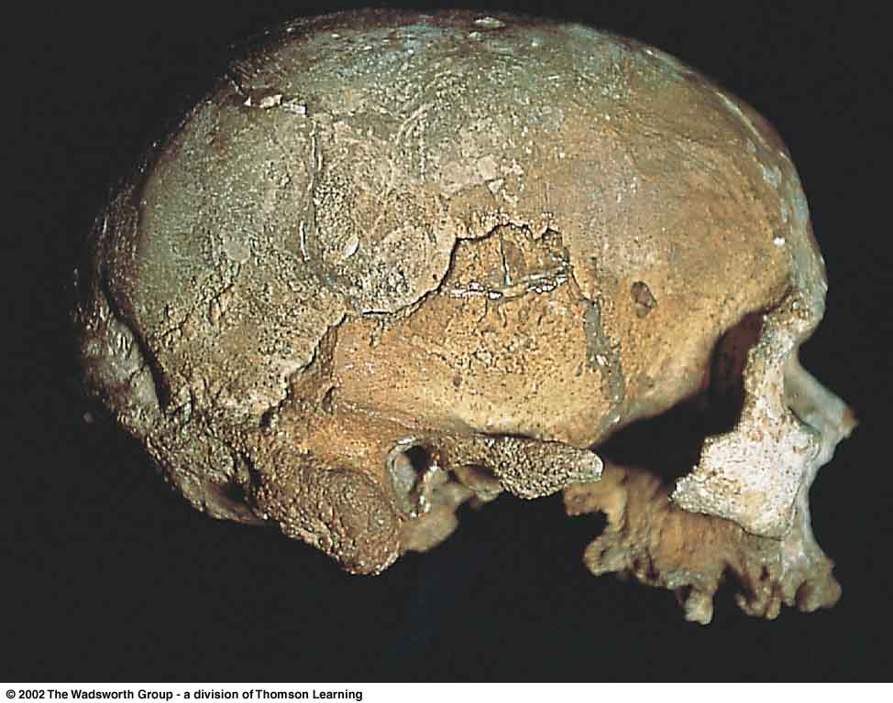
Moderns
Homo sapiens sapiens
Cro-Magnon I
(France)
Prehistoric Cultures Tim Roufs’ section ©2009
Understanding Humans (10th Ed.), p. 297

Slide 2
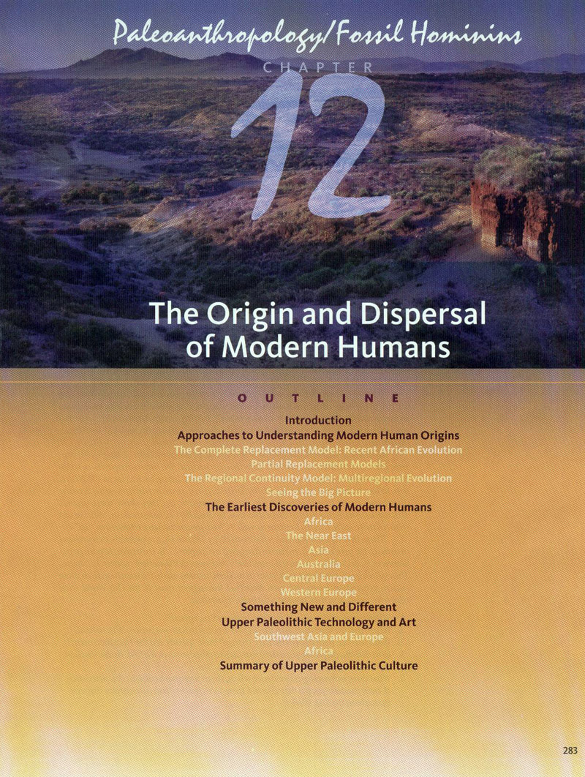

Slide 3
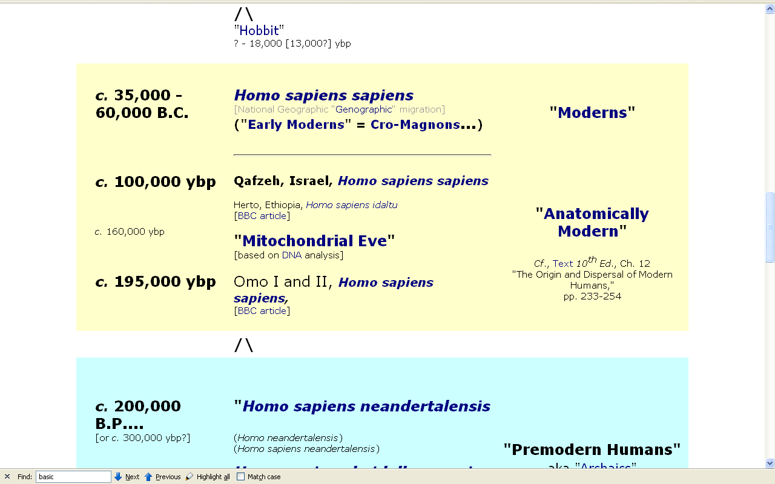
http://www.d.umn.edu/cla/faculty/troufs/anth1602/pctimes.html

Slide 4
Homo
Genus
Homo
Species
rudolfensis ( “early” )
habilis ( “early” )
erectus
Java (Trinil)
Pithecanthropus erectus
China (Beijing)
Homo erectus pekinensis
Africa . . .
Europe . . .
sapiens

Slide 5
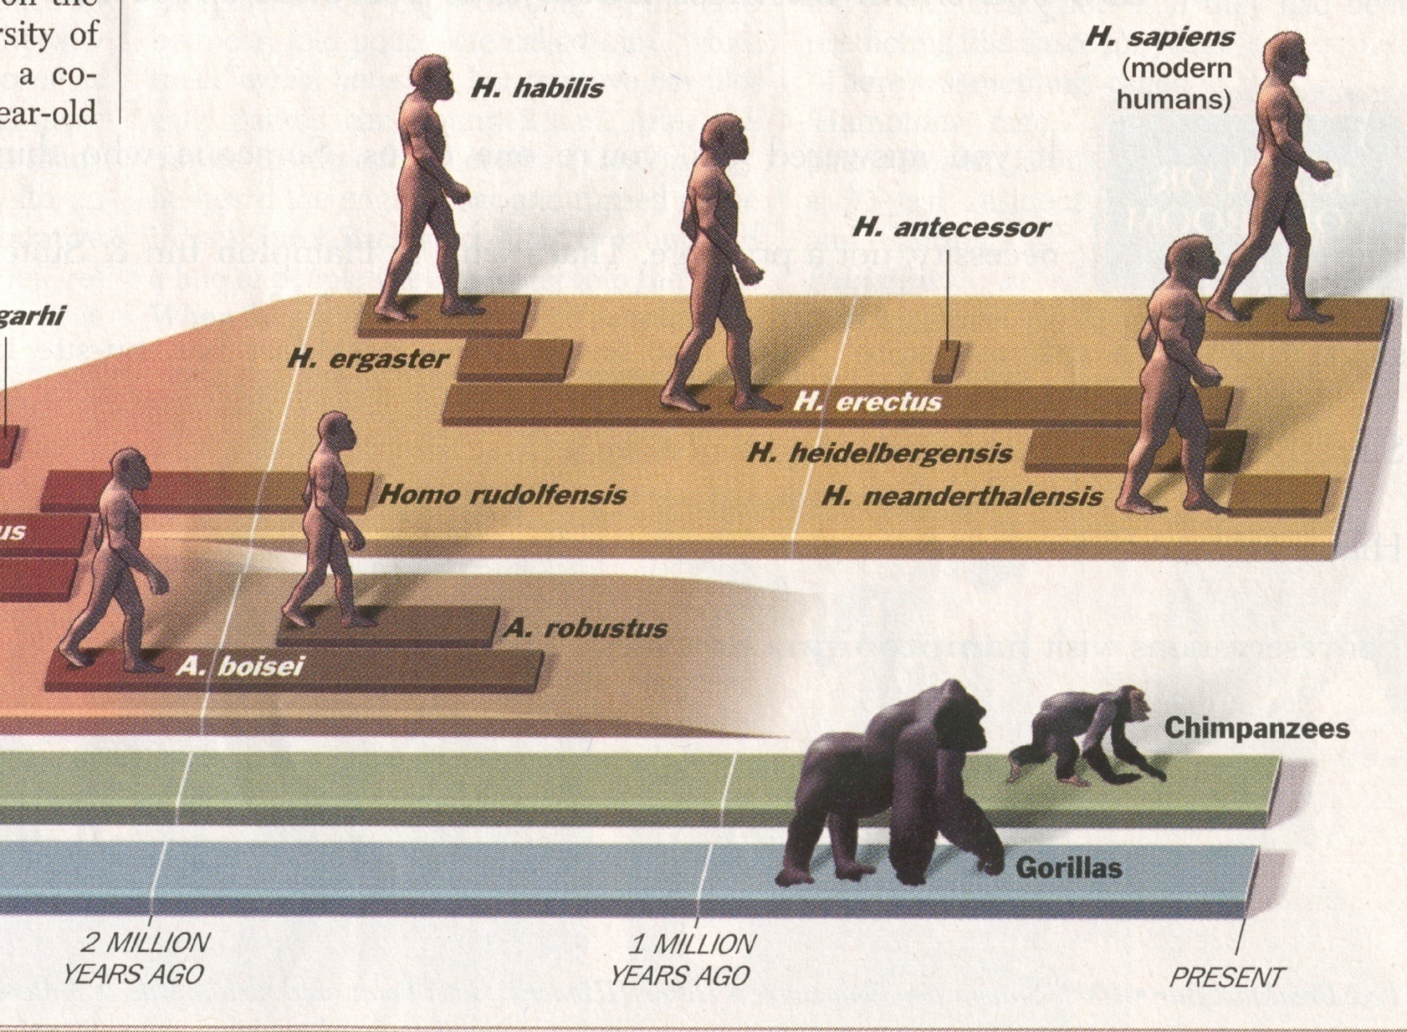
“Early Homo”
“Premodern Humans”
(aka “Archaics”)
Time, 23 July 2001
Notes:
5

Slide 6
^{Homo sapiens sapiens}
“Modern Humans”
Time, 23 July 2001
Notes:
6

Slide 7
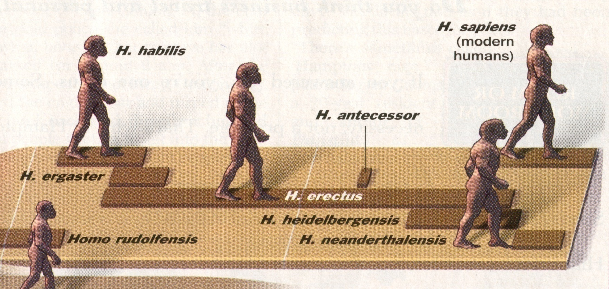
^{Homo sapiens sapiens}
Time, 23 July 2001

Slide 8
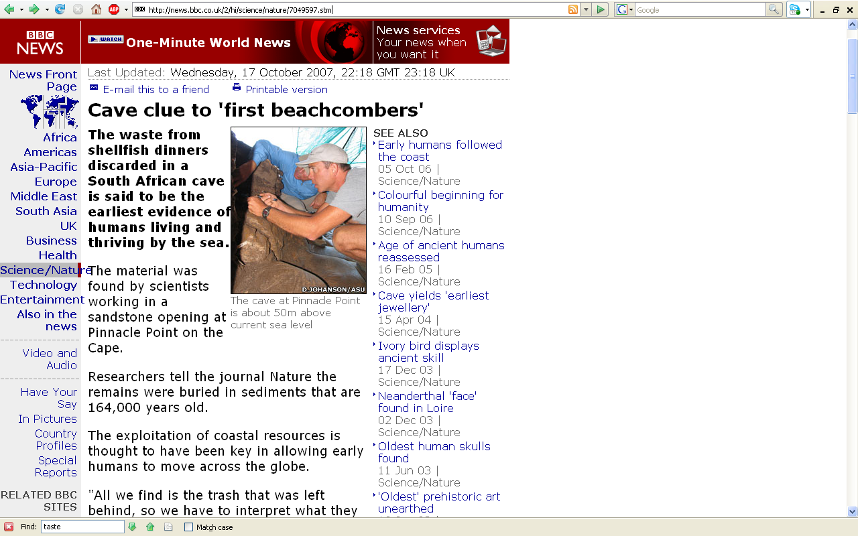
http://news.bbc.co.uk/2/hi/science/nature/7049597.stm

Slide 9
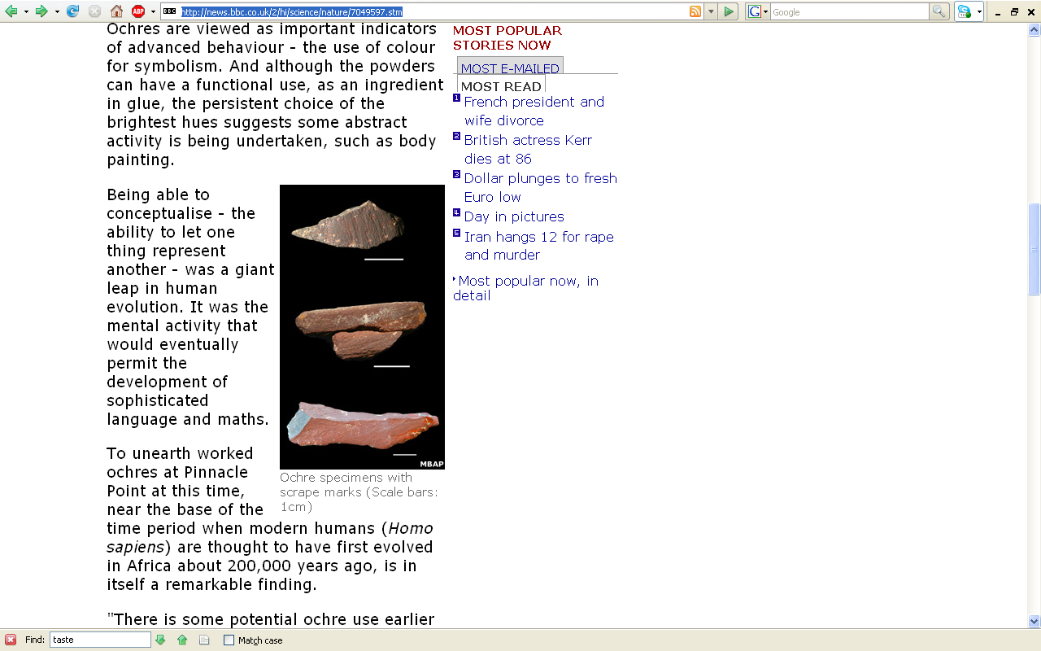
http://news.bbc.co.uk/2/hi/science/nature/7049597.stm

Slide 10
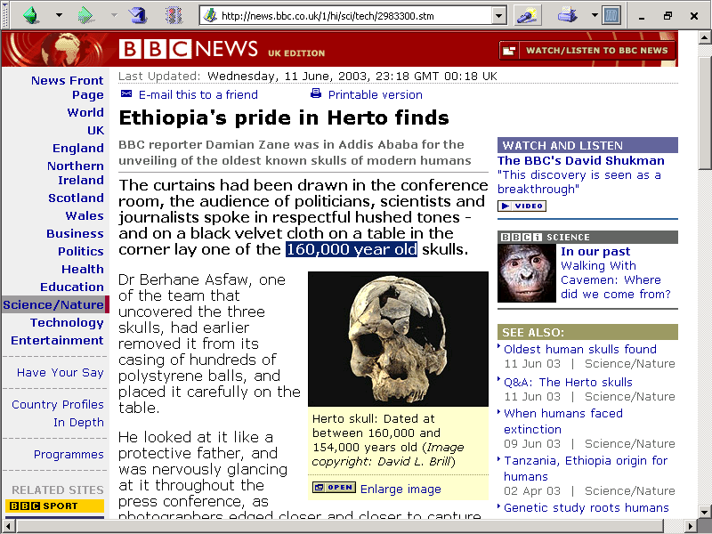
http://news.bbc.co.uk/1/hi/sci/tech/2983300.stm

Slide 11
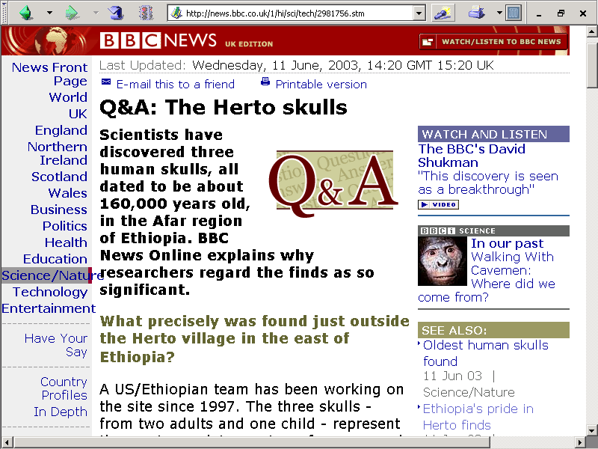
http://news.bbc.co.uk/1/hi/sci/tech/2981756.stm

Slide 12
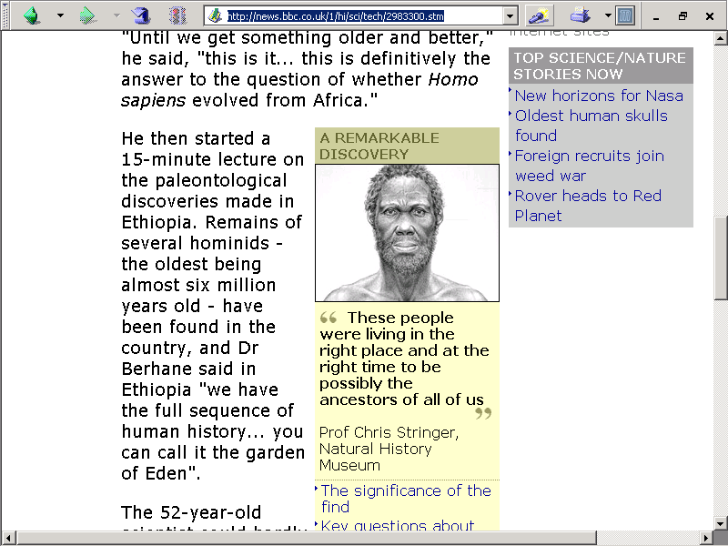
Ethiopia:
ca. 6 mya – 150,000 ybp
http://news.bbc.co.uk/1/hi/sci/tech/2983300.stm

Slide 13
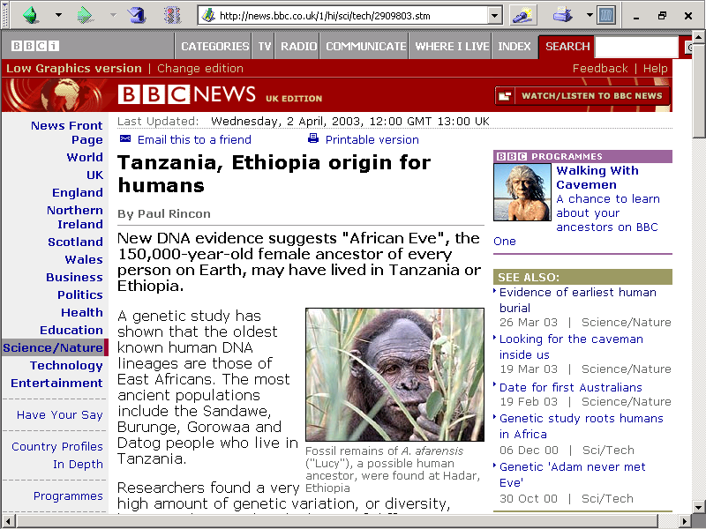
http://news.bbc.co.uk/1/hi/sci/tech/2909803.stm

Slide 14
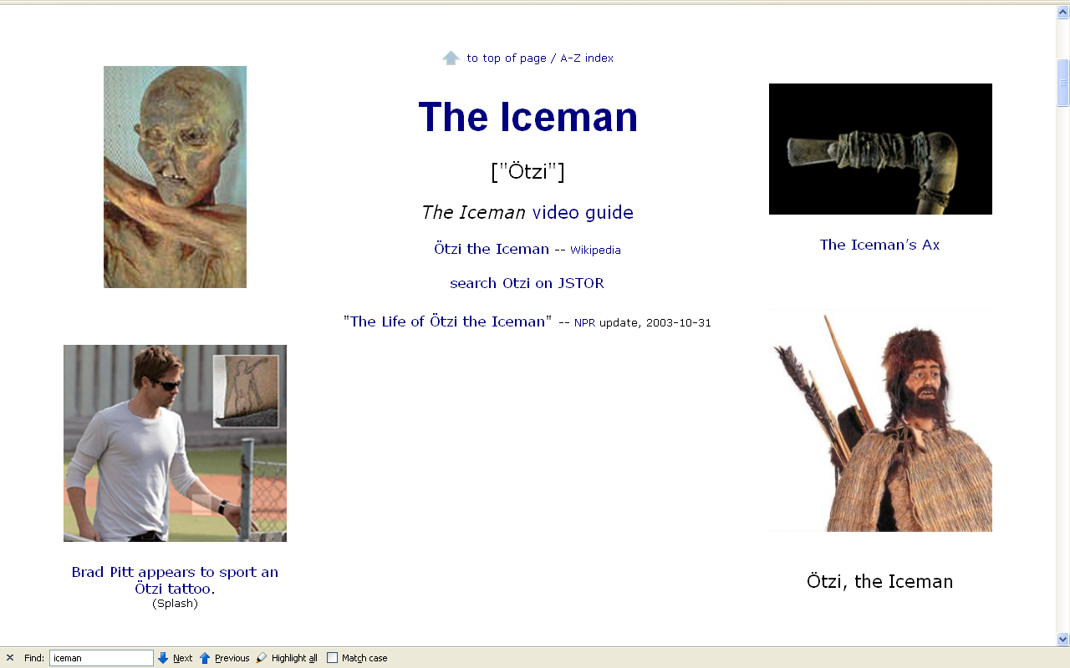
http://www.d.umn.edu/cla/faculty/troufs/anth1602/pcice_man.html

Slide 15
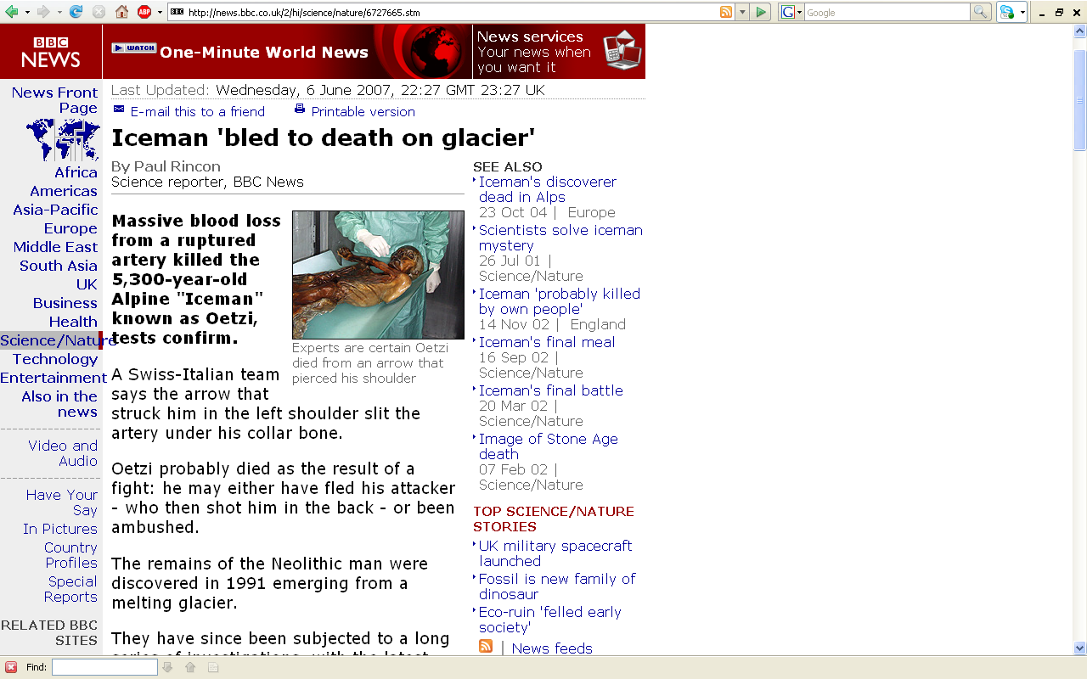
http://news.bbc.co.uk/2/hi/science/nature/6727665.stm

Slide 16
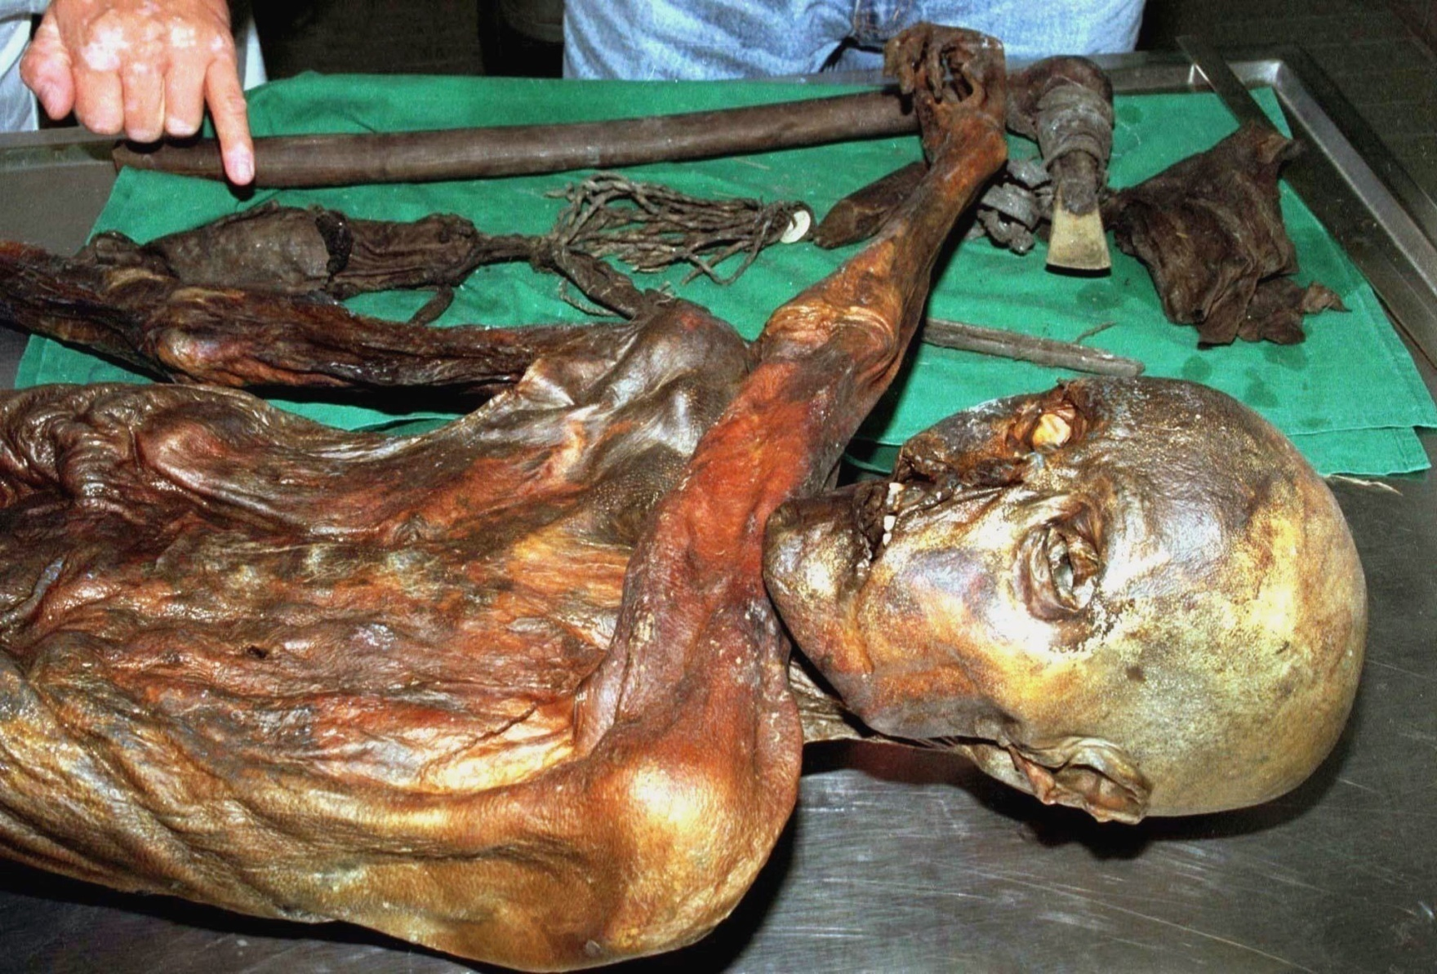
http://thegist.smithsonianmag.com/archives/date/2007/06/page/2/

Slide 17
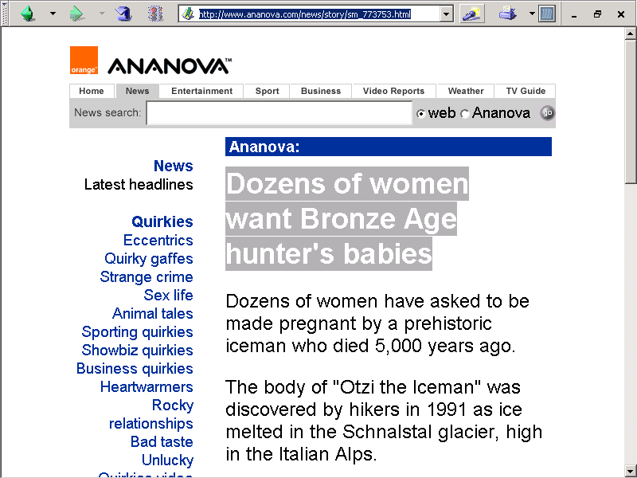
www.ananova.com/news/story/sm_773753.htmlhttp://www.ananova.com/news/story/sm_773753.html

Slide 18
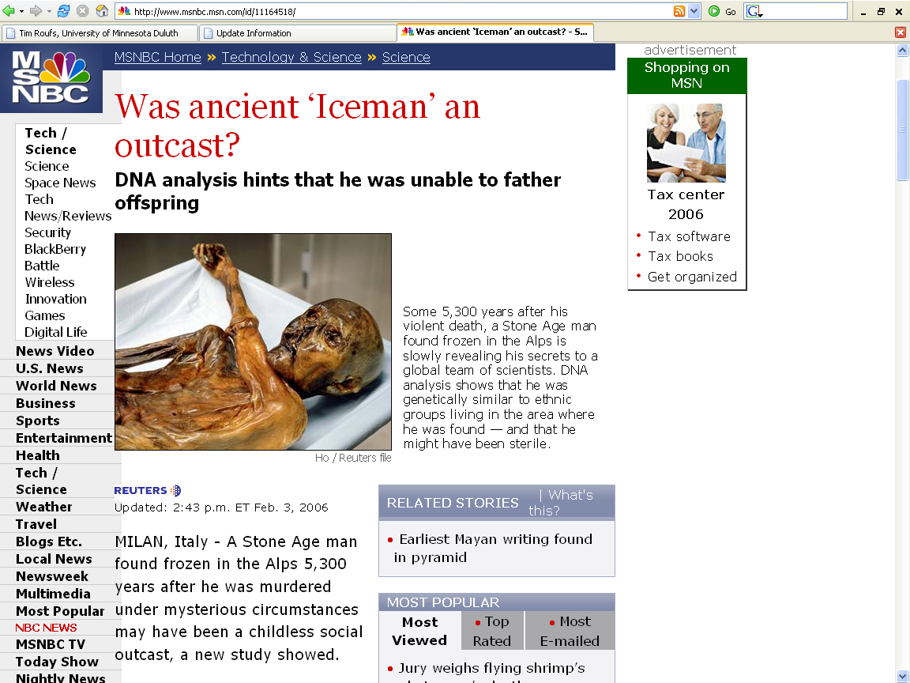
www.msnbc.msn.com/id/11164518/

Slide 19
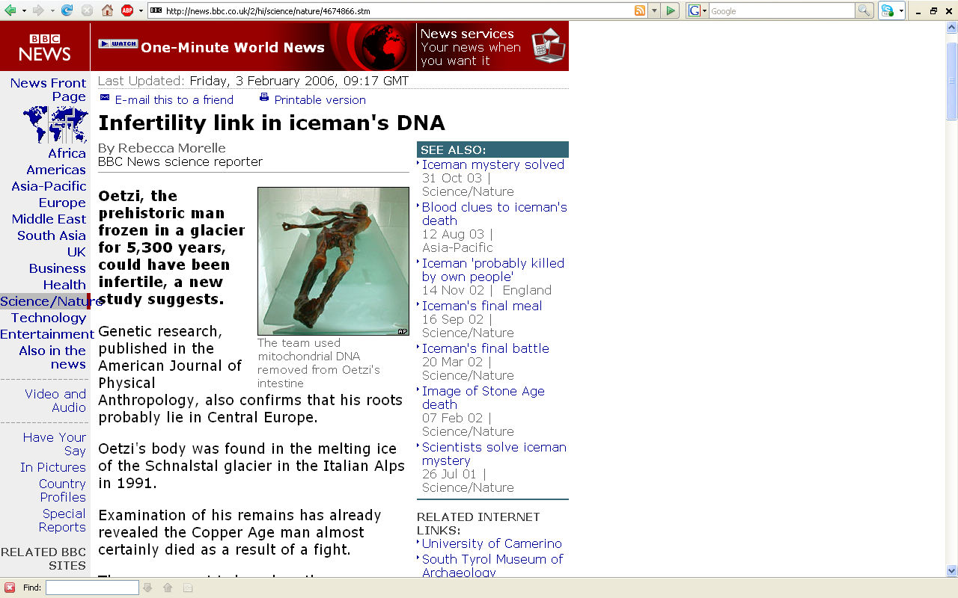
http://news.bbc.co.uk/2/hi/science/nature/4674866.stm

Slide 20
http://news.bbc.co.uk/2/hi/science/nature/4674866.stm

Slide 21
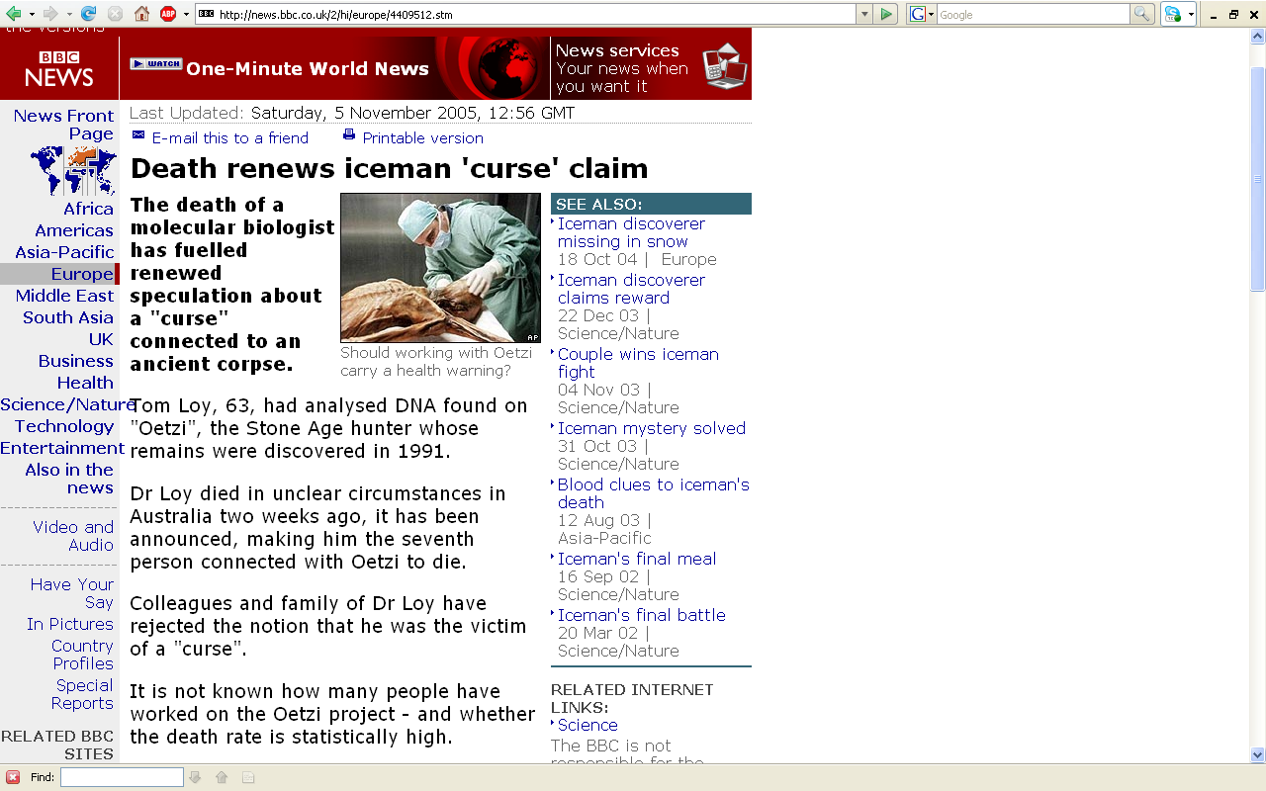
http://news.bbc.co.uk/2/hi/europe/4409512.stm

Slide 22
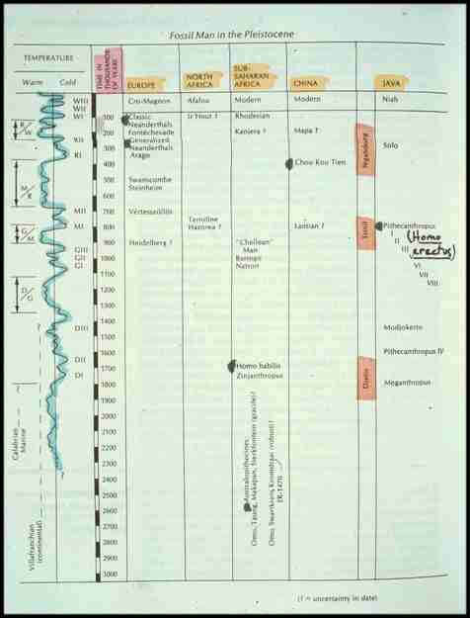
^{Homo sapiens}
^{Homo erectus}
^{Homo}
^{habilis}
^{Australopithecus}

Slide 23
^{Homo sapiens sapiens}
^{aka “moderns”}

Slide 24
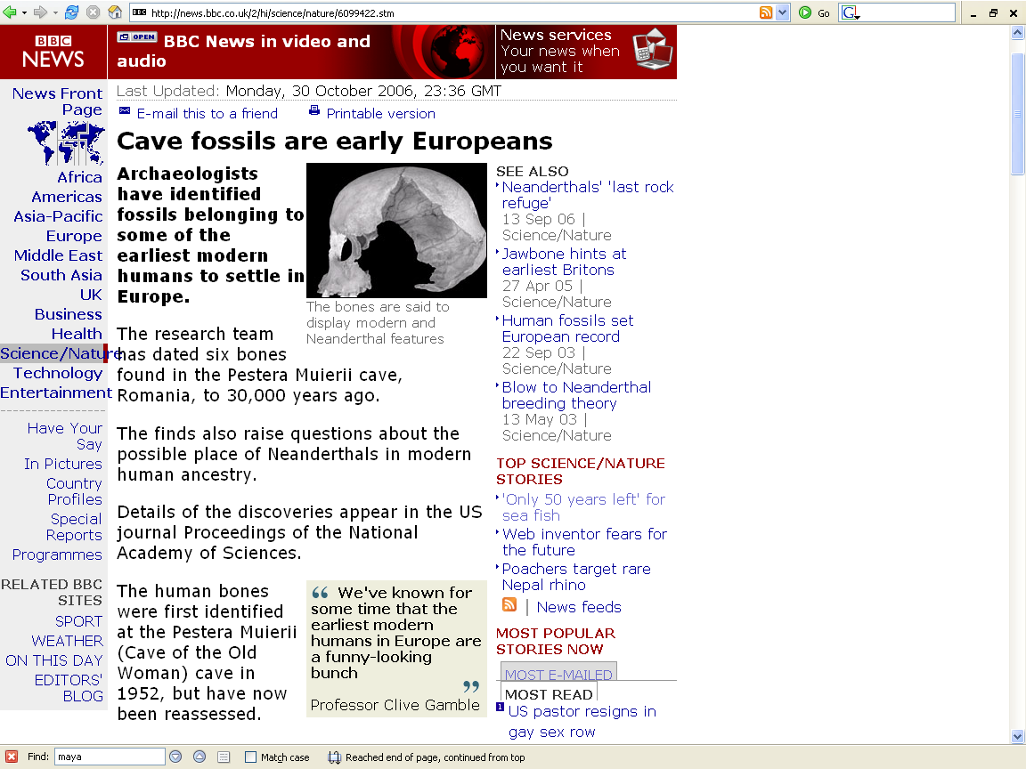
http://news.bbc.co.uk/2/hi/science/nature/6099422.stm

Slide 25
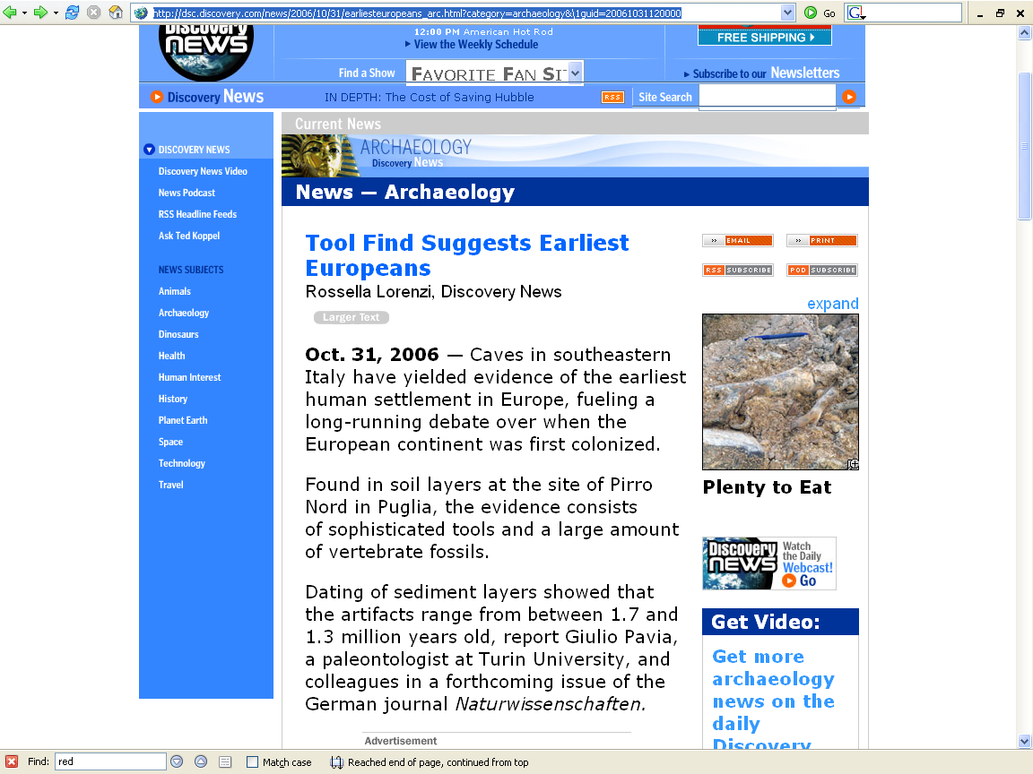
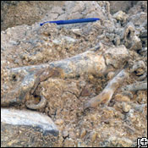
http://dsc.discovery.com/news/2006/10/31/earliesteuropeans_arc.html?category=archaeology&\1guid=20061031120000

Slide 26
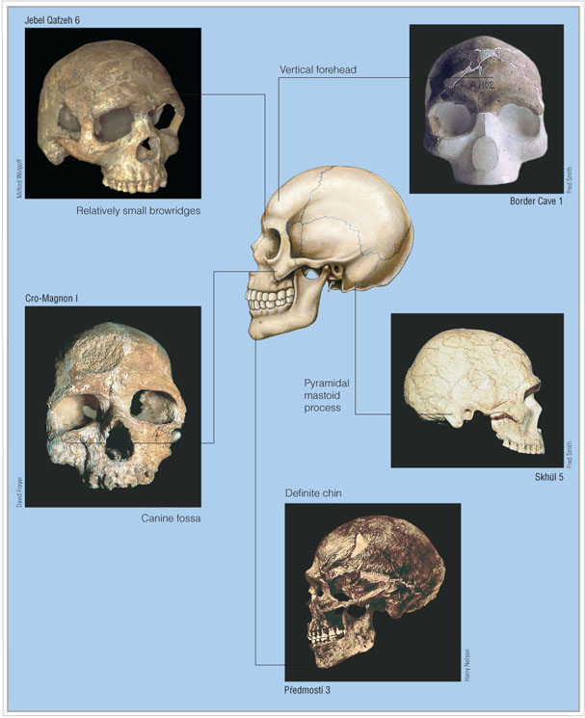
Morphology and variation
10th Ed., p. 290
Examples
Morphology and variation in early specimens of modern Homo sapiens.
Understanding Humans, 10th Ed., p. 290
Notes:
26

Slide 27
reference
skull
Morphology and variation in early specimens of modern Homo sapiens.
Understanding Humans, 10th Ed., p. 290
Notes:
27

Slide 28
APPENIDX A: Human cranium.
10th Ed., p. 290
Morphology and variation in early specimens of modern Homo sapiens.
Understanding Humans, 10th Ed., p. 290
Notes:
28

Slide 29
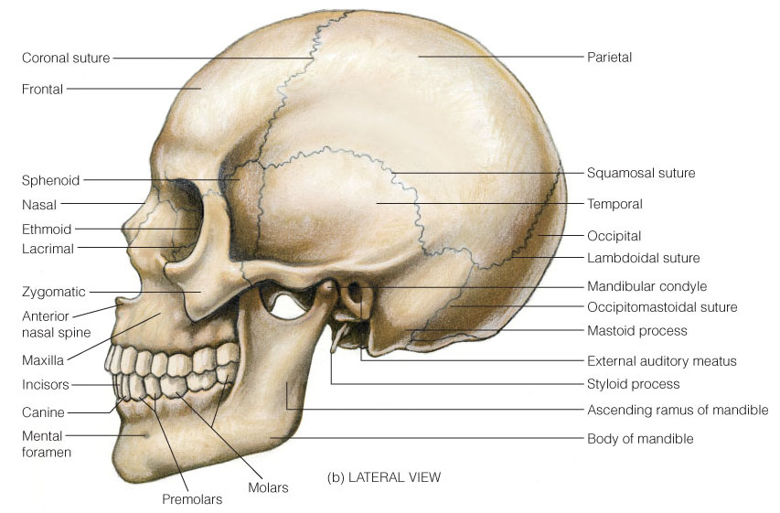
APPENIDX A: Human cranium.
Understanding Humans, 10th Ed., p. 428
Notes:
29

Slide 30
Relatively
small
browridges
Qafzeh 6
Morphology and variation in early specimens of modern Homo sapiens.
Understanding Humans, 10th Ed., p. 290
Notes:
30

Slide 31
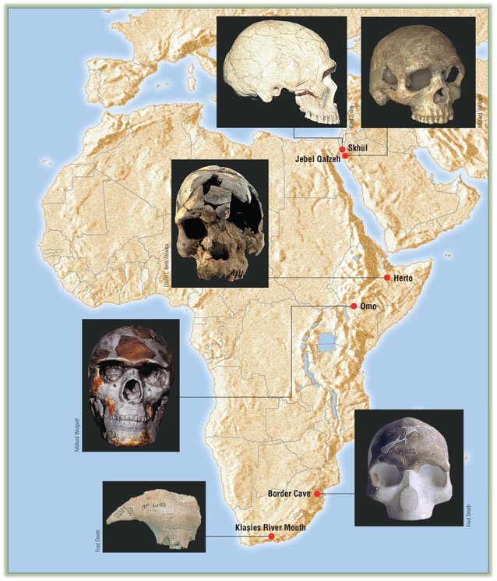
Relatively
small
browridges
Qafzeh 6
Modern Homo sapiens from Africa and the Near East.
Understanding Humans, 10th Ed., p. 286
Notes:
31

Slide 32
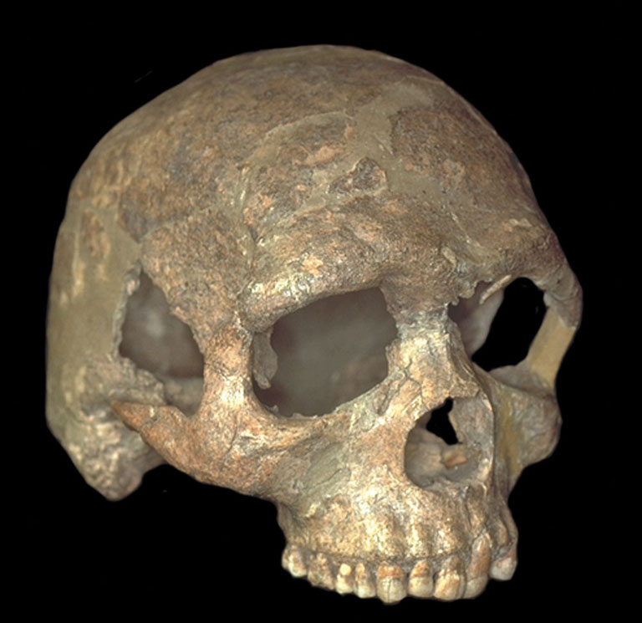
Relatively
small
browridges
Qafzeh 6
Morphology and variation in early specimens of modern Homo sapiens.
Morphology and variation in early specimens of modern Homo sapiens.
Understanding Humans, 10th Ed., p. 290
Notes:
32

Slide 33
Relatively
small
browridges
APPENIDX A: Human cranium.
Understanding Humans, 10th Ed., p. 428
Notes:
33

Slide 34
Vertical
forehead
Border Cave
Morphology and variation in early specimens of modern Homo sapiens.
Understanding Humans, 10th Ed., p. 290
Notes:
34

Slide 35
Vertical
forehead
Border Cave
Modern Homo sapiens from Africa and the Near East.
Understanding Humans, 10th Ed., p. 286
Notes:
35

Slide 36
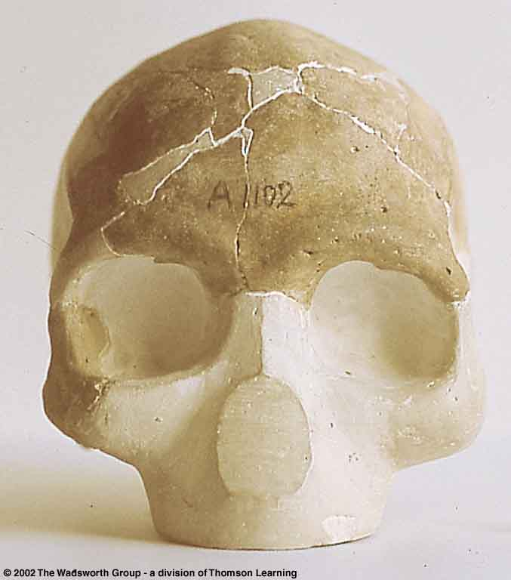
Vertical
forehead
Border Cave
Modern Homo sapiens from Africa and the Near East.
Understanding Humans, 10th Ed., p. 286
Notes:
36

Slide 37
Vertical
forehead
APPENIDX A: Human cranium.
Understanding Humans, 10th Ed., p. 428
Notes:
37

Slide 39
Canine fossa
Cro-Magnon I
(France)
Morphology and variation in early specimens of modern Homo sapiens.
Understanding Humans, 10th Ed., p. 290
Notes:
39

Slide 40
Canine fossa
Fossa is the Latin word for ditch or trench
Morphology and variation in early specimens of modern Homo sapiens.
Understanding Humans, 10th Ed., p. 290
Notes:
40

Slide 41
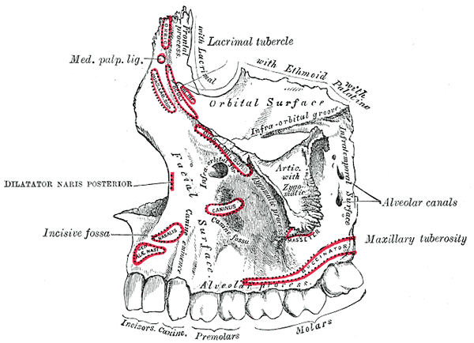
Canine fossa
Canine fossa
Cro-Magnon I
(France)
Wikipedia
Morphology and variation in early specimens of modern Homo sapiens.
Understanding Humans, 10th Ed., p. 290
Notes:
41

Slide 42
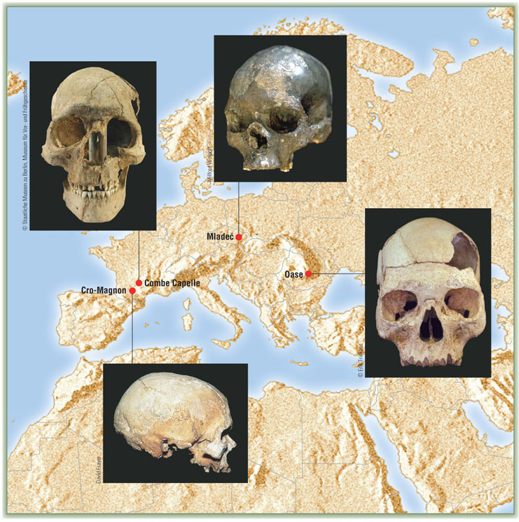
Cro-Magnon I
(France)
Anatomically modern Homo sapiens from Europe.
Understanding Humans, 10th Ed., p. 296
Notes:
42

Slide 43
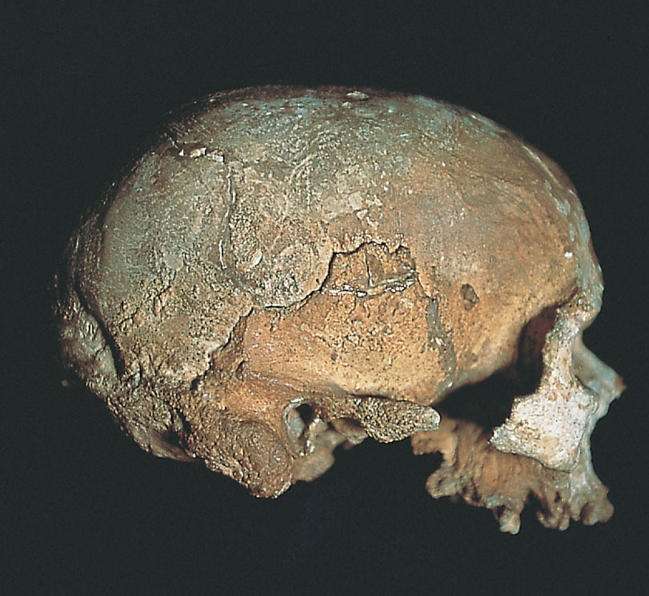
Canine fossa
Cro-Magnon I
(France)
Anatomically modern Homo sapiens from Europe.
Understanding Humans, 10th Ed., p. 297
Notes:
43

Slide 44
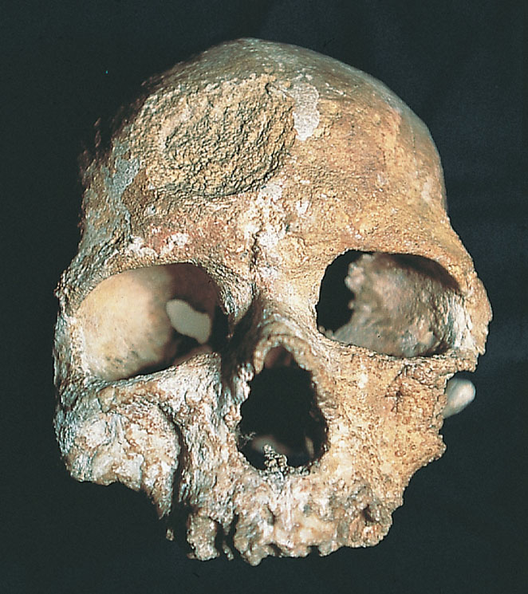
Canine fossa
Canine fossa
Cro-Magnon I
(France)
Morphology and variation in early specimens of modern Homo sapiens.
Understanding Humans, 10th Ed., p. 290
Notes:
44

Slide 45
Canine fossa
Cro-Magnon I
(France)
Anatomically modern Homo sapiens from Europe.
Understanding Humans, 10th Ed., p. 297
Notes:
45

Slide 46
Canine fossa
APPENIDX A: Human cranium.
Understanding Humans, 10th Ed., p. 428
Notes:
46

Slide 47
Skhúl 5
Pyramidal
mastoid
process
Morphology and variation in early specimens of modern Homo sapiens.
Understanding Humans, 10th Ed., p. 290
Notes:
47

Slide 48
Pyramidal
mastoid
process
Skhúl
Modern Homo sapiens from Africa and the Near East.
Understanding Humans, 10th Ed., p. 286
Notes:
48

Slide 49
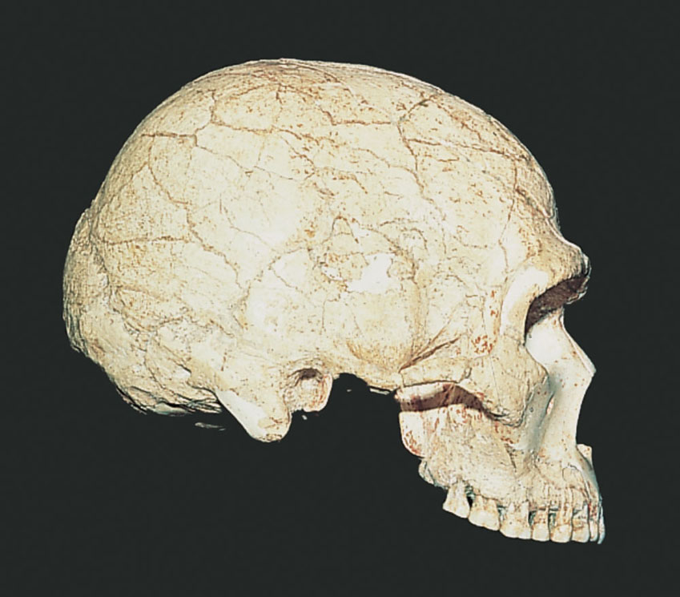
Skhúl 5
Pyramidal
mastoid
process
Morphology and variation in early specimens of modern Homo sapiens.
Understanding Humans, 10th Ed., p. 290
Notes:
49

Slide 50
Pyramidal
mastoid
process
APPENIDX A: Human cranium.
Understanding Humans, 10th Ed., p. 428
Notes:
50

Slide 51
Predmosti 3
Definite
chin
Morphology and variation in early specimens of modern Homo sapiens.
Understanding Humans, 10th Ed., p. 290
Notes:
51

Slide 52
Definite
chin
Předmost
Anatomically modern Homo sapiens from Europe.
Understanding Humans, 10th Ed., p. 296
Notes:
52

Slide 53
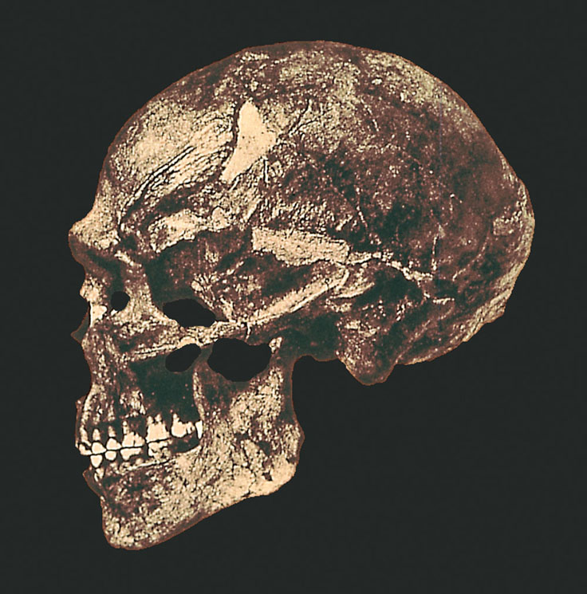
Predmosti 3
Definite
chin
Morphology and variation in early specimens of modern Homo sapiens.
Understanding Humans, 10th Ed., p. 290
Notes:
53

Slide 54
Definite
chin
APPENIDX A: Human cranium.
Understanding Humans, 10th Ed., p. 428
Notes:
54

Slide 55
Modern Homo sapiens from Africa and the Near East.
Understanding Humans, 10th Ed., p. 286
Notes:
55

Slide 56
Omo
(No. 1)
Modern Homo sapiens from Africa and the Near East.
Understanding Humans, 10th Ed., p. 286
Notes:
56

Slide 57
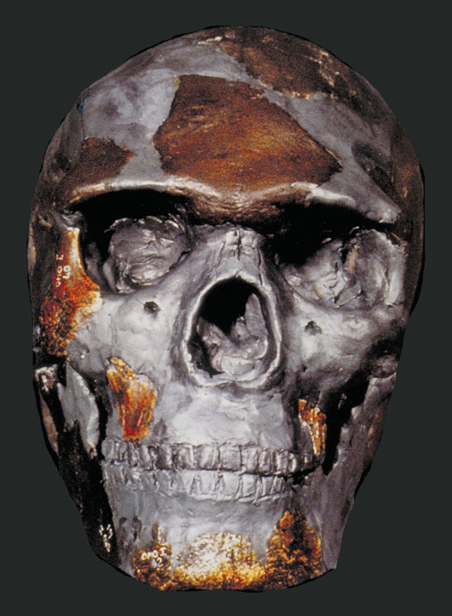
Omo
(No. 1)
Morphology and variation in early specimens of modern Homo sapiens.
Understanding Humans, 10th Ed., p. 289
Notes:
57

Slide 58
Relatively
small
brow ridges
Qafzeh 6
Modern Homo sapiens from Africa and the Near East.
Understanding Humans, 10th Ed., p. 286
Notes:
58

Slide 59
Relatively
small
brow ridges
Qafzeh 6
Morphology and variation in early specimens of modern Homo sapiens.
Morphology and variation in early specimens of modern Homo sapiens.
Understanding Humans, 10th Ed., p. 290
Notes:
59

Slide 61
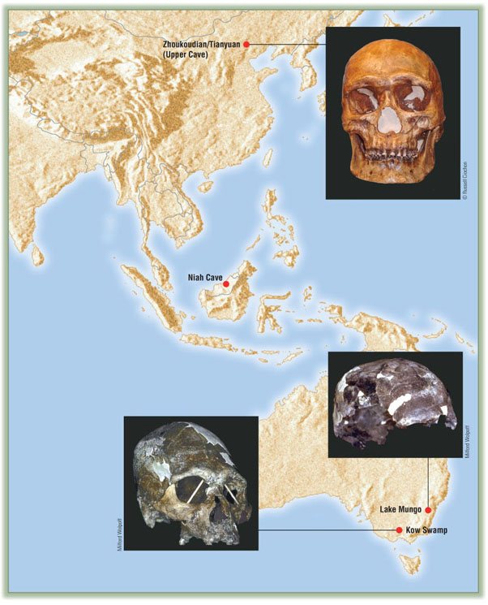
Zhoukoudian / Tianyuan
(“Upper Cave”)
(“Dragon Bone Hill”)
Anatomically modern Homo sapiens from Asia and Australia.
Understanding Humans, 10th Ed., p. 294
Notes:
61

Slide 62
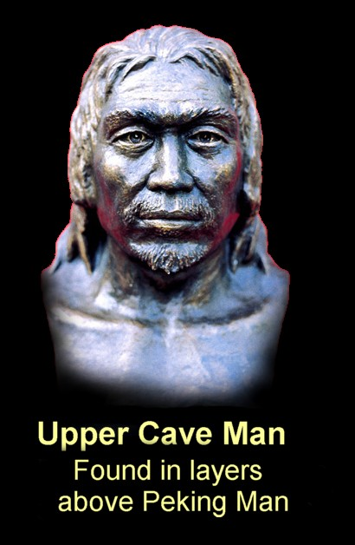
Anatomically modern Homo sapiens from Asia and Australia.
Early Man
Notes:
62

Slide 63
Kow Swamp
Anatomically modern Homo sapiens from Asia and Australia.
Understanding Humans, 10th Ed., p. 294
Notes:
63

Slide 64
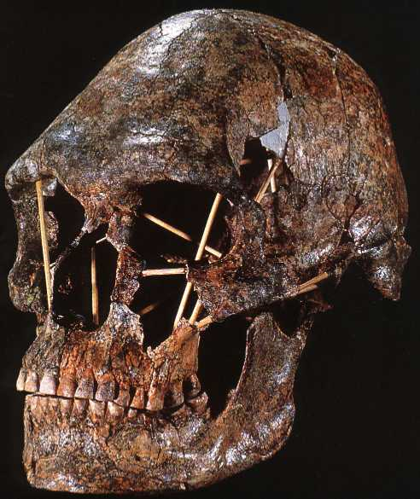
Kow Swamp
Anatomically modern Homo sapiens from Asia and Australia.
Understanding Humans, 10th Ed., p. 294
Notes:
64

Slide 65
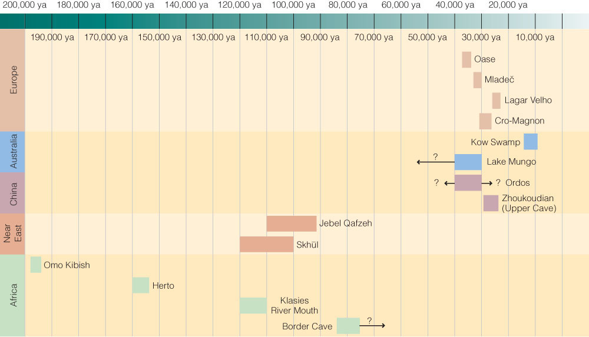
Time line of modern Homo sapiens discoveries.
Understanding Humans, 10th Ed., p. 293
Notes:
65

Slide 66
“anatomically modern”
“modern”
Homo sapiens sapiens
Time line of modern Homo sapiens discoveries.
Understanding Humans, 10th Ed., p. 293
Notes:
66

Slide 67
Lagar Velho
“The Lapedo child”
Portugal
Time line of modern Homo sapiens discoveries.
Understanding Humans, 10th Ed., p. 293
Notes:
67

Slide 68
Lagar Velho
Lagar Velho
“The Lapedo child”
Portugal
Anatomically modern Homo sapiens from Asia and Australia.
Understanding Humans, 10th Ed., p. 296
Notes:
68

Slide 69
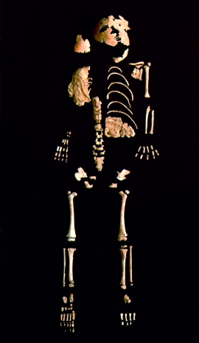
Lagar Velho
“The Lapedo child”
Portugal
Anatomically modern Homo sapiens from Asia and Australia.
Understanding Humans, 10th Ed., p. 298
Notes:
69

Slide 71
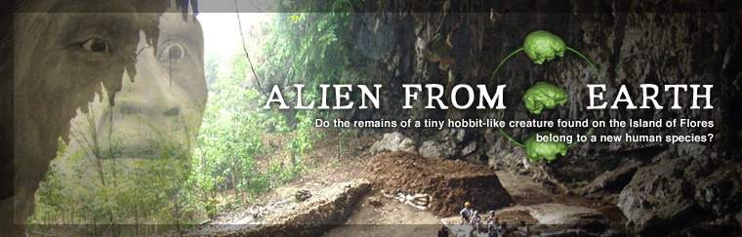
http://www.d.umn.edu/cla/faculty/troufs/anth1602/pchobbit.html#alienfromearth
Notes:
71

Slide 72
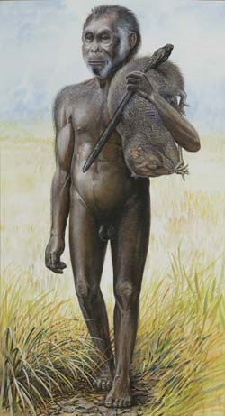
Homo floresiensis reconstruction.
National Geographic
Notes:
72

Slide 73
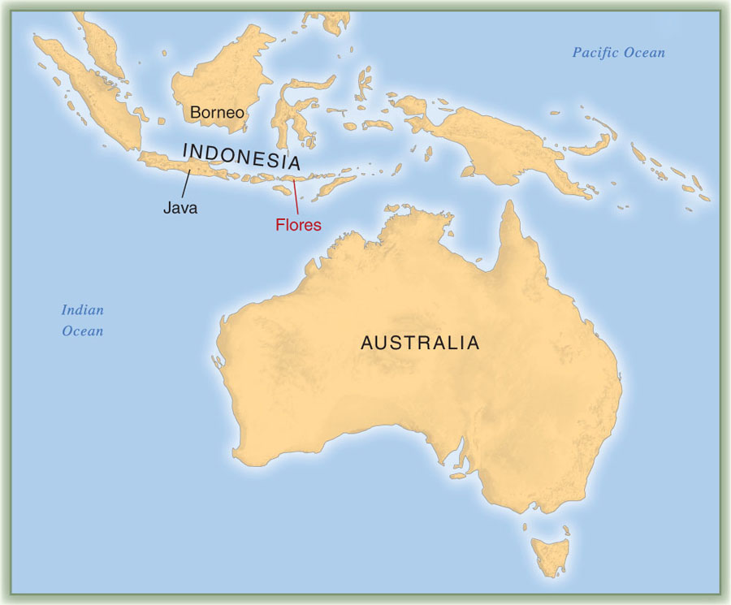
Flores
Location of the Flores site, in Indonesia.
Understanding Humans, 10th Ed., p. 299
Notes:
73

Slide 74
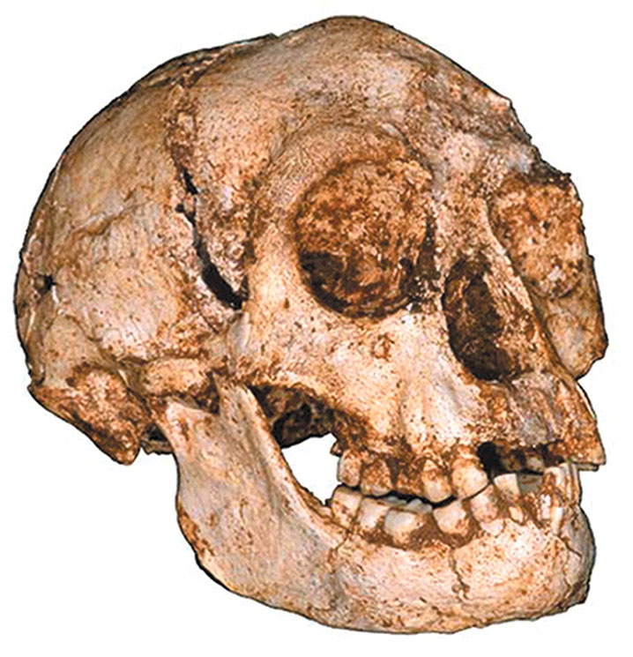
Cranium of adult female Homo floresiensis
18,000 ybp
Understanding Humans, 10th Ed., p. 299
Notes:
74

Slide 75
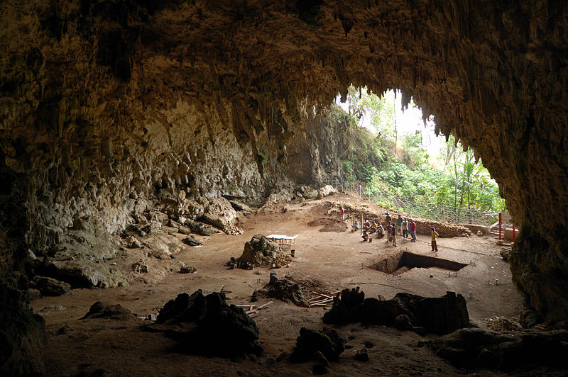
Cave on Flores Island where the Homo floresiensis were discovered.
Wikipedia
Notes:
75

Slide 76
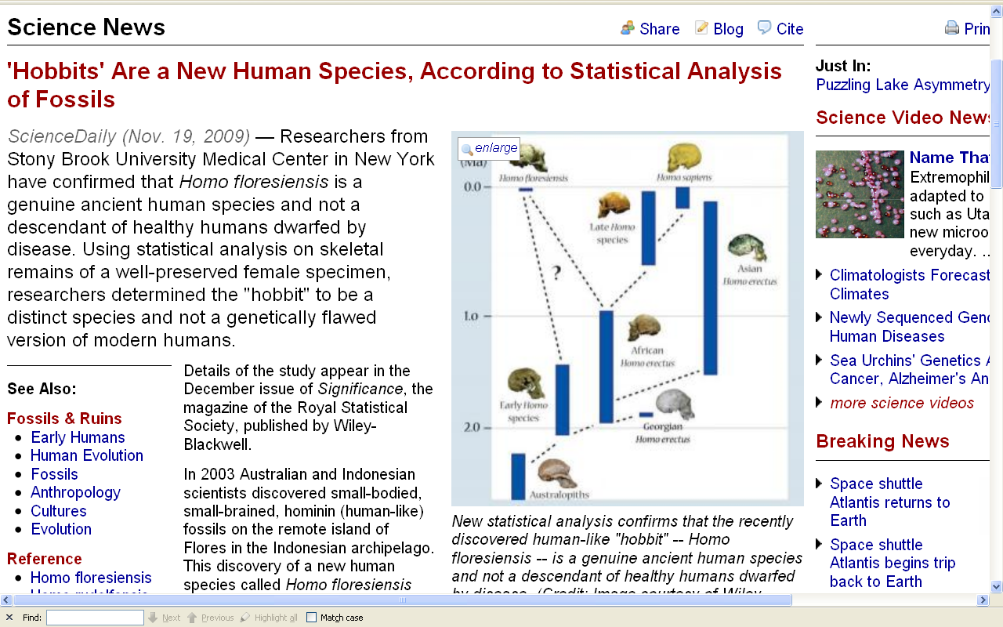
http://www.sciencedaily.com/releases/2009/11/091119101034.htm
Notes:
76

Slide 77
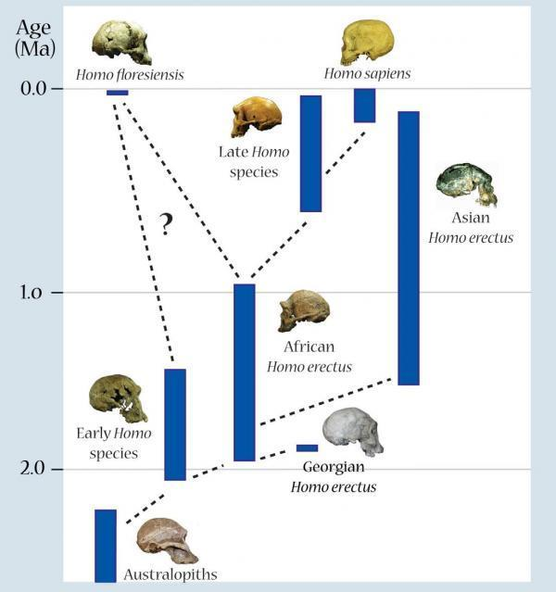
http://www.sciencedaily.com/releases/2009/11/091119101034.htm
Notes:
77

Slide 78
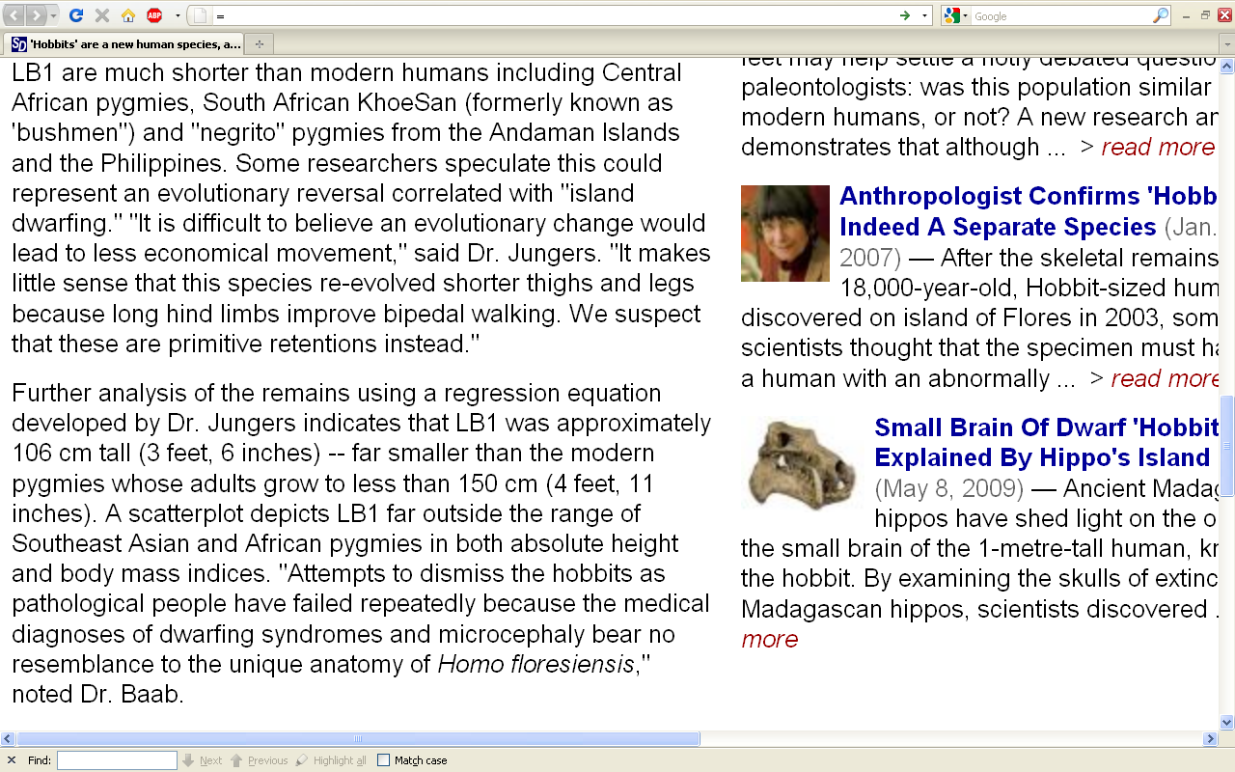
http://www.sciencedaily.com/releases/2009/11/091119101034.htm
Notes:
78

Slide 81
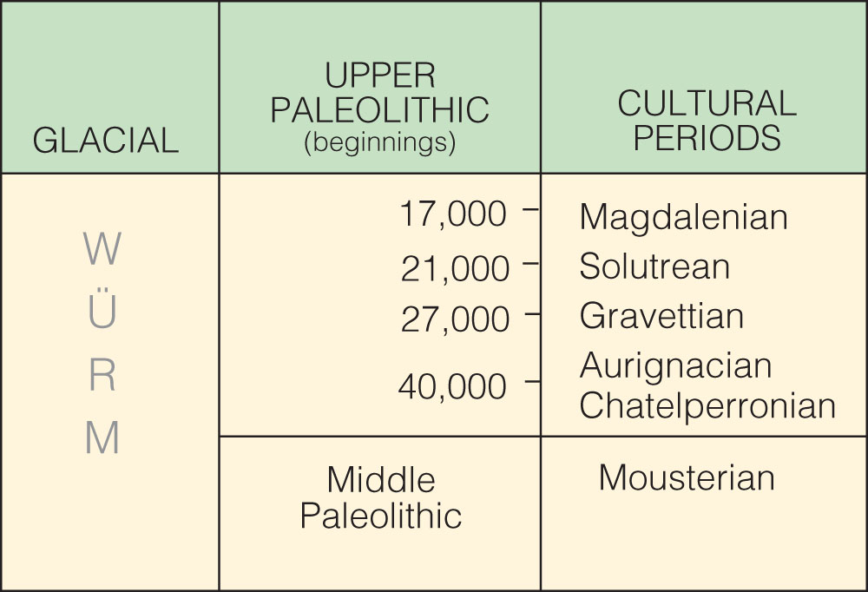
Upper
Paleolithic
traditions
(SW France)
Upper
Paleolithic
traditions
(SW France)
is the “culture”
the technique is called “Levallois”
Cultural periods of the European Upper Paleolithic.
Understanding Humans, 10th Ed., p. 257

Slide 82
“anatomically modern”
“modern”
Homo sapiens sapiens
Time line of modern Homo sapiens discoveries.
Understanding Humans, 10th Ed., p. 293

Slide 83
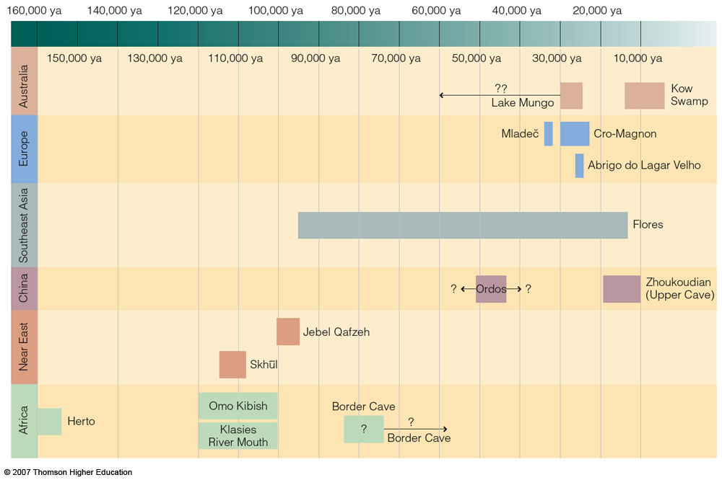
“modern”
Homo sapiens sapiens
“anatomically modern”
Understanding Physical Anthropology and Archaeology, 9th Ed., p. 284.

Slide 84
is the “culture”
the technique is called “Levallois”
Cultural periods of the European Upper Paleolithic.
Understanding Humans, 10th Ed., p. 257

Slide 85
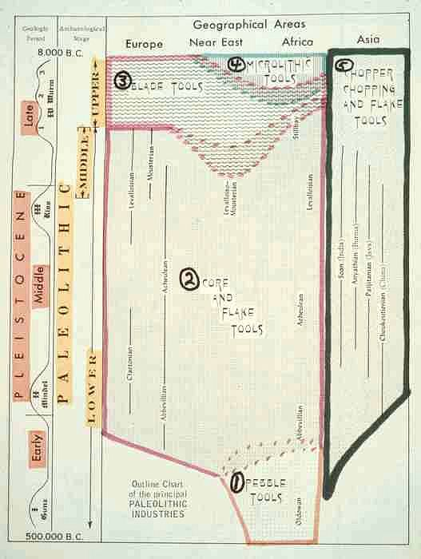

10th p. 257
Upper
Paleolithic
traditions
(SW France)

Slide 86
10th p. 257

Slide 87
10th p. 257

Slide 88
10th p. 257

Slide 89
Upper
Paleolithic
traditions
(SW France)
is the “culture”
the technique is called “Levallois”
Cultural periods of the European Upper Paleolithic.
Understanding Humans, 10th Ed., p. 257

Slide 90

Brian Fagan, People of the Earth, 10th Ed., p. 132

Slide 91

Burin.
Understanding Humans, 10th Ed., p. 303

Slide 92

Solutrean blade
Understanding Physical Anthropology and Archaeology (9th Ed.), p. 289

Slide 93

http://lithiccastinglab.com/gallery-pages/cloviswheredidcomefrompage2.htm

Slide 94


Burin. Solutrean blade.
Understanding Physical Anthropology and Archaeology, 9th Ed., p. 289.

Slide 95

Percussion flaking using a hammer stone and punch.
Understanding Humans, 10th Ed., p. 303

Slide 96

The punch blade technique.
Understanding Physical Anthropology and Archaeology (9th Ed), p. 291

Slide 97

The punch blade technique.
Understanding Physical Anthropology and Archaeology (9th Ed), p. 291

Slide 98

prismatic
blade
The punch blade technique.
Understanding Physical Anthropology and Archaeology (9th Ed), p. 291

Slide 99


Slide 100

Magdalenian Spear-thrower (atlatl). Note the carving..
Understanding Humans, 10th Ed., p. 302

Slide 101

^{Magdalenian bone artifact.}
Understanding Physical Anthropology and Archaeology (9th Ed.), p. 292
Notes:
101

Slide 102

Braidwood, Prehistoric Men 2nd Ed. (Chicago Natural History Museum, 1951), p. 74

Slide 103

Symbolic artifacts from the Middle Stone Age of Africa and the Upper Paleolithic in Europe
Understanding Humans, 10th Ed., p. 306
Notes:
103

Slide 104
Sungir
Symbolic artifacts from the Middle Stone Age of Africa and the Upper Paleolithic in Europe
Understanding Humans, 10th Ed., p. 306
Notes:
104

Slide 105

Symbolic artifacts from the Middle Stone Age of Africa and the Upper Paleolithic in Europe
Understanding Humans, 10th Ed., p. 306
Notes:
105

Slide 106

Sungir, Russia
Skeletons of two teenagers, a male and a female, from Sungir, Russia.
Dated 24,000 ya this is the richest find of any Upper Paleolithic grave.
Understanding Humans, 10th Ed., p. 301
Notes:
106

Slide 107

Sungir, Russia
Skeletons of two teenagers, a male and a female, from Sungir, Russia.
Dated 24,000 ya this is the richest find of any Upper Paleolithic grave.
Understanding Humans, 10th Ed., p. 301
Notes:
107

Slide 108
Chauvet
Lascaux
Altamira
Symbolic artifacts from the Middle Stone Age of Africa and the Upper Paleolithic in Europe
Understanding Humans, 10th Ed., p. 306
Notes:
108

Slide 109
Symbolic artifacts from the Middle Stone Age of Africa and the Upper Paleolithic in Europe
Understanding Humans, 10th Ed., p. 306
Notes:
109

Slide 110
Grotte Chauvet
France
Symbolic artifacts from the Middle Stone Age of Africa and the Upper Paleolithic in Europe
Understanding Humans, 10th Ed., p. 306
Notes:
110

Slide 111

Cave art from Grotte Chauvet, France
Understanding Humans, 10th Ed., p. 305
Notes:
111

Slide 112

Cave art from Grotte Chauvet, France
Understanding Humans, 10th Ed., p. 305
Notes:
112

Slide 113

www.d.umn.edu/cla/faculty/troufs/anth1602/pcchauvet.html#title

Slide 114

www.d.umn.edu/cla/faculty/troufs/anth1602/pcchauvet.html#title

Slide 115
Altamira
Spain
Symbolic artifacts from the Middle Stone Age of Africa and the Upper Paleolithic in Europe
Understanding Humans, 10th Ed., p. 306
Notes:
115

Slide 116

Altamira, Spain.
Wikipedia
Notes:
116

Slide 117

Altamira, Spain.
http://www.csj.org.uk/caminodelnorte.htm
Notes:
117

Slide 118
Lascaux
France
Symbolic artifacts from the Middle Stone Age of Africa and the Upper Paleolithic in Europe
Understanding Humans, 10th Ed., p. 306
Notes:
118

Slide 119

Lascaux, France.
http://slowpainting.wordpress.com/2009/02/04/the-art-instinct/
Notes:
119

Slide 120

Lascaux, France.
http://www.conceptgroen.nl/projecten/sphinx-egypt.html
Notes:
120

Slide 121
Brassempouy
France
Symbolic artifacts from the Middle Stone Age of Africa and the Upper Paleolithic in Europe
Understanding Humans, 10th Ed., p. 306
Notes:
121

Slide 122

Venus of Brassempouy, France. Upper Paleolithic.
Understanding Humans, 10th Ed., p. 304
Notes:
122

Slide 123
Willendorf
Austria
Symbolic artifacts from the Middle Stone Age of Africa and the Upper Paleolithic in Europe
Understanding Humans, 10th Ed., p. 306
Notes:
123

Slide 124

Venus of Willendorf, Austria.
Understanding Humans, 10th Ed., p. 305
Notes:
124

Slide 126

Key Early Modern Homo sapiens Discoveries from Europe and Asia.
Understanding Humans, 10th Ed., p. 298
Notes:
126

Slide 127

Key Early Modern Homo sapiens Discoveries from Africa and the Near East.
Understanding Humans, 10th Ed., p. 291
Notes:
127

Slide 128

Key Fossil Discoveries of Early Modern Humans an Homo floresiensis.
Understanding Humans, 10th Ed., p. 309
Notes:
128

Slide 129
“anatomically modern”
“modern”
Homo sapiens sapiens
Herto, Ethiopia
ca. 160,000 ybp
Time line of modern Homo sapiens discoveries.
Understanding Humans, 10th Ed., p. 293

Slide 131
Moderns
Homo sapiens sapiens
Cro-Magnon I
(France)
Prehistoric Cultures Tim Roufs’ section ©2009
Understanding Humans (10th Ed.), p. 297

Slide 132

To Class Slides Set 21
Next: Tools and Technologies I
Introduction: Basic Terms / Basic Types

Slide 133


Skhúl 5
Qafzeh 6
These specimens from Israel
are thought to be representatives of early modern Homo sapiens.
The vault height, forehead, and lack of prognathism
are modern traits.
Understanding Physical Anthropology and Archaeology, 9th Ed., p. 283.

