Slide 1
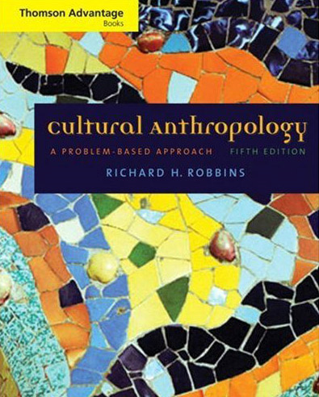
Kinship and Descent
including
kinship symbols
and notation conventions
Tim Roufs
© 2010

Slide 2
Louis Henry Morgan
The Beaver. . . .
Iroquois
Robertson
Wisconsin Chippewa
Sir E.B. Tylor “Survivals”

Slide 3
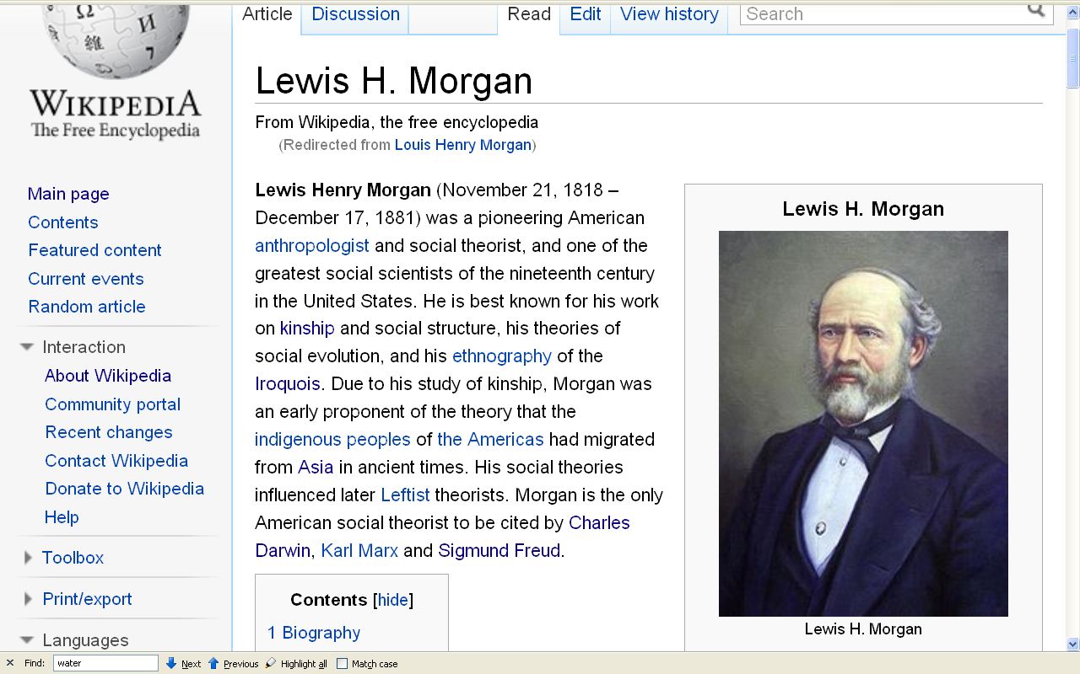
http://en.wikipedia.org/wiki/Louis_Henry_Morgan

Slide 4
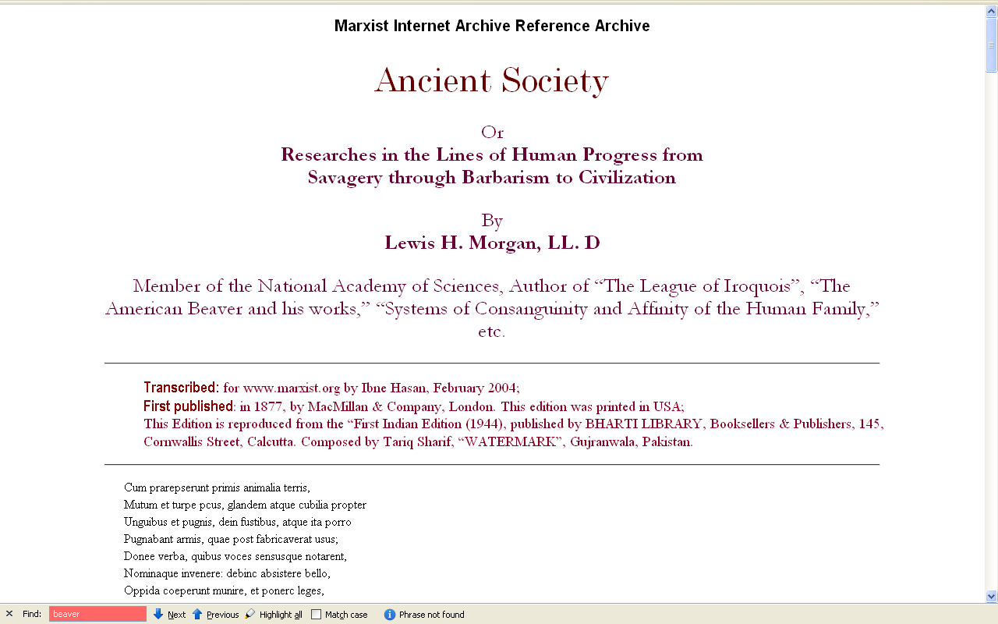
http://www.marxists.org/reference/archive/morgan-lewis/ancient-society/

Slide 5
Ancient Society
Influence on Marxism . . .

Slide 6
Louis Henry Morgan
The Beaver. . . .
Franz Boas
The Color of Seawater
Bronislaw Malinowski
Mathematics and Physical Science
W.H.R. Rivers
M.D.

Slide 7
Louis Henry Morgan
Systems of Consanguinity and Affinity in the Human Family
Ancient Society

Slide 8
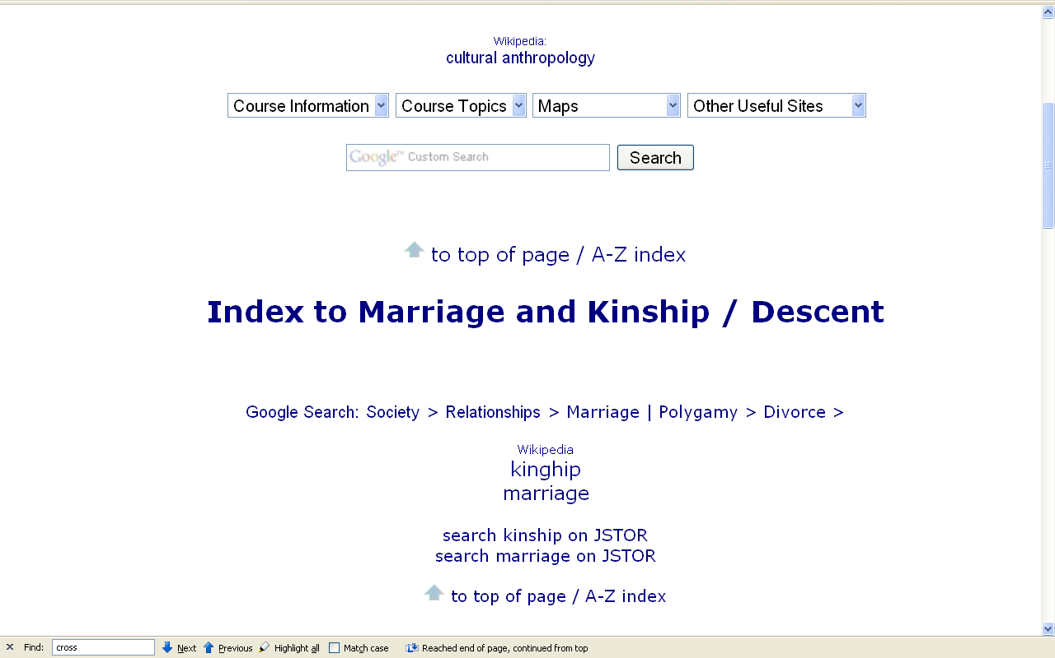

Slide 9
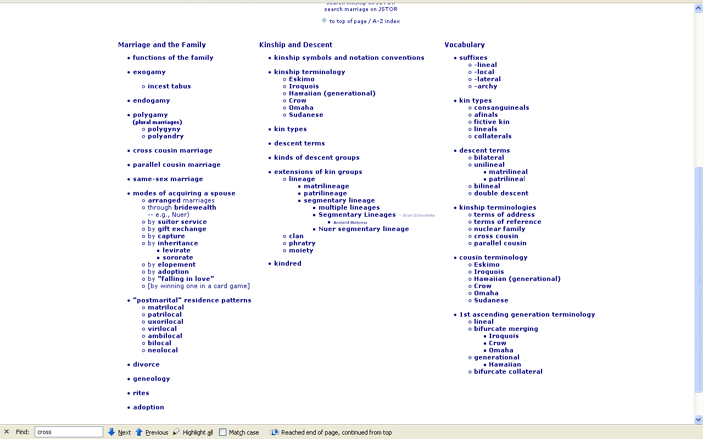

Slide 10
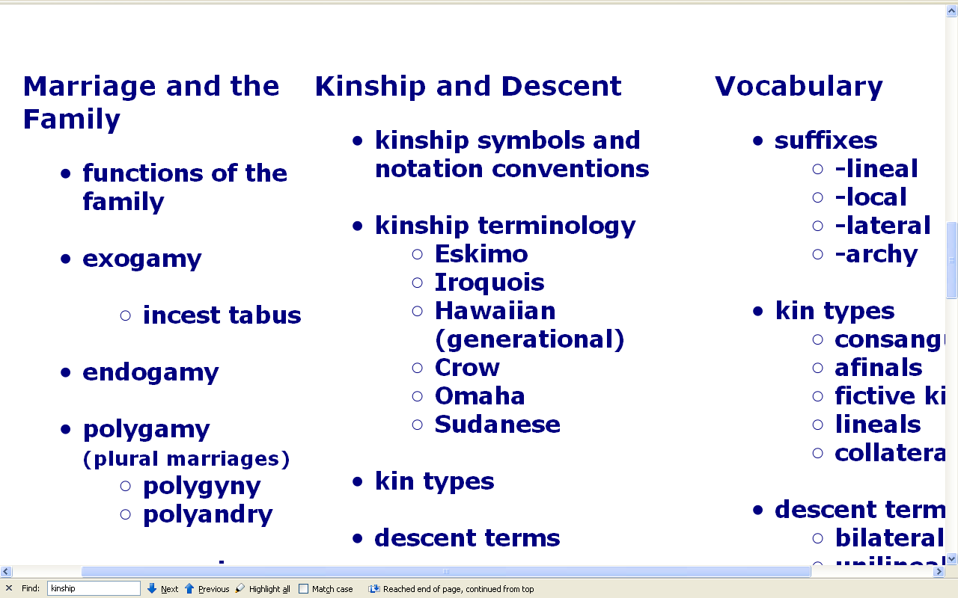

Slide 11
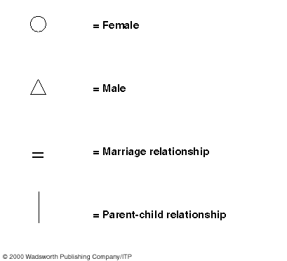

Slide 12
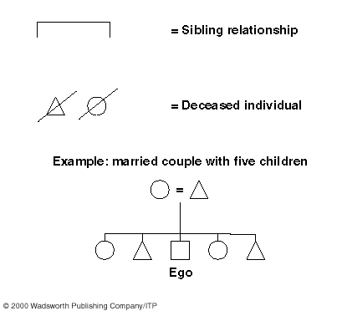

Slide 13
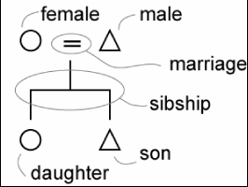
http://www.anthro.ucdavis.edu/winterweb/html/UCD_classes/128/fox1.htm

Slide 14
terms of address
(what you call a relative: “Aunt Helen”)
terms of reference
(how you refer to a relative: “my Aunt”)
descriptive terms
(used by anthropologist: “MoSi” / “FaSi”)

Slide 15
terms of address
(what you call a relative: “Aunt Helen”)
terms of reference
(how you refer to a relative: “my Aunt”)
descriptive terms
(used by anthropologist: “MoSi” / “FaSi”)
(used by anthropologist: “MoZ” / “FrZ”)

Slide 16
terms of address
(what you call a relative: “Aunt Helen”)
terms of reference
(how you refer to a relative: “my Aunt”)
descriptive terms
(used by anthropologist: “Cross Cousin”)
(used by anthropologist: “Parallel Cousin”)

Slide 17
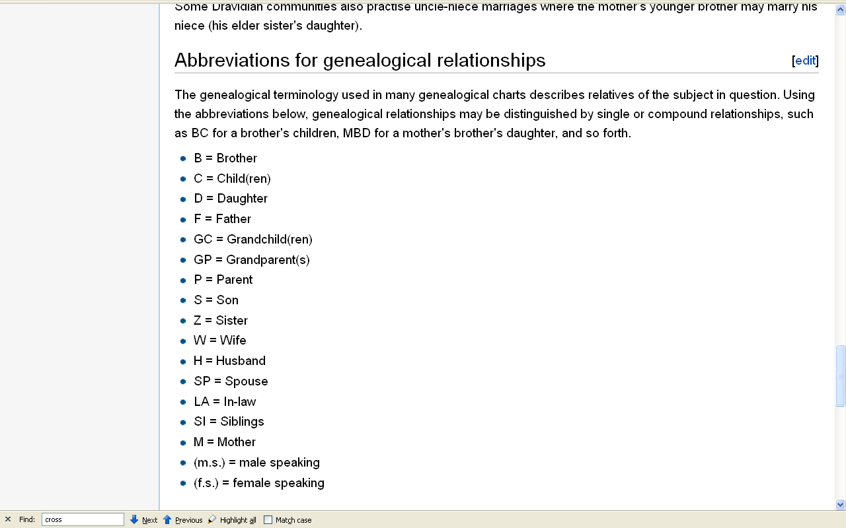
http://en.wikipedia.org/wiki/Dravidian_kinship#Discovery_of_Dravidian_kinship_terminology

Slide 18
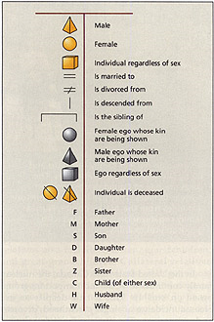

Slide 19
these are kinship systems
and system diagrams
not family trees or genealogies

Slide 20

e.g. British Monarchs’ family tree
Queen Victoria to present
http://www.oup.com/uk/orc/bin/9780198564942/resources/celebres/ch12/

Slide 21
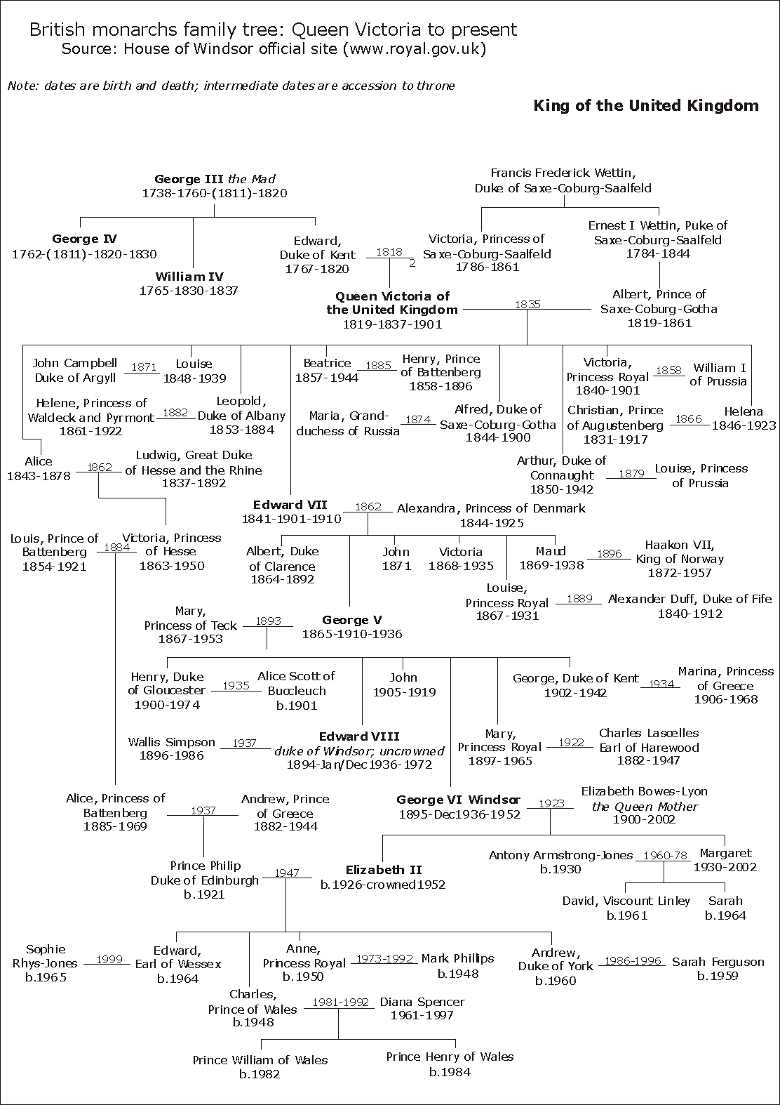
not kinship
http://www.oup.com/uk/orc/bin/9780198564942/resources/celebres/ch12/

Slide 22
Genealogy
traces individuals
in specific families
http://www.oup.com/uk/orc/bin/9780198564942/resources/celebres/ch12/

Slide 23
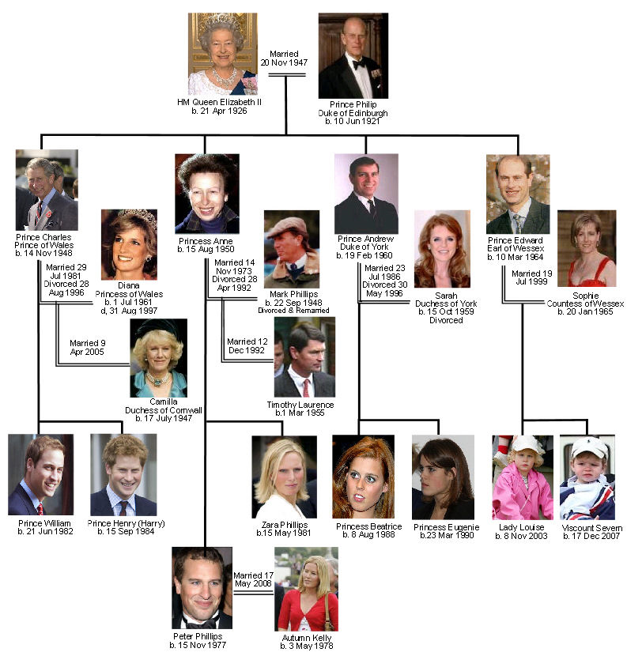
Genealogy
http://www.britroyals.com/

Slide 24
sometimes referred to as
kindred
(distant and close relatives)
http://www.britroyals.com/

Slide 25
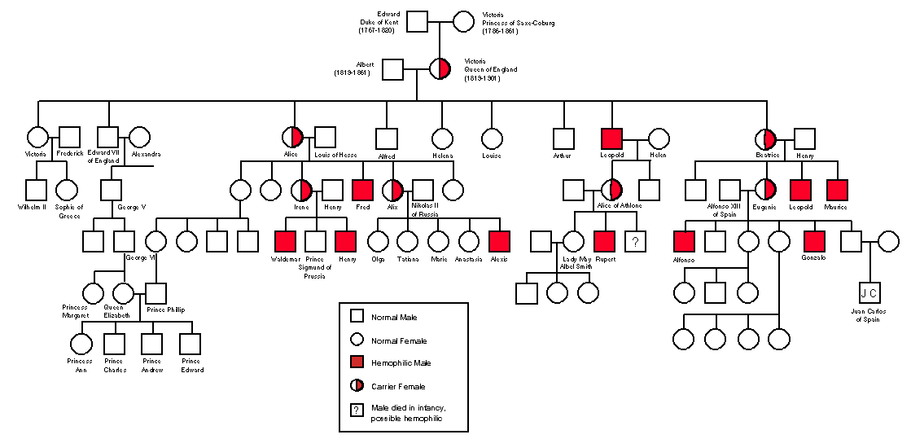
Genealogy
Medical Studies tracing inheritance of hemophilia
http://www.sciencecases.org/hemo/hemo.asp

Slide 26
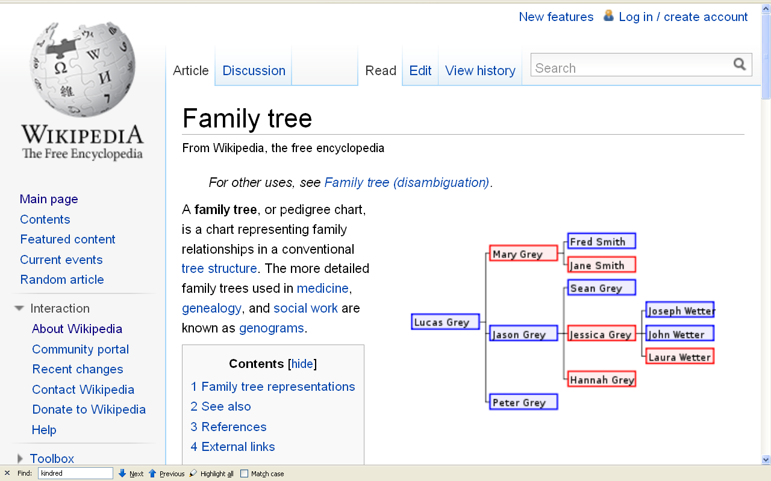
not kinship

Slide 27
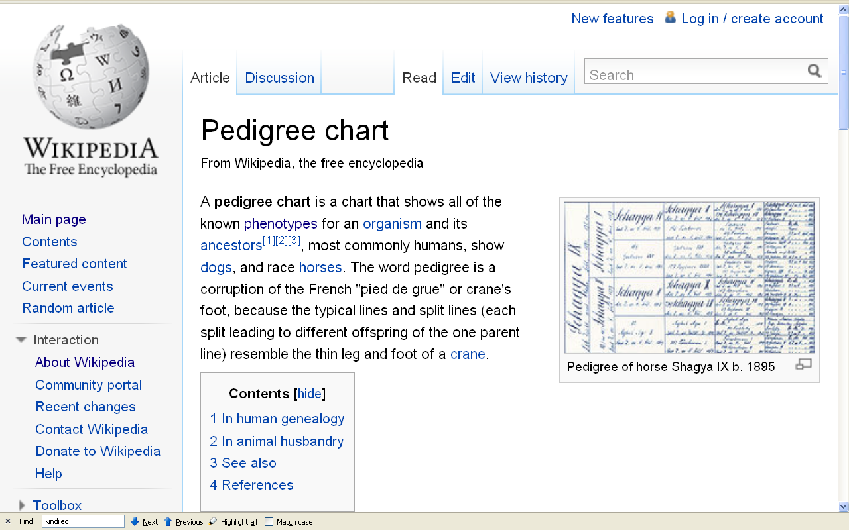
not kinship

Slide 28
Kinship Systems

Slide 29
Kinship Systems

Slide 30
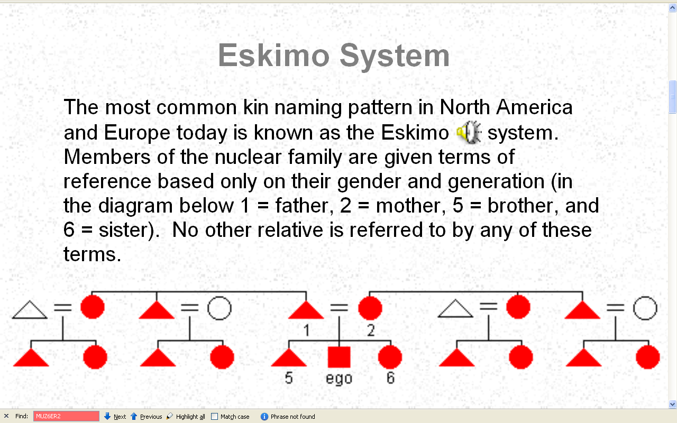
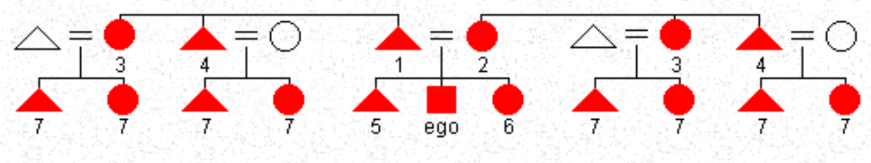
Kinship Systems
http://anthro.palomar.edu/kinship/kinship_6.htm

Slide 31
http://anthro.palomar.edu/kinship/kinship_6.htm

Slide 32
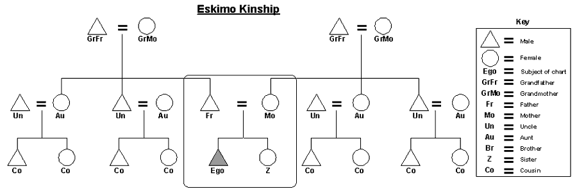
http://en.wikipedia.org/wiki/Eskimo_kinship

Slide 33
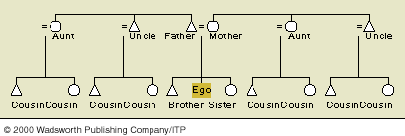

Slide 34
http://anthro.palomar.edu/kinship/kinship_6.htm

Slide 35
http://en.wikipedia.org/wiki/Eskimo_kinship

Slide 36
Yanomamo and English Terms Compared According to Kin Type
Kin Term | Kin Type | English Term
Haya | F | Father
 | FB | Uncle
Soaya | MB
Eiwa | B | Brother
 | FBS | Cousin
 | MZS
Soriwa | FZS
 | MBS
 | WB | Brother-in-Law
 | ZH
Teeya | S | Son
 | BS | Nephew
Tataya | ZS
Yanomamó Kin Terms -- Brian Schwimmer
English Kin Terms -- Brian Schwimmer

Slide 38
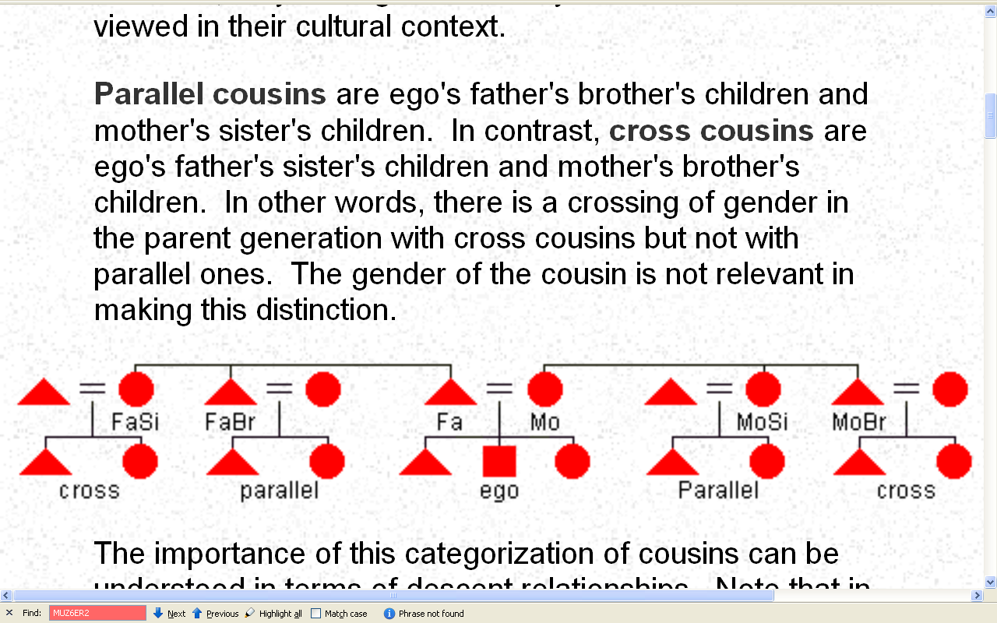
http://anthro.palomar.edu/kinship/kinship_6.htm

Slide 39
http://anthro.palomar.edu/kinship/kinship_6.htm

Slide 40
= brother / sister
= cousins
http://anthro.palomar.edu/kinship/kinship_6.htm

Slide 41
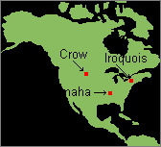
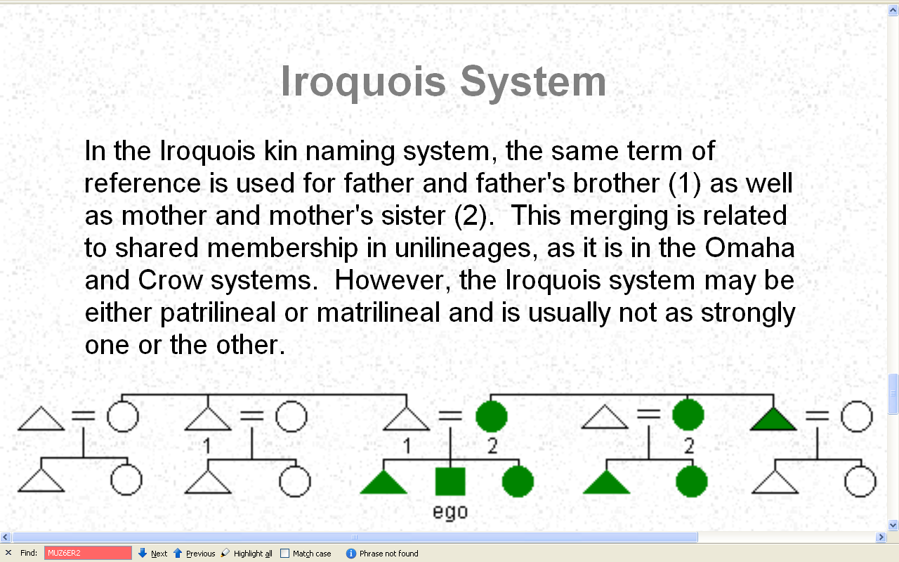
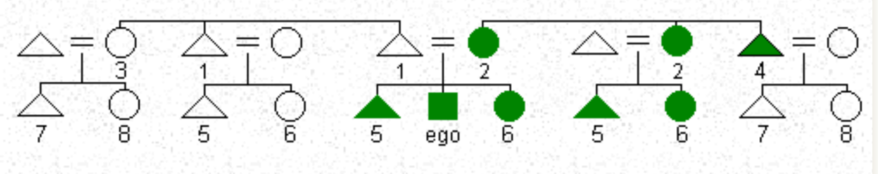
http://anthro.palomar.edu/kinship/kinship_6.htm

Slide 42
http://anthro.palomar.edu/kinship/kinship_6.htm

Slide 43
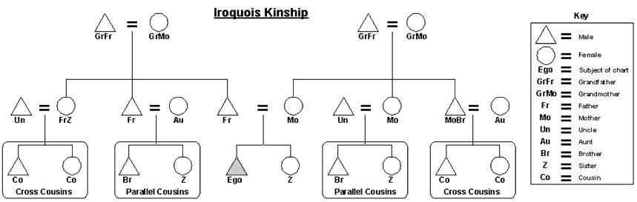
http://en.wikipedia.org/wiki/Iroquois_kinship

Slide 44
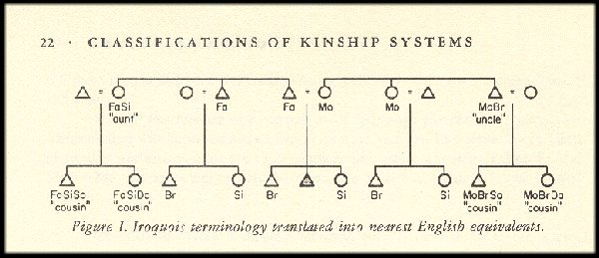
Source: Ernest L. Schusky, Manual for Kinship Analysis, 2nd ed. NY: Holt, Rinehart and Winston, 1972, p. 22.

Slide 45
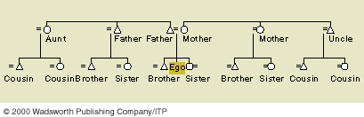

Slide 46
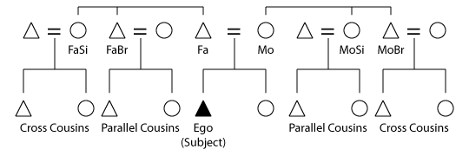
http://en.wikipedia.org/wiki/Cross_cousin

Slide 47
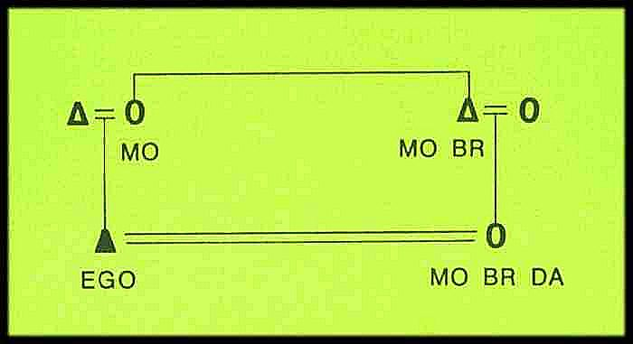

Slide 48
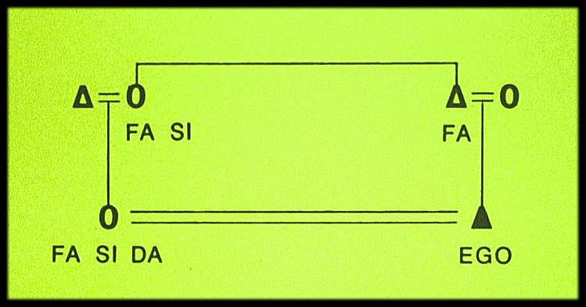

Slide 49
Yanomamo and English Terms Compared According to Kin Type
Kin Term | Kin Type | English Term
Haya | F | Father
 | FB | Uncle
Soaya | MB
Eiwa | B | Brother
 | FBS | Cousin
 | MZS
Soriwa | FZS
 | MBS
 | WB | Brother-in-Law
 | ZH
Teeya | S | Son
 | BS | Nephew
Tataya | ZS
Source: Lizot 1971

Slide 51
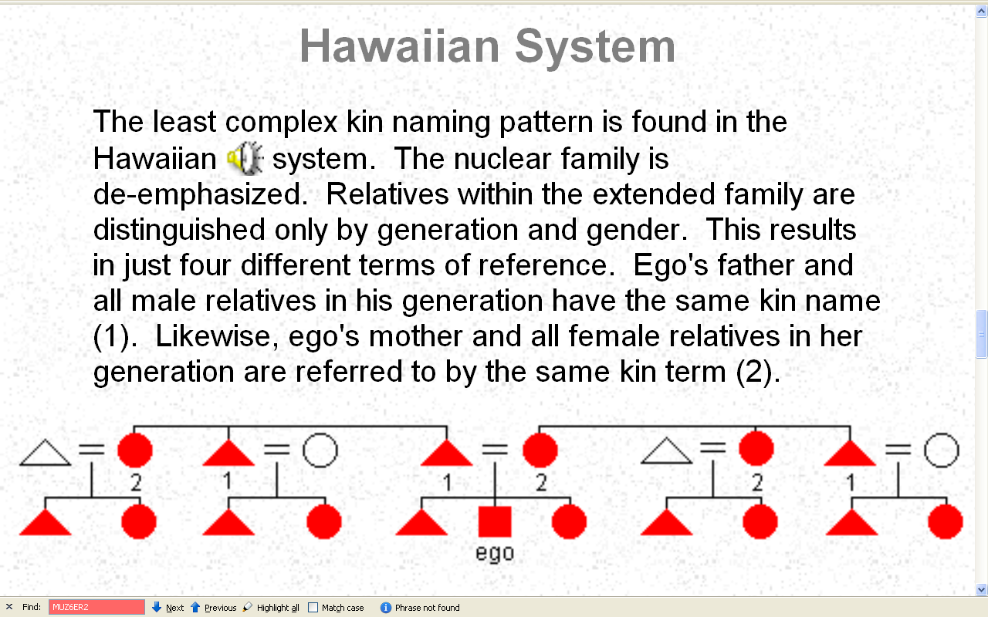
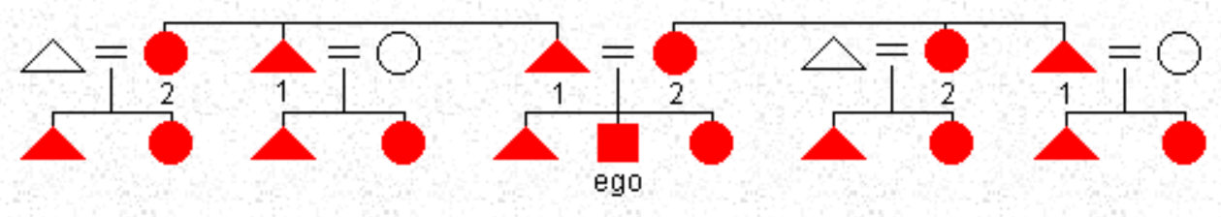
http://anthro.palomar.edu/kinship/kinship_6.htm

Slide 52
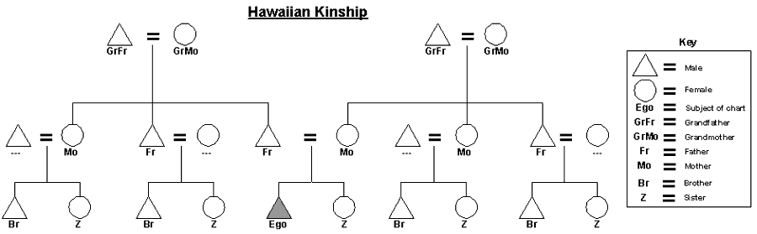
http://en.wikipedia.org/wiki/Hawaiian_kinship

Slide 53
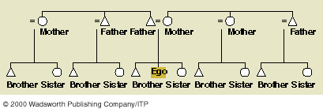

Slide 54
Matrilineal Kinship

Slide 55
REM:
http://anthro.palomar.edu/kinship/kinship_6.htm

Slide 56
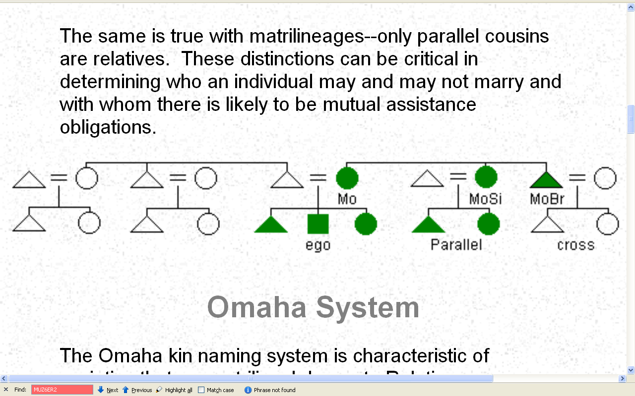
Matrilineal Kinship
http://anthro.palomar.edu/kinship/kinship_6.htm

Slide 57
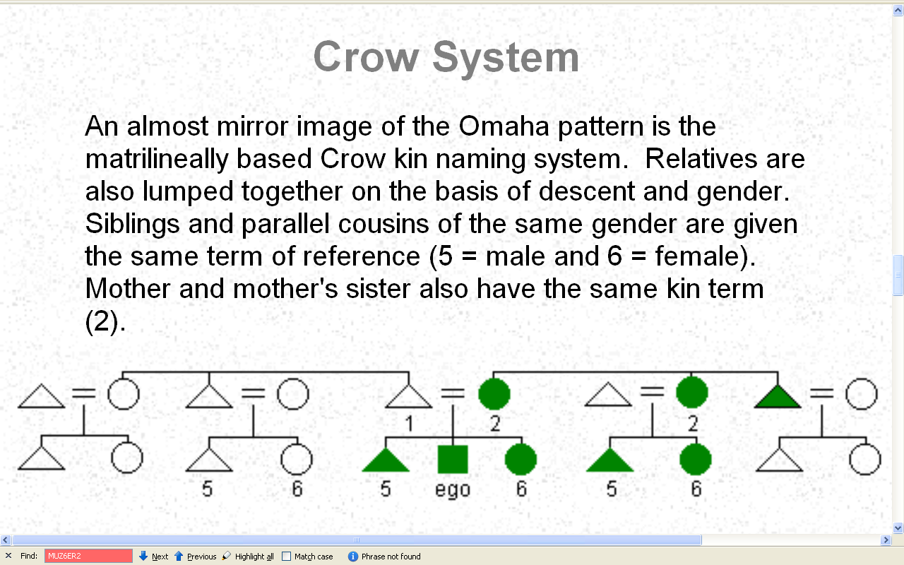
http://anthro.palomar.edu/kinship/kinship_6.htm

Slide 58
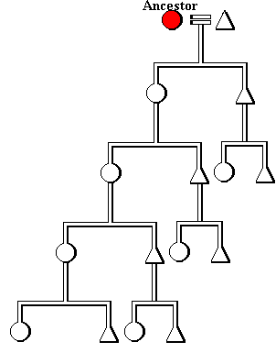
Matrilineal
(uterine)
descent
http://www.umanitoba.ca/faculties/arts/anthropology/tutor/descent/unilineal/patri01.html

Slide 59
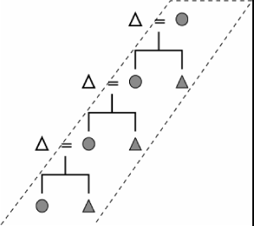
A matrilineage
http://www.anthro.ucdavis.edu/winterweb/html/UCD_classes/128/fox1.htm

Slide 60
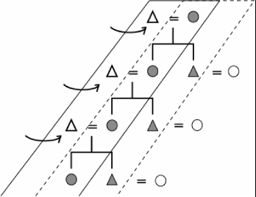
matrilocal
Matrilineal, matri- or uxori-local
http://www.anthro.ucdavis.edu/winterweb/html/UCD_classes/128/fox1.htm

Slide 61
"postmarital"
residence patterns
matrilocal (locale of the woman's matrilineage)
patrilocal (locale of the man’s patrilineage)
uxorilocal (locale of the woman's parents)
virilocal (locale of the man's parents)
ambilocal (locale of either woman’s or man’s parents)
[aka bilocal]
neolocal (independent establishment of residence)

Slide 62
"postmarital"
residence patterns
matrilocality (locale of the woman's matrilineage)
patrilocality (locale of the man’s patrilineage)
uxorilocality (locale of the woman's parents)
virilocality (locale of the man's parents)
ambilocality (locale of either woman’s or man’s parents)
[aka bilocality]
neolocality (independent establishment of residence)

Slide 63
kinship related suffixes
-lineal
(line of descent)
-local
(place of “postmarital” residence)
-lateral
(behavioral bias toward)
-focal
(cultural hub)
-archy
(who “rules”)

Slide 64
kinship related suffixes
matri--lineal
(line of descent)
matri--local
(place of “postmarital” residence)
matri--lateral
(behavioral bias toward)
matri--focal
(cultural hub)
matri--archy
(who “rules”)

Slide 65
kinship related suffixes
patri--lineal
(line of descent)
patri--local
(place of “postmarital” residence)
patri--lateral
(behavioral bias toward)
patri--focal
(cultural hub)
patri--archy
(who “rules”)

Slide 66
"postmarital"
residence patterns
matrilocal
patrilocal
uxorilocal
virilocal
ambilocal
(bilocal)
neolocal

Slide 67
matrilocal
Matrilineal, matri- or uxori-local
http://www.anthro.ucdavis.edu/winterweb/html/UCD_classes/128/fox1.htm

Slide 68
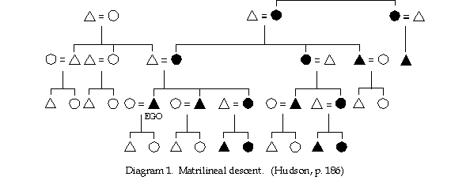
http://www.boulder.net/~gillman/anthpaper/anthpap.html

Slide 69
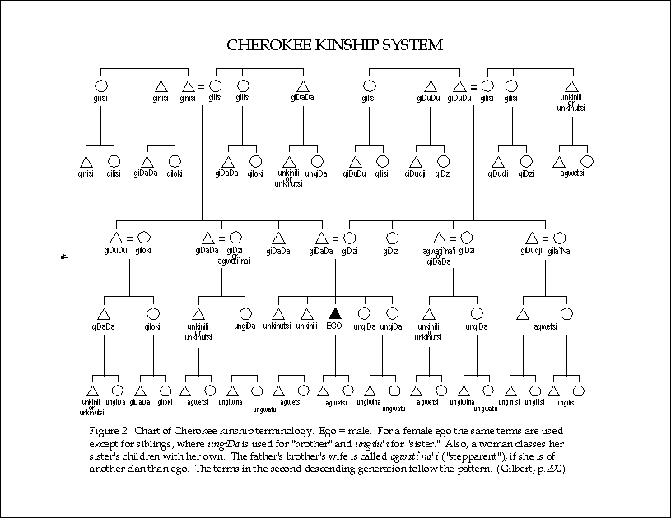
http://www.boulder.net/~gillman/anthpaper/anthpap.html

Slide 70
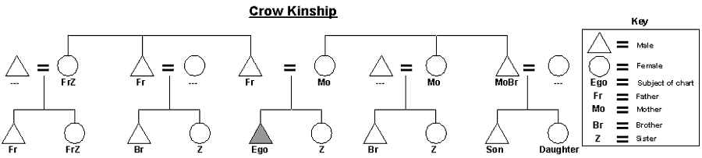
Matrilineal Kinship
http://en.wikipedia.org/wiki/Crow_kinship

Slide 71
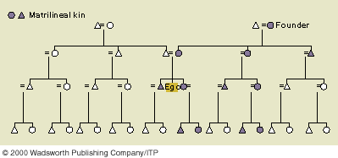
Matrilineal Kinship

Slide 72
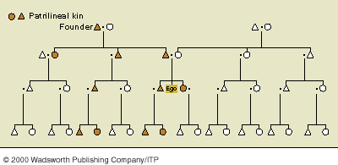
Patrilineal Kinship

Slide 73
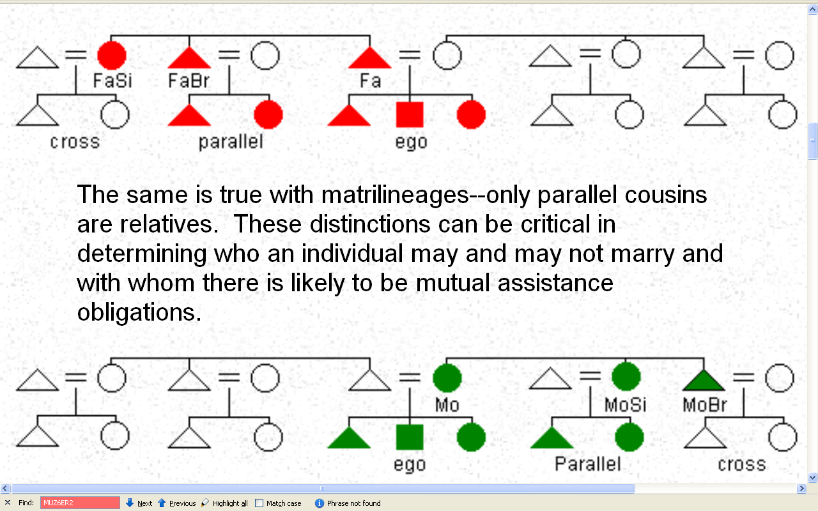
Patrilineage
Matrilineage
http://anthro.palomar.edu/kinship/kinship_6.htm

Slide 74
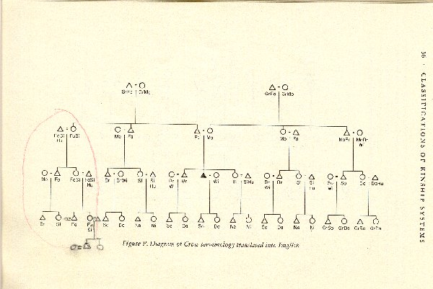

Slide 75
Patrilineal Kinship

Slide 76
Patrilineal Kinship
http://anthro.palomar.edu/kinship/kinship_6.htm

Slide 77
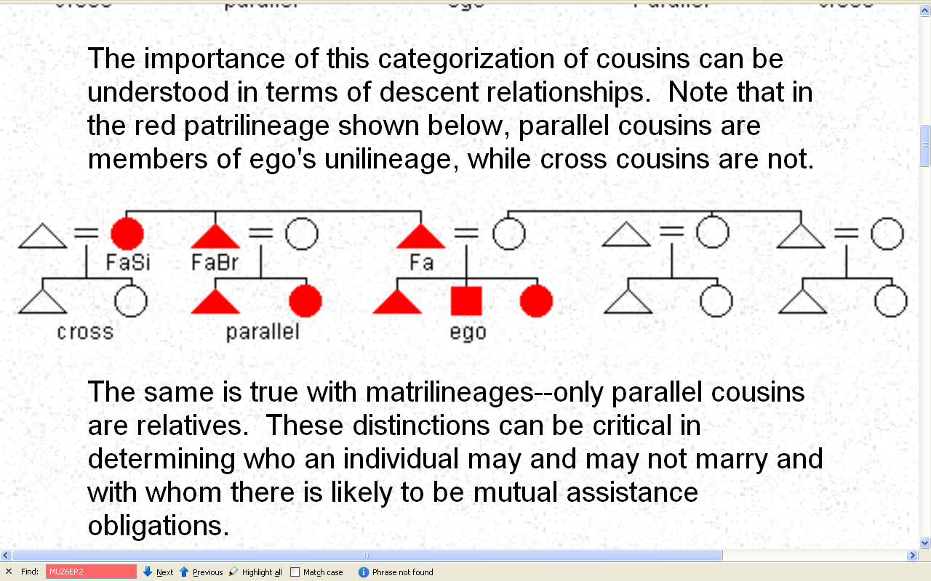
Patrilineal Kinship
http://anthro.palomar.edu/kinship/kinship_6.htm

Slide 78
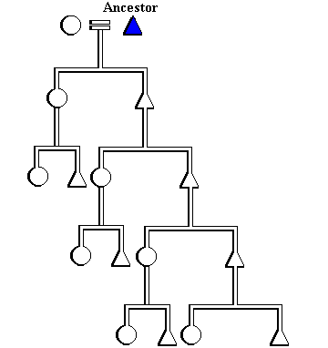
Patrilineal
(agnatic)
descent
http://www.umanitoba.ca/faculties/arts/anthropology/tutor/descent/unilineal/patri01.html

Slide 79
Matrilineal
(uterine)
descent
http://www.umanitoba.ca/faculties/arts/anthropology/tutor/descent/unilineal/patri01.html

Slide 80
Patrilineal
(agnatic)
descent
Matrilineal
(uterine)
descent
http://www.umanitoba.ca/faculties/arts/anthropology/tutor/descent/unilineal/patri01.html

Slide 81
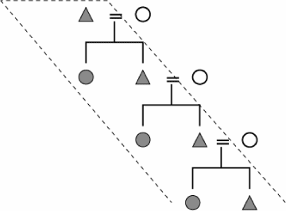
A patrilineage
http://www.anthro.ucdavis.edu/winterweb/html/UCD_classes/128/fox1.htm

Slide 82
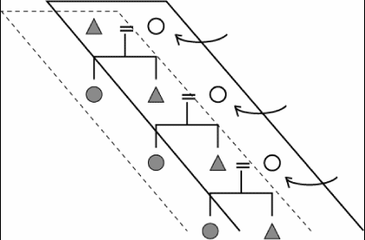
patrilocal
patrilineal, patrilocal
http://www.anthro.ucdavis.edu/winterweb/html/UCD_classes/128/fox1.htm

Slide 83
Descent rule | Number | Percentage
Patrilineal | 105 | 60%
Matrilineal | 52 | 30%
Dual | 18 | 10%
Total | 175 | 100%
Incidence of Descent Rules among Unilineal Societies
Source: Murdock 1949:59.
http://www.umanitoba.ca/faculties/arts/anthropology/tutor/descent/unilineal/patri01.html

Slide 84

http://anthro.palomar.edu/kinship/kinship_6.htm

Slide 85
Patrilineage
Matrilineage
http://anthro.palomar.edu/kinship/kinship_6.htm

Slide 86

Patrilineal Kinship
http://en.wikipedia.org/wiki/Omaha_kinship

Slide 87
Matrilineal Kinship
http://en.wikipedia.org/wiki/Crow_kinship

Slide 88
English Term | Kin Type | Dani Term
Father | F | Opaije
Uncle | FB
 | MB | Ami
Cousin | MBS
 | FBS | Oe
 | MZS
Brother | B
Cousin | FZS | Ejak
Nephew | ZS
 | BS | Abut
Son | S
Dani Kin Terms -- Brian Schwimmer

Slide 90

http://anthro.palomar.edu/kinship/kinship_6.htm

Slide 91
Kinterm | Kintype
Baba | F
Kardesh | B
Okul | S
Emme | FB
Dayi | MB
Emme Okul | FBS
Dayi Okul | MBS
Yiken | BS, ZS
Turkish Kin terms Designated by Kin Types
Male Terms Only
Turkish kin terms -- Brian Schwimmer

Slide 92
Modern English | Kin Type | Old English
Father | F | Faeder
Mother | M | Modor
Uncle | FB | Faedera
 | MB | Eam
Aunt | FS | Fathu
 | MS | Modrige
Old English kin terms -- Brian Schwimmer

Slide 93
Kinship and Descent
including
kinship symbols
and notation conventions
Tim Roufs
© 2010

