Slide 1
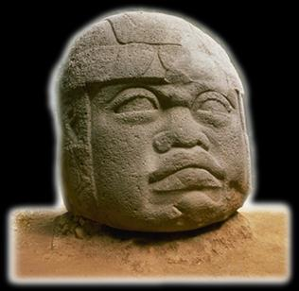
Ancient Middle America
The Early Preclassic
“Early Formative”
“Pre- Olmec”
University of Minnesota Duluth
Ancient Middle America
Tim Roufs ©2009-2019

Slide 2
The Preclassic Stage can be broken down into three
sub-stages . . .

Slide 3
Late Preclassic
Middle Preclassic
Early Preclassic

Slide 4
Early Preclassic Stage
Late Preclassic
Middle Preclassic
Early Preclassic

Slide 5
Early Preclassic Stage
Early Preclassic Stage
1800 – 1000 B.C. (The Maya)
1800 – 1200 B.C. (Mexico)
2500 – 1250 B.C.

Slide 6
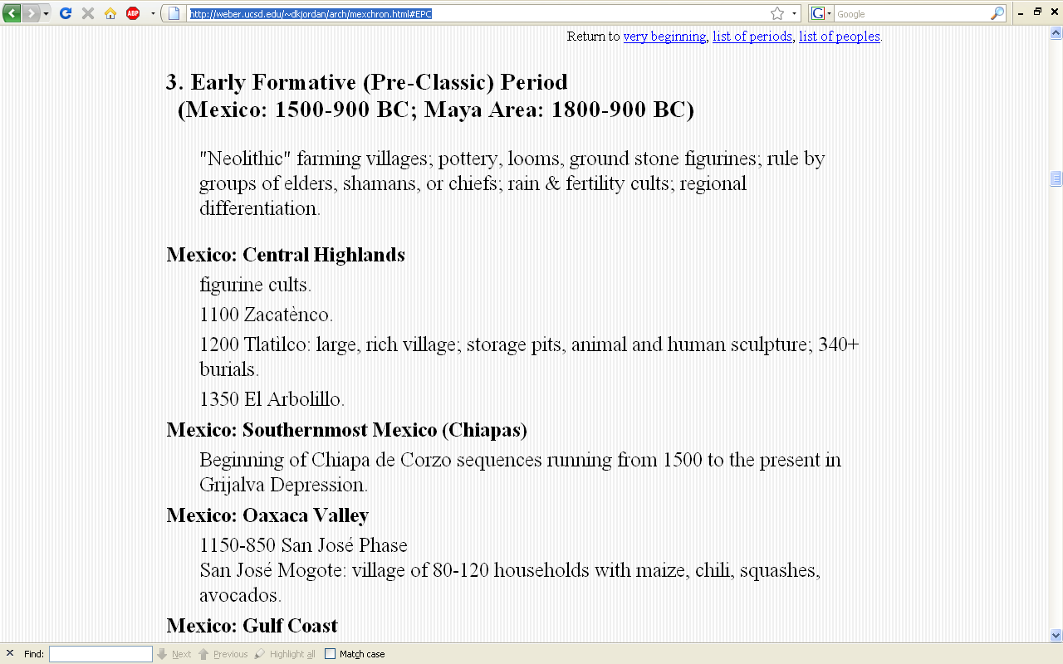
http://weber.ucsd.edu/~dkjordan/arch/mexchron.html#EPC

Slide 7
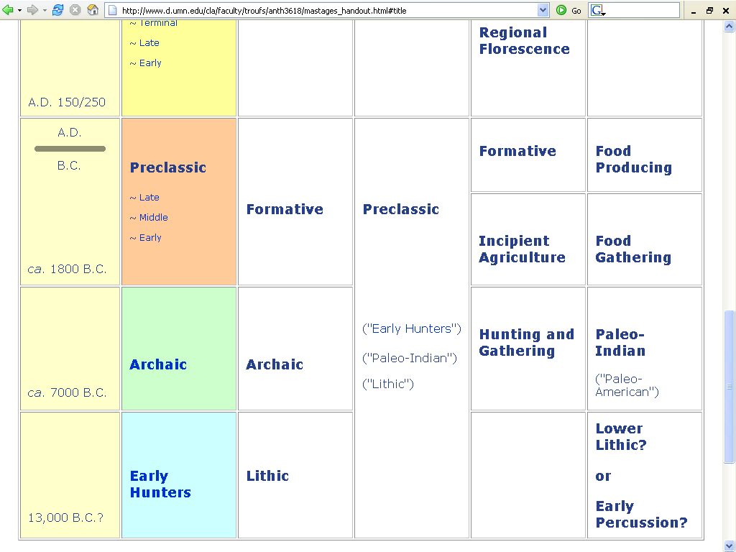

Slide 8
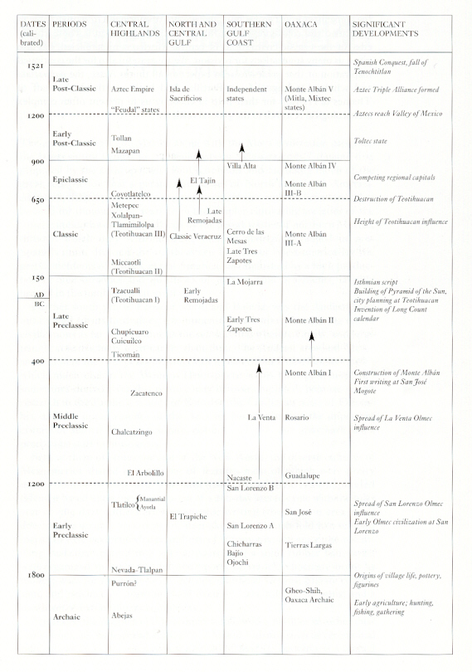
Mexico
(6th ed.)
Page 236

Slide 9
Mexico
(6th ed.)
Page 236

Slide 10
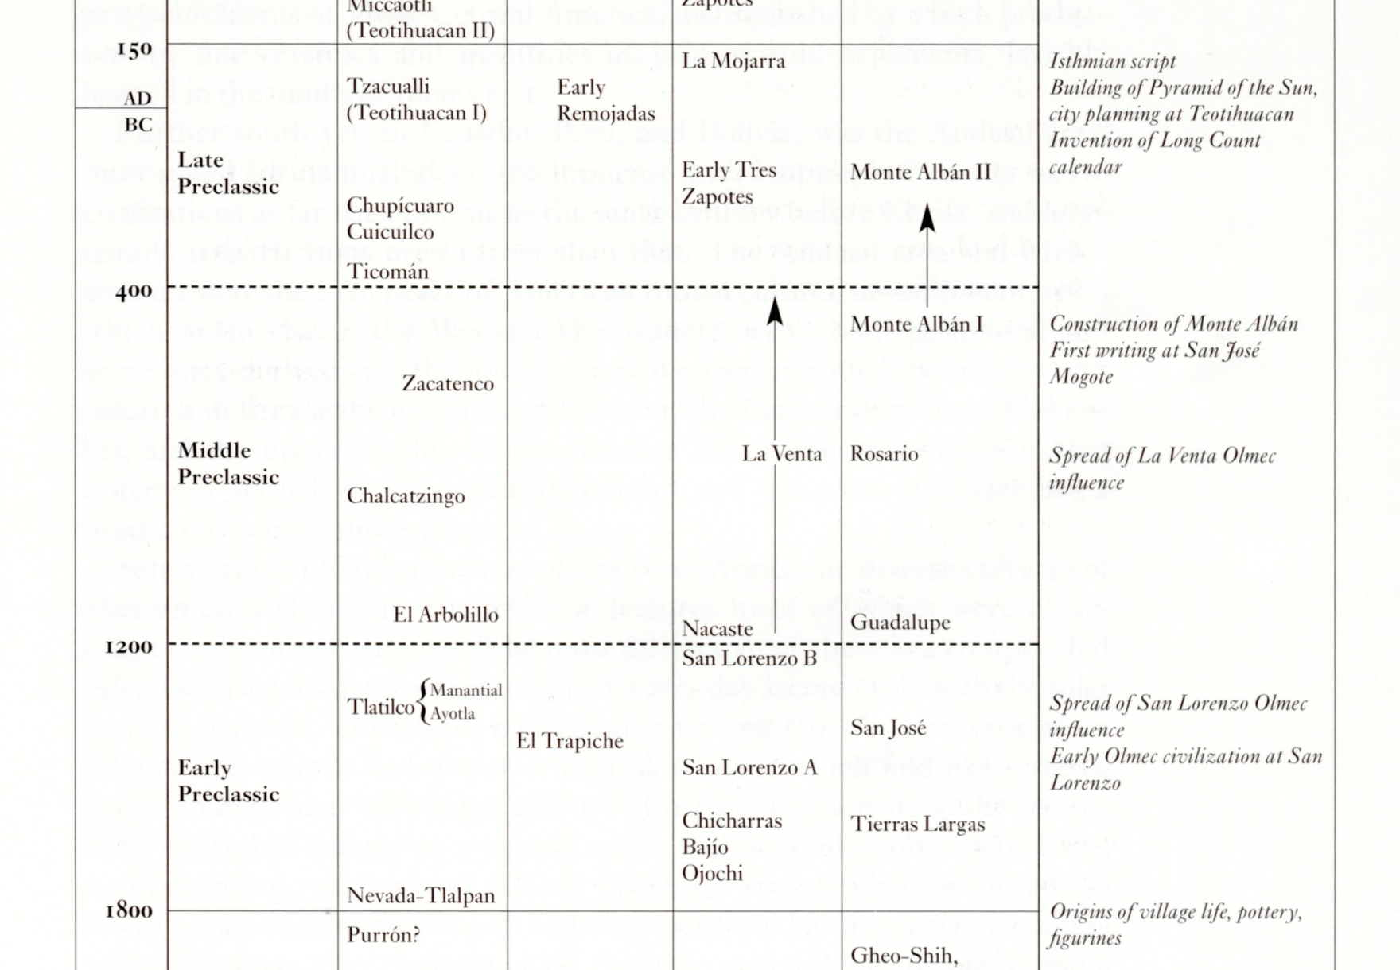
Mexico
(6th ed.)
Page 236

Slide 11
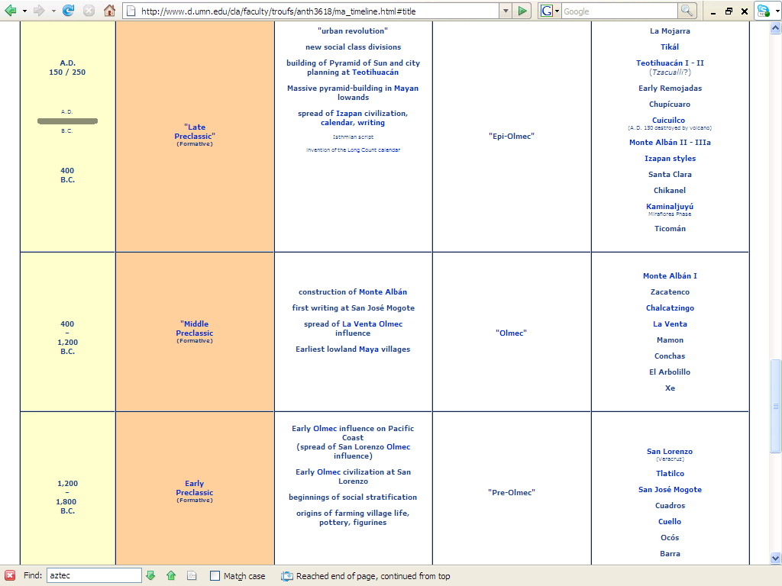
http://www.d.umn.edu/cla/faculty/troufs/anth3618/ma_timeline.html#Late_Preclassic

Slide 12
Early Preclassic Stage
Early Preclassic Stage
1800 – 1000 B.C. (The Maya)
1800 – 1200 B.C. (Mexico)
2500 – 1250 B.C.
characterized by. . .

Slide 13
Early Preclassic Stage
the Early Preclassic is characterized by the predominance of small rural communities comprised of a limited number of huts built of perishable materials . . .

Slide 14
Early Preclassic Stage
the Early Preclassic is characterized by the predominance of small rural communities comprised of a limited number of huts built of perishable materials . . .

Slide 15
Early Preclassic Stage
. . . and a distinct type of pottery in the Highlands -- one with a round bottom
  tecomate / tecomatl

Slide 16
Early Preclassic Stage
. . . and a distinct type of pottery in the Highlands -- one with a round bottom
  tecomate / tecomatl

Slide 17
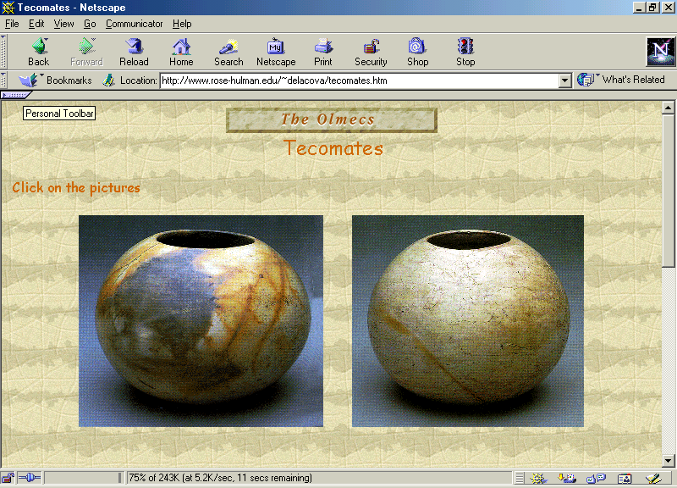

Slide 18
Early Preclassic Stage
in contrast, the Early Preclassic of the Gulf Coast
has pottery with flat bottoms
. . .

Slide 19
Early Preclassic Stage
the pottery in the Valley of Mexico is mostly monochrome
  they are painted black, white, dark brown, chestnut-brown and reddish brown
  figurines are present, and all represent women
    “Tradition C” of the Central Highlands

Slide 20
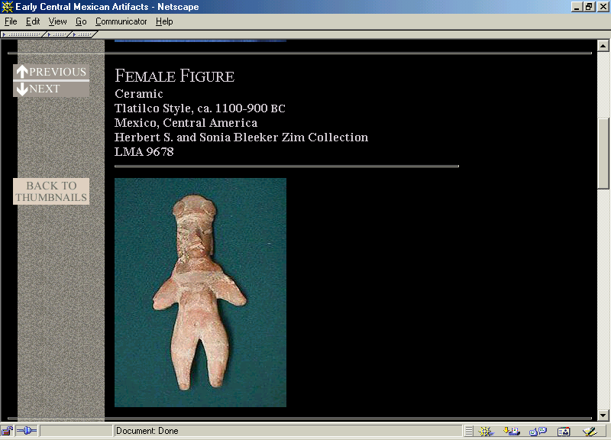

Slide 21
Early Preclassic Stage
figurines are important because they give us some indication of what the people of those times were like
      how they dressed
      how they adorned themselves
      their daily lives

Slide 22
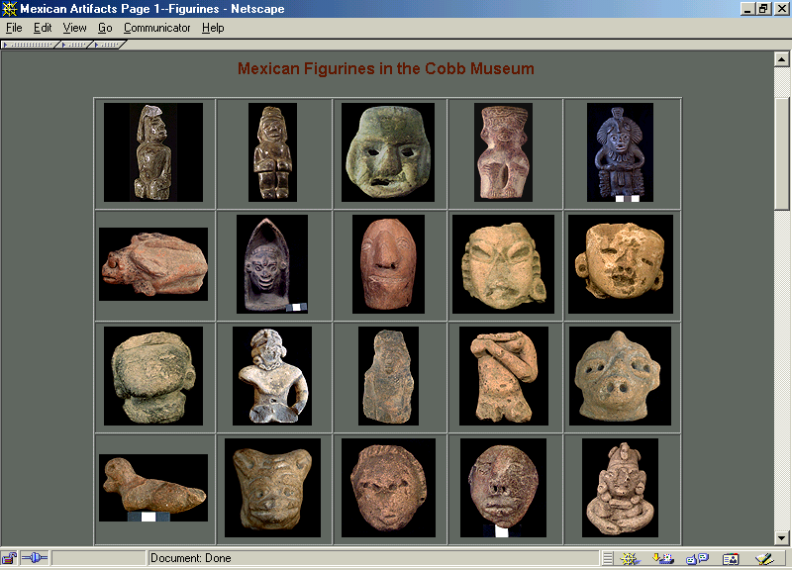

Slide 23
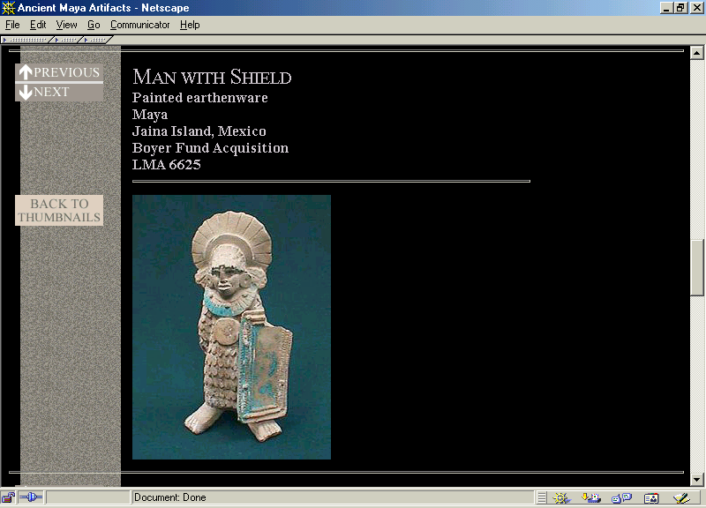

Slide 24
Early Preclassic Stage
figurine types are varied and some show specialized practices:
      cranial deformation
      dental mutilation
      shaven heads
      tattooing
      body and facial painting

Slide 25
Early Preclassic Stage
figurine types are varied and some show specialized practices:
      cranial deformation
      dental mutilation
      shaven heads
      tattooing
      body and facial painting

Slide 26
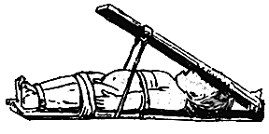
halfmoon.org

Slide 27
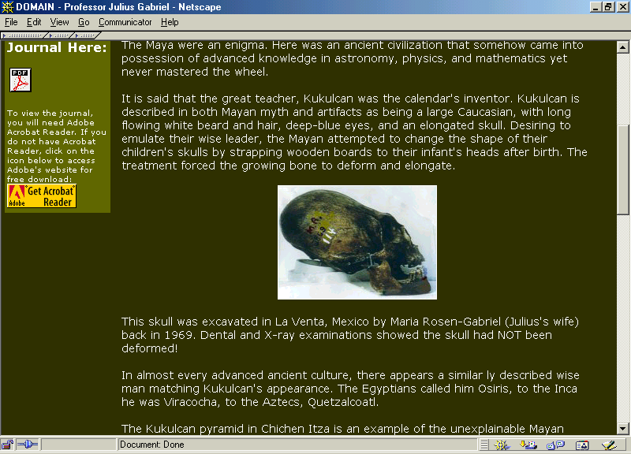

Slide 28
Early Preclassic Stage
figurine types are varied and some show specialized practices:
      cranial deformation
      dental mutilation
      shaven heads
      tattooing
      body and facial painting

Slide 29
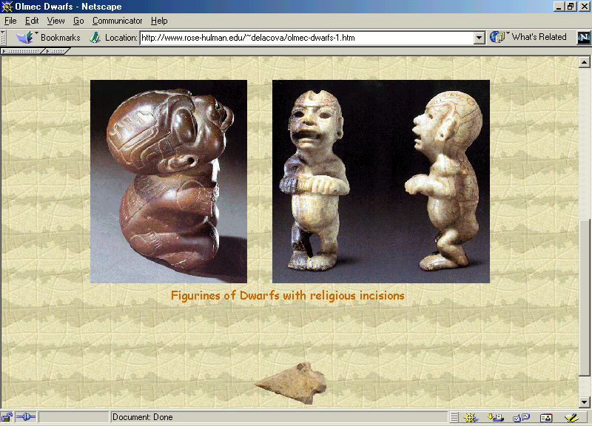

Slide 30
Early Preclassic Stage
also evidenced in pottery:
  use of loin-cloths, short skirts, sandals, hats, turbans
  earplugs
  necklaces
  pyrite mirrors
  and many other items of clothing and adornment

Slide 31
Early Preclassic Stage
also evidenced in pottery:
  use of loin-cloths, short skirts, sandals, hats, turbans
  earplugs
  necklaces
  pyrite mirrors
  and many other items of clothing and adornment

Slide 32
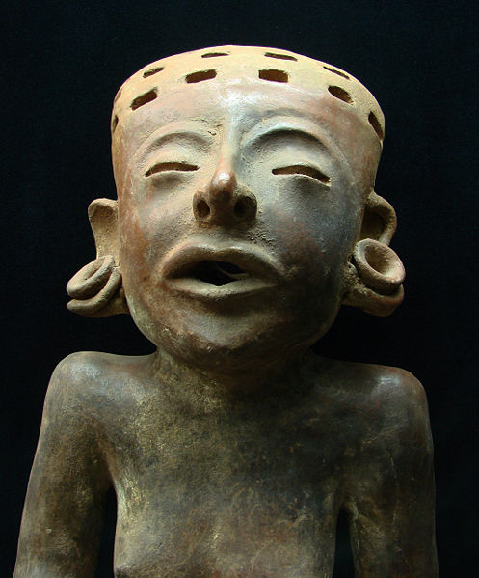
Statuette totonaque (600-1200 B.C.)
http://en.wikipedia.org/wiki/Earspool

Slide 33
Early Preclassic Stage
also evidenced in pottery:
  use of loin-cloths, short skirts, sandals, hats, turbans
  earplugs
  necklaces
  pyrite mirrors
  and many other items of clothing and adornment

Slide 34
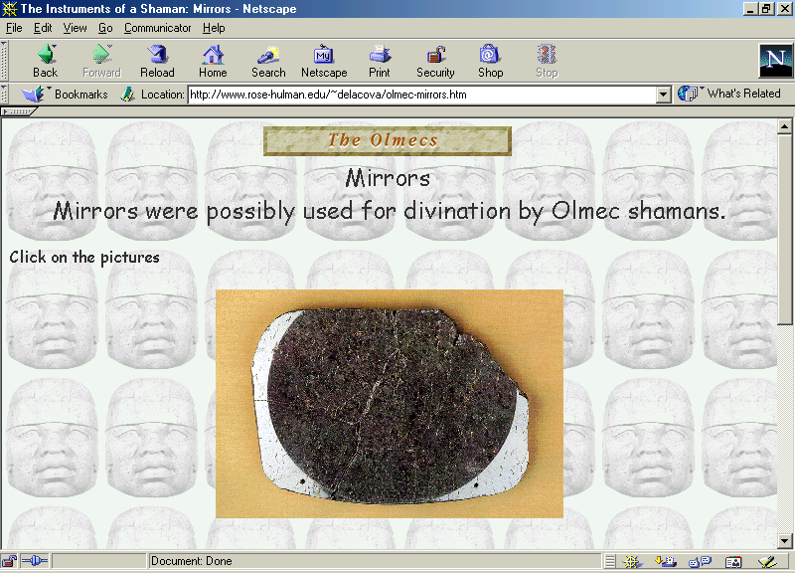

Slide 35
Early Preclassic Stage
pottery forms in the Valley of Mexico include:
  large jars for storing water and seeds
  composite-silhouette bowls with incised decoration
  jars with flaring sides
  plates and other simple forms with round bottoms

Slide 36
Early Preclassic Stage
Early Preclassic Sites include:
    San Lorenzo
    Chiapa de Corzo
    Cerros
    Ocós
    Cuello

Slide 37
Early Preclassic Stage
Early Preclassic Sites include:
    El Arbolillo
    Zacatenco
    Tlatilco
    Barra
    Cuadros
    San José Mogote

Slide 38
Early Preclassic Stage
Early Preclassic Sites include:
    Ajalpan
    Izucar

Slide 39
Middle Preclassic Stage
Late Preclassic
Middle Preclassic
Early Preclassic

Slide 40
End of The Early Preclassic
Continue on to The Middle Classic

