Slide 1
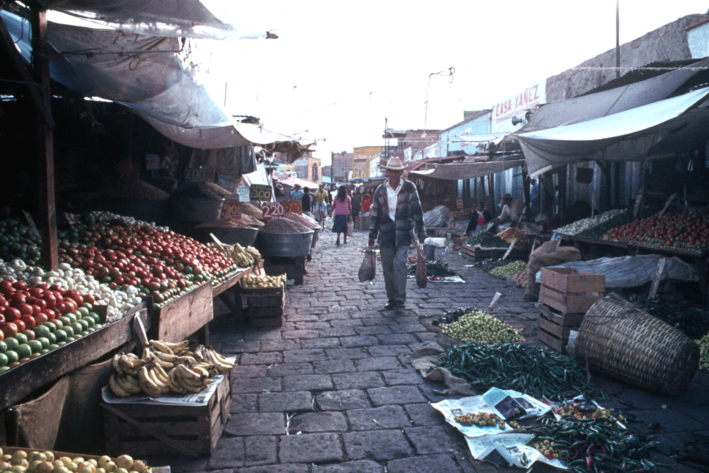
Welcome to
San Luis Potosi
Tim Roufs
© 2010
University of Minnesota Duluth

Slide 2
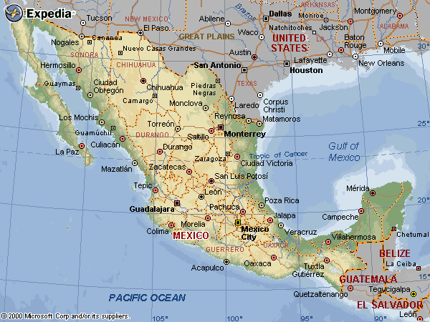
Compound of the 9 Brothers, Nuevo León, Mexico

Slide 3
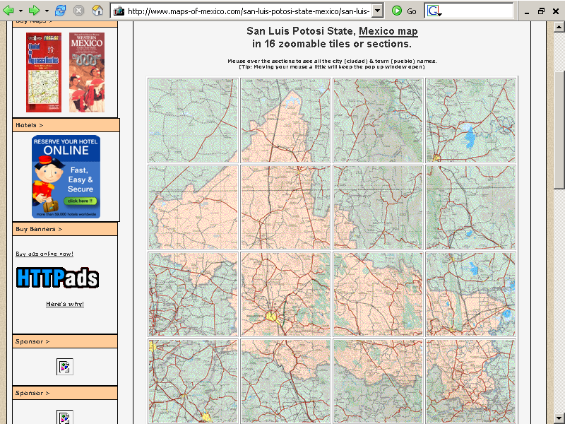
Matehuala
San Luis
Potosi
Matehuala, Nuevo León, Mexico

Slide 4
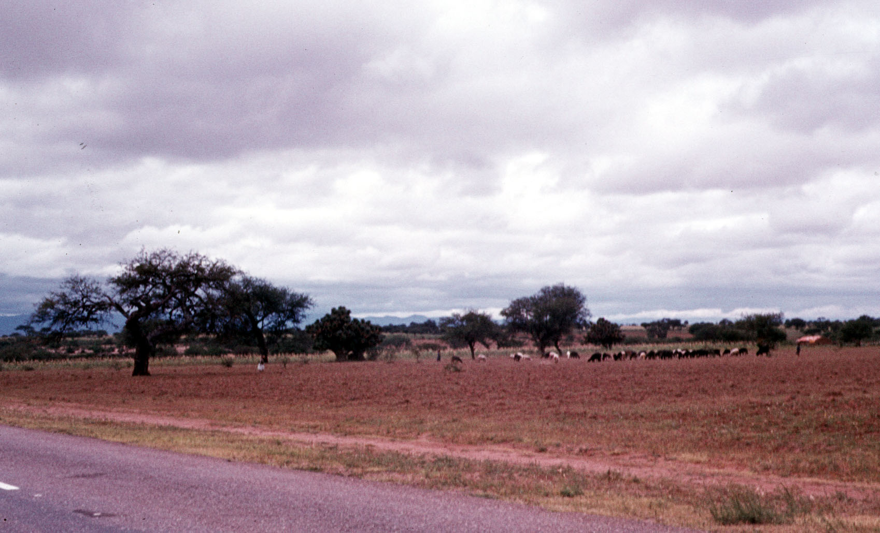
Matehuala to San Luis Potosi, SLP, Mexico

Slide 5
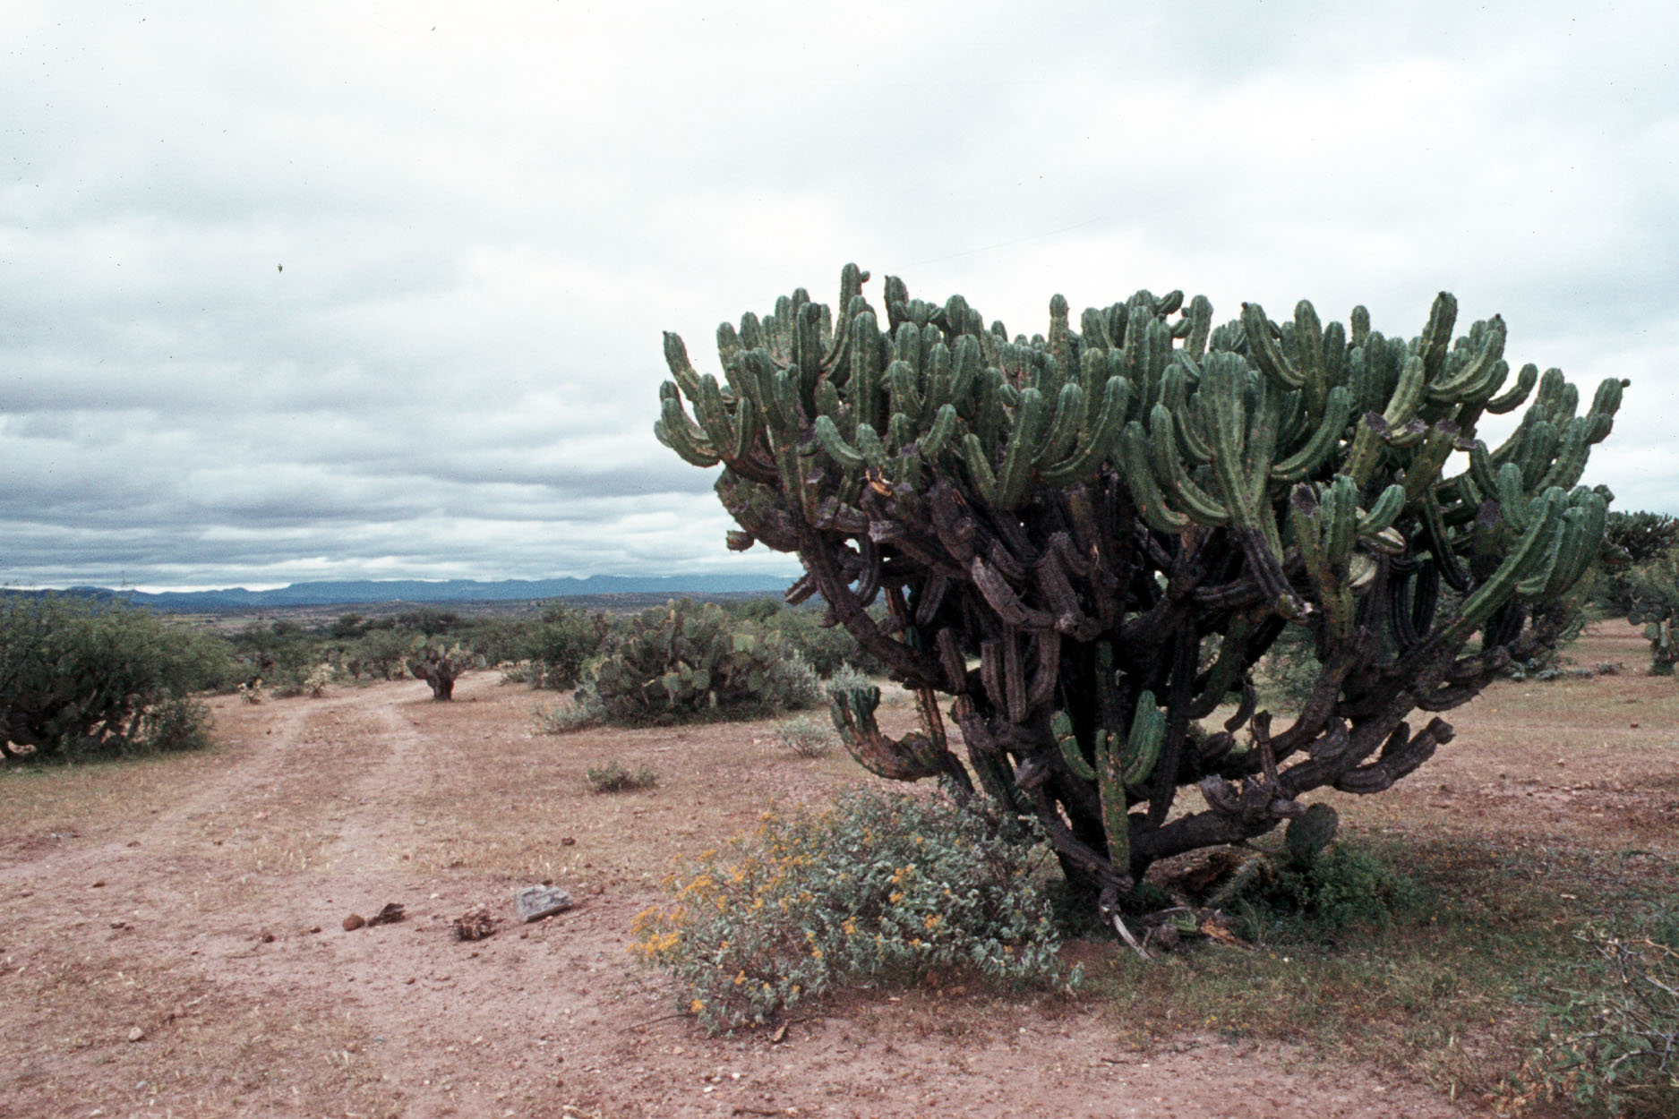
Matehuala to San Luis Potosi, SLP, Mexico

Slide 6
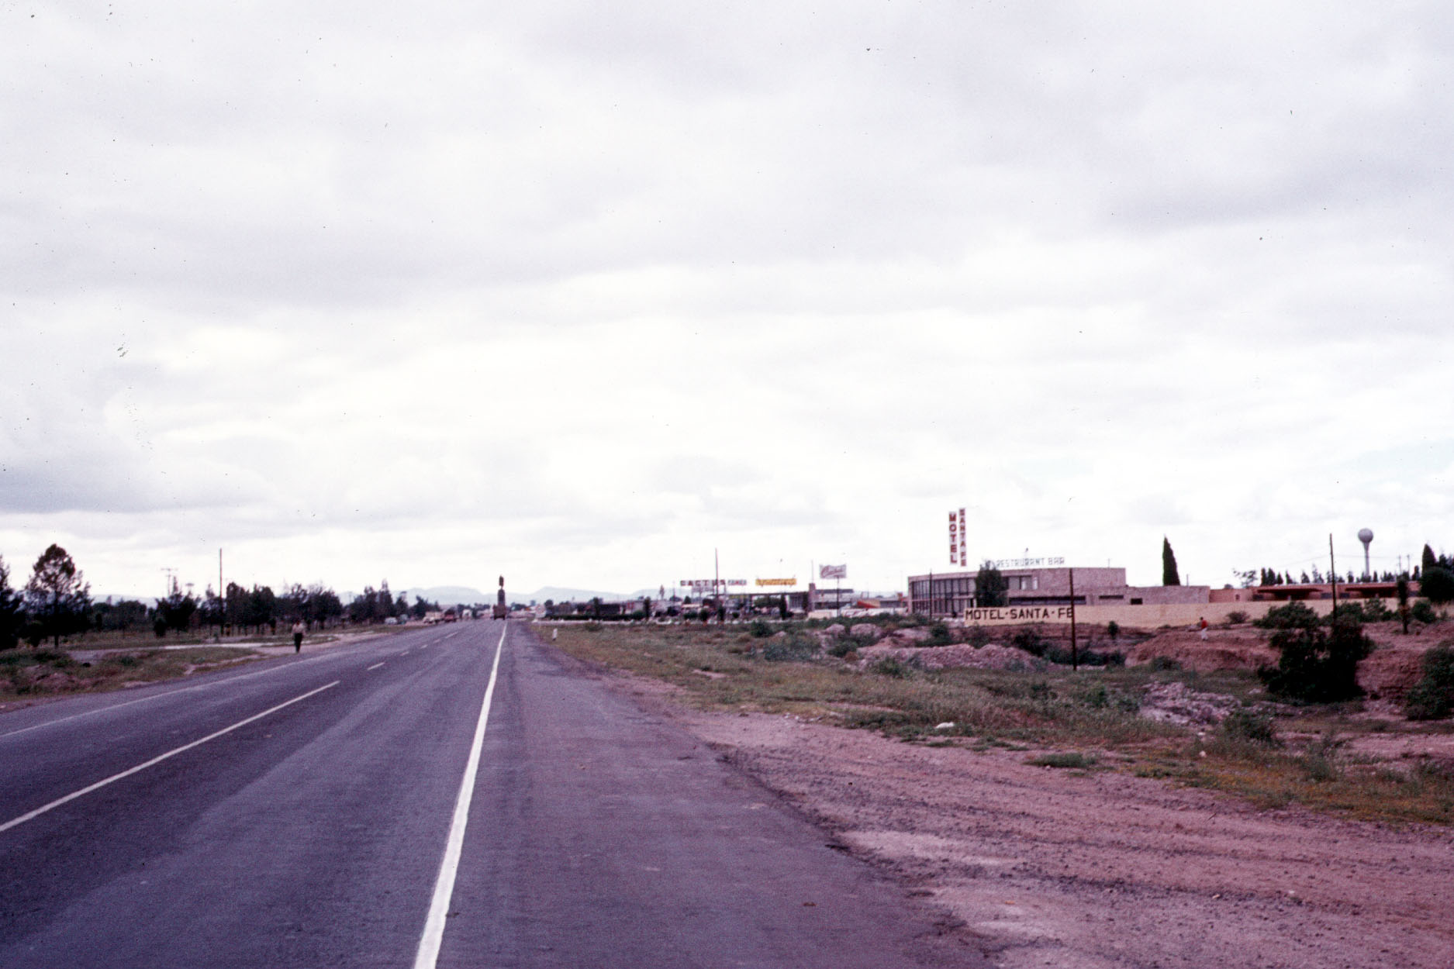
San Luis Potosi, SLP, Mexico

Slide 7
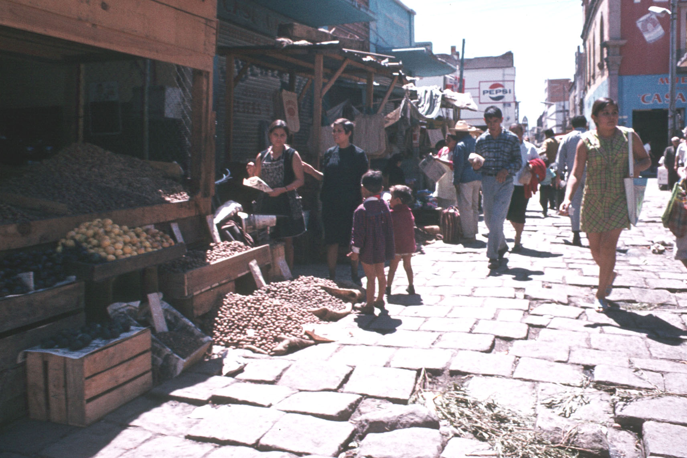
San Luis Potosi, SLP, Mexico

Slide 8
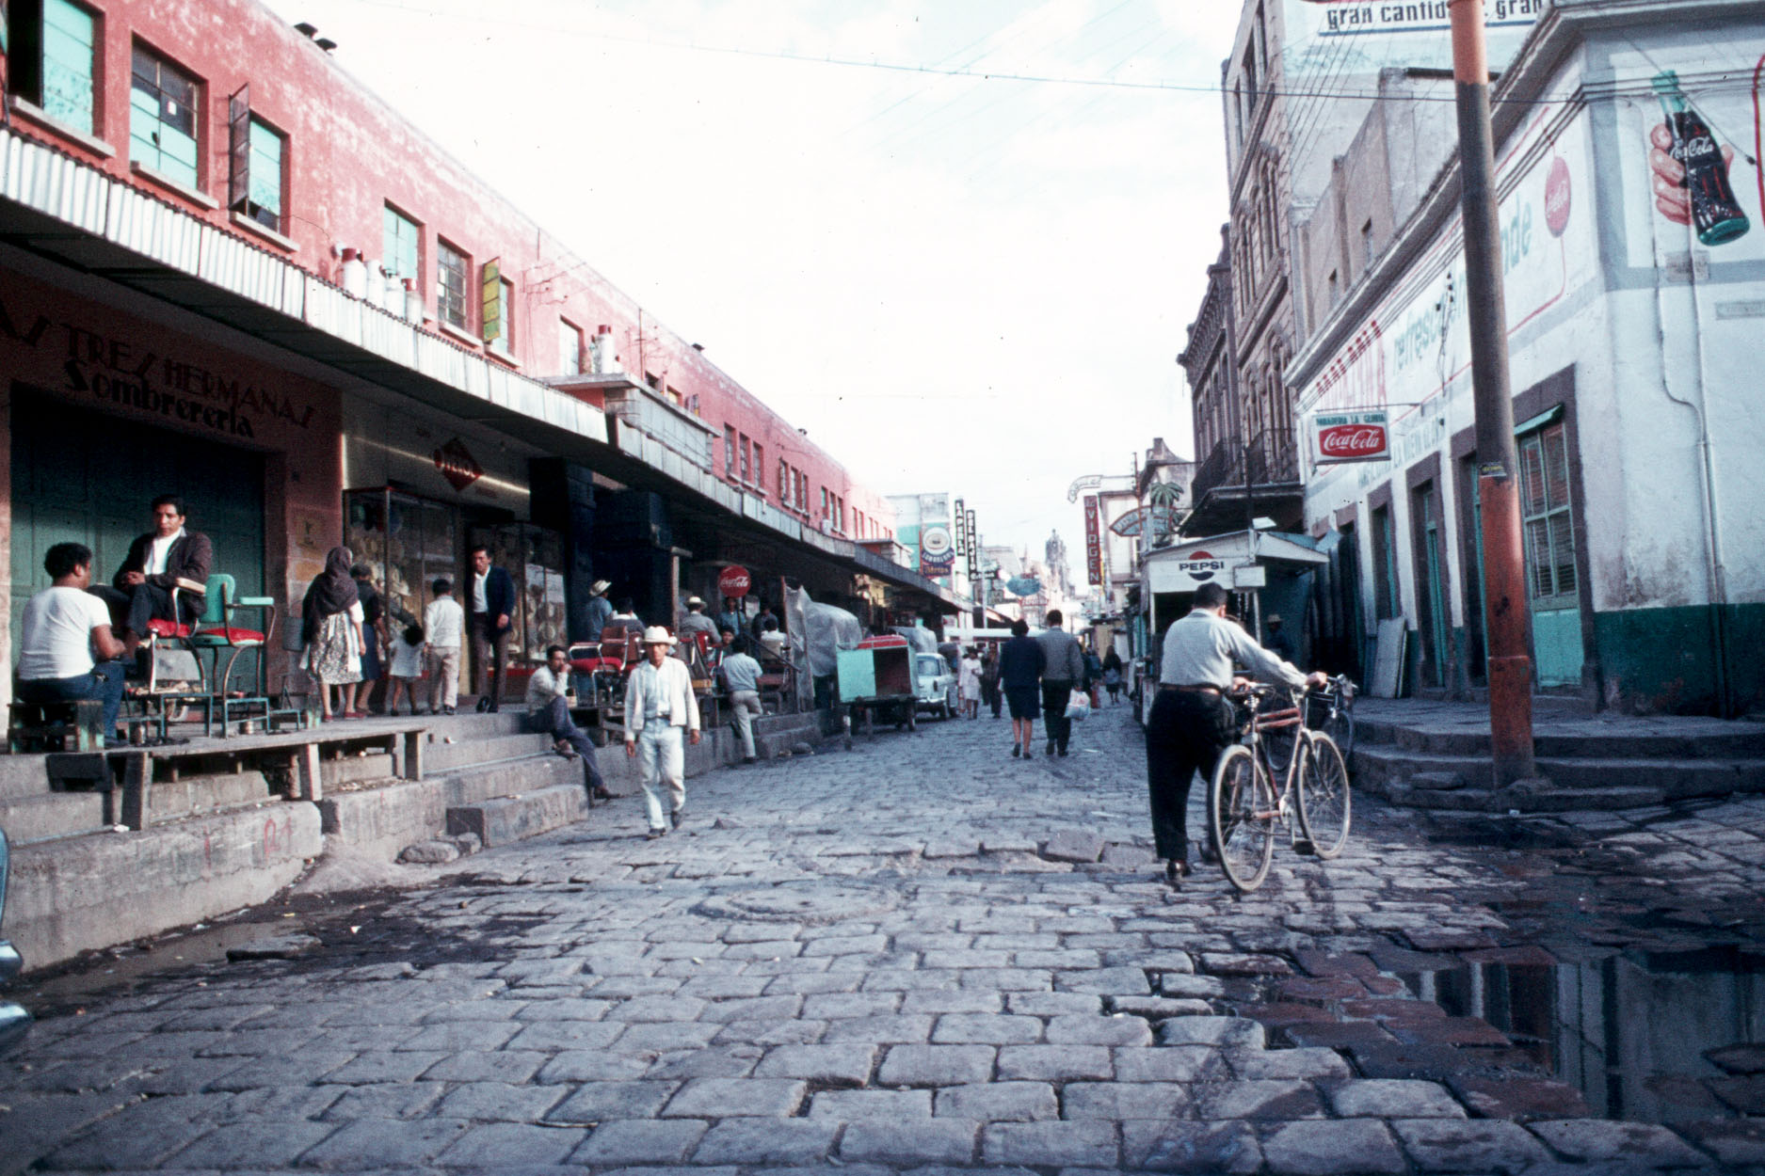
San Luis Potosi, SLP, Mexico

Slide 9
San Luis Potosi, SLP, Mexico

Slide 10
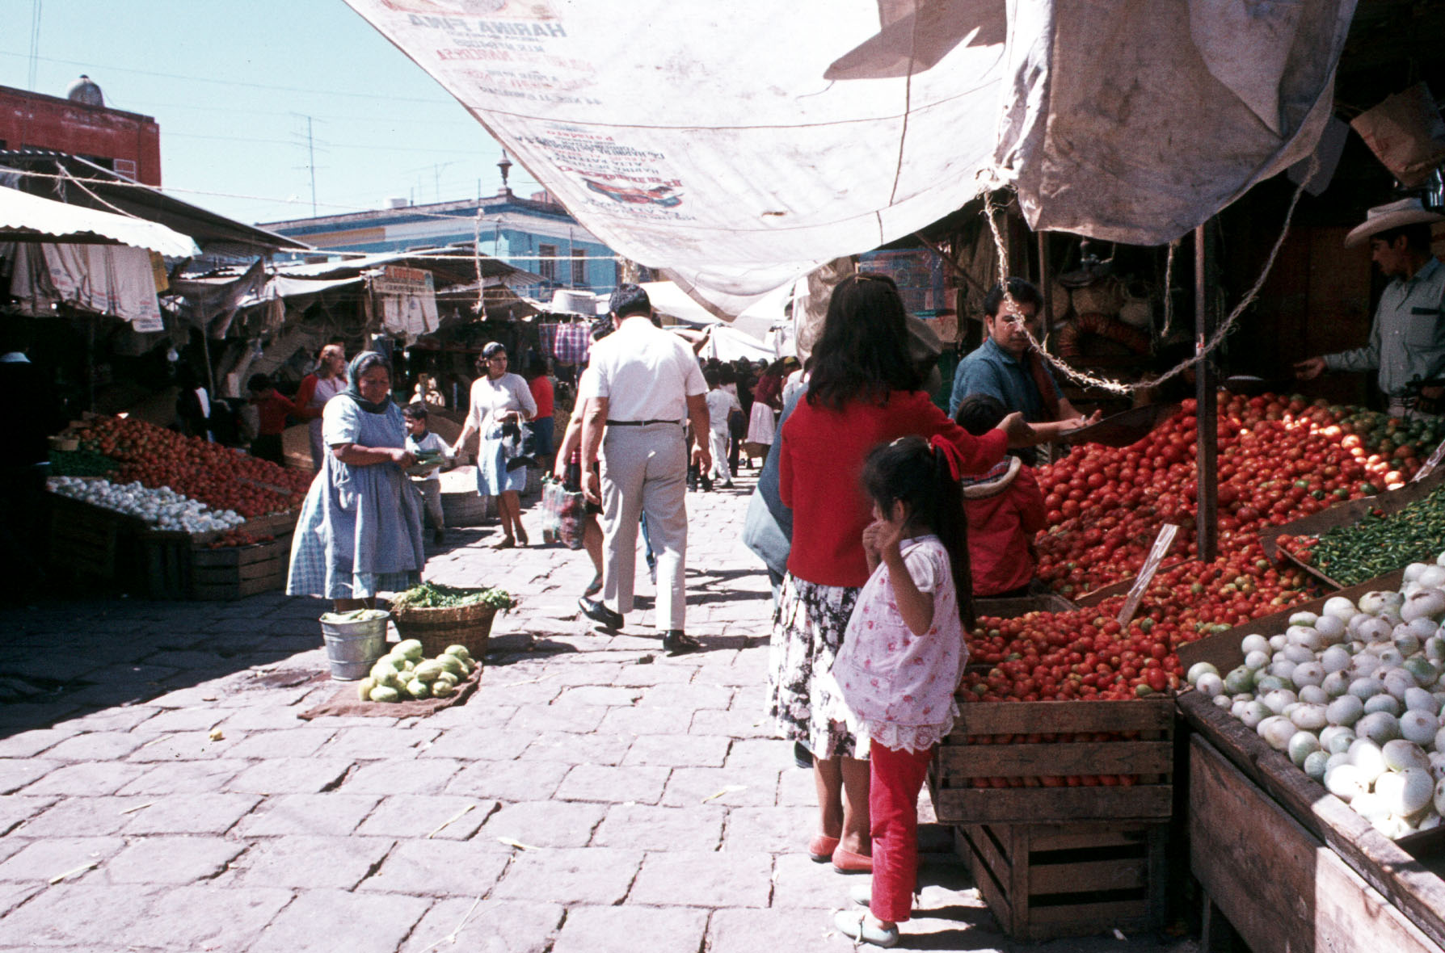
San Luis Potosi, SLP, Mexico

Slide 11
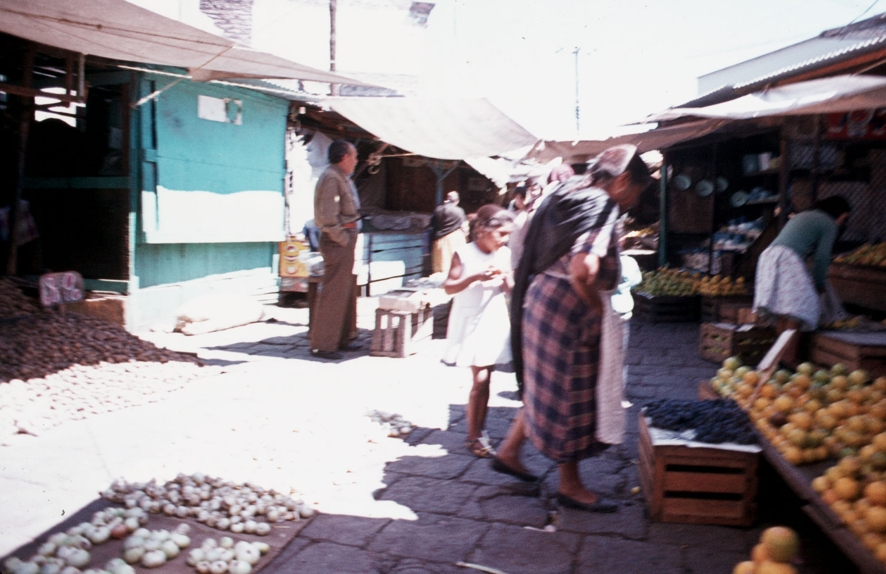
San Luis Potosi, SLP, Mexico

Slide 12
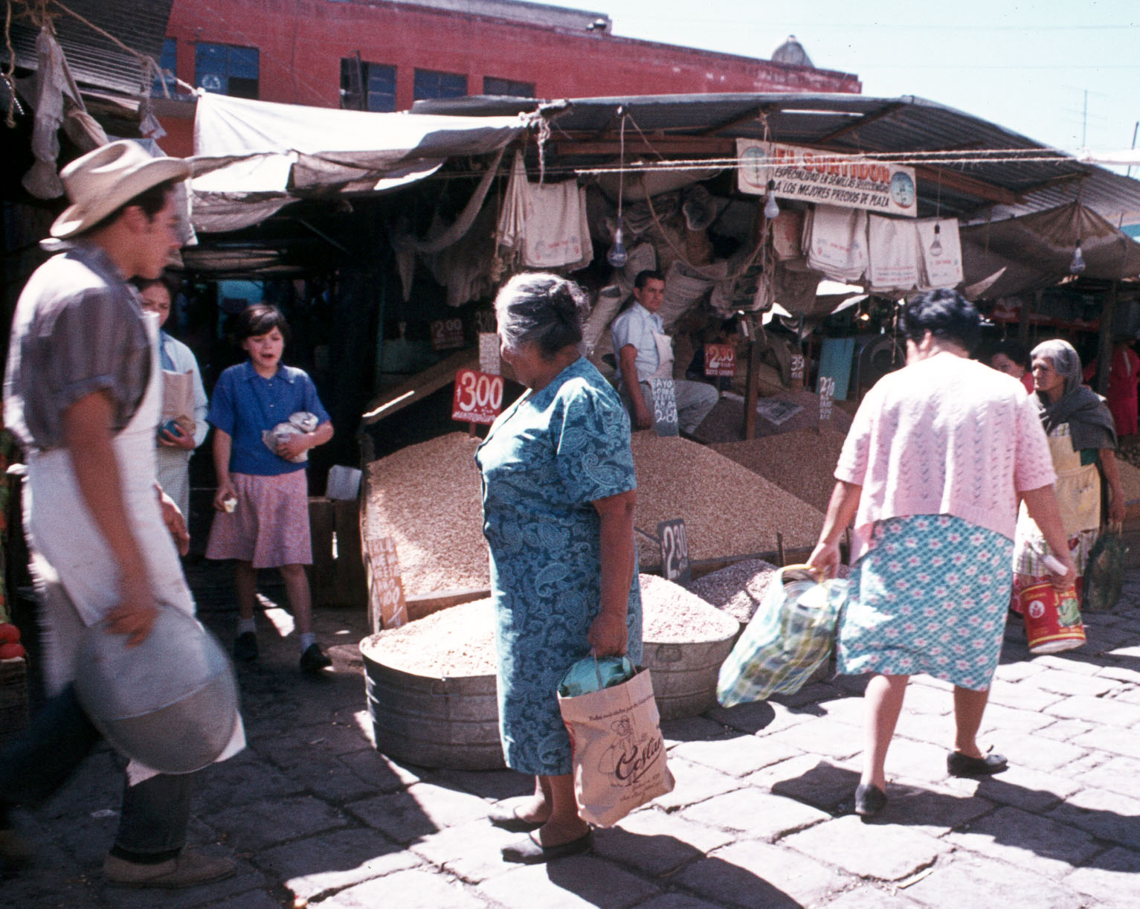
San Luis Potosi, SLP, Mexico

Slide 13
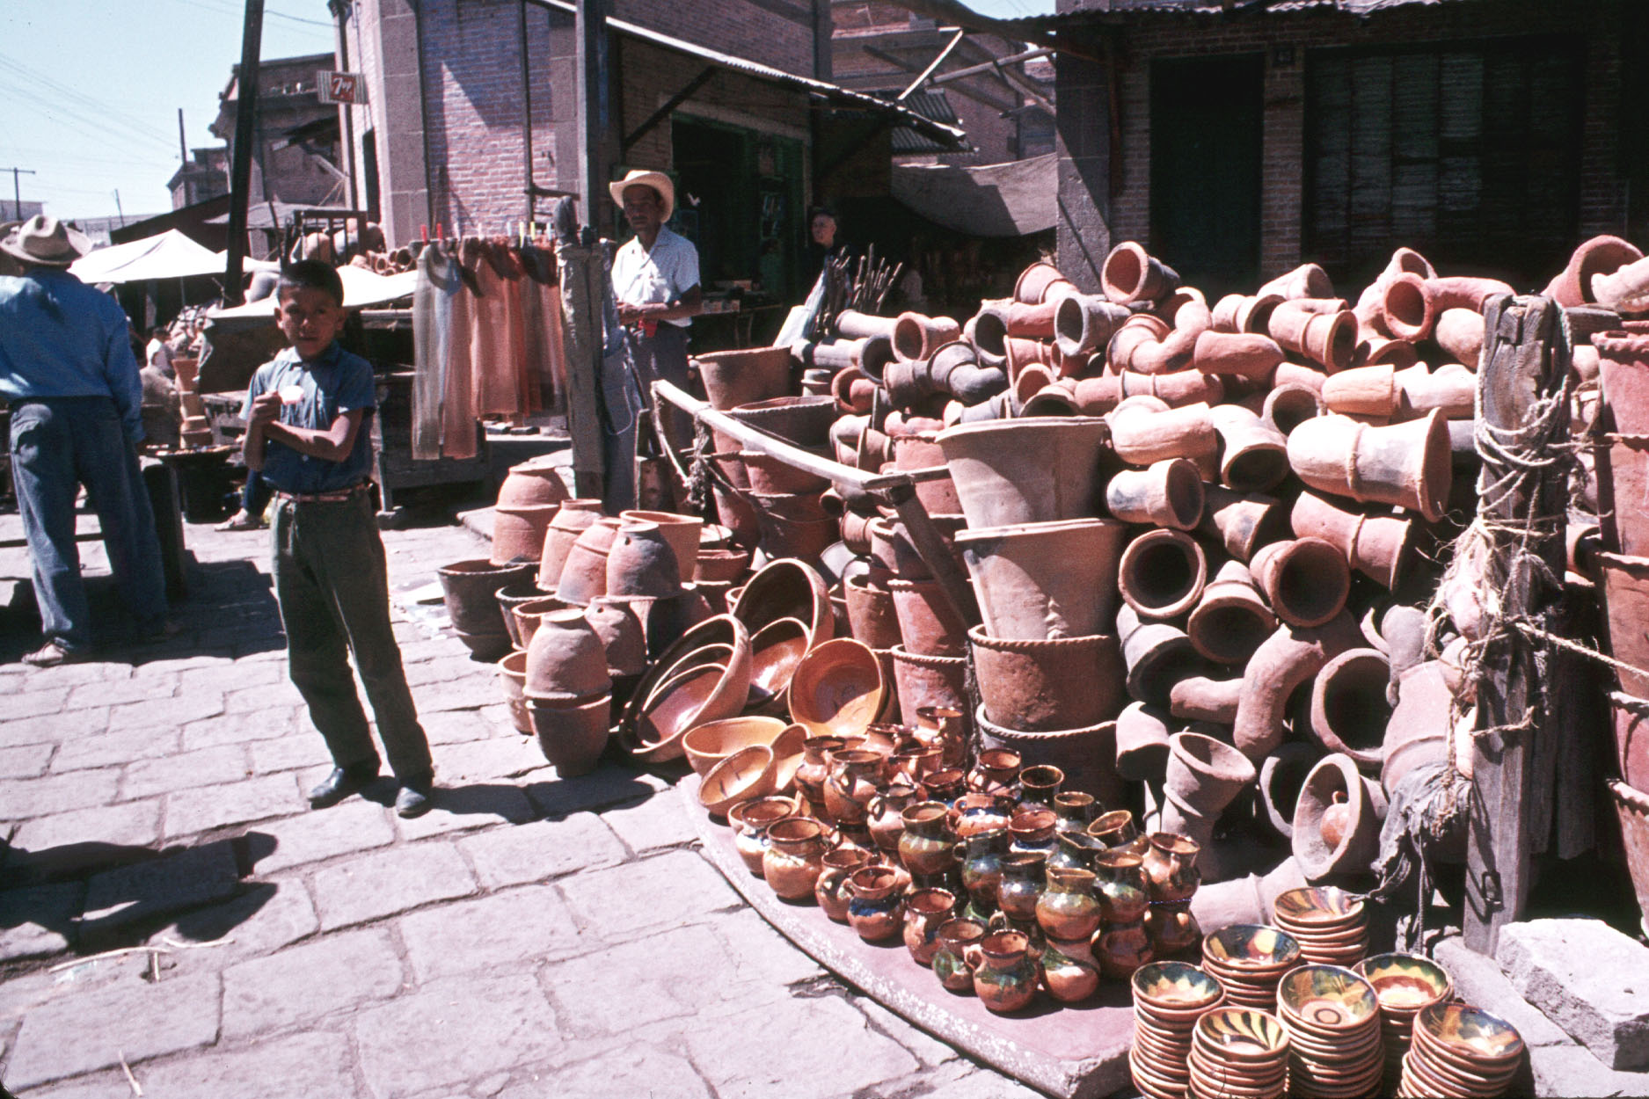
San Luis Potosi, SLP, Mexico

Slide 14
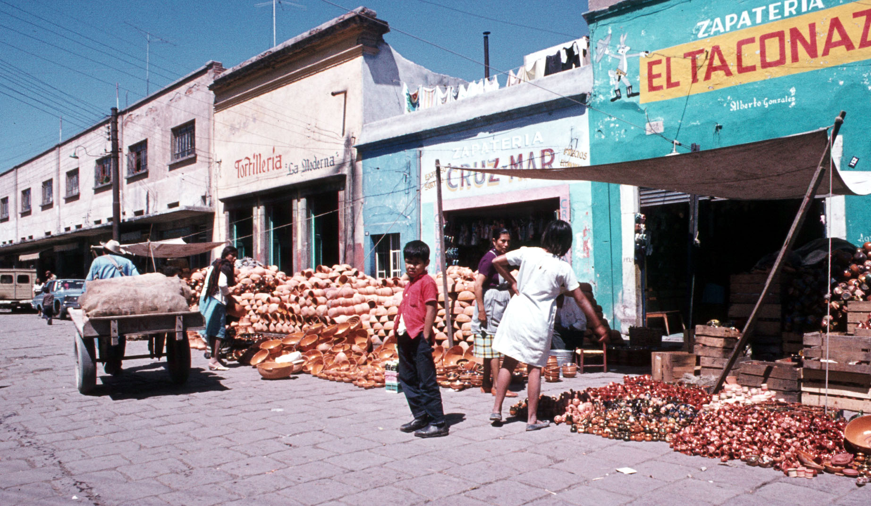
San Luis Potosi, SLP, Mexico

Slide 15
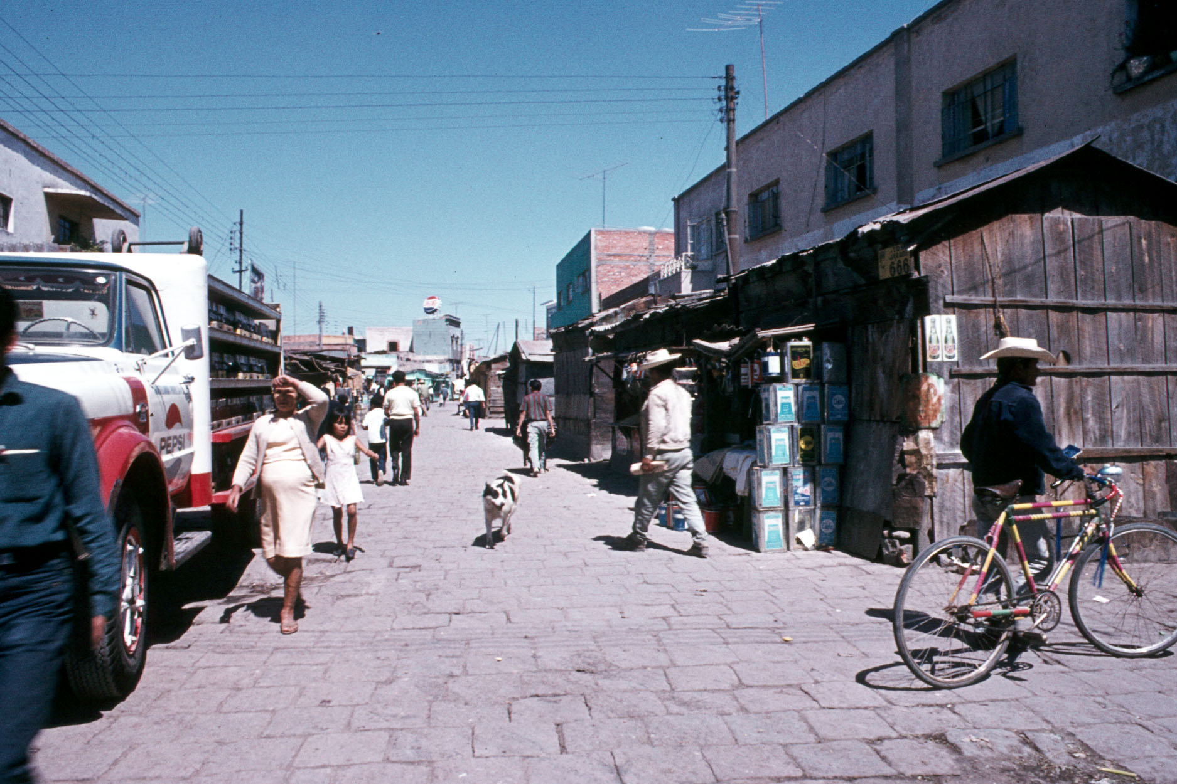
San Luis Potosi, SLP, Mexico

Slide 16
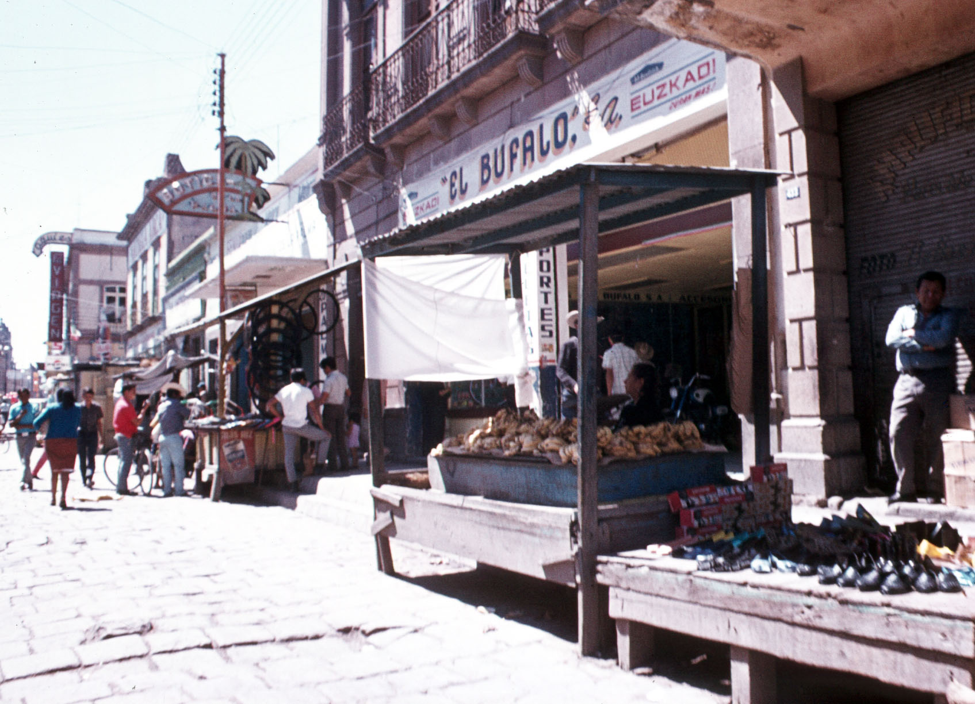
San Luis Potosi, SLP, Mexico

Slide 17
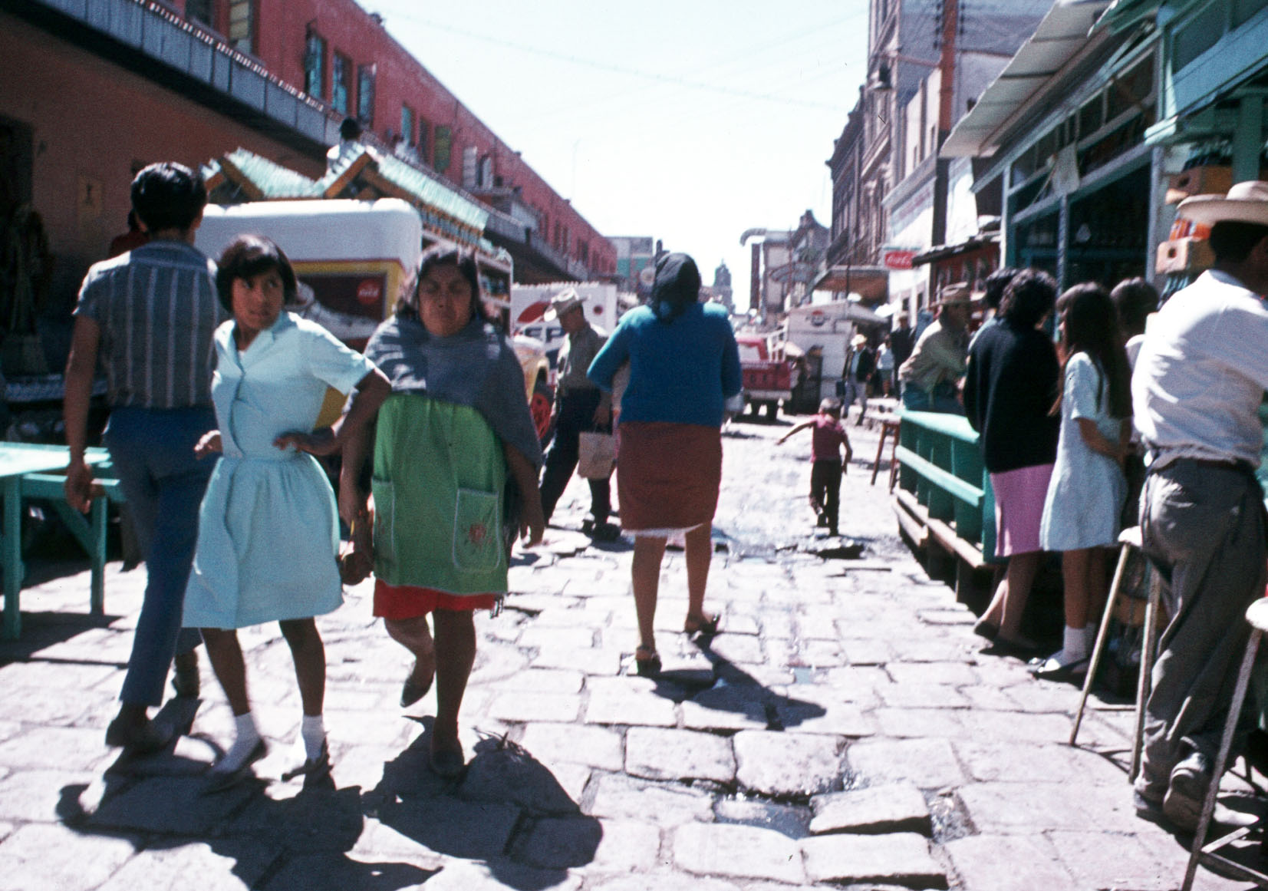
San Luis Potosi, SLP, Mexico

Slide 18
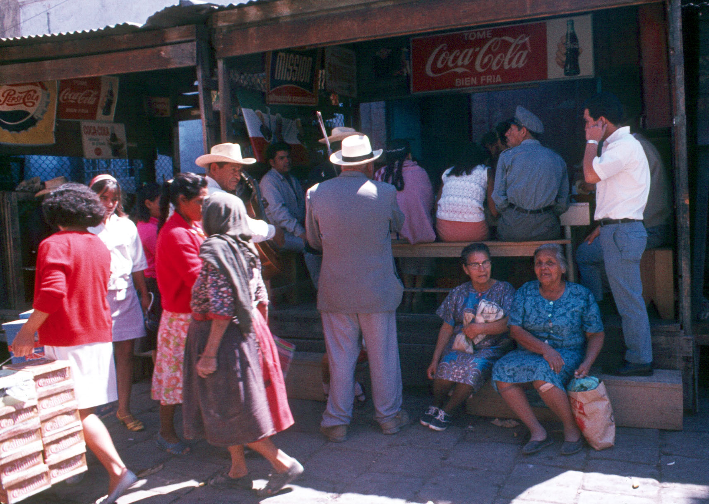
San Luis Potosi, SLP, Mexico

Slide 19
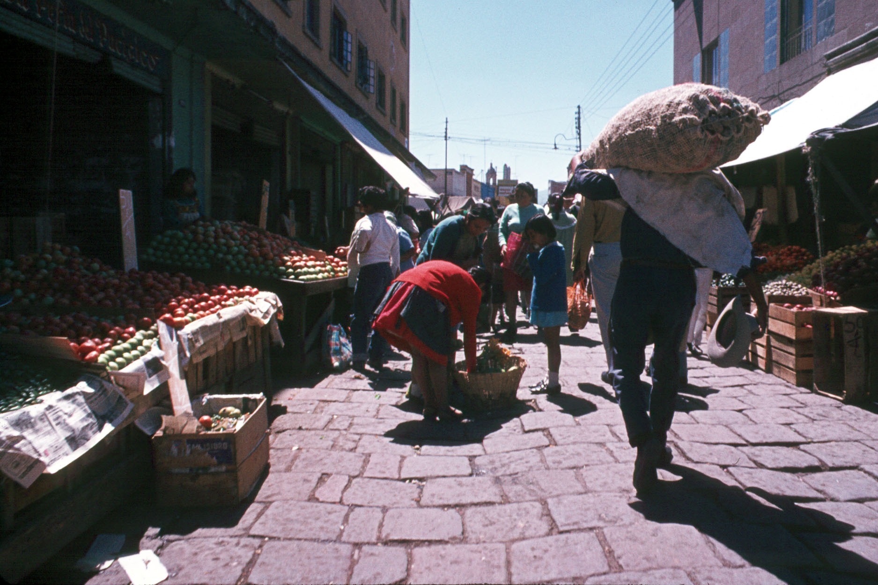
San Luis Potosi, SLP, Mexico

Slide 20
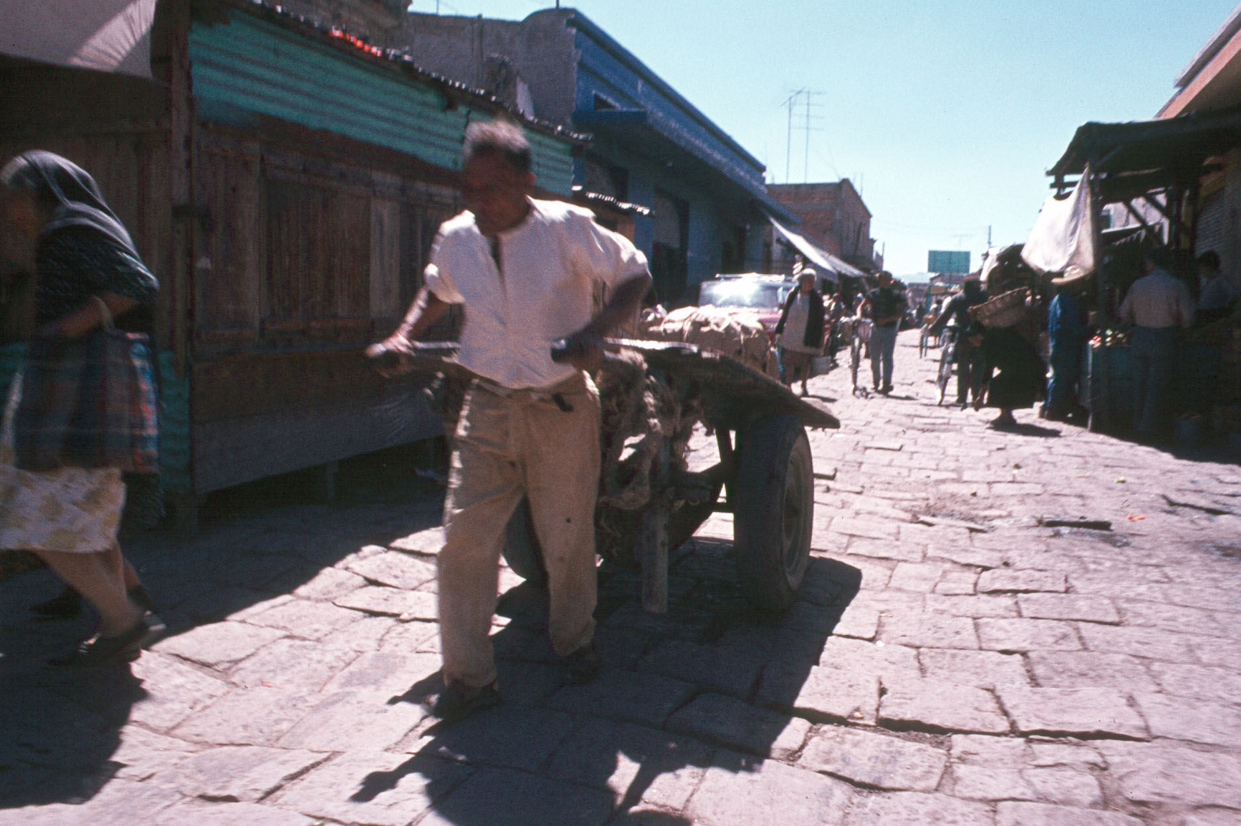
San Luis Potosi, SLP, Mexico

Slide 21
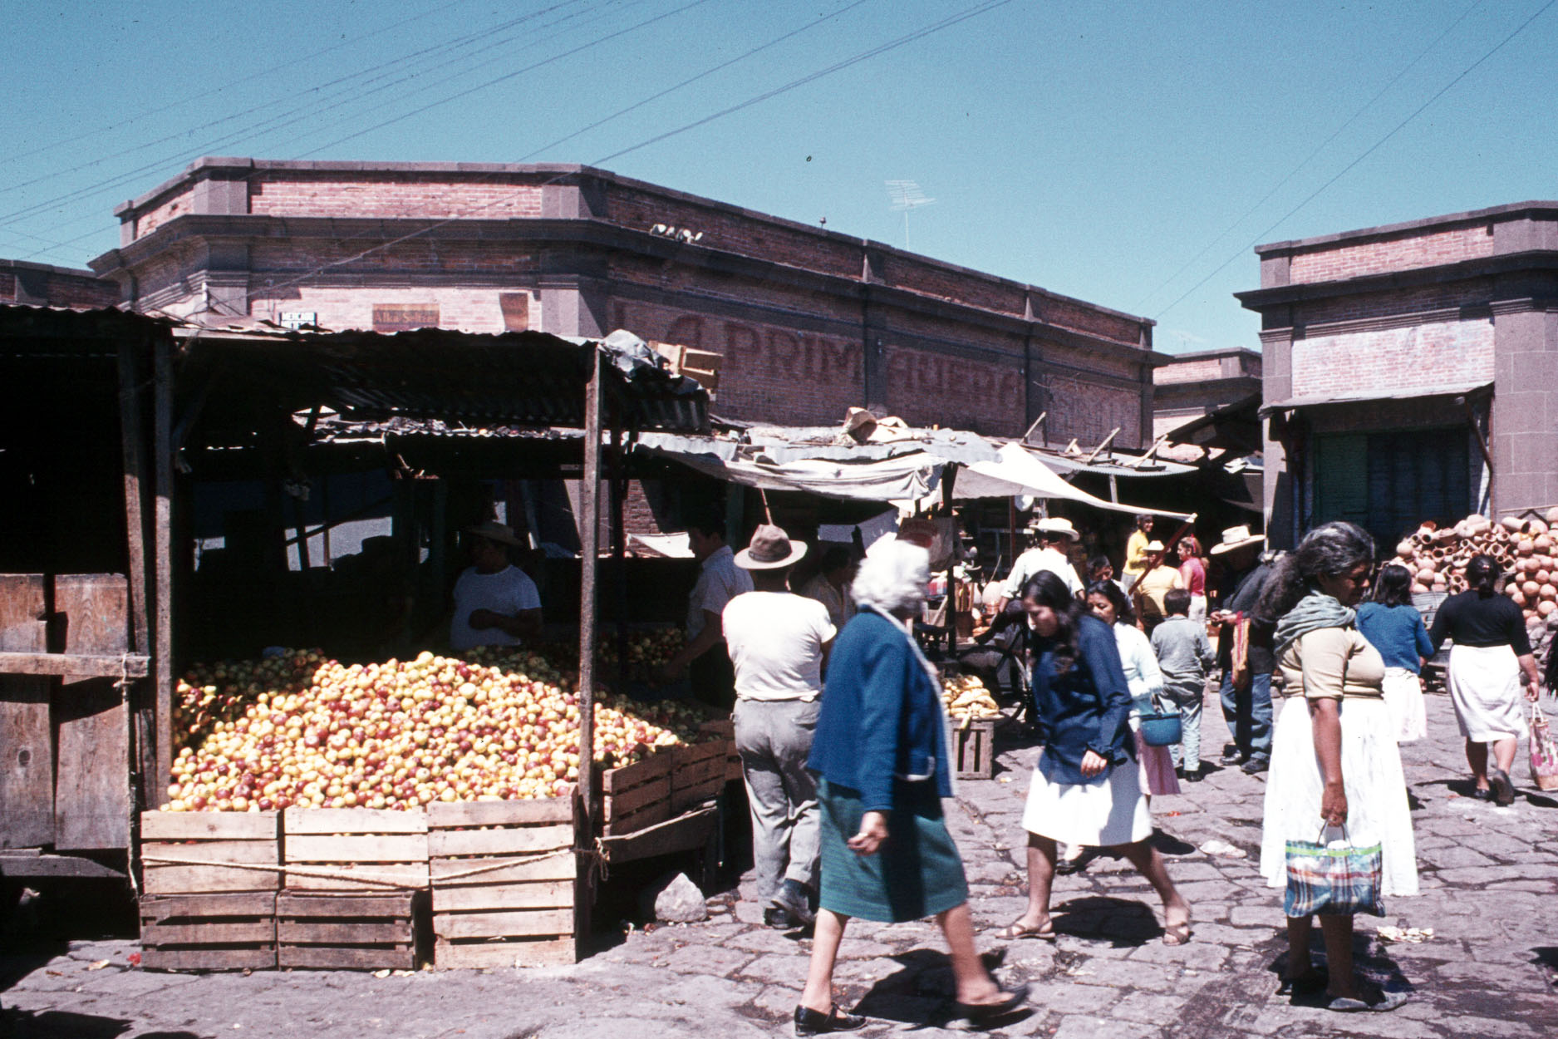
San Luis Potosi, SLP, Mexico

Slide 22
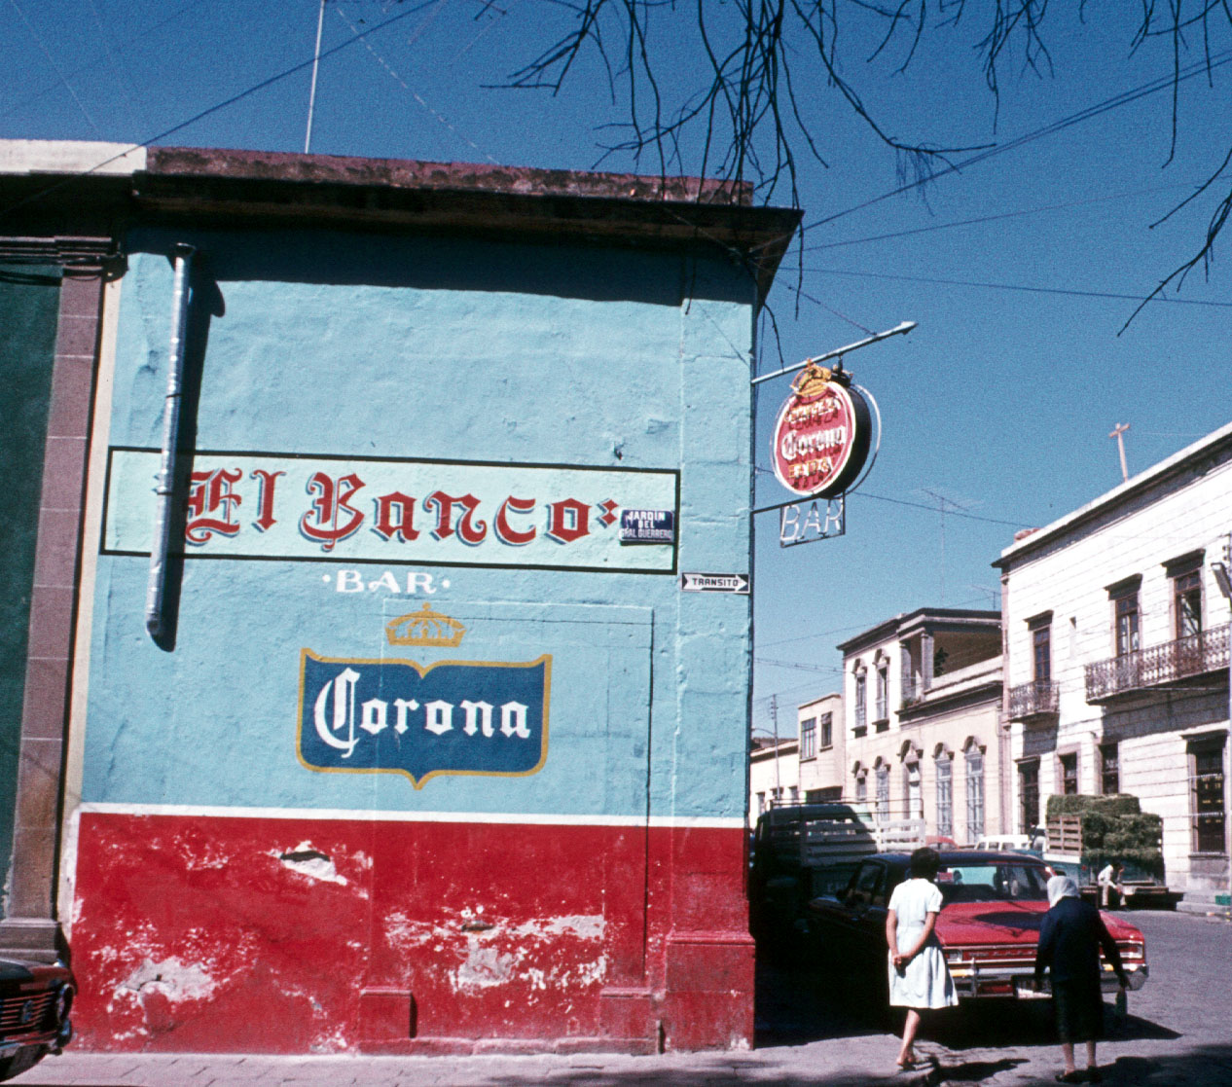
San Luis Potosi, SLP, Mexico

Slide 23
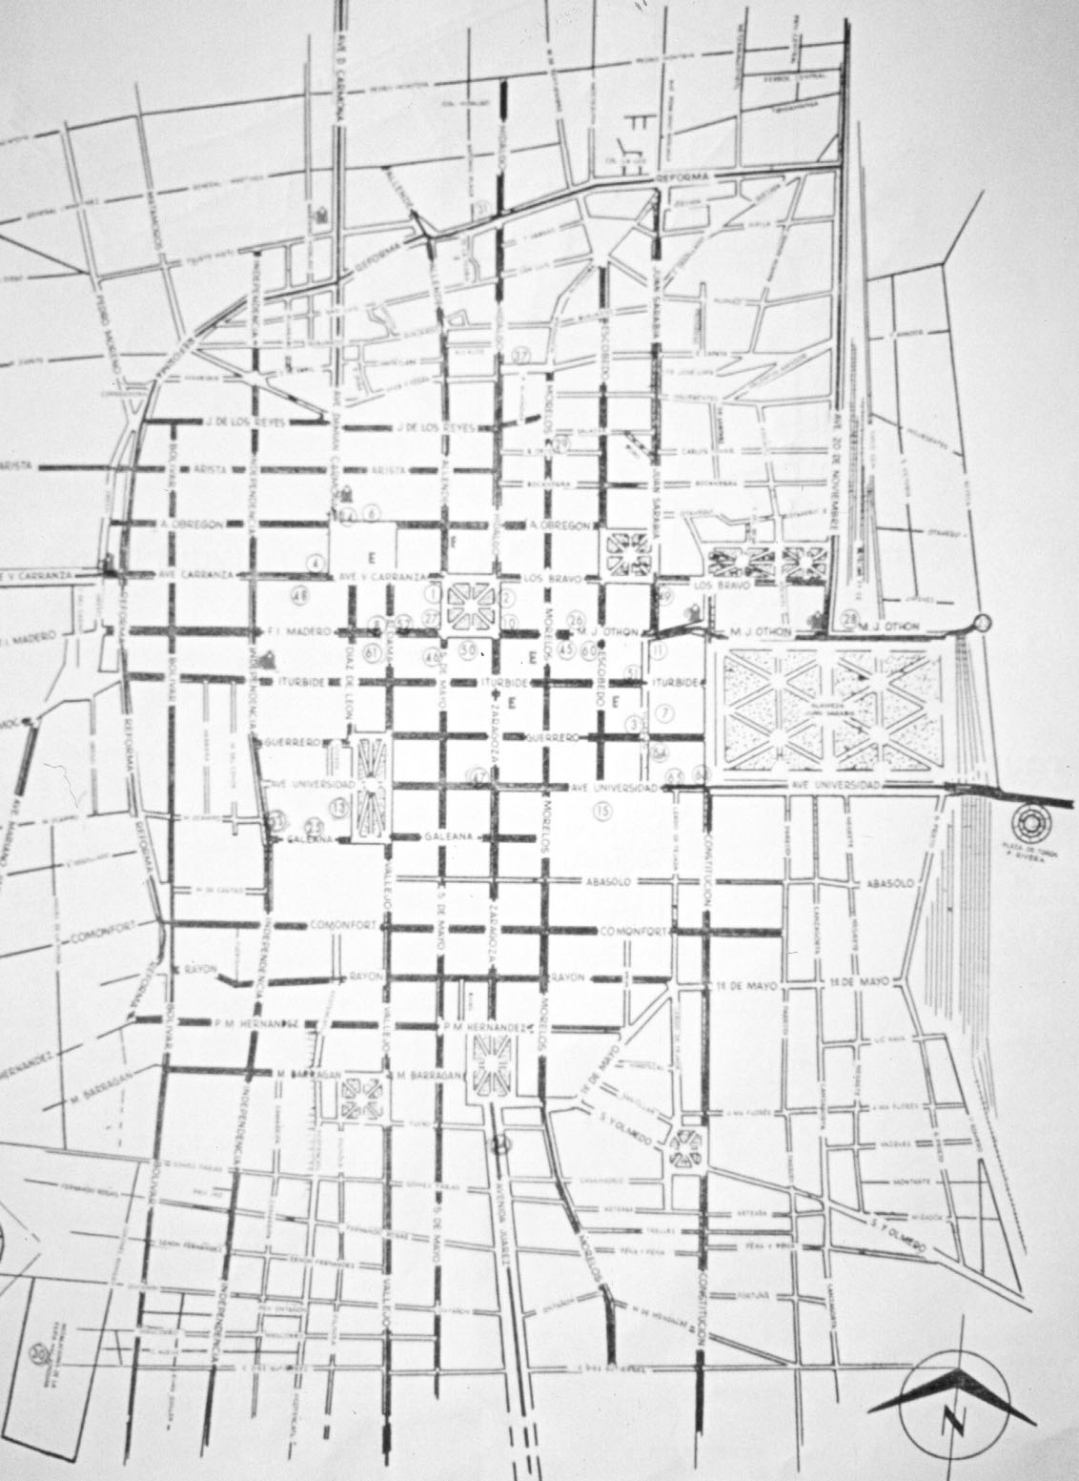
San Luis Potosi, SLP, Mexico

Slide 24
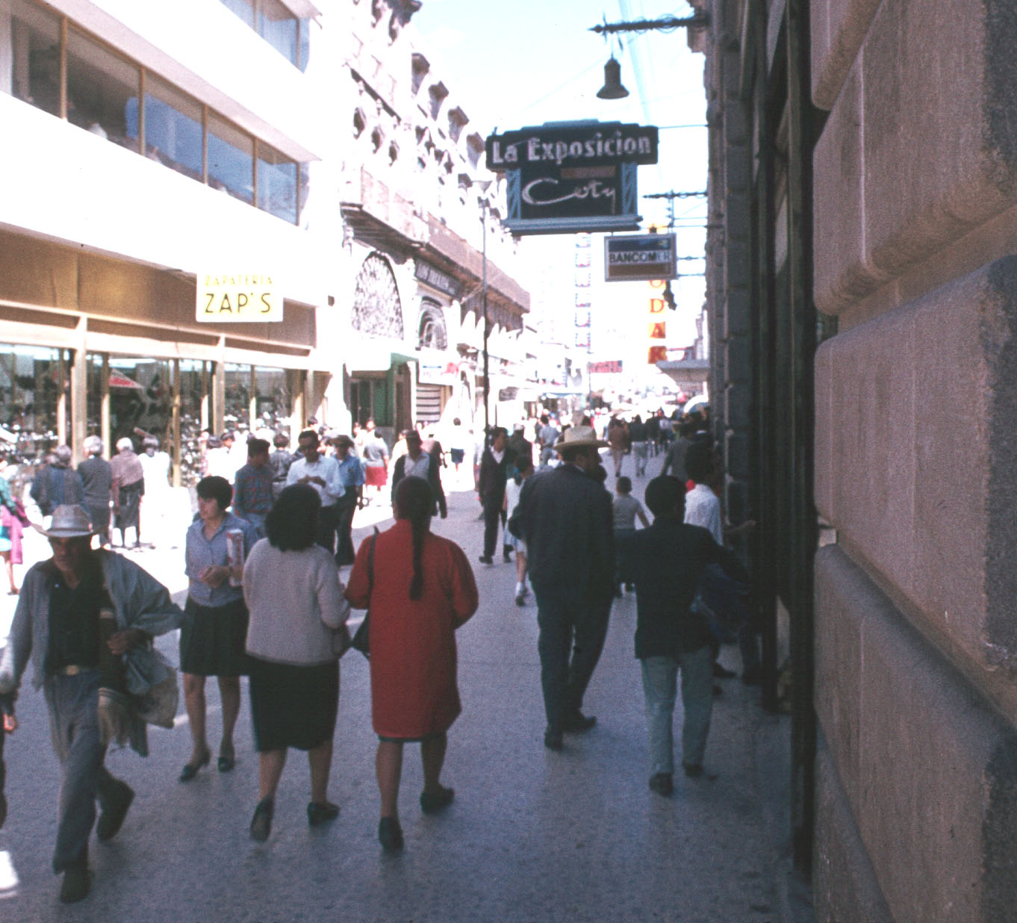
San Luis Potosi, SLP, Mexico

Slide 25
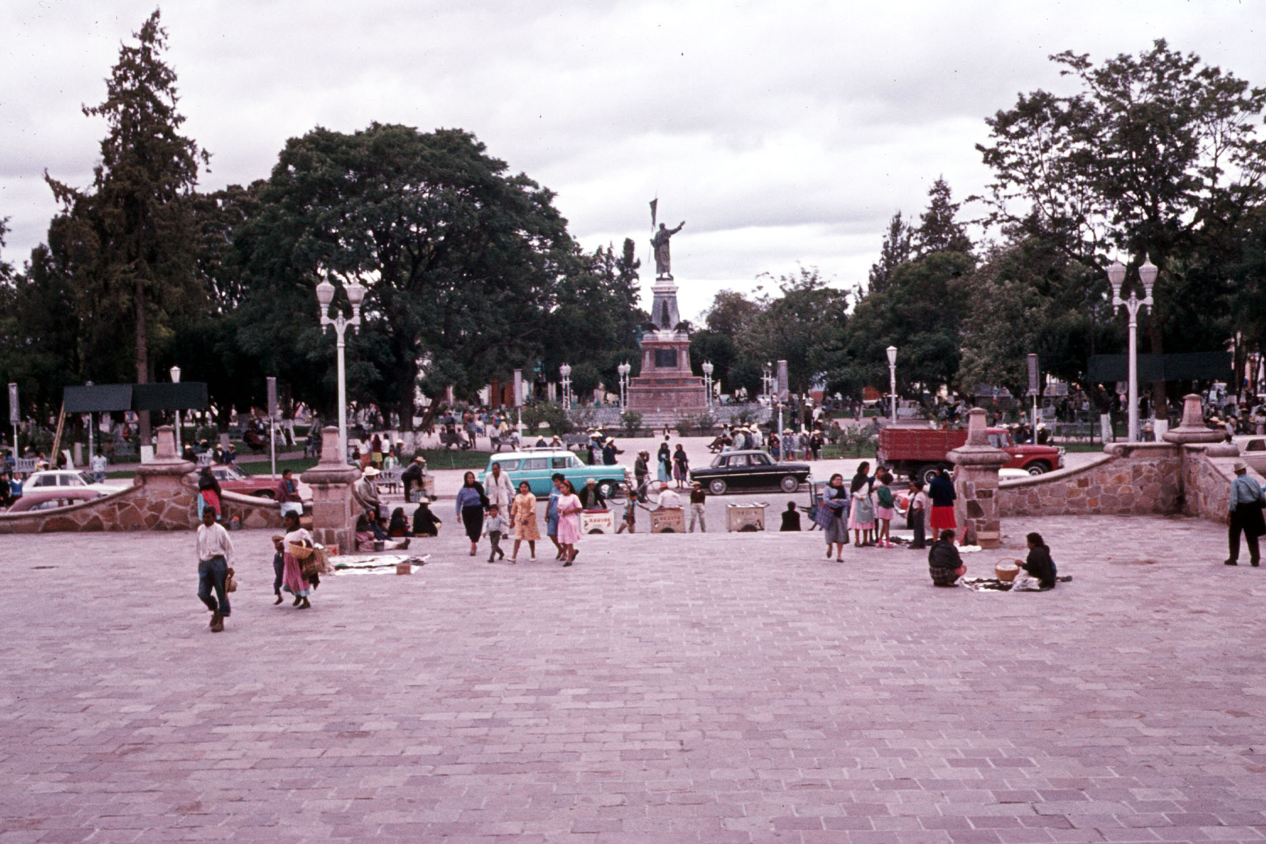
San Luis Potosi, SLP, Mexico

Slide 26
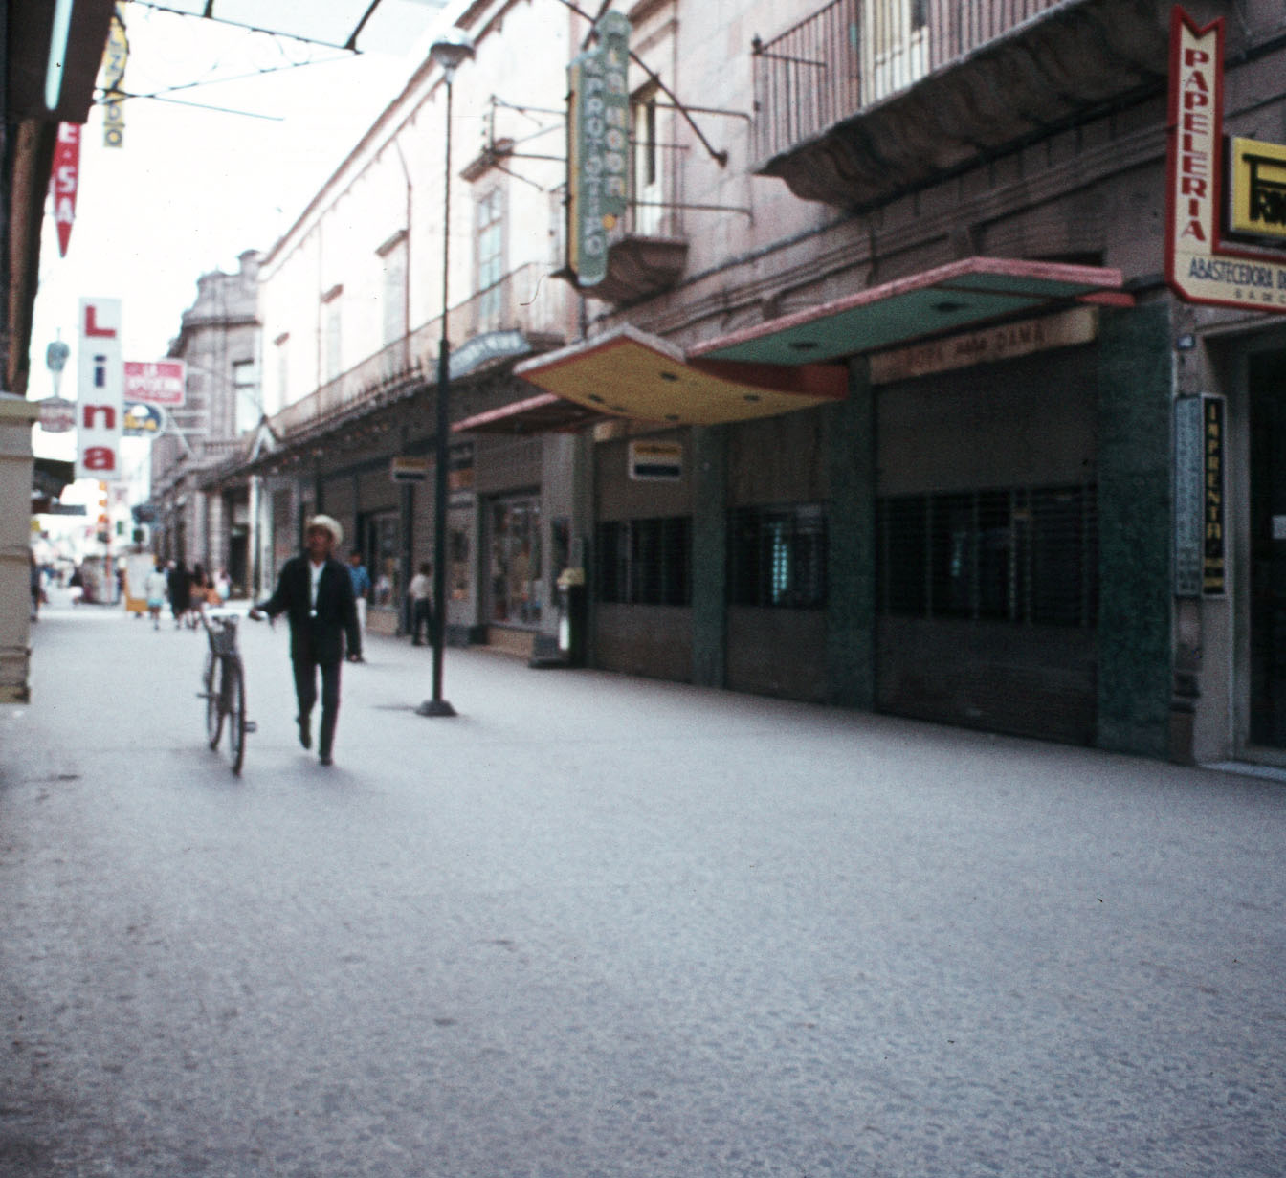
San Luis Potosi, SLP, Mexico

Slide 27
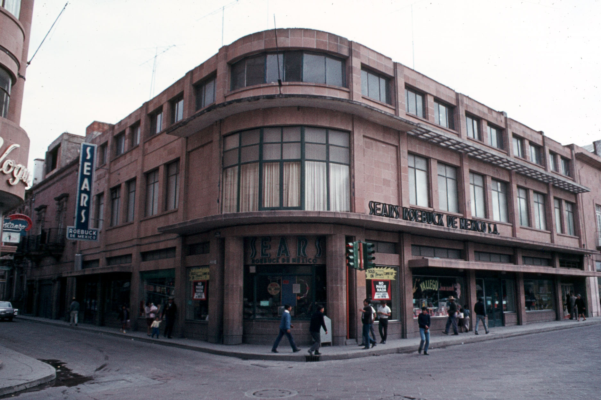
San Luis Potosi, SLP, Mexico

Slide 28
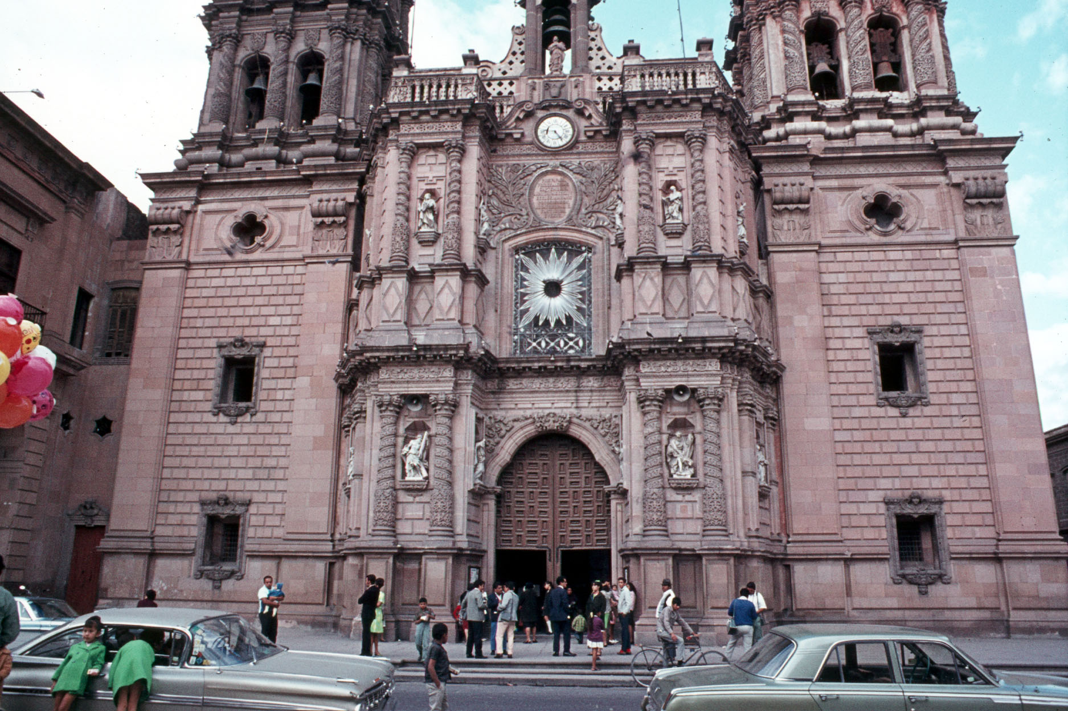
San Luis Potosi, SLP, Mexico

Slide 29
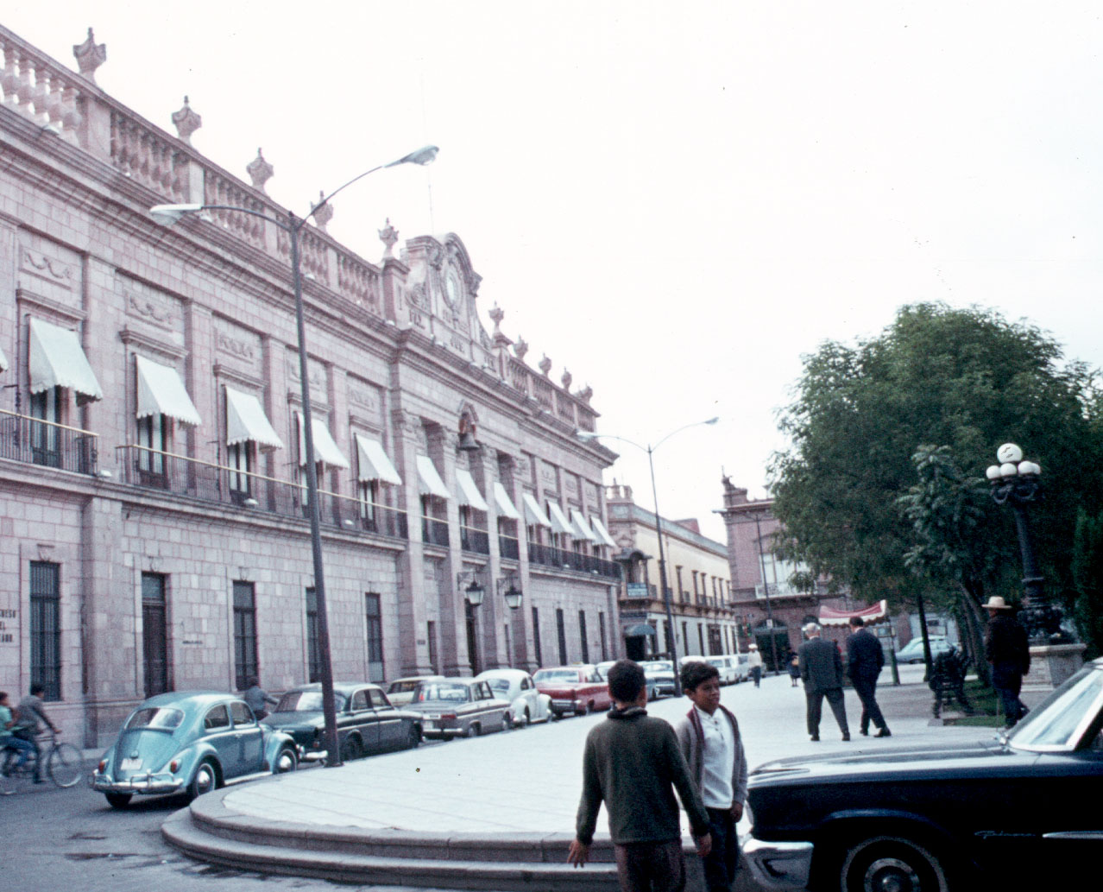
San Luis Potosi, SLP, Mexico

Slide 30
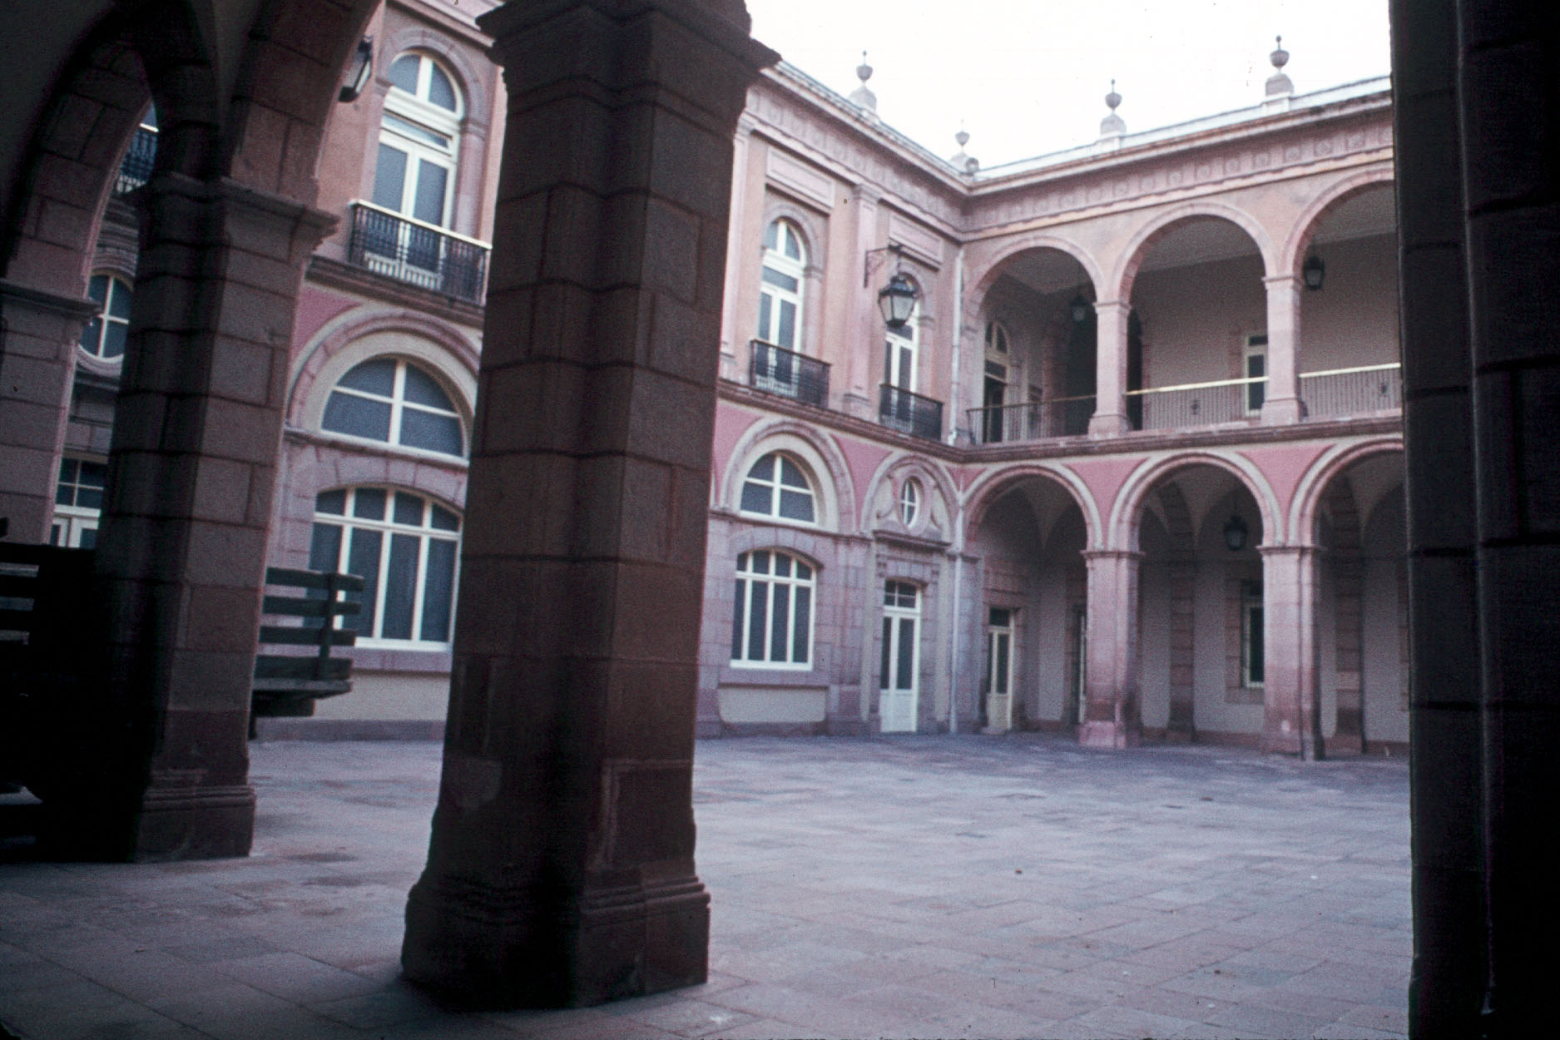
San Luis Potosi, SLP, Mexico

Slide 31
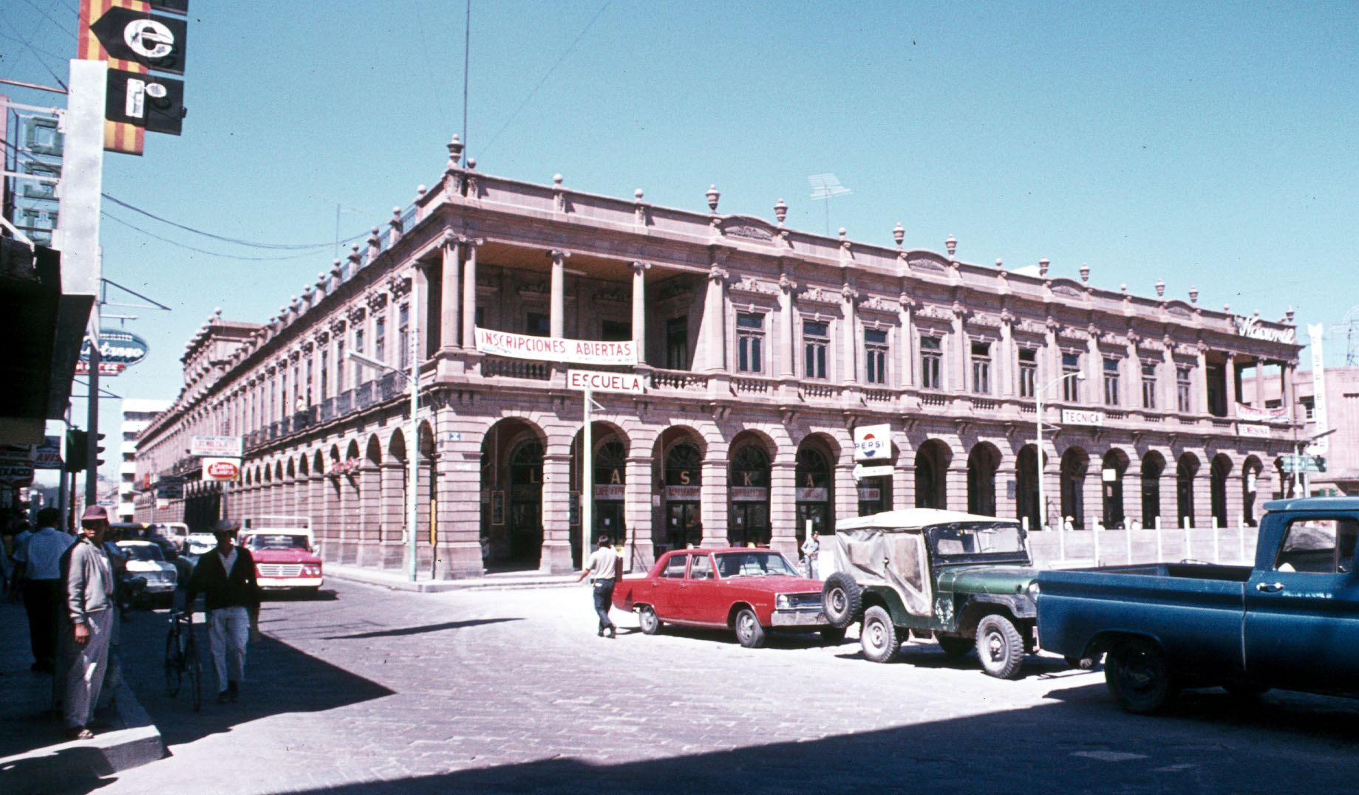
San Luis Potosi, SLP, Mexico

Slide 32
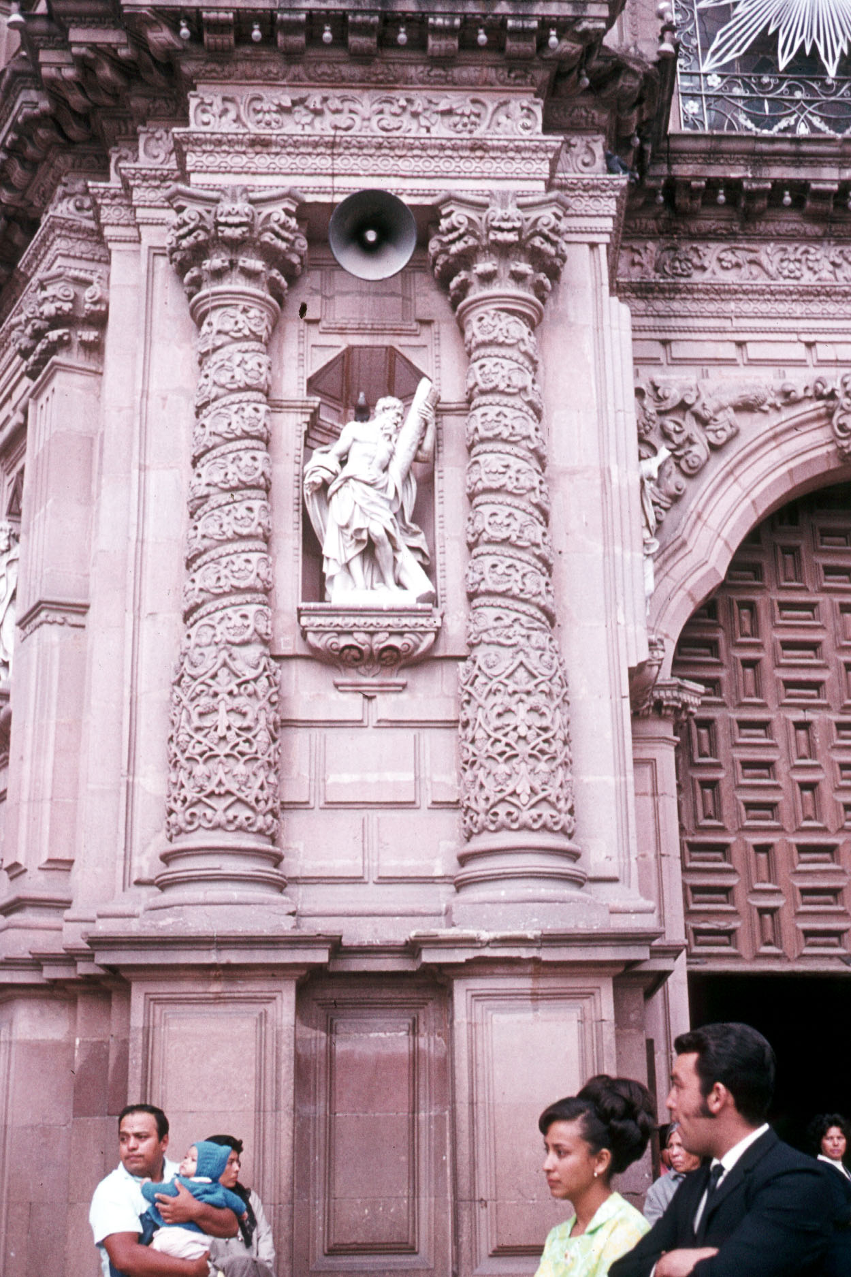
San Luis Potosi, SLP, Mexico

Slide 33
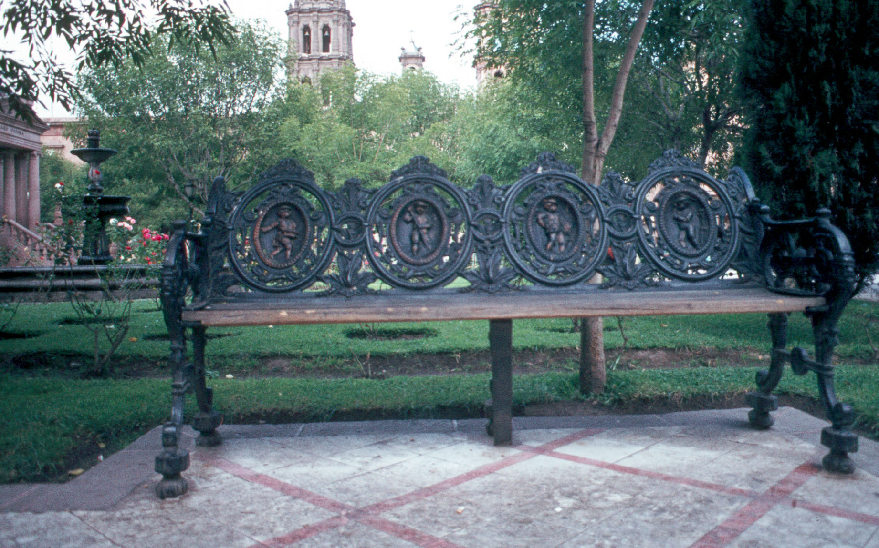
San Luis Potosi, SLP, Mexico

Slide 34
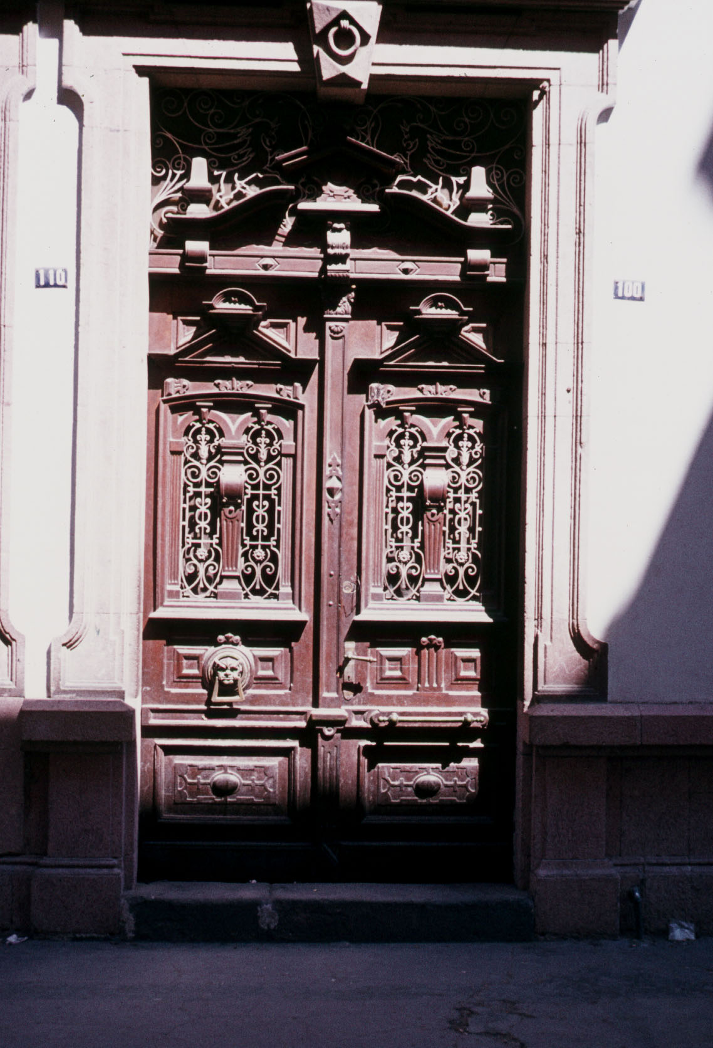
San Luis Potosi, SLP, Mexico

Slide 35
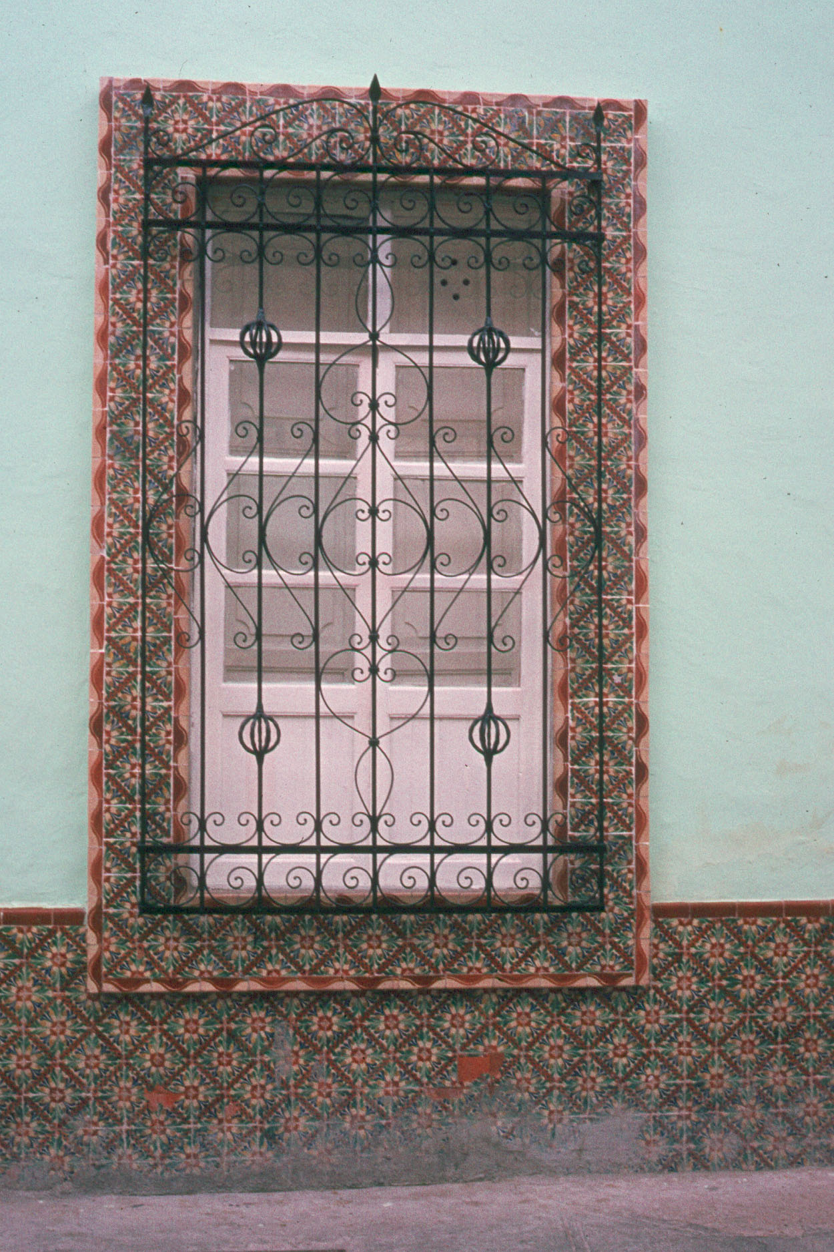
San Luis Potosi, SLP, Mexico

Slide 36
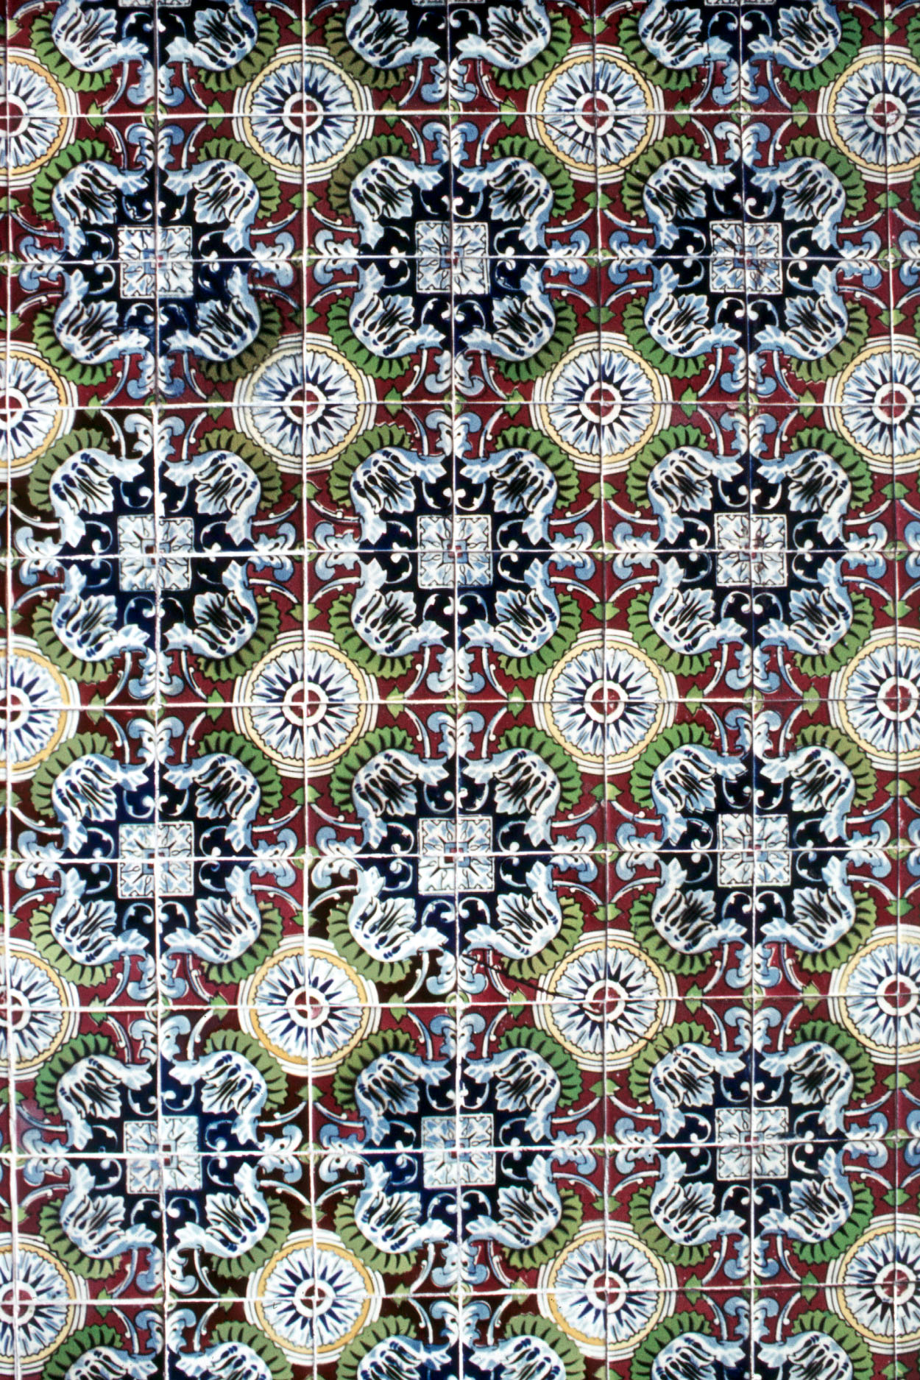
San Luis Potosi, SLP, Mexico

Slide 37

San Luis Potosi, SLP, Mexico

Slide 38
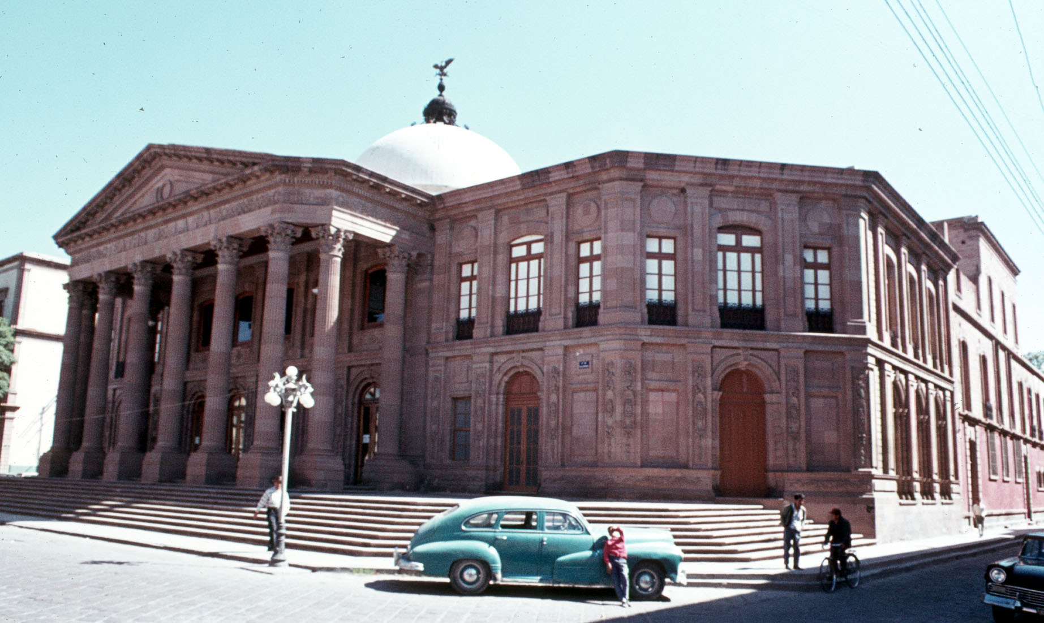
San Luis Potosi, SLP, Mexico

Slide 39
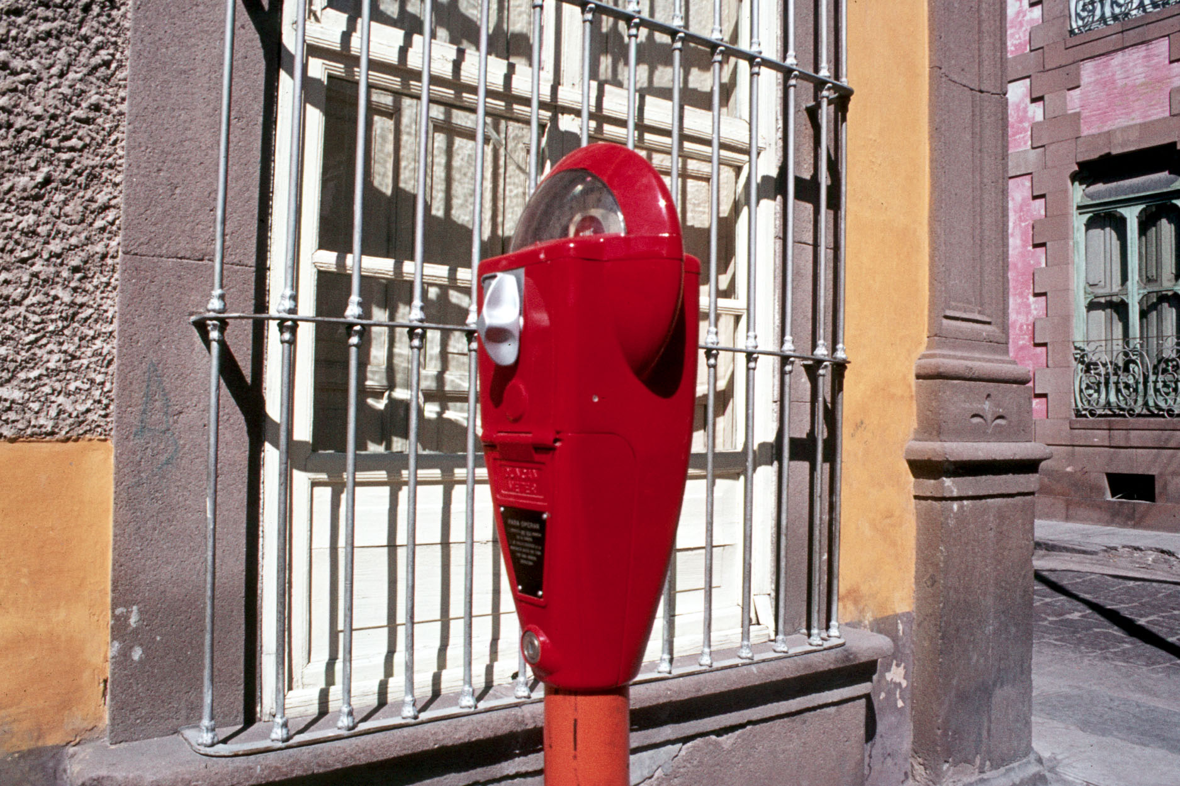
San Luis Potosi, SLP, Mexico

