Slide 1
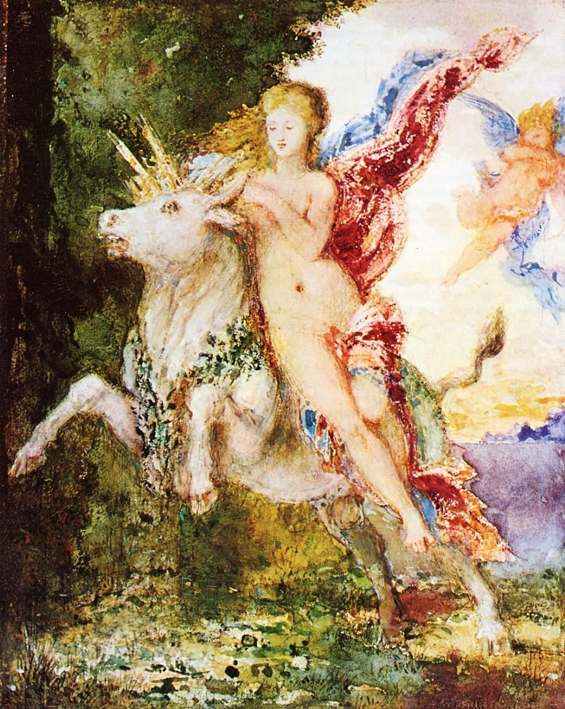
And, once again . . .
Welcome to
Peoples and Cultures
of Europe
Start deck in “Slide Show” mode,
and use your up/down arrow keys and/or
your space bar to advance the slides
University of Minnesota Duluth
Europa and the Bull
Gustave Moreau,
c.1869
Tim Roufs’ © 2010-2024
http://www.d.umn.edu/cla/faculty/troufs/anth3635/

Slide 2
REM
indicates that the materials
are a REMinder
and are thus being repeated . . .
REMinder

Slide 3
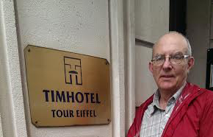
Tim Roufs at the TimHotel Tour Eiffel, Paris
How to sign up for your In-the-News report

Slide 4
A very brief
In-the-News report
is a part of the course.
You only need
to present one news report,
but you should read the reports of your classmates.

Slide 5
A very brief
In-the-News report
is a part of the course.
You only need
to present one news report,
but you should read the reports of your classmates.

Slide 6
In-the-News reports
look something like this . . .

Slide 7
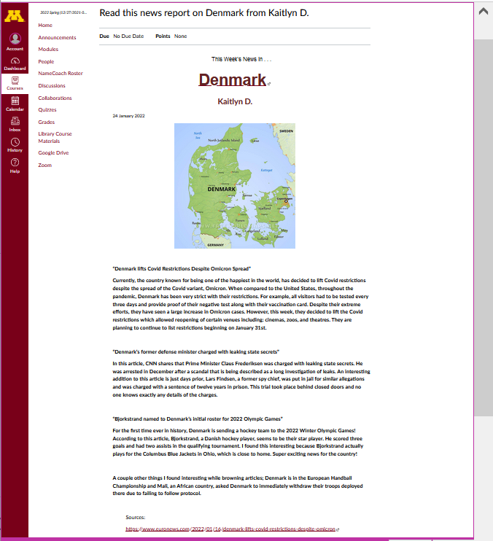

Slide 8
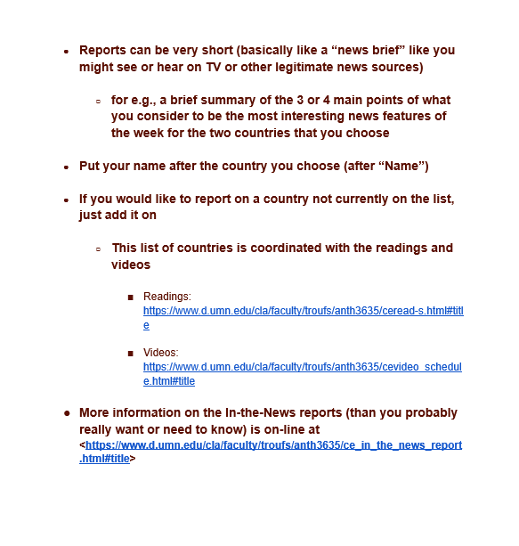






Slide 9
Starting the second week of the semester there will generally be one or two news reports per week.
Detailed information about
the In-the-News assignment is on-line at . . .
<https://www.d.umn.edu/cla/faculty/troufs/anth1095/gc_in_the_news_report.html#title>

Slide 10
Starting the second week of the semester there will generally be one or two news reports per week.
Detailed information about
the In-the-News assignment is on-line at . . .
<https://www.d.umn.edu/cla/faculty/troufs/anth3635/ce_in_the_news_report.html#title>

Slide 11
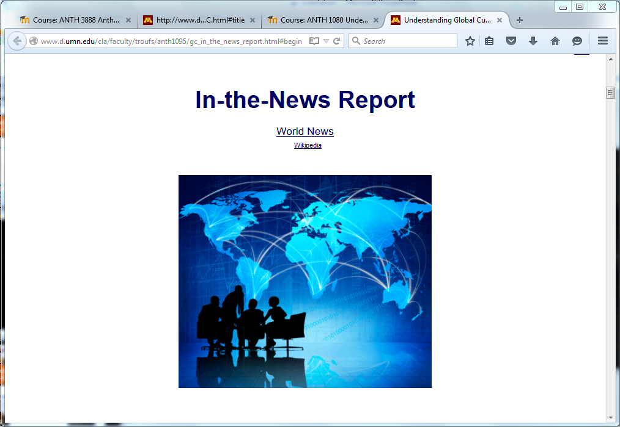
to sign up for your In-the-News report go to . . .

Slide 12
1. Go to your UM Gmail . . .
(you only need to do this once this semester)

Slide 13
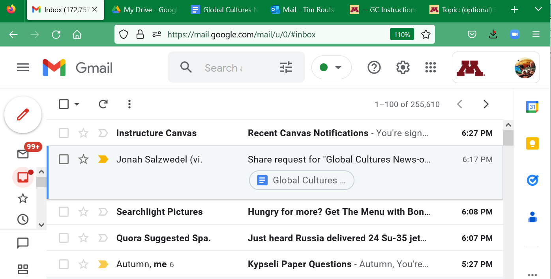
1. UM Gmail

Slide 14
2. Go to your Google Apps Folder on your UM Gmail page . . .

Slide 15

2. Google Apps

Slide 16
3. From your Google Apps menu, click on
the Google Drive icon . . .

Slide 17
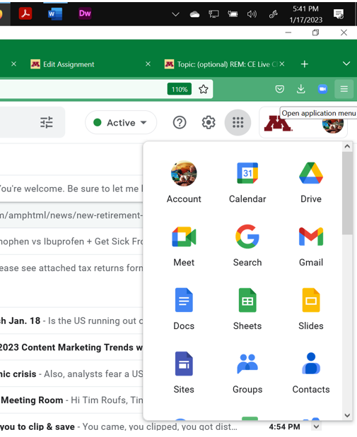
2. Google Drive

Slide 18
That should bring you to the Global Cultures
In-the-News
sign-up sheet link . . .

Slide 19
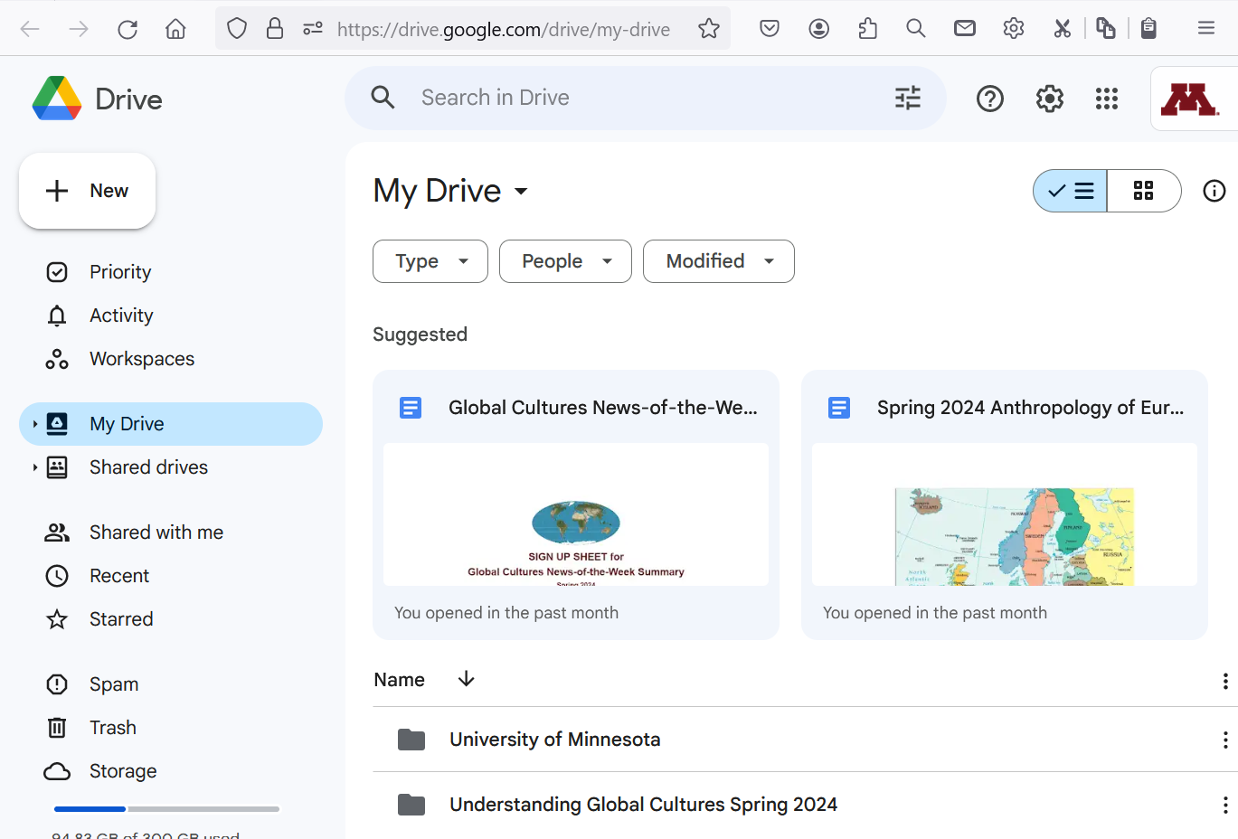


Search (if necessary)
Anthropology of Europe
In-the-News s2024

Slide 20

(if need be)
double-click
on sign-up sheet
and open

Slide 21
your In-the-News
sign-up sheet
will look like this . . .

Slide 22
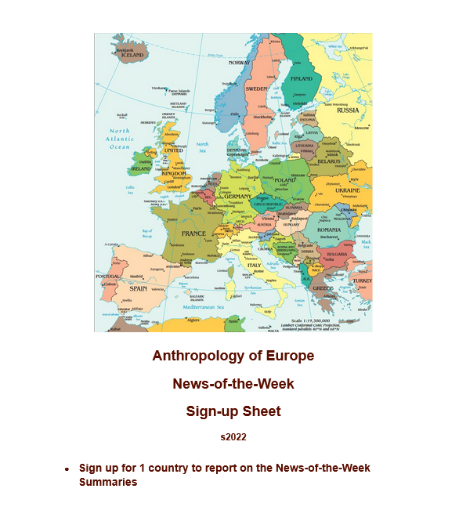


Slide 23
Scroll down for basic information on Home Page . . .

Slide 24
Scroll down for basic information on Home Page . . .

Slide 25
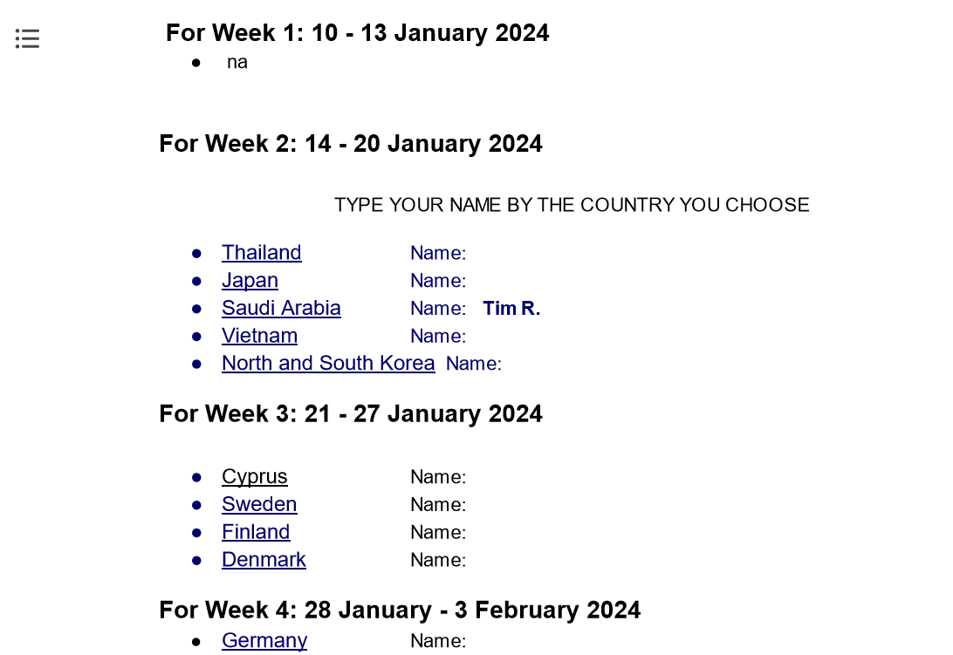
enter your name

Slide 26
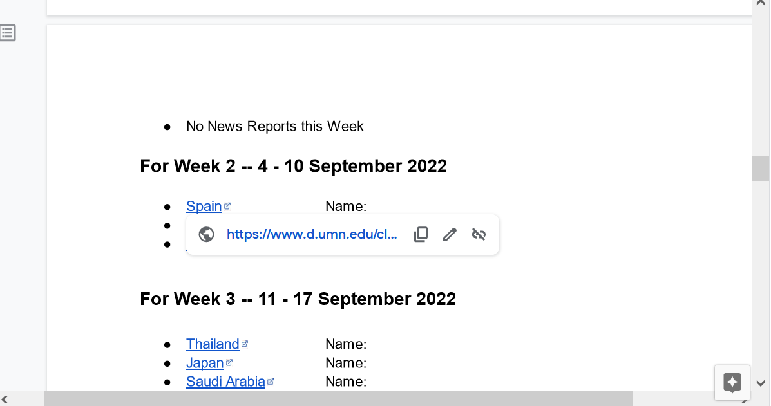
click on country
and URL will drop down
2. click on link
to get to useful links for your country . . .

Slide 27
and your country resources WebPage
will look something like this . . .

Slide 28


Slide 29
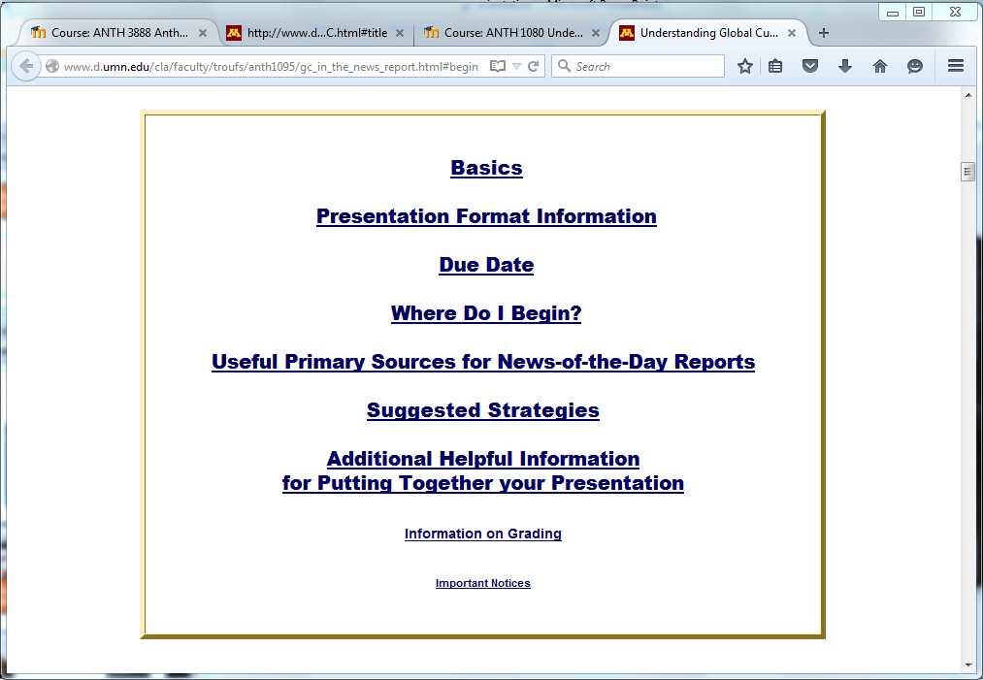
we’ll get to more information on the
In-the-news in-class reports later on . . .

Slide 30
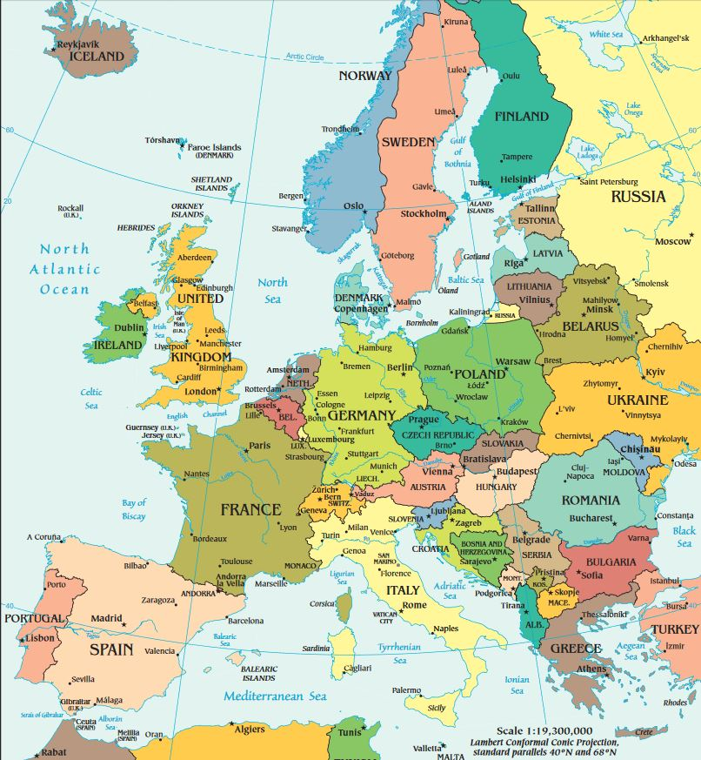
as we go
around Europe . . .

Slide 31

© 2010-2024 Timothy G. Roufs, University of Minnesota Duluth

Slide 32
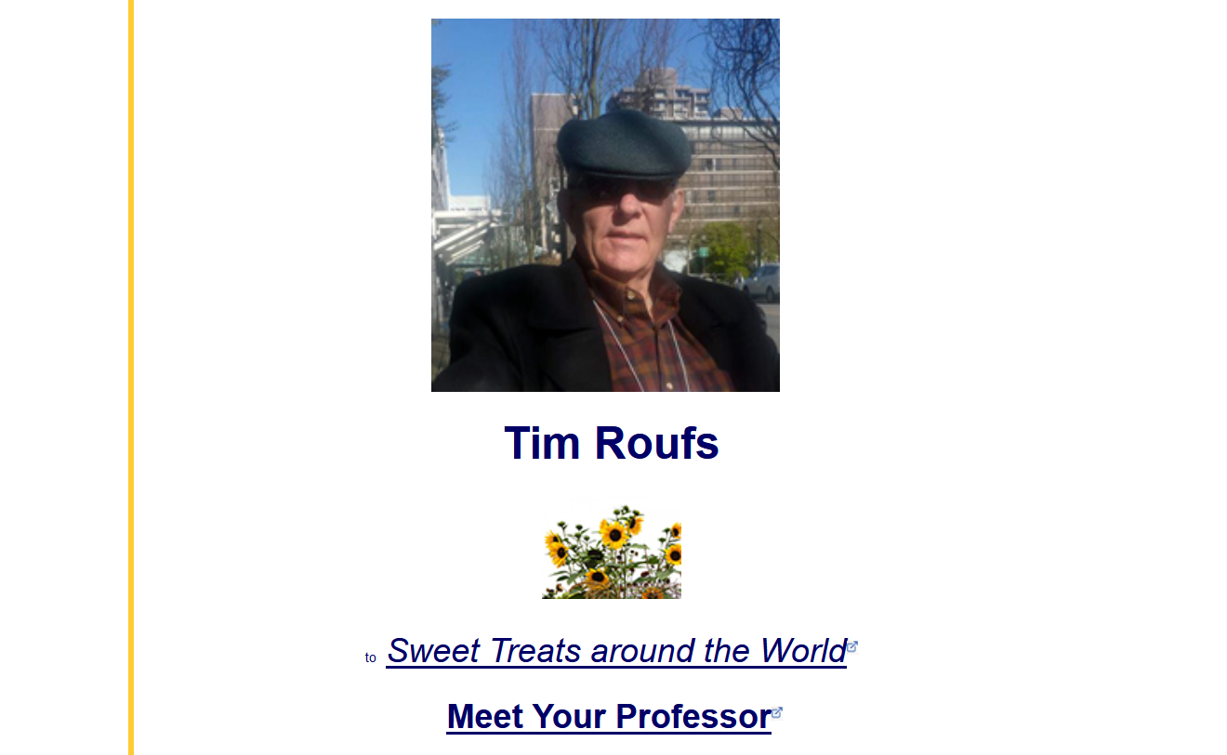
http://www.d.umn.edu/cla/faculty/troufs/index.html
0

