Slide 1
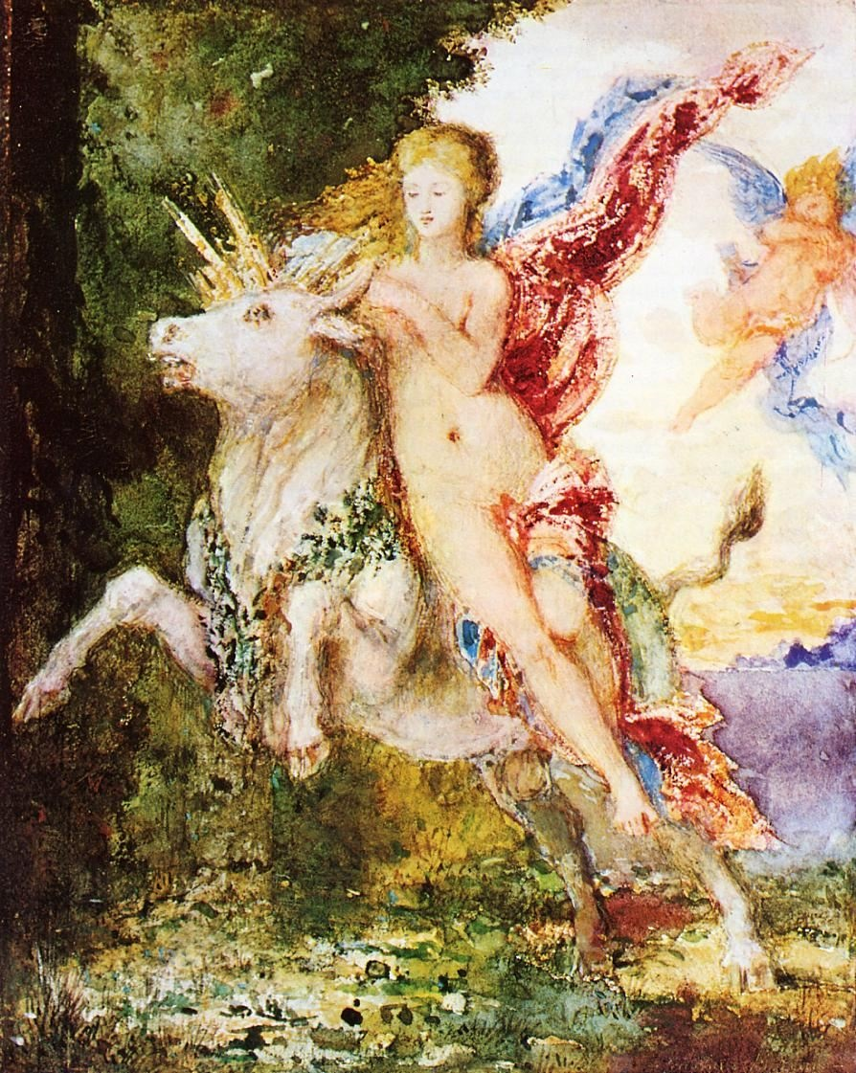
And, once again . . .
Welcome to
Peoples and Cultures
of Europe
Use your up/down arrow keys and/or
your space bar to advance the slides
Europa and the Bull
Gustave Moreau,
c.1869
University of Minnesota Duluth
Tim Roufs’ © 2010-2024
http://www.d.umn.edu/cla/faculty/troufs/anth3635/

Slide 2
REM
indicates that the materials
are a REMinder
and are thus being repeated . . .
REMinder

Slide 3
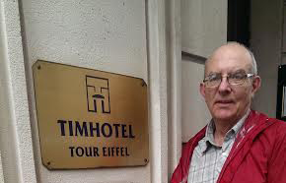
Welcome to
Anthropology of Europe
Tim Roufs at the TimHotel Tour Eiffel, Paris

Slide 4
This will be a great course . . .
you will see . . .
Tim Roufs at the TimHotel Tour Eiffel, Paris

Slide 5
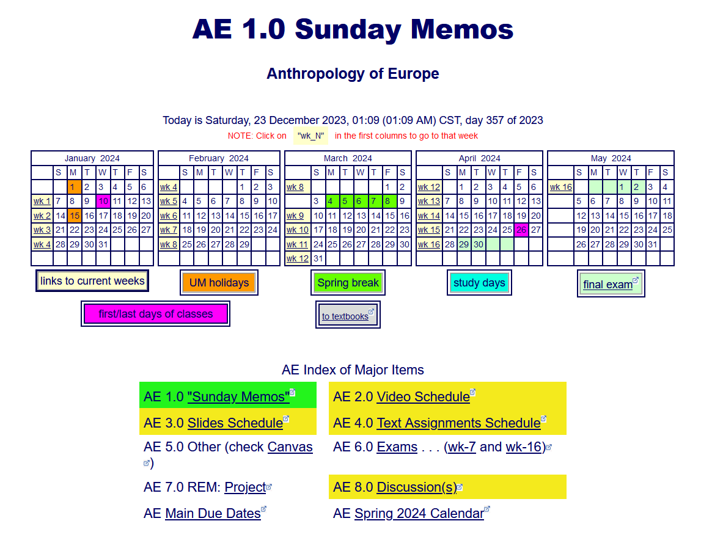
First thing . . .
go to your Week 1
“Sunday Memo”
and check it out . . .

Slide 6
How do you find
the “Sunday Memos”
in the first place?

Slide 7
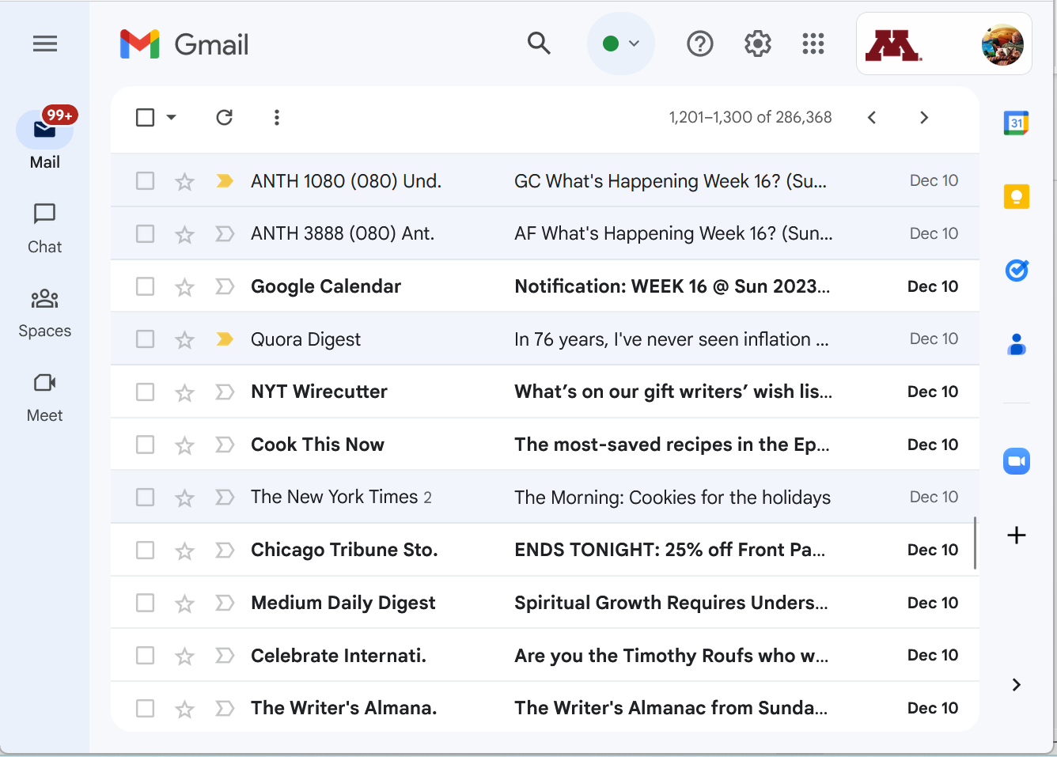


Your “Sunday Memos”
will appear in your
UM Gmail account . . .
(something like this)

Slide 8
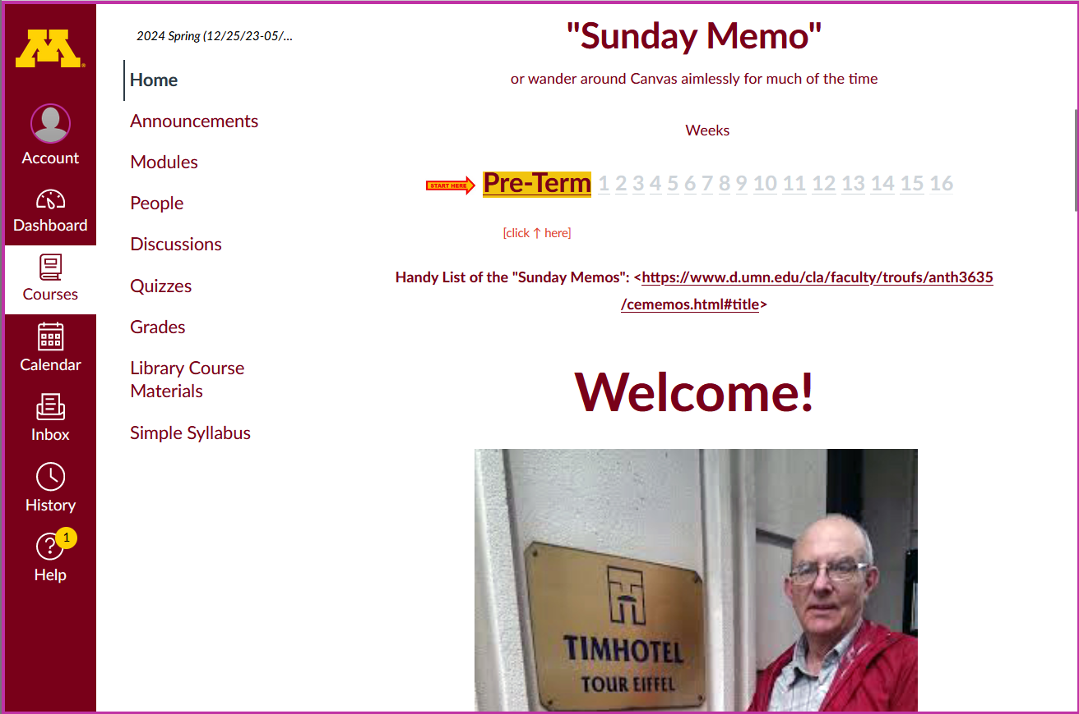
“Sunday Memos”
Your “Sunday Memos”
will also appear on your
Canvas “Home” page . . .

Slide 9
“Sunday Memo” Week 1
1

Slide 10
“Sunday Memo” Week 1
scroll up
1

Slide 11
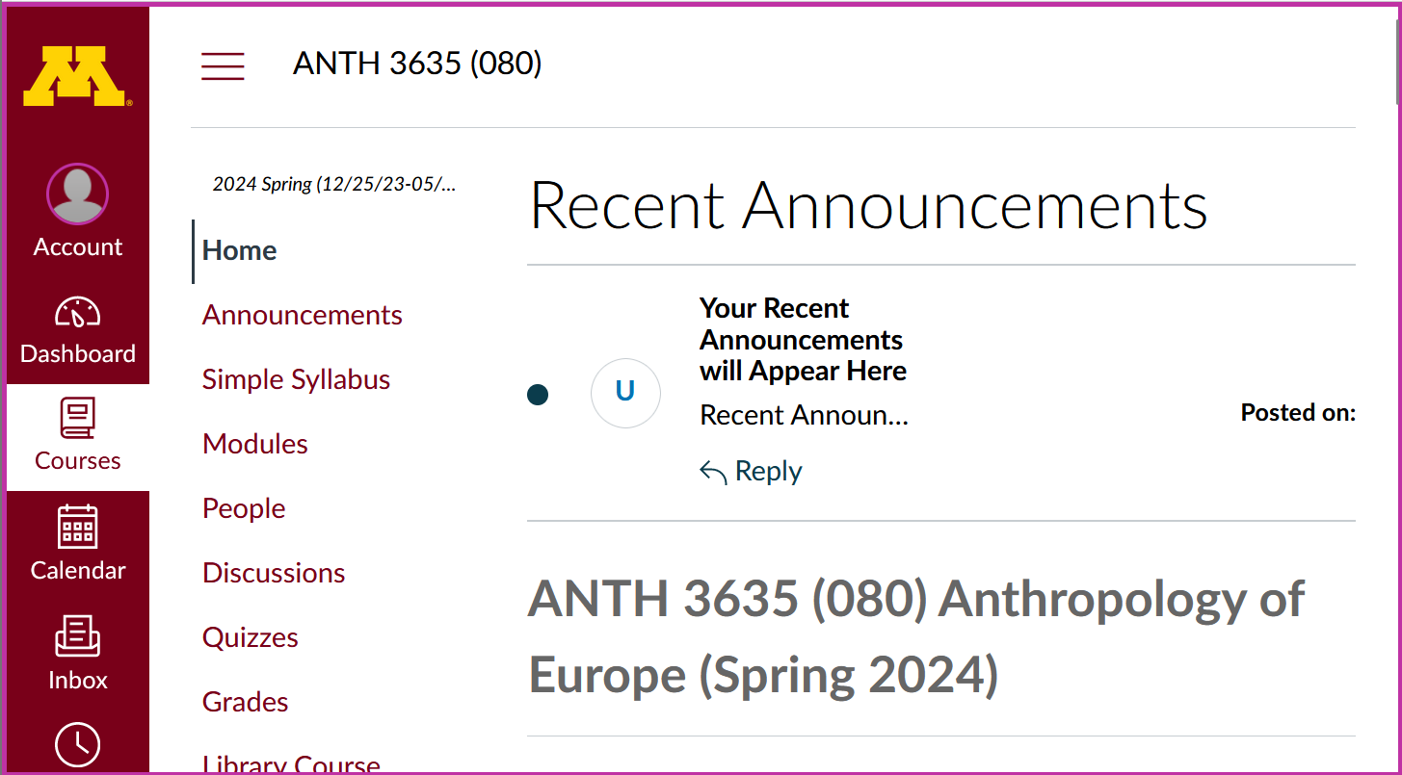
And in your “Announcements” Folder
“Sunday Memos”
Recent Announcements Window.
And your “Sunday Memos”
will also appear on your
Canvas “Home” page at the top . . .

Slide 12
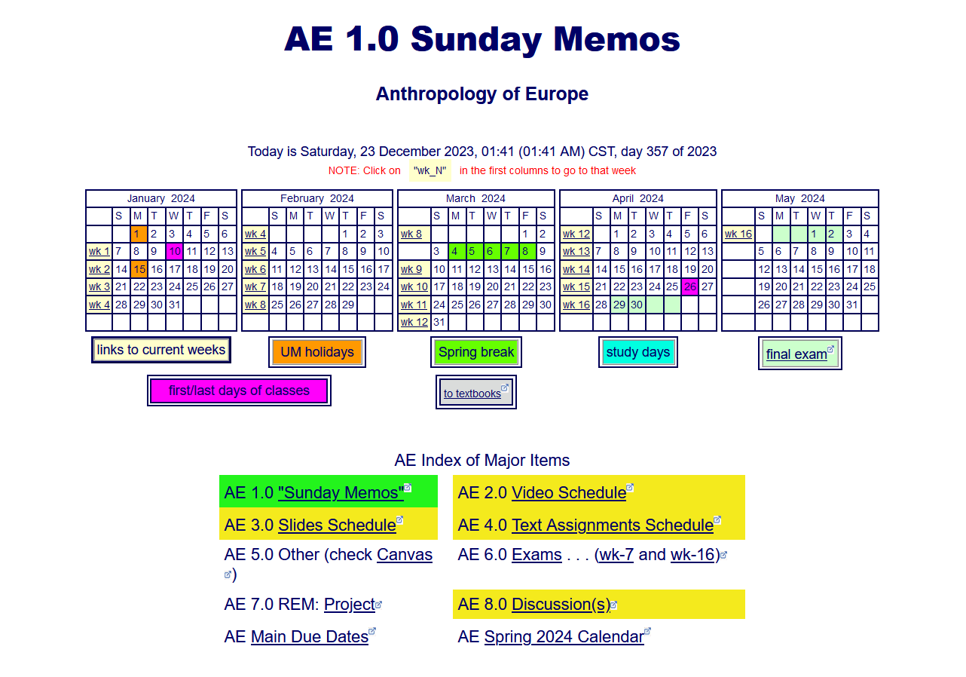
. . . and on a WebPage index

Slide 13
scroll down

Slide 14
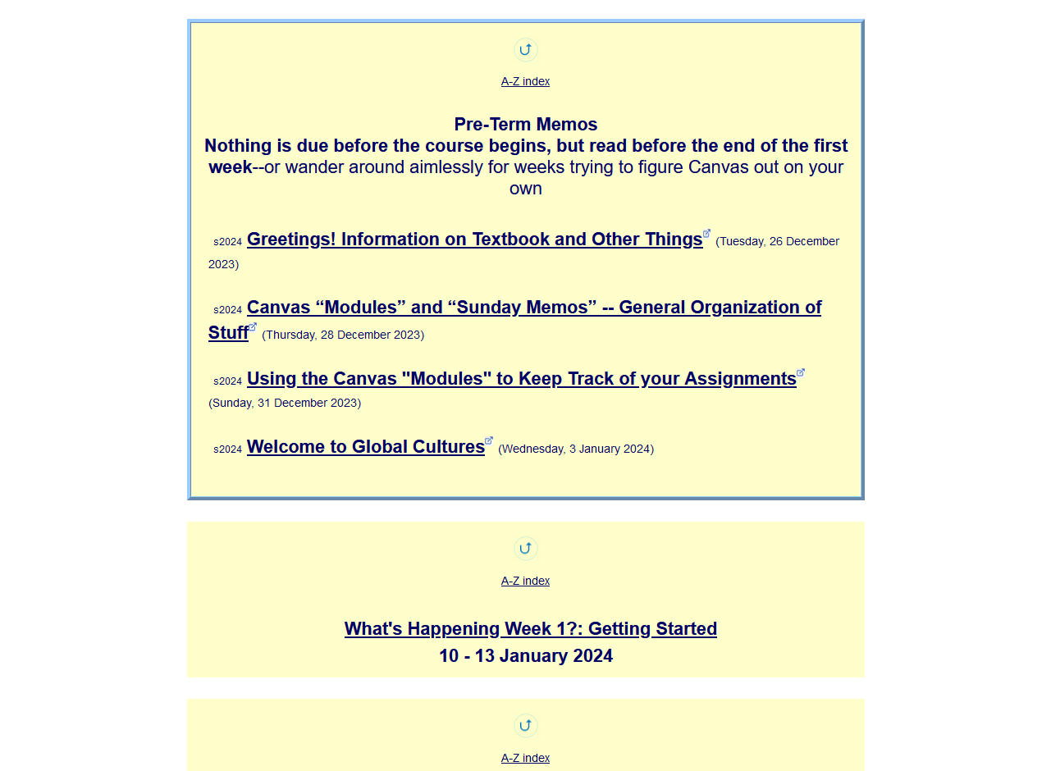

open the
Week 1 “Sunday Memo”

Slide 15
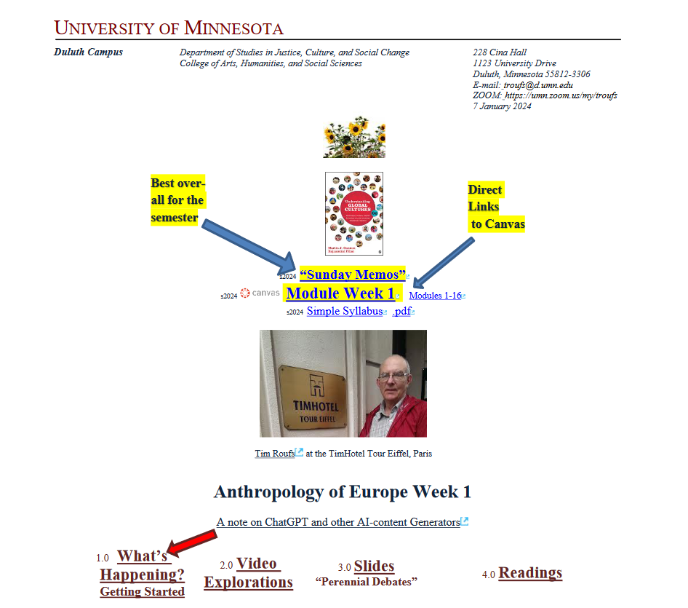
it looks like this . . .

Slide 16
it looks like this . . .
check out the memo
Generally speaking,
the “Sunday Memos”
are the best place to find out
“What’s Happening”
for the week

Slide 18

(if you are not already in Canvas)
Go to your
course management site
and check it out . . .

Slide 19
How do you find your
folder?

Slide 20
Further instructions follow,
but if you want,
and your browser permits,
clicking on the URL that follows
in the next slide
will take you to your Canvas home . . .
(your browser may require that you double-click)
There is another link at the end of this program

Slide 21
https://canvas.umn.edu
(your browser may require that you double-click)
If your browser does not allow you to click on the above URL just enter it in your browser window . . .
Continue on here for further instructions . . .
There is another link at the end of this program

Slide 22
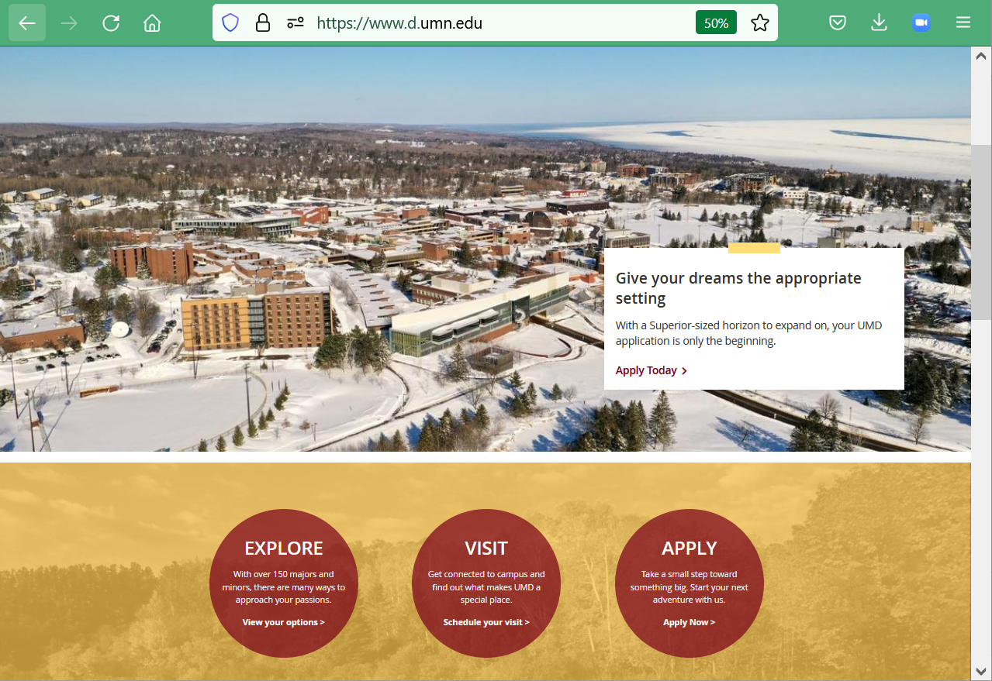
or enter:
canvas.umn.edu
here

Slide 23
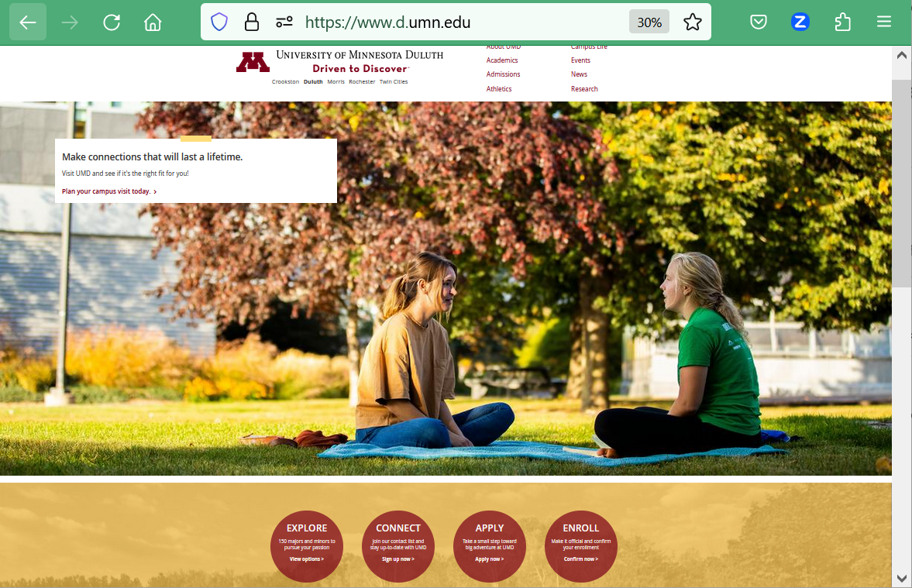
or enter:
canvas.umn.edu
here

Slide 24

or enter:
canvas.umn.edu
here

Slide 25
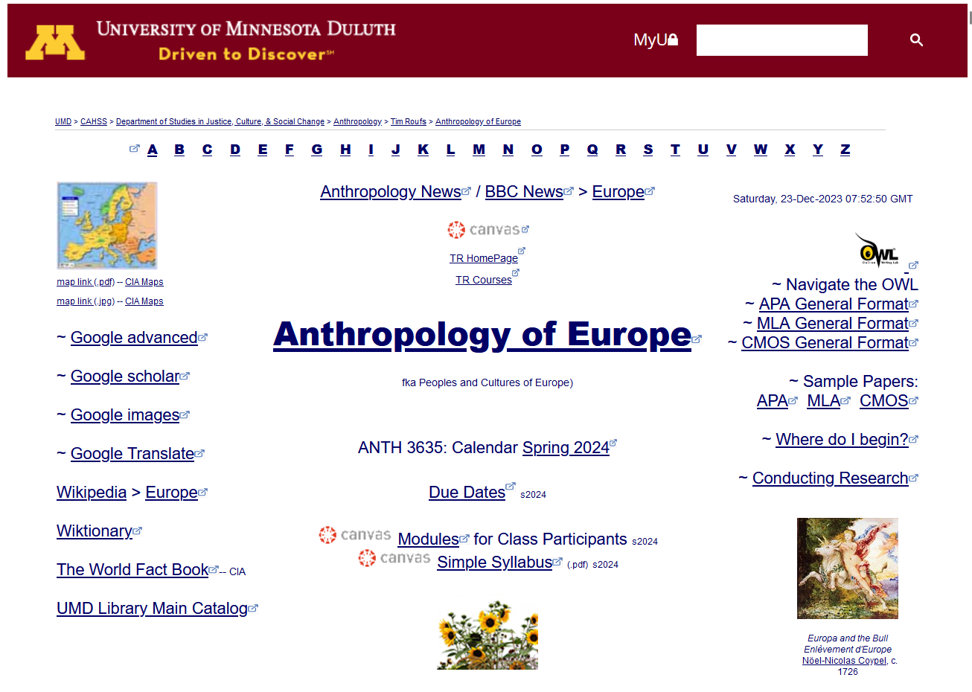
or Click links like this

Slide 26
You may also access your Canvas folder from any of the many
course index and content
web pages . . .

Slide 27
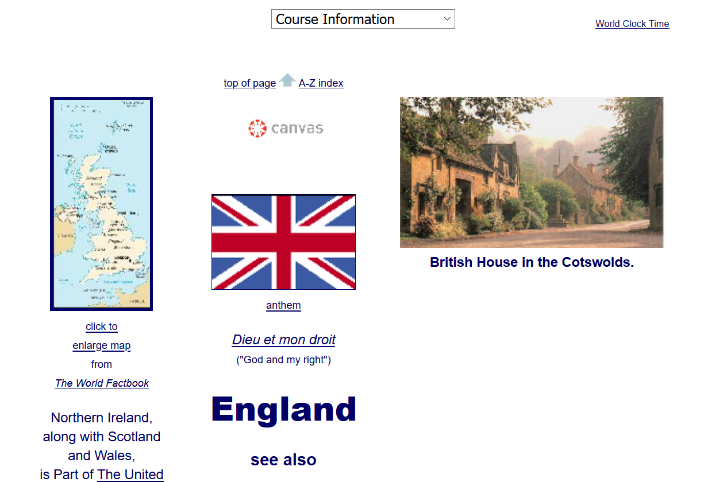
Click Here

Slide 28
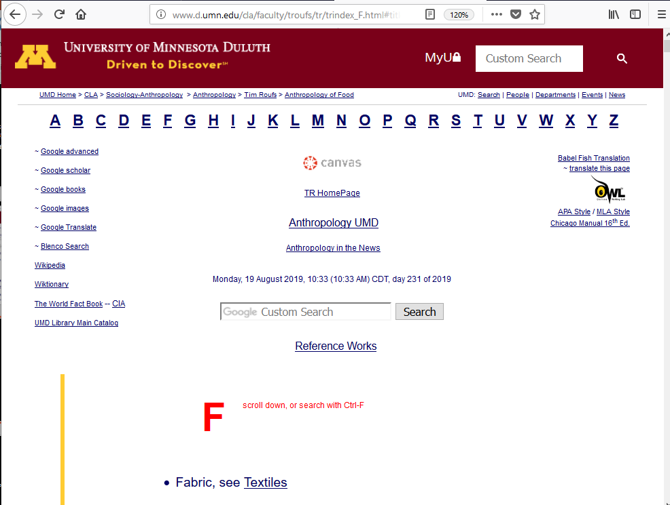
Click Here

Slide 29
Your log-in page
will then present
the UM Canvas Sign In prompt . . .

Slide 30
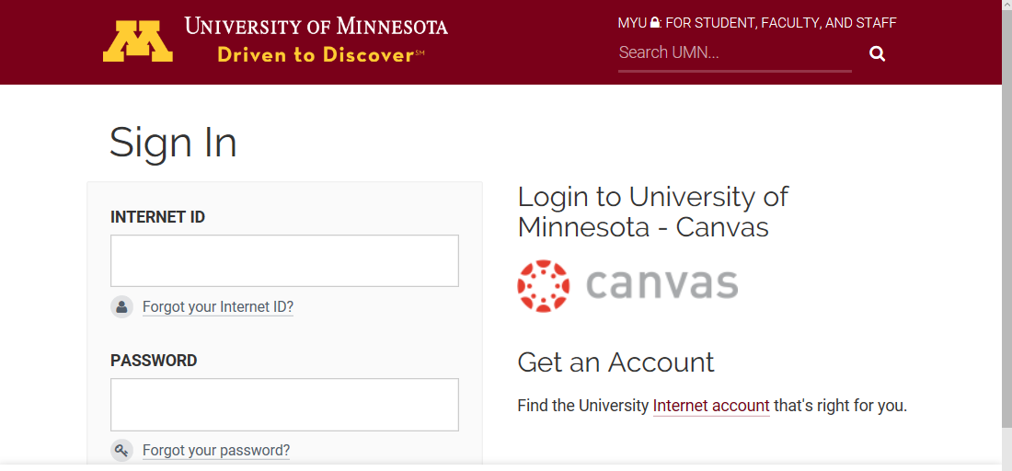
Log in using your “x.500” information . . .
(that’s the log-in information you use for your e-mail)

Slide 31
Log in using your “x.500” information . . .
(that’s the log-in information you use for your e-mail)
Log in using your “x.500” information . . .

Slide 32
Your Sign In will then bring
you to the “Duo Push” screen . . .

Slide 33
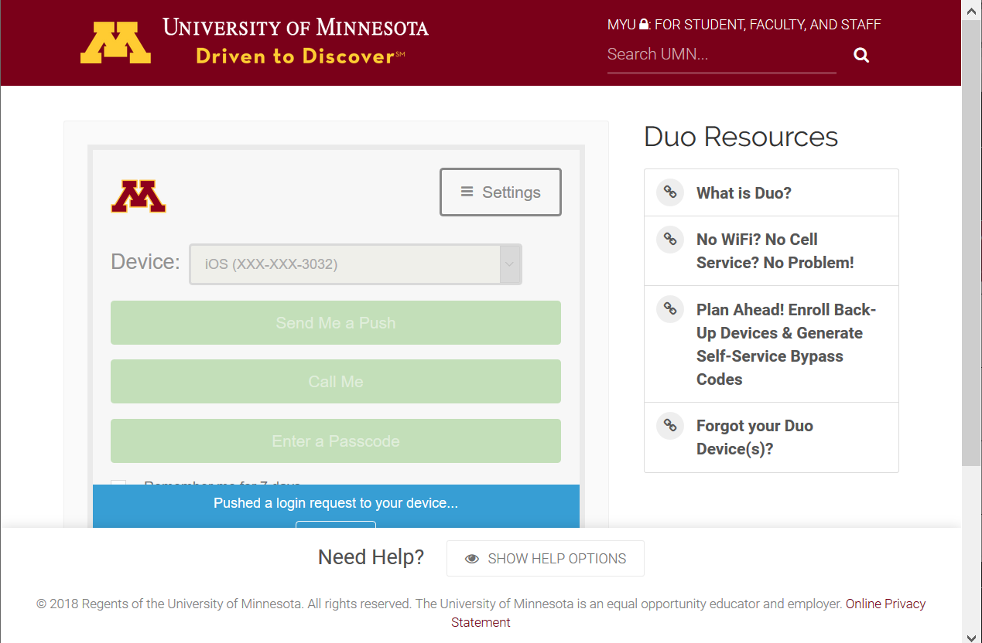

Slide 34
And the “Duo Push” will send
a Login Request
(generaly) to your phone . . .

Slide 35
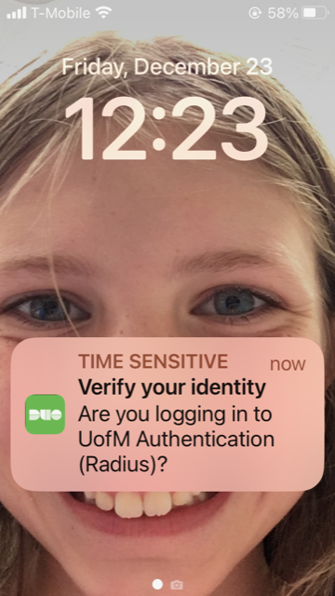
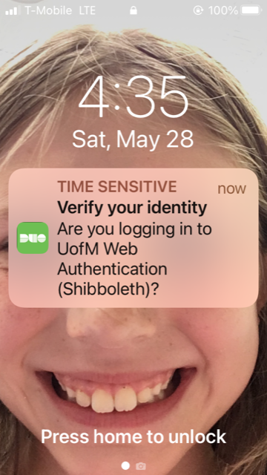
Duo Login Request Alert

Slide 36
Approve the
Login Request
and “Bob’s your uncle” . . .
1887 Lord Salisbury?

Slide 37
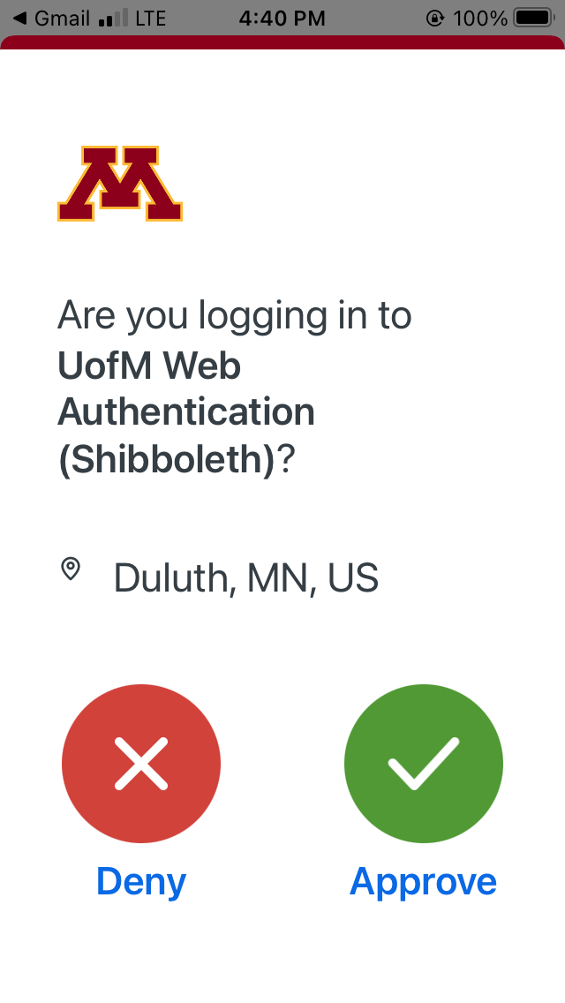
verify here in your UM e-mail

Slide 38
Your Canvas “Dashboards”
will look something like the following . . .
https://canvas.umn.edu/

Slide 39
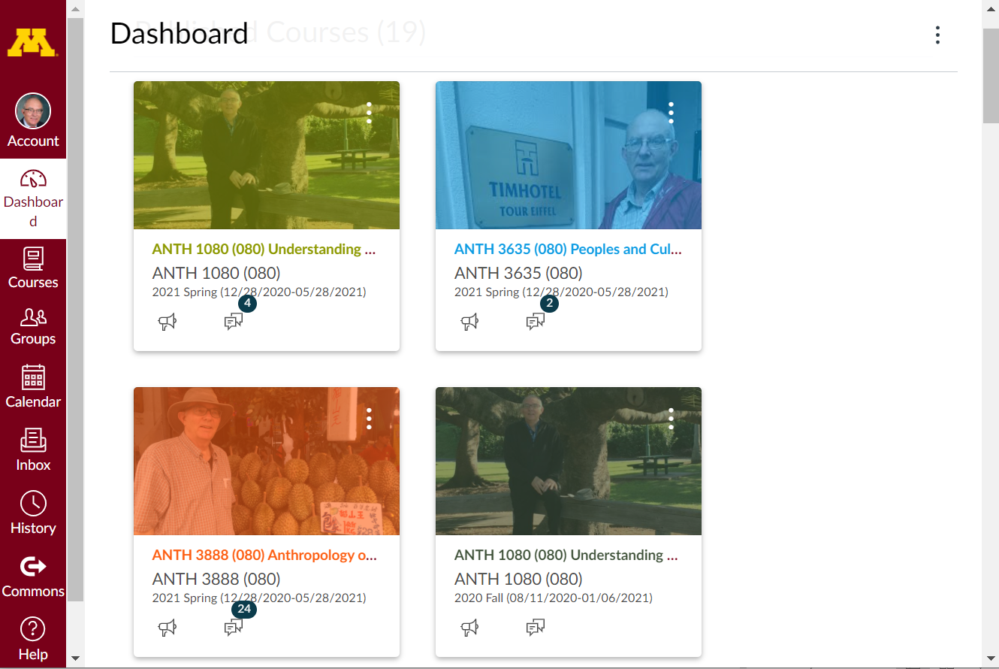
Dashboard
Select ANTH 3635
Your Canvas “Dashboard” will look something like this . . .

Slide 40
Your Canvas “Dashboard” on your phone
will look something like the following . . .
https://canvas.umn.edu/

Slide 41
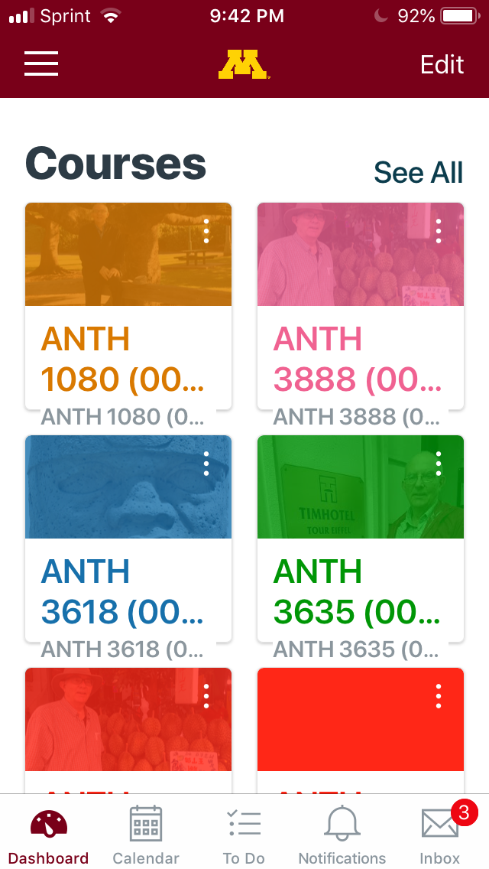
Your Canvas phone app
Dashboard screen
will look
something like this . . .

Slide 42
click on
ANTH 3635

Slide 43
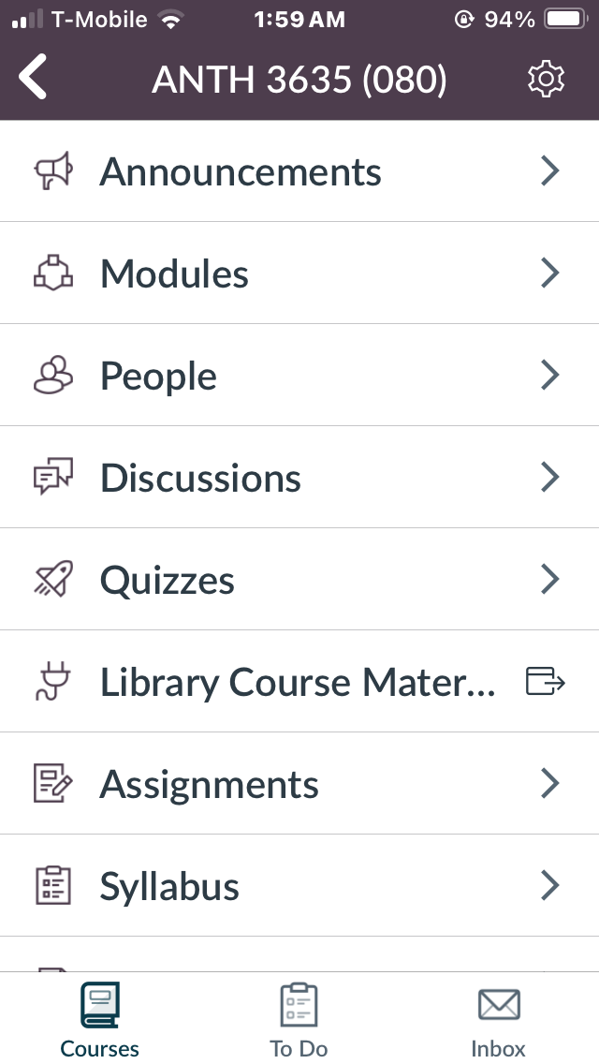
Your Canvas phone app
“Home” screen
will look
something like this

Slide 44
Your Canvas iPhone app
“Home” screen
will look
something like this
the weekly “What’s Happening?” memo is available here on your phone

Slide 45
NOTE: Not all Canvas features work on phone apps . . .
And different phone models work differently . . .

Slide 46
Your Canvas “Home” screen
on your laptop
will look something like the following . . .

Slide 47
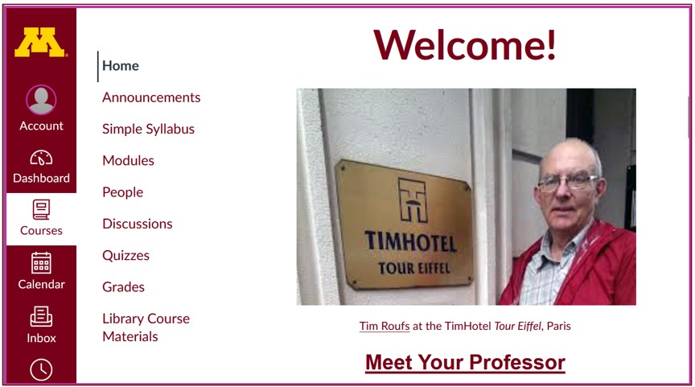

Home page
Your laptop Canvas “Home” screen will look something like this

Slide 48
your laptop
Canvas folder has
two important
navigation panels . . .

Slide 49
GLOBAL navigation . . .
COURSE navigation . . .

Slide 50
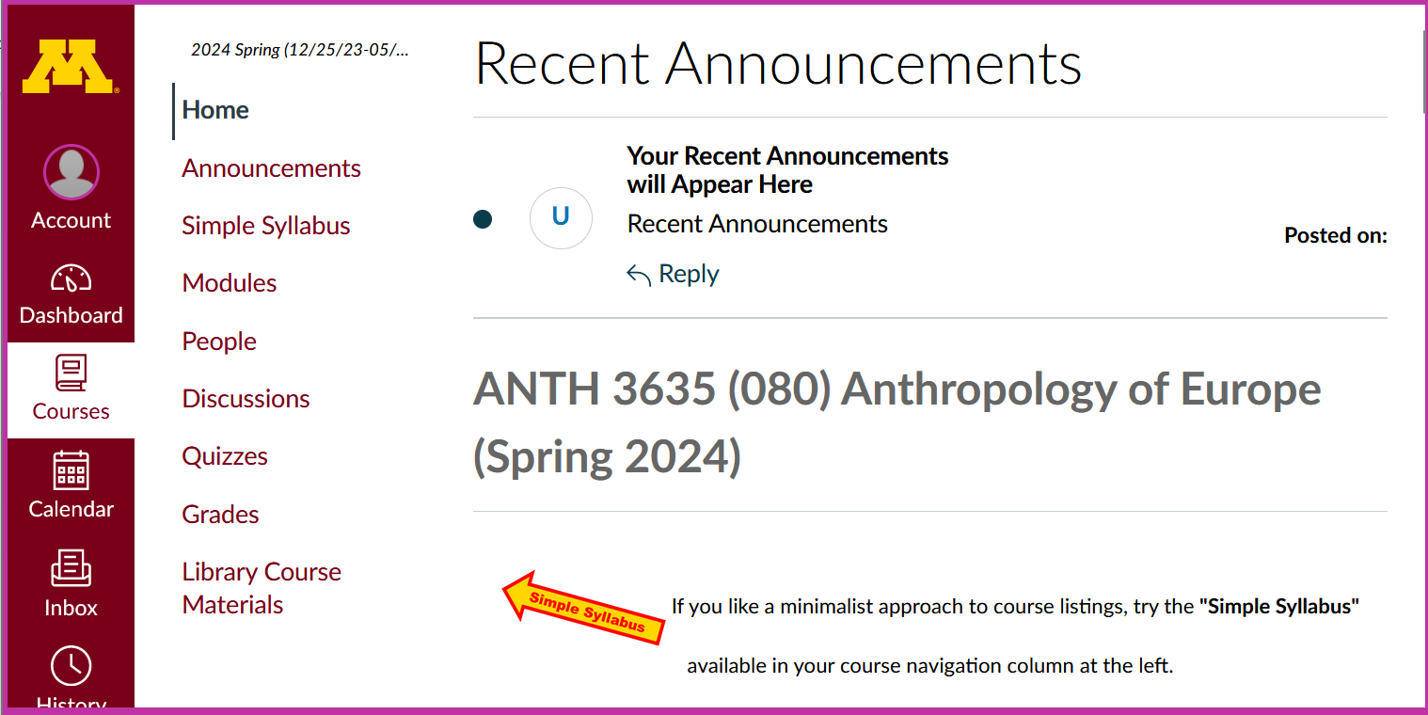
global navigation

Slide 51
GLOBAL navigation . . .
and
COURSE navigation . . .

Slide 52
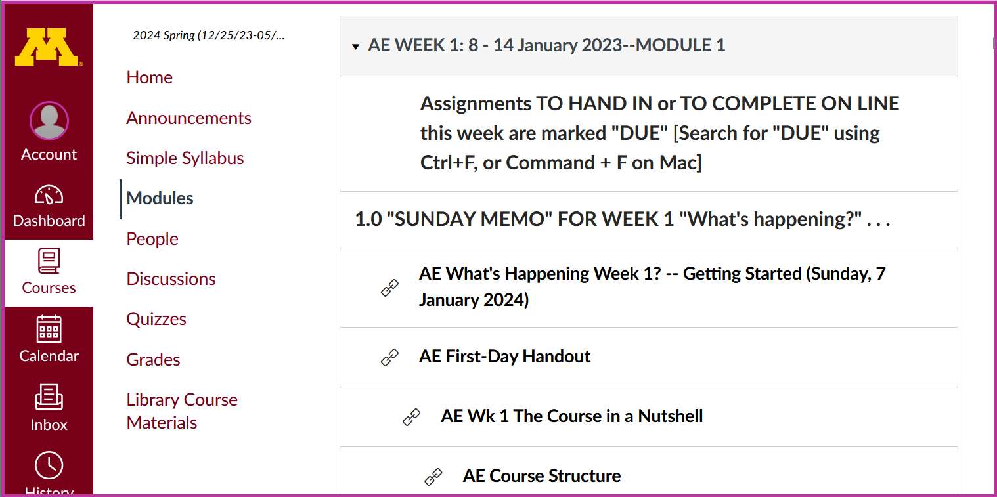
course navigation

Slide 53
How to hide the
“course Navigation”
panel . . .

Slide 54
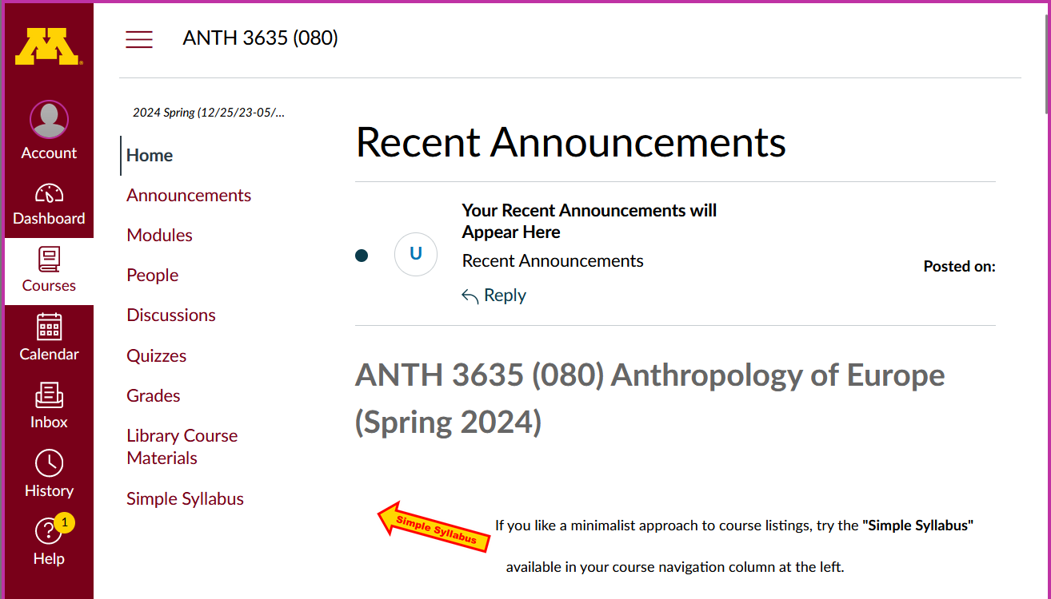
Home page
use the “hamburger” button
to turn panel on/off
(sometimes the border is turned off when panel is on)

Slide 55
course navigation
Home page

Slide 56
hide course navigation panel here
Home page

Slide 57
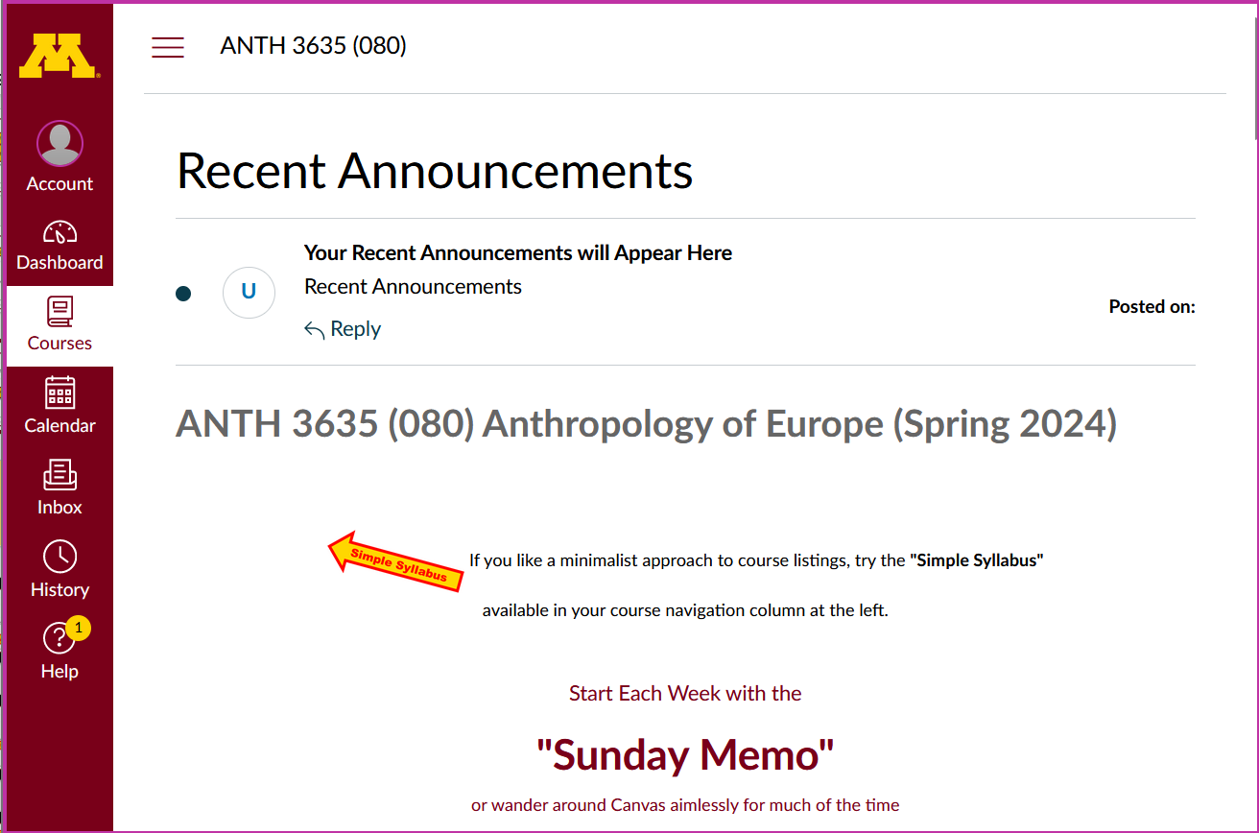
course navigation panel disappears

Slide 58
global navigation remains

Slide 59
to un-hide course navigation panel
use the “hamburger” button

Slide 60
Home page
course navigation returns

Slide 61
Home page
Scroll down for basic information on Home Page . . .

Slide 62
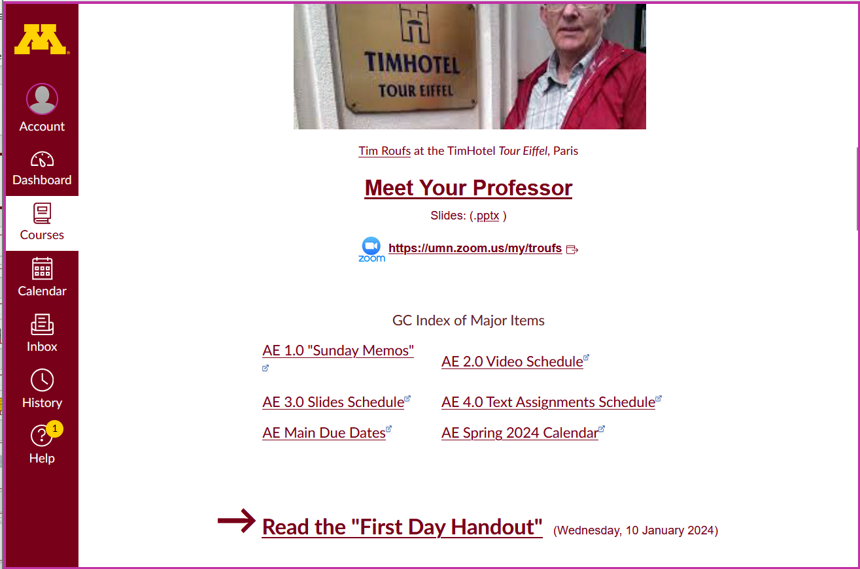
Home page

Slide 63
Home page
Have a look at the
“First Day Handout” . . .

Slide 64
The “First-Day” Handout information contains the basic course information . . .
It’s the syllabus
It look something like the following . . .
https://canvas.umn.edu/

Slide 65
The “First-Day” Handout information contains the basic course information . . .
It’s the syllabus
It look something like the following . . .
https://canvas.umn.edu/

Slide 66
Where to Begin?

Slide 67
Where to Begin?
Read the Week 1 “Sunday Memo”
Open your Canvas folder,
select ANTH 3635,
and have a look around . . .
    Check out your Week 1 Canvas “Module”
    Read the “First-Day” handout
Have fun

Slide 68
Where to Begin?
Read the Week 1 “Sunday Memo”
Open your Canvas folder,
select ANTH 3635,
and have a look around . . .
    Check out your Week 1 Canvas “Module”
    Read the “First-Day” handout
Have fun

Slide 69
Where to Begin?
Read the Week 1 “Sunday Memo”
Open your Canvas folder,
select ANTH 3635,
and have a look around . . .
    Check out your Week 1 Canvas “Module”
    Read the “First-Day” handout
Have fun

Slide 70
Where to Begin?
Read the Week 1 “Sunday Memo”
Open your Canvas folder,
select ANTH 3635,
and have a look around . . .
    Check out your Week 1 Canvas “Module”
    Read the “First-Day” handout
Have fun

Slide 71
Where to Begin?
Read the Week 1 “Sunday Memo”
Open your Canvas folder,
select ANTH 3635,
and have a look around . . .
    Check out your Week 1 Canvas “Module”
    Read the “First-Day” handout
Have fun

Slide 72
Where to Begin?
Read the Week 1 “Sunday Memo”
Open your Canvas folder,
select ANTH 3635,
and have a look around . . .
    Check out your Week 1 Canvas “Module”
    Read the “First-Day” handout
Have fun

Slide 73
REM
Dashboard
Select ANTH 3635
Your Canvas “Dashboard” will look something like this . . .

Slide 74
AVISO!
One of the main complaints regarding Canvas is that it is difficult to find assignments.
Right now, before you do anything else,
do this to fix that problem . . .
Go to the "Modules" Section
(using the Course Navigation Panel)

Slide 75
AVISO!
One of the main complaints regarding Canvas is that it is difficult to find assignments.
Right now, before you do anything else,
do this to fix that problem . . .
Go to the "Modules" Section
(using the Course Navigation Panel)

Slide 76
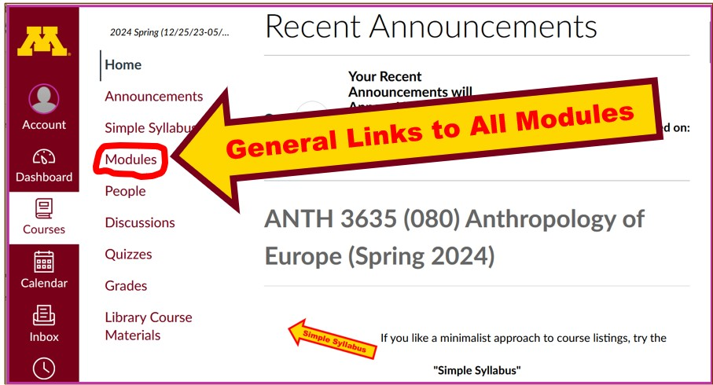

Slide 77
. . . and that wll take you
to the Modules folder,
which looks
something like this . . .

Slide 78
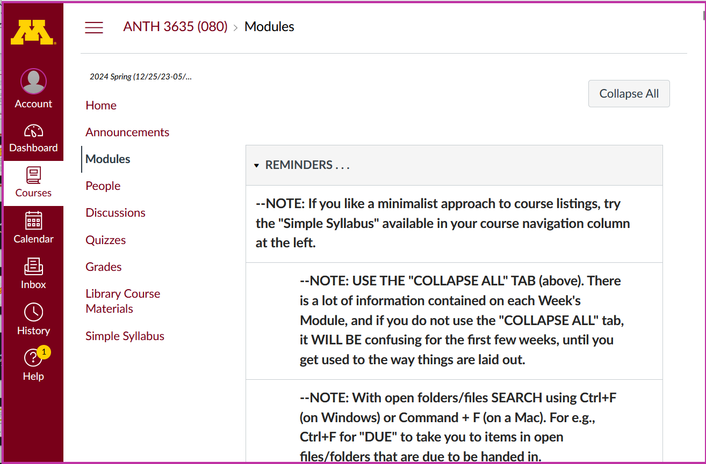


Slide 79
COLLAPSE / EXPAND ALL SECTIONS AT ONCE HERE

Slide 80
Then open each Module
one-by-one
as you need it / them . . .

Slide 81
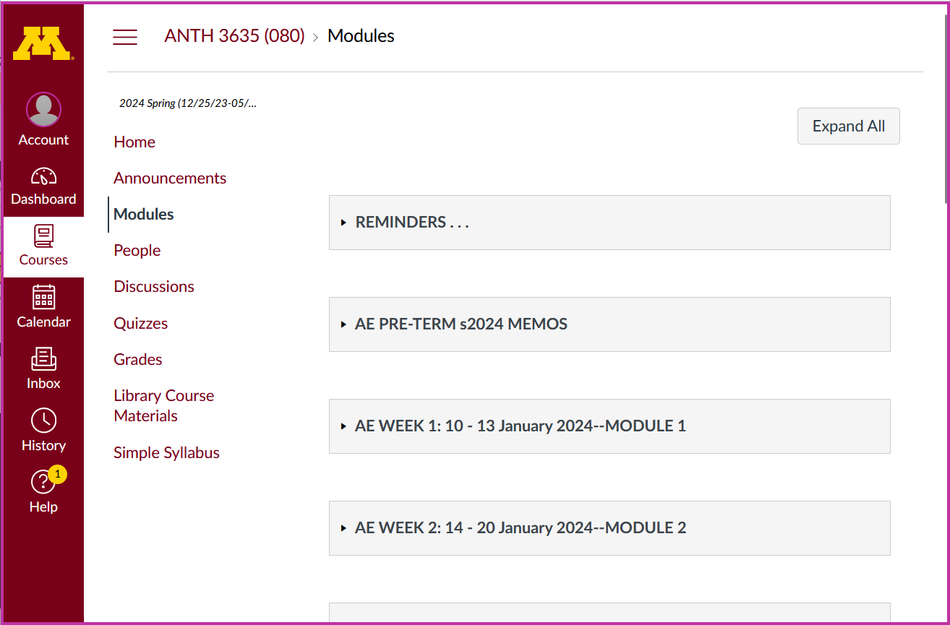
open / close Modules as you need them

Slide 82
And the expanded
Week 1 Module
will look like this . . .

Slide 83


Slide 84
To get started
with the basics of the course,
check out the Week 1 “Sunday Memo”
"What's Happening Week 1?
-- Getting Started" . . .

Slide 85

Getting Started

Slide 86
After you are done with that check out
the "First Day Handout” . . .
(the class syllabus) . . .

Slide 87

First-Day Handout

Slide 88
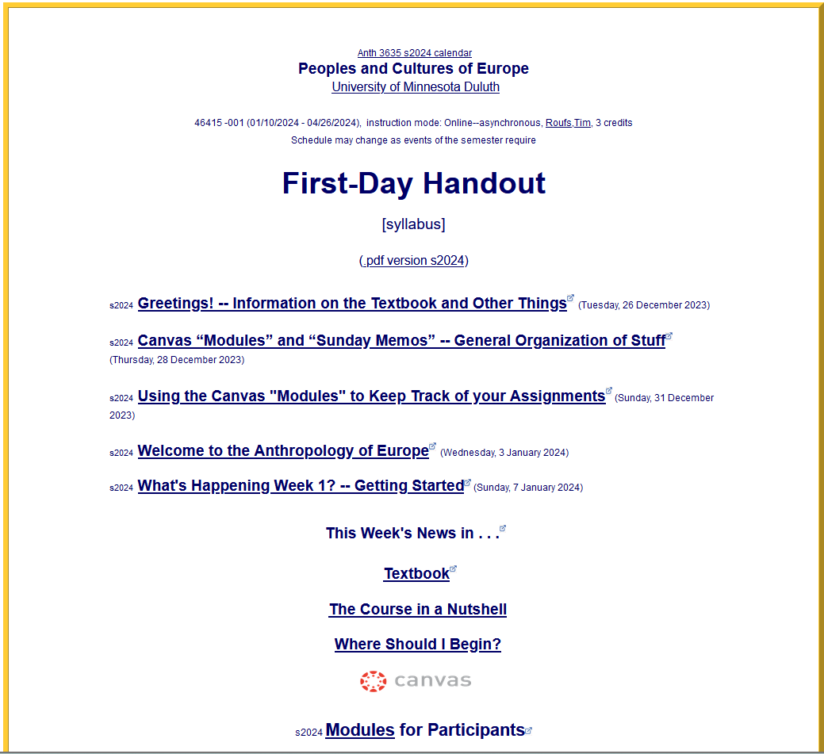

Slide 89
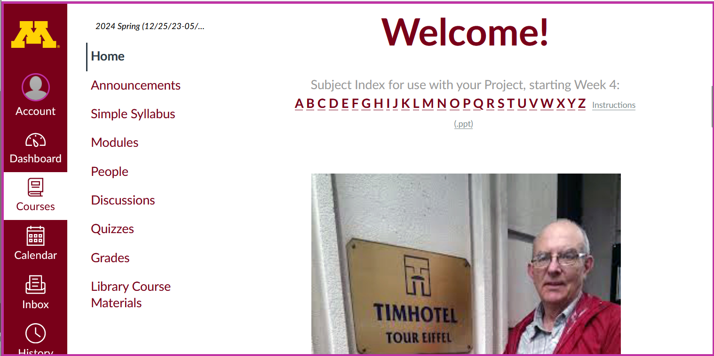
to return to the beginning from anywhere, simply click “Home”

Slide 90
Other useful information . . .

Slide 91
Home page
Simple Syllabus
Try the Simple Syllabus . . .

Slide 92
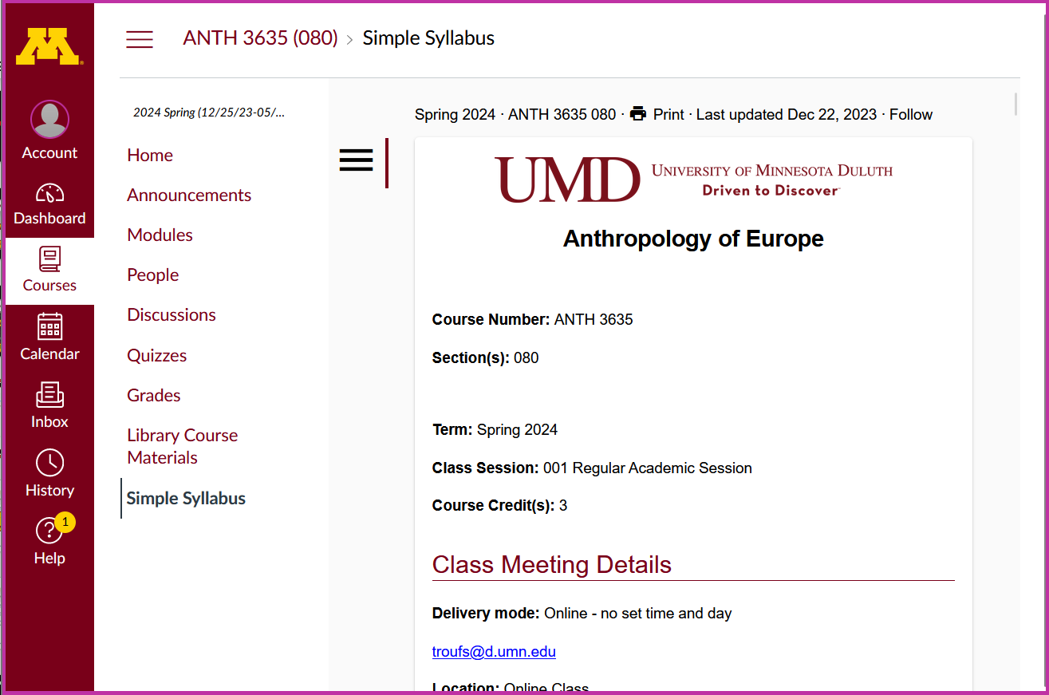

Slide 93
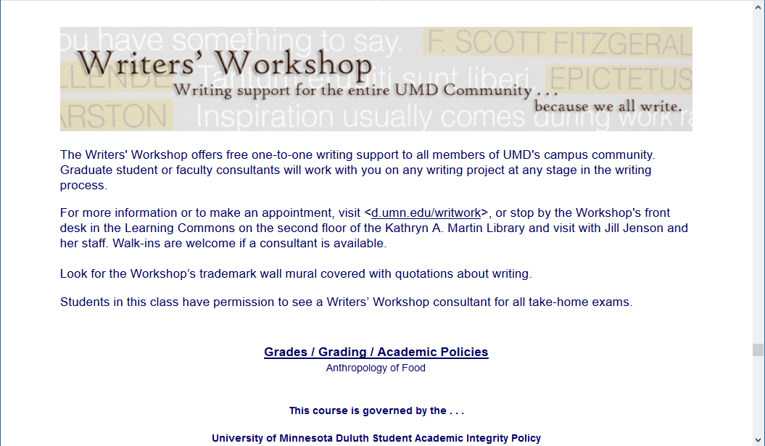
Other Useful Information . . .
Writers’ Workshop
is an excellent resource for
Everyone!
Second Floor UMD Library

Slide 94
Other Useful Information . . .

Slide 95
Governing Procedures
pay attention . . .

Slide 96
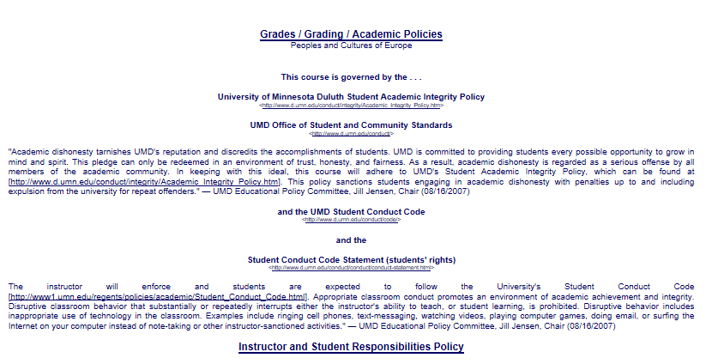

Slide 97
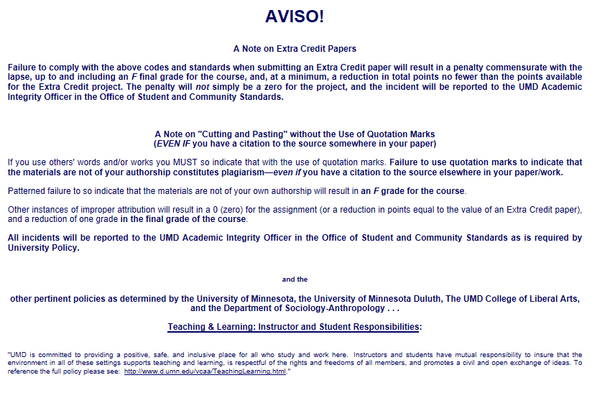

Slide 98
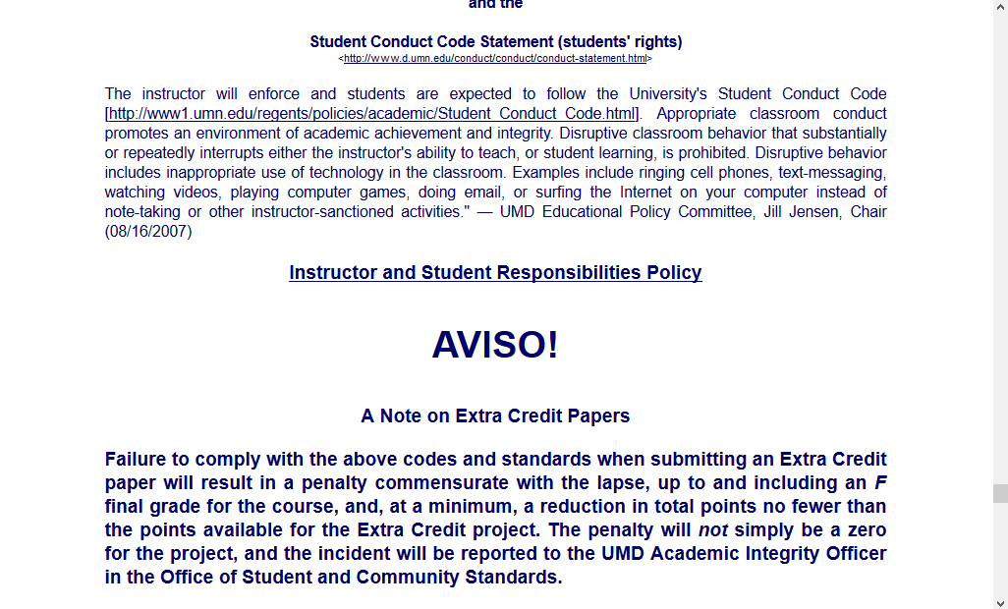
NB: Governing Procedures
note on Extra Credit Papers

Slide 100
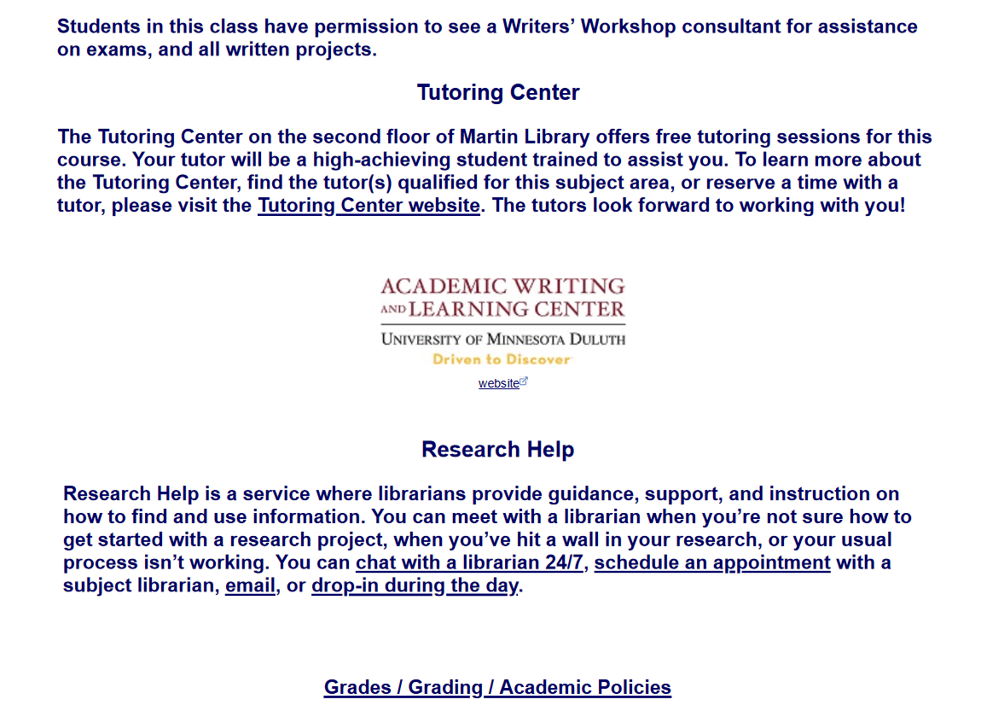

Slide 101
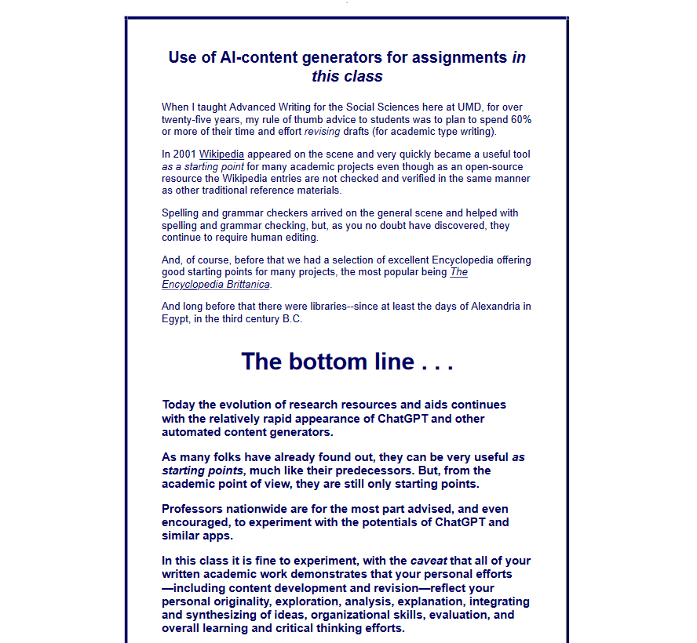

Slide 102
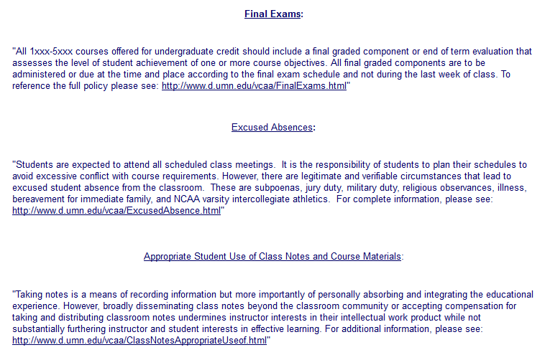

Slide 103
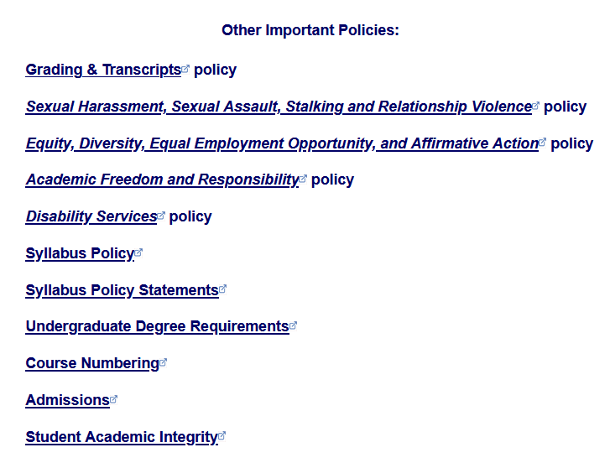

Slide 104
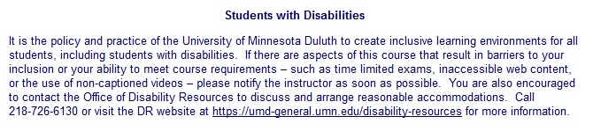
Special Facilities Information

Slide 105
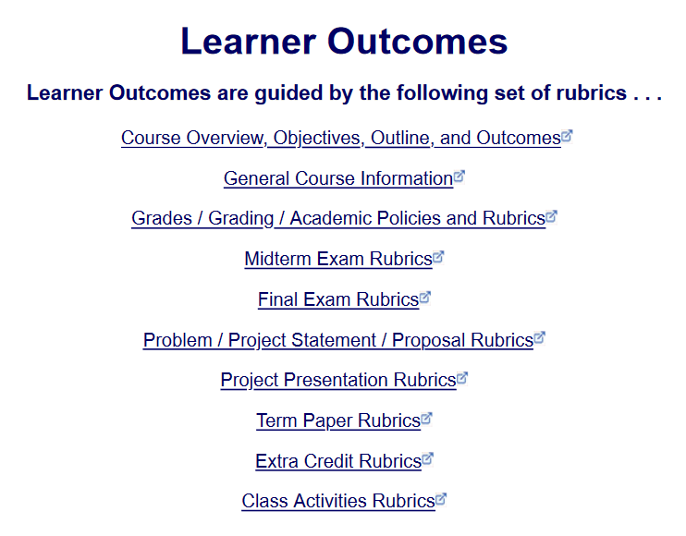




Slide 106
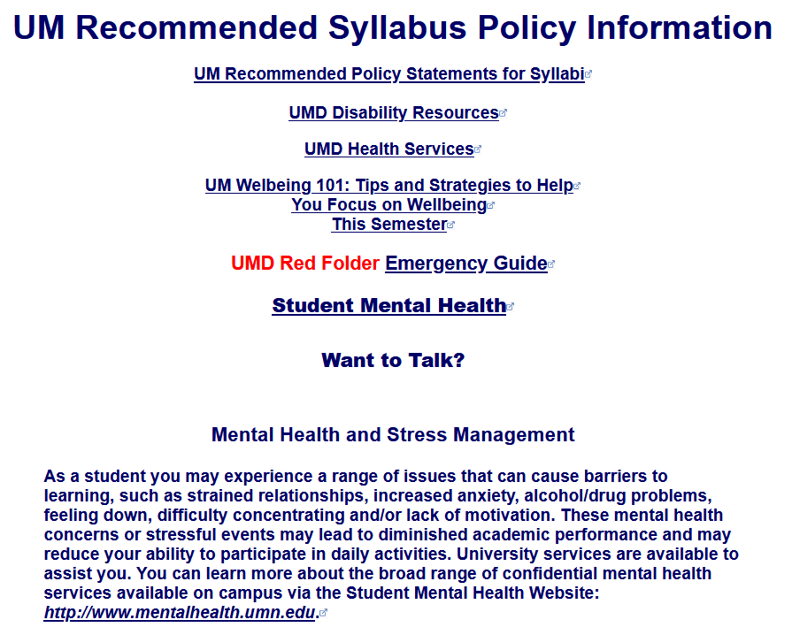

Slide 107
And, once again . . .
Oriented
Peoples and Cultures
of Europe
Europa and the Bull
Gustave Moreau,
c.1869
University of Minnesota Duluth
Tim Roufs’ ©2010-2024
http://www.d.umn.edu/cla/faculty/troufs/anth3635/

Slide 108
And, once again . . .
Enjoy Your Stay!
Peoples and Cultures
of Europe
Europa and the Bull
Gustave Moreau,
c.1869
University of Minnesota Duluth
Tim Roufs’ ©2010-2024
http://www.d.umn.edu/cla/faculty/troufs/anth3635/

Slide 109

© 2010-2024 Timothy G. Roufs, University of Minnesota Duluth

Slide 110
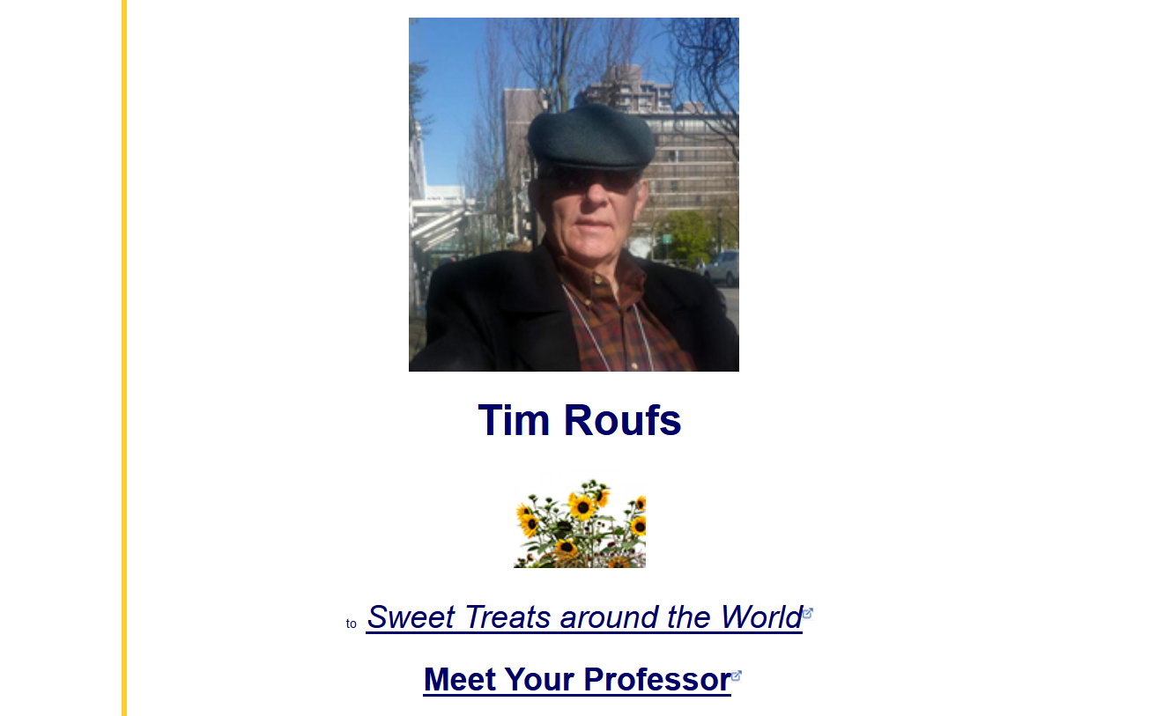
http://www.d.umn.edu/cla/faculty/troufs/index.html
0

Slide 111
