Slide 1
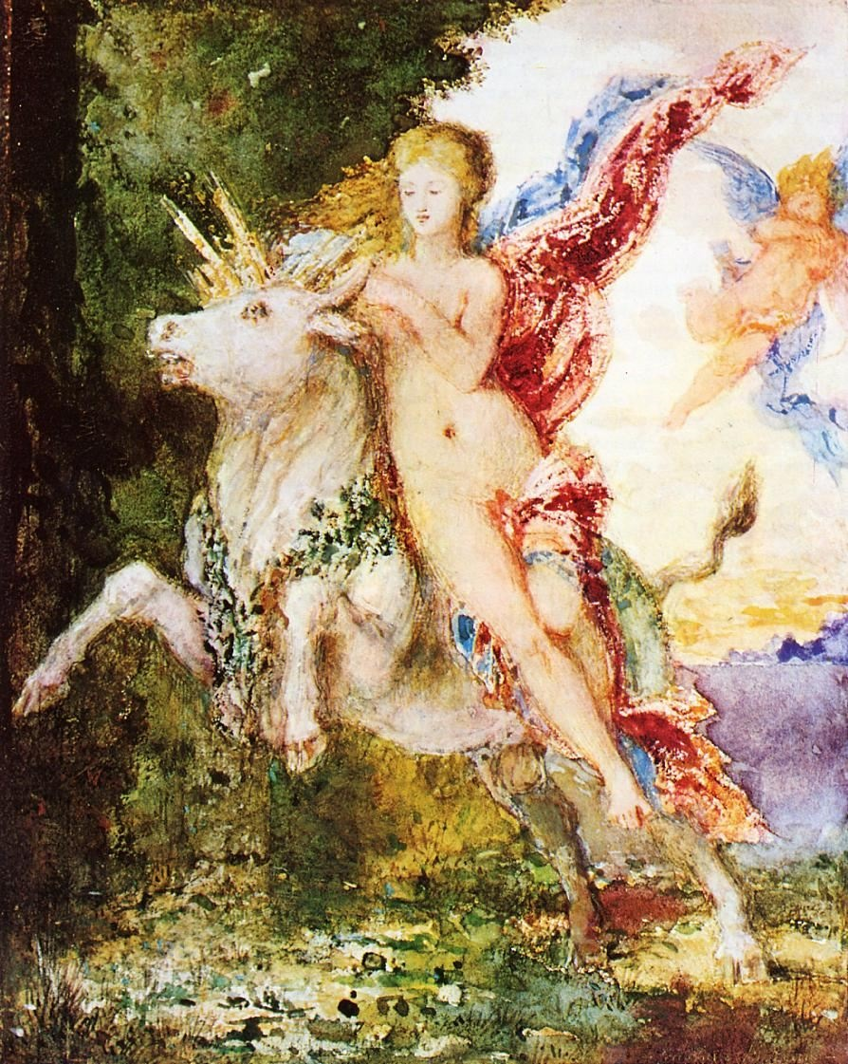
And, once again . . .
Use your up / down arrow keys and / or
your space bar to advance the slides
Europa and the Bull
Gustave Moreau,
c.1869
University of Minnesota Duluth
Tim Roufs’ ©2009-2024
http://www.d.umn.edu/cla/faculty/troufs/anth3635/

Slide 2
And, once again . . .
Europa and the Bull
Gustave Moreau,
c.1869
University of Minnesota Duluth
Tim Roufs’ ©2009-2024
http://www.d.umn.edu/cla/faculty/troufs/anth3635/

Slide 3
And, once again . . .
Other
Important
Terms
Anthropology of Europe
Europa and the Bull
Gustave Moreau,
c.1869
University of Minnesota Duluth
Tim Roufs’ ©2009-2024
http://www.d.umn.edu/cla/faculty/troufs/anth3635/

Slide 4
In a nutshell, ANTH 3888 Anthropology of Food
consists of three main segments:
I Orientation and Background
  Introduction
  Basic Concepts
  History
  Theory
  Methods and Techniques
II Explorations
Comparative / Cross-Cultural
Holistic
Ethnographic Case Studies from the Real World: Real People . . . Real Places from Around the Globe
III Student Presentations on Term Research Project
http://www.d.umn.edu/cla/faculty/troufs/anthfood/afproject.html

Slide 5
In a nutshell, ANTH 3888 Anthropology of Food
consists of three main segments:
I Orientation and Background
  Introduction
  Basic Concepts
  History
  Theory
  Methods and Techniques
II Explorations
Comparative / Cross-Cultural
Holistic
Ethnographic Case Studies from the Real World: Real People . . . Real Places from Around the Globe
III Student Presentations on Term Research Project
http://www.d.umn.edu/cla/faculty/troufs/anthfood/afproject.html

Slide 6
And, once again . . .
include
Other
Important
Terms
Anthropology of Europe
Europa and the Bull
Gustave Moreau,
c.1869
University of Minnesota Duluth
Tim Roufs’ ©2009-2024
http://www.d.umn.edu/cla/faculty/troufs/anth3635/

Slide 7
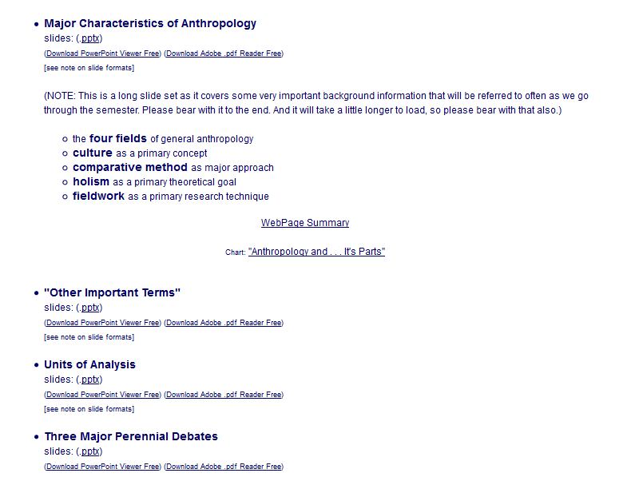

Slide 8
. . . and one or more of these term clarifications
might prove interesting, and even helpful with your class project

Slide 9
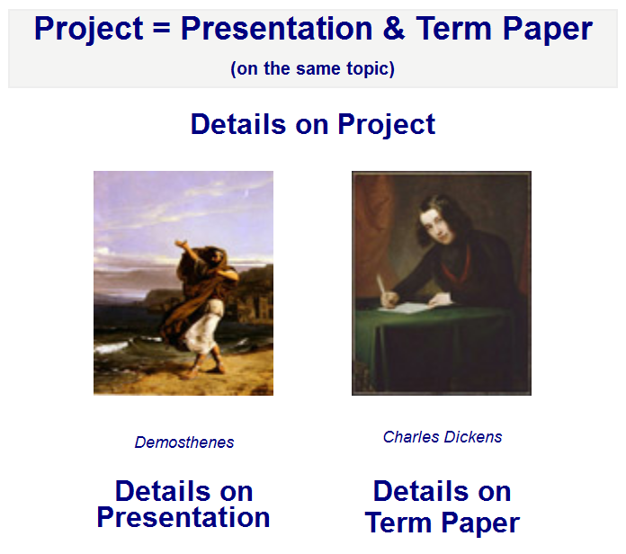

Slide 10
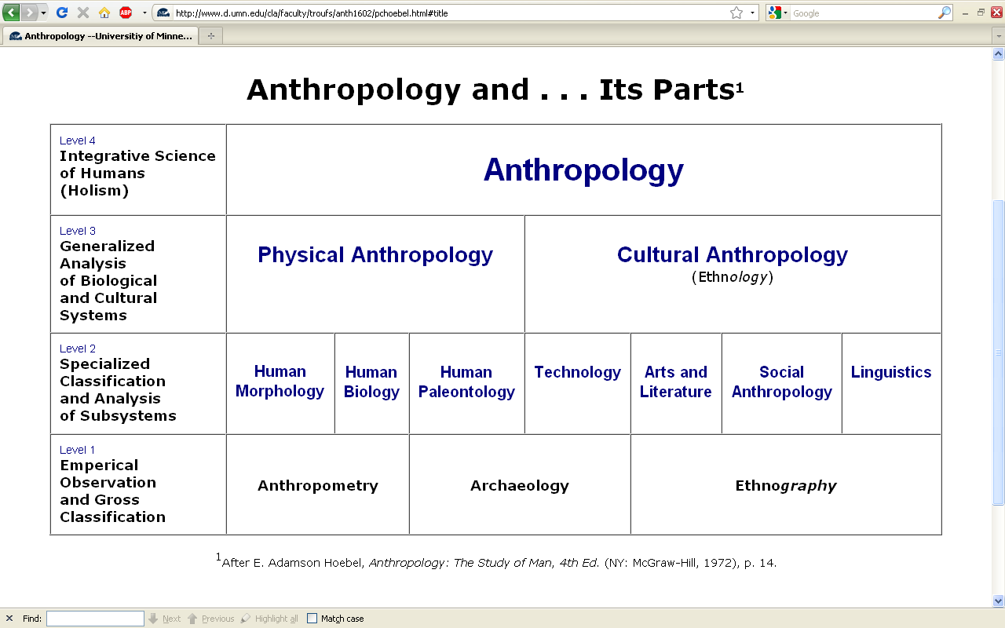
This is the same chart as in the
“Main Characteristics of Anthropology”
material

Slide 11
difficult terms

Slide 12
ethnography
  scientific description of cultures
  (“a portrait of a people”)

Slide 13
ethno – graphy
  graph from the Greek, meaning something “written” or “drawn”

Slide 14
ethno – graphy
  ethnography looks at “who,” “what,” “where” and “when”

Slide 15
ethnology
  comparative study of cultures

Slide 16
ethn – ology
  comparative study of cultures

Slide 17
ethn – ology
  ethnology looks at “why” and “how”

Slide 18
ethnology
  comparative study of cultures

Slide 19
ethnology
  comparative study of cultures
Take out the n and that yields an entirely different word . . .

Slide 20
ethology
  comparative study of cultures
  scientific study of the social behavior of animals, especially in their natural environments

Slide 21
primatology
  scientific study of the social behavior of primates, especially (non-human primates) apes and monkeys

Slide 22
“primatologist”
  usually refers to one who studies the behavior and social lives of chimpanzees, gorillas, orangutans, monkeys, etc.
      e.g., Jane Goodall, Diane Fossy
      Birute Galdikas-Brindamour

Slide 23

Jane Goodall is the most famous primatologist of all time
Grand Central Publishing, 2006

Slide 24
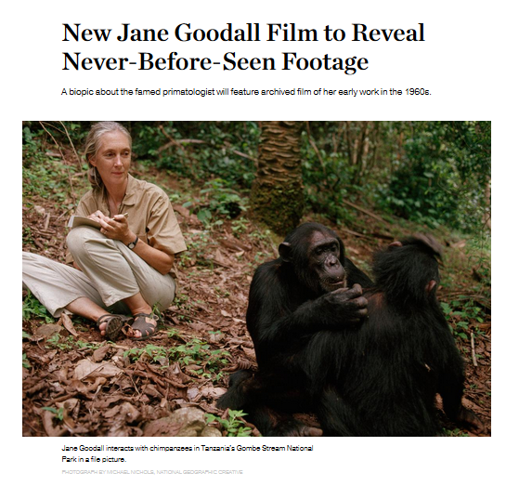
The 2016 film premiered
on the National Geographic Channel
in 171 countries and 44 languages.
(21 January 2016)
Jane Goodall was born in April 1934 in Hampstead, London

Slide 25
“primates” include
    prosimians (“pre-monkeys”)
    monkeys
    apes
    and also humans

Slide 26
include
“primates”
    prosimians (“pre-monkeys”)
    monkeys
    apes
    and also humans

Slide 27
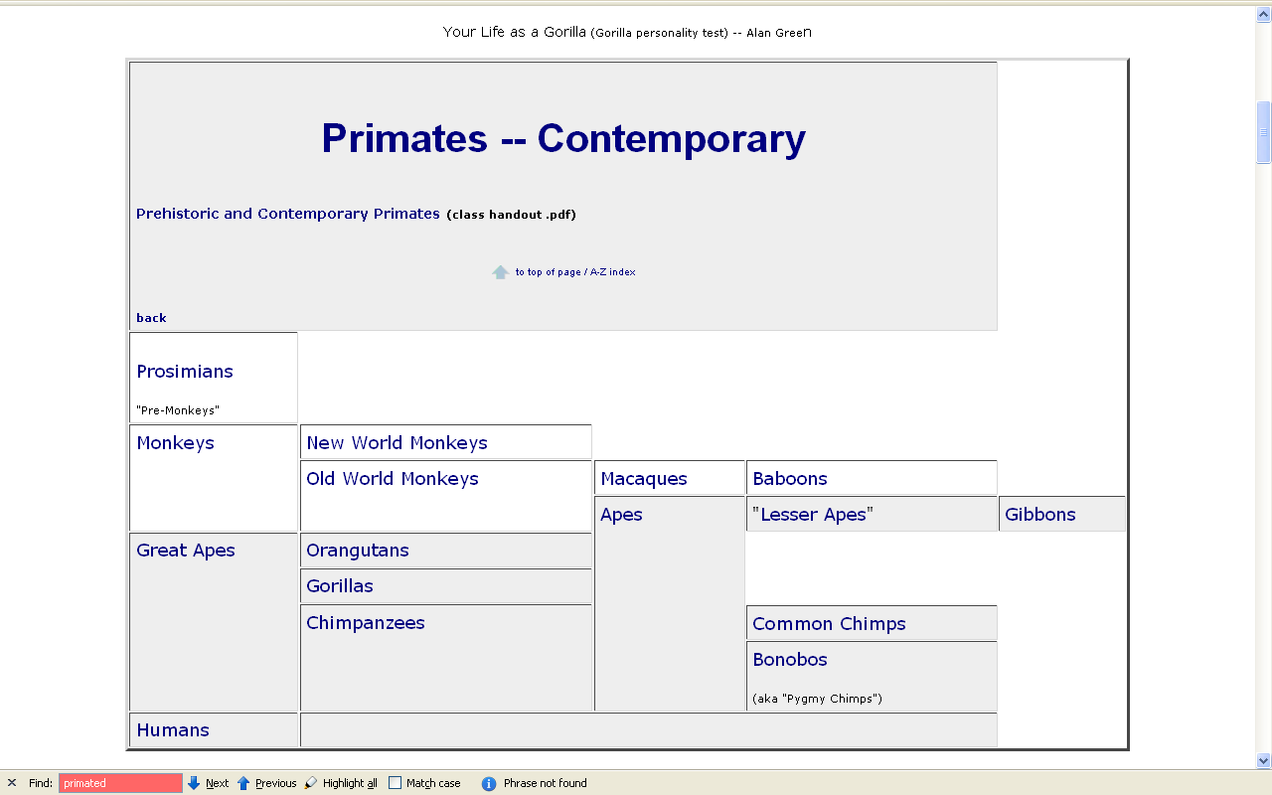

www.d.umn.edu/cla/faculty/troufs/anth1602/pcprim.html

Slide 28
“non-human primates” are
  prosimians (“pre-monkeys”)
  monkeys
  apes

Slide 29
“non-human primates”
www.d.umn.edu/cla/faculty/troufs/anth1602/pcprim.html

Slide 30
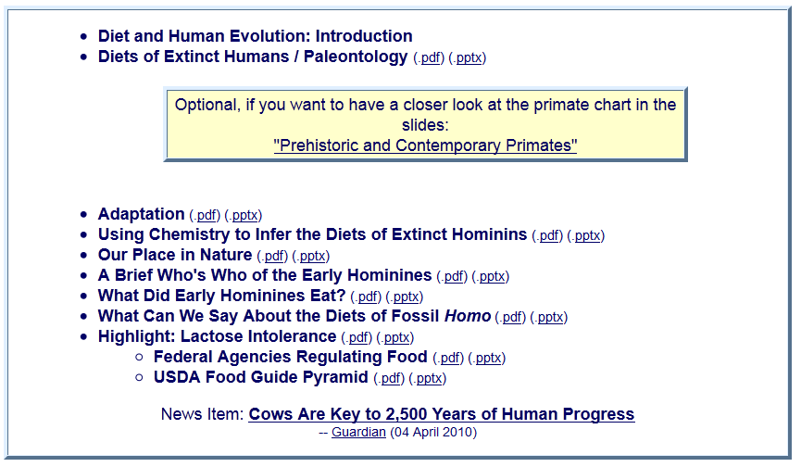
With regard to non-human primates, note one major relatively recent change

Slide 31
“hominins” is now generally used rather than “hominids”

Slide 32
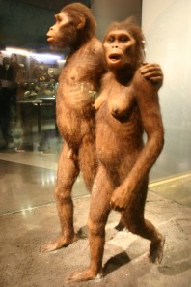
This reflects a relatively recent change in the classification of the Great Apes and many new prehistoric forms like “Lucy” . . . through the newest discovery, Homo naledi
“hominins” is now generally used rather than “hominids”

Slide 33
other important terms include . . .

Slide 34
ethnocentrism
  judging other cultures by the standards of one’s own culture rather than by the standards of that particular culture

Slide 35
two fundamental concepts in anthropology are . . .
ethnocentrism
  judging other cultures by the standards of one’s own culture rather than by the standards of that particular culture
cultural relativism

Slide 36
ethnocentrism
  is the mindset of judging other cultures by the standards of one’s own culture rather than by the standards of that particular culture

Slide 37
cultural relativism
  refers to the perspective that each culture must be understood in terms of the values and ideas of that culture and should not be judged by the standards of another

Slide 38
in recent times two types of cultural relativism have emerged . . .
cultural relativism
  absolute cultural relativism
  critical cultural relativism

Slide 39
the term as originally proposed came to be referred to as . . .
in recent times two types of cultural relativism have emerged . . .
cultural relativism
  absolute cultural relativism
  critical cultural relativism

Slide 40
absolute cultural relativism
  the perspective that says a person from one culture should not question the rightness or wrongness of behavior or ideas in other cultures because that would be ethnocentric

Slide 41
absolute cultural relativism
  was quickly criticized as unacceptable as, taken literally, [absolute] cultural relativism suggested we should accept anything and everything that was thought to be OK by the people under consideration

Slide 42
absolute cultural relativism
  critics quickly pointed to Hitler and the World War II Holocaust and (rightfully) said that no one should accept behaviors that resulted in The [WW II] Holocaust; that such behavior was unacceptable under any circumstances

Slide 43
absolute cultural relativism
  and the critics added enough other examples so that the original concept of cultural relativism was modified and resulted in today’s concept of
  critical cultural relativism

Slide 44
critical cultural relativism
  offers an alternative view that poses questions about cultural practices and ideas in terms of who accepts them and why, and who they might be harming or helping

Slide 45
critical cultural relativism . . .
answered many of the early critics
But—even accepting the modified concept—it is oftentimes not easy to figure out what “. . . in terms of who accepts them and why, and who they might be harming or helping” means

Slide 46
critical cultural relativism . . .
Let’s look at several examples of where
“it is oftentimes not easy to figure out what ‘. . . in terms of who accepts them and why, and who they might be harming or helping’ means” . . .

Slide 47
And where do you draw the line with critical cultural relativism . . .?
This is a very difficult question,
so let’s look at a large number of items . . .

Slide 48
The rest of this slide deck is devoted to a large number of examples of
critical cultural relativism and
ethnocentrism
in various cultural situations around the world.
Take a break and come back if you get tired. The examples are interesting. . . .

Slide 49
absolute cultural relativism
  How about?
  Doctor Assisted Suicide
  arranged “underage” marriage
  female genital mutilations
  withholding of medical treatment of children for religious reasons
  polygyny . . .

Slide 50
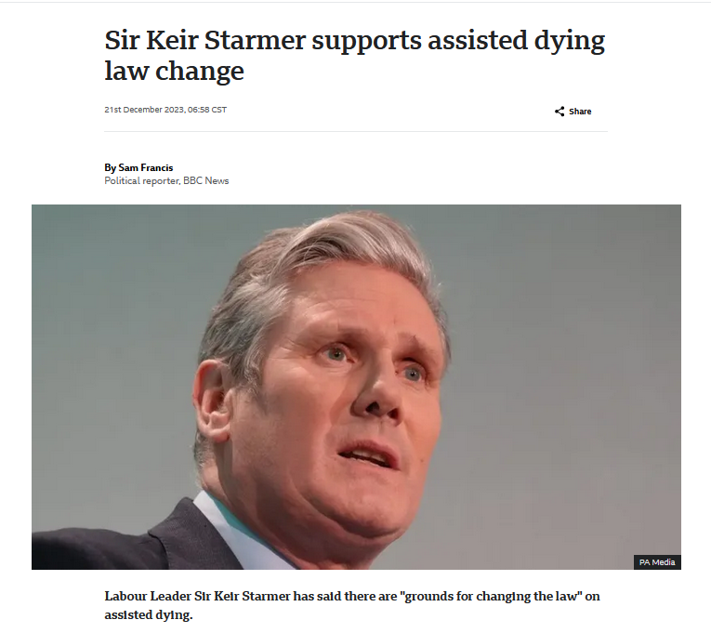

21 December 2023
UK Labour Leader
https://www.bbc.com/news/uk-politics-67785112

Slide 51
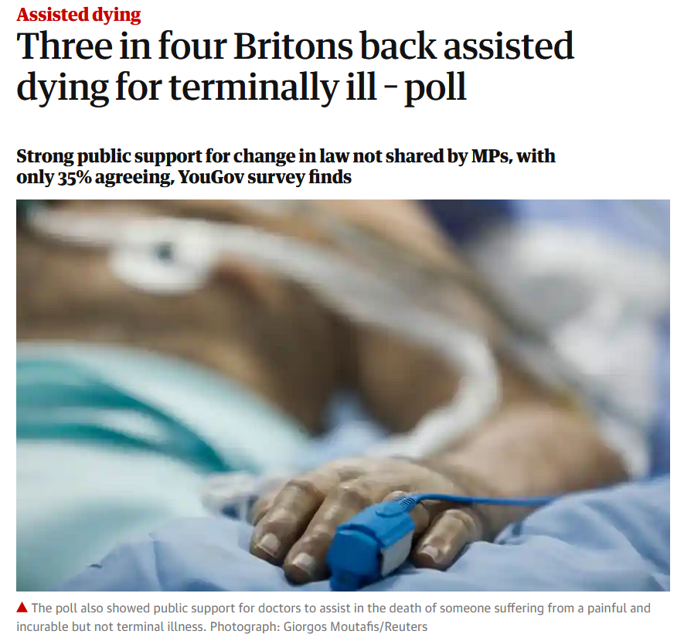

04 August 2021
https://www.theguardian.com/society/2021/aug/04/three-in-four-britons-back-assisted-dying-for-terminally-ill-poll

Slide 52


https://www.bioedge.org/bioethics/the-puzzling-trajectory-of-support-for-assisted-suicide-in-the-uk/13865

Slide 53
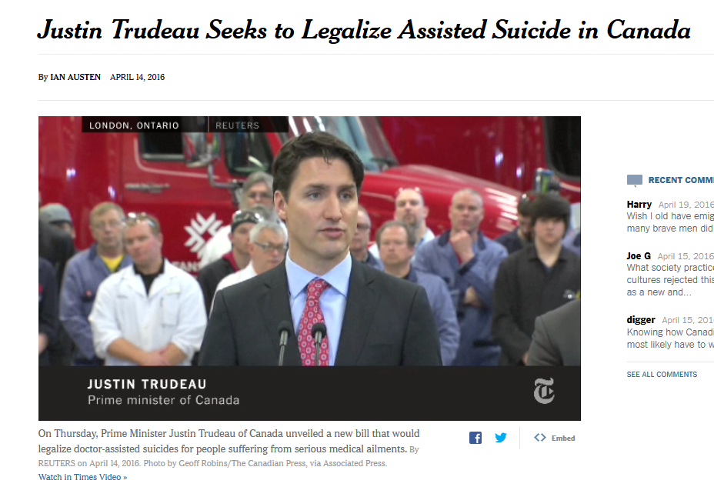
14 APRIL2016
https://www.nytimes.com/2016/04/15/world/americas/canadian-prime-minister-seeks-to-legalize-physician-assistedsuicide.html?emc=edit_na_20160414&nlid=60046204&ref=cta

Slide 54

27 December 2023
14 APRIL2016
https://www.nytimes.com/2023/12/27/world/canada/medical-assisted-death-mental-illness.html?smid=nytcore-ios-share&referringSource=articleShare

Slide 55
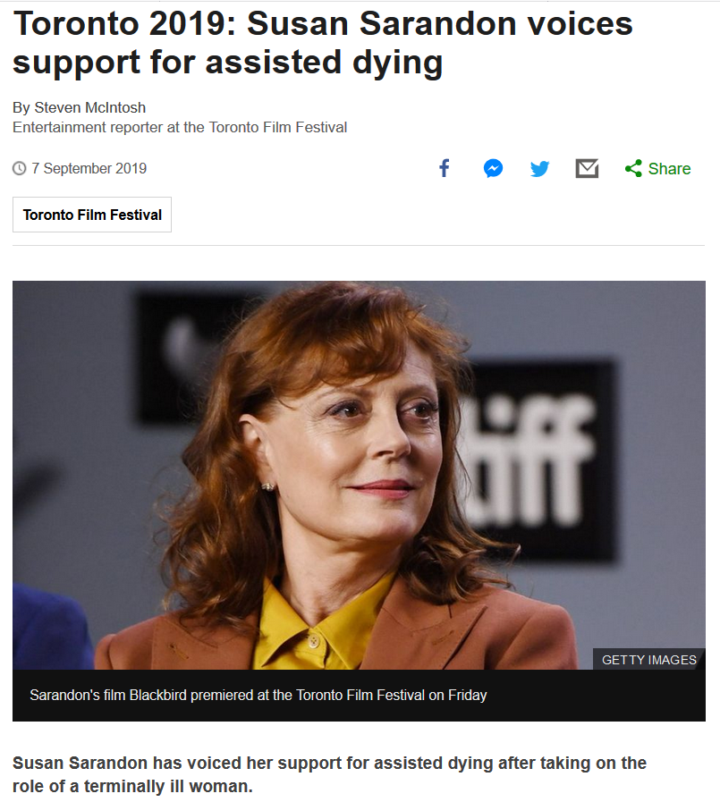
Source

Slide 56
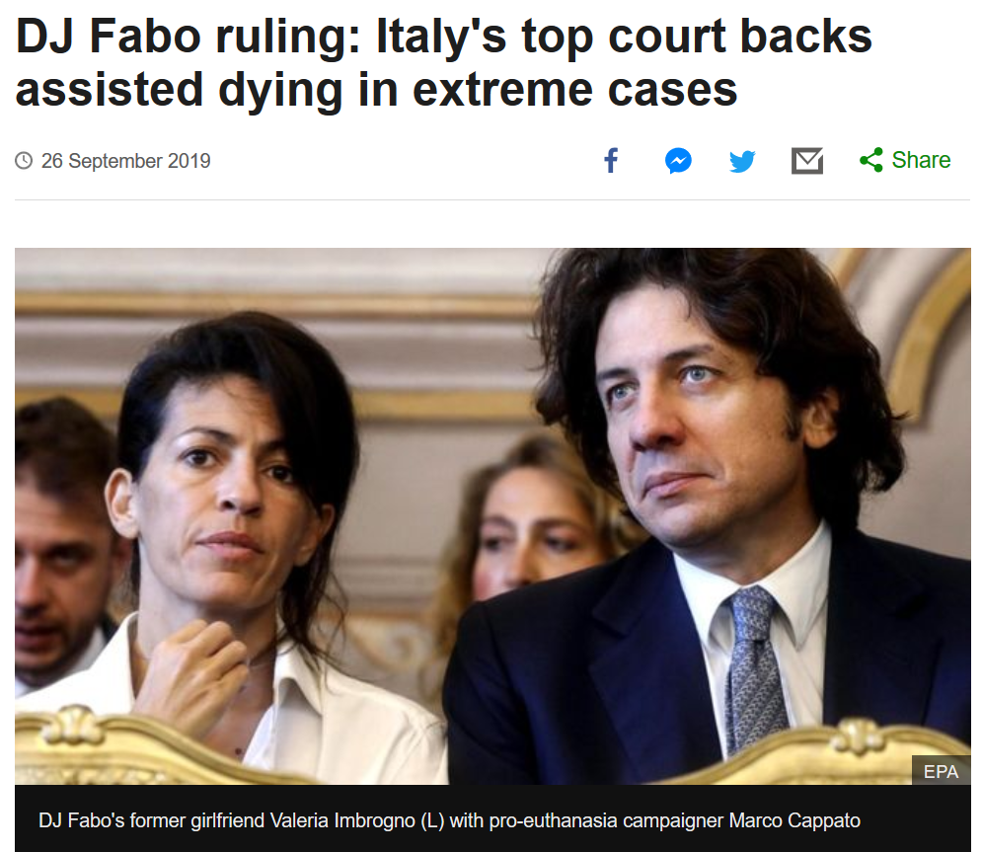
Source

Slide 57


https://www.psychiatrictimes.com/view/first-do-no-harm

Slide 58
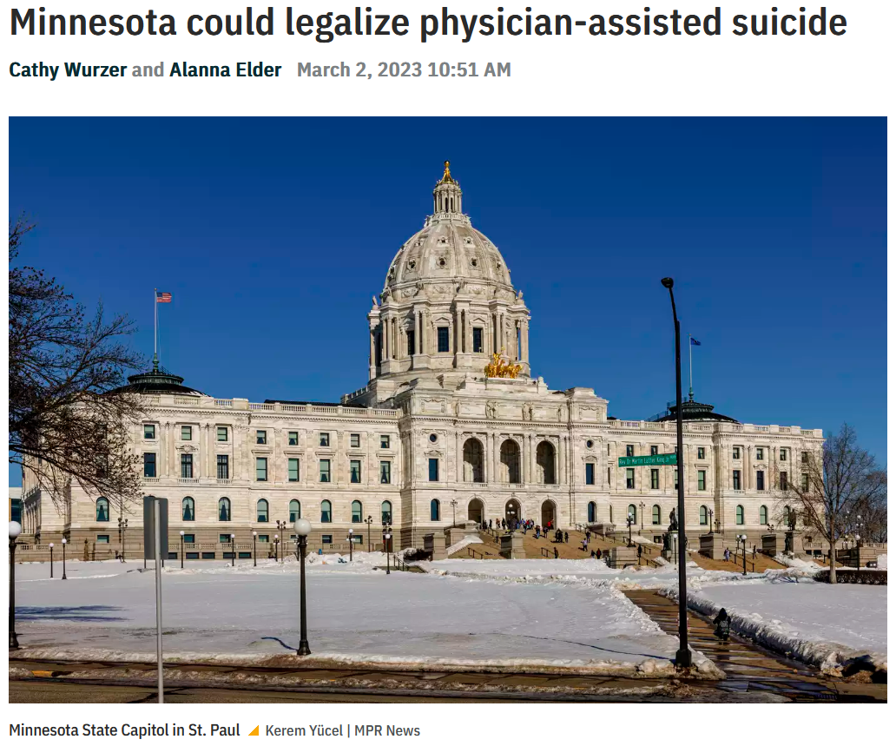

https://www.mprnews.org/episode/2023/03/02/minnesota-could-legalize-physicianassisted-suicide

Slide 59
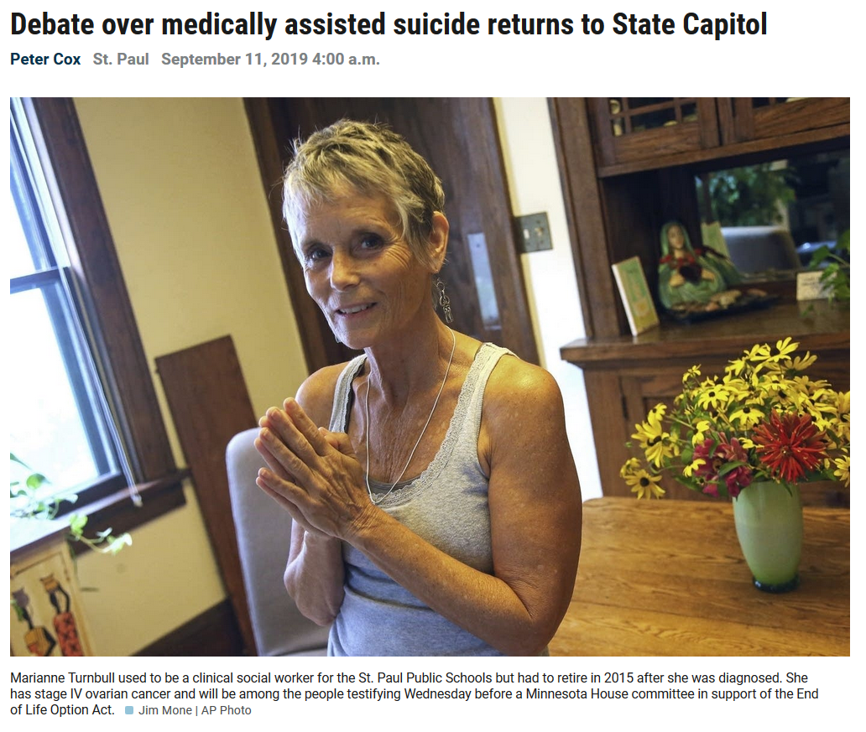

https://www.mprnews.org/story/2019/09/11/debate-over-medically-assisted-suicide-returns-to-minn-capitol

Slide 60
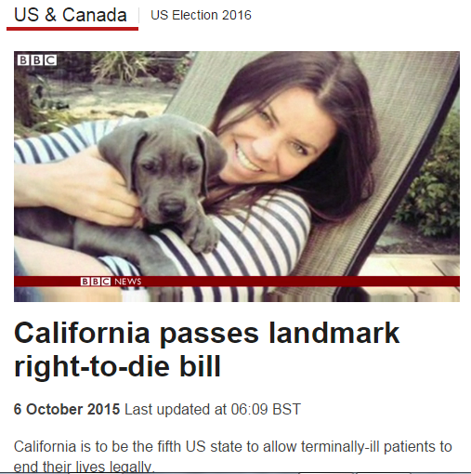
http://www.bbc.com/news/world-us-canada-34451379

Slide 61


1 January 2023
https://www.sbs.com.au/news/article/voluntary-assisted-dying-is-now-legal-in-queensland-heres-what-you-need-to-know/9lzfjxve2

Slide 62
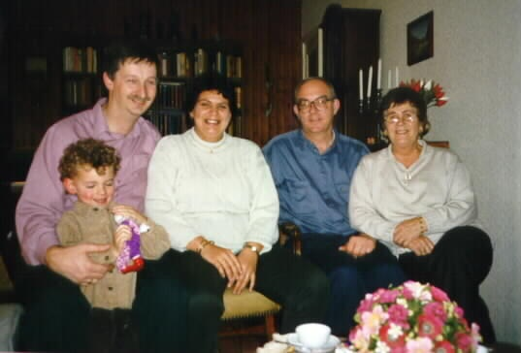
in many places doctor assisted suicide is legal, perfectly acceptable to many if not most, of the members of a culture

Slide 63
is that OK?

Slide 64
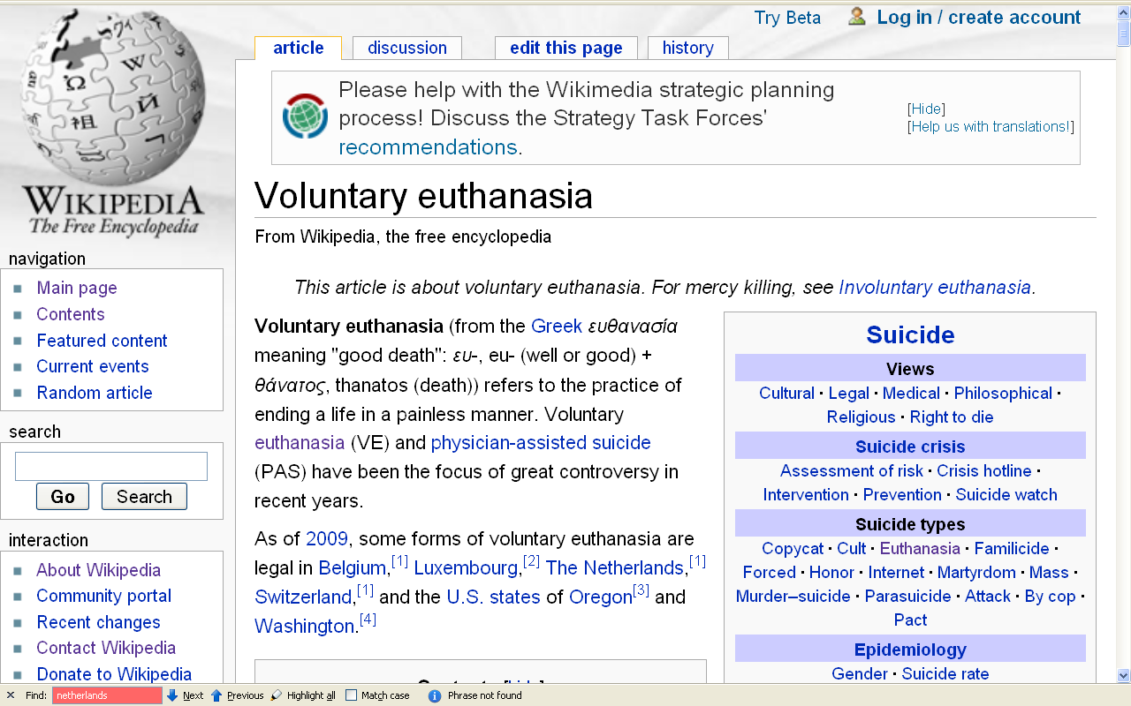
people living in the states of Oregon and Washington, and the countries of Belgium, Luxembourg, The Netherlands, Australia, and Switzerland think so (for e.g.)
\ http://en.wikipedia.org/wiki/Voluntary_euthanasia

Slide 65
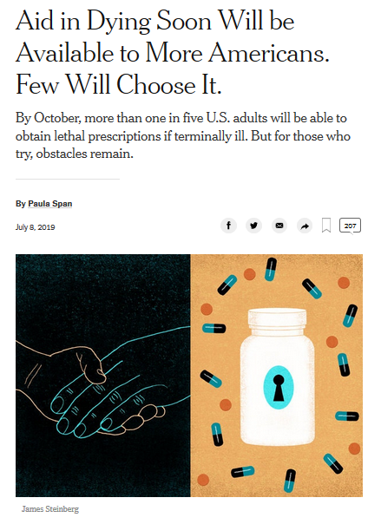
8 July 2019
https://www.nytimes.com/2019/07/08/health/aid-in-dying-states.html

Slide 66
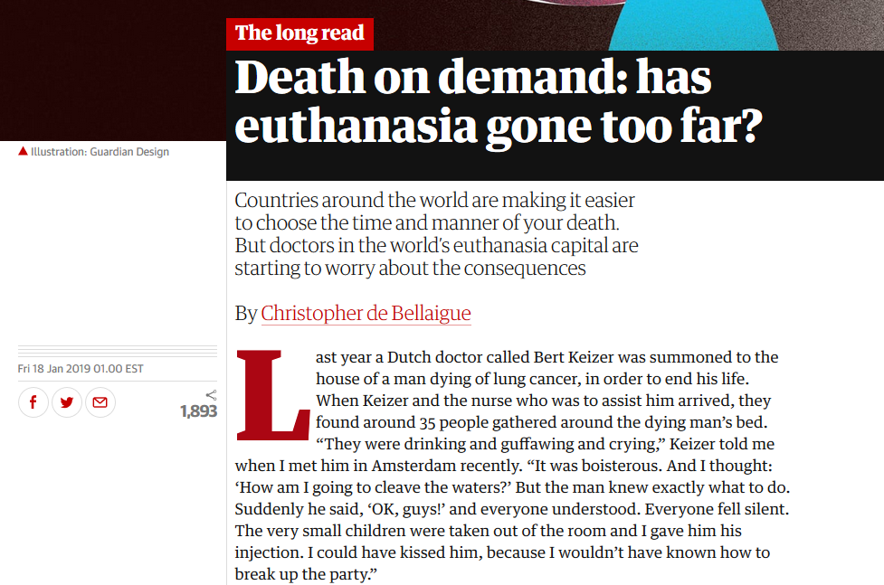
18 January 2019

Slide 67
absolute cultural relativism
  how about?
  Doctor Assisted Suicide
  arranged “underage” forced marriage
  female genital mutilations
  withholding of medical treatment of children for religious reasons
  polygyny
  marriage of first cousins . . .

Slide 68
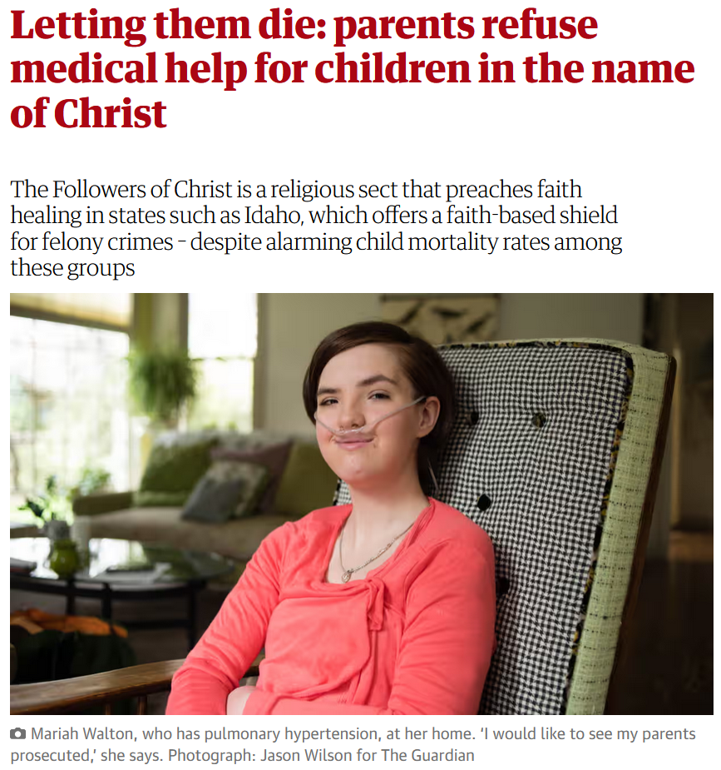
13 April 2016
https://www.theguardian.com/us-news/2016/apr/13/followers-of-christ-idaho-religious-sect-child-mortality-refusing-medical-help

Slide 69
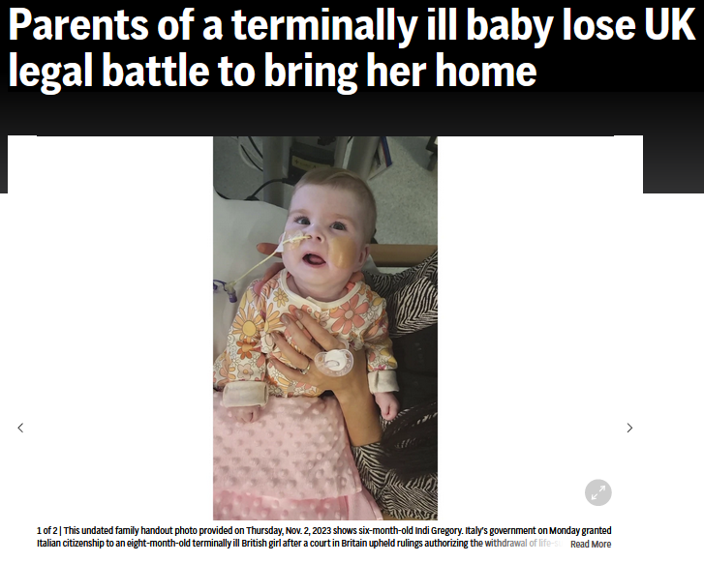

8 November 2023
https://www.theguardian.com/us-news/2016/apr/13/followers-of-christ-idaho-religious-sect-child-mortality-refusing-medical-help

Slide 70


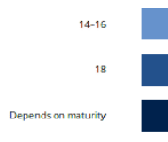
http://fra.europa.eu/en/publication/2017/mapping-minimum-age-requirements-concerning-rights-child-eu/consenting-medical-treatment-without-parental-consent

Slide 71
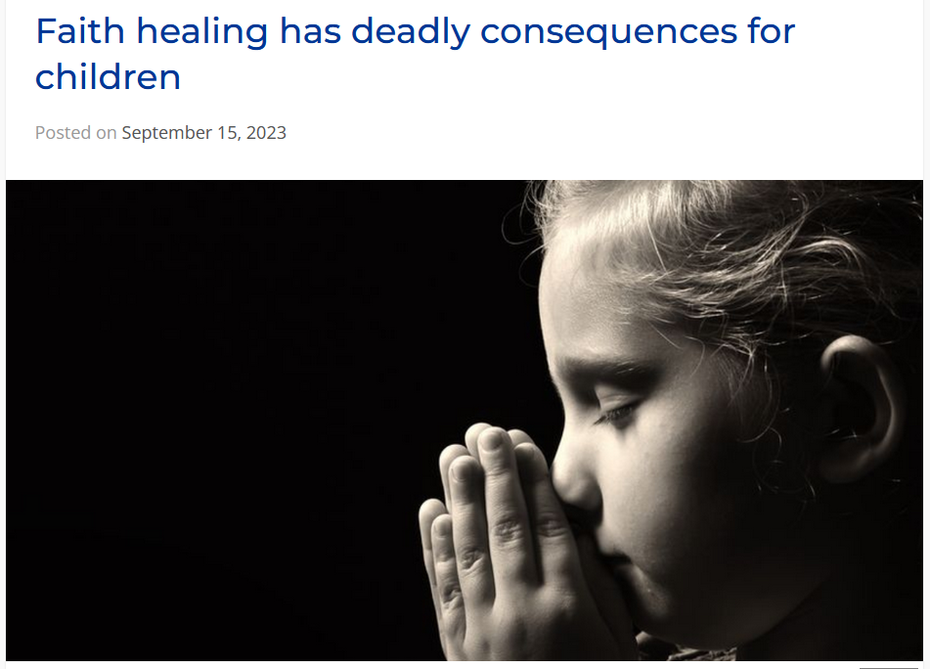

15 September 2023
https://secularaz.org/faith-healing/

Slide 72
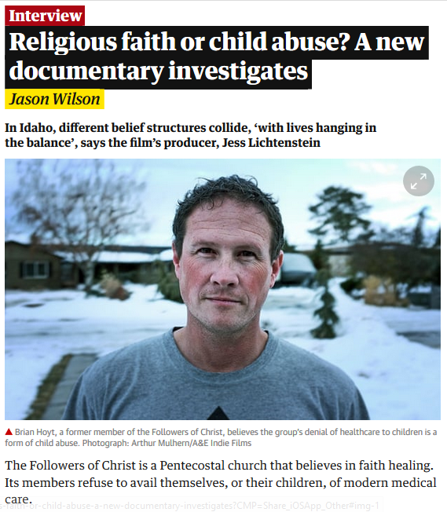
Sat 22 Sep 2018

Slide 73

www.wuwm.com/programs/news/view_news.php?articleid=2242

Slide 74
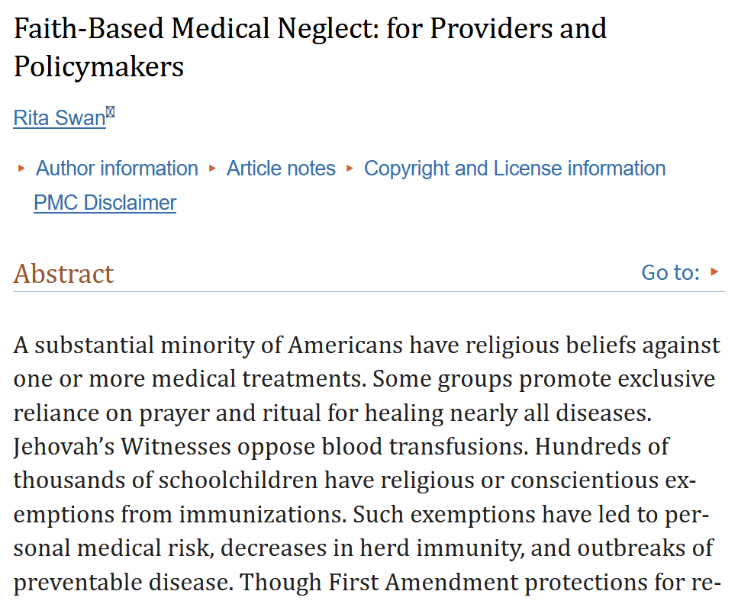
https://www.ncbi.nlm.nih.gov/pmc/articles/PMC7545013/

Slide 75


3 December 2023
https://www.nytimes.com/2023/12/03/us/politics/mississippi-childhood-vaccine-mandates.html

Slide 76
absolute cultural relativism
  how about?
  Doctor Assisted Suicide
  arranged “underage” forced marriage
  female genital mutilations
  withholding of medical treatment of children for religious reasons
  polygyny
  marriage of close cousins . . .
  -- child exploitation in general?

Slide 77
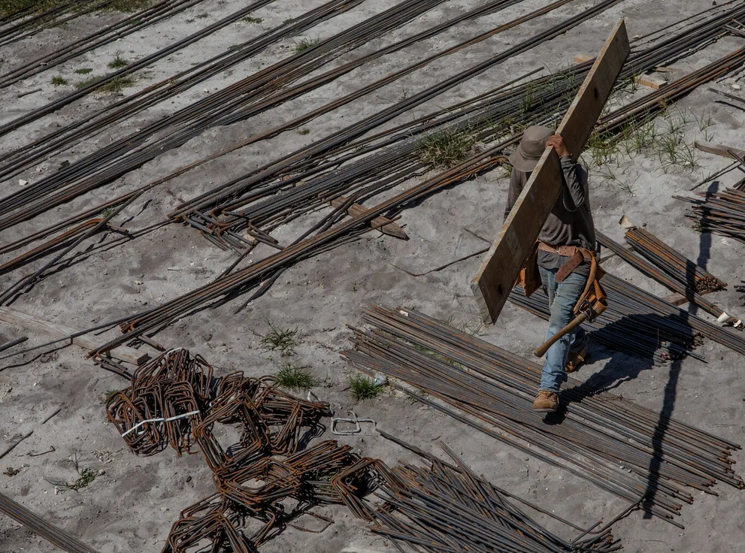

  2 February 2023
Alone and Exploited, Migrant Children Work Brutal Jobs Across the U.S.
Arriving in record numbers, they’re ending up in dangerous jobs that violate child labor laws — including in factories that make products for well-known brands like Cheetos and Fruit of the Loom.
source

Slide 78
  2 February 2023
Alone and Exploited, Migrant Children Work Brutal Jobs Across the U.S.
Cristian, 14, has been working in construction in North Miami for two years instead of going to school. Federal law bars minors from a long list of such jobs. Credit...Kirsten Luce for The New York Times
source

Slide 79
absolute cultural relativism
  How about?
  Doctor Assisted Suicide
  arranged “underage” marriage
  female genital mutilations
  withholding of medical treatment of children for religious reasons
  polygyny . . .

Slide 80
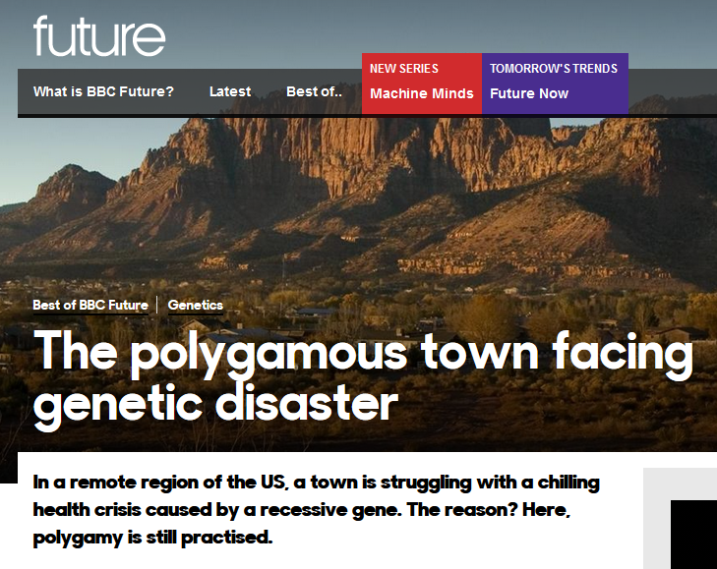
  26 July 2017

Slide 81


“When a leader in a fundamentalist polygamist group bought land last year in Cook County outside of Grand Marais it caused alarm in the small North Shore community. . . .”
  18 May 2019

Slide 82
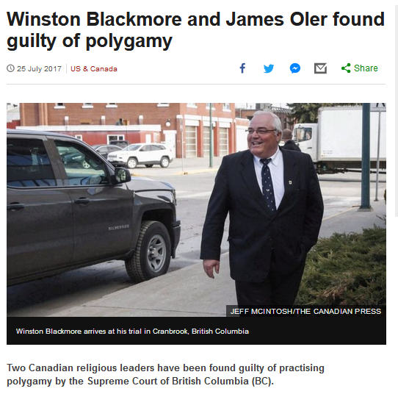
  25 July 2017
http://www.bbc.com/news/world-us-canada-40709250?ocid=global_bbccom_email_25072017_top+news+stories

Slide 83
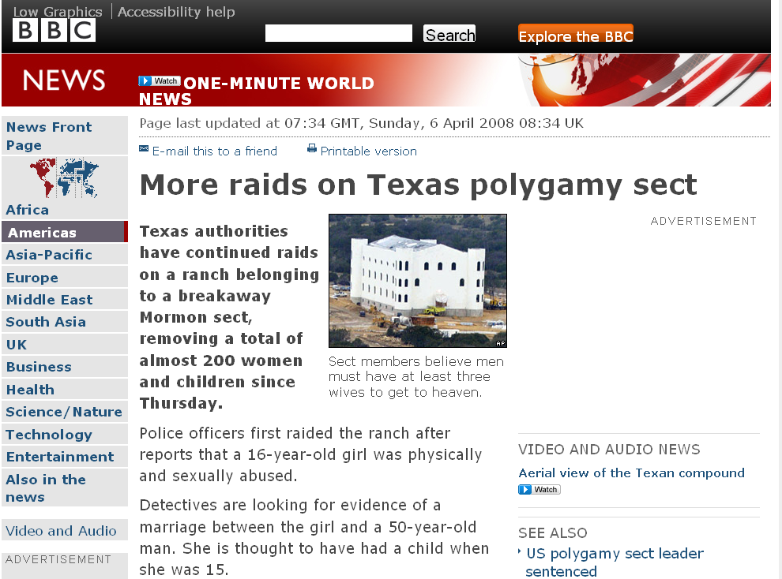
A classic case . . .
http://news.bbc.co.uk/2/hi/americas/7333004.stm

Slide 84
absolute cultural relativism
  how about the
  State of Texas authorities feeding food with preservatives to the Mormon children when they had them in custody?
  Doctor Assisted Suicide
  arranged “underage” marriage
  female genital mutilations
  withholding of medical treatment of children for religious reasons
  polygyny . . .

Slide 85
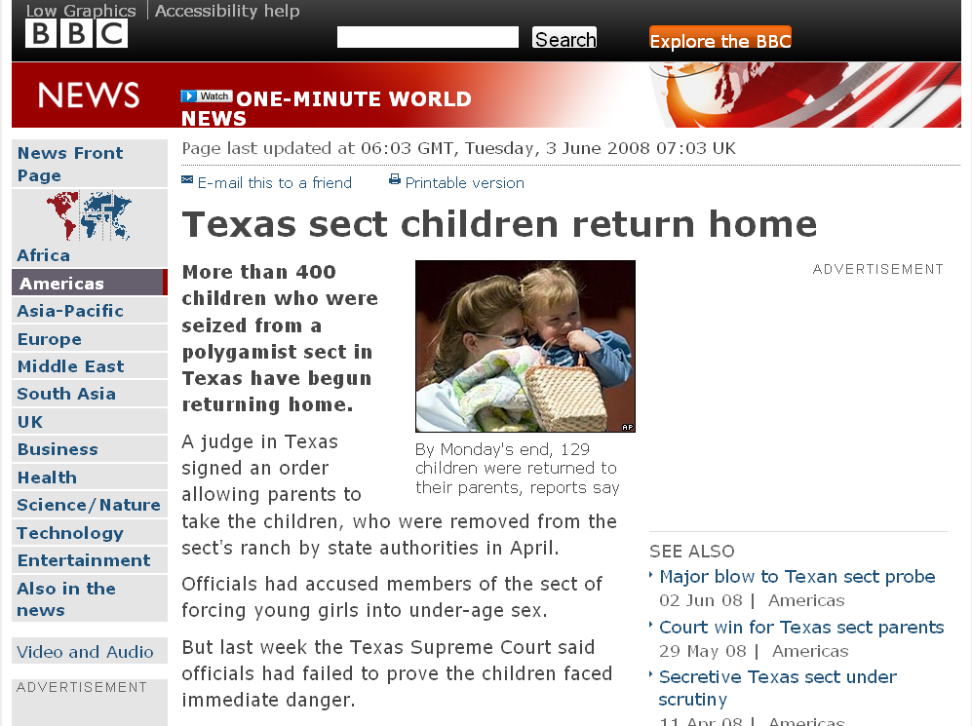
one of the complaints of the Mormons of Texas in court was that the State of Texas
was poisoning their children
with their [State provided] food
(with all it’s additives, sugars,
fats . . .)
http://news.bbc.co.uk/2/hi/americas/7431848.stm

Slide 86

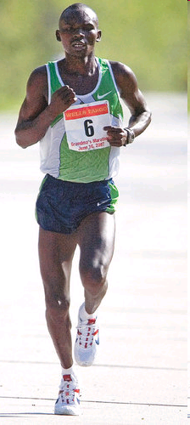
Grandma's Marathon: Remembering a fallen champion
Kevin Pates Duluth News Tribune
Published Sunday, June 15, 2008
There will be a moment of silence before the start of Saturday’s 32nd Grandma’s Marathon.
Standing on North Shore Drive, just south of Two Harbors, Stephen Muturi will gather his thoughts and emotions before the day’s task of running 26.2 miles.
He’ll remember close friend and countryman Wesly Ngetich, last year’s champion, who was killed Jan. 21 at Emarti village in Kenya’s Trans Mara district. Ngetich was caught in the middle of an incident that turned violent. He was 31 and had two wives and three children, ages 8, 6 and 1. “Wesly was a peacemaker. . . .”
www.duluthnewstribune.com/articles/index.cfm?id=68557
Notes:
86

Slide 87
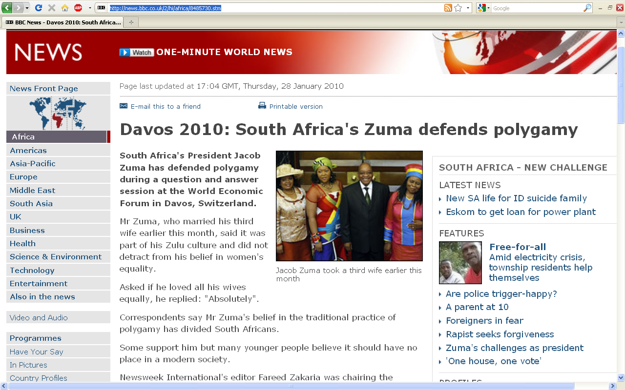
http://news.bbc.co.uk/2/hi/africa/8485730.stm
Notes:
87

Slide 88
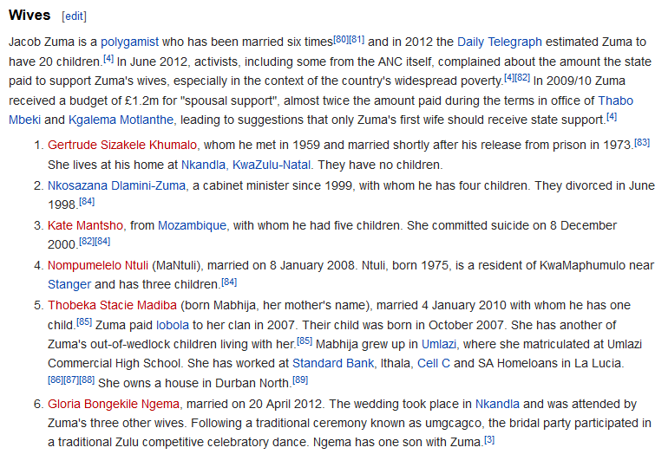
  How does the White House hadle official protocol at a state dinner when the President / Prime Minister of the other country has three or more wives?

Slide 89
  How does Buckingham Palace handle official protocol at a state dinner with the Queen and a Prime Minister of another country who has three or more wives?
  (at the same time, not successively with the President of the U.S.A.)

Slide 90
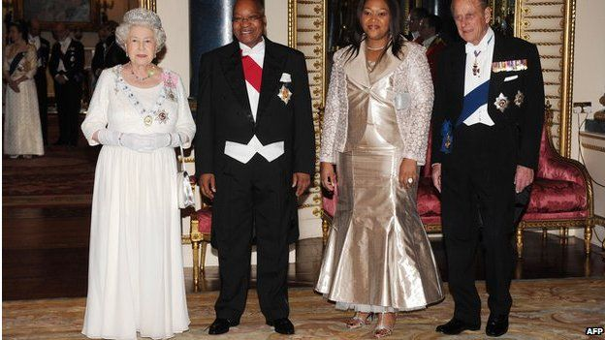
President Zuma attended a banquet at Buckingham Palace in 2010 with one of his wives, Tobeka Madiba Zuma
BBCNews

Slide 91
absolute cultural relativism
  how about?
  Doctor Assisted Suicide
  arranged “underage” forced marriage
  female genital mutilations
  withholding of medical treatment of children for religious reasons
  polygyny
  marriage of first cousins . . .

Slide 92
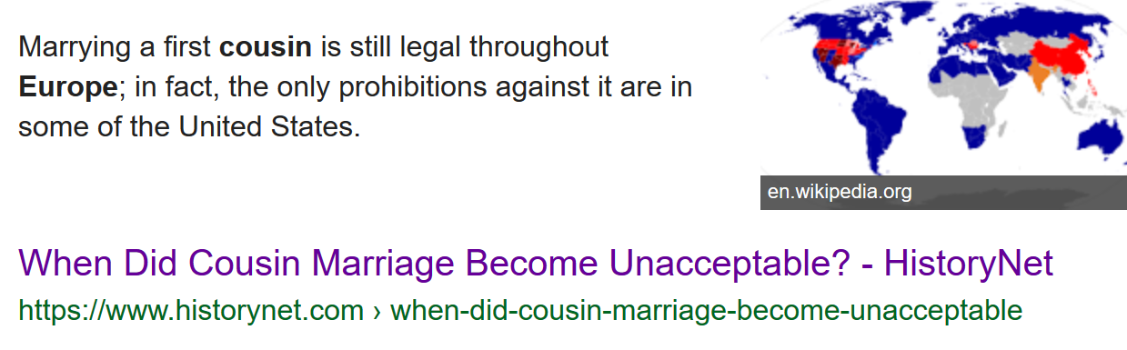
Source
Notes:
92

Slide 93
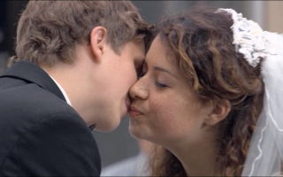
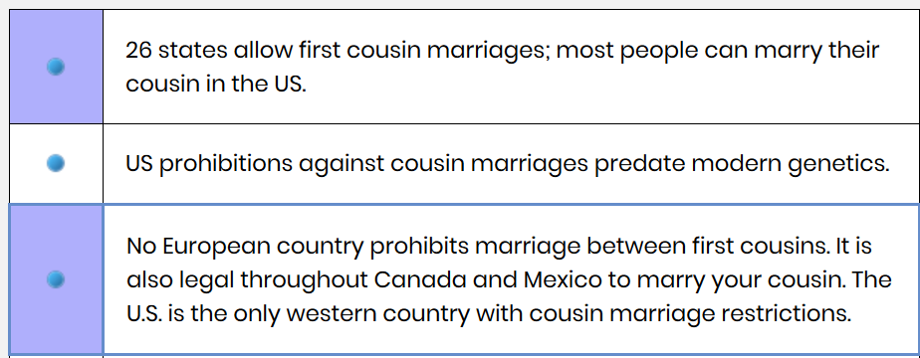
https://www.cousincouples.com/marriage-facts/
Notes:
93

Slide 94
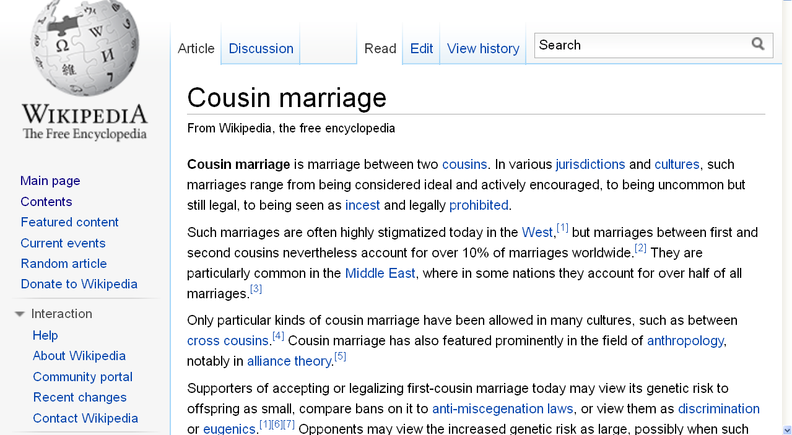
http://en.wikipedia.org/wiki/Cousin_marriage
Notes:
94

Slide 95
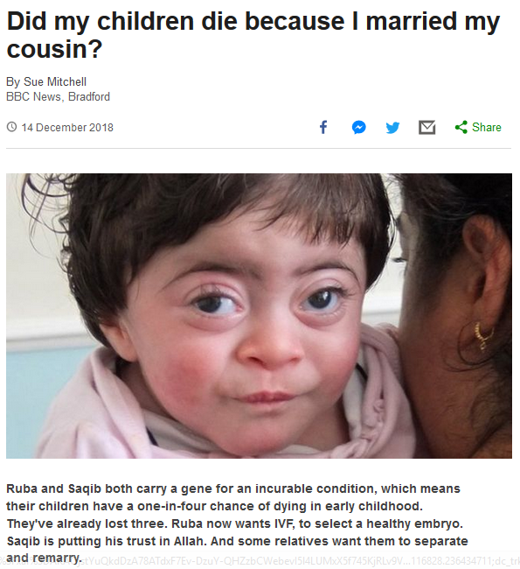

14 December 2018
Notes:
95

Slide 96
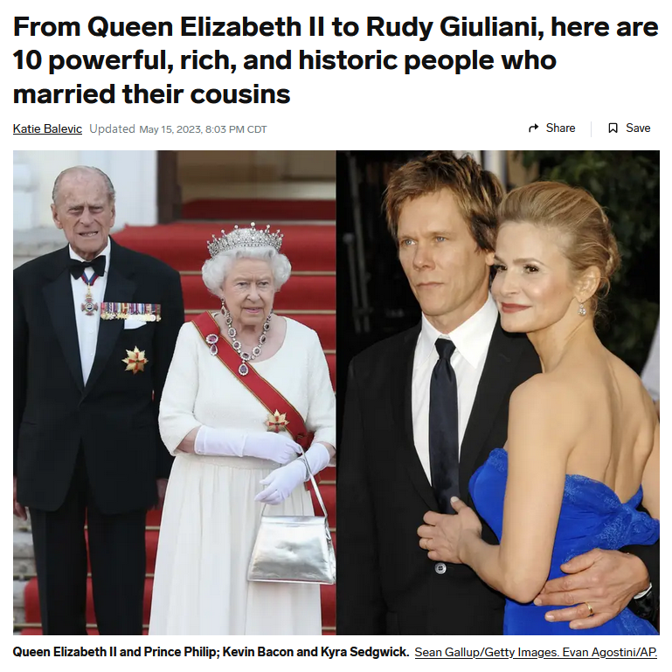
15 May 2023
https://www.insider.com/here-10-powerful-rich-historic-people-who-married-their-cousins-2022-12
Notes:
96

Slide 97
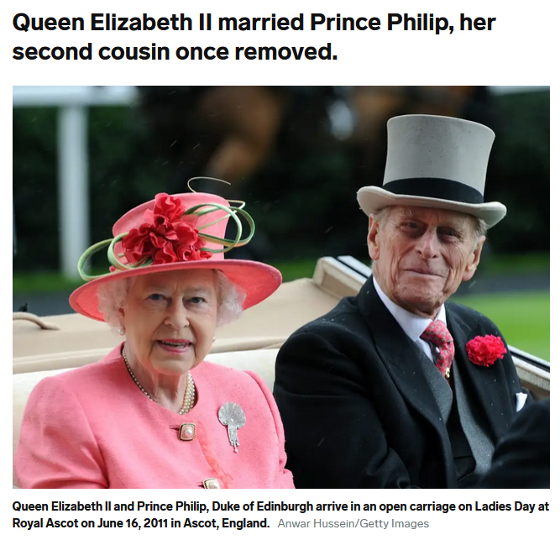
15 May 2023
https://www.insider.com/here-10-powerful-rich-historic-people-who-married-their-cousins-2022-12
Notes:
97

Slide 98
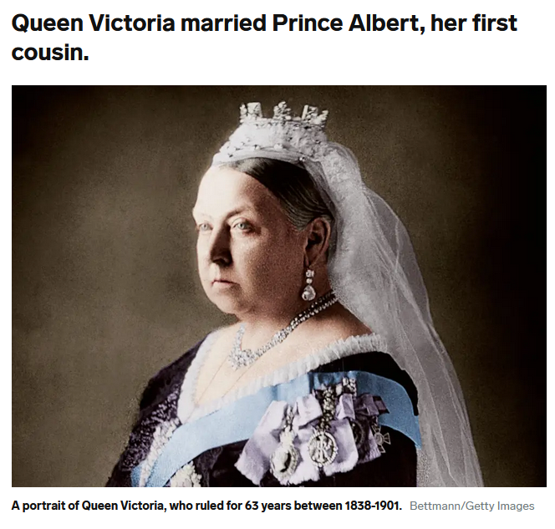
15 May 2023
https://www.insider.com/here-10-powerful-rich-historic-people-who-married-their-cousins-2022-12
Notes:
98

Slide 99
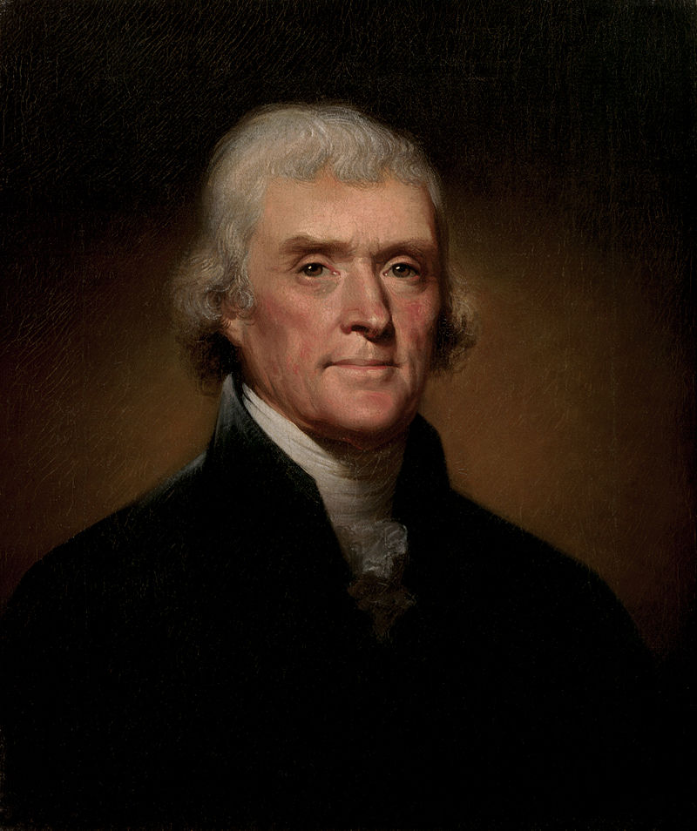
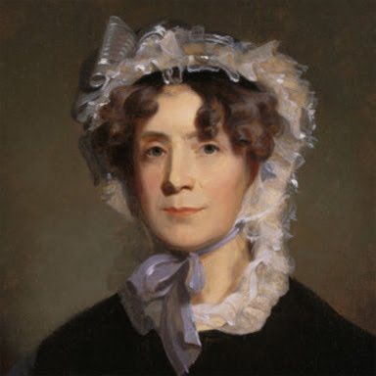
Thomas Jefferson
(1743 -1826)
married his third cousin
Martha Wayles Skelton
(1748-1782)
https://en.wikipedia.org/wiki/Thomas_Jefferson

Slide 100
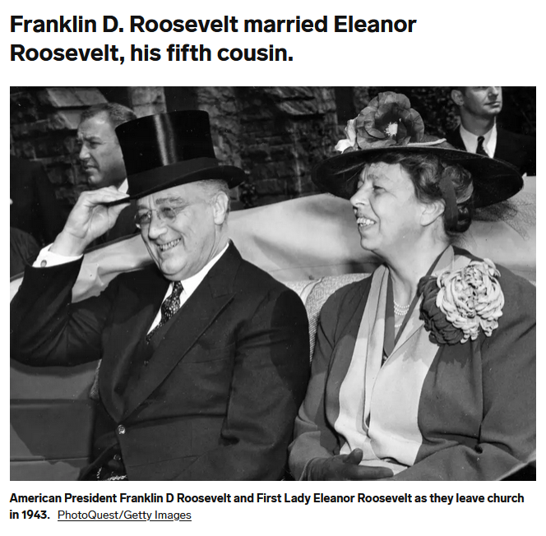
15 May 2023
https://www.insider.com/here-10-powerful-rich-historic-people-who-married-their-cousins-2022-12
Notes:
100

Slide 101
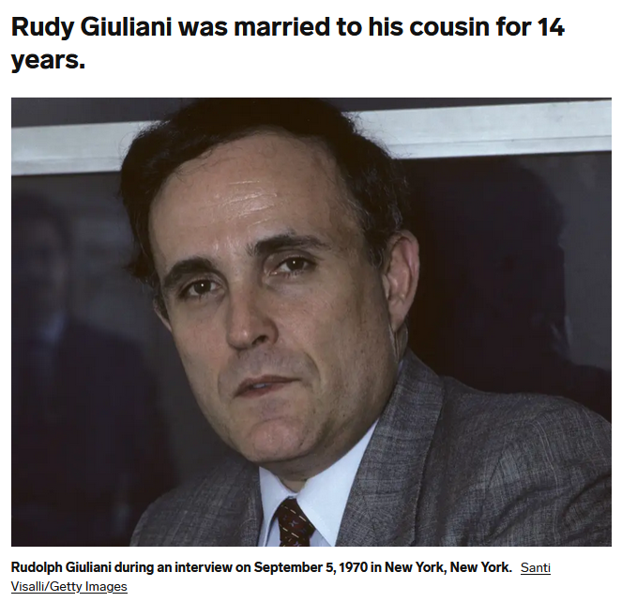
15 May 2023
https://www.insider.com/here-10-powerful-rich-historic-people-who-married-their-cousins-2022-12
Notes:
101

Slide 102
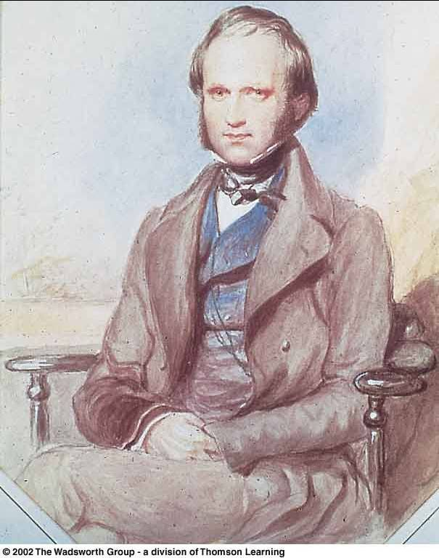
In 1839 Charles Darwin married his first cousin, Emma Wedgwood
Daughter of the younger Josiah Wedgwood, son of the Josiah Wedgwood who founded the pottery works
Darwin's mother Susannah was the sister of his wife’s father

Slide 103
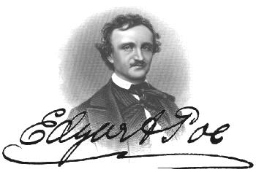
In 1835 Edgar Allan Poe married his widowed aunt’s daughter, Virginia Eliza Clemm
Virginia was 13 years old

Slide 104
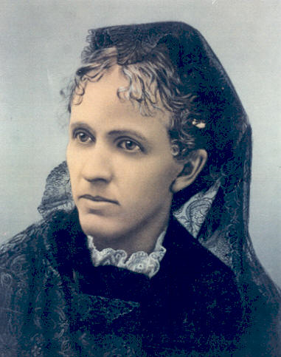

Jesse James married his first cousin
Zerelda "Zee" Mimms, named for his own mother
Zerelda "Zee" Mimms
“cousin of Jesse James and commonly accepted by historians as his wife”

Slide 105

In 1919 Einstein married
his second cousin, his second wife,
Elsa Lowenthal

Slide 106

Johann Sebastian Bach
(1685-1750)
married his second cousin
Maria Barbara Bach
(1685-1750)
the daughter of Johann Michael Bach
http://news.bbc.co.uk/2/hi/americas/6057004.stm

Slide 107

15 May 2023
https://www.insider.com/here-10-powerful-rich-historic-people-who-married-their-cousins-2022-12
Notes:
107

Slide 108

William and Mary
(English Monarchs William III and Mary II)
(Reigned 1689-1702/1694)
were first cousins
Mary was 15 when they married,
William was 26
https://en.wikipedia.org/wiki/William_and_Mary

Slide 109

College of
William and Mary in Williamsburg,
Virginia
https://en.wikipedia.org/wiki/William_and_Mary

Slide 110

1 March 2018
https://www.nytimes.com/2018/03/01/science/cousins-marriage-family-tree.html
Notes:
110

Slide 111

Jacob married two first cousins, Rachel and Leah
https://commons.wikimedia.org/wiki/Category:Paintings_of_Jacob_and_Rachel#/media/File:Spanish_-_Jacob_and_Rachel_at_the_Well_-_Google_Art_Project.jpg

Slide 112

Adam and Eve’s Grandchildren
http://commons.wikimedia.org/wiki/File:Jordaens_Fall_of_man.jpg

Slide 113

https://en.wikipedia.org/wiki/List_of_coupled_cousins
Notes:
113

Slide 114

http://www.cousincouples.com/info/states.shtml

Slide 115

http://en.wikipedia.org/wiki/Cousin_marriage
Notes:
115

Slide 116
usually children of brothers marry
FA-BR-DA
http://en.wikipedia.org/wiki/Cousin_marriage
Notes:
116

Slide 117

Robin Fox has a good discussion on cousin marriage
Harvard University Press , 2011
Notes:
117

Slide 118
absolute cultural relativism
  How about?
  Doctor Assisted Suicide
  arranged “underage” and arranged/forced marriage
  female genital mutilations
  withholding of medical treatment of children for religious reasons
  polygyny . . .

Slide 119

8 March 2021
https://www.nytimes.com/2021/03/08/world/asia/child-marriage-nepal-covid19.html?referringSource=articleShare

Slide 120

5 May 2023
https://www.theguardian.com/global-development/2023/may/05/child-marriage-in-decline-but-will-take-300-years-to-eliminate?CMP=share_btn_link

Slide 121


2 January 2022
https://www.npr.org/sections/goatsandsoda/2022/01/02/1066099271/child-grooms-are-often-overlooked-in-the-fight-to-stop-child-marriage

Slide 122

30 April 2022
https://www.theguardian.com/society/2022/apr/30/ethiopian-drought-leading-to-dramatic-increase-in-child-marriage-unicef-warns?CMP=share_btn_link

Slide 123

1 July 2018
https://www.bbc.com/news/world-asia-44672939

Slide 124

28 November 2023
https://www.bbc.com/news/world-africa-67549633

Slide 125

15 July 2020
https://www.bbc.com/news/world-africa-53420353

Slide 126

9 March 2021
https://www.bbc.com/news/stories-56337182

Slide 127

10 February 2021
https://www.theguardian.com/global-development/2021/feb/10/family-of-girl-12-forced-to-marry-abductor-condemn-pakistan-authorities?CMP=Share_iOSApp_Other

Slide 128


26 July 2021
https://www.usatoday.com/story/news/nation/2021/07/23/child-marriage-new-york-bans-all-minors-being-able-marry/8076855002/

Slide 129

15 Aug 2021
https://www.theguardian.com/us-news/2021/aug/15/north-carolina-child-marriage-new-bill

Slide 130

https://www.theguardian.com/world/2019/nov/04/new-zealand-accused-of-racism-after-visa-rule-throws-arranged-marriages-into-chaos?CMP=Share_iOSApp_Other
Notes:
130

Slide 131

https://www.theguardian.com/world/2019/nov/04/new-zealand-accused-of-racism-after-visa-rule-throws-arranged-marriages-into-chaos?CMP=Share_iOSApp_Other
Notes:
131

Slide 132

a 9-year-old requests a divorce in Yemen
http://news.bbc.co.uk/2/hi/middle_east/7711554.stm
Notes:
132

Slide 133

http://news.bbc.co.uk/2/hi/middle_east/7711554.stm
Notes:
133

Slide 134

Notes:
134

Slide 135

Birmingham, England
Notes:
135

Slide 136

Birmingham, England
1985 Asian Teen HelpLine
received ca. 1,400 calls / month

Slide 137

N!ai, one of the little girls in the film The Hunters,
was married to Gunda at the age of 8

Slide 138

27 May 2020
https://www.bbc.com/news/world-middle-east-52811631
Notes:
138

Slide 139

http://www.bbc.com/news/world-asia-36486974
Notes:
139

Slide 140
Glossary
  ?
absolute cultural relativism
  World War II Holocaust
  arranged “underage” marriage
  female infanticide
  collateral infanticide

Slide 141

  1 November 2017
source

Slide 142


  26 January 2023
https://www.cbsnews.com/news/conjoined-twins-separated-texas-amielynn-jamielynn-finley/

Slide 143

  15 July 2019
https://www.bbc.co.uk/news/extra/PLNMqvmycN/conjoined-twins

Slide 144
absolute cultural relativism
  How about . . .

Slide 145
absolute cultural relativism
  “freak shows” ?

Slide 146

9 October 2023
https://www.theguardian.com/us-news/2023/oct/09/stoneman-willie-mummified-man-reading-pennsylvania?CMP=share_btn_link

Slide 147

https://www.mprnews.org/story/2017/08/22/history-state-fair-sideshow

Slide 148

Saartjie Baartman
1789 - 1815

Slide 149

Saartjie Baartman
1789 - 1815

Slide 150

Saartjie Baartman
1789 - 1815

Slide 151

Saartjie Baartman
1789 - 1815

Slide 152

Saartjie Baartman
1789 - 1815

Slide 153

http://en.wikipedia.org/wiki/Saartjie_Baartman

Slide 154
She died on 29 December 1815
Her skeleton, preserved genitals and brain were placed
on display in Paris' Musée de l'Homme until 1974.
Her remains were repatriated to her homeland, the Gamtoos Valley, on 6 May 2002 and she was
finally laid to rest on 9 August 2002
on Vergaderingskop, a hill in the town of Hankey
over 200 years after her birth.
Saartjie Baartman
1789 - 1815
http://en.wikipedia.org/wiki/Saartjie_Baartman

Slide 155
She died on 29 December 1815
Her skeleton, preserved genitals and brain were placed
on display in Paris' Musée de l'Homme until 1974.
Her remains were repatriated to her homeland, the Gamtoos Valley, on 6 May 2002 and she was
finally laid to rest on 9 August 2002
on Vergaderingskop, a hill in the town of Hankey
over 200 years after her birth.
Saartjie Baartman
1789 - 1815
http://en.wikipedia.org/wiki/Saartjie_Baartman

Slide 156

6 May 2002
Saartjie Baartman
1789 - 1815

Slide 157

6 May 2002
http://news.bbc.co.uk/1/hi/world/europe/1957240.stm

Slide 158
6 May 2002
http://www.judyshopsthemall.com/2009/08/bodies-the-exhibition-walks-into-controversial-debut-at-mall-of-america/

Slide 159
August 2009

Slide 160

BODIES Exhibit
in Paris
an at
The Mall of America
August 2009
http://www.judyshopsthemall.com/2009/08/bodies-the-exhibition-walks-into-controversial-debut-at-mall-of-america/

Slide 161
August 2009
http://www.judyshopsthemall.com/2009/08/bodies-the-exhibition-walks-into-controversial-debut-at-mall-of-america/

Slide 162
2023 - 2024

Slide 163


Real Bodies at Horseshoe Las Vegas
SEP 5 - JAN 8
August 2009
source

Slide 164

http://news.bbc.co.uk/2/hi/uk_news/scotland/edinburgh_and_east/7492386.stm
Notes:
164

Slide 165

“It all amounts to a 21st Century version of a circus freak show; no one is supposed to watch junk like that but everyone does.”
www.duluthsuperior.com/mld/duluthsuperior/news/editorial/15397954.htmhttp://www.duluthsuperior.com/mld/duluthsuperior/news/editorial/15397954.htm

Slide 166

1862 - 1890
https://www.theguardian.com/uk-news/2016/jun/09/elephant-man-skeleton-should-be-given-christian-burial-say-campaigners

Slide 167

http://www.bbc.com/news/magazine-37344210

Slide 168

http://www.bbc.com/news/magazine-37344210

Slide 169
absolute cultural relativism
  How about human body parts being sold on-line . . .?

Slide 170

POPULAR SCIENCE
18 August 2021
https://www.popsci.com/skeleton-keys-excerpt/

Slide 171

23 August 2016
http://news.nationalgeographic.com/2016/08/human-skulls-sale-legal-ebay-forensics-science/

Slide 172

23 August 2016
http://news.nationalgeographic.com/2016/08/human-skulls-sale-legal-ebay-forensics-science/

Slide 173
absolute cultural relativism
  How about . . .

Slide 174
absolute cultural relativism
  lynching people because of rumors, or just because they do something you don’t like . . .

Slide 175

http://www.bbc.com/news/world-asia-india-34398433?ocid=global_bbccom_email_30092015_top+news+stories
Notes:
175

Slide 176

19 July 2019
https://www.bbc.com/news/world-asia-india-49049372
Notes:
176

Slide 177

23 February 2019
https://www.bbc.com/news/stories-47321871
Notes:
177

Slide 178
  Closer to home . . .

Slide 179



21 December 2023
now deleted
now denied
on X, formerly known as Twitter, at 9:02 p.m. Dec. 20
https://www.tmz.com/2023/12/21/dukes-of-hazzard-star-john-schneider-death-threat-joe-biden/
Notes:
179

Slide 180
absolute cultural relativism
  How about eating habits . . .?

Slide 181

http://www.bbc.com/news/world-asia-india-40428067
Notes:
181

Slide 182

http://www.bbc.com/news/world-asia-india-40393331
Notes:
182

Slide 183

http://www.bbc.com/news/world-asia-india-40116811
Notes:
183

Slide 184
absolute cultural relativism
  How about food stamps? . . .
  and school lunches for kids? . . .
  and federal bailouts to
  mega-farmers? . . .

Slide 185

http://www.mprnews.org/story/2015/09/19/npr-food-stamps
Notes:
185

Slide 186

4 December 2019
https://www.theguardian.com/us-news/2019/dec/04/food-stamps-snap-trum4 Dec 2019 18.18 ESTp-sonny-perdue?CMP=Share_iOSApp_Other
Notes:
186

Slide 187


15 August 2021
https://www.nytimes.com/2021/08/15/us/politics/biden-food-stamps.html
Notes:
187

Slide 188
absolute cultural relativism
  How about food stamps? . . .
  and school lunches for kids . . .?
  and federal bailouts to
  mega-farmers? . . .

Slide 189

https://www.theguardian.com/commentisfree/2019/sep/08/why-school-cafeterias-should-be-the-frontlines-of-policy-change?CMP=Share_iOSApp_Other
Notes:
189

Slide 190
absolute cultural relativism
  How about food stamps? . . .
  and school lunches for kids . . .?
  and federal bailouts to
  mega-farmers? . . .

Slide 191


In the U.S.A., $28 billion in 2019, mostly to large corporate farms
https://www.marketplace.org/2019/12/12/these-are-the-states-benefiting-the-most-from-the-28-billion-farm-bailout/
Notes:
191

Slide 192


https://www.latimes.com/business/hiltzik/la-fi-hiltzik-trump-farm-bailout-20190528-story.html
Notes:
192

Slide 193

20 Aug 2021
https://www.theguardian.com/us-news/2021/aug/20/black-indigenous-farmers-were-promised-reparations-debt-relief-all-but-four-farmers-are-still-waiting?CMP=Share_iOSApp_Other

Slide 194


19 February 2023
“In 2022, the federal government provided farms with $15.6 billion in subsidies, or direct farm program payments.” -- USDA
https://www.npr.org/2023/02/19/1156851675/in-2022-black-farmers-were-persistently-left-behind-from-the-usdas-loan-system

Slide 195
absolute cultural relativism
  How about food stamps? . . .
  and school lunches for kids . . .?
  When we have so much food, we can’t possibly eat it . . .
  (Until just recently we paid business people to use about 40% of our corn to make ethanol for cars.)

Slide 196

https://www.theguardian.com/food/2019/jan/10/america-cheese-surplus-production-dairy-farmers
Notes:
196

Slide 197


http://www.mprnews.org/story/2015/09https://www.vox.com/science-and-health/2018/6/28/17515188/us-cheese-surplus-billion-pounds19/npr-food-stamps
Notes:
197

Slide 198

http://www.mprnews.org/story/2015/09https://www.vox.com/science-and-health/2018/6/28/17515188/us-cheese-surplus-billion-pounds19/npr-food-stamps
Notes:
198

Slide 199
absolute cultural relativism
  How about food stamps . . .?
  and school lunches for kids . . .?
  When we have so much food, we can’t possibly eat it . . .
  . . . So, we feed it to our cars . . .

Slide 200
absolute cultural relativism
  Until just recently we
  (i.e., the U.S. and state Governments)
  paid business people to use about 40% of our corn to make ethanol for cars, and most states forced drivers to use it in their cars . . .

Slide 201

https://www.agmrc.org/media/cms/article_1_picture_74EA1A08B9D90.png

Slide 202


Slide 203

“The USDA currently predicts 5.3 billion bushels of corn will go to ethanol production for 2023-’24.”
-- Ethanol 12 October 2023

Slide 204
absolute cultural relativism
  Around the world folks argue that the current practice is
  exactly opposite
  of good food, environmental, and health policy . . .

Slide 205
absolute cultural relativism
  how about . . .?
  cannibalism
  (Anthropophagy)

Slide 206

7 Dec. 2020
https://www.nytimes.com/2020/12/07/arts/design/Ouroboros-Steak-design-museum.html?referringSource=articleShare

Slide 207


Slide 208

VOGUE
Timothée Chalamet Is an Angsty Teen Cannibal in the First Teaser for Bones and All
https://www.vogue.com/article/bones-and-all-everything-you-need-to-know
Notes:
and

Slide 209

An engraving depicting the Tupi. (DeAgostini/Getty Images)
https://www.vox.com/2015/2/17/8052239/cannibalism-surprising-facts

Slide 210




https://www.cnsnews.com/commentary/john-horvat-ii/uk-professors-attempt-mainstream-cannibalism-normal

Slide 211

13 June 2019
https://www.theguardian.com/world/2019/jun/13/briton-mails-severed-toes-to-canada-for-use-in-notorious-cocktail?CMP=Share_iOSApp_Other

Slide 212

13 June 2019
https://www.theguardian.com/world/2019/jun/13/briton-mails-severed-toes-to-canada-for-use-in-notorious-cocktail?CMP=Share_iOSApp_Other

Slide 213


29 June 2016
https://www.aol.com/article/2016/06/29/places-where-modern-day-cannibalism-still-exists/21421203/

Slide 214

Cambridge University Press, 1986

Slide 215

http://www.bbc.com/news/world-africa-41072524

Slide 216

http://www.d.umn.edu/cla/faculty/troufs/anthfood/afcannibalism.html#title

Slide 217


Slide 218


10 June 2015
http://www.theguardian.com/science/2015/jun/10/brains-helped-papua-new-guinea-tribe

Slide 219

http://english.pravda.ru/science/19/94/377/14863_cannibalism.html

Slide 220

  Cannibalism from an Anthropological viewpoint
  Felipe Fernández-Armesto
Simon & Schuster 2003

Slide 221

http://www.bbc.com/news/science-environment-40886748?ocid=global_bbccom_email_10082017_top+news+stories

Slide 222
cannibalism
Moula-Gercy, France
“Bones Offer Evidence of a Neanderthal - Eat - Neanderthal World”
78 fragments from 6 skeletons
ca. 100,000 ybp
30 September 1999

Slide 223

http://dsc.discovery.com/news/2008/02/27/neanderthal-cannibalism.html
Notes:
223

Slide 224

http://news.nationalgeographic.com/news/2008/06/080604-human-sacrifice.html
Notes:
224

Slide 225

http://www.bbc.com/news/entertainment-arts-39329561

Slide 226


  “survival
  cannibalism”

Slide 227

Stephen King
“Survivor Type”
1985
  “survival
  cannibalism”

Slide 228

  “gustatory
  cannibalism”

Slide 229
  “ritual cannibalism”

Slide 230

cultural relativism?
  stealing peoples’ land and property
  infant cranial deformation
  Aztec human heart sacrifice
  cannibalism
  selling and eating children
  eating insects
  eating dogs
  . . .
  “ritual cannibalism”
e.g., Aztecs must sacrifice and eat humans
in order to please the gods
in order that the gods allow
the sun to rise each day,
so that the world doesn’t end

Slide 231
  but how about other forms of
  extreme cuisine . . .?

Slide 232


23 December 2020
This wild boar carnitas was made from a recipe by Texas-based chef and hunter Jesse Griffiths. Feral hogs are one of the destructive invasive species increasingly appearing on high-end restaurant menus.
Source

Slide 233

20 December 2019
Source

Slide 234


https://gastropod.com/are-insect-guts-the-secret-to-the-most-delicious-kimchi/

Slide 235

Ortolans (or ortolan buntings)
were said to be
French president François Mitterrand’s
favorite dish.
https://gastropod.com/are-insect-guts-the-secret-to-the-most-delicious-kimchi/

Slide 236

Ortolans (or ortolan buntings)
were said to be
French president François Mitterrand’s
favorite dish.
https://gastropod.com/are-insect-guts-the-secret-to-the-most-delicious-kimchi/

Slide 237

  . . . for example,
watch this short video . . .
National Geographic Video
http://video.nationalgeographic.com/video/skorea-liveoctopus-pp?source=relatedvideo

Slide 238
  other “extreme” treats include things like . . .

Slide 239

http://www.bbc.com/travel/story/20160620-weird-foods-only-a-local-could-love

Slide 240

http://www.bbc.com/travel/story/20160620-weird-foods-only-a-local-could-love

Slide 241

http://www.bbc.com/travel/story/20160620-weird-foods-only-a-local-could-love

Slide 242

http://www.bbc.com/travel/story/20160620-weird-foods-only-a-local-could-love

Slide 243

http://www.bbc.com/travel/story/20160620-weird-foods-only-a-local-could-love

Slide 244

http://www.bbc.com/travel/story/20160620-weird-foods-only-a-local-could-love

Slide 245


19 July 2019
https://www.livescience.com/63831-squirrel-brains-rare-disorder-creutzfeldt-jakob-disease.html

Slide 246
absolute cultural relativism
  How about . . .?

Slide 247
cultural relativism
  stealing peoples’ land and property
  infant cranial deformation
  Aztec human heart sacrifice
  cannibalism
  selling and eating children
  eating insects
  eating dogs
  . . .

Slide 248
cultural relativism
  stealing peoples’ land and property
  infant cranial deformation
  Aztec human heart sacrifice
  cannibalism
  selling and eating children
  eating insects
  eating dogs
  . . .

Slide 249


https://people.com/pets/how-to-stop-yulin-dog-meat-festival/

Slide 250
An estimated 10,000 pets are killed each year.
The Chinese Yulin Meat Festival is not endorsed by the local government but it is also not illegal.
https://people.com/pets/how-to-stop-yulin-dog-meat-festival/

Slide 251

25 July 2020
https://www.bbc.com/news/av/world-asia-53514915

Slide 252
cultural relativism
  stealing peoples’ land and property
  infant cranial deformation
  Aztec human heart sacrifice
  cannibalism
  selling and eating children
  eating insects
  eating dogs
  eating horses

Slide 253

cultural relativism
  stealing peoples’ land and property
  infant cranial deformation
  Aztec human heart sacrifice
  cannibalism
  selling and eating children
  eating insects
  eating dogs
  eating horses
Source
Wikipedia

Slide 254

cultural relativism
  stealing peoples’ land and property
  infant cranial deformation
  Aztec human heart sacrifice
  cannibalism
  selling and eating children
  eating insects
  eating dogs
  eating horses
Wikipedia

Slide 255


8 June 2017
https://www.theatlantic.com/technology/archive/2017/06/horse-meat/529665/?utm_source=email&utm_medium=social&utm_campaign=share

Slide 256


Slide 257
absolute cultural relativism
  Questions about eating horses cause big concern in Europe.
  People in some countries eat horses, some do not.

Slide 258


  15 January 2013
http://news.nationalgeographic.com/news/2013/13/130212-horse-meat-beef-scandal-food-france-england-europe-science-taboo-horsemeat/

Slide 259


Slide 260

  15 January 2013

Slide 261


12 May 2020
https://www.foodnavigator.com/Article/2020/05/12/Beef-fraud-Counterfeit-products-the-biggest-threat-to-supply-chain#

Slide 262

  15 January 2013
http://www.bbc.com/news/world-europe-40624073

Slide 263

  29 August 2013

Slide 264

12 January 2023
https://www.irishtimes.com/opinion/2023/01/12/irish-horsemeat-scandal-changed-the-way-europe-looks-at-food-safety/

Slide 265

  15 January 2013

Slide 266

  15 January 2013
http://www.mprnews.org/story/2014/01/17/politics/congress-blocks-slaughtering-horses-for-meat-in-us

Slide 267

or how about eating gorilla?
Spring
2003
http://www.gastronomica.org/gastro/pages/sample3.2.html

Slide 268

Spring
2003
How about baiting, then killing Cecil the Lion to hang his stuffed head on the wall?
http://www.bbc.com/news/uk-england-oxfordshire-33782249

Slide 269
Spring
2003
Cecil was a well-known tourist attraction in Zimbabwe and was shot by dentist Walter Palmer from Minnesota, USA.
http://www.bbc.com/news/uk-england-oxfordshire-33782249

Slide 270
absolute cultural relativism
  how about . . .?

Slide 271
absolute cultural relativism
  jail for vegan/vegetarian parents who refuse to feed their children meat . . .?

Slide 272

http://www.bbc.com/news/world-europe-37034619

Slide 273

https://www.theguardian.com/lifeandstyle/2019/oct/25/why-do-people-hate-vegans?CMP=Share_iOSApp_Other

Slide 274

https://www.theguardian.com/commentisfree/2017/apr/18/veggie-burger-clean-meat-revolution-plant-foods-animals?CMP=Share_iOSApp_Other

Slide 275
absolute cultural relativism
  how about . . .?
  so-called Christians training their young children for urban warfare? . . .

Slide 276

14 August 2019
https://www.theguardian.com/world/2019/aug/13/matt-shea-biblical-war-washington-team-rugged?CMP=Share_iOSApp_Other

Slide 277

https://www.theguardian.com/film/2016/jul/06/jesus-camp-christian-documentary-kids-10-years-later?CMP=oth_b-aplnews_d-1

Slide 278
absolute cultural relativism
  Or . . .

Slide 279


Does it matter that a handful of companies own the world’s major brands?
http://sploid.gizmodo.com/fascinating-graphic-shows-who-owns-all-the-major-brands-1599537576

Slide 280

green queen
16 July 2021
https://www.greenqueen.com.hk/big-food-corporations-market-dominance/

Slide 281
10 of the Biggest Food Companies Basically Own Every Grocery Item You Buy
https://www.wideopeneats.com/biggest-food-companies/

Slide 282
http://sploid.gizmodo.com/fascinating-graphic-shows-who-owns-all-the-major-brands-1599537576

Slide 283
absolute cultural relativism
  For e.g., JAB Holdings, the Luxembourg holding company run by the German billionaire Reimann family

Slide 284

https://www.businessinsider.com/jab-holding-building-a-coffee-and-bagel-empire-2017-4

Slide 285

https://www.businessinsider.com/jab-holding-building-a-coffee-and-bagel-empire-2017-4

Slide 286
absolute cultural relativism
  Or how about . . .

Slide 287

https://finance.yahoo.com/blogs/daily-ticker/how-four-companies-control-the-supply-and-price-of-beef--pork-and-chicken-in-the-u-s-eat-prices-224406080.html

Slide 288
  How about that rich handful of companies—and others—peddling “fake news”—propaganda—lies—”alternative facts” that is/are unfair and “damaging to public discourse”—and to people—and to society in general . . .?

Slide 289


Slide 290
For the record, this is the group from which news is generally taken for this course . . .

Slide 292
absolute cultural relativism
  How about . . .?

Slide 293
absolute cultural relativism
  . . . leniency for a kid who comes “from ‘good family’” . . .?

Slide 294

. . . like rich kids who kill and rape not held responsible because they are rich kids suffering from “affluenza”?
http://www.bbc.com/news/world-us-canada-35117311

Slide 295


Slide 296

How about the rich kid’s mother harboring a fugitive, and aiding and abetting (and even celebrating) his criminal behavior?
http://www.bbc.com/news/world-us-canada-35192267

Slide 297

http://www.bbc.com/news/world-us-canada-36040878

Slide 298


or maybe his genes made him do it . . .
source

Slide 299
source

Slide 300
absolute cultural relativism
  How about . . .?

Slide 301

absolute cultural relativism
  . . . a Supreme Court judge who testified in his own confirmation hearings that (at least in his own case) people shouldn’t be held accountable for things they do as minors, who later ruled as a Supreme Court Judge, and authored the Court opinion, that “Children Deserve Life in Prison with No Chance of Parole?”

Slide 302

22 April 2021
https://www.vanityfair.com/news/2021/04/brett-kavanaugh-life-in-prison

Slide 303
absolute cultural relativism
  More directly related to
  Anthropology of of Europe . . .

Slide 304
absolute cultural relativism
  How about . . .?
  the way girls and women are treated in Kypseli

Slide 305

29 August 2023
  or France?
source

Slide 306

  or Belgium?

Slide 307

  or Italy?

Slide 308


  or on the Web?
https://www.unwomen.org/en/news-stories/explainer/2023/11/creating-safe-digital-spaces-free-of-trolls-doxing-and-hate-speech

Slide 309
absolute cultural relativism
  how about . . .?
bullfighting
corrida de toros

Slide 310

http://www.bbc.com/news/world-europe-38063778

Slide 311

http://www.bbc.com/news/world-europe-37329315

Slide 312


http://www.telegraph.co.uk/news/2016/07/11/ritual-of-slaughtering-mother-of-bull-that-killed-spanish-matado/

Slide 313

https://www.theguardian.com/world/2019/oct/25/spain-young-bullfighters-a-photo-essay?CMP=Share_iOSApp_Other

Slide 314
absolute cultural relativism
  how about . . .?

Slide 315

https://www.bbc.com/reel/video/p06x2v5g/spain-s-elite-female-bullfighter

Slide 316
  Why might it be OK for males to kill bulls, but not for females to kill bulls?
https://www.bbc.com/reel/video/p06x2v5g/spain-s-elite-female-bullfighter

Slide 317
absolute cultural relativism
  how about . . .
  making it illegal for people with dwarfism to perform at bullfights?

Slide 318

12 July 2023
On the Front Line of a War Over Bullfighting Traditions
Opponents of Spain’s comic shows at bullfights by people with dwarfism say they are banned by a new law. But performers say the show must go on.
https://www.nytimes.com/2023/07/12/world/europe/spain-bullfights.html

Slide 319
absolute cultural relativism
  how about . . .
  dwarf tossing as bar and party entertainment in the U.S.A.?

Slide 320

https://dwarftossing.com/

Slide 321
absolute cultural relativism
  how about . . .?

Slide 322

21 October 2016
http://www.bbc.com/capital/story/20161020-where-its-common-to-get-nude-with-your-colleagues?ocid=ww.social.link.email

Slide 323

21 October 2016
http://www.bbc.com/capital/story/20161020-where-its-common-to-get-nude-with-your-colleagues?ocid=ww.social.link.email

Slide 324
absolute cultural relativism
  how about . . .?

Slide 325

(The National Health Service)
http://www.telegraph.co.uk/news/2016/09/02/obese-patients-and-smokers-banned-from-all-routine-operations-by/

Slide 326
absolute cultural relativism
  “trigger warnings in college classes . . .?

Slide 327

Forbes
6 April 2023
Cornell University Rejects Students’ Call For Trigger Warnings
Michael T. Nietzel
source

Slide 328

http://www.telegraph.co.uk/news/2016/08/25/university-of-chicago-rejects-safe-spaces-and-trigger-warnings-i/

Slide 329
absolute cultural relativism
  “trigger warnings in college classes . . .?
  the theatre . . .?

Slide 330

https://www.nytimes.com/2018/11/18/theater/trigger-warnings-plays-theater.html?auth=login-email&login=email

Slide 331
absolute cultural relativism
  how about . . .?

Slide 332
absolute cultural relativism
  giving people licenses for public service who cannot speak English . . .?

Slide 333

https://www.theguardian.com/us-news/2016/aug/27/new-york-yellow-taxi-cab-drivers-english-test?CMP=Share_iOSApp_Other

Slide 334
absolute cultural relativism
  how about? . . .

Slide 335
absolute cultural relativism
  how about . . .?

Slide 336
absolute cultural relativism
  burkinis and burkas worn for religious purposes . . .?

Slide 337


https://hyphenonline.com/2023/09/06/burkini-abaya-ban-france-muslim-swimwear/

Slide 338

http://www.bbc.com/news/world-europe-39334111

Slide 339

https://www.theguardian.com/world/2016/aug/25/burkini-ban-sarkozy-calls-swimsuits-a-provocation-that-support-radical-islam?CMP=Share_iOSApp_Other

Slide 340

magnifique
exquis
en France
délicieux
https://www.theguardian.com/world/2016/aug/24/the-burkini-ban-what-it-really-means-when-we-criminalise-clothes?CMP=Share_iOSApp_Other

Slide 341
magnifique
provocant!
exquis
en France
délicieux
https://www.theguardian.com/world/2016/aug/24/the-burkini-ban-what-it-really-means-when-we-criminalise-clothes?CMP=Share_iOSApp_Other

Slide 342
provocative!
ok
ok
in France
ok
https://www.theguardian.com/world/2016/aug/24/the-burkini-ban-what-it-really-means-when-we-criminalise-clothes?CMP=Share_iOSApp_Other

Slide 343

provocative!
27 June 2019
in France
https://www.theguardian.com/world/2019/jun/27/france-city-shuts-down-public-pools-after-two-women-wear-burkinis

Slide 344

https://www.theguardian.com/world/2016/aug/11/cannes-mayor-bans-burqinis-beachwear-must-respect-secularism?CMP=Share_iOSApp_Other

Slide 345

http://www.telegraph.co.uk/news/2016/07/07/burka-ban-for-muslims-enforced-in-switzerland-with-fines-of-up-t/

Slide 346


14 February 2023
s/burkini-permitted-in-geneva-city-swimming-pools/48284212

Slide 347

29 April 2019
https://mail.google.com/mail/u/0/#search/rem+burkini/FMfcgxwCgVRJHkshQqqHGfFhpGjnFVzj

Slide 348

http://www.bbc.com/news/world-europe-37033286

Slide 349

http://www.telegraph.co.uk/news/2016/08/09/german-judges-could-be-banned-from-wearing-islamic-headscarves-o/

Slide 350

http://www.bbc.com/news/world-europe-37373324

Slide 351
critical cultural relativism
  how about . . .?

Slide 352

14 August 2019
. . . sitting next to someone on a flight from
Edinburgh, Scotland,
to Florence, Italy,
who has not showered or bathed in 9 or 15 years?
https://www.theguardian.com/lifeandstyle/2019/aug/05/i-dont-smell-meet-the-people-who-have-stopped-washing?CMP=Share_iOSApp_Other

Slide 353
14 August 2019
https://www.theguardian.com/lifeandstyle/2019/aug/05/i-dont-smell-meet-the-people-who-have-stopped-washing?CMP=Share_iOSApp_Other

Slide 354


https://www.theguardian.com/lifeandstyle/2019/aug/05/i-dont-smell-meet-the-people-who-have-stopped-washing?CMP=Share_iOSApp_Other

Slide 355
critical cultural relativism
  how about . . .?

Slide 356
critical cultural relativism
  prejudice against people who wear brown shoes . . .?

Slide 357


  In England you might not get a raise and/or a promotion if you wear brown shoes . . .
http://www.telegraph.co.uk/women/work/the-prejudice-against-brown-shoes-is-a-classic-case-of-class-sno/

Slide 358
http://www.telegraph.co.uk/women/work/the-prejudice-against-brown-shoes-is-a-classic-case-of-class-sno/

Slide 359
critical cultural relativism
and finally,
the BIG question . . .

Slide 360
critical cultural relativism
  what is “normal” / “abnormal”?

Slide 361
critical cultural relativism
  We’ll let that one for another day.
  In the meantime . . .

Slide 362
always remember
that
people live in
multiple cultural worlds

Slide 363
multiple cultural worlds include
class
race
ethnicity
gender
age
institutions

Slide 364
multiple cultural worlds include
class
race
ethnicity
gender
age
institutions

Slide 365
multiple cultural worlds include
class
race
ethnicity
gender
age
institutions

Slide 366
multiple cultural worlds include
class
race
ethnicity
gender
age
institutions

Slide 367
multiple cultural worlds include
class
race
ethnicity
gender
age
institutions

Slide 368
multiple cultural worlds include
class
race
ethnicity
gender
age
institutions

Slide 369
multiple cultural worlds include
class
race
ethnicity
gender
age
institutions

Slide 370
multiple cultural worlds include
class
race
ethnicity
gender
age
institutions

Slide 371
And, once again . . .
We’ll investigate these worlds further as we go along . . .
Europa and the Bull
Gustave Moreau,
c.1869
University of Minnesota Duluth
Tim Roufs
http://www.d.umn.edu/cla/faculty/troufs/anth3635/

Slide 372
And, once again . . .
more
Other
Important
Terms
Anthropology of of Europe
to come later . . .
Europa and the Bull
Gustave Moreau,
c.1869
University of Minnesota Duluth
Tim Roufs
http://www.d.umn.edu/cla/faculty/troufs/anth3635/

