Slide 1
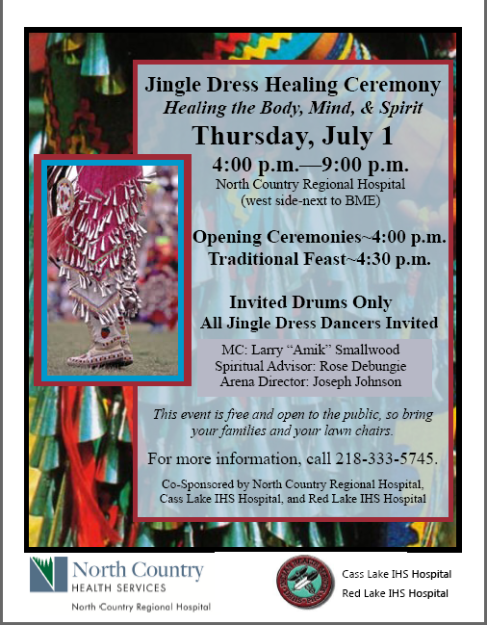
Tim Roufs
© 2010-2016
www.duluthnewstribune.com/articles/index.cfm?id=64520&section=None

Slide 2
Anishinabe Curing
Tim Roufs
University of Minnesota Duluth
Tim Roufs
© 2010-2016

Slide 3
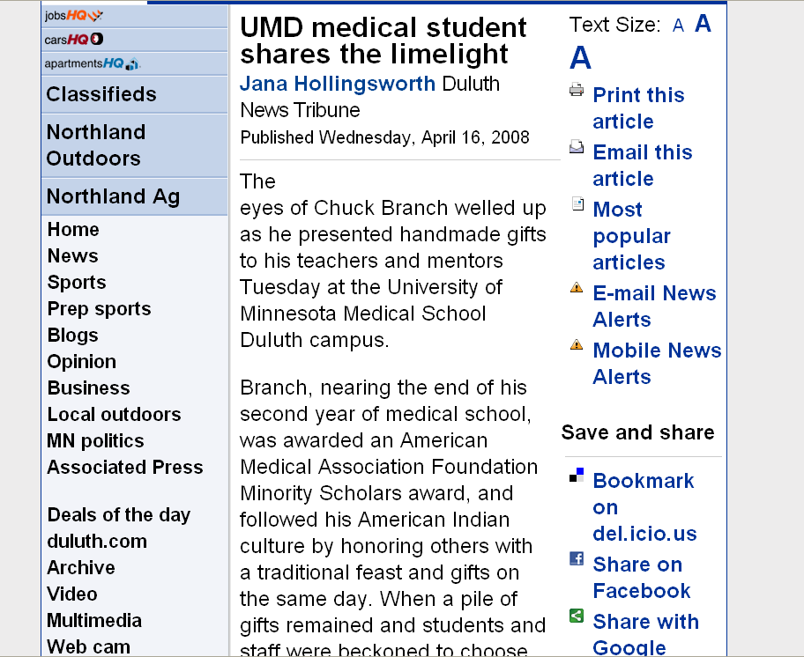
www.duluthnewstribune.com/articles/index.cfm?id=64520&section=None

Slide 4
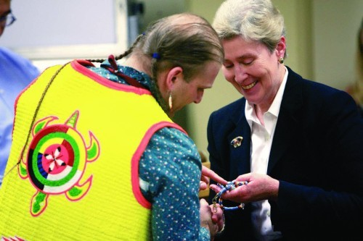
Chuck Branch (left) gives a beaded pen and lanyard to Dr. Deborah Powell, dean of the University of Minnesota Medical School, during a traditional American Indian feast and giveaway Tuesday at the University of Minnesota Medical School Duluth campus. The event was to recognize those who helped him during his two years at the school. He will finish at the University of Minnesota-Twin Cities campus. The pen has turtles in its design, representing his clan.
CLINT AUSTIN / NEWS TRIBUNE Wednesday, 16 April 2008
www.duluthnewstribune.com/articles/index.cfm?id=64520&section=None

Slide 5
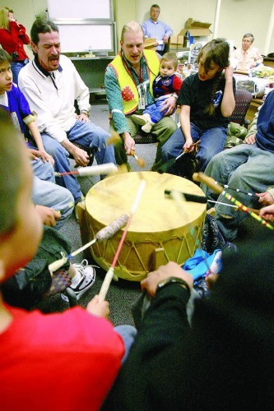
Chuck Branch holds his son, Marcus, while singing with the Onigamising Singers from Grant Language & Arts Magnet School during a traditional American Indian feast and giveaway Tuesday at the University of Minnesota Medical School Duluth campus. It was to recognize those who helped him during his two years there, before he moves to the Twin Cities campus of the medical school.
CLINT AUSTIN / NEWS TRIBUNE Wednesday,
16 April 2008
www.duluthnewstribune.com/articles/index.cfm?id=64520&section=None

Slide 6
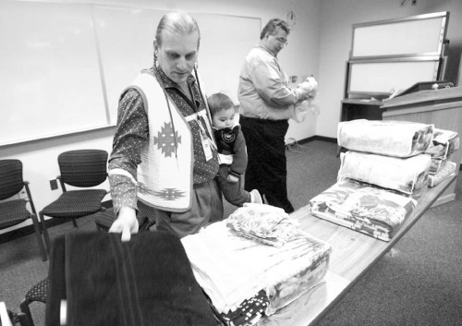
Chuck Branch holds his son, Marcus, while laying out gifts during a traditional American Indian feast and giveaway Tuesday at the University of Minnesota Medical School Duluth campus to recognize those who helped him during his two years there. He will finish at the University of Minnesota-Twin Cities campus.
CLINT AUSTIN / NEWS TRIBUNE Wednesday, 16 April 2008
www.duluthnewstribune.com/articles/index.cfm?id=64520&section=None

Slide 7
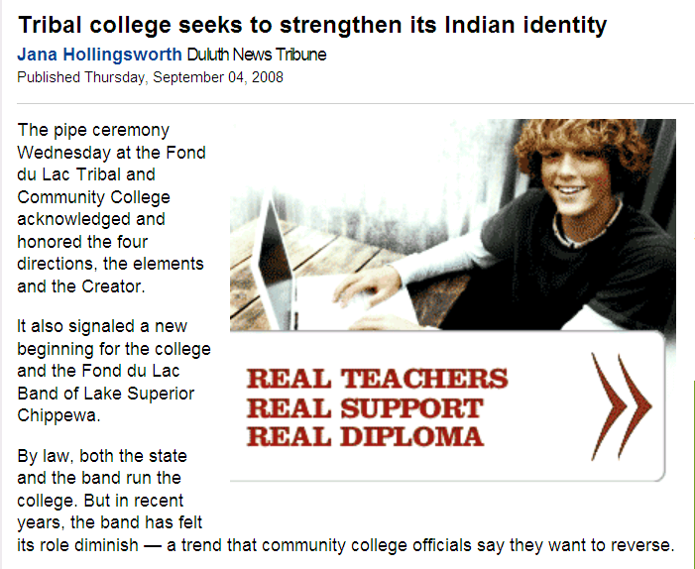
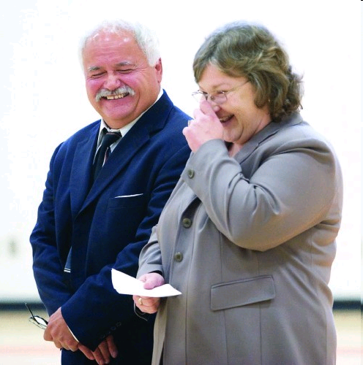
www.duluthnewstribune.com/articles/index.cfm?id=73293&section=homepage
Notes:
7

Slide 8
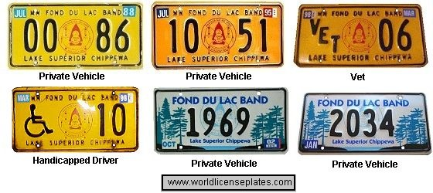
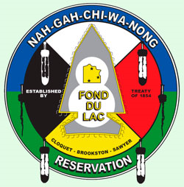
www.worldlicenceplates.com/usa/US_MNXX.html

Slide 9
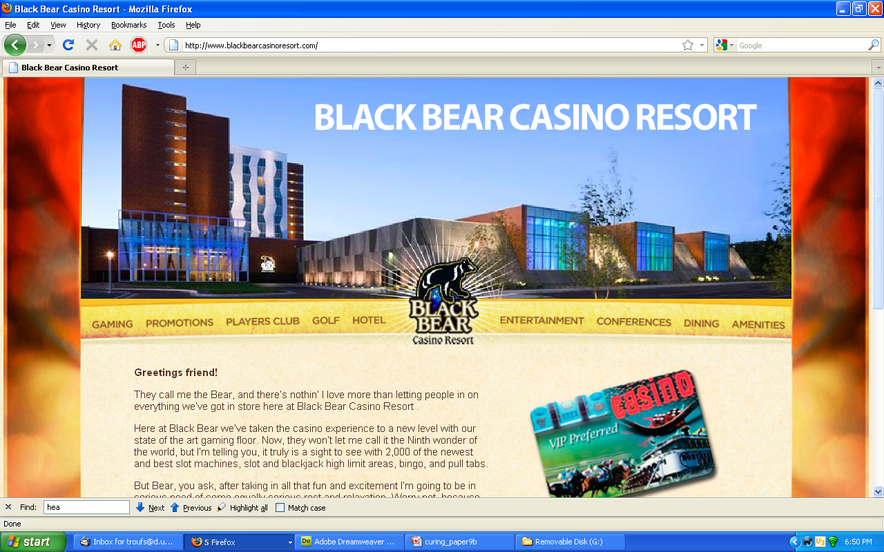

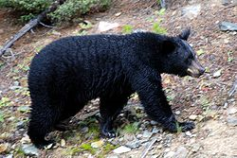
Wikipedia
://www.blackbearcasinoresort.com/

Slide 10
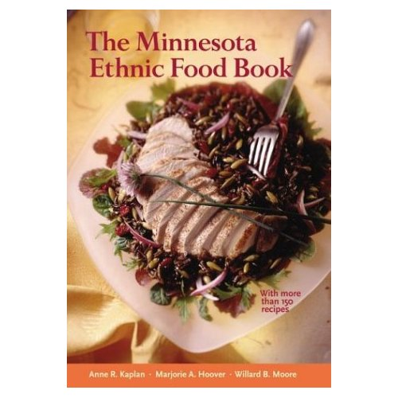
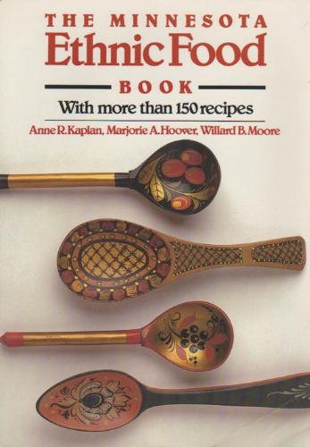
Minnesota Historical Society Press
Notes:
10

Slide 11
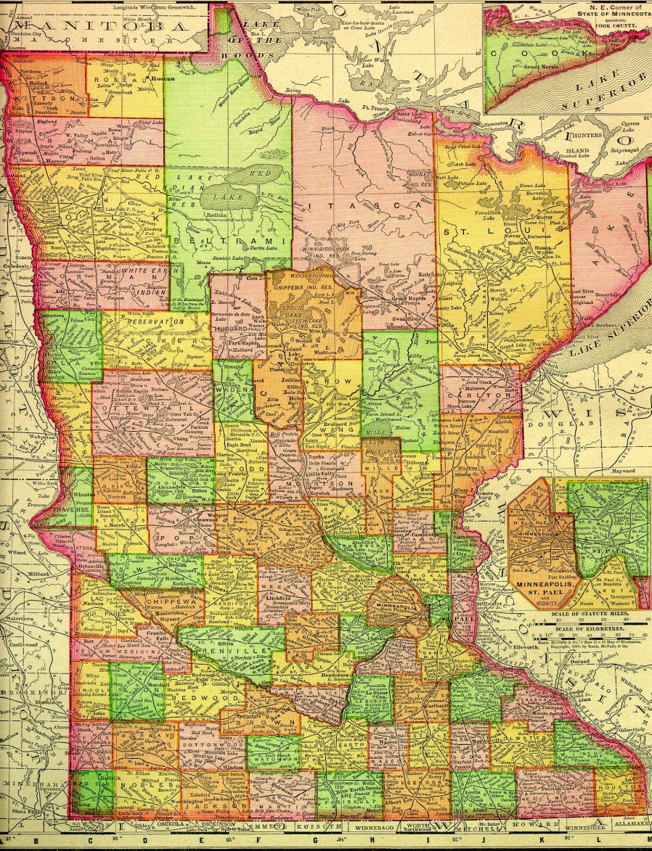
Minnesota Anishinabe

Slide 12
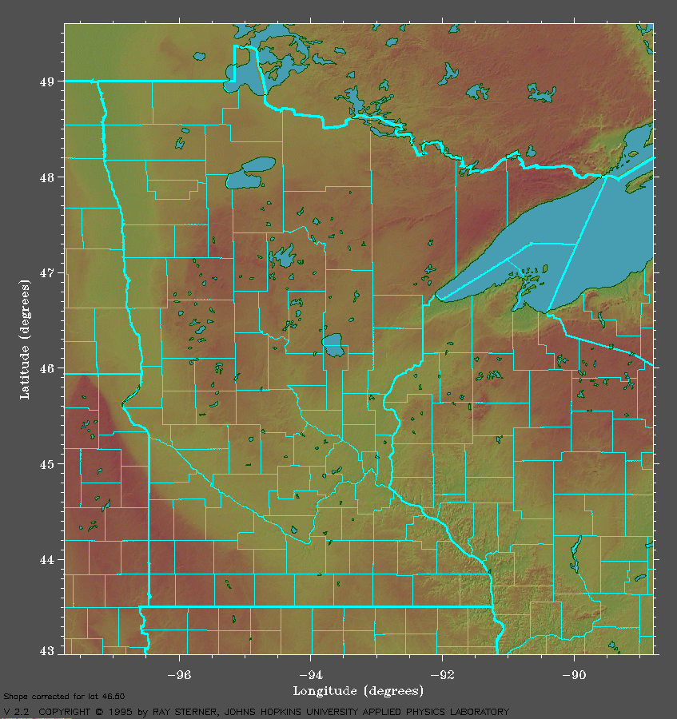
Minnesota Anishinabe

Slide 13
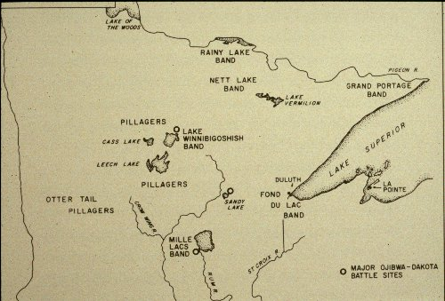
The Anishinabe of the Minnesota Chippewa Tribe.
(Phoenix : Indian Tribal Series, 1975.)
Timothy G. Roufs

Slide 14
Red
Lake
The Anishinabe of the Minnesota Chippewa Tribe.
(Phoenix : Indian Tribal Series, 1975.)
Timothy G. Roufs

Slide 15
Anishinabe
James Jackson, Sr.
  A Gift to One, a Gift to Many / James Jackson, Sr. (1913 – 1992)
  (60 min., VC 2238, 1987)

Slide 16
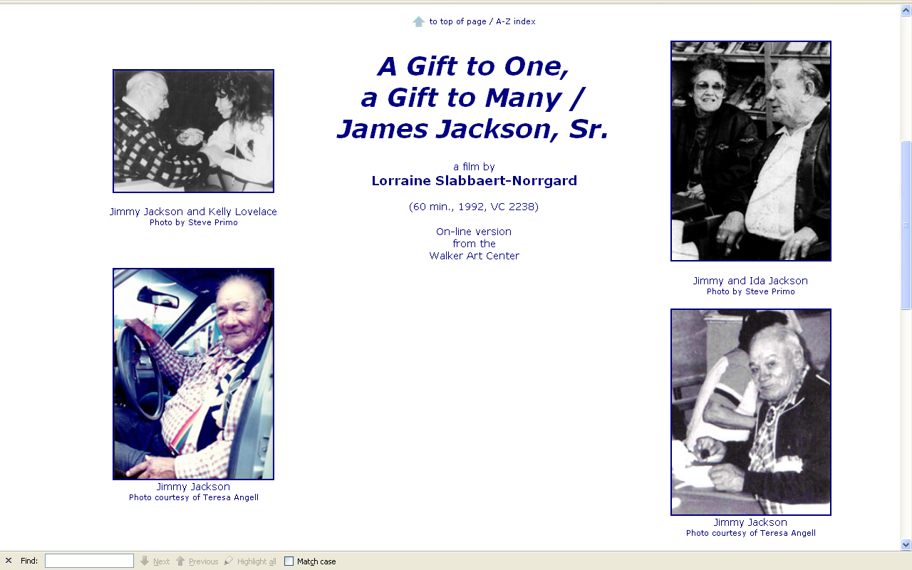
http://www.d.umn.edu/cla/faculty/troufs/anth4616/video/Jimmy_Jackson.html#title

Slide 17
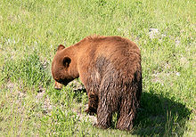
Wikipedia
dodaim
(totem)
http://www.d.umn.edu/cla/faculty/troufs/anth4616/video/Jimmy_Jackson.html#title

Slide 18
Anishinabe
James Jackson, Sr.
  A Gift to One, a Gift to Many / James Jackson, Sr. (1913 – 1992)
  (60 min., VC 2238, 1987)

Slide 19
Anishinabe
James Jackson, Sr.
  A Gift to One, a Gift to Many / James Jackson, Sr. (1913 – 1992)
  (60 min., VC 2238, 1987)
Paul Buffalo
  Excerpts from the An interview with Paul Buffalo (1900 – 1977)
  (18 min., 1971, VC 266B)
    excerpts transcript

Slide 20
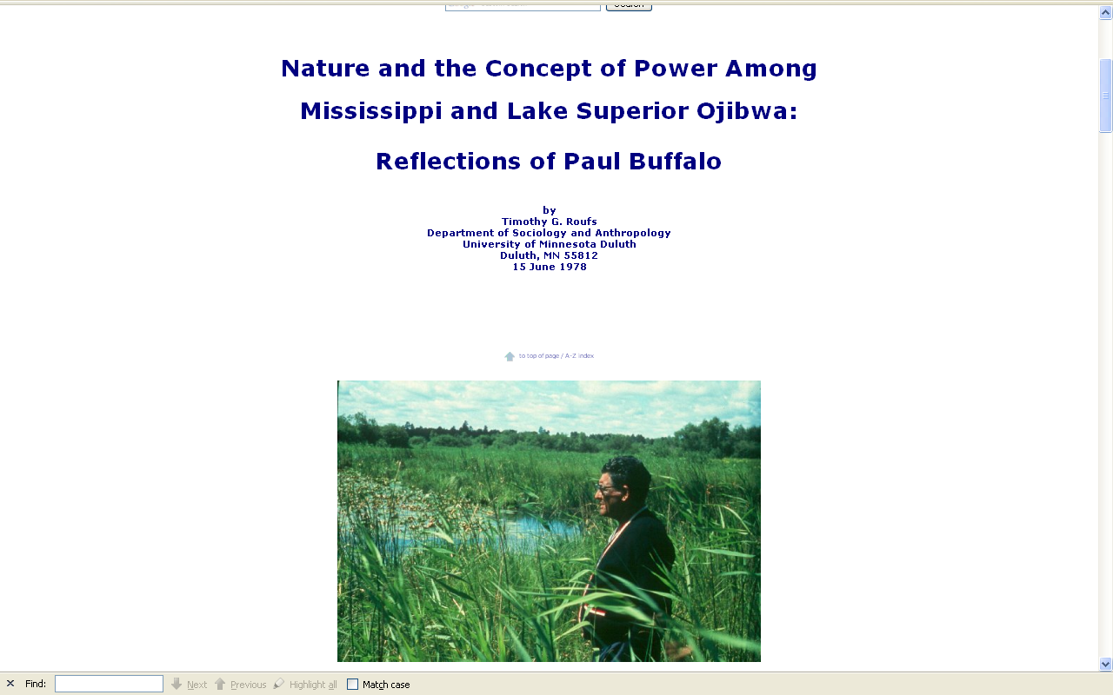
http://www.d.umn.edu/cla/faculty/troufs/Buffalo/28power5.html#title

Slide 21
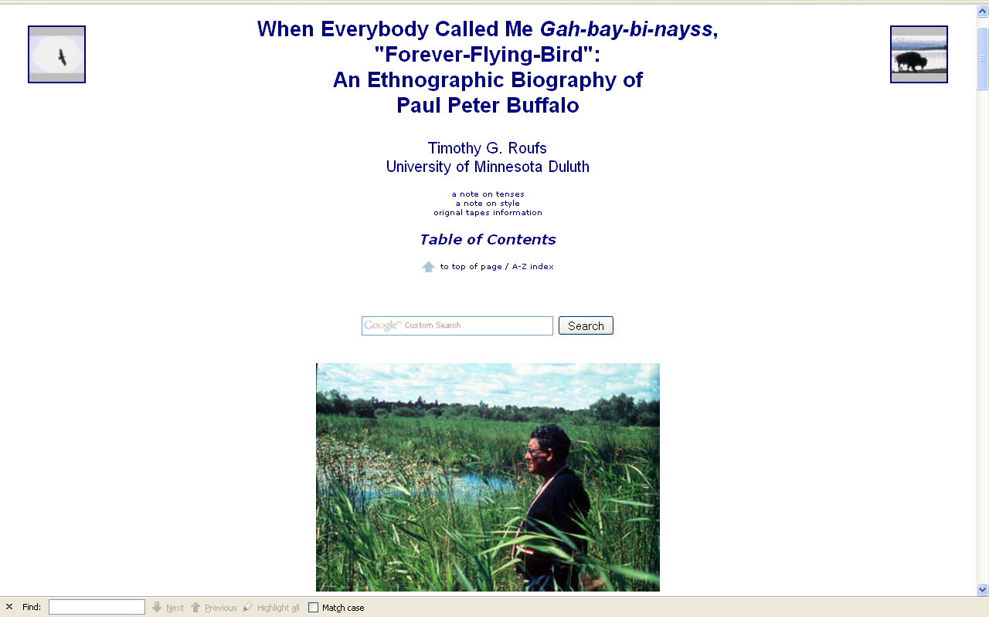
http://www.d.umn.edu/cla/faculty/troufs/Buffalo/pbwww.html#title

Slide 22
The Anishinabe of the Minnesota Chippewa Tribe.
(Phoenix : Indian Tribal Series, 1975.)
Timothy G. Roufs

Slide 23
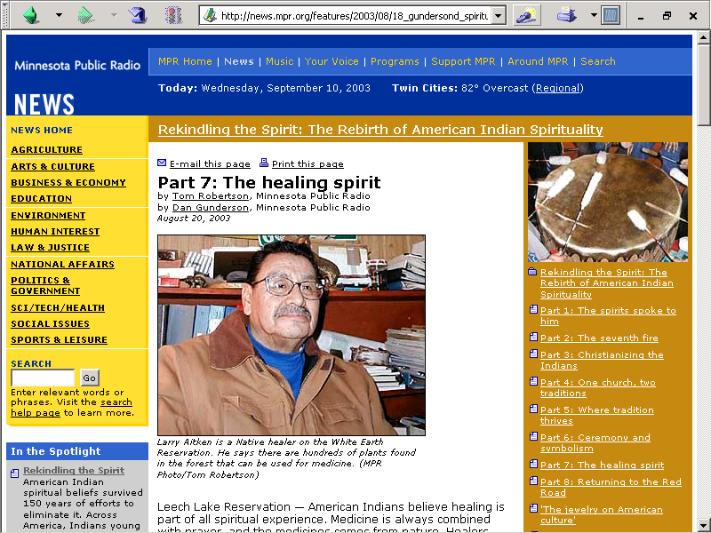

Slide 24
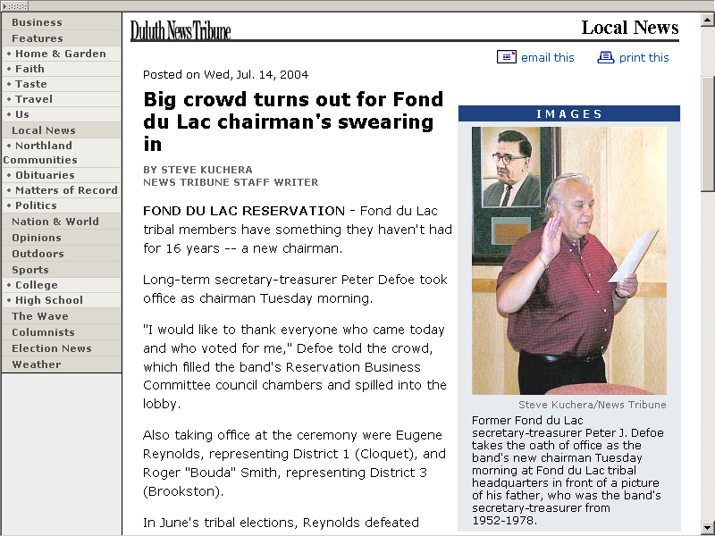
http://www.duluthsuperior.com/mld/duluthtribune/news/local/9149787.htm

Slide 25
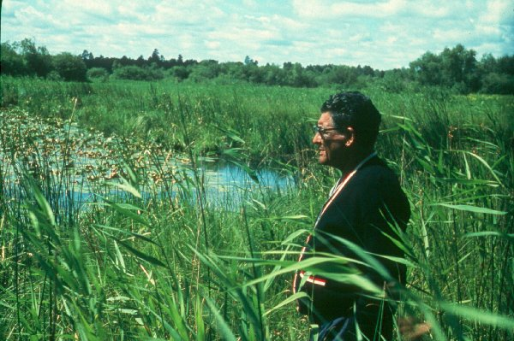
Paul Buffalo Meditating

Slide 26
Anishinabe
Culturally Constituted Behavioral Environment (CCBE)
  A. Irving Hallowell
    Culture and Experience
    Contributions to Anthropology

Slide 27
Pre-Treatment Investigation
screening and referral

Slide 28
Pre-Treatment Investigation
screening and referral to different kinds of doctors
but you can only “work with” one doctor at a time

Slide 29
Pre-Treatment Investigation
screening and referral to different kinds of doctors
  herbalists

Slide 30
Pre-Treatment Investigation
screening and referral to different kinds of doctors
  herbalists
  midwives

Slide 31
Pre-Treatment Investigation
screening and referral to different kinds of doctors
  herbalists
  midwives
  spiritualists
    jessokid or “rabbit bone”

Slide 32
Pre-Treatment Investigation
screening and referral to different kinds of doctors
  herbalists
  midwives
  spiritualists
    jessokid or “rabbit bone”
  MDs

Slide 33
Pre-Treatment Investigation
screening and referral to different kinds of doctors
  herbalists
  midwives
  spiritualists
    jessokid or “rabbit bone”
  MDs
  Grand Medicine (Midewiwin)

Slide 34
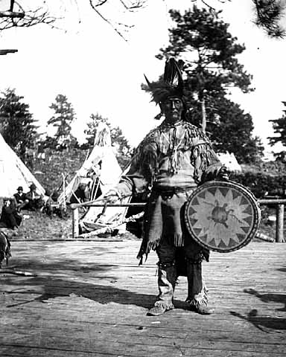
Chippewa medicine man singer with ceremonial turtle clan drum.
Photograph Collection ca. 1900
Minnesota Historical Society, Negative No. 21120

Slide 35
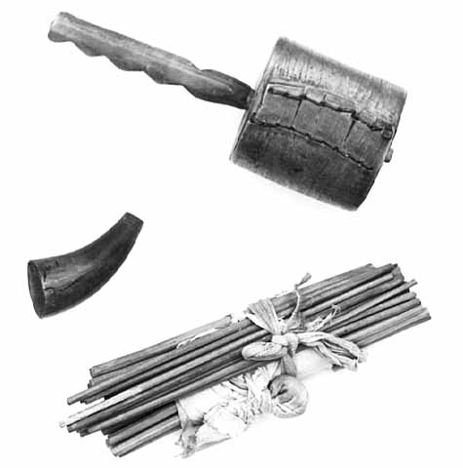
Mide (Medicine Man) rattle and sticks.
Photograph Collection ca. 1950.
Minnesota Historical Society, Negative No. 35594

Slide 36
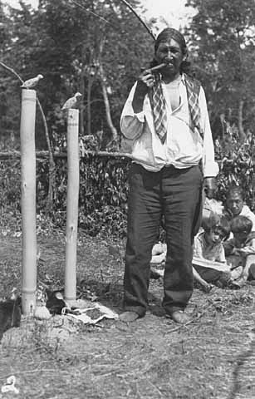
Ojibway Grand Medicine Ceremony at Squaw Point, Leech Lake, 1932.
Minnesota Historical Society, Negative No. 35585

Slide 37
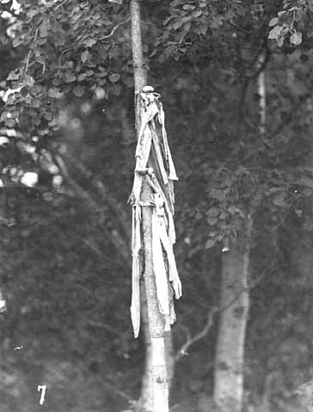
“Medicine” on pole near grave of Mrs. John Nett Lake.
Photograph Collection 9/1947.
Minnesota Historical Society, Negative No. 35601

Slide 38
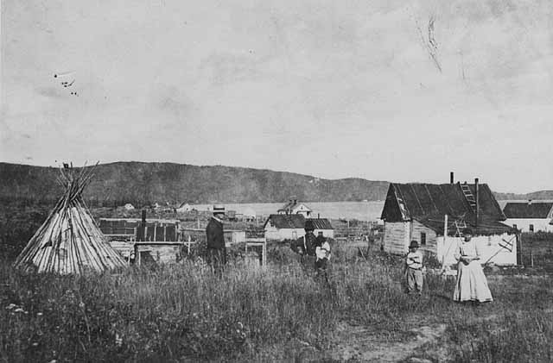
Grand Portage village, medicine man's home and tepee.
Photograph Collection 1925.
Minnesota Historical Society, Negative No. 44367

Slide 39
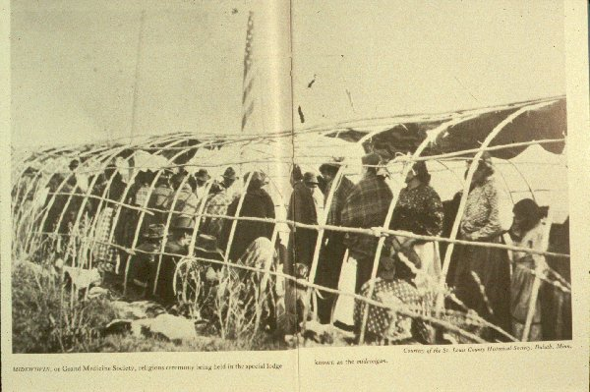
The Anishinabe of the Minnesota Chippewa Tribe.
(Phoenix : Indian Tribal Series, 1975.)
Timothy G. Roufs
From the St. Louis County Historical Society, Duluth, Minnesota.

Slide 40
Pre-Treatment Investigation
screening and referral to different kinds of doctors
  herbalists
  midwives
  spiritualists
    jessokid or “rabbit bone”
  MDs
  Grand Medicine (Midewiwin)

Slide 41
Pre-Treatment Investigation

Slide 42
Pre-Treatment Investigation
people have specific powers
(they’re “specialists”)

Slide 43
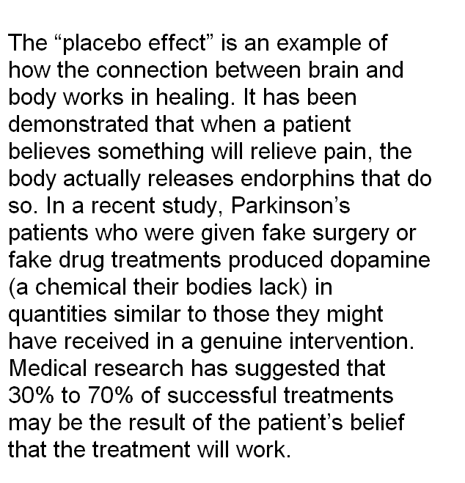
http://www.parade.com/articles/editions/2008/edition_03-09-2008/2Thoughts_Can_Heal
Notes:
4/18/2016
43
⁴³

Slide 44
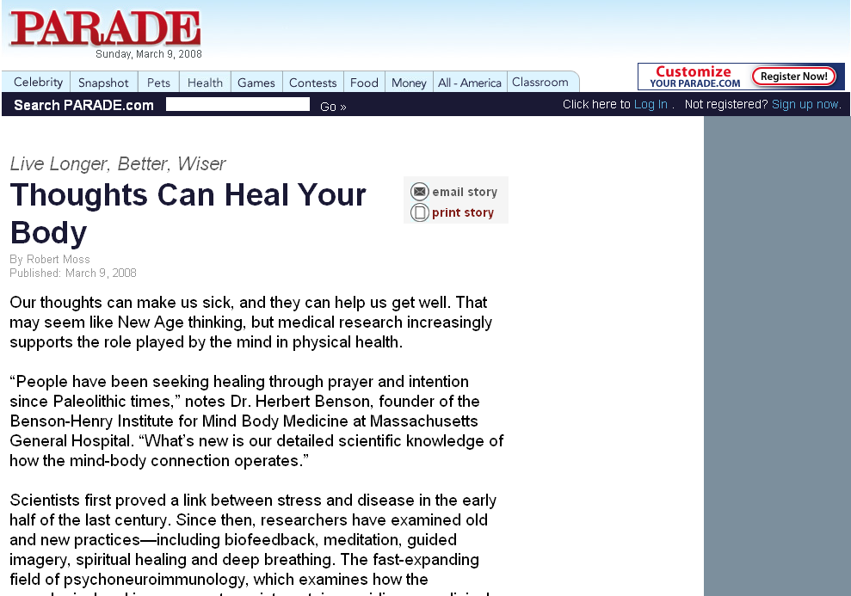
http://www.parade.com/articles/editions/2008/edition_03-09-2008/2Thoughts_Can_Heal
Notes:
4/18/2016
44
⁴⁴

Slide 45
Pre-Treatment Investigation
people have specific powers
(they’re “specialists”)
can lose power
(especially if you don’t practice)

Slide 46
Pre-Treatment Investigation
patients need to believe

Slide 47
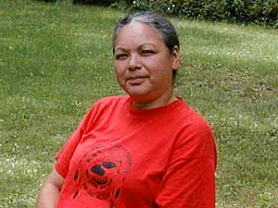
Wanda Baxter, an elder on the Red Lake Reservation, says a Native healer saved her life. She had cancer, but after three years of treatment by a tribal healer, she says she's healthy.
(MPR Photo/Tom Robertson)
http://news.minnesota.publicradio.org/features/2003/08/18_gundersond_spiritualityeigh/
Notes:
⁴⁷

Slide 48
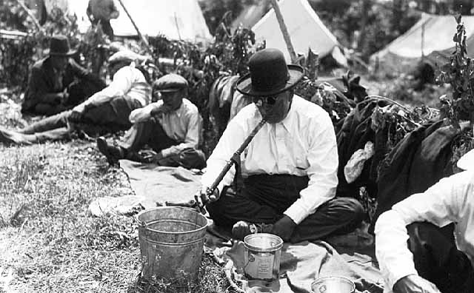
Pre-Treatment Investigation
give gifts to maintain power
Ojibway Grand Medicine Ceremony at Squaw Point, Leech Lake, 1932.
Minnesota Historical Society, Negative No. 35600

Slide 49
Pre-Treatment Investigation
need power to help
  the concept of power is central
  See Paul Buffalo paper:
  “Concept of Power among Mississippi and Lake Superior Ojibwa”

Slide 50
Causes of Illness
“disease” = universal

Slide 51
Causes of Illness
“disease” = universal
“illness” = culturally specific

Slide 52
Causes of Illness
living a bad life

Slide 53
Causes of Illness
living a bad life
relatives living in some bad way

Slide 54
Causes of Illness
living a bad life
relatives living in some bad way
jibik

Slide 55
Causes of Illness
living a bad life
relatives living in some bad way
jibik
soul loss (both souls)

Slide 56
Causes of Illness
living a bad life
relatives living in some bad way
jibik
soul loss (both souls)
unbalanced chemical orientation
to nature

Slide 57
Causes of Illness
living a bad life
relatives living in some bad way
jibik
soul loss (both souls)
unbalanced chemical
orientation to nature
or a combination of the above

Slide 58
Causes of Illness
living a bad life
relatives living in some bad way
jibik
soul loss (both souls)
unbalanced chemical
orientation to nature
or a combination of the above

Slide 59
Causes of Illness
may be a moral question . . .
as well as a medical question

Slide 60
Causes of Illness
may be a moral question . . .
as well as a medical question

Slide 61
Treatment
Involves the medicine itself
    and -- always --
medicine with a lecture
(a “meditation”)

Slide 62
Treatment
-- medicine

Slide 63
Treatment
-- medicine
use a mixture (plus meditation)

Slide 64
Treatment
-- medicine
use a mixture (plus meditation)
1st “shot” = “mild stuff”

Slide 65
Treatment
-- medicine
use a mixture (plus meditation)
1st “shot” = “mild stuff”
you have to pick medicine in the right season, when it is ripe

Slide 66
Treatment
-- medicine
use a mixture (plus meditation)
1st “shot” = “mild stuff”
you have to pick medicine in the right season, when it is ripe
you can’t go to the same place (location) for herbs, etc. twice
in a row

Slide 67
Treatment
-- medicine
use a mixture (plus meditation)
1st “shot” = “mild stuff”
you have to pick medicine in the right season, when it is ripe
you can’t go to the same place (location) for herbs, etc. twice
in a row
you have to know how to meditate the medicine

Slide 68
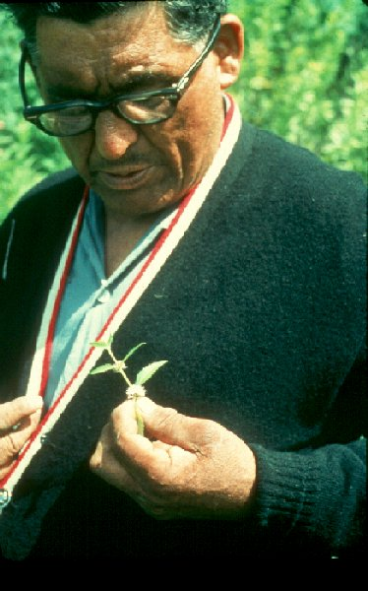
Paul Buffalo Meditating Medicine

Slide 69
Treatment
-- medicine
Healing only works through the doctor
the doctor doesn’t cure,
the Manito does

Slide 70
Treatment
-- medicine / lecture
Interpreter of the medicine interprets the medicine

Slide 71
Treatment
-- medicine / lecture
Interpreter of the medicine interprets the medicine
all of that takes time

Slide 72
Treatment
-- medicine / lecture
Interpreter of the medicine interprets the medicine
all of that takes time
realign life + lecture on good life

Slide 73
Treatment
-- medicine / lecture
Interpreter of the medicine interprets the medicine
all of that takes time
realign life + lecture on good life
pimadezewĺn
bimadizewĺn

Slide 74

Linda Grover
Sunday, 20 April 2008
“In traditional Native values and ways of living, mino-bimaadiziiwin is the Ojibwe word for the living of a good life. Mino-bimaadiziiwin involves standards of behavior that include modesty, respect, thankfulness, generosity and awareness of one’s ability and obligation to contribute to the well-being of others.”
www.duluthbudgeteer.com/

Slide 75
Treatment
-- medicine / lecture
Interpreter of the medicine interprets the medicine
all of that takes time
realign life + lecture on good life
emphasizes that one “has to believe in it”

Slide 76
Treatment
-- medicine / lecture
Interpreter of the medicine interprets the medicine
all of that takes time
realign life + lecture on good life
emphasizes that one “has to believe in it”
community support necessary
  amount varies with the disease
  Inger ceremony

Slide 77
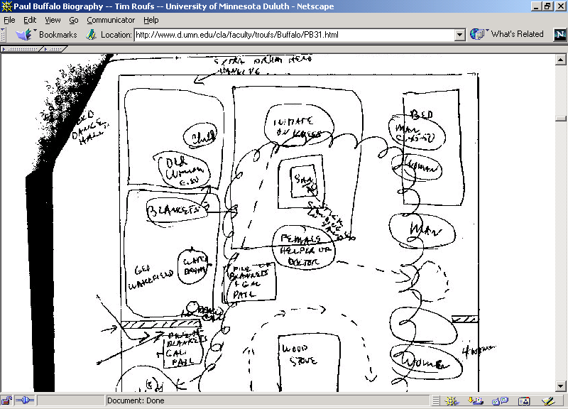

Slide 78
Treatment
-- medicine / lecture
If you don’t believe, and/or are just “fooling around” your kids and relatives can be affected

Slide 79
Post 1st Treatment
cure
no-cure

Slide 80
Post 1st Treatment
-- cure
medicine / manipulation does some good

Slide 81
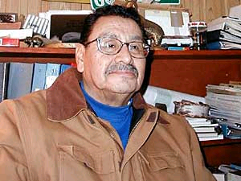
Larry Aitken is a Native healer on the White Earth Reservation. He says there are hundreds of plants found in the forest that can be used for medicine.
(MPR Photo/Tom Robertson)
http://news.minnesota.publicradio.org/features/2003/08/18_gundersond_spiritualityeigh/
Notes:
⁸¹

Slide 82
Post 1st Treatment
-- cure
medicine / manipulation does some good
placebo affect
  including effect of belief in
  doctor’s power
  and positive attitude

Slide 83
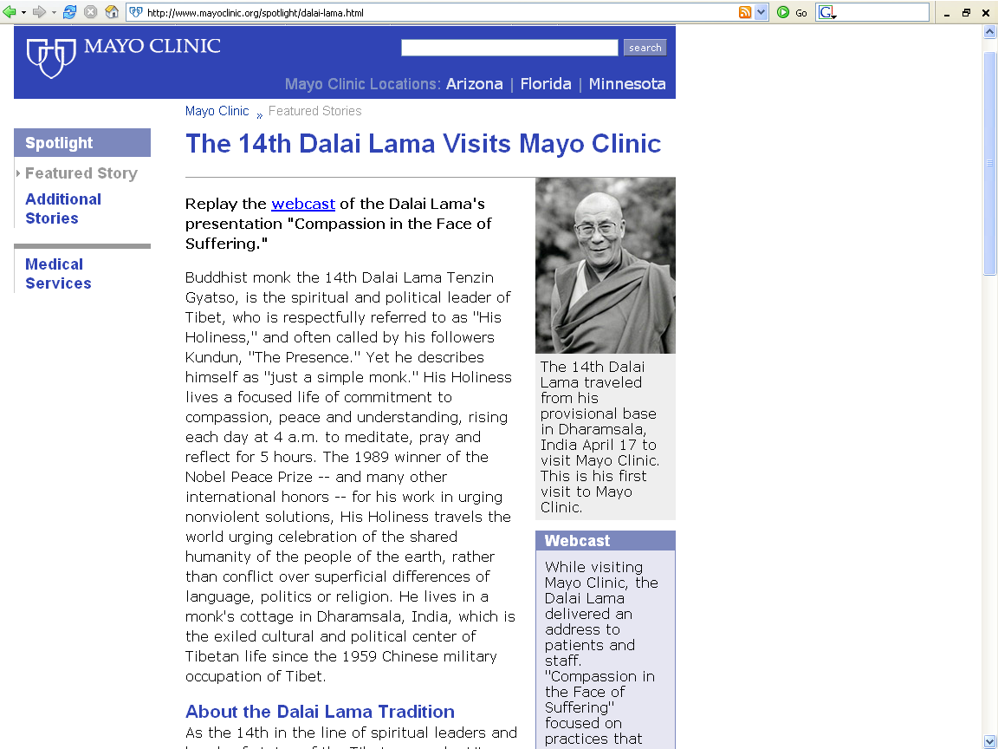
http://www.mayoclinic.org/spotlight/dalai-lama.html

Slide 84
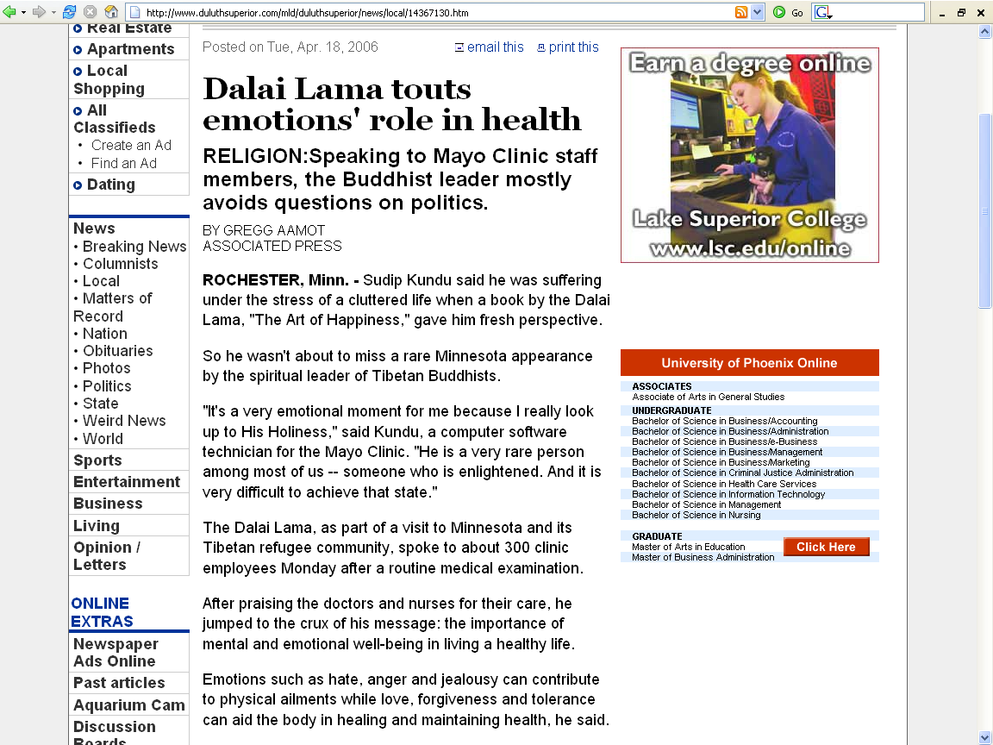
http://www.duluthsuperior.com/mld/duluthsuperior/news/local/14367130.htm

Slide 85
http://www.parade.com/articles/editions/2008/edition_03-09-2008/2Thoughts_Can_Heal
Notes:
⁸⁵

Slide 86
http://www.parade.com/articles/editions/2008/edition_03-09-2008/2Thoughts_Can_Heal
Notes:
⁸⁶

Slide 87
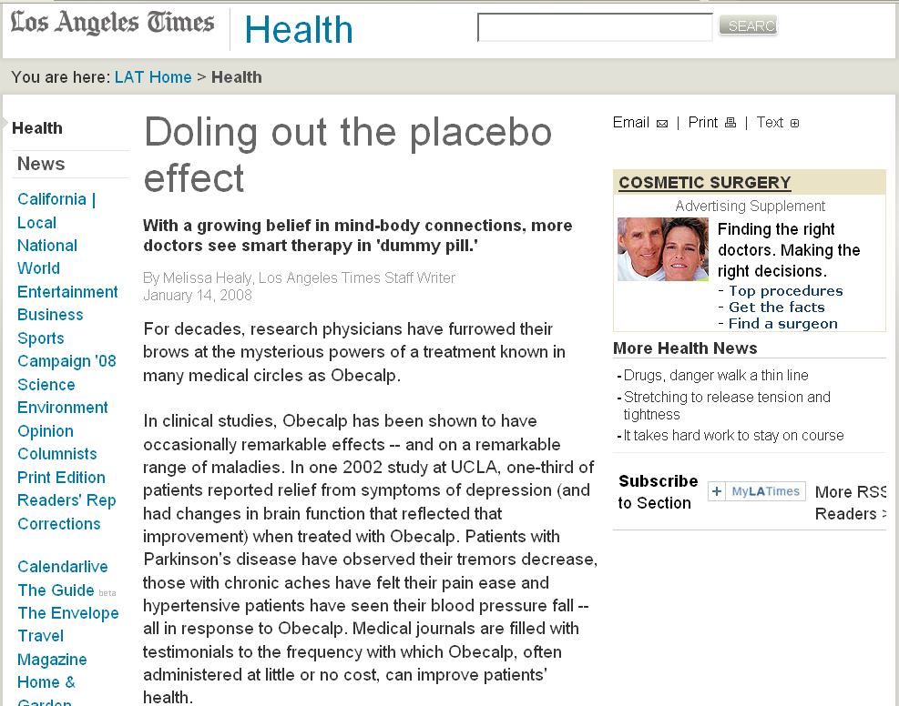
www.latimes.com/features/health/la-he-placebo14jan14,1,4887792.story
Notes:
87

Slide 88
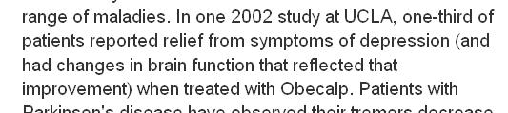
www.latimes.com/features/health/la-he-placebo14jan14,1,4887792.story
Notes:
88

Slide 89
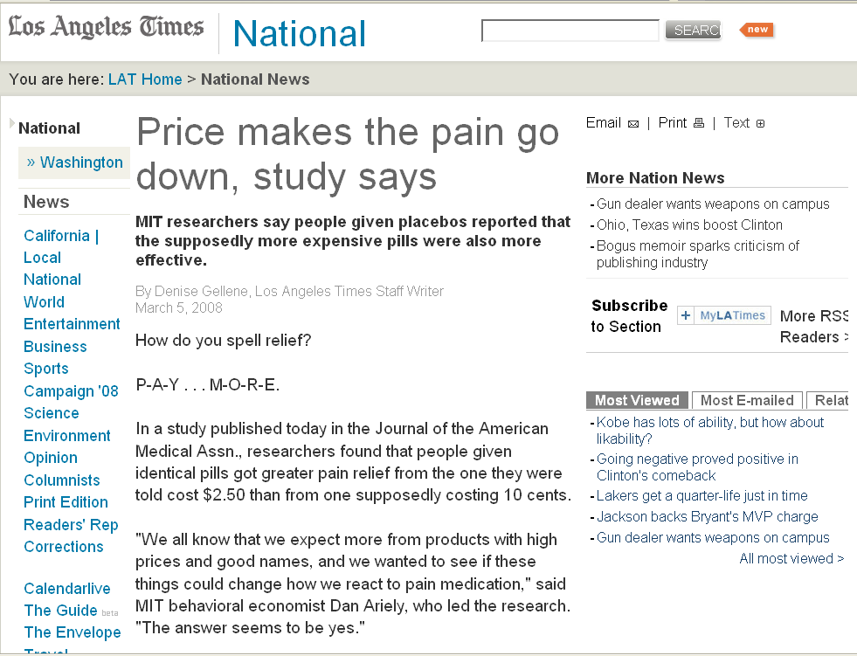
www.latimes.com/news/nationworld/nation/la-sci-pain5mar05,1,6333231.story
Notes:
⁸⁹

Slide 90
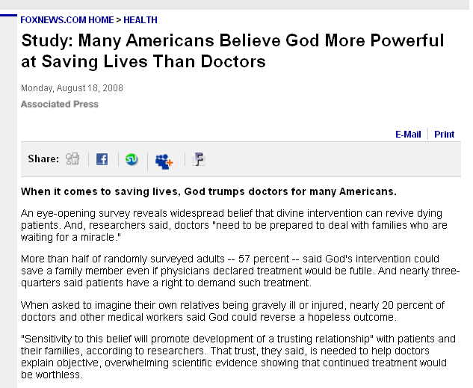
www.foxnews.com/story/0,2933,405765,00.html
Notes:
⁹⁰

Slide 91
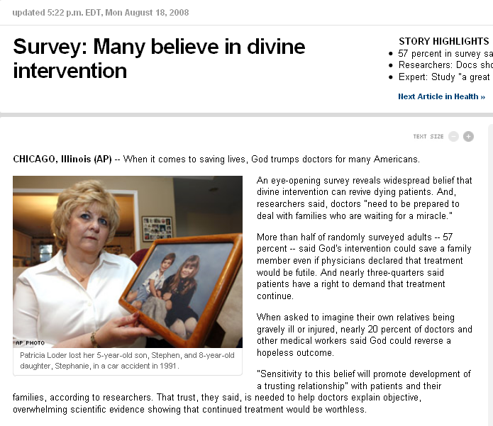
www.cnn.com/2008/HEALTH/08/18/god.vs.doctors.ap/index.html
Notes:
⁹¹

Slide 92
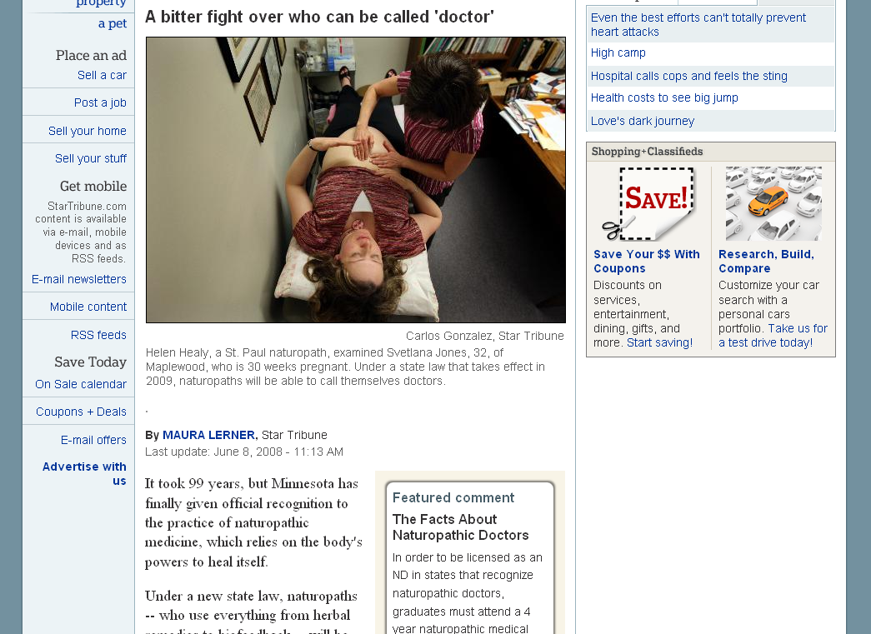
www.startribune.com/lifestyle/health/19632179.html
Notes:
⁹²

Slide 93
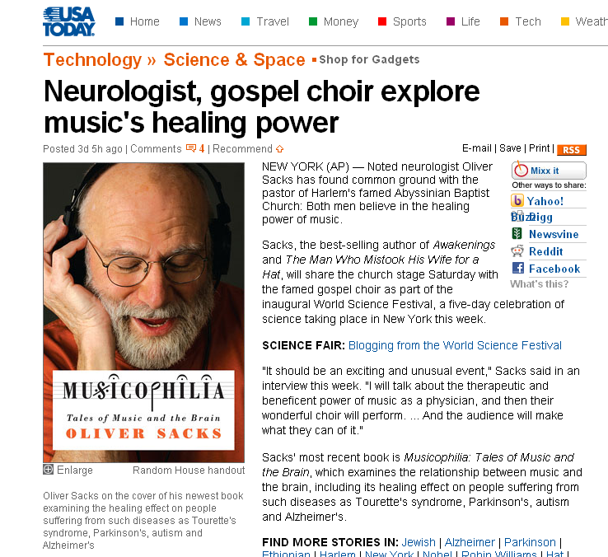
www.usatoday.com/tech/science/2008-05-30-worldfestival-music-brain_N.htm

Slide 94
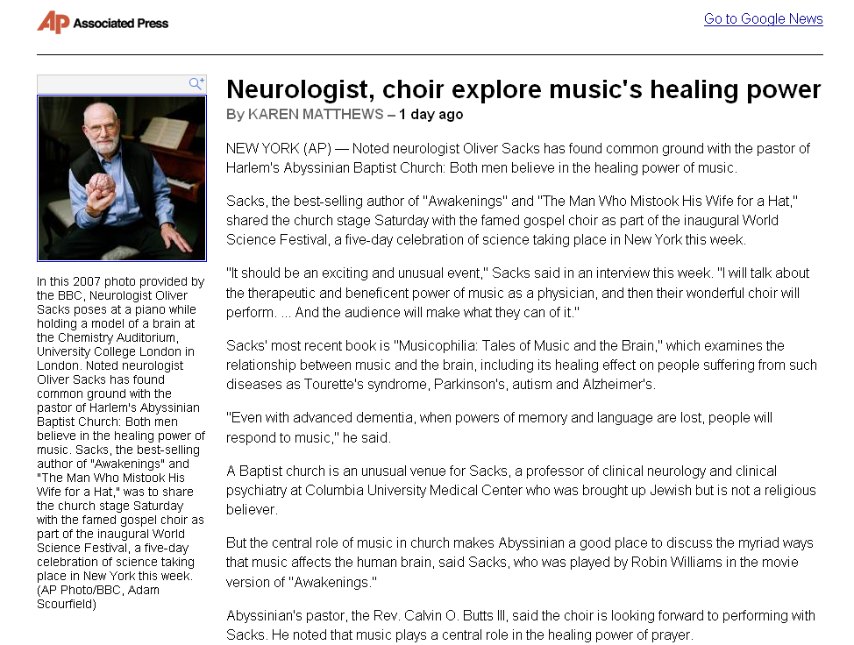
http://ap.google.com/article/ALeqM5ihrjui69QARvHuFo2GZ-z9cp9C0gD91119R80

Slide 95
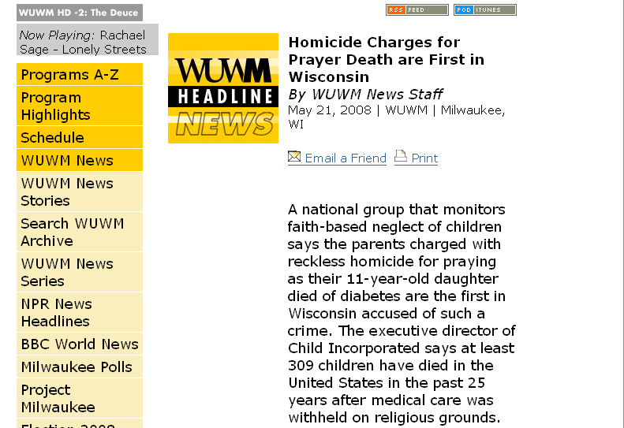
www.wuwm.com/programs/news/view_news.php?articleid=2242

Slide 96
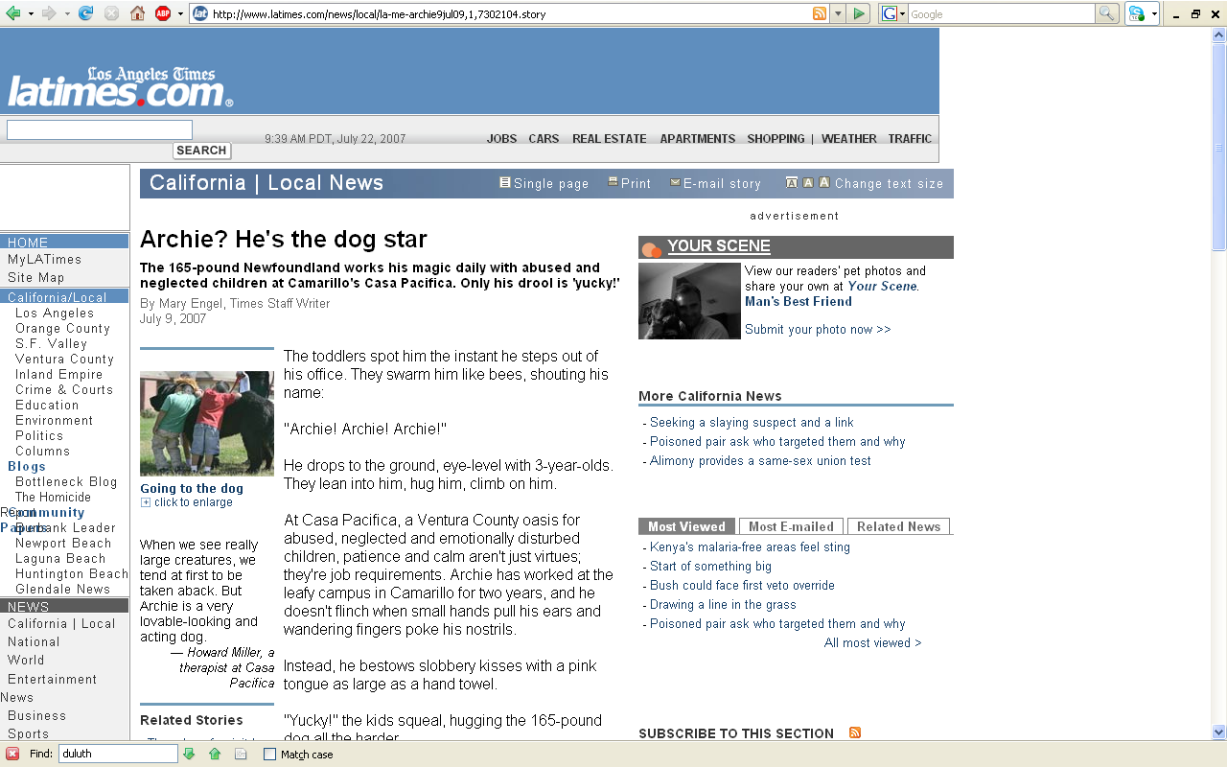
http://www.latimes.com/news/local/la-me-archie9jul09,1,7302104.story

Slide 97
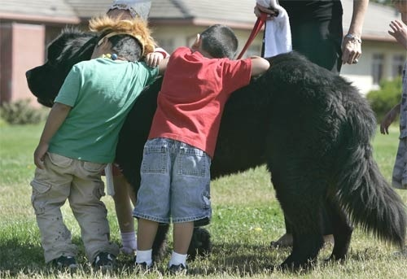
GOING TO THE DOG: Children hug and pet Archie at Casa Pacifica in Camarillo. Vicki Murphy, the facility’s director of operations and development, chose Archie after learning about Newfoundlands’ reputation for being natural baby-sitters.
(Ken Hively / LAT)
http://www.latimes.com/news/local/la-me-archie9jul09,1,7302104.story

Slide 98
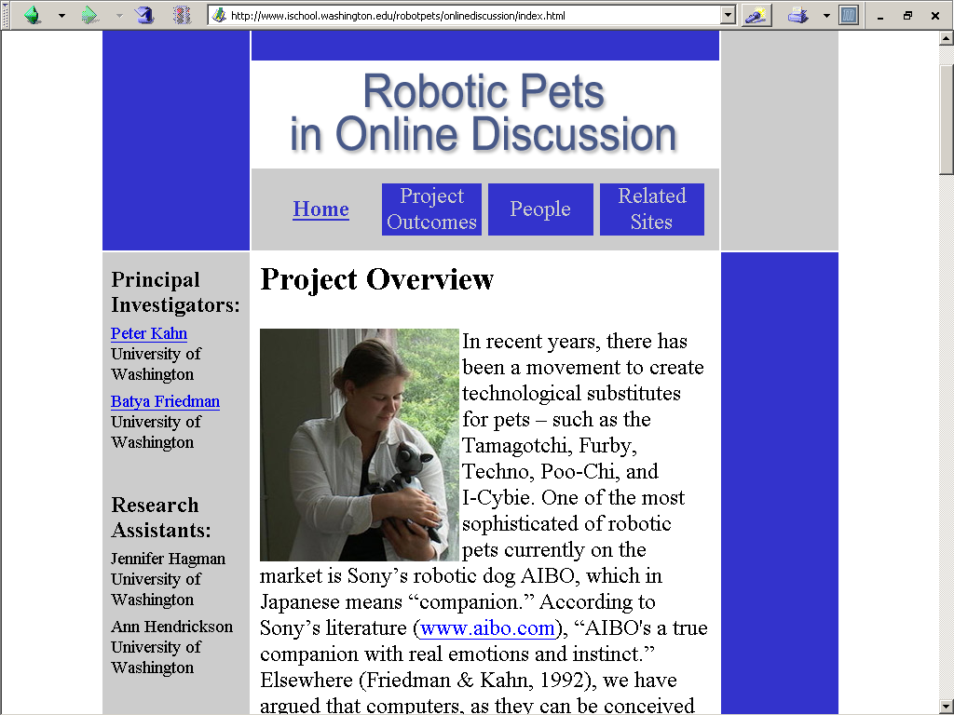
http://www.ischool.washington.edu/robotpets/onlinediscussion/index.html

Slide 99

Oscar, a hospice cat at the Steere House Nursing and Rehabilitation Center in Providence, R.I., walks past an activity room at the facility Monday, July 23, 2007. Oscar the cat seems to have an uncanny knack for predicting when nursing home patients are going to die, by curling up next to them during their final hours.
(AP Photo/Stew Milne)
http://www.pantagraph.com/articles/2007/07/25/news/doc46a7c3771368d214063275.txt

Slide 100
“His accuracy, observed in 25 cases, has led the staff to call family members once he has chosen someone. It usually means they have less than four hours to live.”
“’He doesn't make too many mistakes. He seems to understand when patients are about to die,’" said Dr. David Dosa in an interview. He describes the phenomenon in a poignant essay in Thursday's issue of the New England Journal of Medicine.’
(AP Photo/Stew Milne)
http://www.pantagraph.com/articles/2007/07/25/news/doc46a7c3771368d214063275.txt

Slide 101

“Oscar is better at predicting death than the people who work there, said Dr. Joan Teno of Brown University, who treats patients at the nursing home and is an expert on care for the terminally ill.”
http://www.pantagraph.com/articles/2007/07/25/news/doc46a7c3771368d214063275.txt

Slide 102
Post 1st Treatment
-- cure
passage of time
  Nat Pallone

Slide 103
Post 1st Treatment
-- cure
passage of time
  Nat Pallone
naming in curing

Slide 104
Post 1st Treatment
-- cure
passage of time
  Nat Pallone
naming in curing
“works if it ain’t too late”

Slide 105
Post 1st Treatment
-- no cure

Slide 106
Post 1st Treatment
-- no cure
medicine too weak
  solution: stronger medicine

Slide 107
Post 1st Treatment
-- no cure
medicine too weak
  solution: stronger medicine
medicine from a location not good
  solution: use medicine from a different location

Slide 108
Post 1st Treatment
-- no cure
medicine too weak
  solution: stronger medicine
medicine from a location not good
  solution: use medicine from a different location
medicine picked in wrong seasons
  solution: use different medicine

Slide 109
Post 1st Treatment
-- no cure
Life (bad living) has not changed
  solution: change life

Slide 110
Post 1st Treatment
-- no cure
Life (bad living) has not changed
  solution: change life
Life (bad living) of relative has not changed
  solution: have relative or relatives change life

Slide 111
Post 1st Treatment
-- no cure
Medicine “interpreted” incorrectly
  solution: reinterpret or re-mix

Slide 112
Post 1st Treatment
-- no cure
other’s power overriding or interfering
  solution: talk with them about that

Slide 113
Post 1st Treatment
-- no cure
need more time
  solution: more time

Slide 114
Post 1st Treatment
-- no cure
presence of somebody at the curing ceremony might have “interfered” with the cure
  for e.g., a white person
  or “nonbeliever”
  or someone who “doesn’t know about it”
    Inger ceremony
  solution: redo ceremony

Slide 115
Post 1st Treatment
-- no cure
presence of somebody at the curing ceremony might have “interfered” with the cure
  for e.g., a white person
  or “nonbeliever”
  or someone who “doesn’t know about it”
    Inger ceremony
  solution: redo ceremony

Slide 116
Post 1st Treatment
-- no cure
it could be that you are trying to “work with” more than one doctor at a time
  solution: go work with the other doctor exclusively

Slide 117
Post 1st Treatment
-- no cure
gifts given weren’t right
  solution: new gifts
  solution: gifts from different people

Slide 118

http://www.journaltimes.com/articles/2006/10/09/local/iq_4249864.txt

Slide 119

http://www.journaltimes.com/articles/2006/10/09/local/iq_4249864.txt

Slide 120
Post 1st Treatment
-- no cure
lost power
  solution: refer patient out

Slide 121
Post 1st Treatment
-- no cure
maybe have started too late
  solution: new procedure . . .
  or fault may not be correctable

Slide 122
Post 1st Treatment
-- no cure
if it doesn’t clear up then:
  you know why directly, or
  go to the jessokid (or MD) . . .
    to find out why
    and / or for further referral or work

Slide 123
The Curing Process

Slide 124
The Curing Process
The Manito heals,
  only through the doctor
Therefore, the ultimate fate of the patient is attributed
  to The Manito

Slide 125
The Curing Process
  The concept of power is central
    See Paul Buffalo paper:
    “Concept of Power among Mississippi and Lake Superior Ojibwa”

Slide 126
Anishinabe Curing
Tim Roufs
University of Minnesota Duluth

Slide 127
http://www.mayoclinic.org/spotlight/dalai-lama.html

Slide 128

www.d.umn.edu/~troufs/

Slide 129

http://en.wikipedia.org/wiki/Loon

Slide 130

http://en.wikipedia.org/wiki/Loon

Slide 131

http://www.duluthsuperior.com/mld/duluthtribune/news/nation/10772181.htm

