Slide 1

Start deck in “Slide Show” mode,
and use your up/down arrow keys and/or
your space bar to advance the slides
University of Minnesota Duluth
Tim Roufs
© 2010-2026

Slide 2
What's with the A-B-Cs? . . .

Slide 4
Let’s have a look . . .

Slide 5
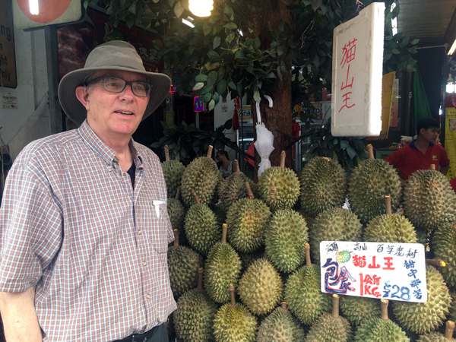
Using the A-Z Subject Index at the top of the
WebPages
University of Minnesota Duluth
Tim Roufs
© 2010-2026

Slide 6
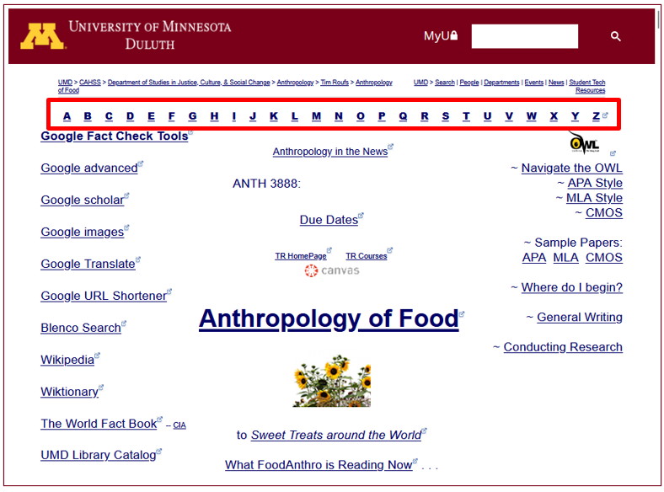
What’s this?

Slide 7
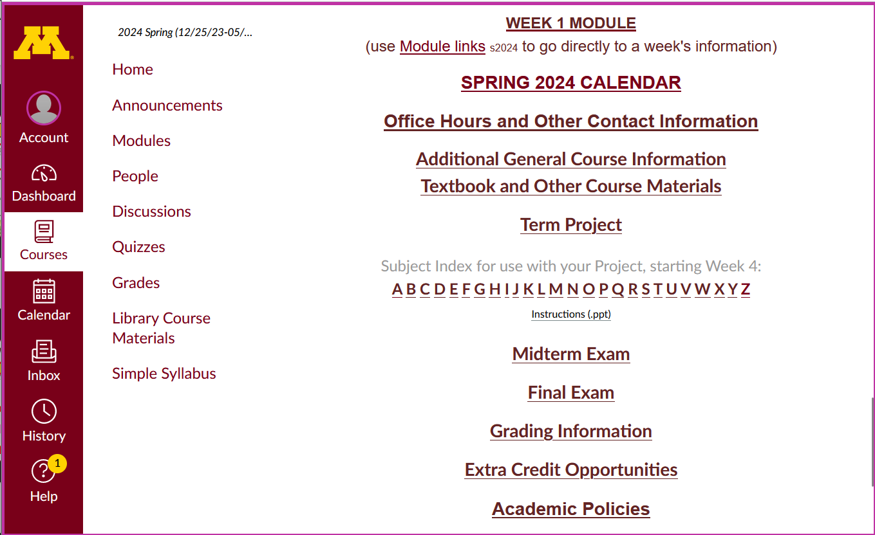
and this?

Slide 8
These "A-Z" links index hundreds of WebPages listing interesting and useful up-to-date sources of information related to this class, as well as other pertinent information in anthropology and related disciplines

Slide 9
They are handy to find out more information on any subject that is scheduled to be covered in the Anthropology of Food These can really be useful when you start looking for a topic for your term project

Slide 10
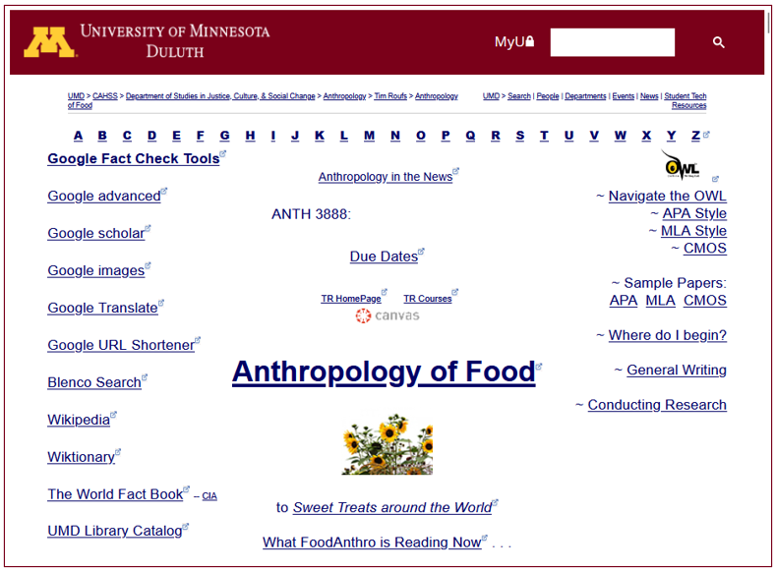
Notice the A-Z Links
A-Z Subject Index links

Slide 12
This information is very useful

Slide 13
Notice the A-Z Links

Slide 14
to access a topic simply click on its first letter to go to an index page . . .

Slide 15
Let’s see what’s available for “Chocolate” . . .

Slide 16
click on the letter C
Let’s see what’s available for “Chocolate” . . .

Slide 17
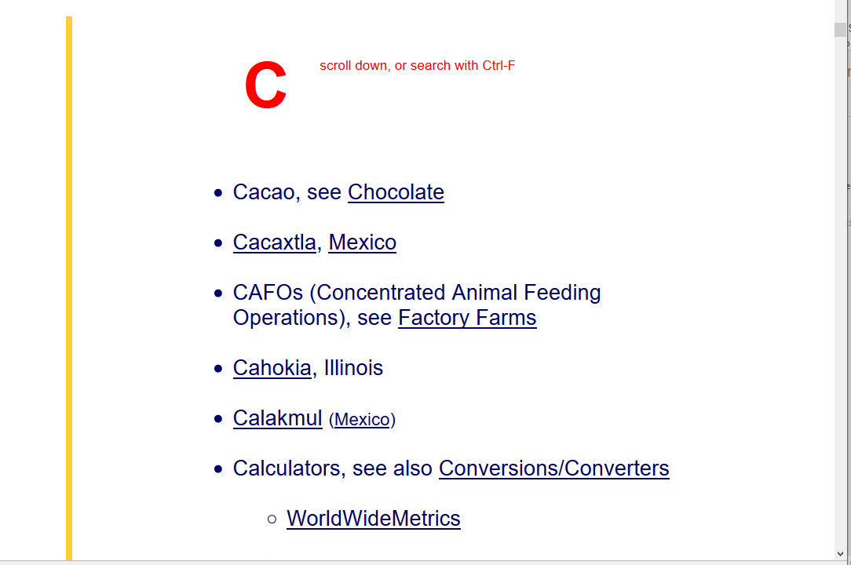
using “Chocolate” for an example

Slide 18
when you’re on the “C” A-Z Subject Index page, click on the item you want . . .
. . . for our example, it’s “Chocolate” . . .

Slide 19
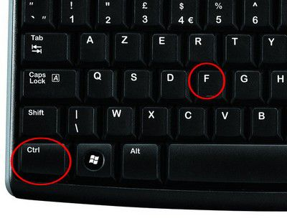
on the index page, on a PC search for item using Ctrl + F . . . ^f

Slide 20
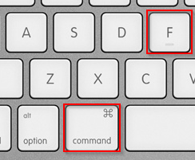
on a Mac, search for an item using Command + F . . .

Slide 21
on the index page, search for item using Ctrl + F / Command+F
or scroll down for the item

Slide 22
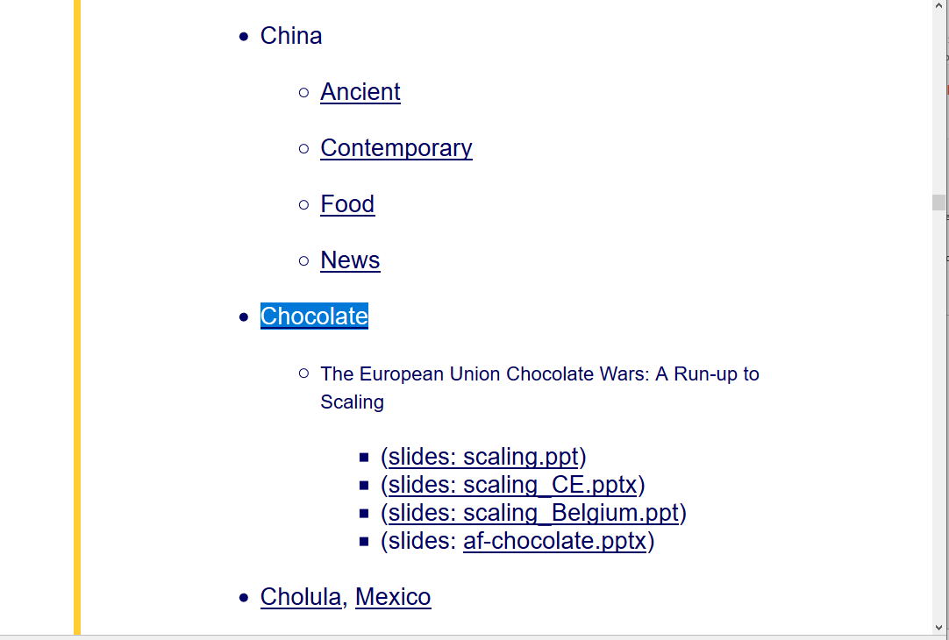
using “Chocolate” for an example
click on item . . .

Slide 23
et Voilá . . .

Slide 24
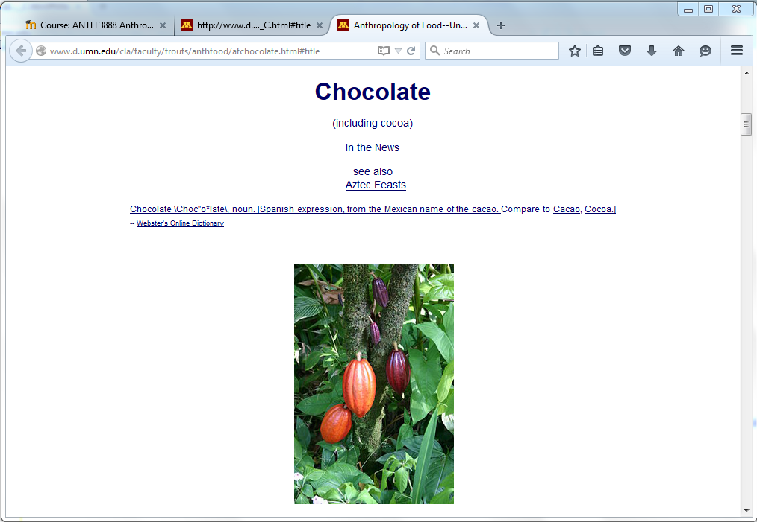

Slide 25
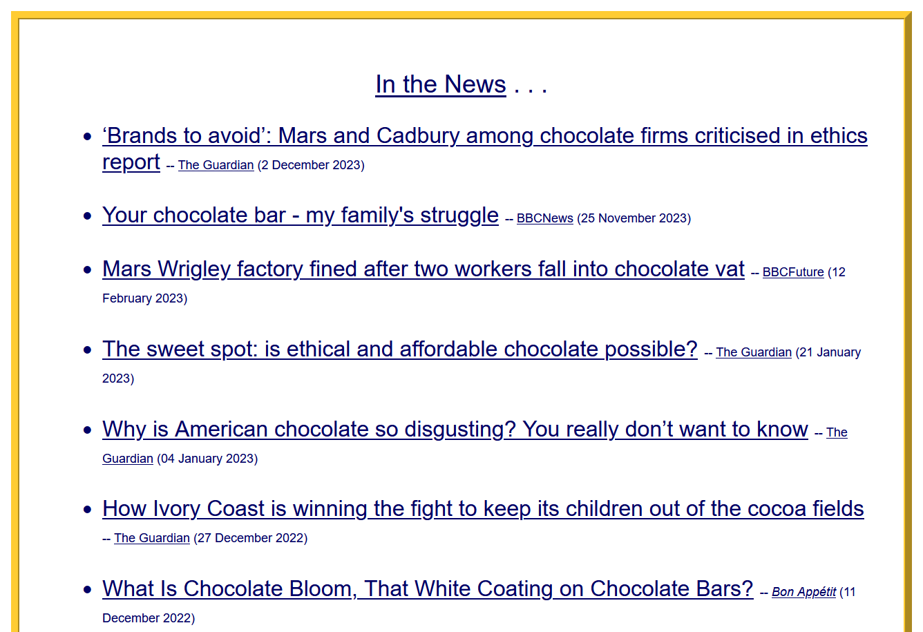
including instant links to up-to-date on-line sources relevant to Anthropology of Food . . .

Slide 26
Let’s see what’s available for France . . .

Slide 27
Let’s see what’s available for “France” . . .

Slide 28
click on the letter F
Let’s see what’s available for “France” . . .

Slide 29
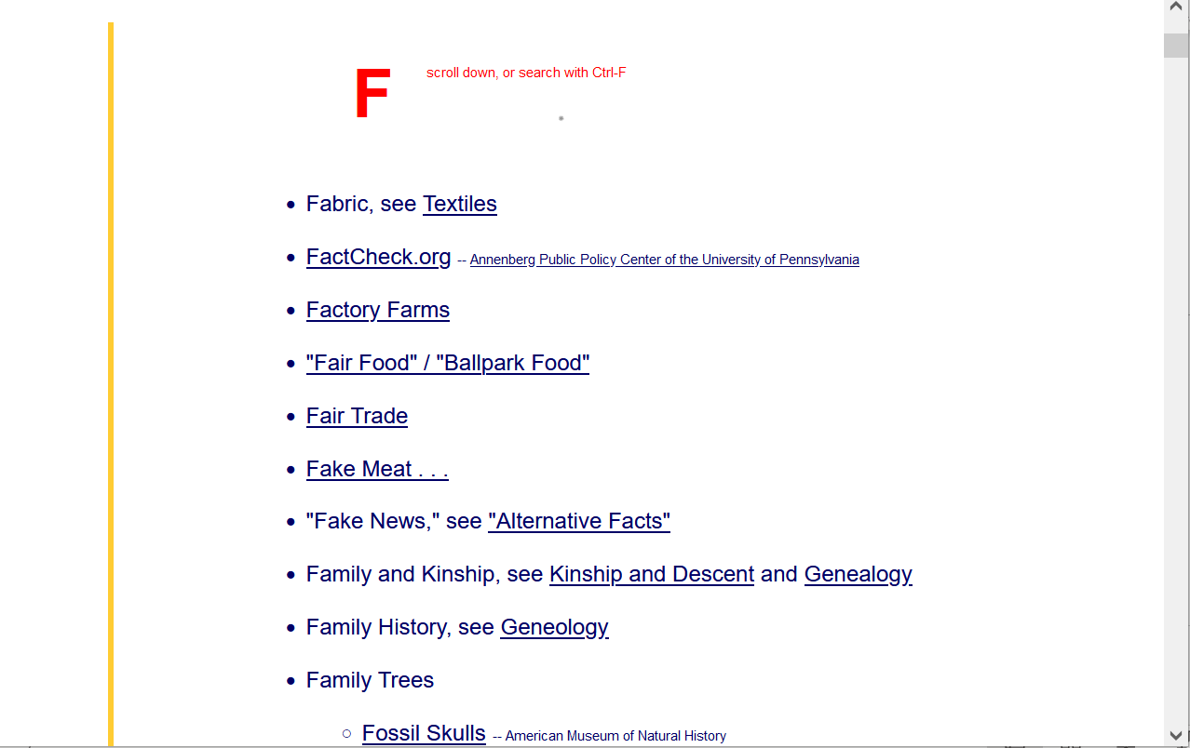

using “France” as an example

Slide 30
when you’re on the “F” A-Z Subject Index page, click on the item you want . . .
. . . for our example, it’s “France” . . .

Slide 31
on the index page, on a PC search for item using Ctrl + F . . . ^f

Slide 32
on a Mac, search for an item using Command + F . . .

Slide 33
on the index page, search for item using Ctrl + F / Command+F
or scroll down for the item

Slide 34
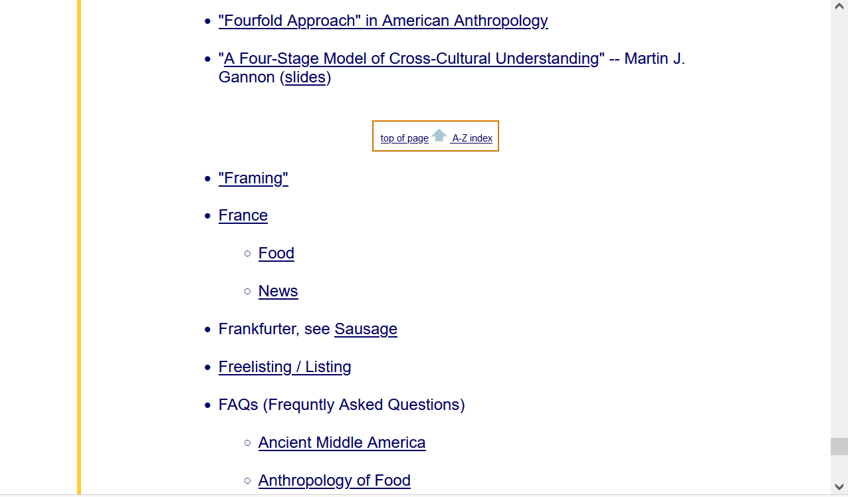

using “France” as an example
click on the item you want when you’re on the A-Z index page . . .
“France” . . . for our example . . .

Slide 35

et Voilá . . .

Slide 36
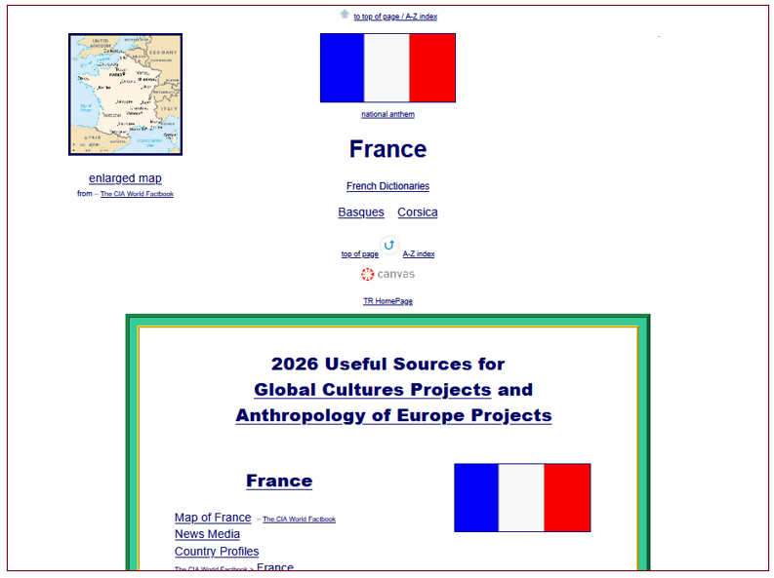

Slide 37
with the latest news links and basic reliable
on-line information on the topic that is relative to France and
Anthropology of Food . . .

Slide 38
The A - Z information should also be very useful when it comes time to start thinking about your class project

Slide 39
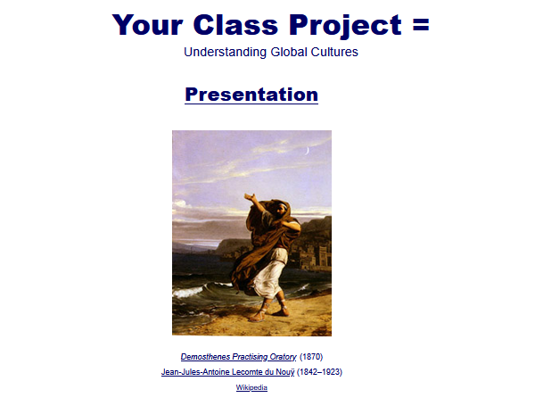
The A - Z information should also be very useful when it comes time to start thinking about your class project

Slide 40
With Your Presentation
. . . keep in mind . . . .
AUDIENCE
PURPOSE
STYLE

Slide 41
Your Presentation and your Term Paper
are on the same subject . . .
but . . .
. . . they differ in major ways
in terms of . . . .
AUDIENCE
PURPOSE
STYLE

Slide 42
Your Presentation and your Term Paper
are on the same subject . . .
but . . .
. . . they differ in major ways
in terms of . . . .
AUDIENCE
PURPOSE
STYLE

Slide 43
Your Presentation and your Term Paper
are on the same subject . . .
but . . .
. . . they differ in major ways
in terms of . . . .
AUDIENCE
PURPOSE
STYLE

Slide 44
AUDIENCE
PURPOSE
STYLE
Your Presentation and your Term Paper
are on the same subject . . .
but . . .
. . . they differ in major ways
in terms of . . . .

Slide 45
more about your class project on another day . . .

Slide 46
Anthropology of Food
University of Minnesota Duluth
Tim Roufs

