Slide 1
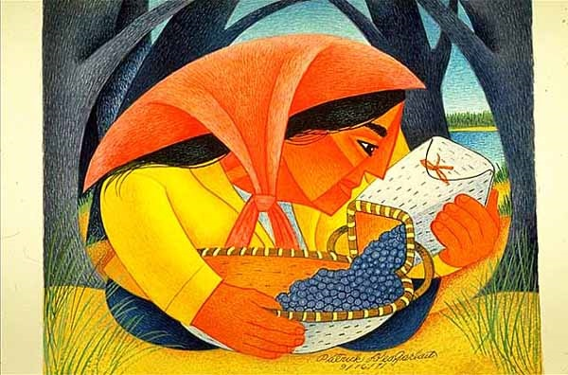
Start deck in “Slide Show” mode,
and use your up/down arrow keys and/or
your space bar to advance the slides
University of Minnesota Duluth
Tim Roufs
© 2010-2026

Slide 2
ANTH 3888
Anthropology of Food
University of Minnesota Duluth
Tim Roufs
© 2010-2026

Slide 3
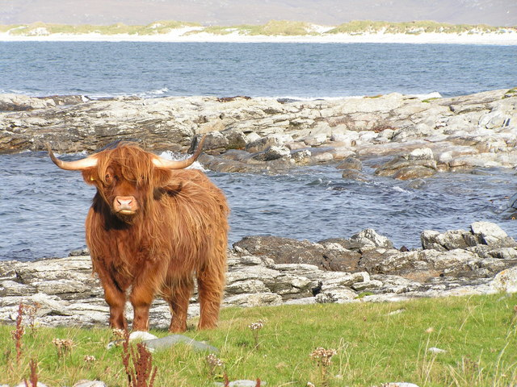
A Very Brief Outline
of the Course Structure
Anthropology of Food
University of Minnesota Duluth
Tim Roufs
© 2010-2026
http://en.wikipedia.org/wiki/Highland_cattle

Slide 4
Many disciplines tend to tell students and other interested adults what to see.
Anthropologists tend to suggest how to look.
Our approach is to understand the full sweep of the human condition, past and present.
© 2010-2026 Timothy G. Roufs, University of Minnesota Duluth

Slide 5
That observing is done from a unique perspective which emphasizes:
Holism: The core idea that you cannot fully understand one part of a human society (like its economy, politics, religion, or art) without seeing how it connects to all the other parts—including the environment and the human body itself.
© 2010-2026 Timothy G. Roufs, University of Minnesota Duluth

Slide 6
The 4-Fields + 1 Approach allows us to holistically explore humanity across all time and space:
    Archaeology (our deep and recent past)
    Sociocultural Anthropology (living cultures)
    Biological/Biophysical Anthropology (human evolution and biology)
    Linguistics (language and communication)
    + Applied Anthropology (using all four fields to solve real-world problems)
© 2010-2026 Timothy G. Roufs, University of Minnesota Duluth

Slide 7
Information obtained primarily through participatory fieldwork (living with and learning from people).
Interdisciplinary Approaches that support this 4-field +1 view, pulling from history, biology, sociology, psychology, fine arts, and more.
Information obtained primarily through participatory fieldwork (living with and learning from people).
Written reports emphasizing Ethnography (rich, detailed description) and Ethnology (cross-cultural analysis and explanation).
And tying all of this together is our overarching concept "Culture" the shared, learned behavior and ideas that act as the single most essential concept for understanding the patterns and differences we see across human groups.
© 2010-2026 Timothy G. Roufs, University of Minnesota Duluth

Slide 8
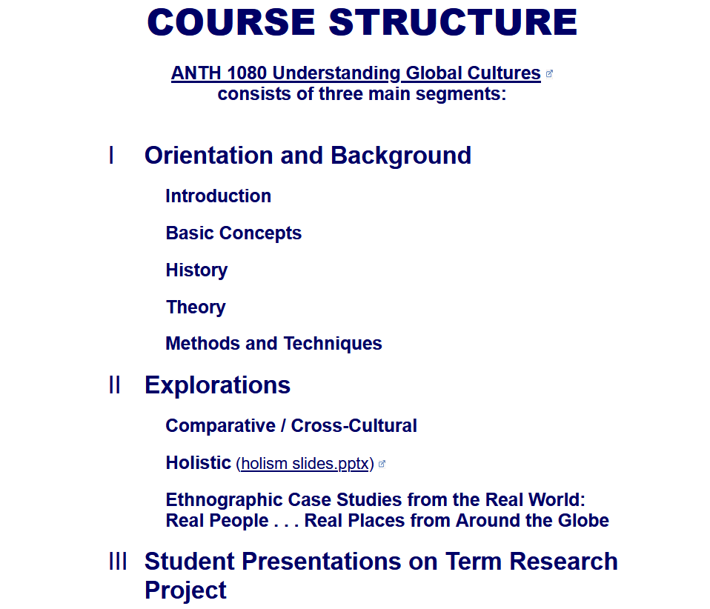
The Course Outline in a Nutshell
Course Structure
Course Structure

Slide 10
In a nutshell, ANTH 3888 Anthropology of Food
consists of three main segments:
I Orientation and Background
  Introduction
  Basic Concepts
  History
  Theory
  Methods and Techniques
II Explorations
Comparative / Cross-Cultural
Holistic
Ethnographic Case Studies from the Real World: Real People . . . Real Places from Around the Globe
III Student Presentations on Term Research Project
http://www.d.umn.edu/cla/faculty/troufs/anthfood/afproject.html

Slide 11
In a nutshell, ANTH 3888 Anthropology of Food
consists of three main segments:
I Orientation and Background
  Introduction
  Basic Concepts
  History
  Theory
  Methods and Techniques
II Explorations
Comparative / Cross-Cultural
Holistic
Ethnographic Case Studies from the Real World: Real People . . . Real Places from Around the Globe
III Student Presentations on Term Research Project
http://www.d.umn.edu/cla/faculty/troufs/anthfood/afproject.html

Slide 12
In a nutshell, ANTH 3888 Anthropology of Food
consists of three main segments:
I Orientation and Background
  Introduction
  Basic Concepts
  History
  Theory
  Methods and Techniques
II Explorations
Comparative / Cross-Cultural
Holistic
Ethnographic Case Studies from the Real World: Real People . . . Real Places from Around the Globe
III Student Presentations on Term Research Project
http://www.d.umn.edu/cla/faculty/troufs/anthfood/afproject.html

Slide 13
In a nutshell, ANTH 3888 Anthropology of Food
consists of three main segments:
I Orientation and Background
  Introduction
  Basic Concepts
  History
  Theory
  Methods and Techniques
II Explorations
Comparative / Cross-Cultural
Holistic
Ethnographic Case Studies from the Real World: Real People . . . Real Places from Around the Globe
III Student Presentations on Term Research Project
http://www.d.umn.edu/cla/faculty/troufs/anthfood/afproject.html

Slide 14
OVERVIEW TO BEGIN MODULE
    Readings
    Slides
    Videos
    In-the-News
    Discussion
    Semester Project
    Other
    Trivia (for fun)
  MODULE WRAP-UP
This is the way your
Canvas Modules
are organized . . .

Slide 15
OVERVIEW TO BEGIN MODULE
    Readings
    Slides
    Videos
    In-the-News
    Discussion
    Semester Project
    Other
    Trivia (for fun)
  MODULE WRAP-UP

Slide 16
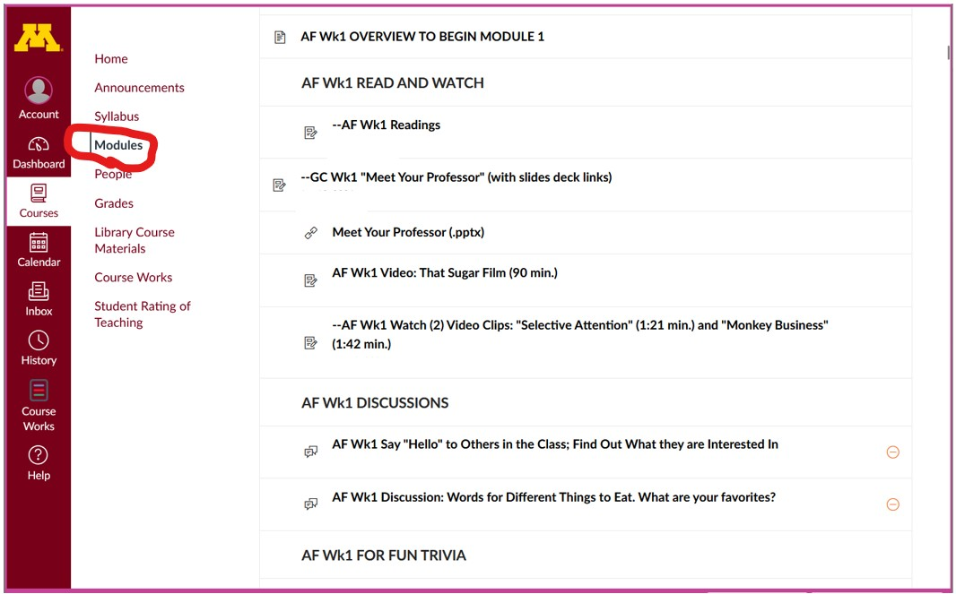

Slide 17
OVERVIEW TO BEGIN MODULE
    Readings
    Slides
    Videos
    In-the-News
    Discussion
    Semester Project
    Other
    Trivia (for fun)
  MODULE WRAP-UP

Slide 18
The End
An Outline
of the Course Structure
Anthropology of Food
University of Minnesota Duluth
Tim Roufs
© 2010-2026
http://en.wikipedia.org/wiki/Highland_cattle

