Slide 1

Cuisine
use your up/down arrow keys and/or
your space bar to advance the slides
Tim Roufs
© 2010-2026

Slide 2
Cuisine
Tim Roufs
© 2010-2026

Slide 4
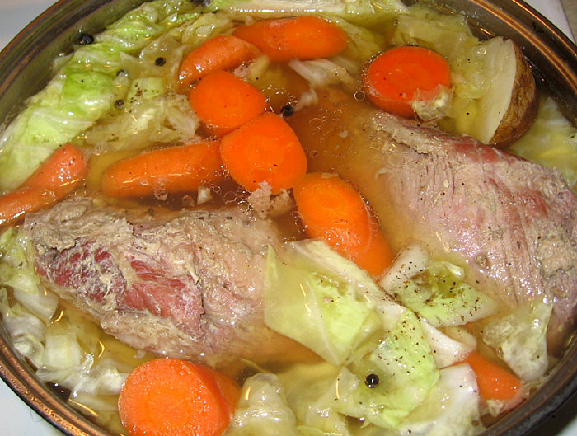
Cuisine
Anthropology of Food
University of Minnesota Duluth
Tim Roufs
© 2010-2026
Irish corned beef and cabbage
http://s184.photobucket.com/albums/x318/RennyBA/StPatricksDayOslo2008/IrishStew.jpg

Slide 5
if your focus of inquiry is
something having to do with
a group
then, in food research,
that is known as . . .

Slide 6
Biocultural Framework
for the Study of Diet and Nutrition
  Nutritional Status
  Biological Makeup
  Human Nutrient Needs
  Diet
  Cuisine
  The Environment
    Physical Environment
    Sociocultural Environment
    Economic and Political Environment
individual
nutritional
needs

Slide 7
“cuisine”
“refers to the foods, food preparation techniques, and taste preferences that are
shared by the members of a group of people”
The Cultural Feast, 2nd ed., p. 9

Slide 8
so
“cuisine”
“refers to the foods, food preparation techniques, and taste preferences that are shared by the members of a group of people”
applies only to groups of people
that share a culture
The Cultural Feast, 2nd ed., p. 9

Slide 9

How about a little game of
RIP Alex Trebek
1940 - 2020
https://www.usatoday.com/story/entertainment/celebrities/2020/11/08/alex-trebek-dies-ken-jennings-james-holzhauer-more-pay-tribute/6214106002/

Slide 10

How about a little game of . . .
Mike Richards
2021
https://www.nytimes.com/2021/08/11/arts/television/jeopardy-mike-richards-mayim-bialik-new-hosts.html

Slide 11
answer:
haggis
Finnan Haddie
spurtle
(theevil)

Slide 12
you got it!
Finnan Haddie
spurtle
(theevil)

Slide 13
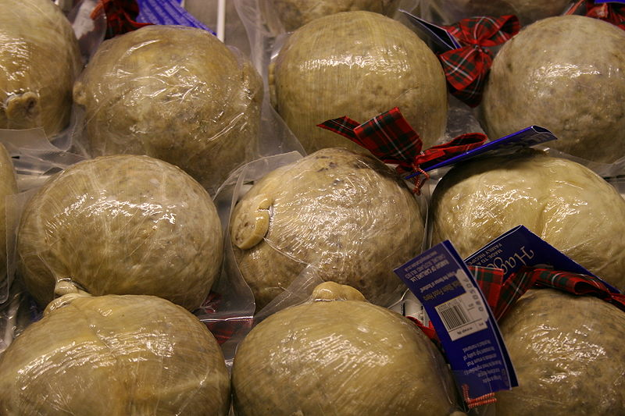
Scottish
http://en.wikipedia.org/wiki/Spurtle

Slide 14
and
gulas
paprikas
kolbász
tokaji
Egri Bikavér

Slide 15
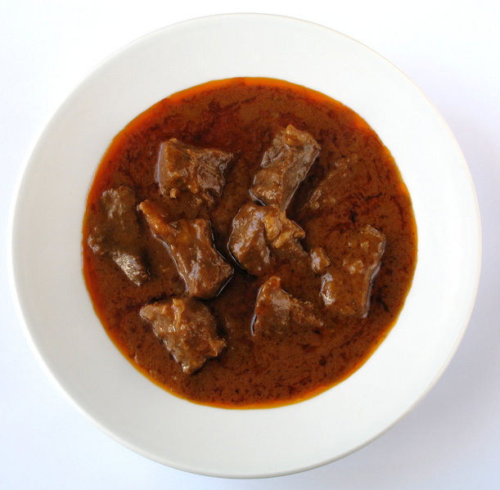
Hungarian
Gulas
http://en.wikipedia.org/wiki/Hungary

Slide 16
and
boxty
soda bread
stew
Guinness

Slide 17
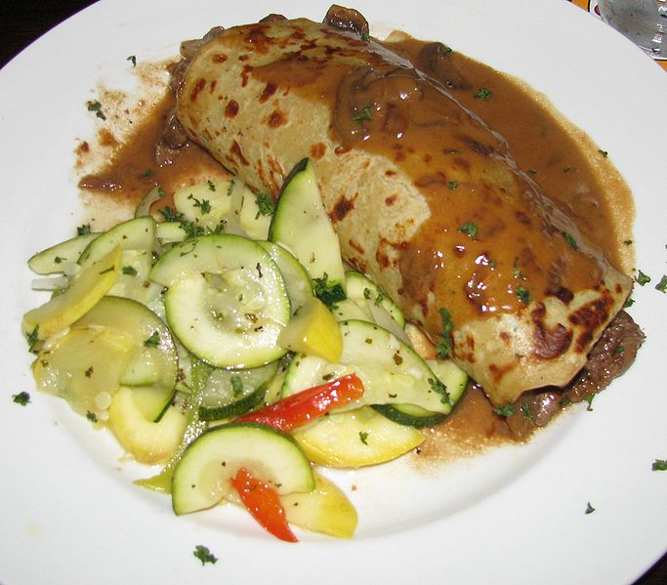
Irish
http://en.wikipedia.org/wiki/Boxty

Slide 18
and
jambalaya

Slide 19
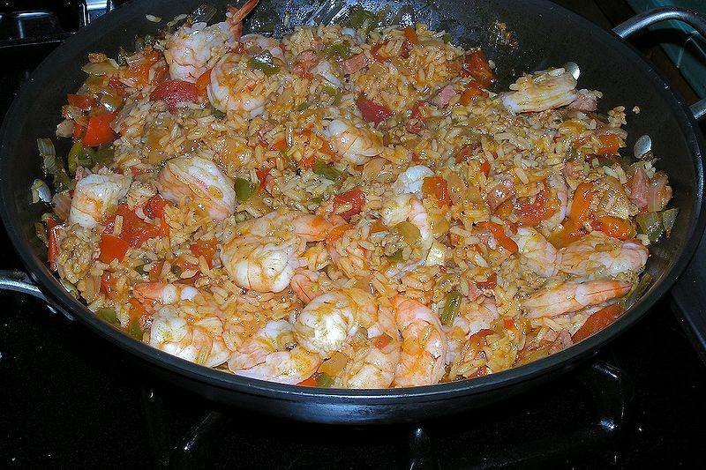
Creole
Creole Jambalaya with shrimp, ham, tomato, and Andouille sausage
http://en.wikipedia.org/wiki/Jambalaya

Slide 20
and
ANZAC biscuits

Slide 21
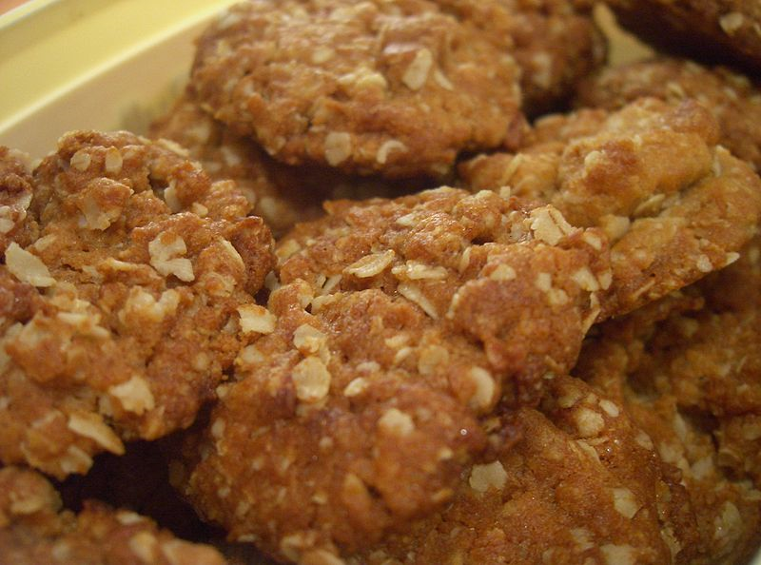
answer:
Vegemite
ANZAC biscuits
Australian and New Zealand Army Corps
(that’s why they're “ANZAC”)
ANZAC biscuits
http://en.wikipedia.org/wiki/ANZAC_biscuit

Slide 22
so in terms of the “units of analysis”
“cuisine”
may be the focus of inquiry with
any unit that pertains to a group
and is usually reserved for
a culture, subculture,
and, but only occasionally, a nation
usually a “community” would not have its own “cuisine” apart from a possible identity
with a microcultural group
but a “cuisine” could be part of a metaphorical analysis . . .

Slide 23
thus the “cuisine” . . .
“units of analysis” may include:
  one person
  the family
  the community
  a region
  a “culture area”
  a culture / “subculture”
  a nation
  an item or action itself . . .
  a “cultural metaphor”

Slide 24
thus the “cuisine” . . .
“units of analysis” may include:
  one person
  the family
  the community
  a region
  a “culture area”
  a culture / “subculture”
  a nation
  an item or action itself
  a “cultural metaphor”
and, as mentioned,
a cuisine could also be considered as . . .

Slide 25
cuisines
“It is also worth noting that
a society’s cuisine interacts with its members’ biological makeup and nutrient requirements”
The Cultural Feast, 2nd ed., p. 10

Slide 26
so basically,
as a rule of thumb
“cuisine”
refers to groups
“diet”
refers to individuals or an item
(with the exceptions noted above and in the Diet slide set)

Slide 27
cuisines
“are influenced by the sociocultural and physical environments in which they develop”
  the physical/biological environment and the social/cultural environment provide opportunities and constraints for human food consumption
The Cultural Feast, 2nd ed., p. 10

Slide 28
cuisines
“are influenced by the sociocultural
and physical environments in which they develop”
it may be more correct to say that
people “like what they eat”
than to say that
they “eat what they like”

Slide 29
cuisines and diet
in the biocultural model
diet is nested within cuisine
to demonstrate that a given set of preferred preparation techniques and dishes that characterize a particular culture group has an important impact on the diets of the individual members
The Cultural Feast, 2nd ed., p. 10

Slide 30
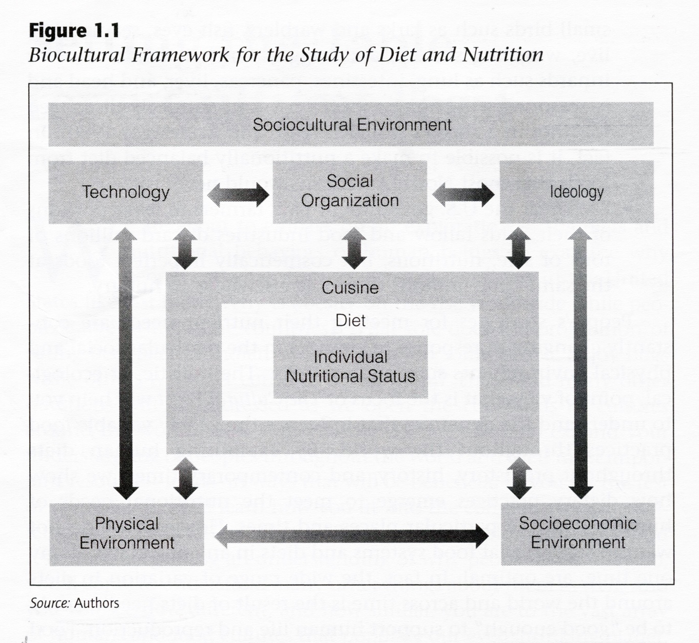
The Cultural Feast, 2nd ed., p. 4

Slide 31
cuisines
Where do they come from?
The Cultural Feast, 2nd ed., p. 10

Slide 32
that will be one of the questions the text addresses as we go through the semester . . .

Slide 33
cuisines
Does “America” have one?
Some French say “no”?
The Cultural Feast, 2nd ed., p. 10

Slide 34
cuisines
Does “America” have one?
some French, and Italians, and others say “no”
The Cultural Feast, 2nd ed., p. 10

Slide 35
cuisines
America has regional and microcultural cuisines for sure . . .
but beyond that?
The Cultural Feast, 2nd ed., p. 10

Slide 36
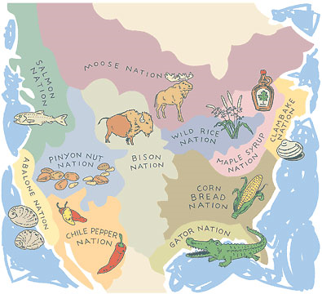
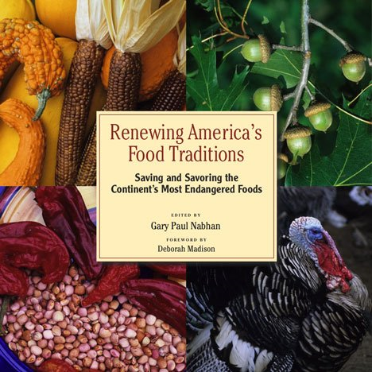
  Gary Paul Nabhan . . . a major figure
  in modern-day Anthropology of Food suggests regional “food traditions” . . .
  but these are regional, and technically speaking they’re not really “cuisines” . . .
Chelsea Green (2008)
http://en.wikipedia.org/wiki/Culture_areas_of_North_America

Slide 37
If you hear . . .
“French cuisine”
“Italian cuisine”
“Greek cuisine”
“Indian cuisine”
“Chinese cuisine”
“Mexican cuisine”
or even
“Tex-Mex cuisine”
you know immediately
what the person is talking about
The Cultural Feast, 2nd ed., p. 10

Slide 38
If you hear . . .
“French cuisine”
“Italian cuisine”
“Greek cuisine”
“Indian cuisine”
“Chinese cuisine”
“Mexican cuisine”
or even
“Tex-Mex cuisine”
you know immediately
what the person is talking about
The Cultural Feast, 2nd ed., p. 10

Slide 39
If you hear . . .
“French cuisine”
“Italian cuisine”
“Greek cuisine”
“Indian cuisine”
“Chinese cuisine”
“Mexican cuisine”
or even
“Tex-Mex cuisine”
and you probably even have vivid images of food come to mind
The Cultural Feast, 2nd ed., p. 10

Slide 40
“American cuisine”
What does that do for you?
The Cultural Feast, 2nd ed., p. 10

Slide 41
“American cuisine”
What does that do for you?
What came to mind?
The Cultural Feast, 2nd ed., p. 10

Slide 42
“American cuisine”
What does that do for you?
What came to mind?
The Cultural Feast, 2nd ed., p. 10

Slide 43
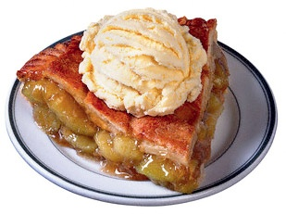

Slide 44
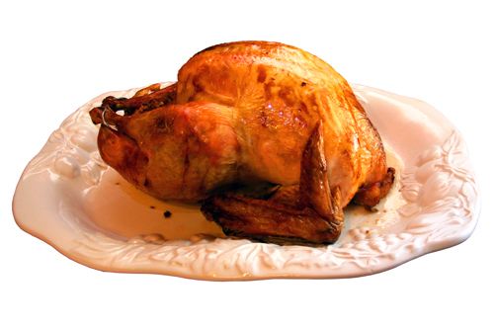

Slide 45
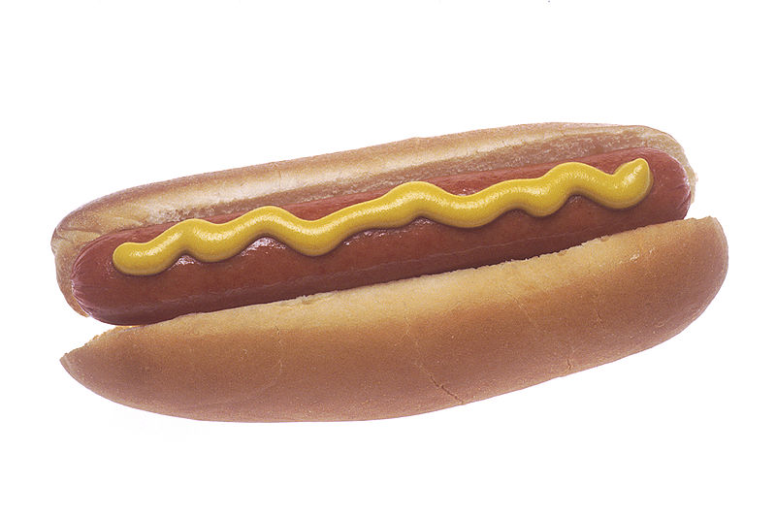

Slide 46
or if you’re from Chicago,
maybe it was more like this . . .

Slide 47
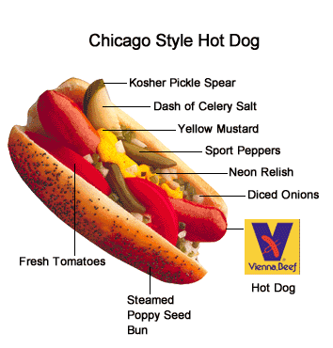

Slide 48
or if you’re from Chicago,
maybe it was more like or this . . .

Slide 49
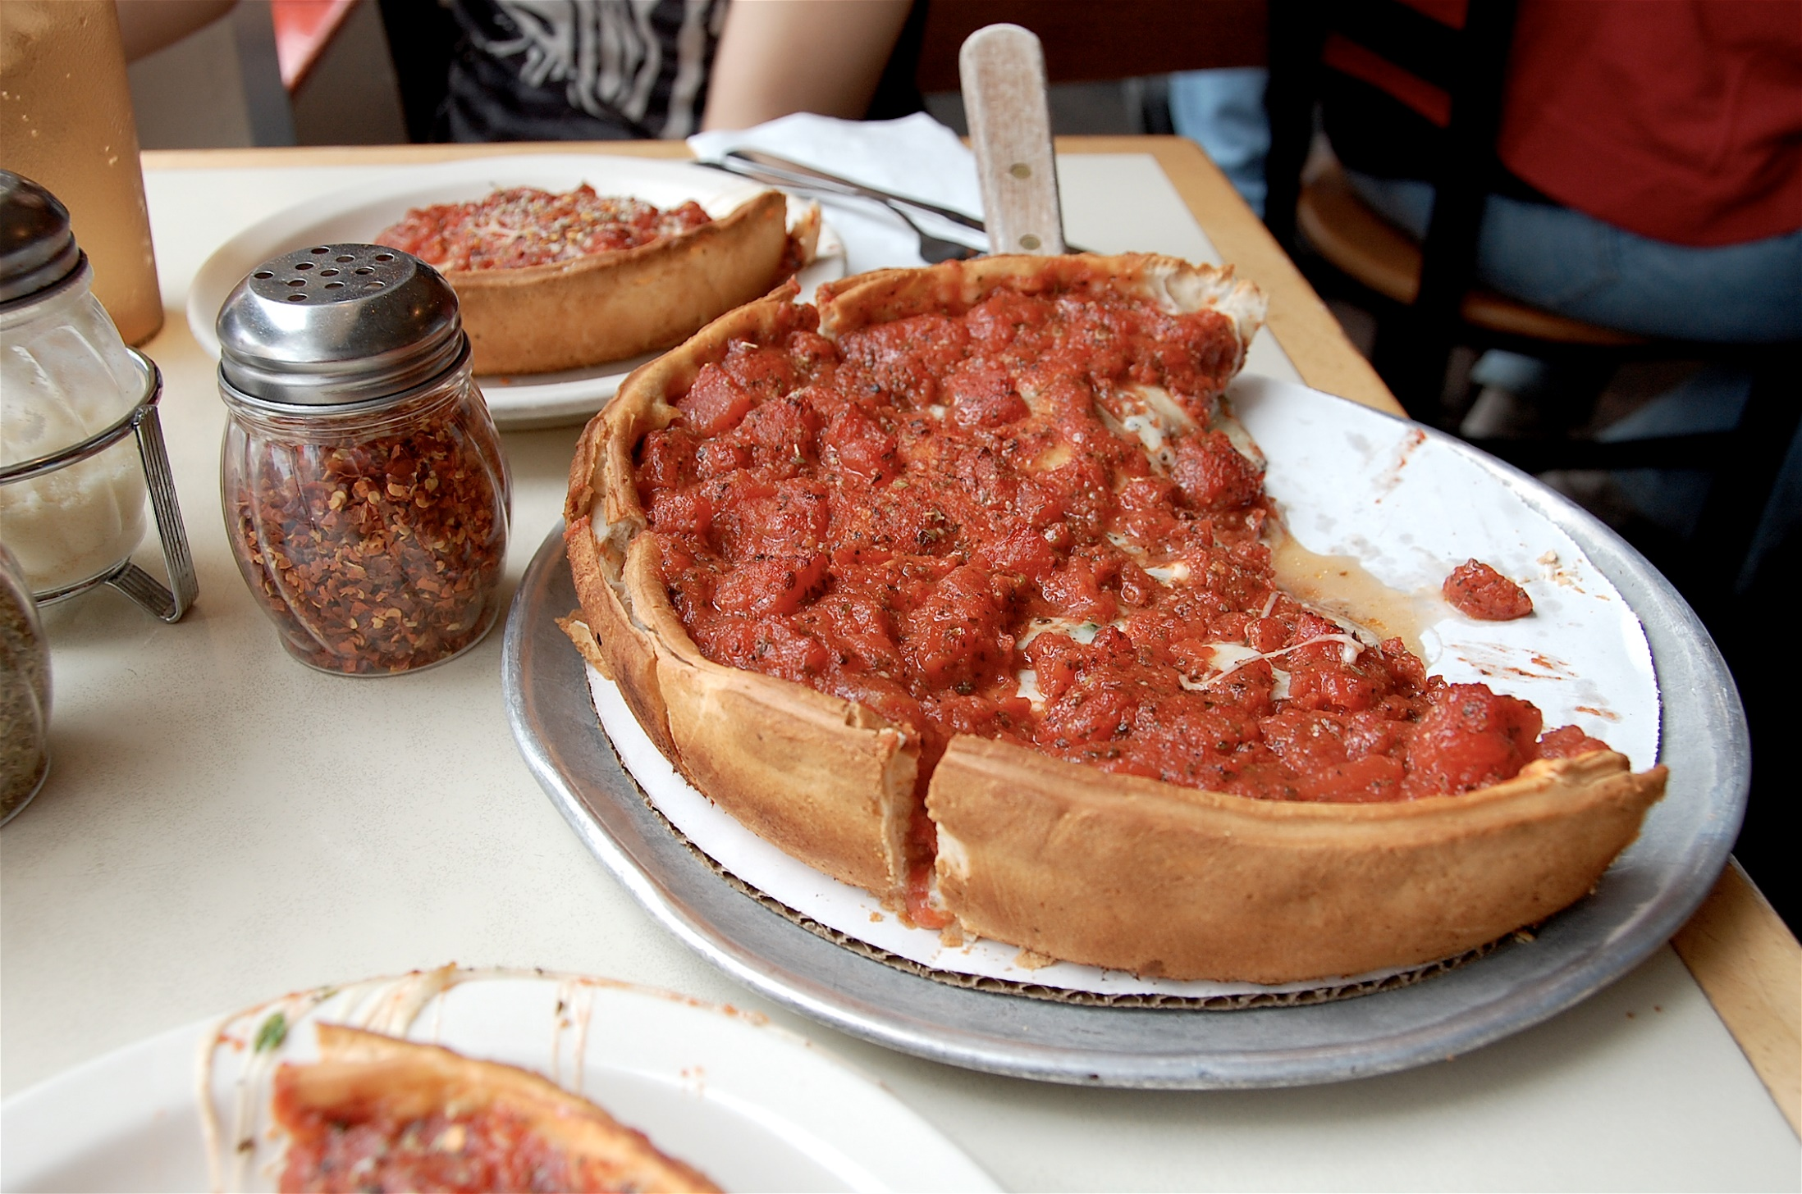
Chicago-style pizza
Wikipedia

Slide 50
Do we have an
“American cuisine?”
or a
“Canadian cuisine?”
The Cultural Feast, 2nd ed., p. 10

Slide 51
I’ll let you decide . . .
The Cultural Feast, 2nd ed., p. 10

Slide 52
we’ll see quite a bit of information on cuisines as we go through the semester . . .
and there is a lot of information on the cuisines and foods of peoples on-line . . .
The Cultural Feast, 2nd ed., p. 10

Slide 53
we’ll see quite a bit of information on cuisines as we go through the semester . . .
and there is a lot of information on the cuisines and foods of various peoples and countries on-line . . .
The Cultural Feast, 2nd ed., p. 10

Slide 54
and there is a course WebPage listing all of the countries, cultures and areas available for this course . . .

Slide 55
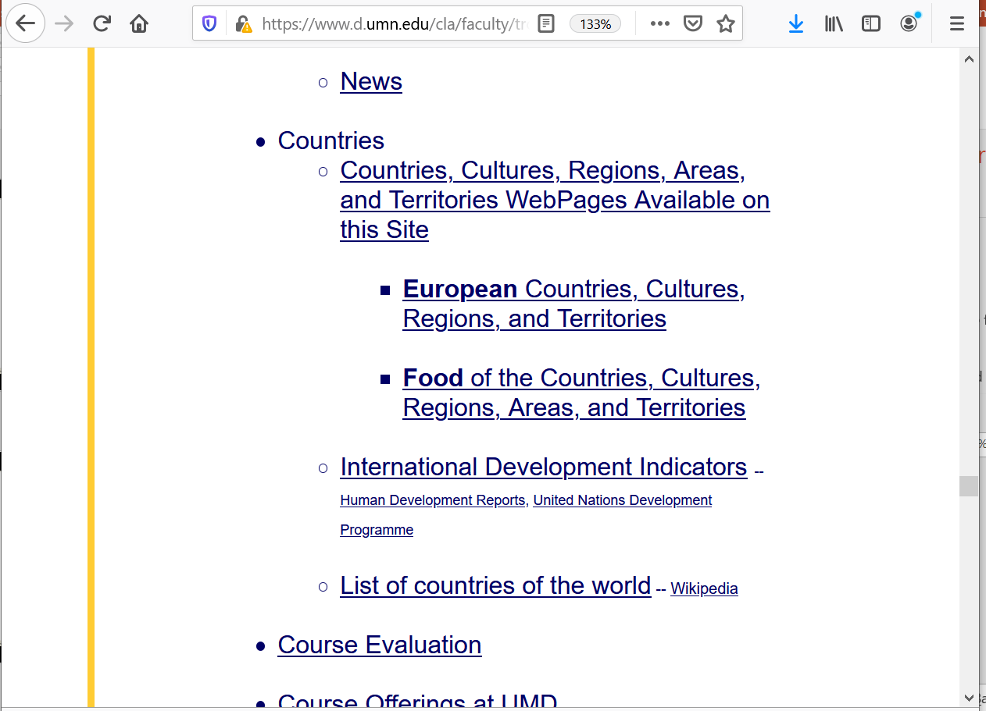

Slide 56
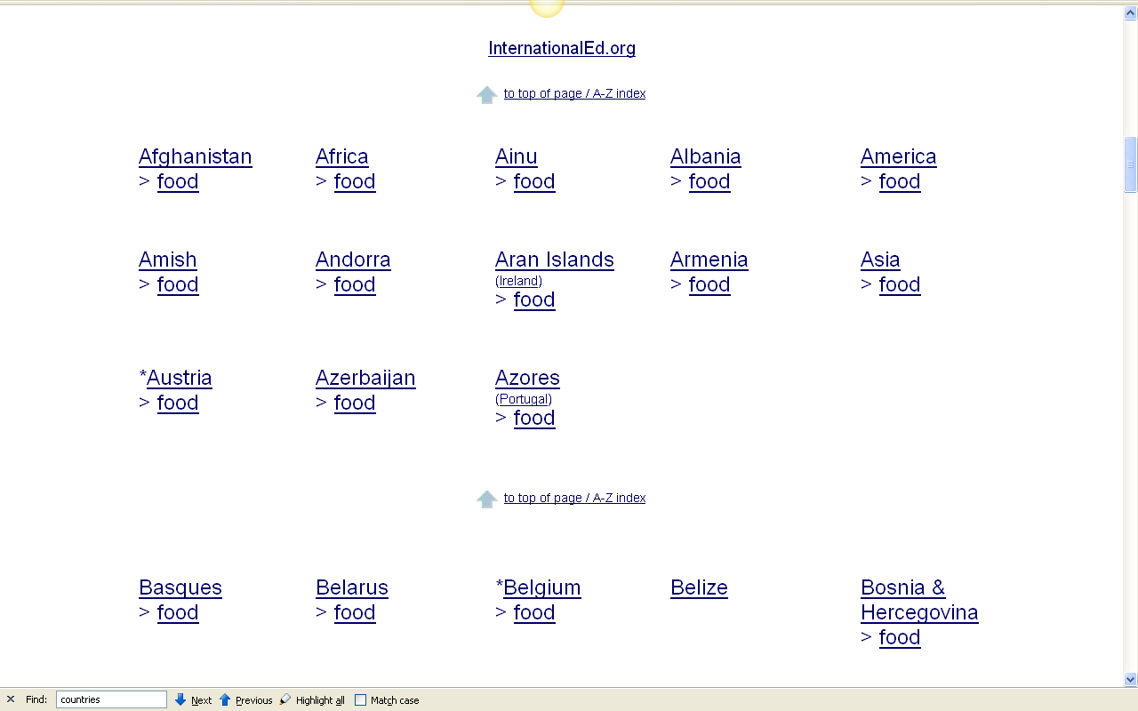
on that page the information is listed like this . . .
for over 100 countries and cultures . . .

Slide 57
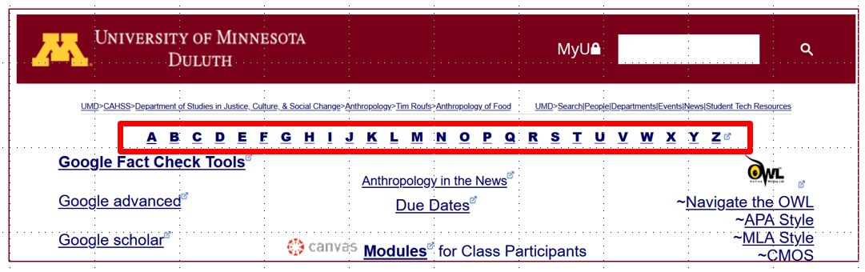
They will be useful later on with your project . .
A-Z Subject Index links

Slide 58
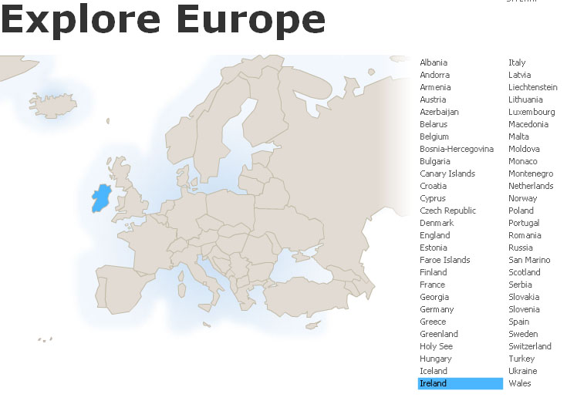
and that will get you lots of . . .
Food Information
on
Countries . . .
and Cuisines . . .
Anthropology of Food
University of Minnesota Duluth
Tim Roufs © 2010-2026

Slide 59
Cuisine
Tim Roufs
© 2010-2026

