Slide 1

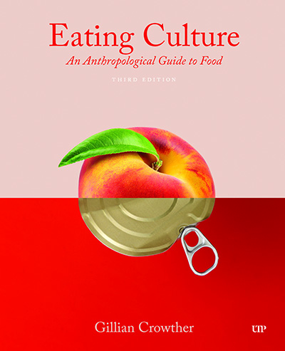
use your up/down arrow keys and/or
your space bar to advance the slides
Tim Roufs
© 2010-2026

Slide 2
Diet and Evolution:
Adaptation
Tim Roufs
© 2010-2026

Slide 3
Tim Roufs
© 2010-2026

Slide 4
Diet and Human Evolution
  Exploring the Diets of Extinct Humans
  Through Paleontology
      Teeth
      Skulls and Jaws
      The Postcranial Skeleton
  What Is Adaptation?
  Using Chemistry to Infer the Diets
  of Extinct Hominini
  Our Place in Nature
  A Brief Who's Who of the Early Hominini
  What Did Early Hominini Eat?
  What Can We Say About the Diets of Fossil Homo?
  Summary
  Highlight: Lactose Intolerance

Slide 5
Diet and Human Evolution
  Exploring the Diets of Extinct Humans
  Through Paleontology
      Teeth
      Skulls and Jaws
      The Postcranial Skeleton
  What Is Adaptation?
  Using Chemistry to Infer the Diets
  of Extinct Hominini
  Our Place in Nature
  A Brief Who's Who of the Early Hominini
  What Did Early Hominini Eat?
  What Can We Say About the Diets of Fossil Homo?
  Summary
  Highlight: Lactose Intolerance
  What Is Adaptation?

Slide 6
“There is a difference between
‘fine-tuning,’ via selection and adaptation, the features
that individuals of a species have,
and the emergence of those features in the first place.”
The Cultural Feast, 2nd ed., p. 24

Slide 7
“There is a difference between
‘fine-tuning,’ via selection and adaptation, the features
that individuals of a species have,
and the emergence of those features in the first place.”
The Cultural Feast, 2nd ed., p. 24

Slide 8
“There is a difference between
‘fine-tuning,’ via selection and adaptation, the features
that individuals of a species have,
and the emergence of those features in the first place.”
=
= evolution
The Cultural Feast, 2nd ed., p. 24

Slide 9
“Unfortunately,
Darwin confused adaptation
(the ‘fine-tuning’)
with evolution
(the emergence of novelty),
and this is still done today”
The Cultural Feast, 2nd ed., p. 24

Slide 10
“Darwin’s portrayal of natural selection is that it is a force that is constantly choosing variations
believed to be the most advantageous, thereby creating the ‘fittest’ individuals.”
“. . . but this may not be how things work in nature.”
The Cultural Feast, 2nd ed., p. 25

Slide 11
“. . . a more realistic way to look at selection [is]
to focus on the
elimination of the unfit
(say, by death)
rather than the selection of the fittest.”
The Cultural Feast, 2nd ed., p. 25

Slide 12
It’s not the “survival of the fittest” . . .
“The difference between these two views is important: Darwinian selection implies a constant culling and improvement of the cream of the crop, whereas the idea based on elimination of the unfit emphasizes the
survival of the just ‘OK’.”
The Cultural Feast, 2nd ed., p. 25

Slide 13
. . . and food is central to all of it . . .

Slide 14
. . . chimpanzee groups utilize foods efficiently in different
microenvironments

Slide 15
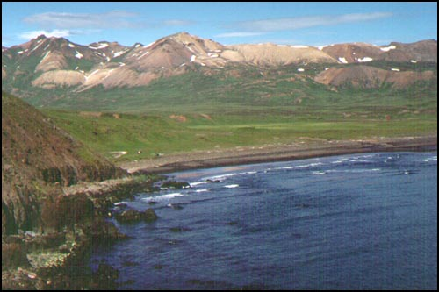
microenvironments

Slide 16
microenvironments

Slide 17
microenvironments

Slide 18
microenvironments

Slide 19
microenvironments

Slide 20
microenvironments

Slide 21
microenvironments

Slide 22
microenvironments

Slide 23
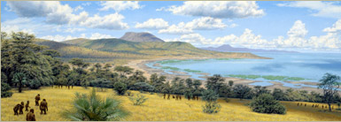
microenvironments
How many can you find in the following picture?
The African Savannah
Illustration by Jay H. Matternes
http://www.amnh.org/exhibitions/atapuerca/africa/branches.php

Slide 24
microenvironments
The African Savannah
Illustration by Jay H. Matternes
http://www.amnh.org/exhibitions/atapuerca/africa/branches.php

Slide 25
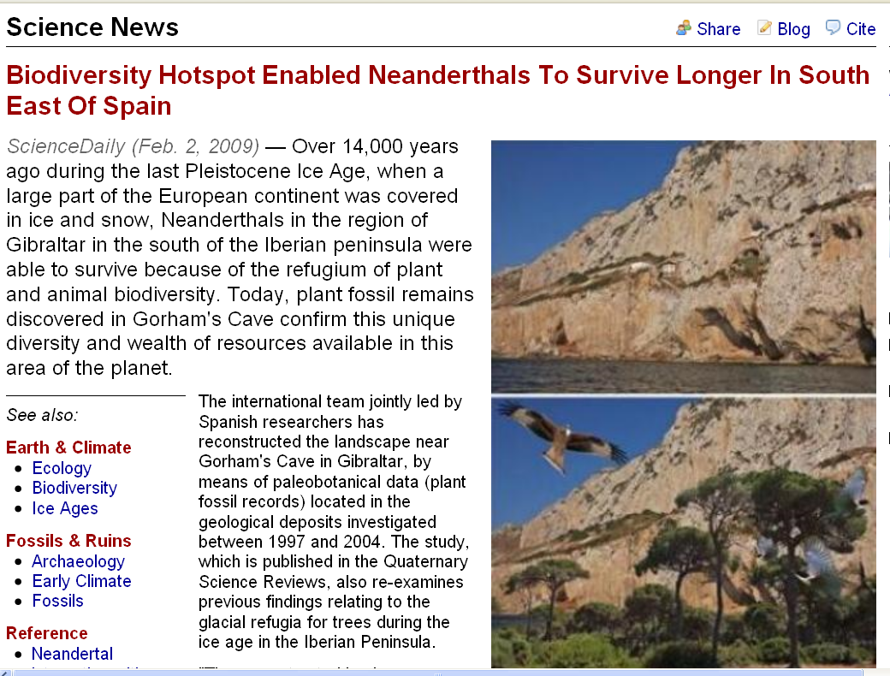
microenvironments
www.sciencedaily.com/releases/2009/02/090202140046.htm

Slide 26
. . . chimpanzee groups utilize foods efficiently in different microenvironments
. . . that is, they
are opportunistic feeders
“. . . if it’s a matter of their survival,
they can do it.”
The Cultural Feast, 2nd ed., p. 25

Slide 27
. . . effective adaptive food use
is a characteristic
of primates in general,
even monkeys . . .

Slide 28
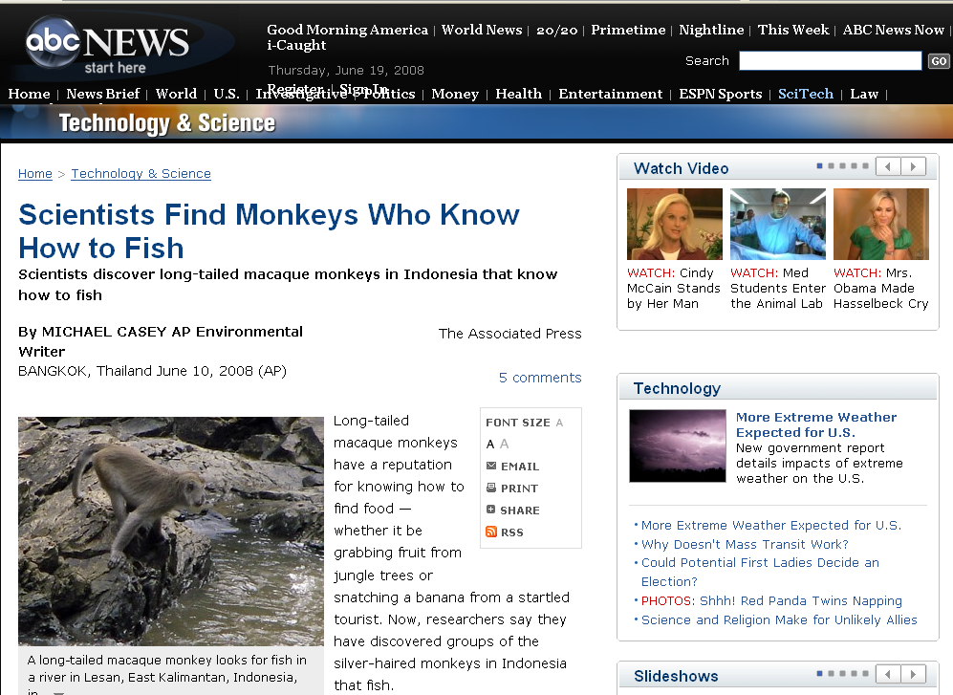
for e.g.,
abcnews.go.com/Technology/wireStory?id=5035837
Notes:
28

Slide 29
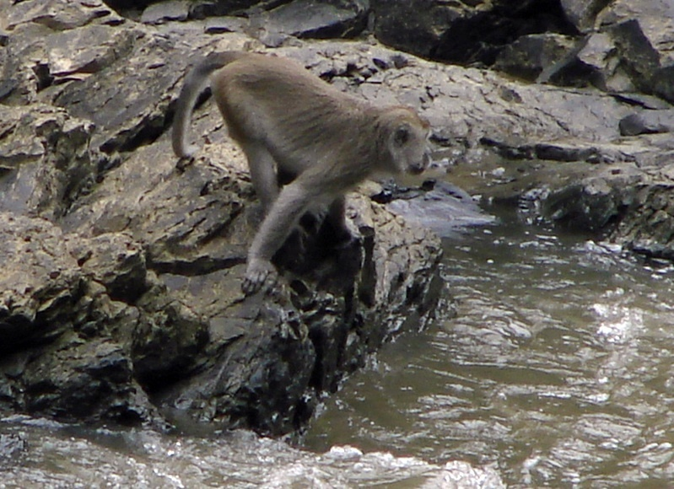
monkeys know how to fish
abcnews.go.com/Technology/wireStory?id=5035837
Notes:
29

Slide 30
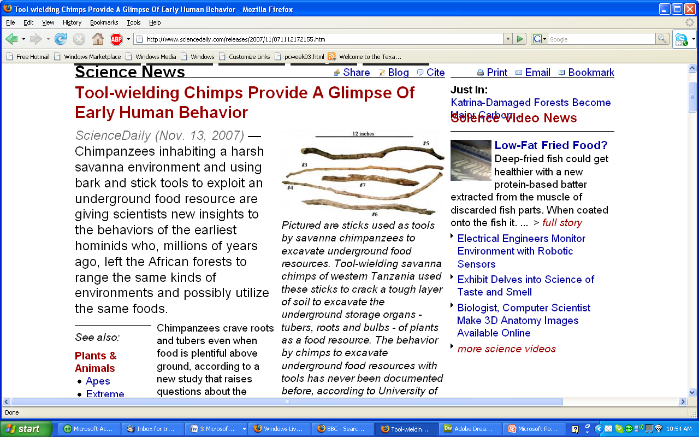
www.sciencedaily.com/releases/2007/11/071112172155.htm
Notes:
30

Slide 31

tidal pools offer luxury living
www.bolenhq.com/scubaandsnorkeling.htm
Notes:
31

Slide 32
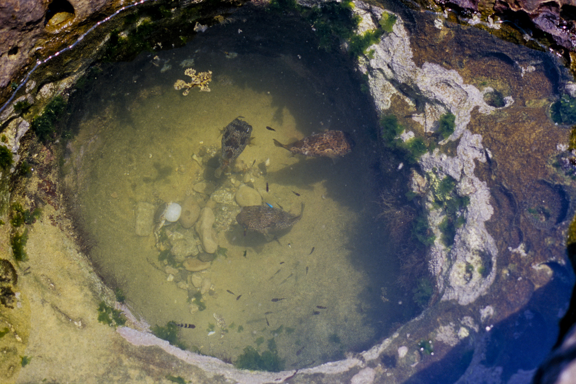
excellent food for the taking,
delivered twice a day to the tidal pools
http://tirugondar.wordpress.com/2008/08/03/yehliu-and-the-yehliu-geopark/
Notes:
32

Slide 33
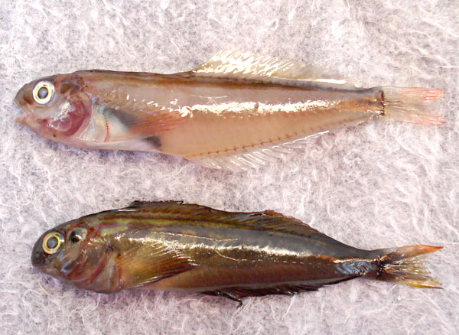
www.mexfish.com/fish/pfblen/pfblen.htm
Notes:
33

Slide 34
Panamic Fanged Blenny, Ophioblennius steindachneri: [Adults] are common and always found in tidal pools, even with extreme low tides, with plenty of water and a place to hide under a rock
. . . Collected in January 2008 in a dry El Tule Tidal pool, Km. 17, San Jose del Cabo, Mexico . . .
www.mexfish.com/fish/pfblen/pfblen.htm
Notes:
34

Slide 35
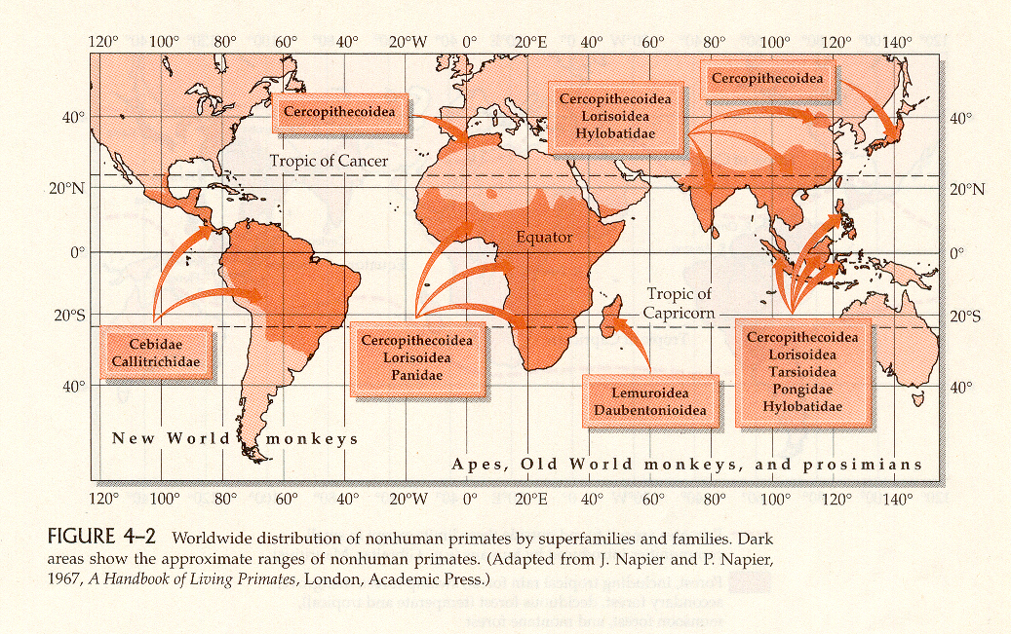
Primates are tropical and temperate climate creatures
Distribution of Nonhuman Primates
(mostly in the tropics and subtropics)
Humankind Emerging, 7th ed., p. 93

Slide 36
over the millennia there were a number of important food “revolutions” . . .

Slide 37

this is an excellent source for a discussion on food “revolutions” . . .
Simon & Schuster 2003

Slide 38
Eight Food “Revolutions”
Invention of Cooking
Discovery that Food is More Than Sustenance
The “Herding Revolution”
Snail Farming
Use of Food as a Means and Index of Social Differentiation
Long-Range Exchange of Culture
Ecological Revolution of last 500 years
Industrial Revolution of the 19th and 20th Centuries
Simon & Schuster 2003

Slide 39
Eight Food “Revolutions”
Invention of Cooking
Discovery that Food is More Than Sustenance
The “Herding Revolution”
Snail Farming
Use of Food as a Means and Index of Social Differentiation
Long-Range Exchange of Culture
Ecological Revolution of last 500 years
Industrial Revolution of the 19th and 20th Centuries
Simon & Schuster 2003

Slide 40
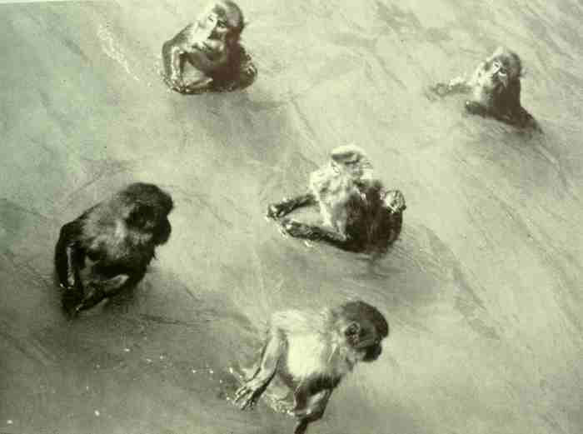
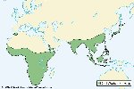
Old World Monkeys: Macaques

Slide 41
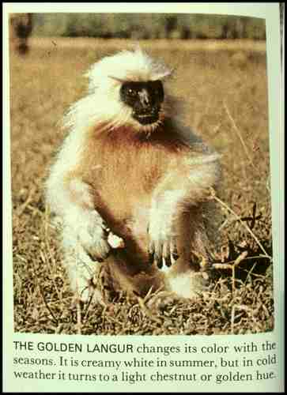
Old World Monkey: Golden Langur
The Primates, Time-Life (1974) p. 54

Slide 42
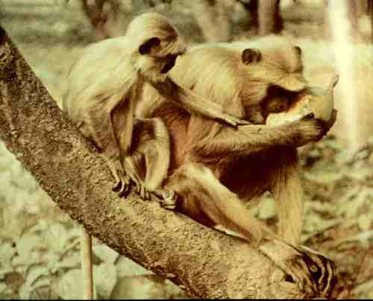
Old World Monkeys: Langurs
The Primates, Time-Life (1974) p. 100

Slide 43
. . . but remember always . . .
the hunter is also the hunted . . .

Slide 44
“tropic level”
is
an animal
or a plant’s position
in the food chain
The Cultural Feast, 2nd ed., p. 28

Slide 45
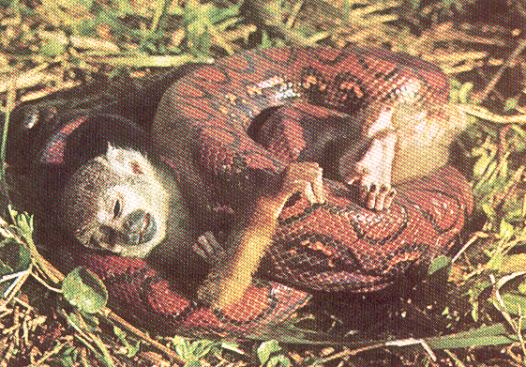
New World Monkey: Squirrel Monkey
The Primates, Time-Life (1974) p. 49

Slide 46
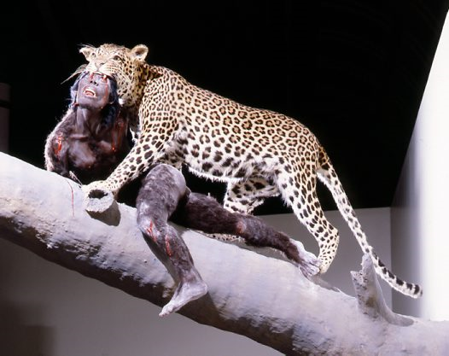
Reconstruction of the death of a hominin by a leopard,
based on fossils found in South Africa
http://australianmuseum.net.au/image/A-leopards-lunch/

Slide 47
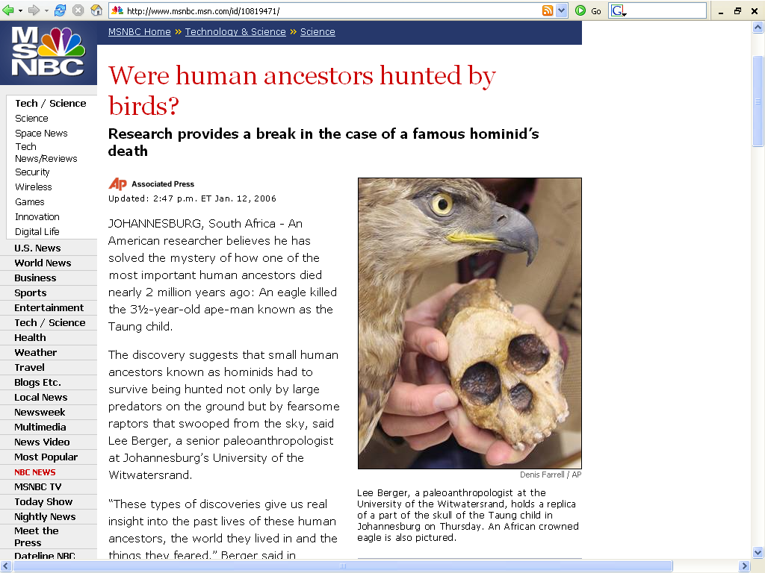
http://www.msnbc.msn.com/id/10819471/
Notes:
47

Slide 48
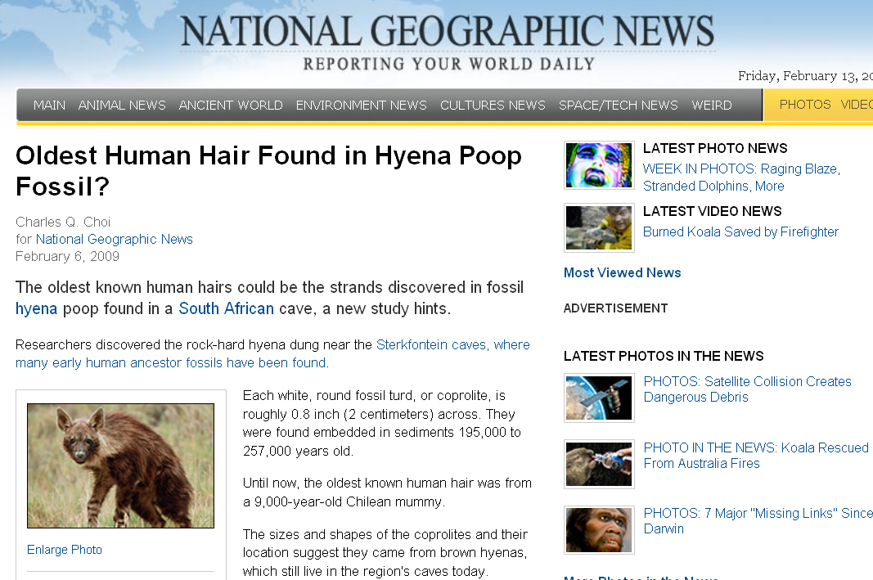
http://news.nationalgeographic.com/news/2009/02/090206-oldest-hair-hyenas.html
Notes:
48

Slide 49
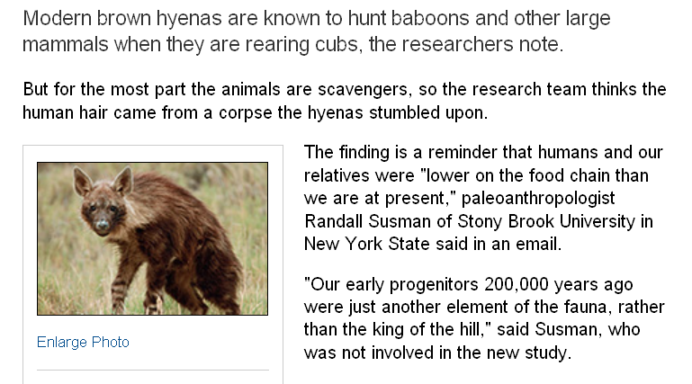
“tropic level”
http://news.nationalgeographic.com/news/2009/02/090206-oldest-hair-hyenas.html
Notes:
49

Slide 50
moral of the adaptation story:
“. . . aspects of an animal’s dietary and locomotory behavior cannot necessarily be reconstructed from features of its teeth and skeletal anatomy.”
“Looking at the ‘hardware’ alone may not give us much insight into the variety of diets for many existing and extinct primates.”
The Cultural Feast, 2nd ed., p. 26-27

Slide 51
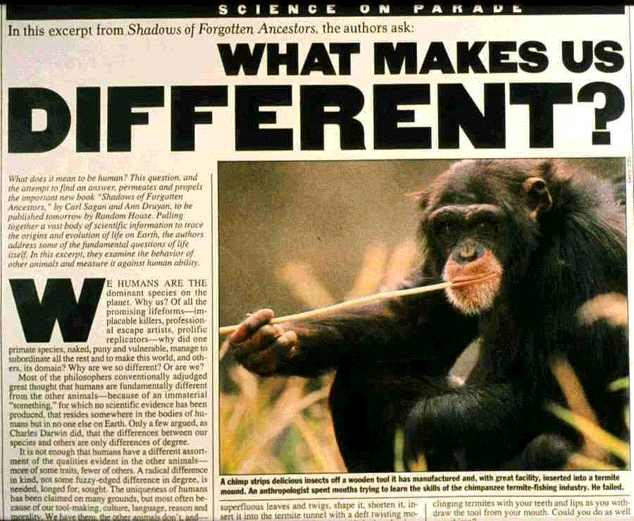

Slide 52
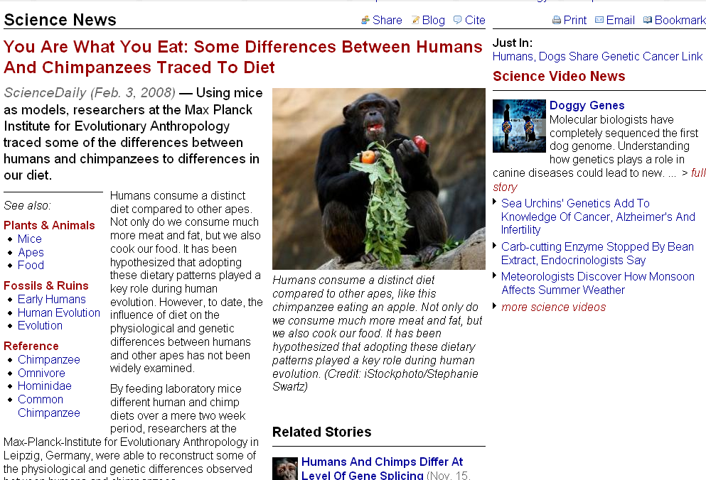
  differences are traced to diet
www.sciencedaily.com/releases/2008/01/080130092139.htm
Notes:
52

Slide 53
hominids
“We are what they ate.”
The Cultural Feast, 2nd ed., p. 17

Slide 54
now
“hominins” / hominini
hominids
“We are what they ate.”
The Cultural Feast, 2nd ed., p. 17

Slide 55
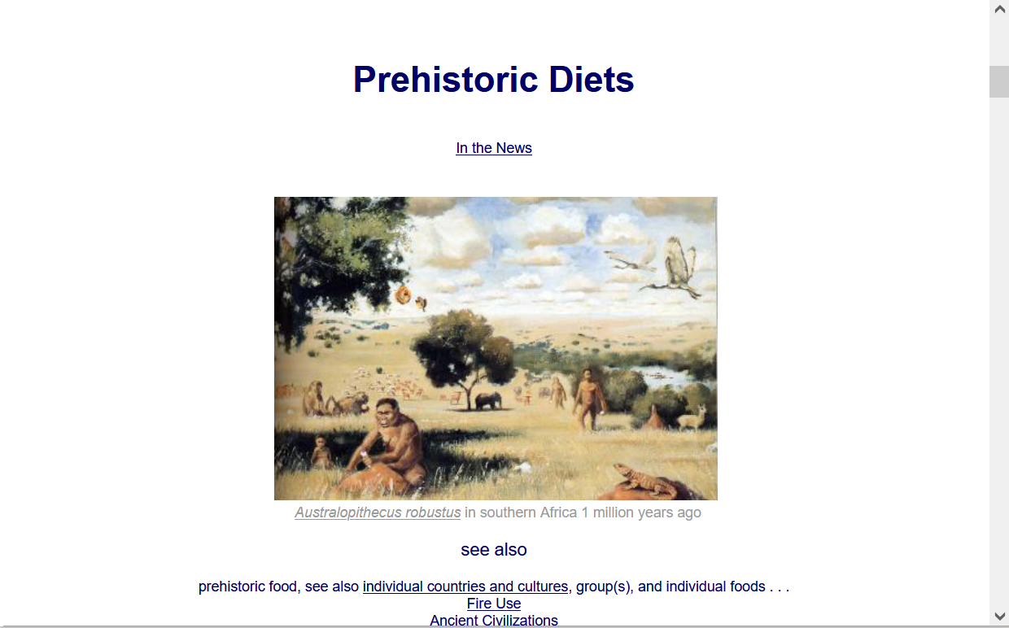
  For more information see the class Prehisoric Diets Web Page . . .
https://www.d.umn.edu/cla/faculty/troufs/anth1602/pcdiet.html#title

Slide 56
Diet and Evolution:
Adaptation
Tim Roufs
© 2010-2026

