Slide 1
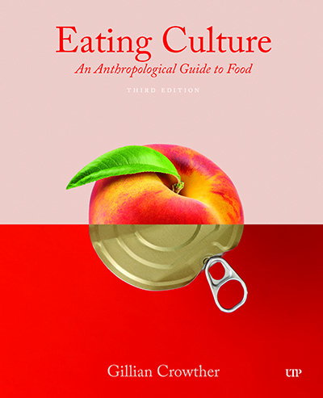
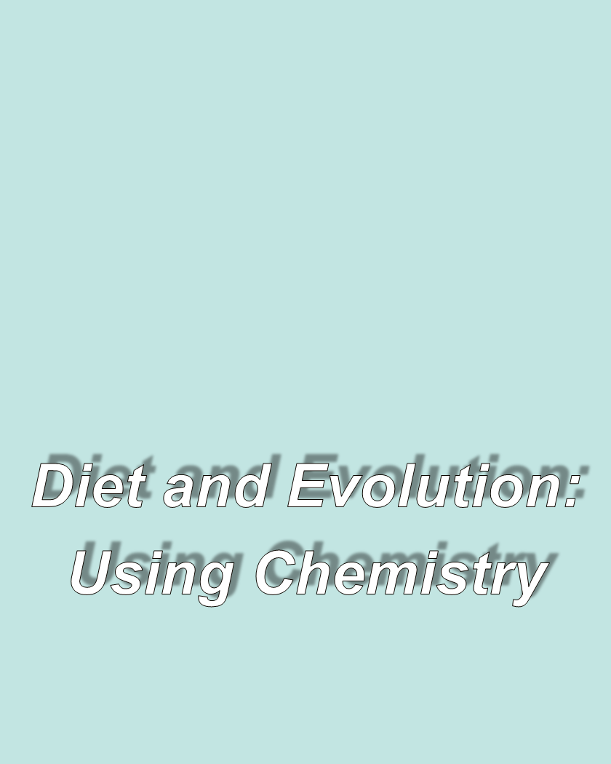
use your up/down arrow keys and/or
your space bar to advance the slides
Tim Roufs
© 2010-2026

Slide 2
Tim Roufs
© 2010-2026

Slide 3
Diet and Human Evolution
  Exploring the Diets of Extinct Humans
  Through Paleontology
      Teeth
      Skulls and Jaws
      The Postcranial Skeleton
  What Is Adaptation?
  Using Chemistry to Infer the Diets
  of Extinct Hominini
  Our Place in Nature
  A Brief Who's Who of the Early Hominini
  What Did Early Hominini Eat?
  What Can We Say About the Diets of Fossil Homo?
  Summary
  Highlight: Lactose Intolerance

Slide 4
Diet and Human Evolution
  Exploring the Diets of Extinct Humans
  Through Paleontology
      Teeth
      Skulls and Jaws
      The Postcranial Skeleton
  What Is Adaptation?
  Using Chemistry to Infer the Diets
  of Extinct Hominini
  Our Place in Nature
  A Brief Who's Who of the Early Hominini
  What Did Early Hominini Eat?
  What Can We Say About the Diets of Fossil Homo?
  Summary
  Highlight: Lactose Intolerance
  Using Chemistry to Infer the Diets
  of Extinct Hominini

Slide 5
. . . in the last 20 years techniques for analyzing the chemistry of prehistoric bone and on other remains have become very reliable
carbon stable isotope analysis
nitrogen stable isotope analysis
isotopes are chemical elements that have the same atomic number but different atomic weights
The Cultural Feast, 2nd ed., p. 27

Slide 6
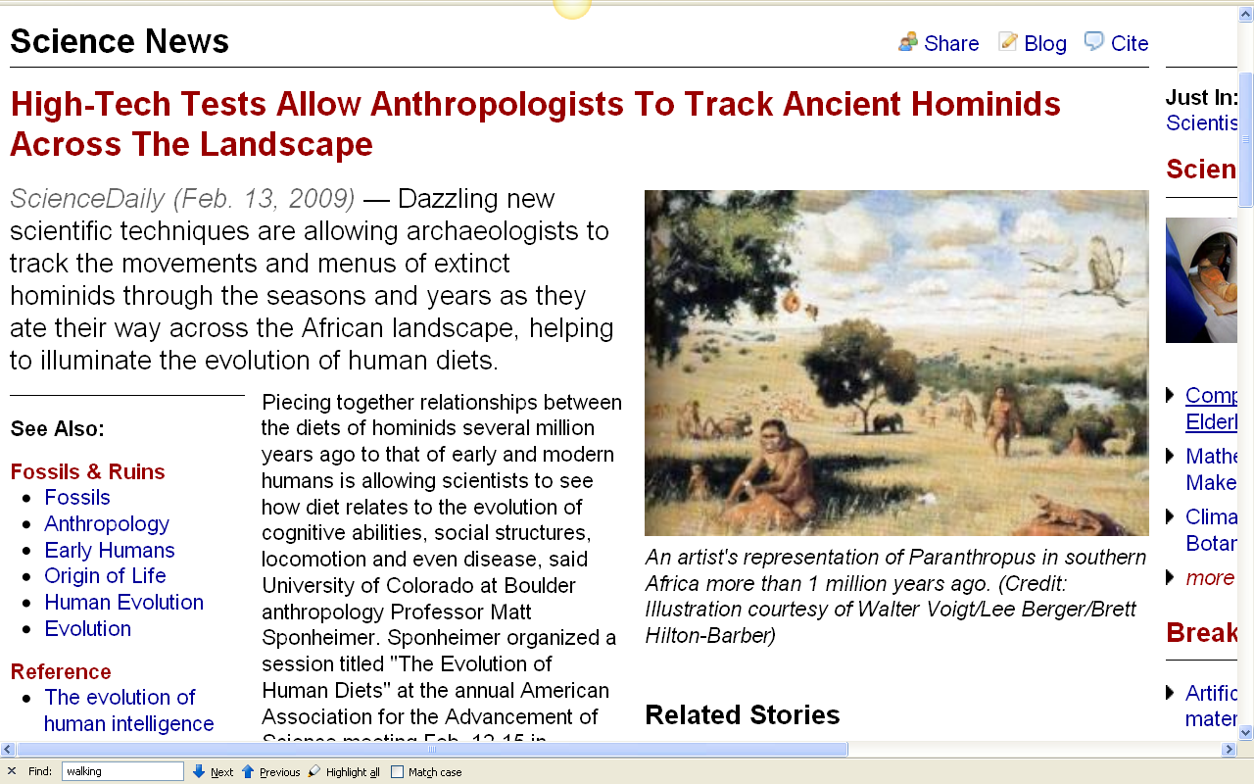
http://www.sciencedaily.com/releases/2009/02/090212150838.htm
Notes:
6

Slide 7
. . . in the last 20 years techniques for analyzing the chemistry of prehistoric bone and on other remains have become very reliable
on teeth (stable after eruption)
on bone (constantly rebuilding itself)
on stone tools and ceramics . . .
The Cultural Feast, 2nd ed., p. 27

Slide 8
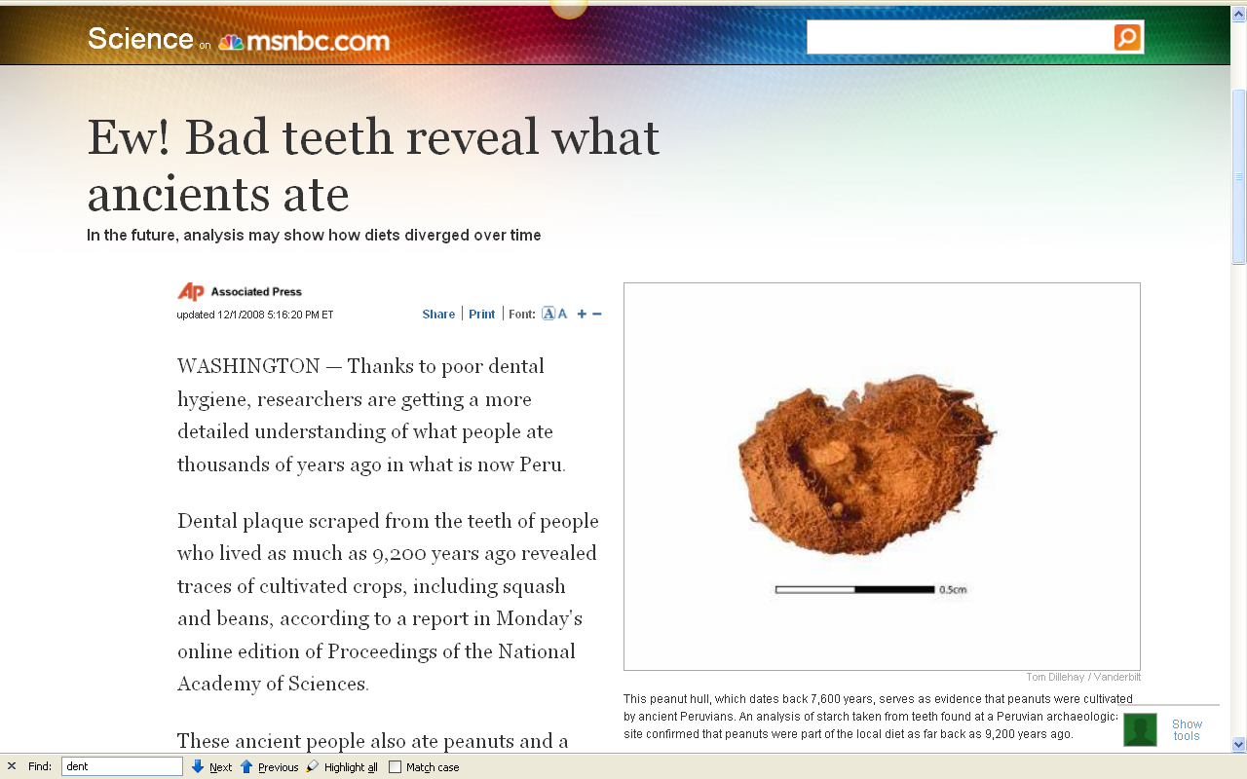
http://www.msnbc.msn.com/id/28000618/
Notes:
8

Slide 9
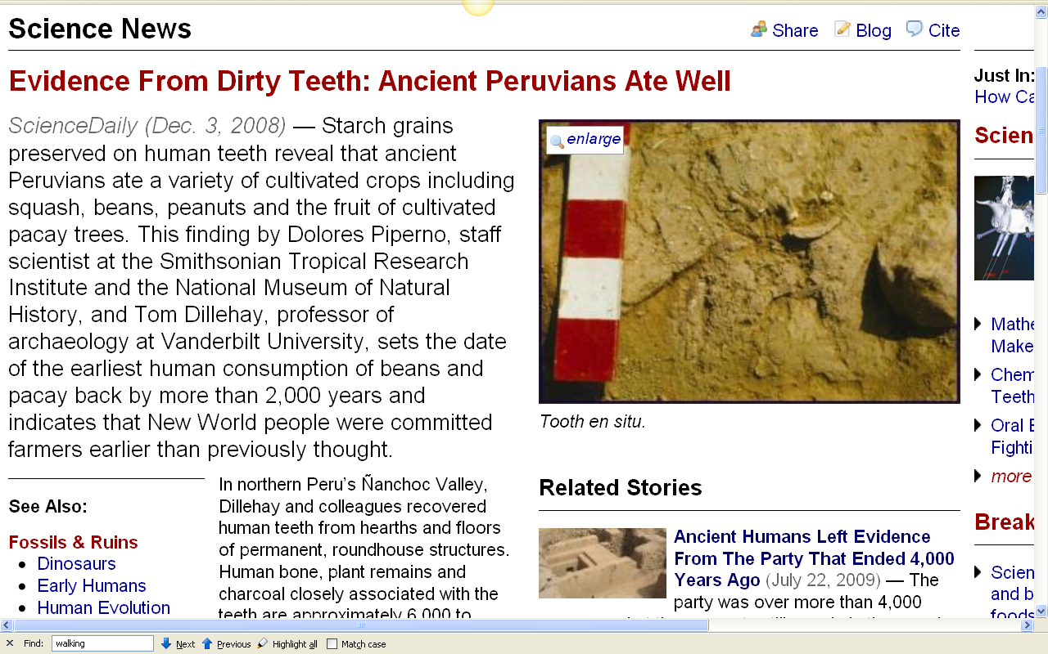
http://www.sciencedaily.com/releases/2008/12/081201200121.htm
Notes:
9

Slide 10
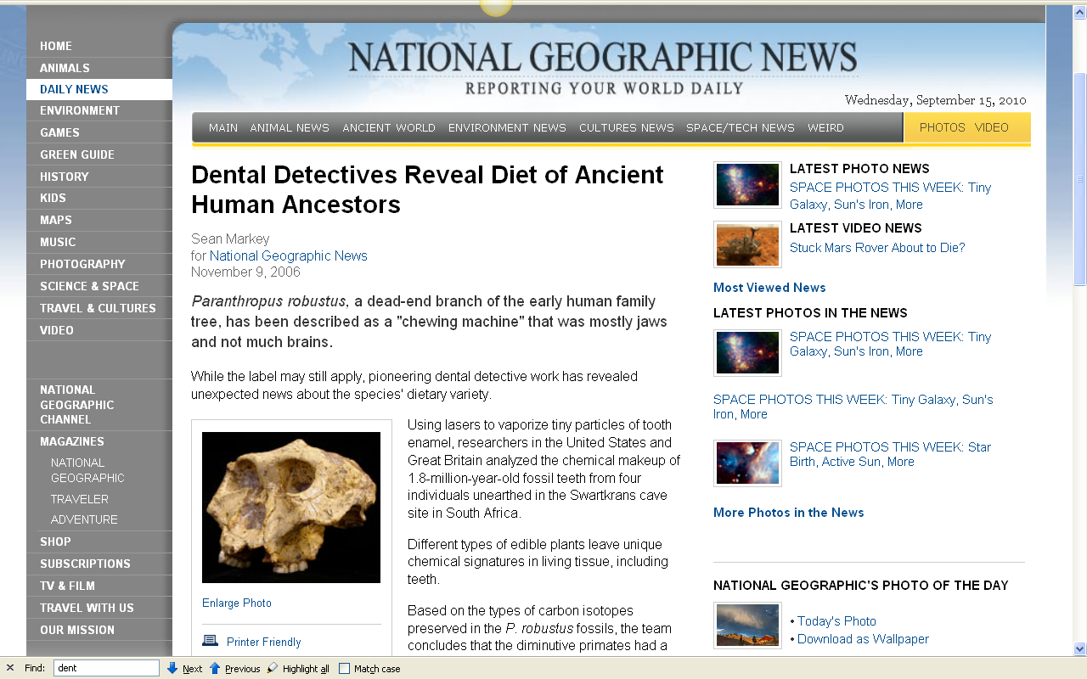
http://news.nationalgeographic.com/news/2006/11/061109-teeth-diet.html
Notes:
10

Slide 11
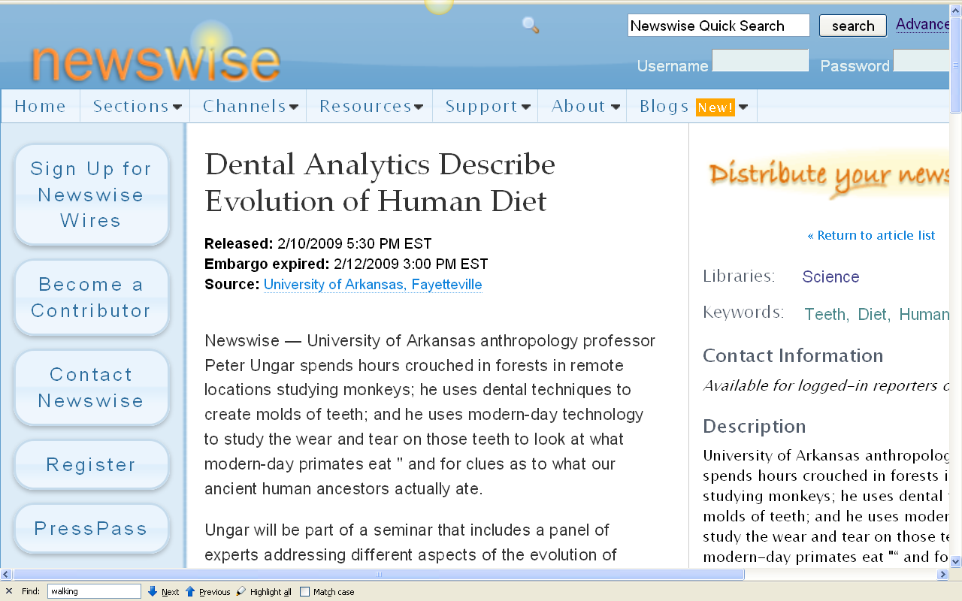
http://www.newswise.com/articles/view/549004/?sc=rssn
Notes:
11

Slide 12
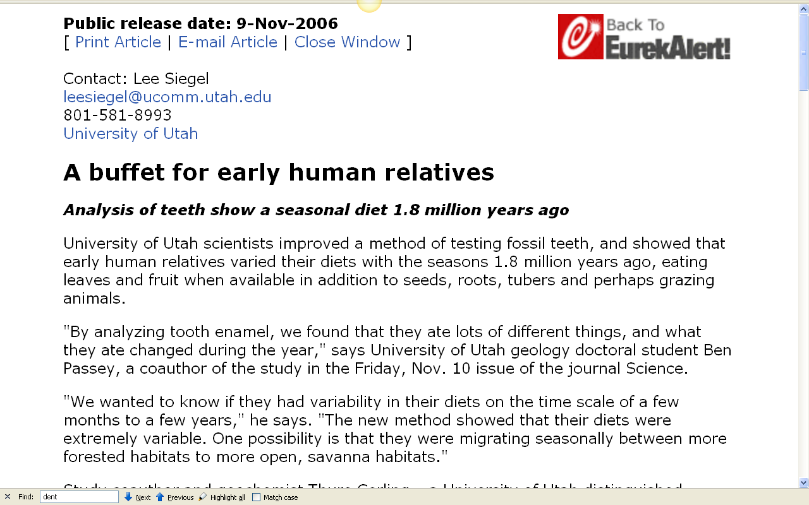
http://www.eurekalert.org/pub_releases/2006-11/uou-abf110306.php
Notes:
12

Slide 13
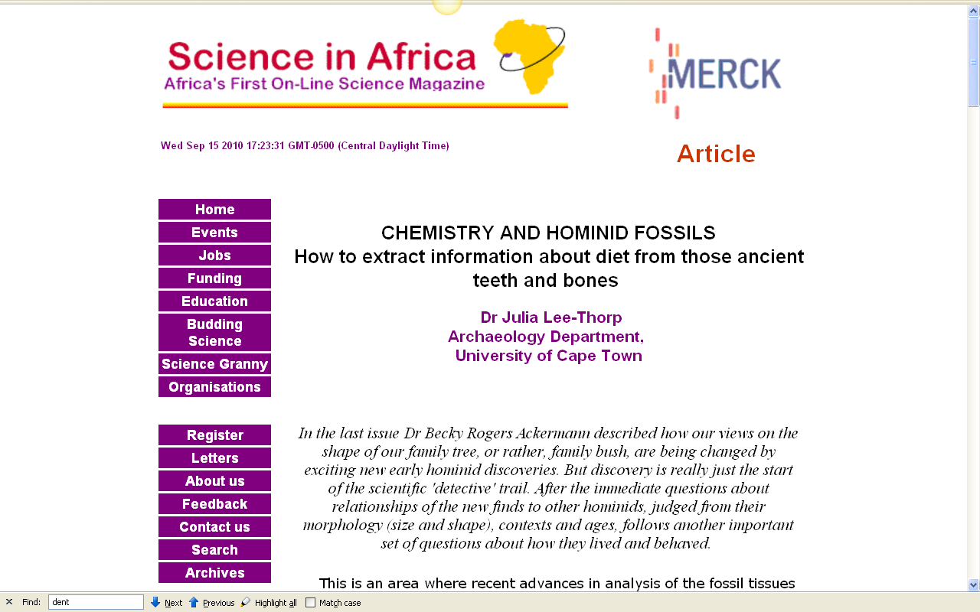
http://www.scienceinafrica.co.za/2001/december/hominids.htm
Notes:
13

Slide 14
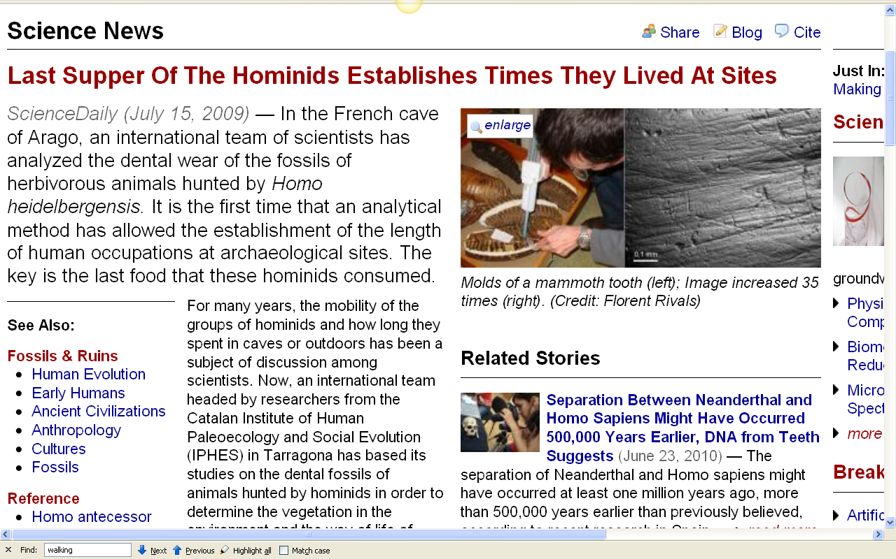
http://www.sciencedaily.com/releases/2009/07/090714103526.htm
Notes:
14

Slide 15
. . . in the last 20 years techniques for analyzing the chemistry of prehistoric bone and on other remains have become very reliable
on teeth (stable after eruption)
on bone (constantly rebuilding itself)
on stone tools and ceramics . . .
The Cultural Feast, 2nd ed., p. 27

Slide 16
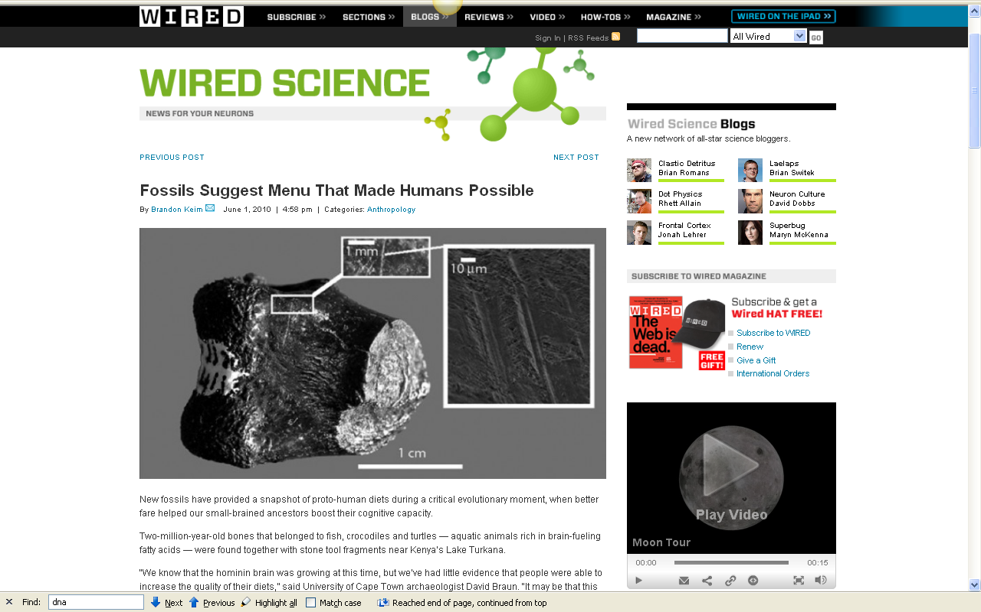
http://www.wired.com/wiredscience/2010/06/first-fish-diet/
Notes:
16

Slide 17
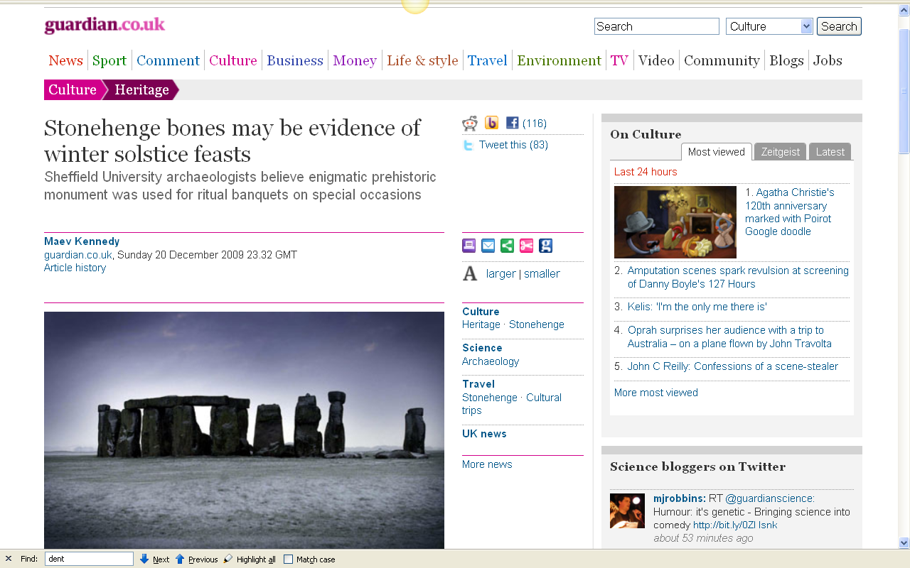
http://www.guardian.co.uk/culture/2009/dec/20/stonehenge-animal-bones-solstice-feast
Notes:
17

Slide 18
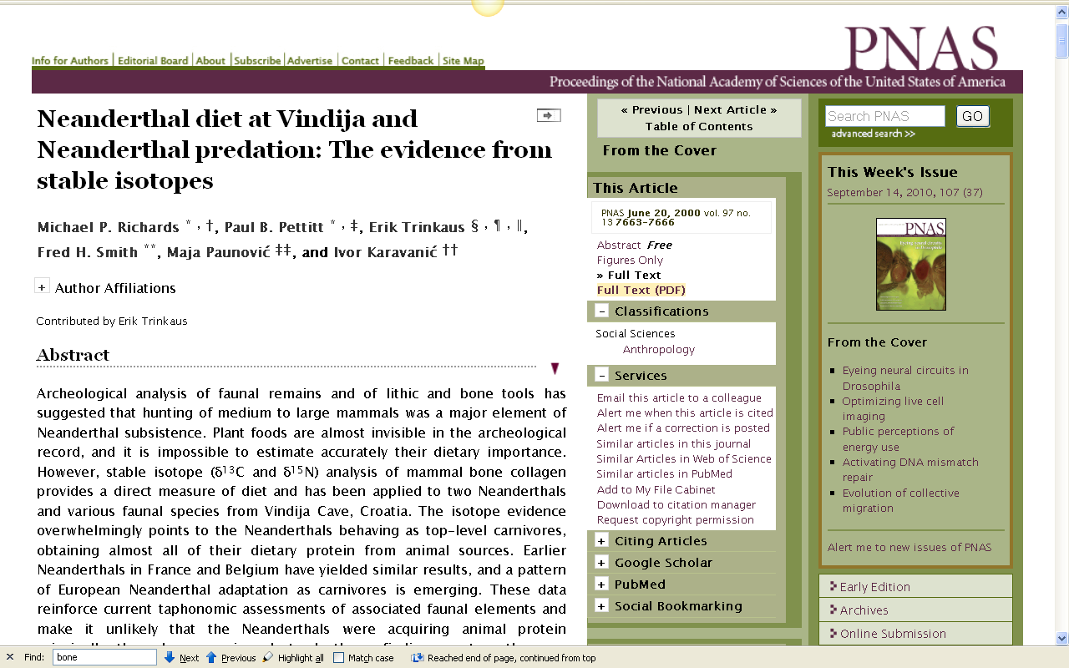
http://www.pnas.org/content/97/13/7663.full
Notes:
18

Slide 19
. . . in the last 20 years techniques for analyzing the chemistry of prehistoric bone and on other remains have become very reliable
on teeth (stable after eruption)
on bone (constantly rebuilding itself)
on stone tools and ceramics . . .
The Cultural Feast, 2nd ed., p. 27

Slide 20
. . . microscopic and chemical analysis of residues and tissues preserved on the edges of stone tools have been brought to bear on identifying the animals on whom the tools were used . . .
The Cultural Feast, 2nd ed., p. 28

Slide 21
. . . and microscopic and chemical analysis has been used for
residue analysis on ceramics
to tell what foods were used . . .
The Cultural Feast, 2nd ed., p. 28

Slide 22
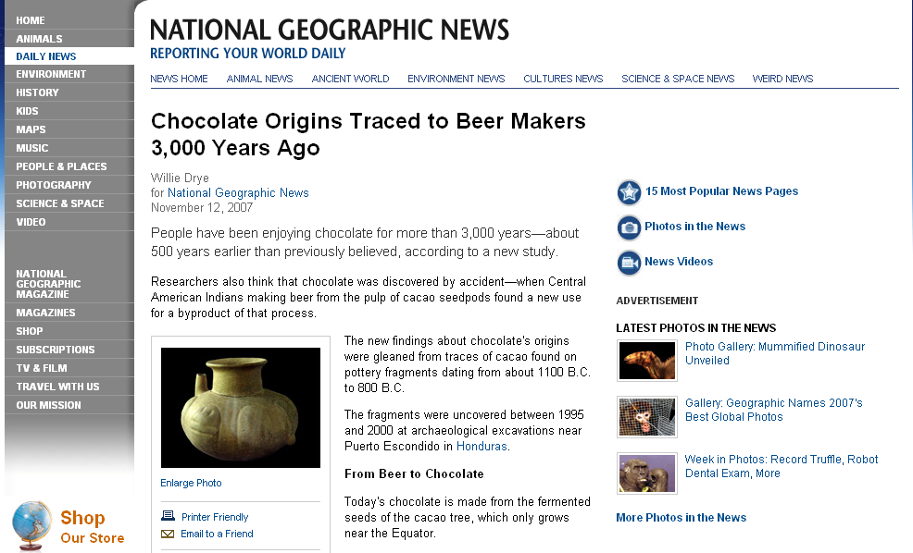
http://news.nationalgeographic.com/news/2007/11/071112-chocolate.html
Notes:
22

Slide 23
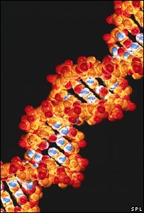
. . . and DNA studies are critical . . .
http://news.bbc.co.uk/2/hi/science/nature/7132794.stm

Slide 24
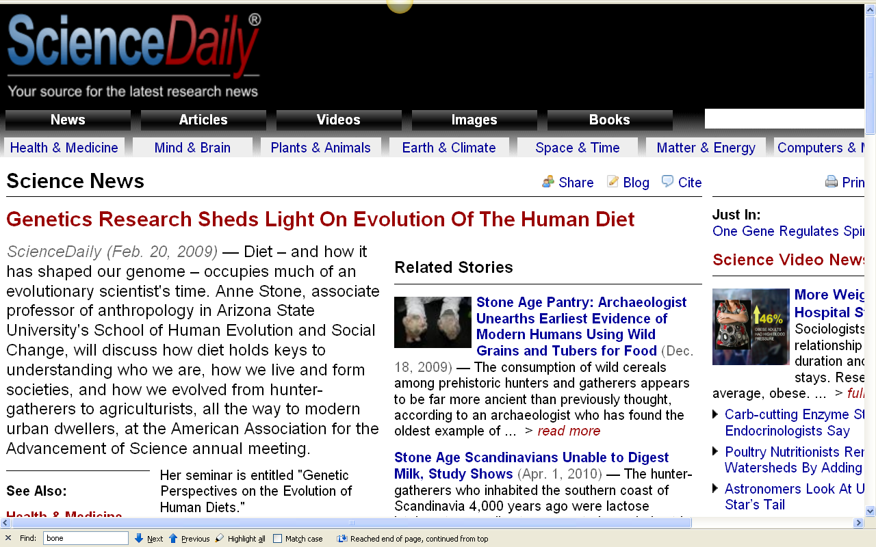
http://www.sciencedaily.com/releases/2009/02/090212150822.htm

Slide 25
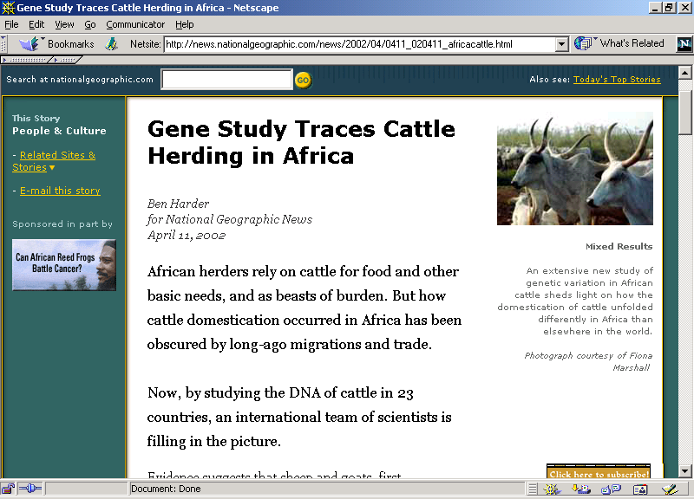

Slide 26
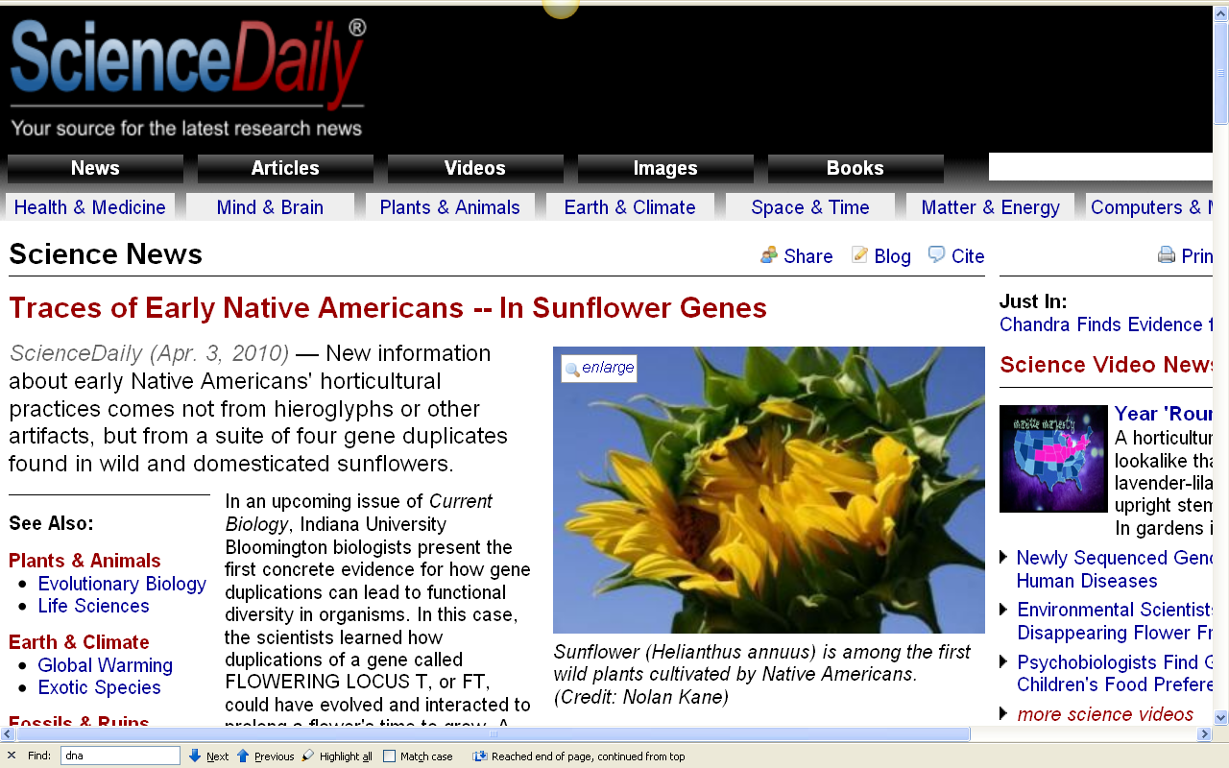
http://www.sciencedaily.com/releases/2010/04/100402110131.htm

Slide 27
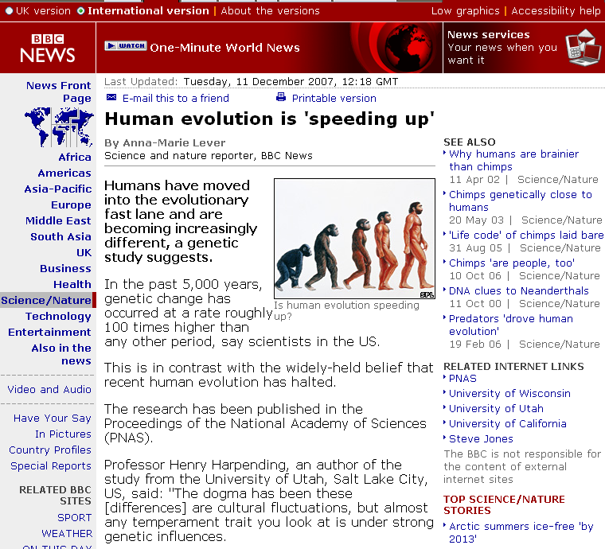
http://news.bbc.co.uk/2/hi/science/nature/7132794.stm

Slide 28
seven percent of human genes are undergoing rapid evolution
http://news.bbc.co.uk/2/hi/science/nature/7132794.stm

Slide 29
“The study looked specifically at genetic variations called
"single nucleotide polymorphisms,"
or SNPs.
These are single-point mutations,
or changes, in the genetic sequence of DNA on chromosomes.”
Seven percent of human genes are undergoing rapid evolution
http://news.bbc.co.uk/2/hi/science/nature/7132794.stm

Slide 30
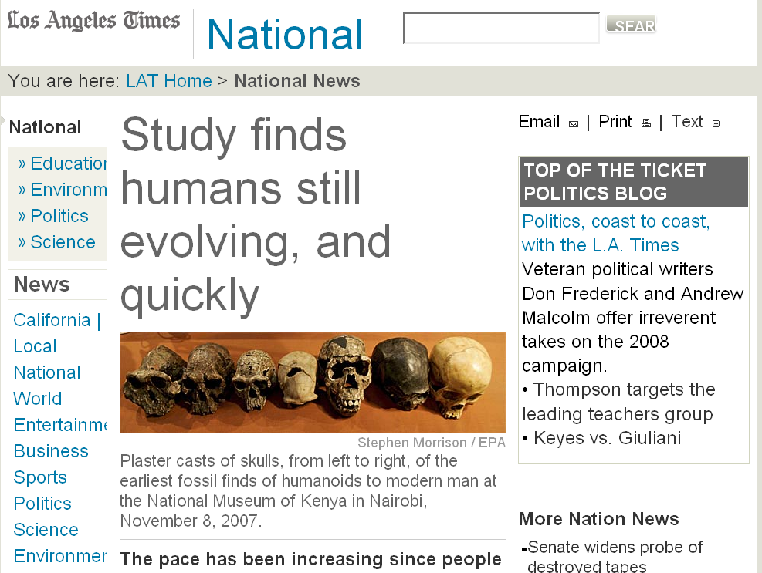
Seven percent of human genes are undergoing rapid evolution
http://www.latimes.com/news/nationworld/nation/la-sci-evolution11dec11,1,2206745.story?coll=la-headlines-nation&ctrack=2&cset=true

Slide 31
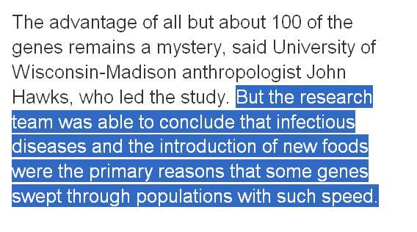
Seven percent of human genes are undergoing rapid evolution
http://www.latimes.com/news/nationworld/nation/la-sci-evolution11dec11,1,2206745.story?coll=la-headlines-nation&ctrack=2&cset=true

Slide 32
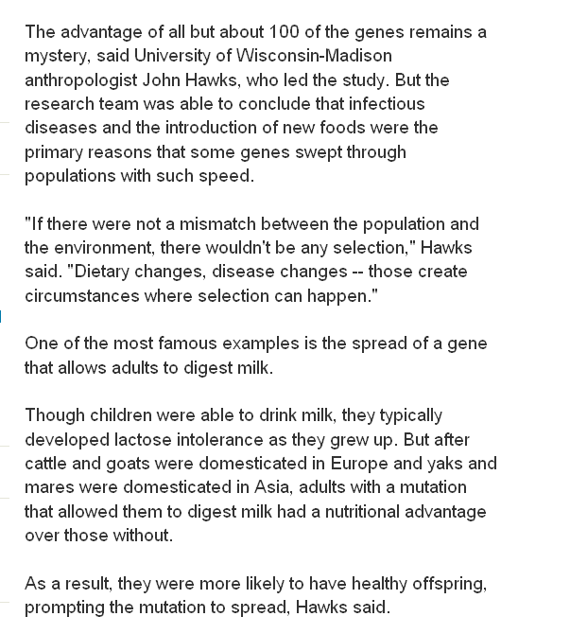
Seven percent of human genes are undergoing rapid evolution
http://www.latimes.com/news/nationworld/nation/la-sci-evolution11dec11,1,2206745.story?coll=la-headlines-nation&ctrack=2&cset=true

Slide 33
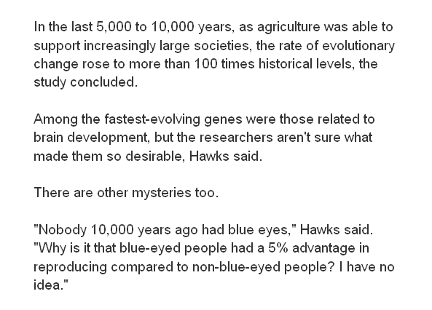
Seven percent of human genes are undergoing rapid evolution
http://www.latimes.com/news/nationworld/nation/la-sci-evolution11dec11,1,2206745.story?coll=la-headlines-nation&ctrack=2&cset=true

Slide 34
Seven percent of human genes are undergoing rapid evolution
http://www.latimes.com/news/nationworld/nation/la-sci-evolution11dec11,1,2206745.story?coll=la-headlines-nation&ctrack=2&cset=true

Slide 35
^{some important terms}

Slide 36
tropic level
an animal
or a plant’s position
in the food chain
The Cultural Feast, 2nd ed., p. 28

Slide 37
photosynthesis
the chemical process green plants use to convert carbon dioxide and water, in the presence of sunlight, into organic compounds
The Cultural Feast, 2nd ed., p. 27

Slide 38
collagen
the predominant protein
in bones
and tooth pulps
The Cultural Feast, 2nd ed., p. 27

Slide 39
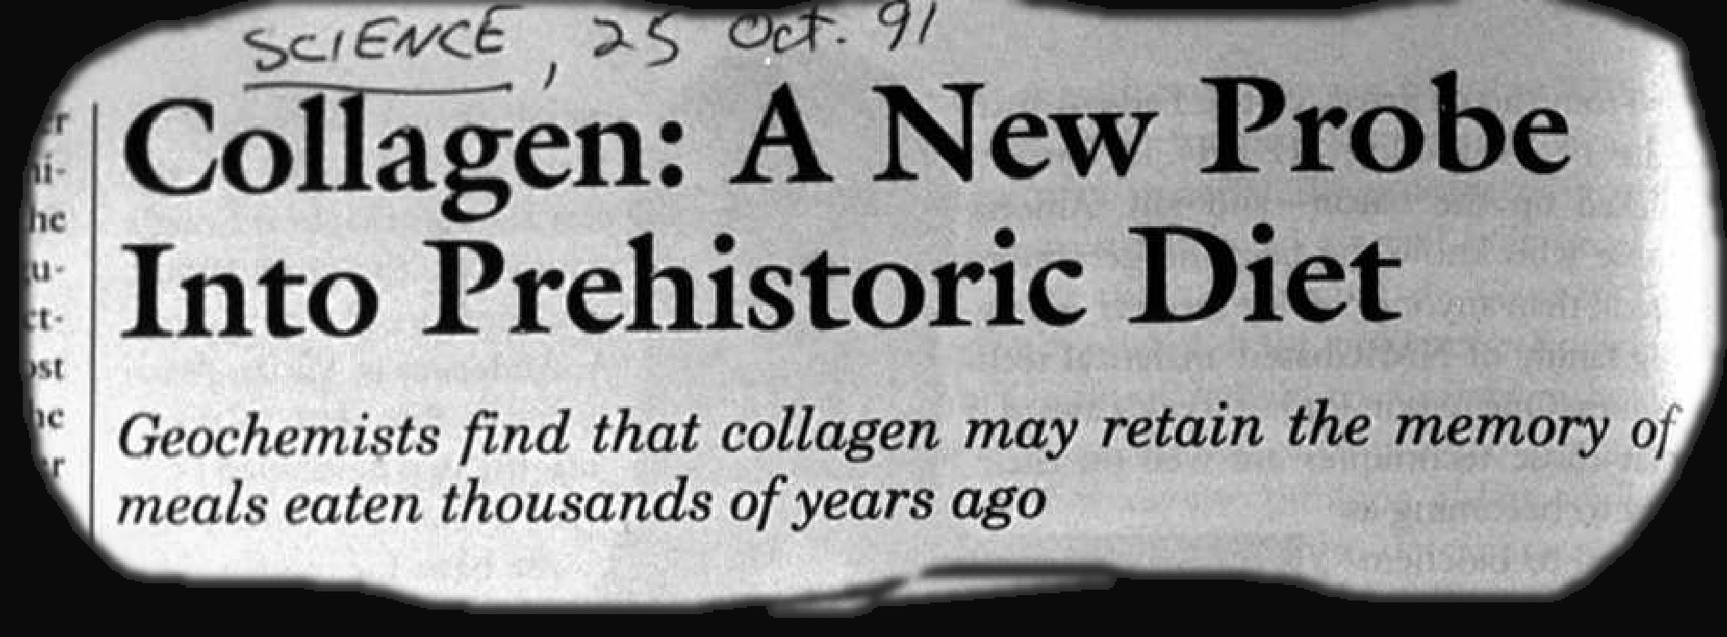

Slide 40
and looking at all of these sorts of things allows us to have a better understanding of prehistoric food use and its implications . . .

Slide 41
Diet and Human Evolution
  Exploring the Diets of Extinct Humans
  Through Paleontology
      Teeth
      Skulls and Jaws
      The Postcranial Skeleton
  What Is Adaptation?
  Using Chemistry to Infer the Diets
  of Extinct Hominini
  Our Place in Nature
  A Brief Who's Who of the Early Hominini
  What Did Early Hominini Eat?
  What Can We Say About the Diets of Fossil Homo?
  Summary
  Highlight: Lactose Intolerance

Slide 42
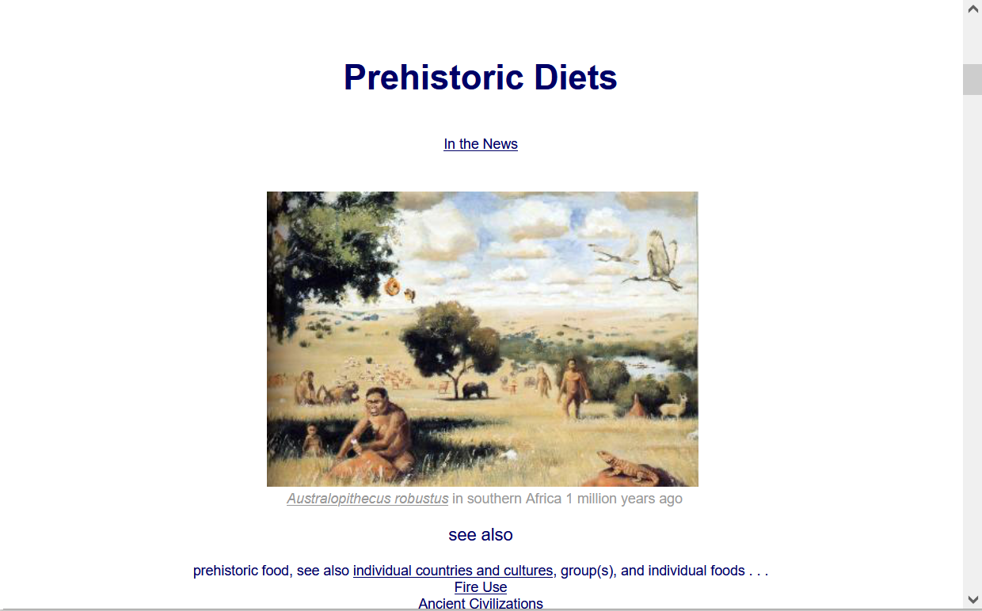
  For more information see the class Prehisoric Diets Web Page . . .
https://www.d.umn.edu/cla/faculty/troufs/anth1602/pcdiet.html#title

Slide 43
Tim Roufs
© 2010-2026

