Slide 1
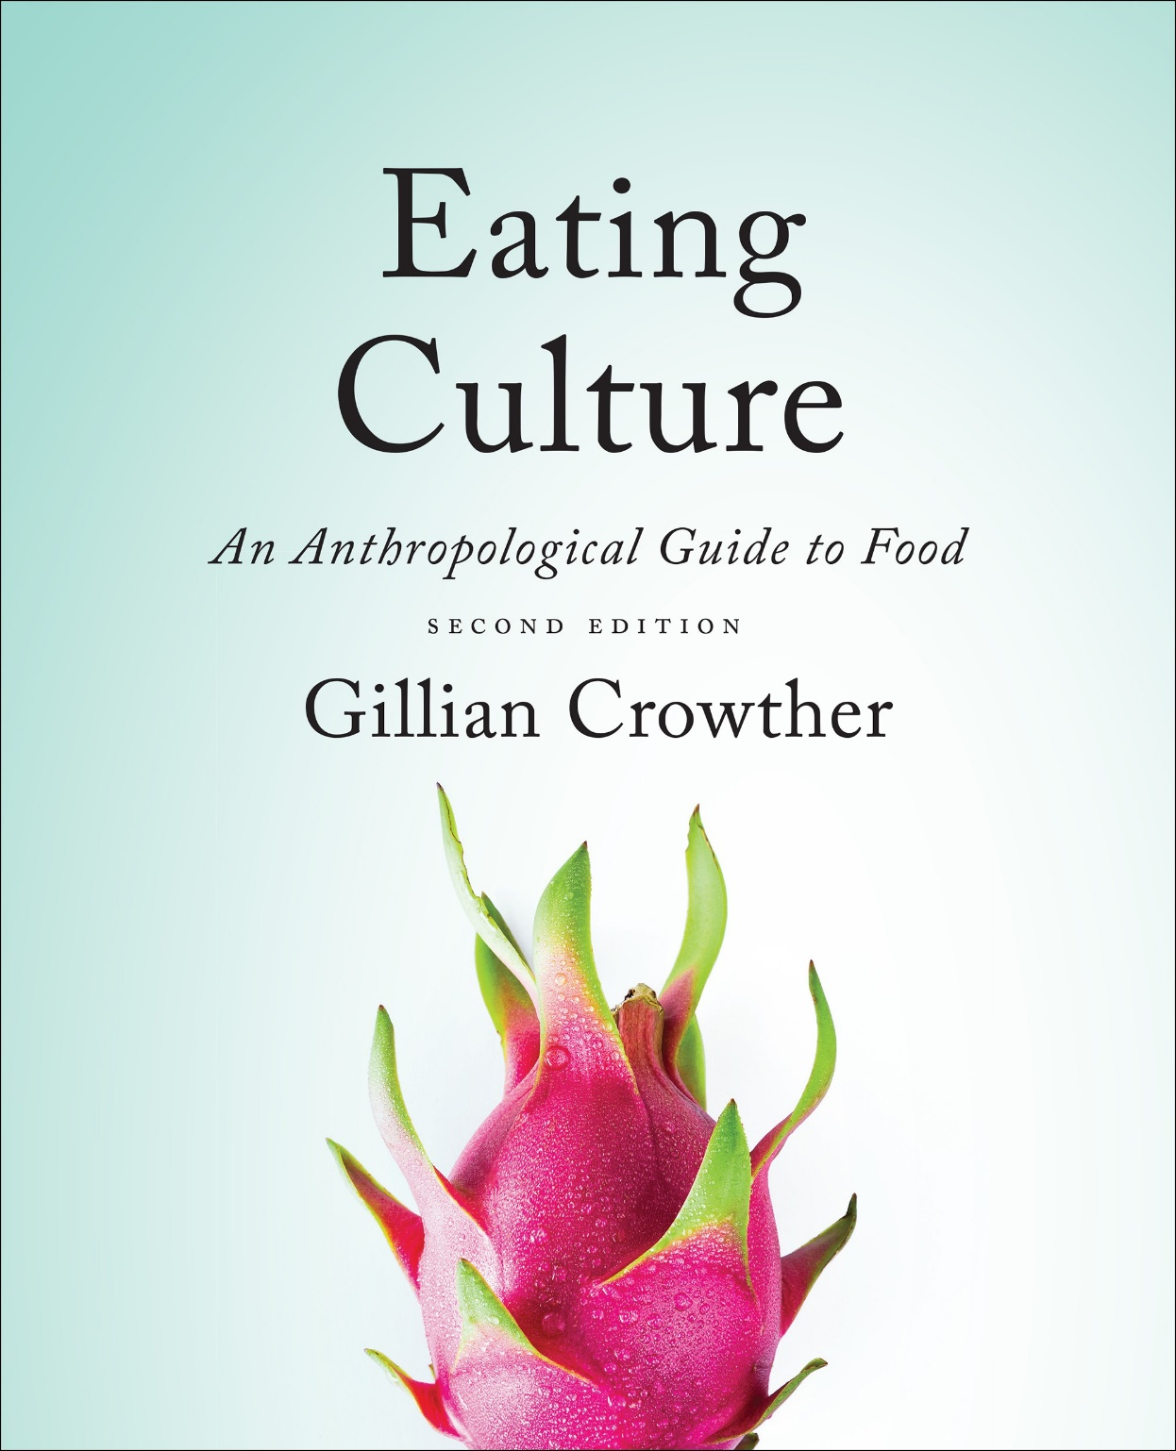
Diet and Evolution:
A Brief Who’s Who . . .
use your up/down arrow keys and/or
your space bar to advance the slides
Tim Roufs
© 2010-2024

Slide 2
Diet and Evolution:
A Brief Who’s Who . . .
Tim Roufs
© 2010-2024

Slide 3
Tim Roufs
© 2010-2024
www.d.umn.edu/cla/faculty/troufs/anthfood/aftexts.html#title

Slide 4
“Diet and Human Evolution”
“Diet and Human Evolution”
Exploring the Diets of Extinct Humans Through Paleontology
Teeth
Skulls and Jaws
The Postcranial Skeleton
What Is Adaptation?
Using Chemistry to Infer the Diets of Extinct Hominids
Our Place in Nature
A Brief Who's Who of the Early Hominids
What Did Early Hominids Eat?
What Can We Say About the Diets of Fossil Homo?
Summary
Highlight: Lactose Intolerance

Slide 5
“Diet and Human Evolution”
Who knows how many different genera and species of hominis really existed in the past?
The Cultural Feast, 2nd Ed., p. 30

Slide 6
the classifying of plants and animals into groups is known as
taxonomy
Notes:
6

Slide 7
and one of the “problems” with
hominid taxonomy is that there are . . .
“splitters”
and
“lumpers”
Notes:
7

Slide 8
and one of the “problems” with
hominid taxonomy is that there are . . .
“splitters”
like to have many species with little
“range of variation”
within a species
“lumpers”
like to have few species, allowing for considerable
“range of variation”
within a species
Notes:
8

Slide 9
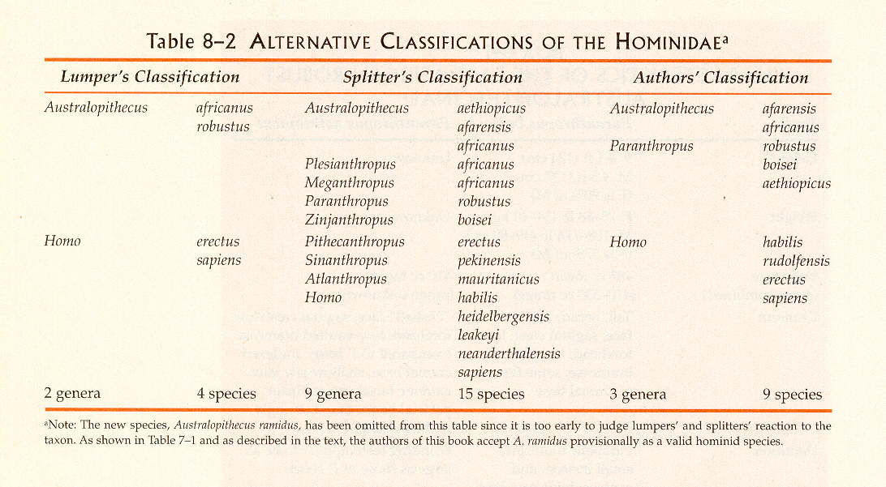
Campbell – Loy, Humankind Emerging, 7th ed., p. 236

Slide 10
Campbell – Loy, Humankind Emerging, 7th ed., p. 236

Slide 11
“Diet and Human Evolution”
generally speaking,
at least 18 hominin species are currently named in the literature
The Cultural Feast, 2nd Ed., p. 29

Slide 12
the main groups are . . .
Notes:
12

Slide 13
Homo sapiens
Moderns (Cro-magnon …)
Premoderns (Neandertal …)
Homo erectus
Homo habilis
Paranthropus
Australopithecus
Ardipithecus
Sivapithecus

Slide 14
to which people often add . . .
Notes:
14

Slide 15
Homo sapiens
“Moderns” (Cro-magnon …)
“Premoderns” (Neandertal …)
Homo erectus
Homo habilis
Paranthropus
Australopithecus
Ardipithecus
Sivapithecus

Slide 16
and they appear about . . .
Notes:
16

Slide 17
Homo sapiens
“Moderns” (Cro-magnon …)
“Premoderns” (Neandertal …)
165,000 ybp-present
500,000-28,000 ybp
Homo erectus
1.8 mya–25,000 ybp
Homo habilis
2.4-1.6 mya
Paranthropus
2.5-1 mya
Australopithecus
4.25-2 mya
Ardipithecus
5.6 -4.4 mya
Sivapithecus
15-7 mya
dates are approximate
and follow Understanding Humans 2009

Slide 18
Homo sapiens
“Moderns” (Cro-magnon …)
“Premoderns” (Neandertal …)
Homo erectus
note that some forms are called …pithecus
Homo habilis
Paranthropus
Australopithecus
Ardipithecus
Sivapithecus
dates are approximate
and follow Understanding Humans 2009

Slide 19
Homo sapiens
“Moderns” (Cro-magnon …)
“Premoderns” (Neandertal …)
anything called
pithecus
is an ape
(from the Greek word for “ape”)
Homo erectus
Homo habilis
Paranthropus
Australopithecus
Ardipithecus
Sivapithecus
dates are approximate
and follow Understanding Humans 2009

Slide 20
so “Who’s Who?
. . . lets have a quick look . . .
Notes:
20

Slide 21
The first “real” ape

Slide 22
The first “real” ape
Sivapithecus
15-7 mya

Slide 23
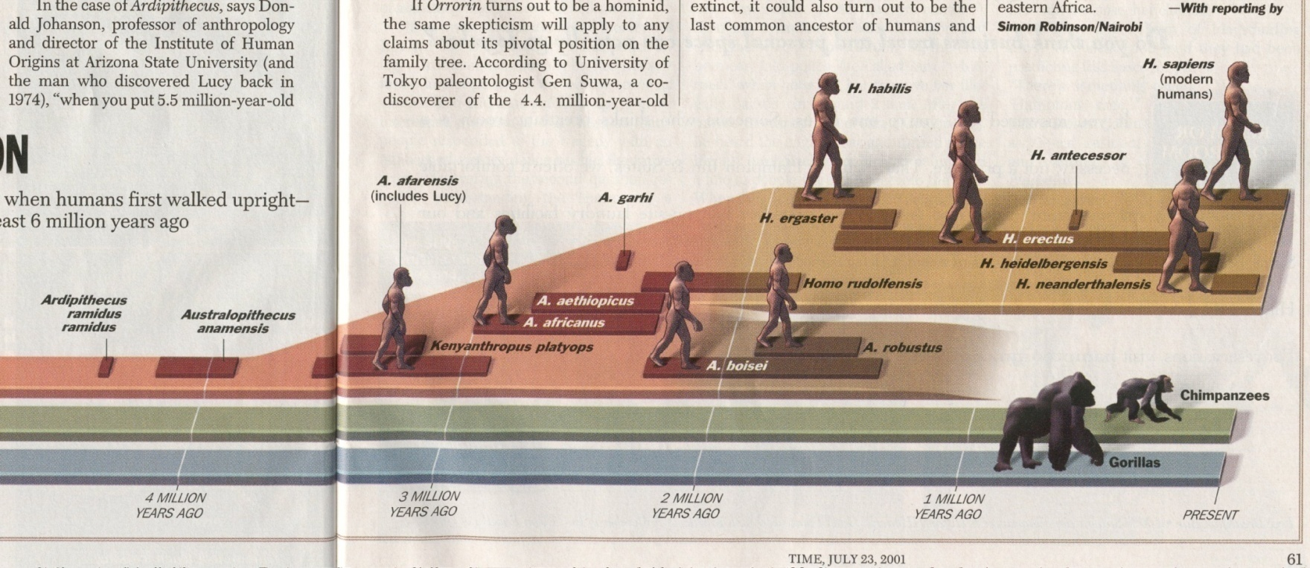
The first “real” ape
15-7 mya
Sivapithicus
Time 23 July 2001

Slide 24
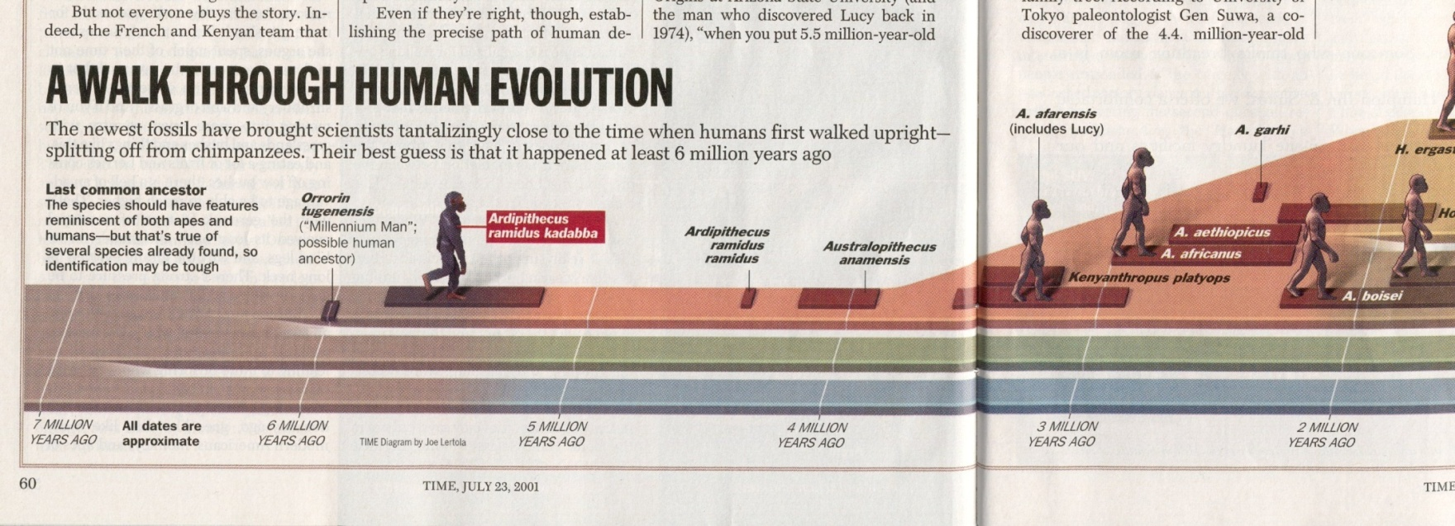
A Walk Through Hominid Evolution
Ardipithicus
Time 23 July 2001

Slide 25
A Walk Through Hominid Evolution
Australopithicus
Time 23 July 2001

Slide 26
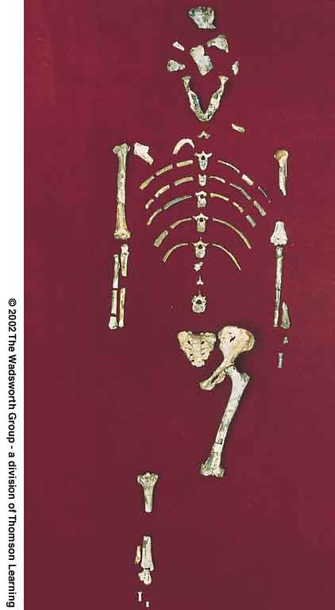
^{e.g.}
^{Lucy}
^{and}
^{“The First Family”}
Understanding Physical Anthropology and Archaeology, 9th ed., p. 206

Slide 27
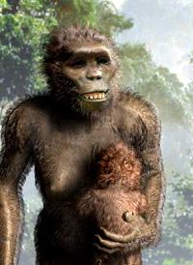
^{e.g.}
^{Lucy}
^{and}
^{“The First Family”}
Understanding Physical Anthropology and Archaeology, 9th ed., p. 206

Slide 28
A Walk Through Hominid Evolution
Paranthropus
“Australopithecus robustus”
Time 23 July 2001

Slide 29
A Walk Through Hominid Evolution
the first humans
Homo habilis
“Early Human”
Time 23 July 2001

Slide 30
A Walk Through Hominid Evolution
Time 23 July 2001

Slide 31
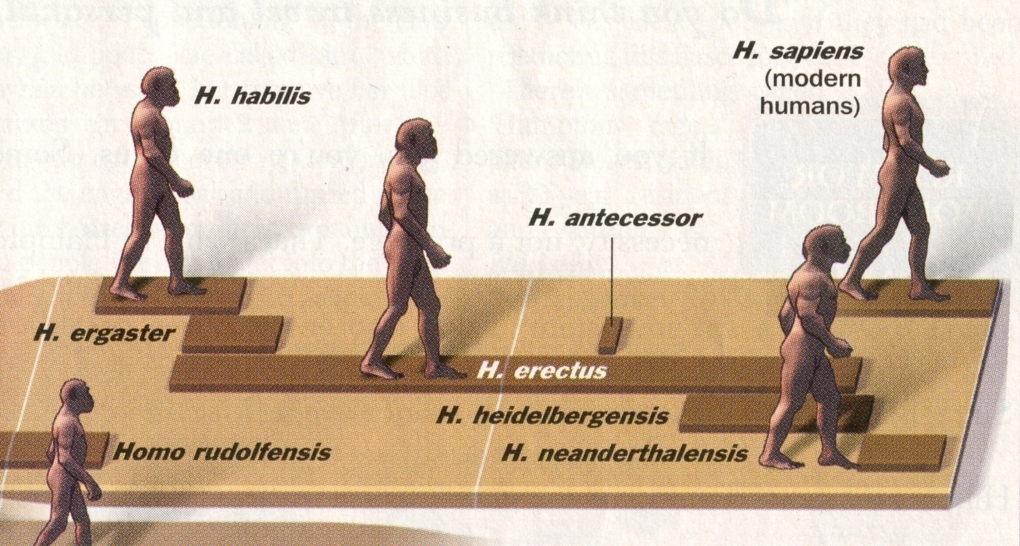
A Walk Through Hominid Evolution
Homo erectus
Time 23 July 2001

Slide 32
A Walk Through Hominid Evolution
“premoderns”
Homo heidelbergensis . . .
Time 23 July 2001

Slide 33
A Walk Through Hominid Evolution
“premoderns”
Neandertal . . .
Time 23 July 2001

Slide 34
A Walk Through Hominid Evolution
“moderns”
Homo sapiens sapiens
Time 23 July 2001

Slide 35
lets have just a little closer look . . .
Notes:
35

Slide 36
The first “real” ape
15-7 mya
Sivapithicus
Time 23 July 2001

Slide 37
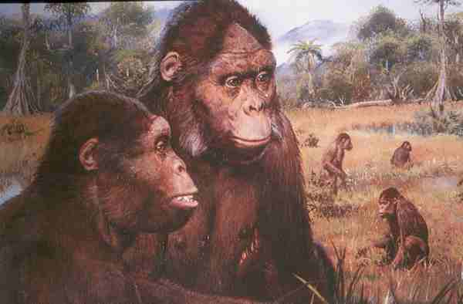
Sivapithecines

Slide 38
note their foraging
Sivapithecines

Slide 39
Homo sapiens
“Moderns” (Cro-magnon …)
“Premoderns” (Neandertal …)
165,000 ybp-present
500,000-28,000 ybp
Homo erectus
1.8 mya–25,000 ybp
Homo habilis
2.4-1.6 mya
Paranthropus
2.5-1 mya
Australopithecus
4.25-2 mya
Ardipithecus
5.6 -4.4 mya
Sivapithecus
15-7 mya
dates are approximate
and follow Understanding Humans 2009

Slide 40
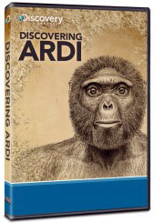
Ardipithicus
Time 23 July 2001

Slide 41
“The teeth of A. ramidus lacked the specialization of other apes, and suggest that it was a generalized omnivore and frugavore (fruit eater) with a diet that did not depend heavily on fibrous plants, ripe fruit or hard or abrasive food. “
http://en.wikipedia.org/wiki/Ardipithecus
Ardipithicus
Time 23 July 2001

Slide 42
Homo sapiens
“Moderns” (Cro-magnon …)
“Premoderns” (Neandertal …)
165,000 ybp-present
500,000-28,000 ybp
Homo erectus
1.8 mya–25,000 ybp
Homo habilis
2.4-1.6 mya
Paranthropus
2.5-1 mya
Australopithecus
4.25-2 mya
Ardipithecus
5.6 -4.4 mya
Sivapithecus
15-7 mya
dates are approximate
and follow Understanding Humans 2009

Slide 43
Australopithicus
Time 23 July 2001

Slide 44
^{e.g.}
^{Lucy}
^{and}
^{“The First Family”}
Understanding Physical Anthropology and Archaeology, 9th ed., p. 206

Slide 45
1975 - 1976
“Lucy”
and
"The First Family"
Hadar, Ethiopia (Site 333 on the Awash River)
Australopithecus afarensis
4 - 3 mya

Slide 46
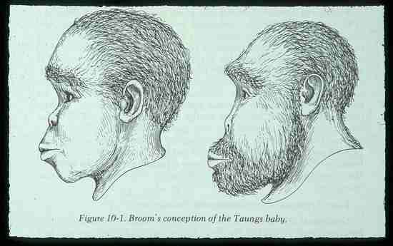
and
“The Taung child”

Slide 47
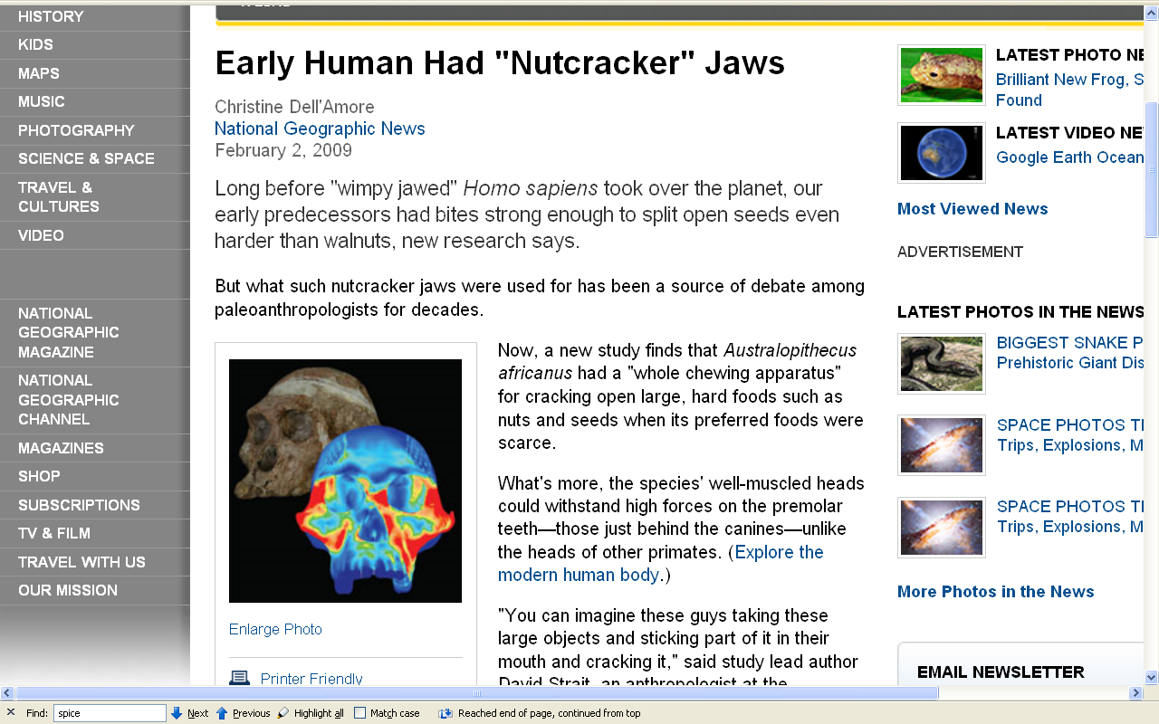
http://news.nationalgeographic.com/news/2009/02/090202-nutcracker-jaws.html?source=rss

Slide 48
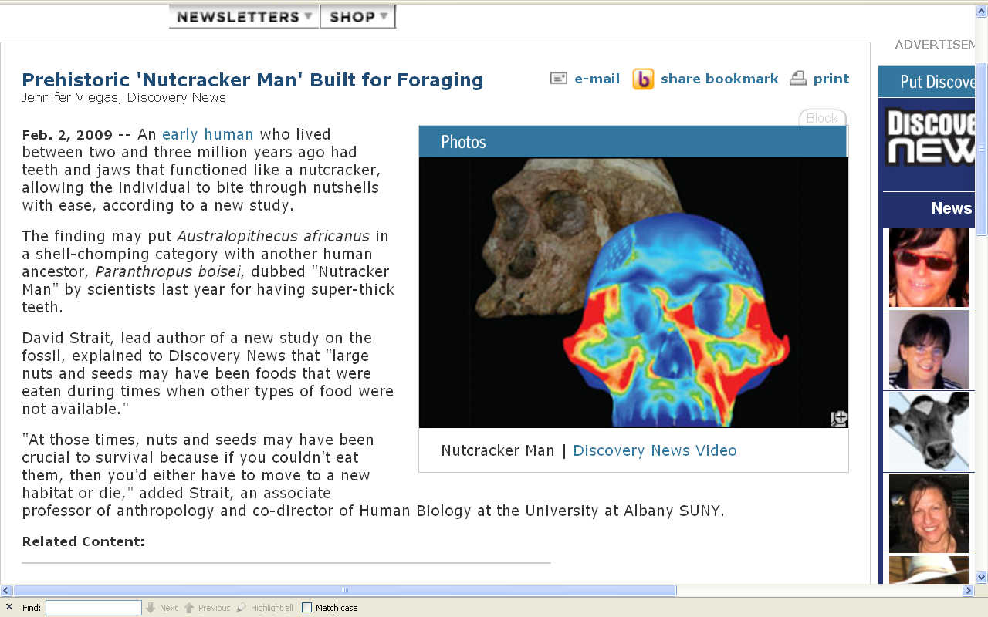
http://dsc.discovery.com/news/2009/02/02/nutcracker-man.html

Slide 49
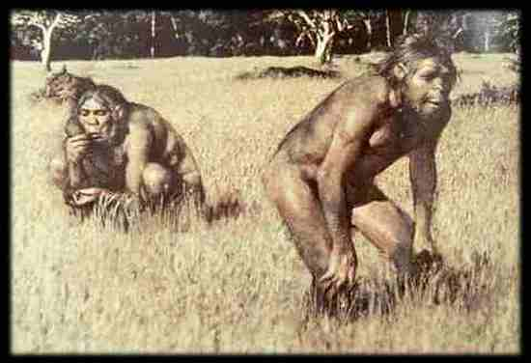
Australopithecus Hunting and Foraging

Slide 50
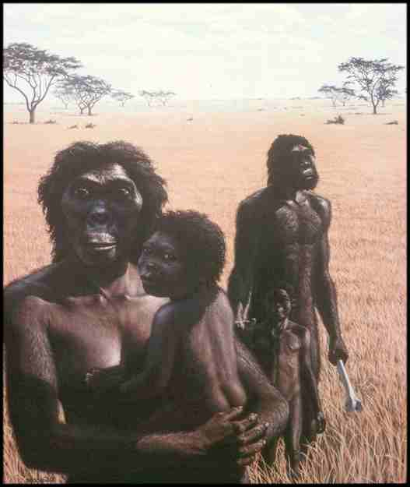

Slide 51
Australopithicines are
definite tool users

Slide 52
definite tool users

Slide 53
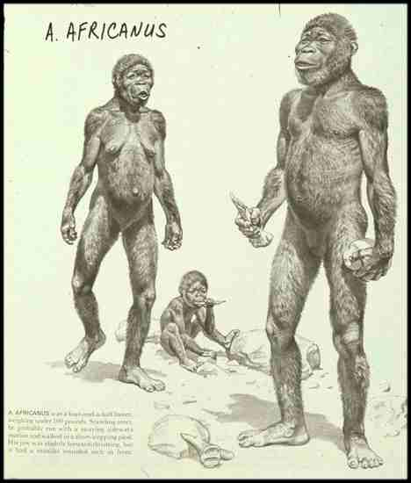

Slide 54
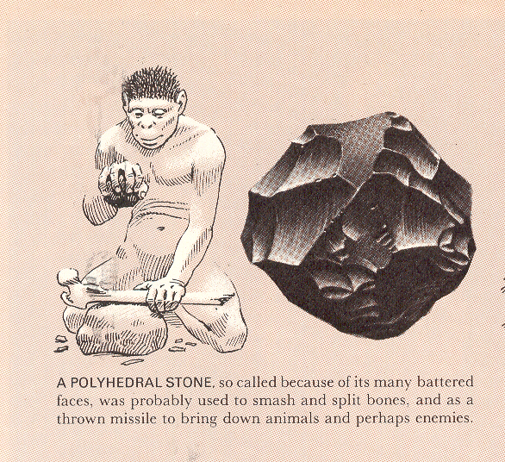
Life Nature Library, Early Man, p. 115.

Slide 55
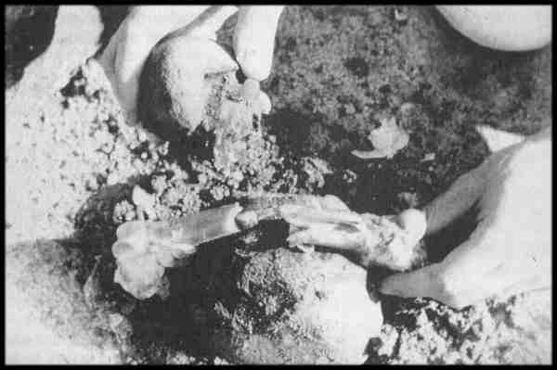
bone broken to get at the bone marrow

Slide 56
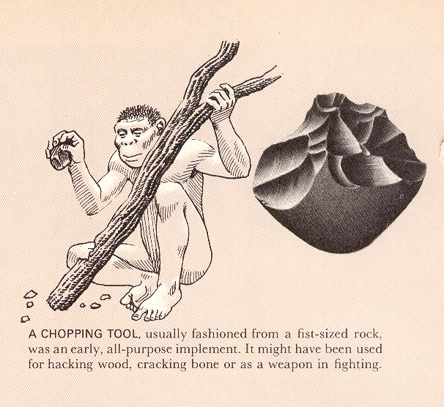
Life Nature Library, Early Man, p. 114

Slide 57
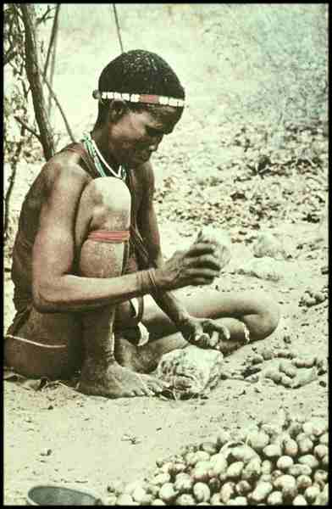
. . . cracking nuts
Life Nature Library, Early Man, p. 183

Slide 58
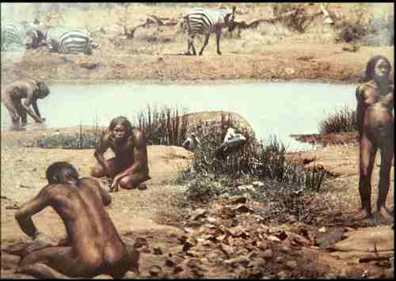
doing camp chores in general

Slide 59
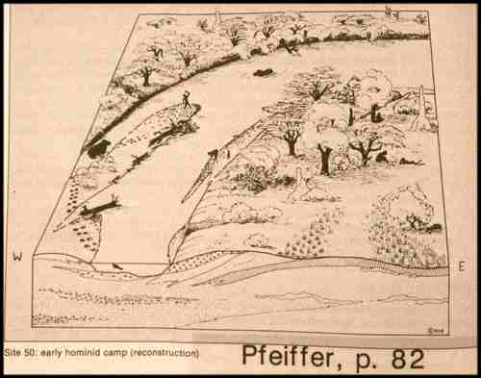
sea resources would have been used

Slide 60
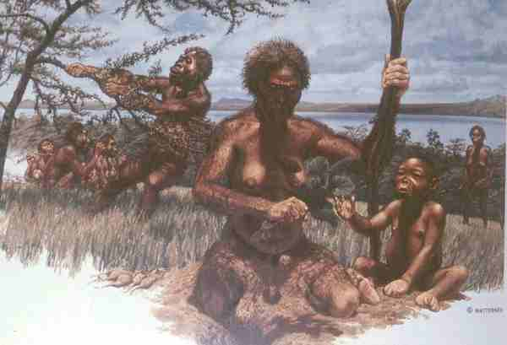
digging sticks most certainly would have been used to get food

Slide 61
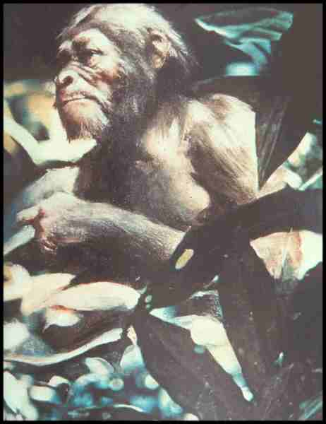
and they would have eaten lots of berries and the like

Slide 62
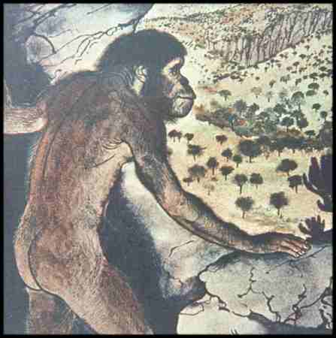
and hunted . . .

Slide 63
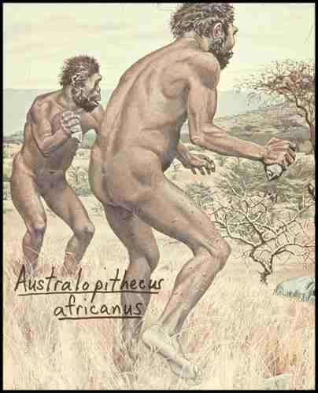

Slide 64
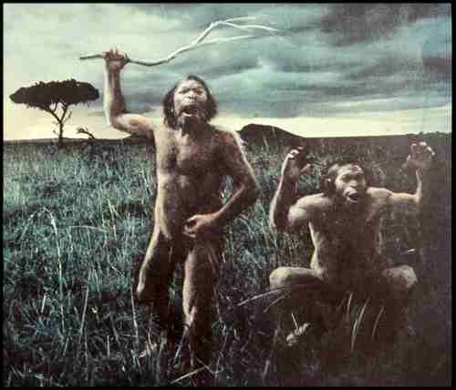

Slide 65
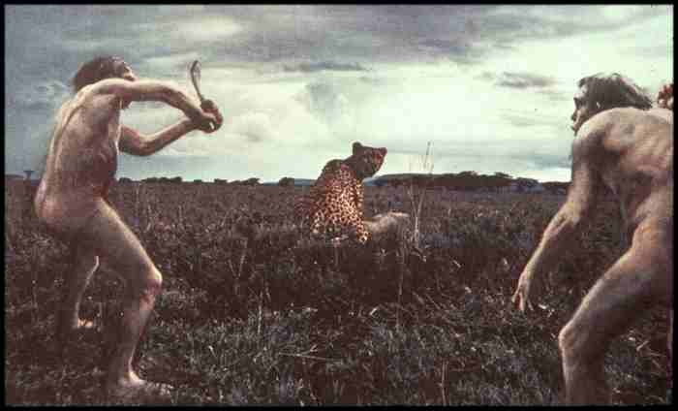

Slide 66
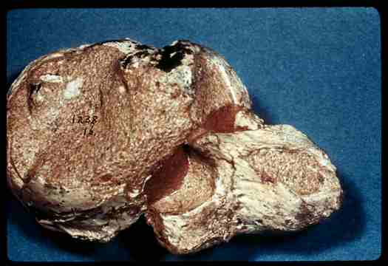
a prehistoric baboon killed by frontal attack, with something like . . .

Slide 67
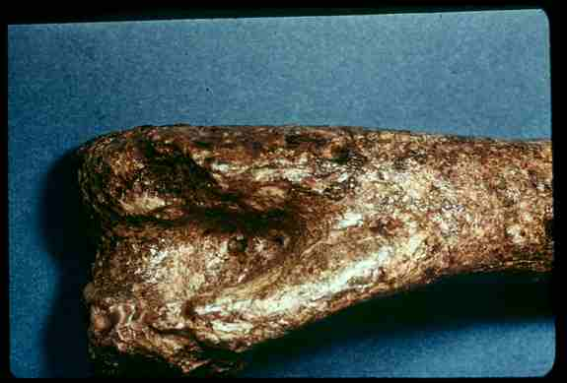
an antelope femur

Slide 68
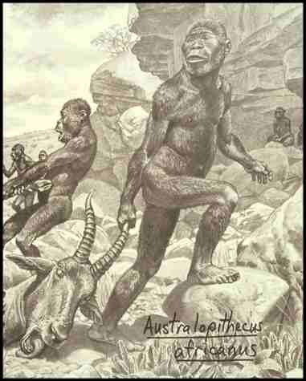

Slide 69
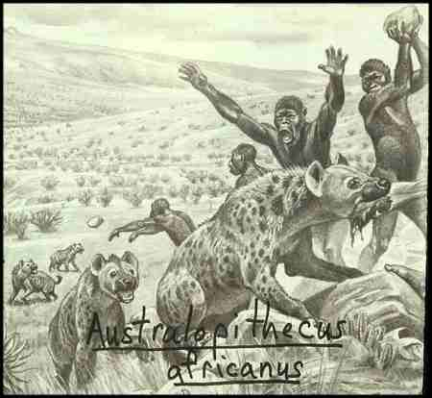

Slide 70
these kind of stones
are sometimes called
“manuports” . . .

Slide 71
“manuports”
are unworked rocks
(hand “carried”)

Slide 72
“manuports”
and can be used as tools
(without leaving much evidence)

Slide 73
Paranthropus
“Australopithecus robustus”
Time 23 July 2001

Slide 74
Homo sapiens
“Moderns” (Cro-magnon …)
“Premoderns” (Neandertal …)
165,000 ybp-present
500,000-28,000 ybp
Homo erectus
1.8 mya–25,000 ybp
Homo habilis
2.4-1.6 mya
Paranthropus
2.5-1 mya
Australopithecus
4.25-2 mya
Ardipithecus
5.6 -4.4 mya
Sivapithecus
15-7 mya
dates are approximate
and follow Understanding Humans 2009

Slide 75
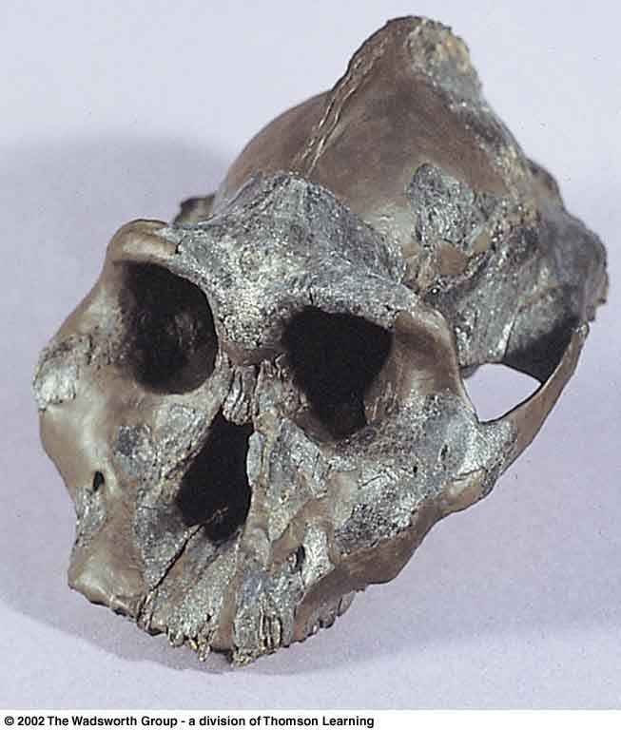
“The Black Skull”
KNM-WT 17000
Australopithecus
aethiopicus
Lake Turkana,
East Africa
2.5 mya
1986
Turnbaugh, Jurmain, Kilgore, and Nelson, 8th Ed., p. 237

Slide 76
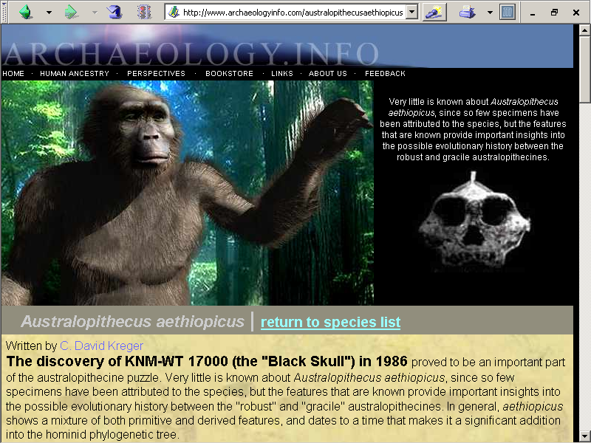
note the “saggital crest” . . .
www.archaeologyinfo.com/australopithecusaethiopicus.htm

Slide 77
and the “disharmonic face” . . .
www.archaeologyinfo.com/australopithecusaethiopicus.htm

Slide 78
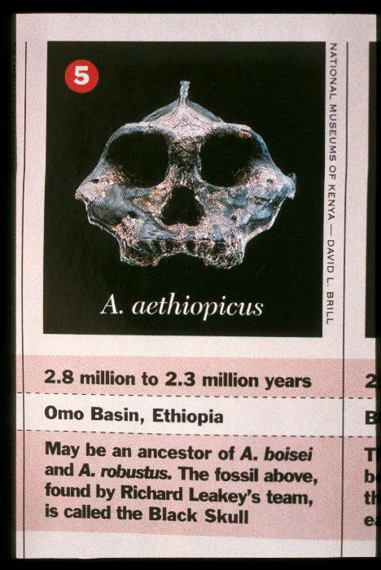
“saggital crest”
“disharmonic face”
for more information see
The Cultural Feast,
2nd ed., p. 22

Slide 79
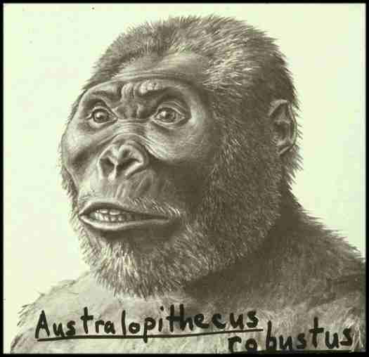

Slide 80
diet classifications
herbivorous (principally plants)
insectivorous (principally insects)
frugivorous (principally fruits)
graminivorous (principally grasses)
folivorous (principally leaf eating)
proteinivorous (principally protein eating)
carnivorous (chiefly meats)
omnivorous (“devours” “all”)
locavore (principally locally available foods)
Paranthropus is largely . . .

Slide 81
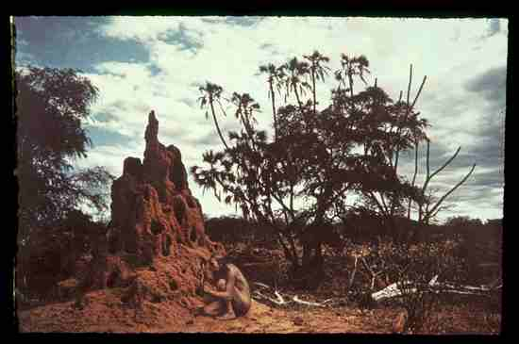
but there is now evidence suggesting that they also ate termites . . .
(and thus did eat some meat)

Slide 82
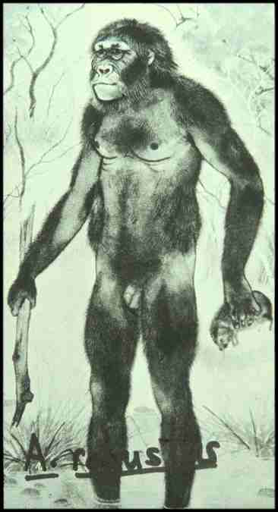
?
and they probably collected some
“ground meats”

Slide 83
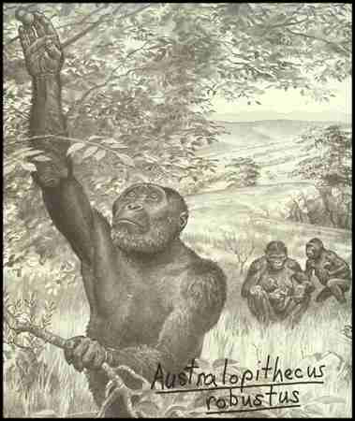
but they were mostly frugivorous

Slide 84
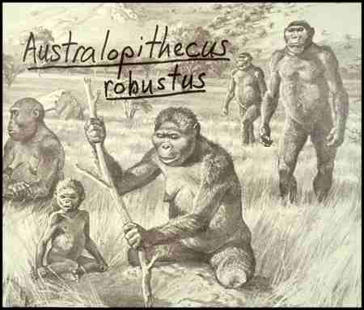
and most probably tool users

Slide 85
most probably tool users

Slide 86
Homo sapiens
“Moderns” (Cro-magnon …)
“Premoderns” (Neandertal …)
165,000 ybp-present
500,000-28,000 ybp
Homo erectus
1.8 mya–25,000 ybp
Homo habilis
2.4-1.6 mya
Paranthropus
2.5-1 mya
Australopithecus
4.25-2 mya
Ardipithecus
5.6 -4.4 mya
Sivapithecus
15-7 mya
dates are approximate
and follow Understanding Humans 2009

Slide 87
the first humans
Homo habilis
“Early Human”
Time 23 July 2001

Slide 88
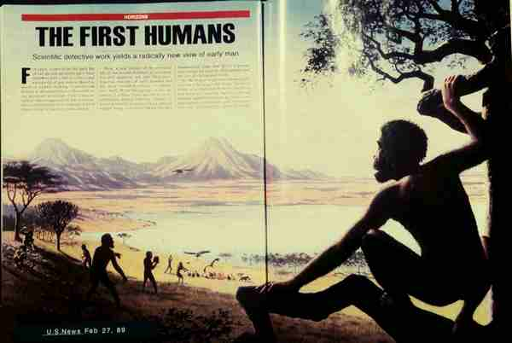
Homo habilis
first human
2.4 mya

Slide 89
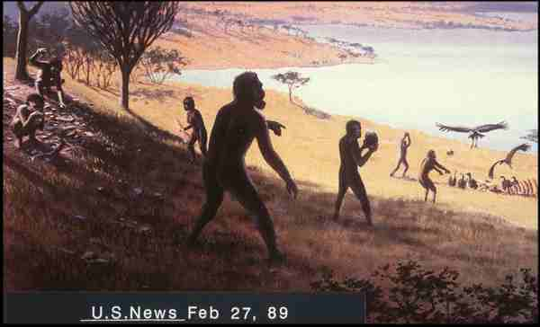
Homo habilis were hunters . . .

Slide 90
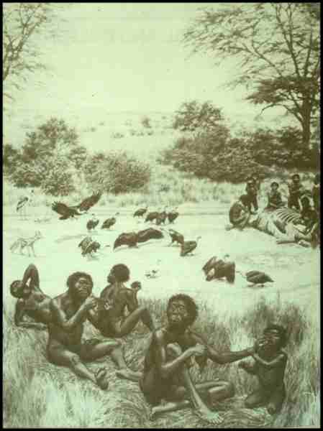
perhaps starting out as scavengers, in competition with the other scavengers . . .

Slide 91
Homo habilis were tool makers
(that’s why they're called “habilis” – “handy man”

Slide 92
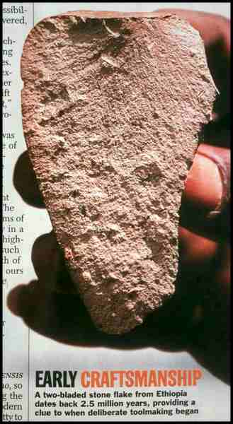
2.5 mya

Slide 93
Homo habilis
were
stone tool makers
2.5 mya

Slide 94
should
stone tool making
be
food revolution #1A?
2.5 mya

Slide 95

Felipe Fernández-Armesto
talks about
Eight Food “Revolutions”
Simon & Schuster 2003

Slide 96
Eight Food “Revolutions”
Invention of Cooking
Discovery that Food is More Than Sustenance
The “Herding Revolution”
Snail Farming
Use of Food as a Means and Index of Social Differentiation
Long-Range Exchange of Culture
Ecological Revolution of last 500 years
Industrial Revolution of the 19th and 20th Centuries
Simon & Schuster 2003

Slide 97
Eight Food “Revolutions”
1A. stone tool making
Invention of Cooking
Discovery that Food is More Than Sustenance
The “Herding Revolution”
Snail Farming
Use of Food as a Means and Index of Social Differentiation
Long-Range Exchange of Culture
Ecological Revolution of last 500 years
Industrial Revolution of the 19th and 20th Centuries
should tool making be the first?
Simon & Schuster 2003

Slide 98
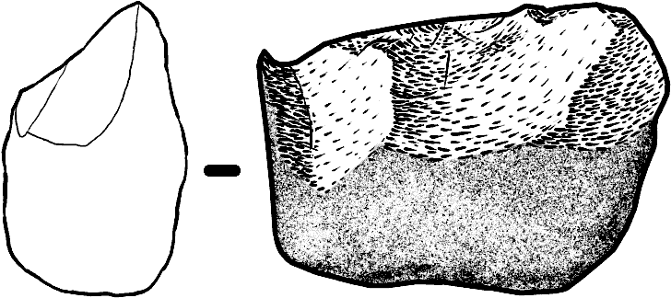
the first stone (“lithic”) tools were . . .
"Oldowan" chopper
aka “pebble tool
(originally from Olduvai Gorge)
Wikipedia

Slide 99
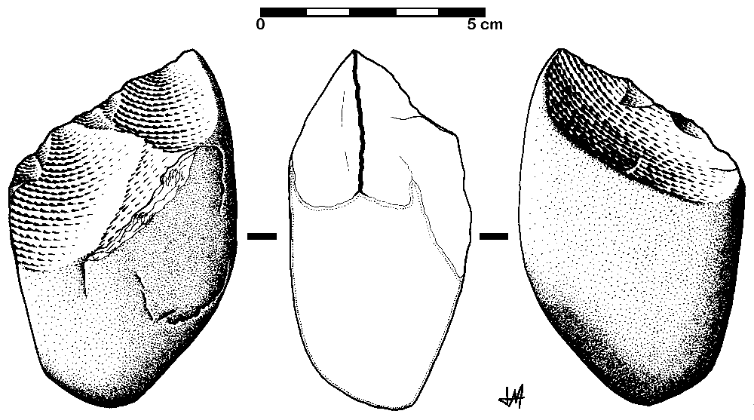
"Oldowan" chopper
aka “pebble tool
Wikipedia

Slide 100
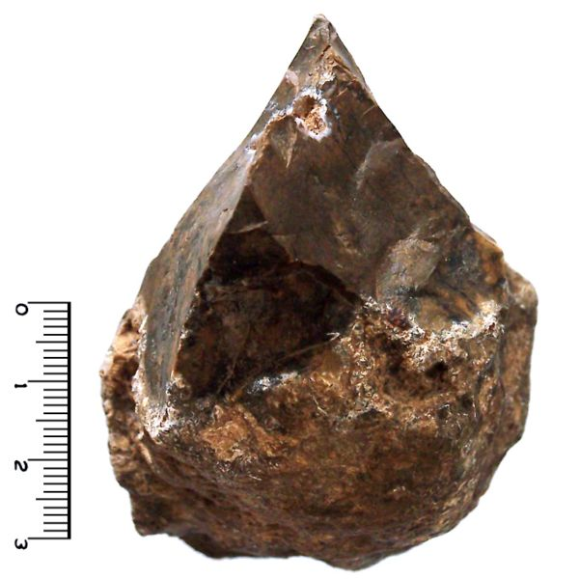
"Oldowan" chopper
Wikimedia

Slide 101
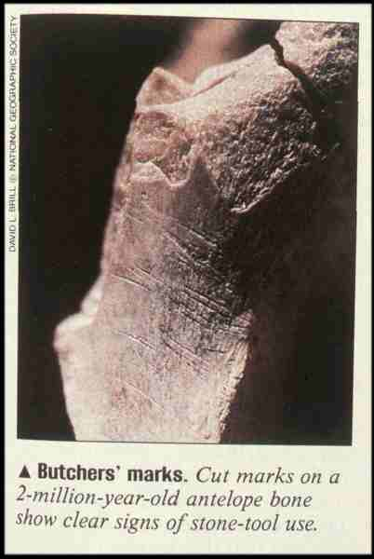
and they were definitely used to get meat . . .

Slide 102
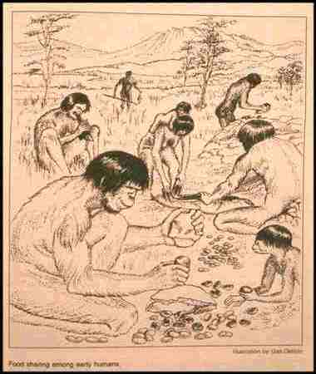
but they were probably also used for other things . . .

Slide 103
Oldowan tools appear and define
the “lower Paleolithic”
(lower “Old Stone Age”)

Slide 104
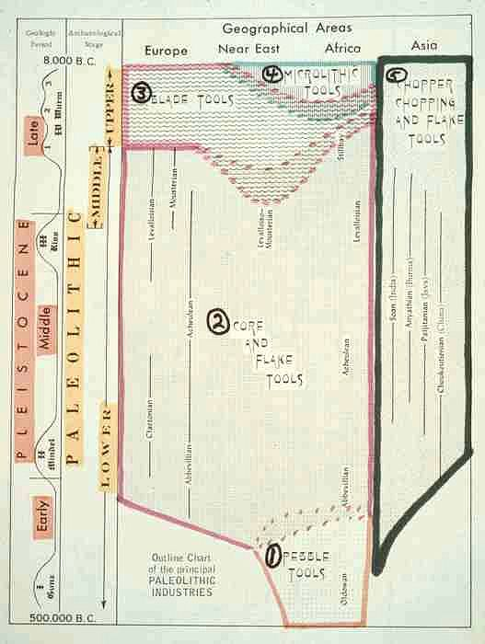

Slide 105
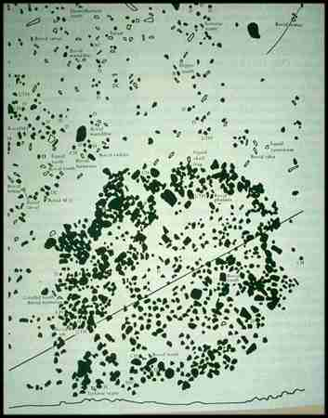
human structures also appear at Olduvai at this time . . .

Slide 106

they may have been simple houses,
but they also may have been something like a hunting blind . . .

Slide 107
Homo sapiens
“Moderns” (Cro-magnon …)
“Premoderns” (Neandertal …)
165,000 ybp-present
500,000-28,000 ybp
Homo erectus
1.8 mya–25,000 ybp
Homo habilis
2.4-1.6 mya
we’ll have a closer look at
Homo sapiens and Homo erectus
when we look at
“What Did Early Hominins Eat?”
Paranthropus
2.5-1 mya
Australopithecus
4.25-2 mya
Ardipithecus
5.6 -4.4 mya
Sivapithecus
15-7 mya

Slide 108
“Diet and Human Evolution”
“Diet and Human Evolution”
Exploring the Diets of Extinct Humans Through Paleontology
Teeth
Skulls and Jaws
The Postcranial Skeleton
What Is Adaptation?
Using Chemistry to Infer the Diets of Extinct Hominids
Our Place in Nature
A Brief Who's Who of the Early Hominids
What Did Early Hominids Eat?
What Can We Say About the Diets of Fossil Homo?
Summary
Highlight: Lactose Intolerance

Slide 109
Homo erectus
Time 23 July 2001

Slide 110
“premoderns”
Homo heidelbergensis . . .
Time 23 July 2001

Slide 111
“premoderns”
Neandertal . . .
Time 23 July 2001

Slide 112
“moderns”
Homo sapiens sapiens
Time 23 July 2001

Slide 113

For more information see the class Prehisoric Diets Web Page . . .
https://www.d.umn.edu/cla/faculty/troufs/anth1602/pcdiet.html#title

Slide 114

Diet and Evolution:
A Brief Who’s Who . . .
Tim Roufs
© 2010-2024
www.d.umn.edu/cla/faculty/troufs/anthfood/aftexts.html#title

