Slide 1

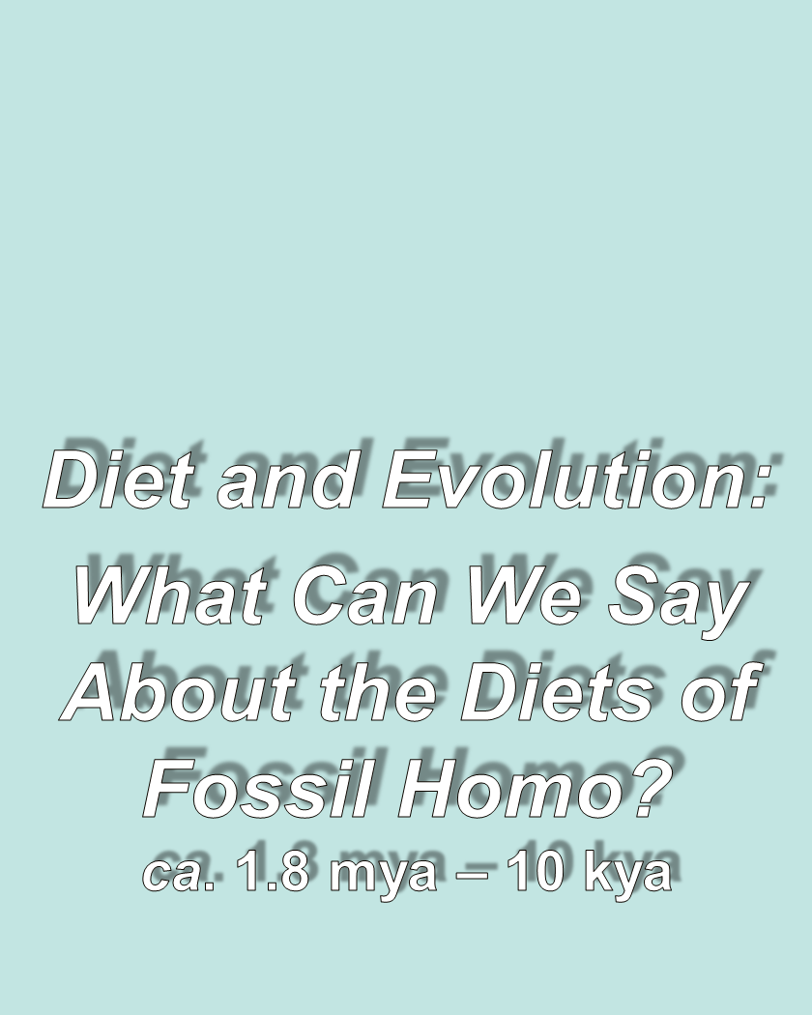
use your up/down arrow keys and/or
your space bar to advance the slides
Tim Roufs
© 2010-2026

Slide 2
Tim Roufs
© 2010-2026
Tim Roufs
© 2010-2026

Slide 3
Tim Roufs
© 2010-2026

Slide 4
Diet and Human Evolution
Diet and Human Evolution
  Exploring the Diets of Extinct Humans
  Through Paleontology
      Teeth
      Skulls and Jaws
      The Postcranial Skeleton
  What Is Adaptation?
  Using Chemistry to Infer the Diets
  of Extinct Hominins
  Our Place in Nature
  A Brief Who's Who of the Early Hominins
  What Did Early Hominins Eat?
  What Can We Say About the Diets of Fossil Homo?
  Summary
  Highlight: Lactose Intolerance
ca. 1.8 mya – 10 kya

Slide 5
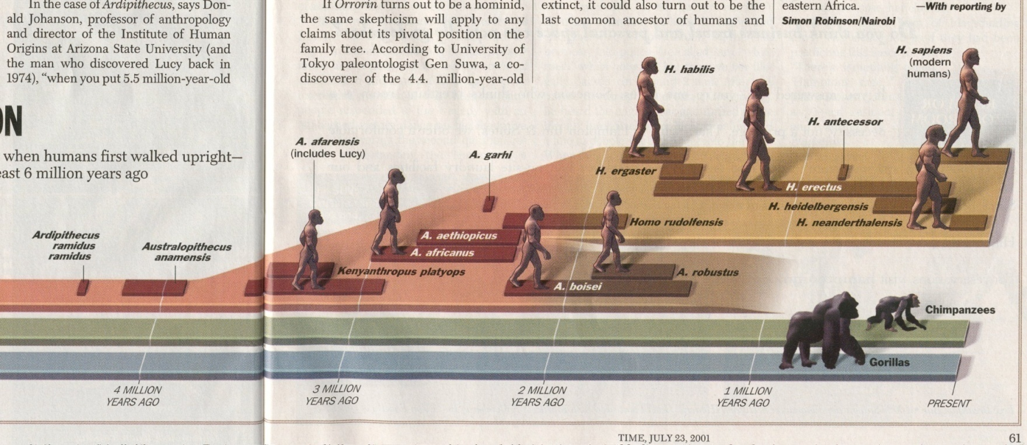
“Fossil Homo”
ca. 1.8 mya – 10 kya
Time 23 July 2001

Slide 6
and a quick glance
will show “fossil Homo” also ate quite a variety of things . . .
Notes:
6

Slide 7
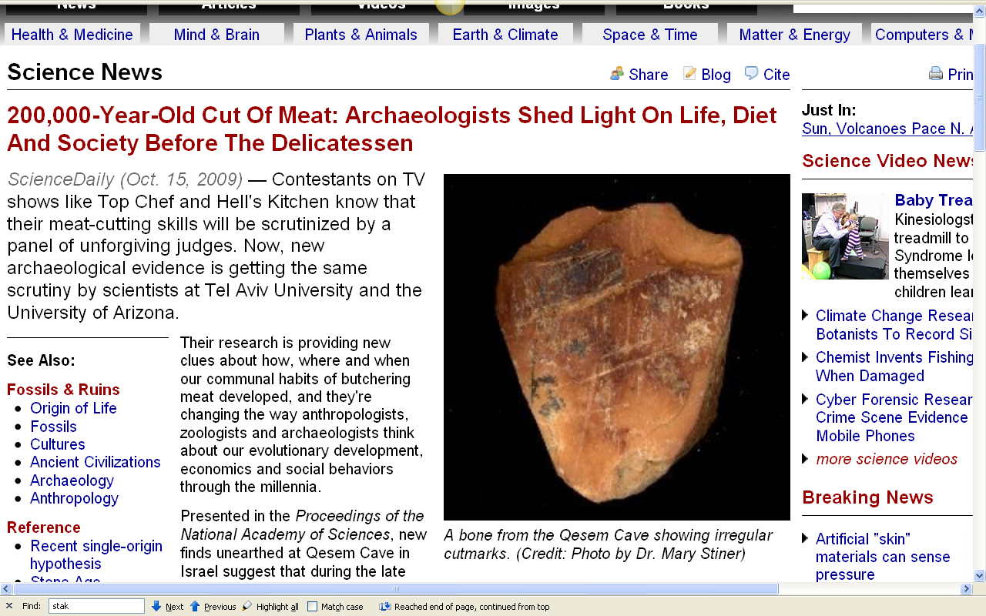
http://www.sciencedaily.com/releases/2009/10/091014111547.htm

Slide 8
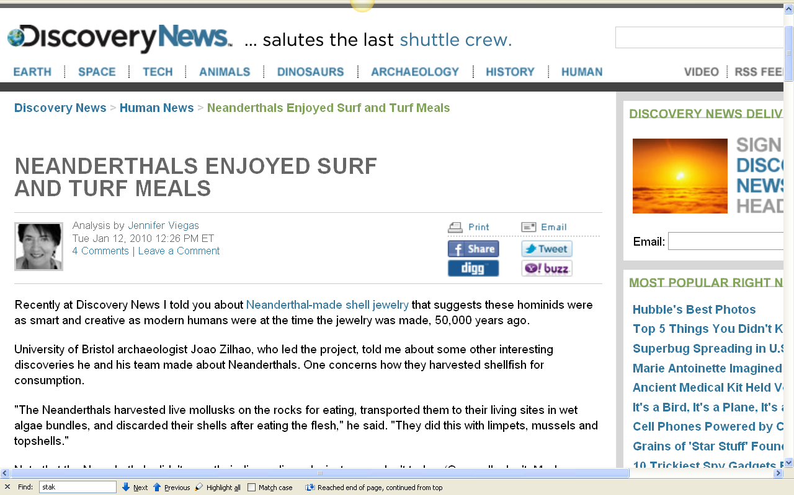
http://news.discovery.com/human/neanderthals-enjoyed-surf-and-turf-meals.html

Slide 9
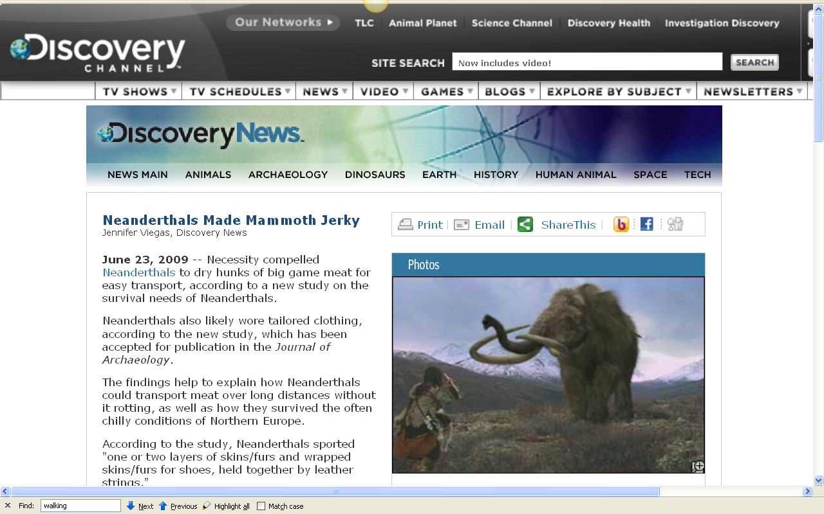
http://dsc.discovery.com/news/2009/06/23/neanderthal-mammoth.html

Slide 10
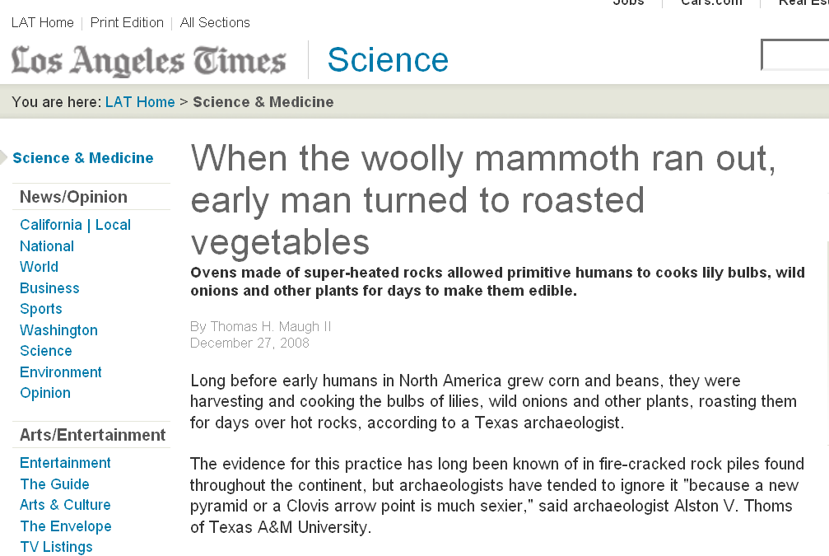
www.latimes.com/news/science/la-sci-earlyfoods27-2008dec27,0,6385869.story?track=rss

Slide 11
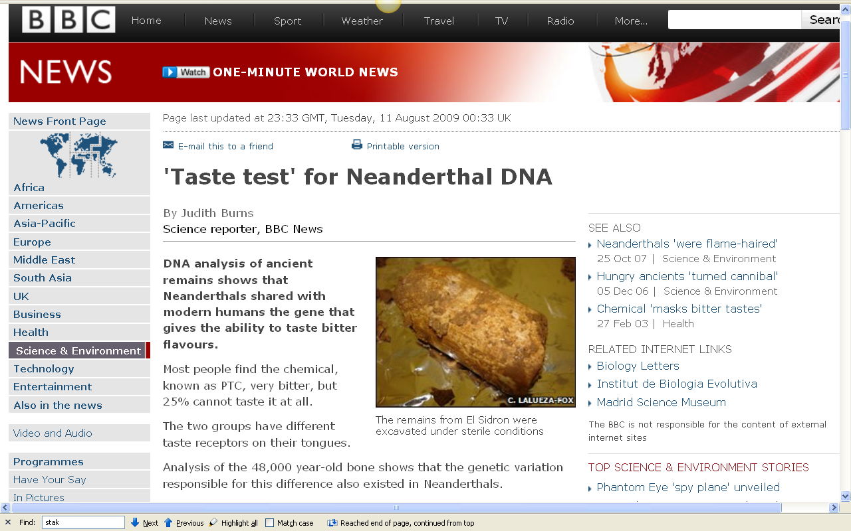
http://news.bbc.co.uk/2/hi/science/nature/8195762.stm

Slide 12
you’ll be having a look at how this “taste test” relates to your personality in the . . .
Forum Discussion: TASTE your personality!
http://news.bbc.co.uk/2/hi/science/nature/8195762.stm

Slide 13
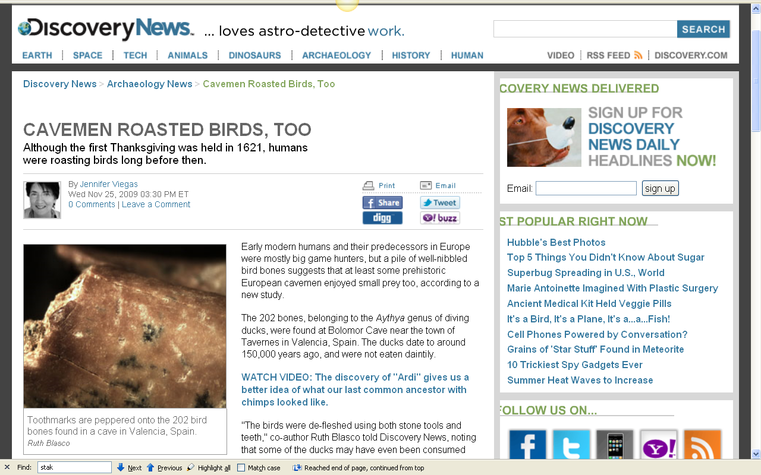
http://news.discovery.com/archaeology/cavemen-bird-bones-roast.html

Slide 14
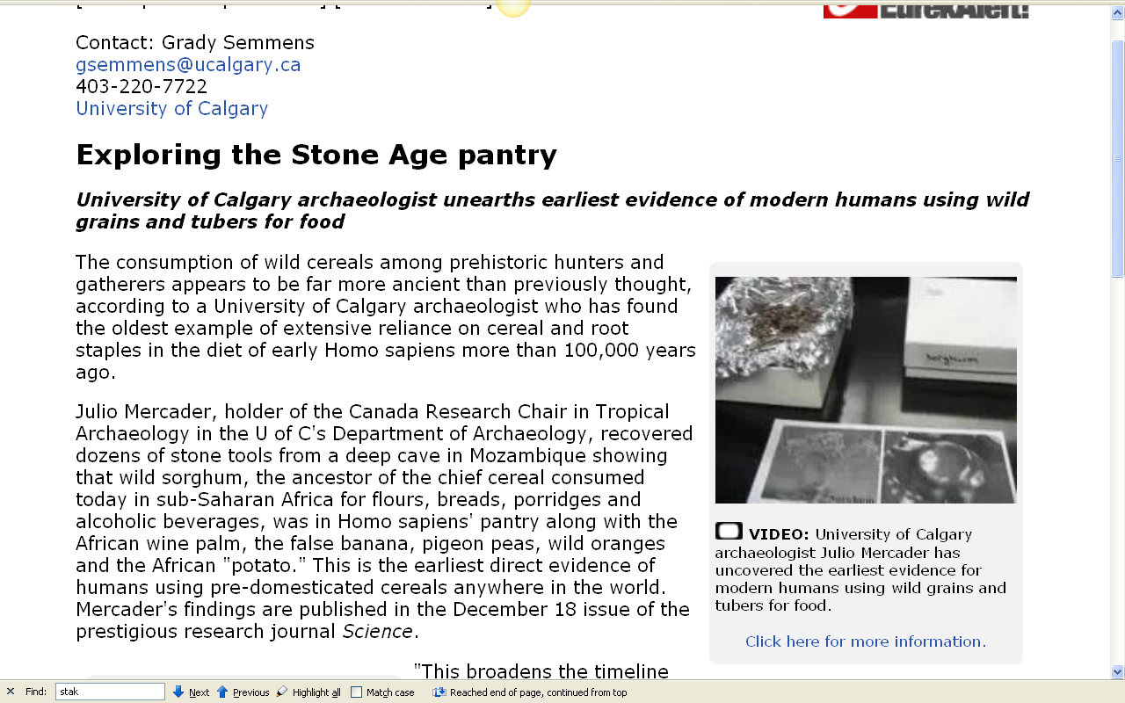
http://www.eurekalert.org/pub_releases/2009-12/uoc-ets121409.php

Slide 15
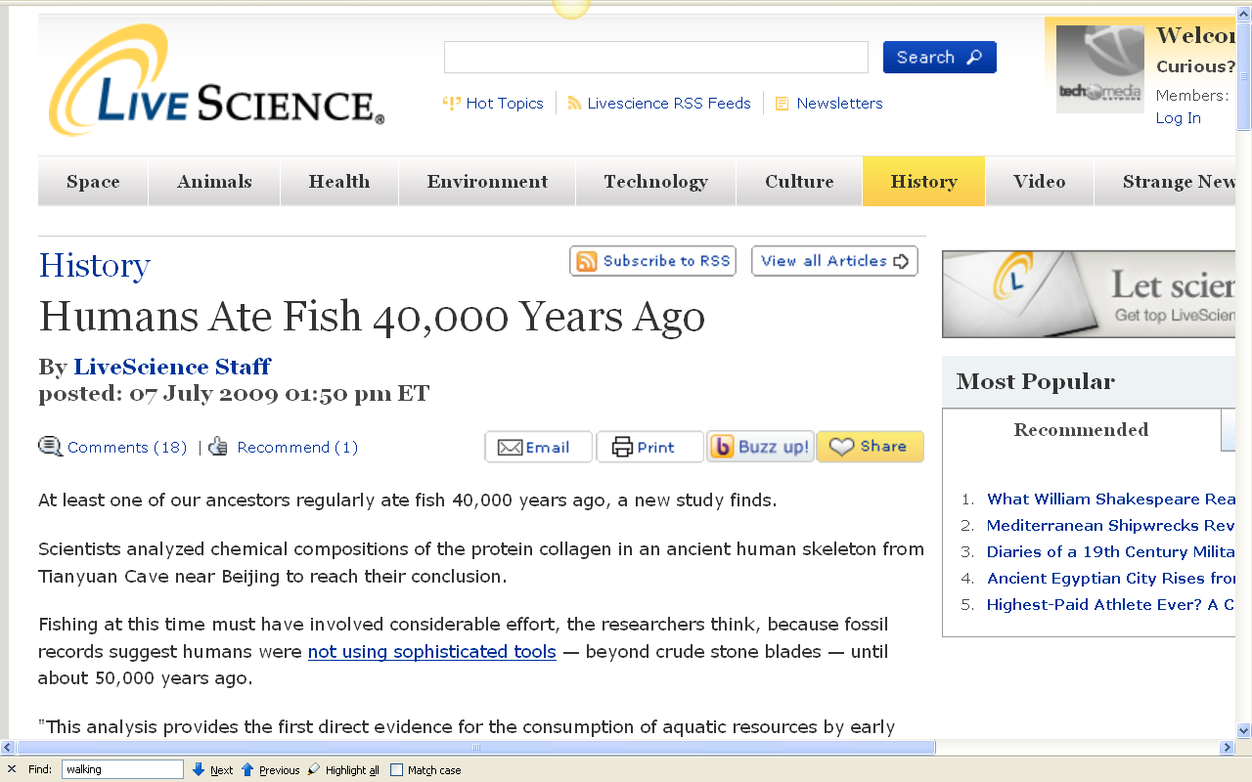
http://www.livescience.com/history/090707-fish-human-diet.html

Slide 16

http://news.nationalgeographic.com/news/2008/05/080508-first-americans.html

Slide 17
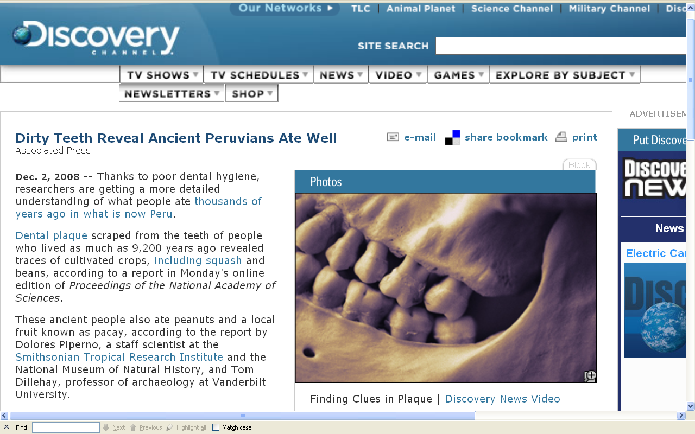
http://dsc.discovery.com/news/2008/12/02/teeth-peru-diet.html

Slide 18
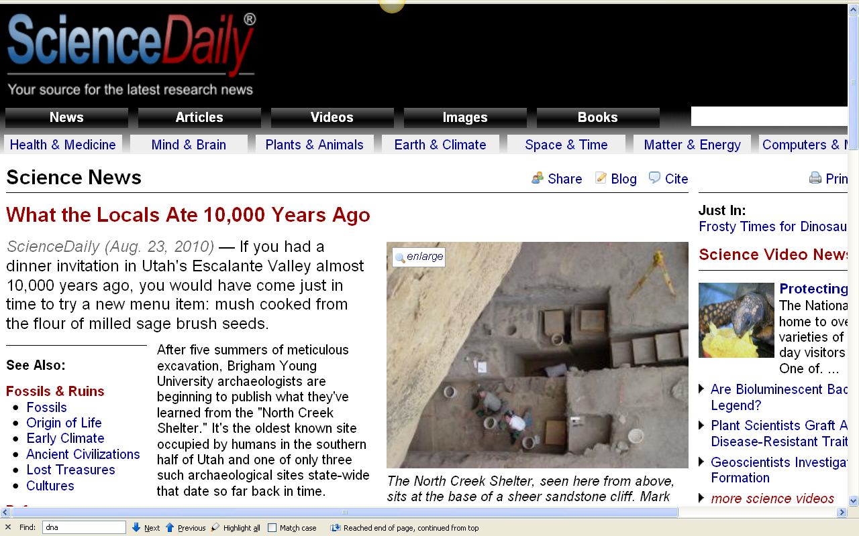
http://www.sciencedaily.com/releases/2010/08/100823131743.htm

Slide 19
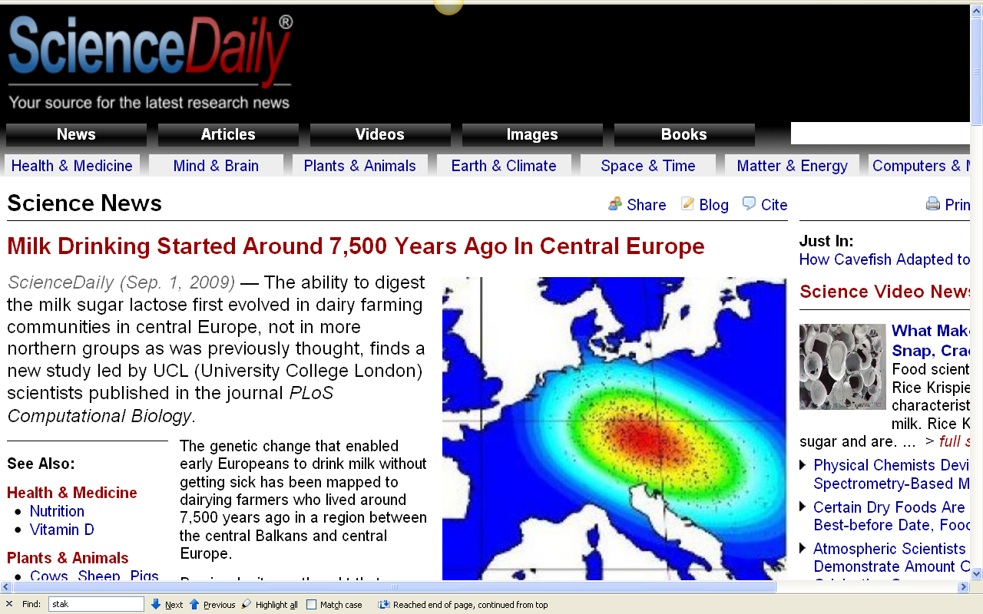
http://www.sciencedaily.com/releases/2009/08/090827202513.htm

Slide 20
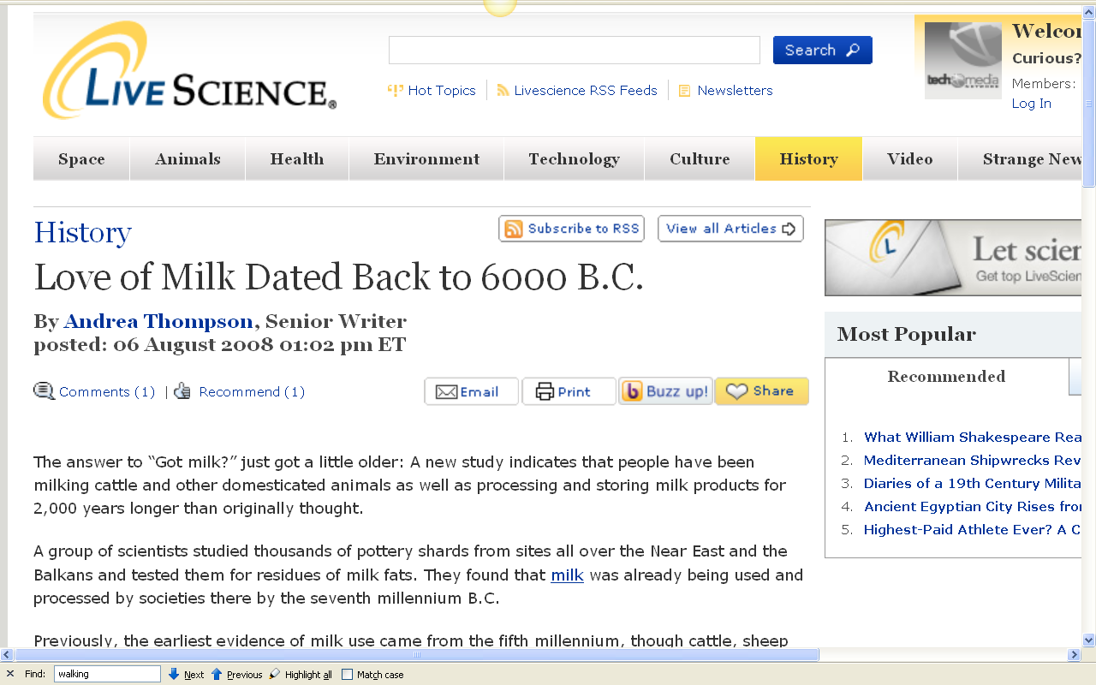
http://www.livescience.com/history/080806-milk-history.html
Notes:
20

Slide 21
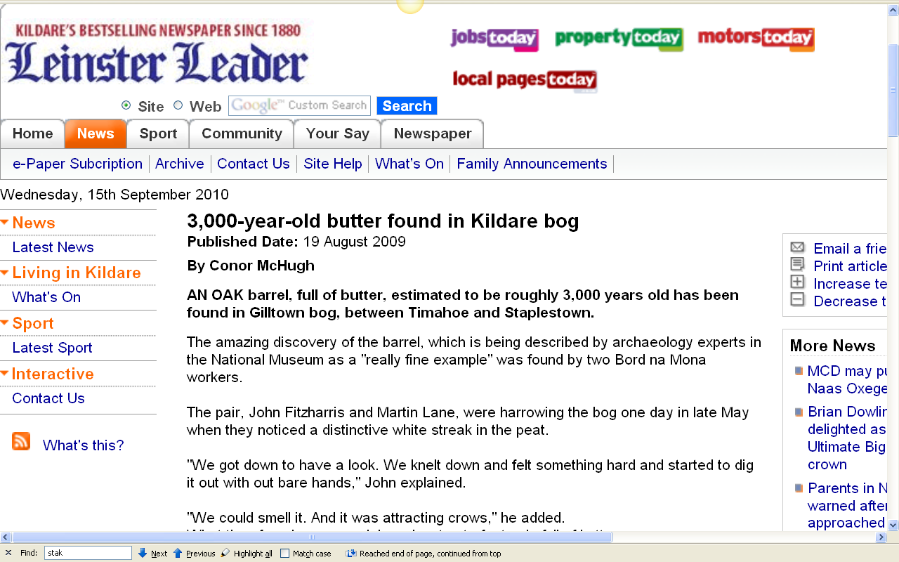
http://www.leinsterleader.ie/news/3000yearold-butter-found-in-Kildare.5567520.jp

Slide 22
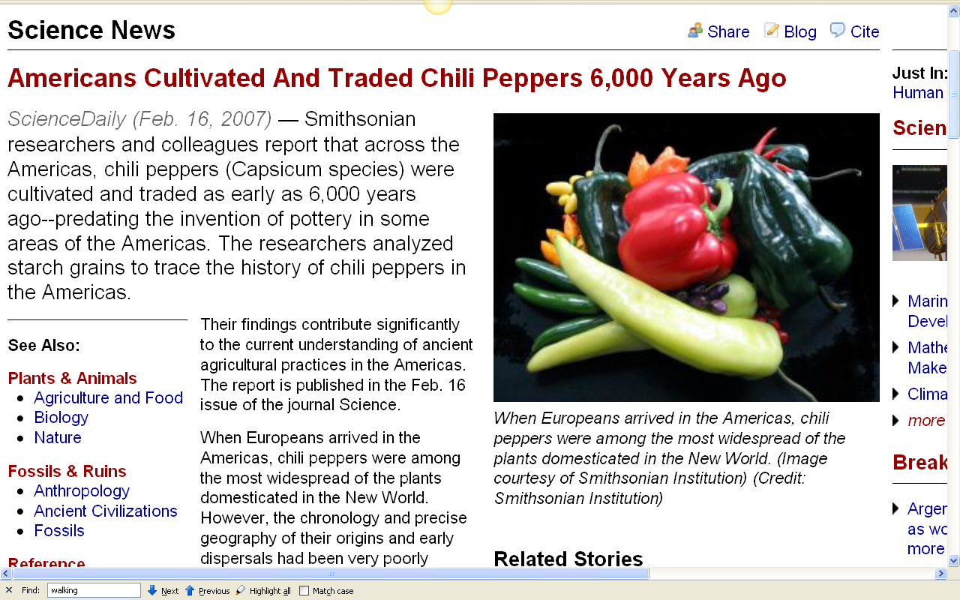
http://www.sciencedaily.com/releases/2007/02/070215144334.htm

Slide 23
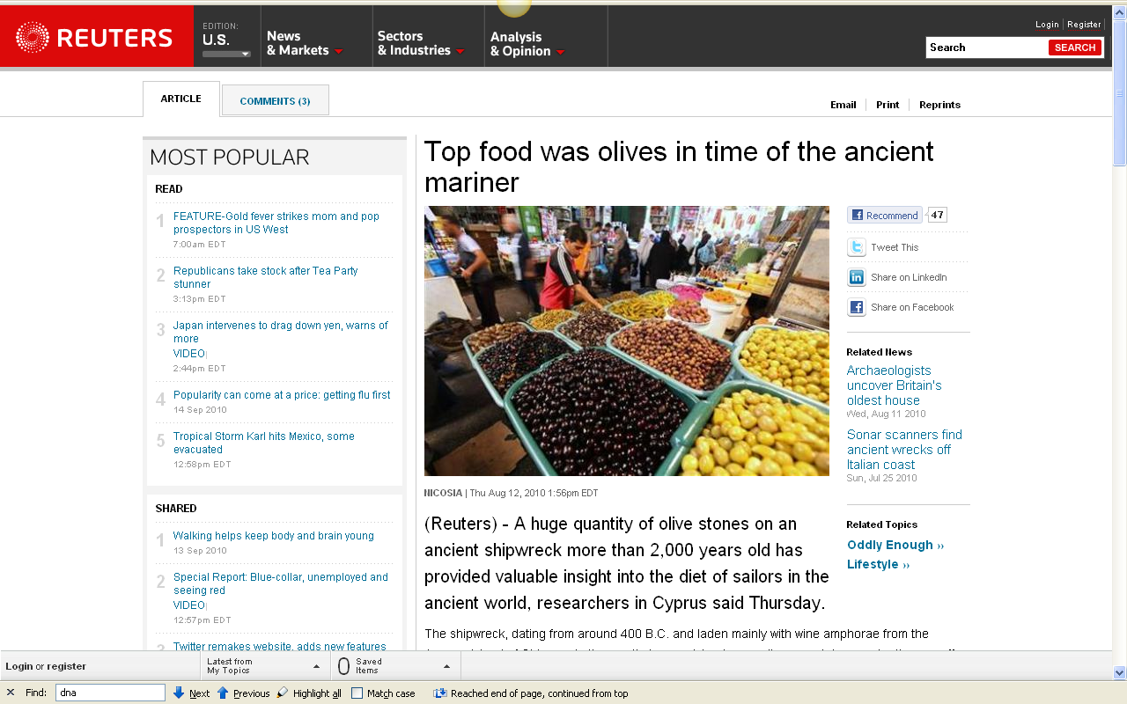
http://www.reuters.com/article/idUSTRE67B3SG20100812

Slide 24
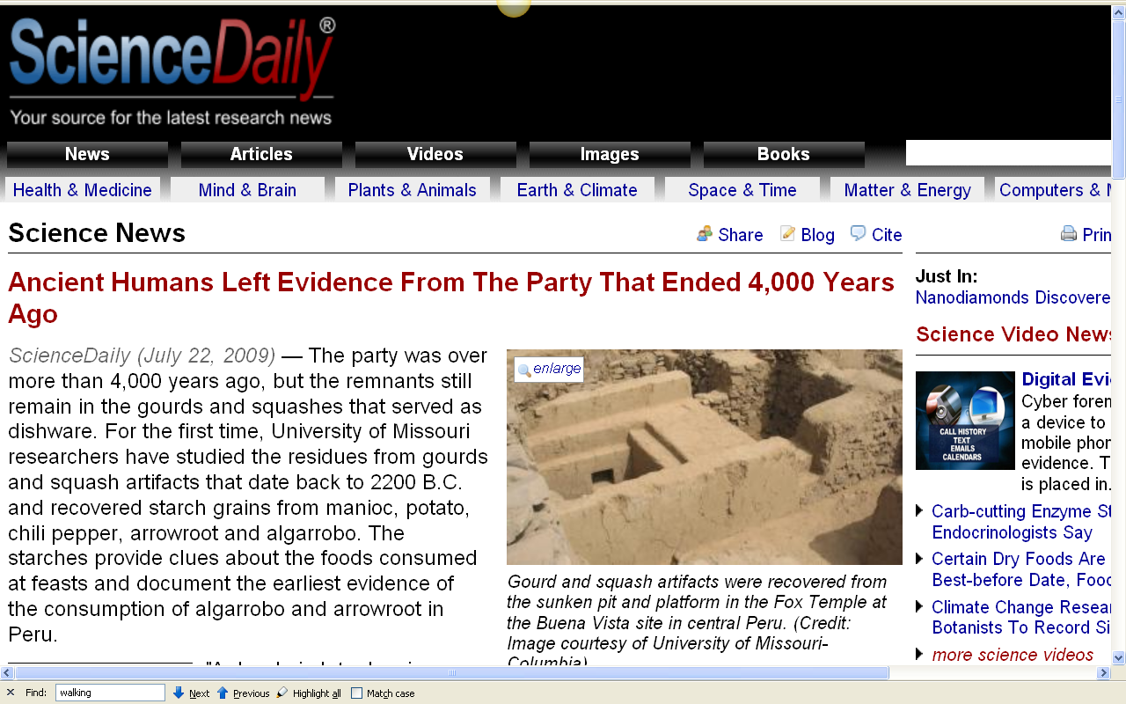
http://www.sciencedaily.com/releases/2009/07/090721135602.htm

Slide 25
Diet and Human Evolution
Diet and Human Evolution
  Exploring the Diets of Extinct Humans
  Through Paleontology
      Teeth
      Skulls and Jaws
      The Postcranial Skeleton
  What Is Adaptation?
  Using Chemistry to Infer the Diets
  of Extinct Hominins
  Our Place in Nature
  A Brief Who's Who of the Early Hominins
  What Did Early Hominins Eat?
  What Can We Say About the Diets of Fossil Homo?
  Summary
  Highlight: Lactose Intolerance
ca. 1.8 mya – 10 kya

Slide 26
“Fossil Homo” =
Homo erectus
Homo Neandertalensis
Homo Heidelbergensis
Homo sapiens sapiens
ca. 1.8 mya – 10 kya
Time 23 July 2001

Slide 27
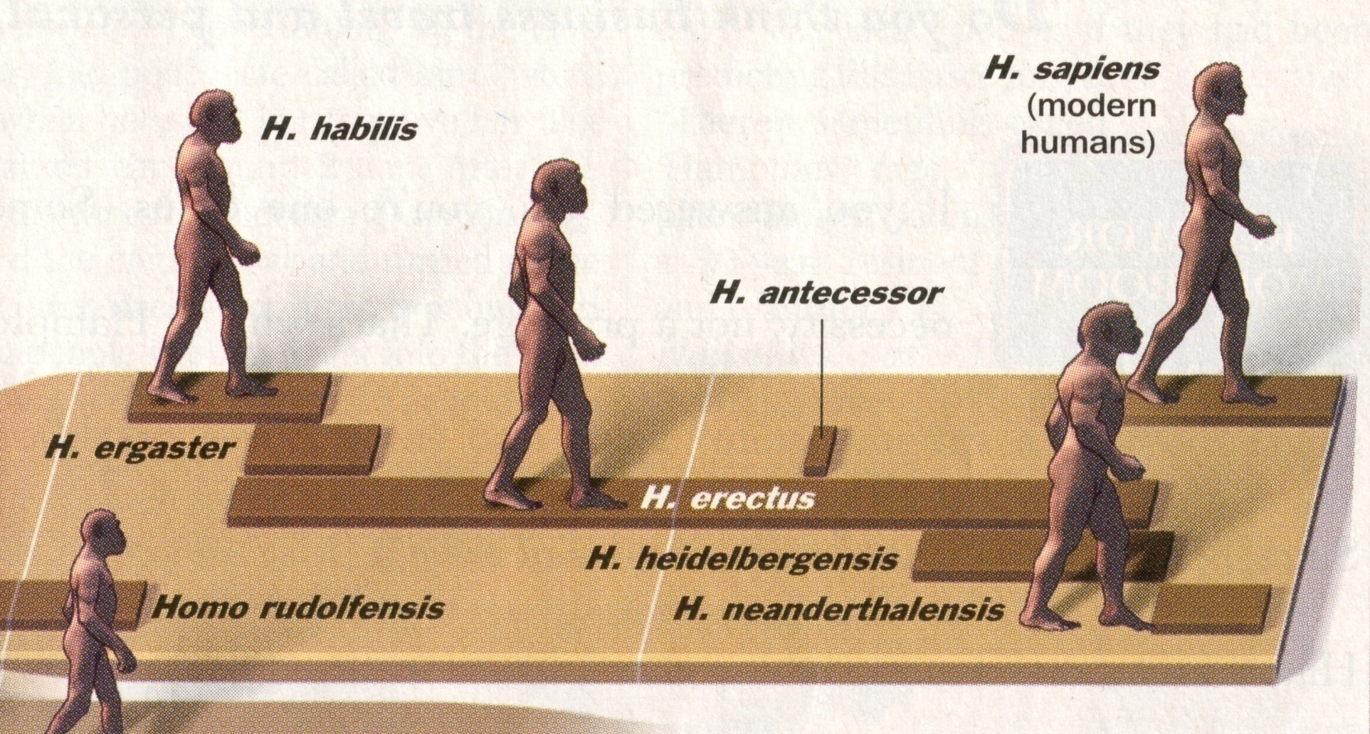
A Walk Through Hominin Evolution
Homo erectus
1.8 mya–25,000 ybp
Time 23 July 2001

Slide 28
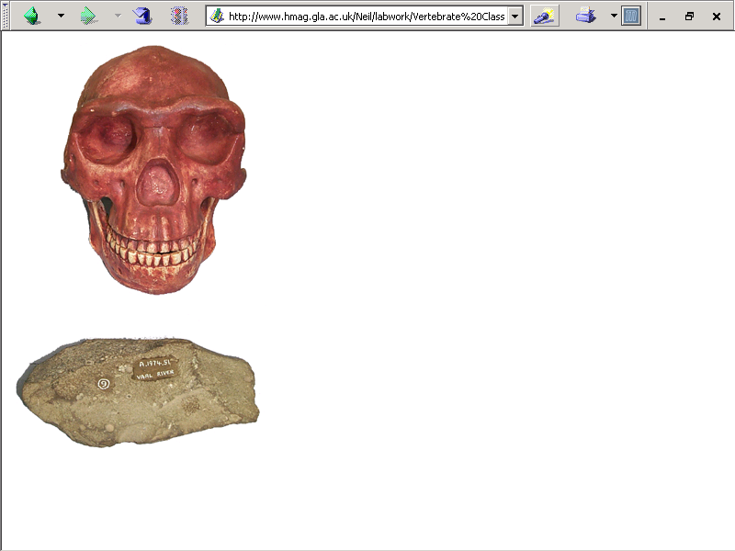
Homo erecti
are hand axe people

Slide 29
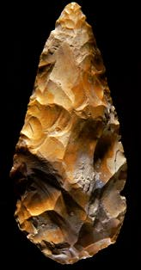
^{Acheulian biface (“hand axe”)}
Richard Effland, Maricopa College

Slide 30
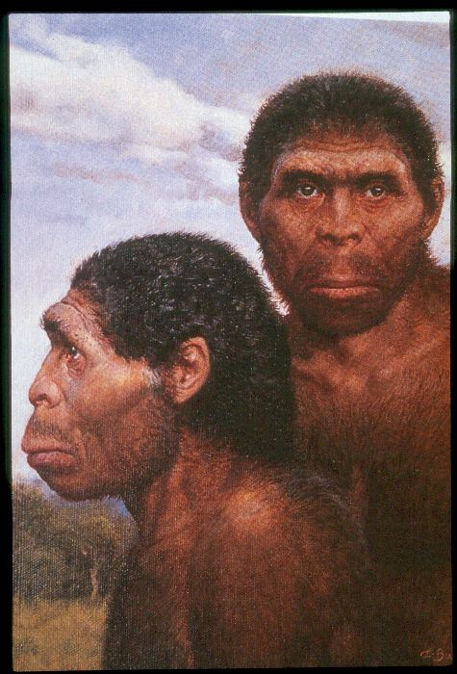
“Java Man” is one of the best-known Homo erectus peoples

Slide 31
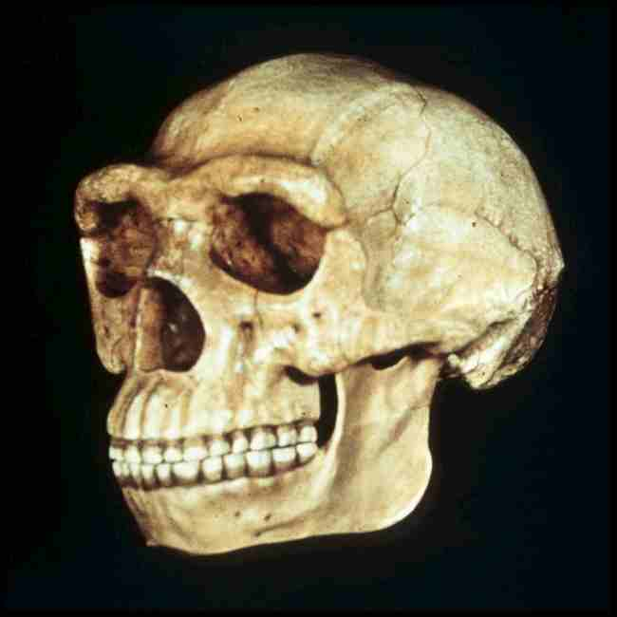
“Peking Man” is another . . .
  aka Homo erectus pekinensis
  aka Sinanthropus

Slide 32
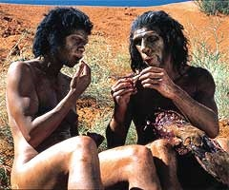
Hunting / Gathering / Foraging
meat eating becomes increasingly more important from 1.8 mya onwards . . .
with the beginning of the Pleistocene,
and the advent of Homo erectus

Slide 33
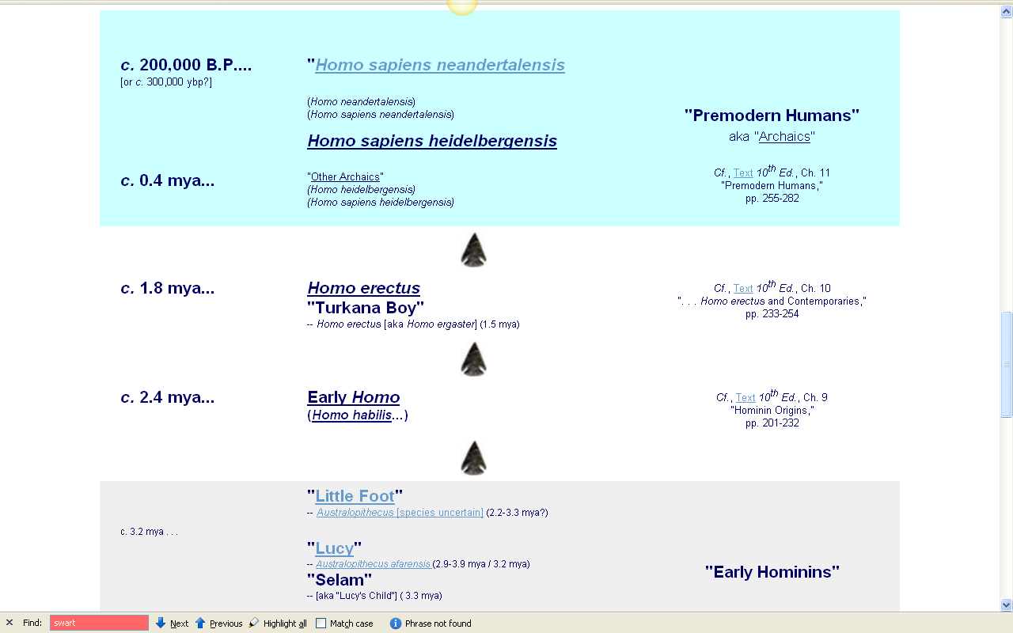
www.d.umn.edu/cla/faculty/troufs/anth1602/pctimes.html#title
Notes:
33

Slide 34
first evidence of
sustained meat eating =
food revolution #2?
ca. 1.8 mya

Slide 35
Hunting / Gathering / Foraging
complex interrelated
and interacting changes occurred with meat eating
bio-physical
socio-cultural

Slide 36
Hunting / Gathering / Foraging
hominin hunting
probably originally followed the hunting of lions or wild dogs in the African savannah . . .

Slide 37
Hunting / Gathering / Foraging
lions, heyenas, and wild dogs
and other hunting animals
hunt in groups
share their food
hunt cooperatively
(i.e., as a team)

Slide 38
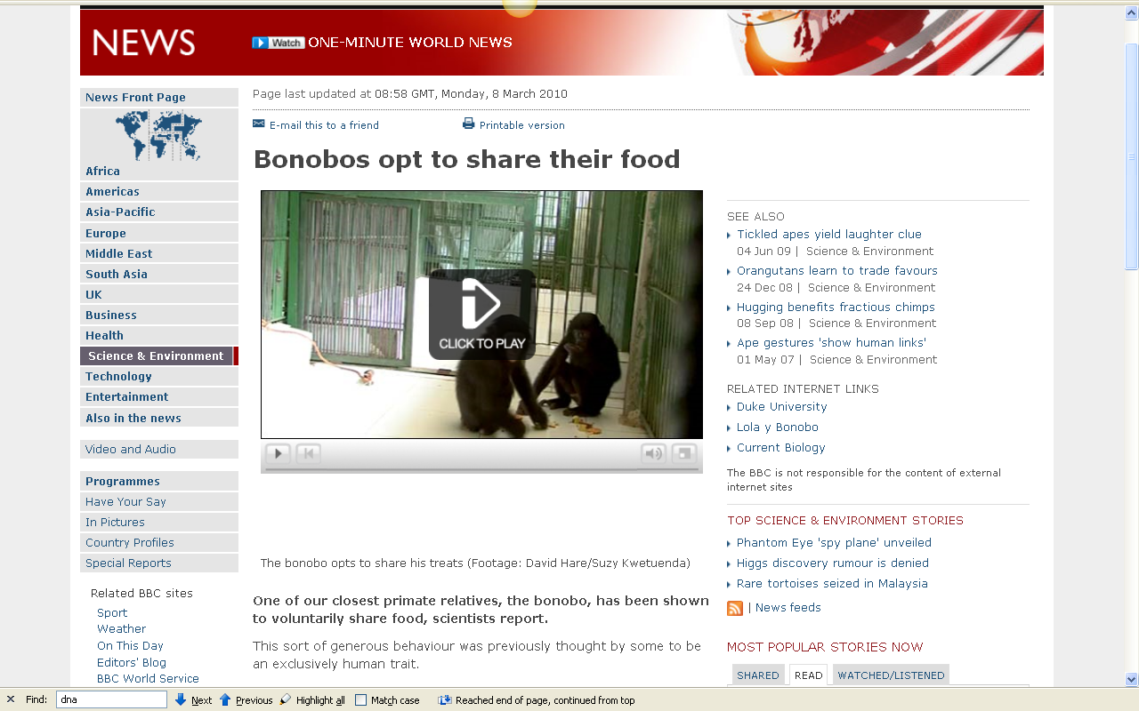
http://news.bbc.co.uk/2/hi/science/nature/8548478.stm

Slide 39
some Homo erectus groups
“had fire” . . .
Notes:
39

Slide 40
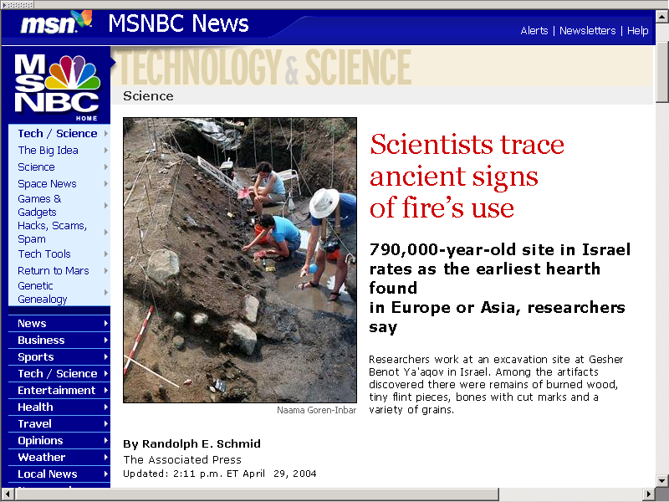
http://msnbc.msn.com/id/4863378/

Slide 41
fire improves the efficiency
of getting food when hunting . . .
(by using fire to drive out small and large animals, for e.g.)
Notes:
41

Slide 42
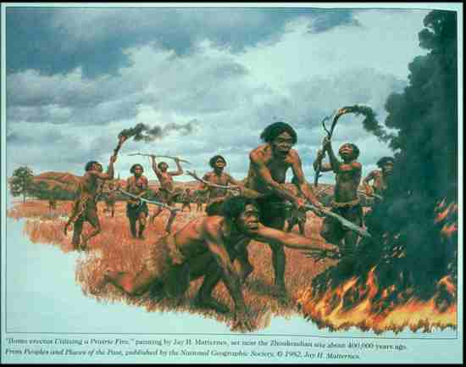
Homo erectus
(Zhoukoudian, China)

Slide 43
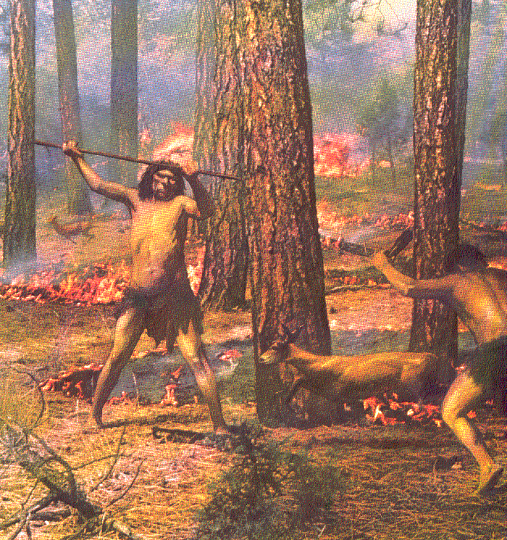
Homo erectus
(Zhoukoudian, China)
The First Men (Little Brown, 1973), p. 26

Slide 44
and fire helps in the collecting of foods by rejuvenating certain valuable wild crops . . .
such as blueberries, for e.g., . . .
http://en.wikipedia.org/wiki/Blueberry
Notes:
44

Slide 45
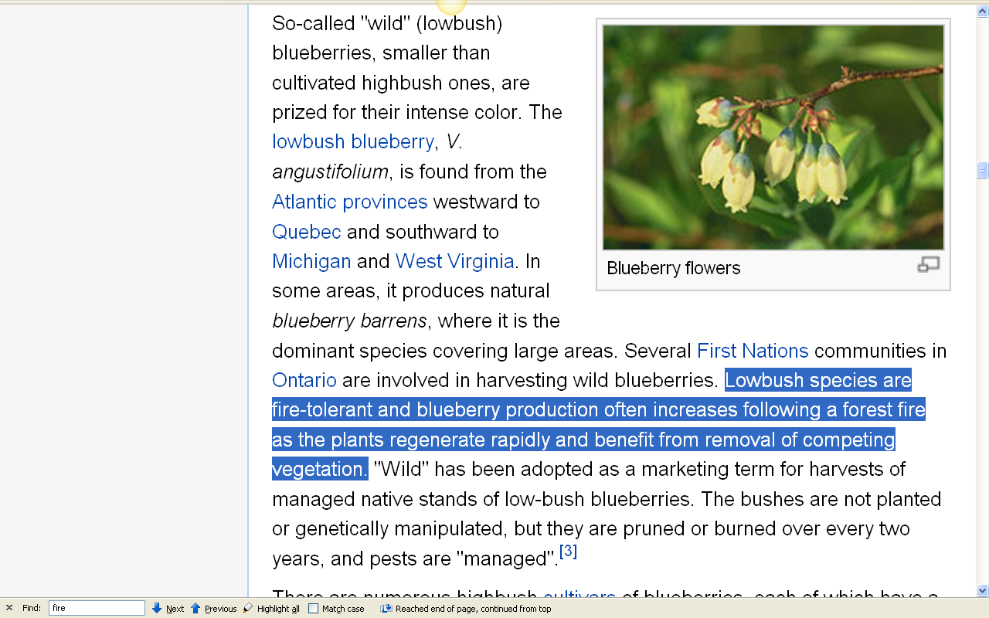
http://en.wikipedia.org/wiki/Blueberry
Notes:
45

Slide 46
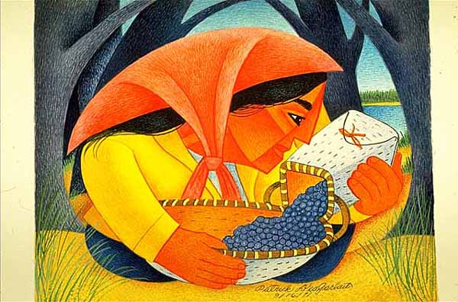
Woman and Blueberries.
Creator: Patrick DesJarlait (1912-1972)
Minnesota Historical Society
Notes:
46

Slide 47
and fire improves
the efficiency
of the digestibility of meat . . .
(that is, a pound of cooked meat provides more net energy than a pound of uncooked meat)
Notes:
47

Slide 48
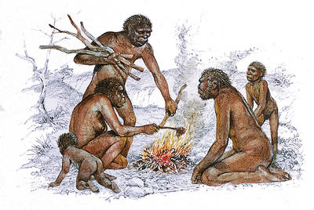
Homo erectus
(Zhoukoudian, China)
www.gridclub.com/fact_gadget/1001/human_world/prehistoric_people/639.html

Slide 49
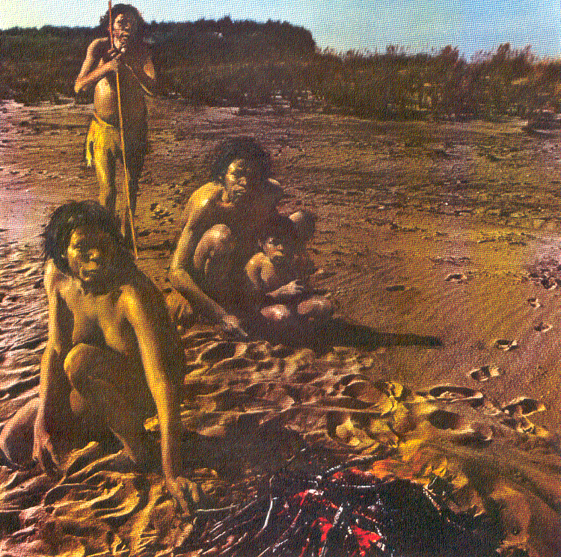
Homo erectus
(Zhoukoudian, China)
The First Men (Little Brown, 1973), p. 8

Slide 50
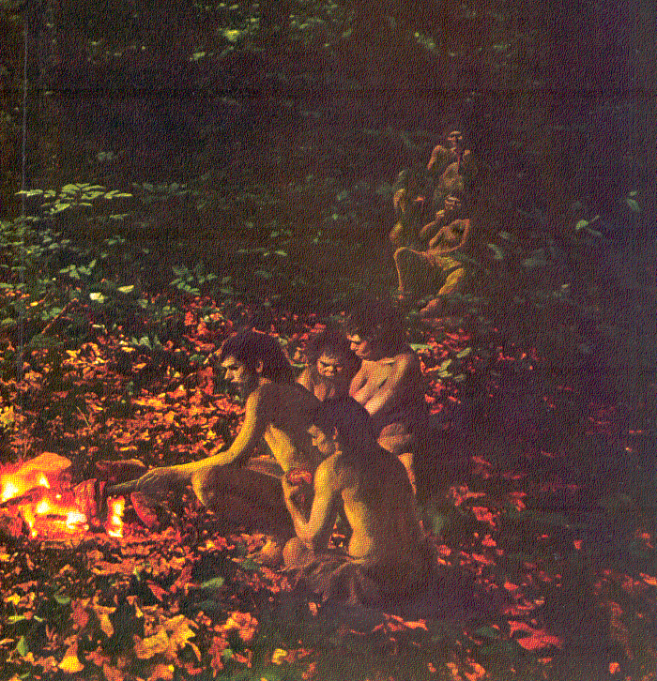
Homo erectus
(Zhoukoudian, China)
The First Men (Little Brown, 1973), p. 29

Slide 51
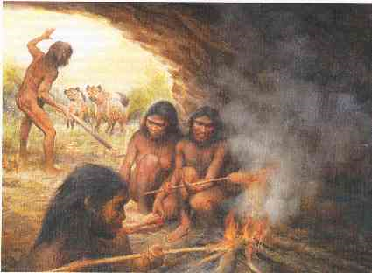
Homo erectus
(Zhoukoudian, China)
and fire become key for protection . . .
http://www.dandebat.dk/eng-hellig1.htm

Slide 52
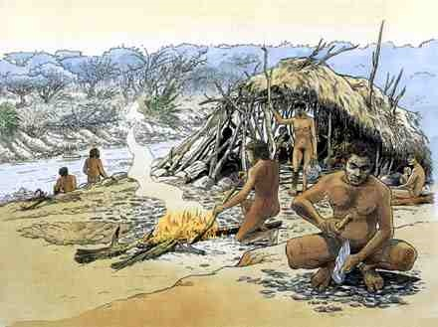
Homo erectus
and a cooking fire generally becomes
the center of home base activity . . .
http://www.memo.fr/en/article.aspx?ID=THE_TEC_002

Slide 53
and with Homo erectus we begin to see a little more detail about food-related matters . . .
for e.g., . . .
Notes:
53

Slide 54
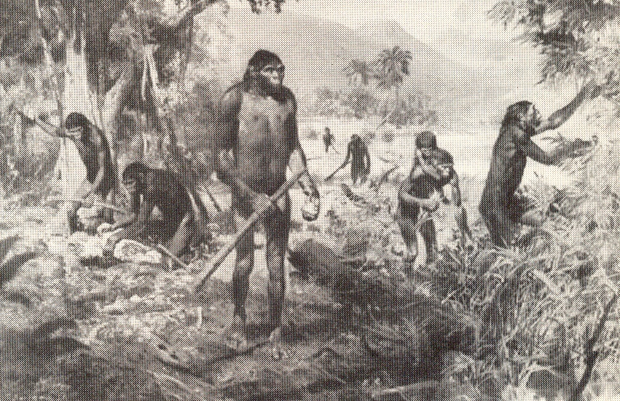
Homo erectus
(Zhoukoudian, China)
The Emergence of Humankind 4th Ed., p. 105

Slide 55
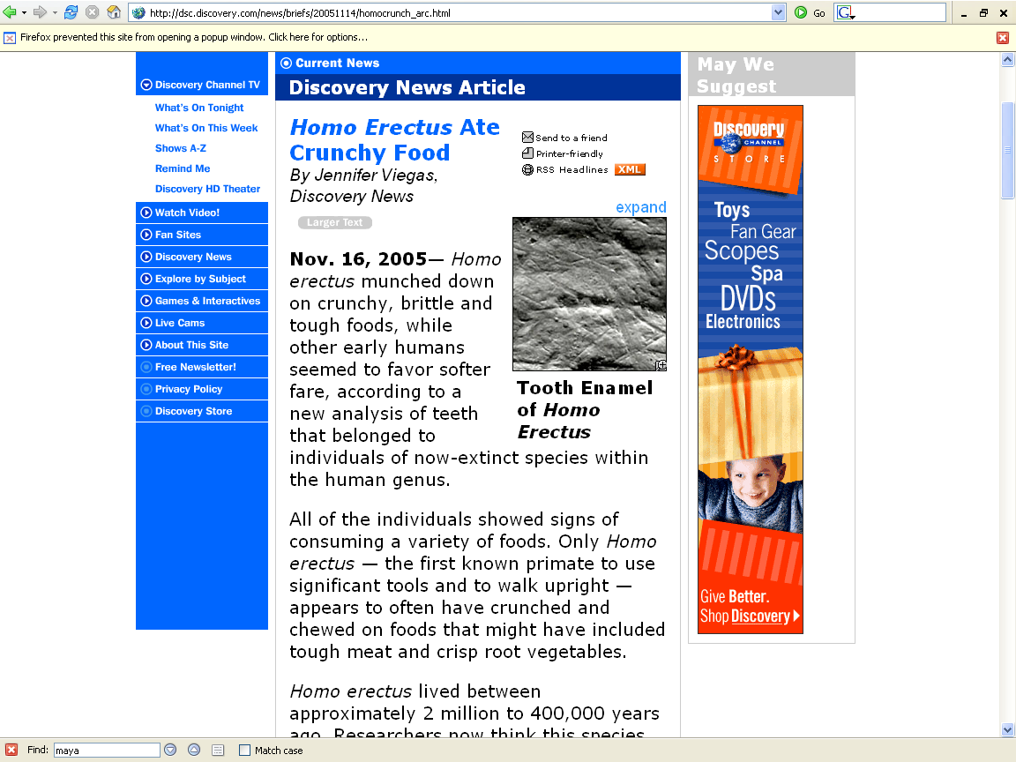
http://dsc.discovery.com/news/briefs/20051114/homocrunch_arc.html

Slide 56
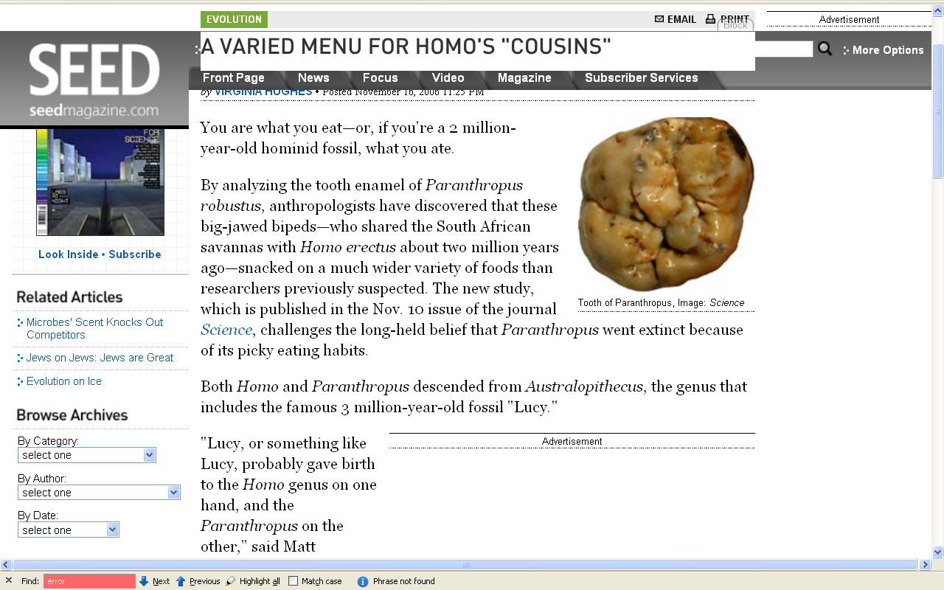

2006
http://seedmagazine.com/news/2006/11/a_varied_menu_for_homos_cousin.php

Slide 57
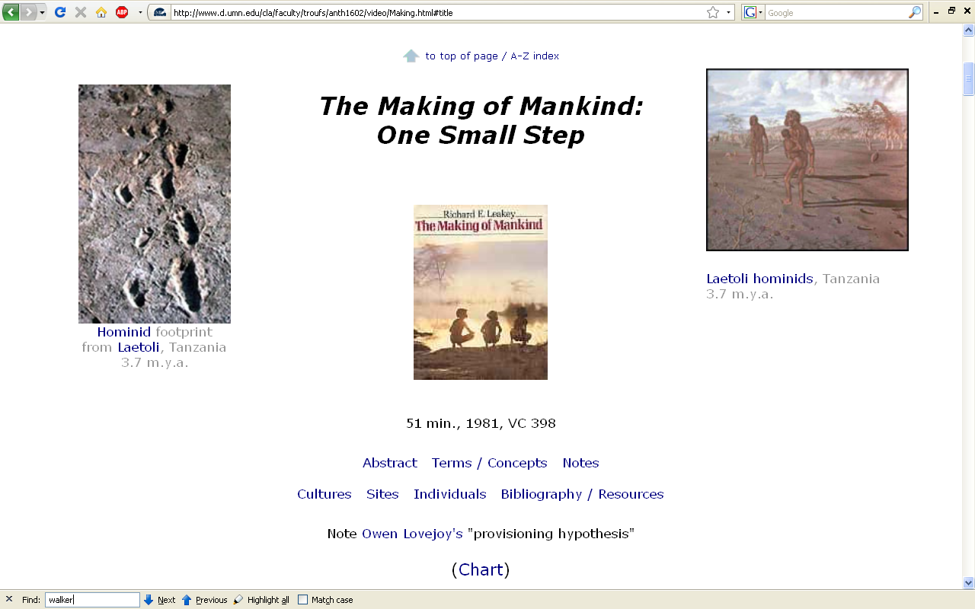
Alan Walker and colleagues suggest, for e.g., that one individual had too much
Vitamin A
(Hypervitaminosis A – probably from too much eating raw liver)
and died as a result . . .
The Cultural Feast, 2nd Ed., p. 35

Slide 58
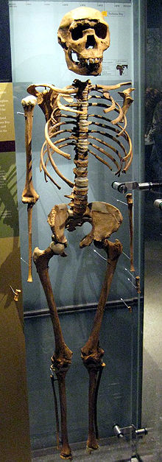
^{KNM-WT15000}
^{from Nariokotome, Kenya:}
^{the most complete Homo erectus}
^{specimen yet found}
http://en.wikipedia.org/wiki/Nariokotome_Boy

Slide 59
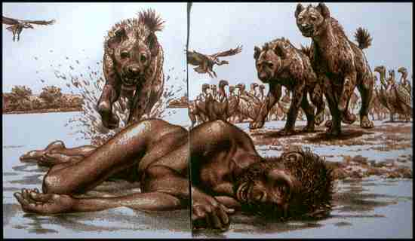
Homo erectus
(Nariokotome, Africa)

Slide 60
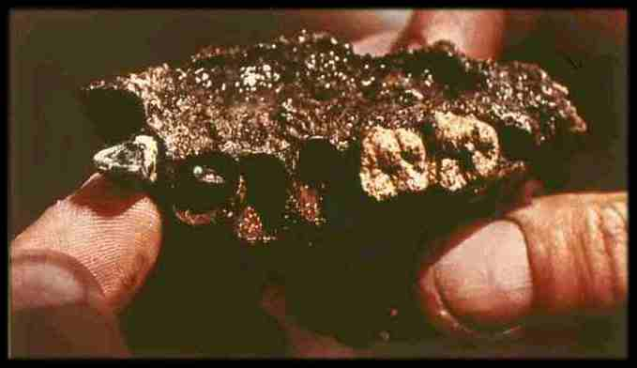
Homo erectus
(Nariokotome, Africa)

Slide 61
all of this clearly suggests that meat eating was most likely a major part of the dietary repertoire of early hominins, including early species of Homo
possibly from eating too much liver
The Cultural Feast, 2nd Ed., p. 36

Slide 62
NOTE:
. . . consumption of honeybee broods qualifies as carnivory
The Cultural Feast, 2nd Ed., pp. 35-36

Slide 63
Homo erectus hunting sites in
the Ambrona Valley of Spain
give us one of the best pictures
of early large-game food procurement techniques . . .
Ambrona and Torralba, Spain
400,000 - 200,000? ybp
associated with “Acheulian” tools

Slide 64
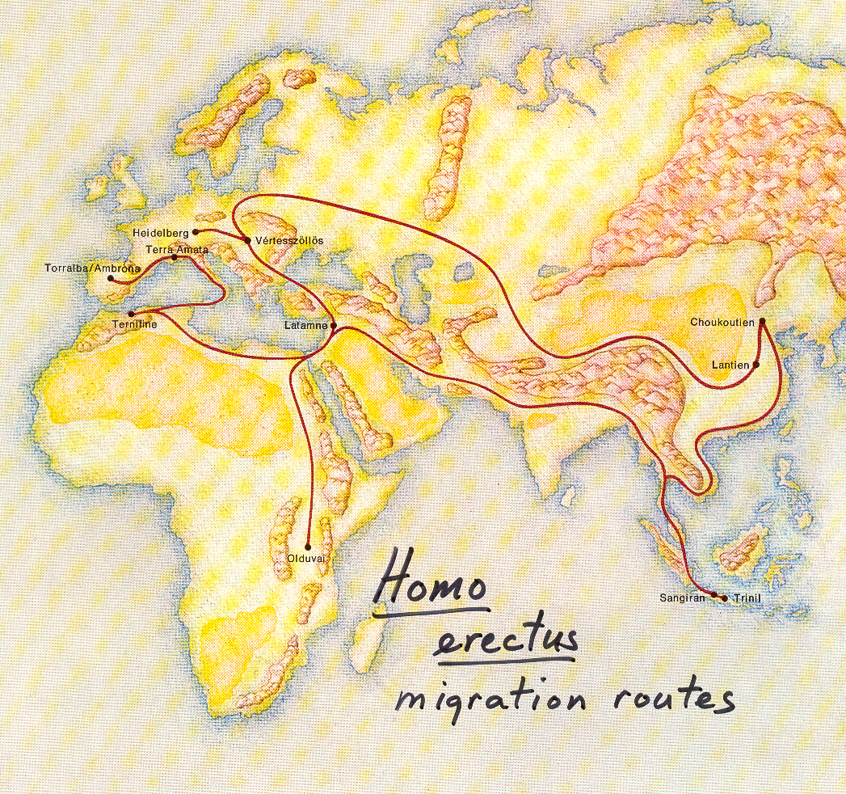
The Emergence of Man: The First Men (Little Brown, 1973), p. 111

Slide 65
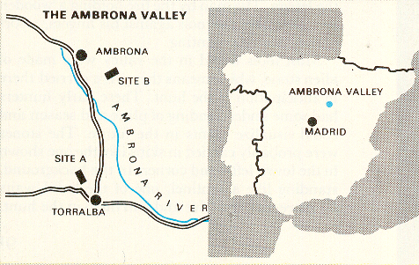
Time-Life, Early Man, p. 92

Slide 66
Ambrona and Torralba
(Spain)
both kill sites were littered with crude hand axes, cleavers, scrapers, and cutting tools
the elephant bones at both sites were buried in clays that were once treacherous marsh

Slide 67
Ambrona and Torralba
(Spain)
were on important game trails between summer and winter grazing areas

Slide 68
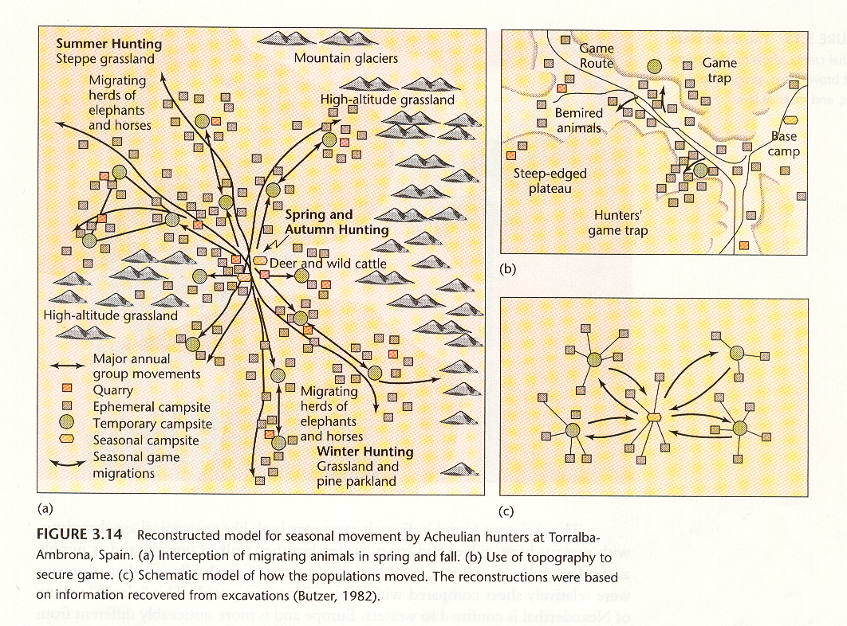
People of the Earth, 10th Ed., p. 97

Slide 69
Ambrona and Torralba
(Spain)
the hunters preyed on migrating elephants each spring and fall, dispersing into smaller groups during the other seasons
  others believe that the hunters were actually scavenging from animals naturally stuck in the mud

Slide 70
Ambrona and Torralba
(Spain)
Homo erectus hunted elephants
but did not exploited small game, birds, fish, or sea mammals on any significant scale

Slide 71
Torralba
(Spain)
yielded most of the left side of a large elephant that had been cut into small pieces

Slide 72
Ambrona
(Spain)
yielded most of the remains of
30 - 35 dismembered elephants
concentration of broken food bones found all over the site
elephants’ skulls had been broken open to expose the brains

Slide 73
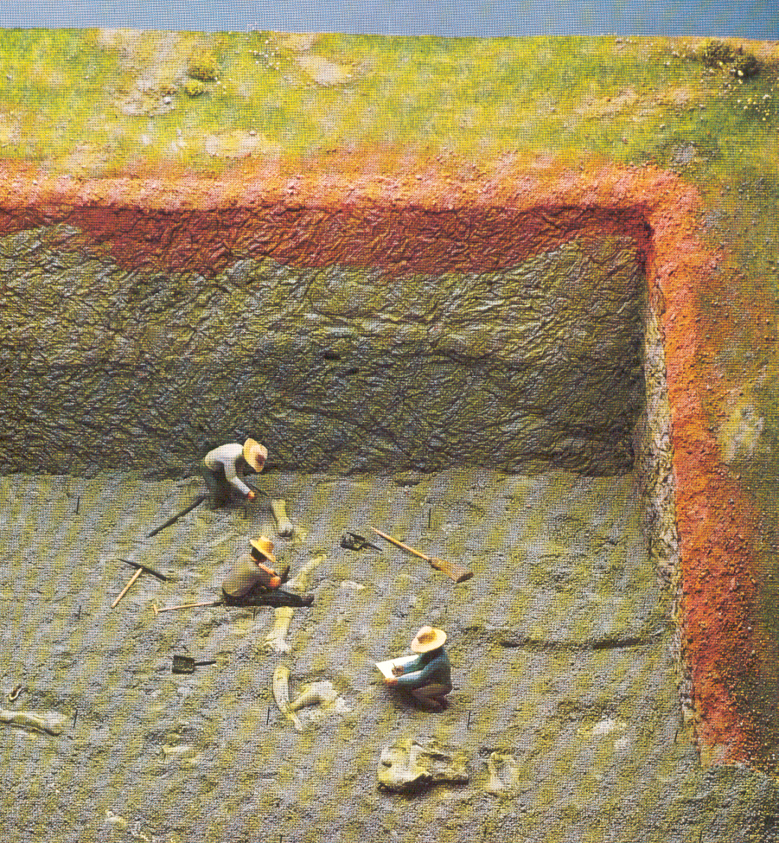
Homo erectus
(Ambrona, Spain)
Source: The Emergence of Man: The First Men (Litte Brown, 1973), p. 93.

Slide 74
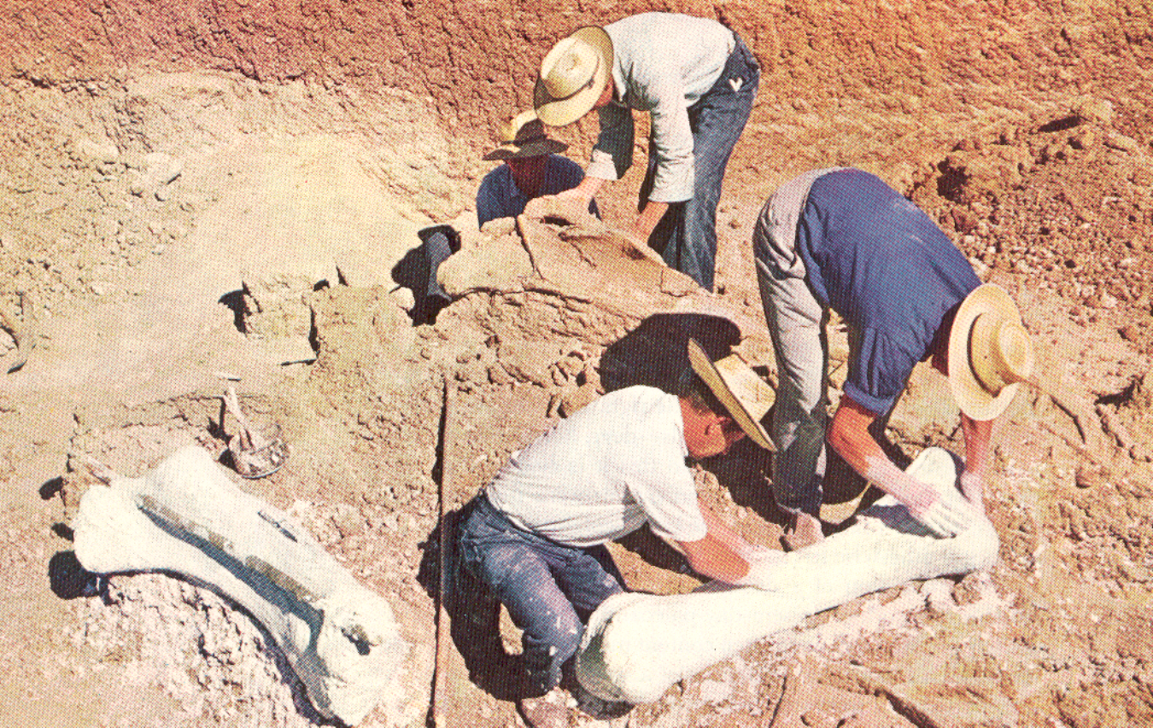
Homo erectus
(Ambrona, Spain)
Time-Life, Early Man, p. 87.

Slide 75
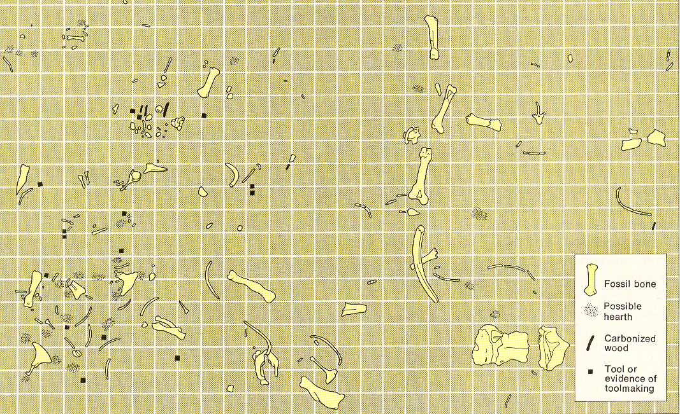
Homo erectus
(Ambrona, Spain)
Living-floor Map
The Emergence of Man: The First Men (Little Brown, 1973), p. 87

Slide 76
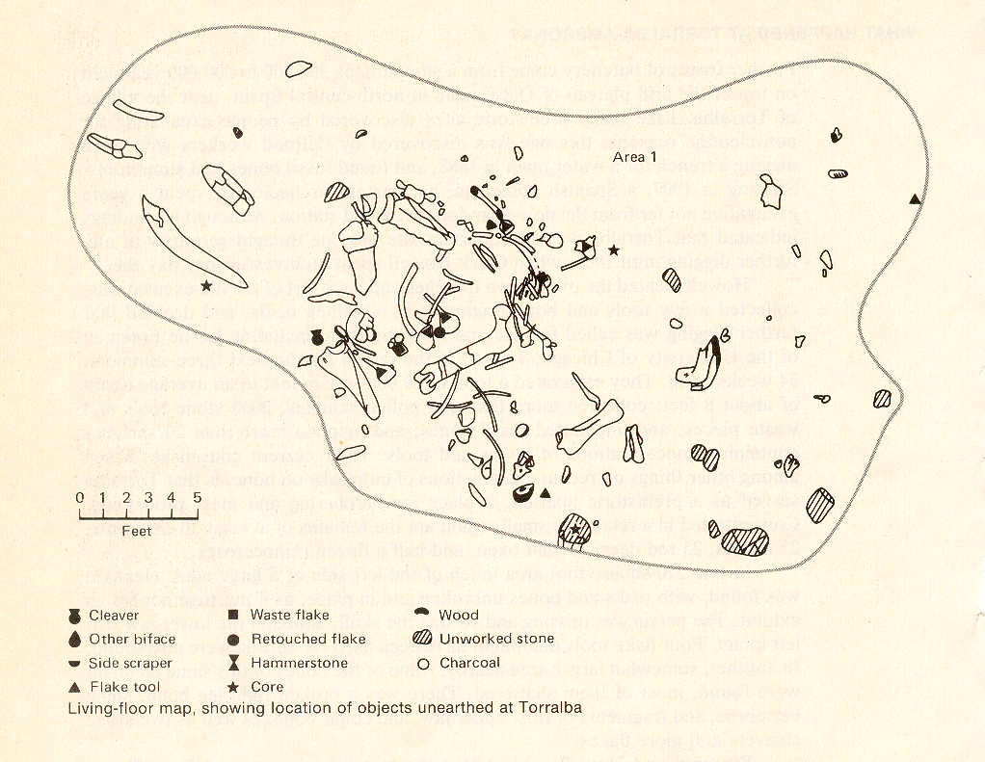
Homo erectus
(Torralba, Spain)
Living-floor Map
The Emergence of Humankind, 4th Ed., p. 110

Slide 77

Homo erectus
(Torralba-Ambrona, Spain)
Time-Life, Early Man, p. 94

Slide 78

Homo erectus
(Torralba-Ambrona, Spain)
Time-Life, Early Man, p. 96

Slide 79

Homo erectus
(Torralba-Ambrona, Spain)
Time-Life, Early Man, p. 90

Slide 80

Homo erectus
(Torralba-Ambrona, Spain)

Slide 81

Homo erectus
(Torralba-Ambrona, Spain)
and like modern-day hunters
they probably celebrated after a successful hunt
Time-Life, Early Man, p. 93

Slide 82

modern-day !Kung san hunters
celebrating after a successful hunt

Slide 83

Homo erectus
(Torralba-Ambrona, Spain)
and like modern-day hunters
they probably celebrated after a successful hunt
Time-Life, Early Man, p. 99

Slide 84

Homo erectus
(Torralba-Ambrona, Spain)
and like modern-day hunters
they probably celebrated after a successful hunt
Time-Life, Early Man, p. 98

Slide 85
at Terra Amata,
near Nice, France,
we find the most complete reconstruction of Middle Pleistocene life in Europe
400,000 - 300,000 ybp

Slide 86

Homo erectus?
(Terra Amata, France)
The Emergence of Man: The First Men (Little Brown, 1973), p. 119

Slide 87

Homo erectus?
(Terra Amata, France)
including cooking hearths and food preparation areas
Cf., The Cultural Feast, 2nd Ed., p. 36
Living at Terra Amata, France
Henry de Lumley, Prehistoric Times (W.H. Freeman, 1983), p. 80

Slide 88

Fire Pit,Terra Amata, France
Henry de Lumley, Prehistoric Times (W.H. Freeman, 1983), p. 83

Slide 89

Homo erectus?
(Terra Amata, France)
Fire Pit

Slide 90
Terra Amata
(France)
Henry de Lumley suggests several huts
  6 - 15 meters by 4 - 6 meters
  estimates that each hut could hold up to 15 people
  a hearth in the center of each hut suggests control and use of fire

Slide 91
Terra Amata
(France)
occupants = ?
no fossil remains allow their identification but were Homo
  Homo erectus?
  archaic Homo sapiens?
  Homo heidelbergensis?

Slide 92

Points and scrapers,Terra Amata, France
Henry de Lumley, Prehistoric Times (W.H. Freeman, 1983), p. 85

Slide 93

Homo erectus?
(Terra Amata, France)
Making a blade tool,Terra Amata, France
Henry de Lumley, Prehistoric Times (W.H. Freeman, 1983), p. 87

Slide 94
at
Zhoukoudian in China
(“Peking Man”)
the Homo erectus were geographically isolated . . .
and this shows up in food-related features associated with heavy chewing

Slide 95
“Peking Man” had . . .
Mongoloid shovel-shaped incisors
taurodontism
    molars and premolars with enlarged pulp cavities extending downward into fused roots
mandibular torus
    heavy bony ridge on inside of lower jaw from canine to first molar on each side
extra foraminia mentalia
    2 - 5 openings in lower jawbone through which pass the nerves and blood vessels

Slide 96

Shovel-shaped incisors, shown here in a modern Homo sapiens sapiens
Understanding Physical Anthropology and Archaeology, 8th Ed., p. 263

Slide 97
“Peking Man” had . . .
Mongoloid shovel-shaped incisors
taurodontism
    molars and premolars with enlarged pulp cavities extending downward into fused roots
mandibular torus
    heavy bony ridge on inside of lower jaw from canine to first molar on each side
extra foraminia mentalia
    2 - 5 openings in lower jawbone through which pass the nerves and blood vessels

Slide 98


Slide 99
“Peking Man” had . . .
Mongoloid shovel-shaped incisors
taurodontism
    molars and premolars with enlarged pulp cavities extending downward into fused roots
mandibular torus
    heavy bony ridge on inside of lower jaw from canine to first molar on each side
extra foraminia mentalia
    2 - 5 openings in lower jawbone through which pass the nerves and blood vessels

Slide 100


Slide 101
“Peking Man” had . . .
Mongoloid shovel-shaped incisors
taurodontism
    molars and premolars with enlarged pulp cavities extending downward into fused roots
mandibular torus
    heavy bony ridge on inside of lower jaw from canine to first molar on each side
extra foraminia mentalia
    2 - 5 openings in lower jawbone through which pass the nerves and blood vessels

Slide 102
Homo erectus
(Zhoukoudian, China)
^{foraminia mentalia}

Slide 103

Homo sapiens sapiens
has only one, maybe two

Slide 104
and like some other
Homo erectus groups
Peking man “had fire” . . .
and they lived in caves
(the two go together)
Notes:
104

Slide 105
and like some other
Homo erectus groups
Peking man “had fire” . . .
and they lived in caves . . .
(the two go together)
Notes:
105

Slide 106

Homo erectus
(Zhoukoudian, China)
http://cssa.mit.edu/worldheritage/img/zkd/big/zkd-08b.jpg

Slide 107

“The Hunters’ Return at Chou-Kou-Tien,”
Henri Breuil, 1945
Beyond the Bounds of History
London: P.R. Gawthorn, 1949

Slide 108

Homo erectus
(Zhoukoudian, China)
British Museum of Natural History

Slide 109
and “Peking Man” had better tools . . .
which improves the ease and efficiency
of food procurement in general . . .
Notes:
109

Slide 110

Homo erectus
(Zhoukoudian, China)
Quartzite chopper Flint point Flint Awl Graver or Burin
Tools from Middle Pleistocene sites
Understanding Physical Anthropology and Archaeology, 8th Ed., p. 268

Slide 111

Homo erectus
(Zhoukoudian, China)

Slide 112

Homo erectus
(Zhoukoudian, China)
http://cssa.mit.edu/worldheritage/img/zkd/big/zkd-08b.jpg

Slide 113

Homo erectus
(Zhoukoudian, China)
http://cssa.mit.edu/worldheritage/img/zkd/big/zkd-08b.jpg

Slide 114
and at Zhoukoudian
as elsewhere,
there is some suggestion that they
seemed inclined to eat their neighbor . . .
(although there is debate on the issue here)
Notes:
114

Slide 115
at the next stage
Neandertal
there is no argument . . .
Notes:
115

Slide 116
cannibalism clearly
shows up at
Moula-Gercy, France
“Bones Offer Evidence of a Neanderthal - Eat - Neanderthal World”
78 fragments from 6 skeletons
ca. 100,000 ybp
30 September 1999

Slide 117

(ABACNEWS.com/MagellanGeographix)

Slide 118

Fragment of a Neandertal thigh bone with cut marks
(UCAL Berkeley / AP Photo)

Slide 119

http://dsc.discovery.com/news/2008/02/27/neanderthal-cannibalism.html
Notes:
119

Slide 120

January 1996

Slide 121
A Walk Through Hominin Evolution
Premoderns
Neandertal . . .
500,000-28,000 ybp
Time 23 July 2001

Slide 122
there are two kinds
of Neandertals . . .
Notes:
122

Slide 123
Neandertal types
“Classic”
“Progressive”
  (aka “Generalized”)

Slide 124
Neandertal types
“Classic”
“Progressive”
  (aka “Generalized”)

Slide 125

Gibraltar I: Reconstruction of a ca. four-year-old Neandertal
Reconstruction artist Elisabeth Daynes

Slide 126


“Classic”
“Progressive”
  (aka “Generalized”)
Fossil Discoveries of Neandertal
Understanding Physical Anthropology and Archaeology, 9th Ed., pp. 260-261

Slide 127
when someone just says “Neanderthal,”
they almost always mean
Classic Neandertal . . .
Notes:
127

Slide 128
“Classic”
“Progressive”
  (aka “Generalized”)
Fossil Discoveries of Neandertal
Understanding Physical Anthropology and Archaeology, 9th Ed., pp. 260-261

Slide 129
Neandertal types
“Classic”
“Progressive”
  (aka “Generalized”)

Slide 130
“Classic” Neandertal
are adapted to cold climates
physically
culturally

Slide 131
“Classic” Neandertal
are adapted to cold climates
physically
culturally
this follows the well-know
Allan and Bergman Rules in biology . . .

Slide 132

the Bergman Rule says that in cold climates members of the same species have stocker bodies than members of the same species in warm climates . . .

Slide 133
the Allan Rule says that in cold climates members of the same species have shorter appendages than members of the same species in warm climates . . .

Slide 134

Neandertal

Slide 135
Neandertal
notice artist’s portrayal of use of teeth . . .

Slide 136

For information on Neandertal tooth wear see
The Cultural Feast, 2nd Ed., pp. 36-37

Slide 137
“Classic” Neandertal
are adapted to cold climates
physically
culturally

Slide 138
“Classic” Neandertal
are culturally
adapted to cold climates
hunting
  technology
  food
  clothing
  shelter

Slide 139

Neandertal
http://www.bilimutopya.com.tr/arsiv/2002/10/bilimgun.htm

Slide 140

Neandertals, living in cold climates, were big meat eaters . . .
www.d.umn.edu/cla/faculty/troufs/anth1602/pcneand.html#title

Slide 141

Neandertals utilized a large variety of game. . .

Slide 142

Neandertal
Early Man (Time-Life Nature Library, 1973), p. 134

Slide 143

Neandertal
The Neanderthals (NY: Time-Life, 1973), p. 31

Slide 144

Neandertal
Early Man (Time-Life Nature Library, 1973), p. 132

Slide 145

Neandertal
The Neanderthals (NY: Time-Life, 1973), p. 165

Slide 146

Neandertal
The Neanderthals (NY: Time-Life, 1973), p. 29

Slide 147

Neandertal hunted “megafauna”
(animals of 100 lbs. or more)

Slide 148

www.nature.ca/notebooks/english/woolly.htm

Slide 149

Neandertal Megafauna

Slide 150

contrary to stereotypes . . .
http://www.nytimes.com/2006/12/05/science/05nean.html?_r=2&\1ref=science&\1oref=slogin&oref=slogin

Slide 151

and they used a wide variety of hunting techniques . . .
The Neanderthals (NY: Time-Life, 1973), p. 32

Slide 152

including bolas?
The Neanderthals (NY: Time-Life, 1973), pp. 36-37

Slide 153

Neandertals were
“Opportunistic hunters”
http://www.newscientist.com/news/news.jsp?id=ns99993085

Slide 154

they often used a frontal attack in hunting . . . .
Early Man (Time-Life Nature Library, 1973), p. 126

Slide 155
^{Bear}
^{Neandertal}
Early Man (Time-Life Nature Library, 1973), p. 126

Slide 156

Neandertal
and probably used only thrusting weapons . . .
(that is, they likely didn’t throw their spears)
Life Nature Library, Early Man, p. 114

Slide 157

Neandertal
which is dangerous . . .
The Neanderthals (NY: Time-Life, 1973), p. 35

Slide 158
and their injury profile was almost exactly
like modern day rodeo riders . . . .
January 1996

Slide 159

Neandertal
National Geographic, January 1996

Slide 160
“Classic” Neandertal
are culturally
adapted to cold climates
hunting
  technology
  food
  clothing
  shelter
  religion ? / beliefs

Slide 161

Neandertal
Anthropology Today, p. 183

Slide 162

REM:
Simon & Schuster 2003

Slide 163
Eight Food “Revolutions”
Invention of Cooking
Discovery that Food is More Than Sustenance
The “Herding Revolution”
Snail Farming
Use of Food as a Means and Index of Social Differentiation
Long-Range Exchange of Culture
Ecological Revolution of last 500 years
Industrial Revolution of the 19th and 20th Centuries
Simon & Schuster 2003

Slide 164

Neandertal
and there is evidence that the hunt became more than a way to get food . . .
Neandertal Cave Bear Cult, Austria
Poirier, In Search of Ourselves, p. 179

Slide 165

Bear skulls apparently stacked in a pit
supports the idea that the cave bear
was the center of a Neandertal cult,
Drachenloch, Switzerland
Campbell – Loy, Humankind Emerging, 7th Ed., p. 441

Slide 166

Neandertal
you will see this ceremonial offering, for e.g., in the film version of . . .
Early Man (Time-Life Nature Library, 1973), p. 127

Slide 167

Bantam 1980

Slide 168

Neandertal
the real life home of The Clan of the Cave Bear is Shanidar, Iraq . . .
Kurdish shepherds helping with excavations at Shanidar, Iraq
Campbell-Loy, Humankind Emerging, 7th Ed., p. 446

Slide 169

Neandertal
The Neanderthals (NY: Time-Life, 1973), p. 113

Slide 170

Neandertal
The Neanderthals (NY: Time-Life, 1973), p. 107

Slide 171

finally, it should be mentioned that contrary to all stereotypes, Neandertals were intelligent, and they lasted for several hundred thousand years . . .
And, at least one scientist thinks . . .
it’s the Neandertals who are “normal” . . .
http://www.livescience.com/othernews/060908_humans_odd.html
Notes:
171

Slide 172
Homo heidelbergensis
is another “pre-modern” you’ll see in the text . . .
basically, they are Hominins that lived
between 600,000 and 400,000 ybp
and who are
not Homo erectus,
and they are not Neandertal,
and they are not Homo sapiens . . .
Notes:
172

Slide 173
A Walk Through Hominin Evolution
Premoderns
Homo heidelbergensis . . .
600,000-400,000 ybp
Time 23 July 2001

Slide 174

http://www.mnh.si.edu/anthro/humanorigins/ha/mauer.htm

Slide 175

http://www.archaeologyinfo.com/homoheidelbergensis.htm

Slide 176
we are
Homo sapiens sapiens
aka “Moderns”
(our prehistoric version is Cro-magnon)
Notes:
176

Slide 177
A Walk Through Hominin Evolution
“Moderns”
Homo sapiens sapiens
165,000 ybp-present
Time 23 July 2001

Slide 178

“Moderns”
Homo sapiens sapiens

Slide 179

^{Clovis}
^{Folsom}
^{Plano}
^{Dalton}
Major types of North American Paleo-Indian projectile points
Understanding Physical Anthropology and Archaeology, 9th Ed., p. 315

Slide 180

164,0000 ybp
http://dsc.discovery.com/news/2007/10/17/makeup-ancient-human.html

Slide 181

164,0000 ybp
http://news.bbc.co.uk/2/hi/science/nature/7049597.stm

Slide 182

14,0000 ybp
http://news.nationalgeographic.com/news/bigphotos/15550150.html
Notes:
182

Slide 183

8,400 ybp
www.d.umn.edu/cla/faculty/troufs/anth1602/pckennewick.html#title

Slide 184

we’ll have a close look at
pre-industrial Moderns in
Ch. 5, “. . . How People Get Their Food in Nonindustrial Societies”
ca. 1.8 mya – 10 kya
Anthropology of Food
University of Minnesota Duluth
Tim Roufs
©2009-2010

Slide 185


and in the video
The Desert People
www.d.umn.edu/cla/faculty/troufs/anth1602/pchunt.html#title

Slide 186


video:
The Desert People
www.d.umn.edu/cla/faculty/troufs/anth1602/pchunt.html#title

Slide 187
in summary . . .
ca. 1.8 mya – 10 kya

Slide 188
Diet and Human Evolution
“. . . regardless of the actual number of hominin species resent in the Middle and Upper Paleolithic . . . throughout the Paleolithic, all hominins survived by hunting and gathering wild resources.”
The Cultural Feast, 2nd Ed., p. 38

Slide 189
Diet and Human Evolution
“It is only at about 9-11 kya
that we see a major change,
which is primarily restricted to
the Near East, with
the appearance of settlements and the
domestication of plants, animals,
or both.”
The Cultural Feast, 2nd Ed., p. 38

Slide 190
and with that comes food production, and
“The Agricultural Revolution” . . .
(known in the Mideast as “The Neolithic Revolution”)
ca. 1.8 mya – 10 kya

Slide 191

Time line for Ch.14 "Food Production”
Understanding Physical Anthropology and Archaeology, 13th Ed., p. 341 (2013)

Slide 192
Time line for Ch.14 "Food Production”
Understanding Physical Anthropology and Archaeology, 13th Ed., p. 341 (2013)

Slide 193
transition from end of last
ice age to conditions
approximating the present
Time line for Ch.14 "Food Production”
Understanding Physical Anthropology and Archaeology, 13th Ed., p. 341 (2013)

Slide 194
Time line for Ch.14 "Food Production”
Understanding Physical Anthropology and Archaeology, 13th Ed., p. 341 (2013)

Slide 195
Chapter 3: “Food in Historical Perspective: Dietary Revolutions”
Ch. 3, “Food in Historical Perspective:
Dietary Revolutions”
looks more closely at this food revolution
  food
  collection
  food
  production
  ca., 12,000 ybp
  people ate
  a wide variety
  of foraged foods
  people eat
  a small number
  of domesticated plants and animals

Slide 196
Diet and Human Evolution
“A number of authors have suggested that modern humans have a
twenty-first-century diet
and a Paleolithic body.”
“… the likelihood that there is a single, limited ‘Paleolithic’ physiology
is incorrect.”
parting thoughts . . .
The Cultural Feast, 2nd Ed., p. 38

Slide 197
Diet and Human Evolution
“A number of authors have suggested that modern humans have a
twenty-first-century diet
and a Paleolithic body.”
“. . . the likelihood that there is a single, limited ‘Paleolithic’ physiology
is incorrect.”
The Cultural Feast, 2nd Ed., p. 38

Slide 198
Diet and Human Evolution
“Paleolithic humans, like contemporary humans, exploited
many different types of environments and diets,
and probably developed
different ways of adapting.”
The Cultural Feast, 2nd Ed., p. 38

Slide 199

  For more information see the class Prehisoric Diets Web Page . . .
https://www.d.umn.edu/cla/faculty/troufs/anth1602/pcdiet.html#title

Slide 200
Tim Roufs
© 2010-2026
Tim Roufs
© 2010-2026

