Slide 1

Diet and Evolution:
Paleontology
use your up/down arrow keys and/or
your space bar to advance the slides
Tim Roufs
© 2010-2024

Slide 2
Diet and Evolution:
Paleontology
Tim Roufs
© 2010-2024

Slide 3
Tim Roufs
© 2010-2024
www.d.umn.edu/cla/faculty/troufs/anthfood/aftexts.html#title

Slide 4
Diet and Human Evolution
Diet and Human Evolution
Exploring the Diets of Extinct Humans Through Paleontology
Teeth
Skulls and Jaws
The Postcranial Skeleton
What Is Adaptation?
Using Chemistry to Infer the Diets of Extinct Hominids
Our Place in Nature
A Brief Who's Who of the Early Hominids
What Did Early Hominids Eat?
What Can We Say About the Diets of Fossil Homo?
Summary
Highlight: Lactose Intolerance

Slide 5
Diet and Human Evolution
Diet and Human Evolution
Exploring the Diets of Extinct Humans Through Paleontology
Teeth
Skulls and Jaws
The Postcranial Skeleton
What Is Adaptation?
Using Chemistry to Infer the Diets of Extinct Hominids
Our Place in Nature
A Brief Who's Who of the Early Hominids
What Did Early Hominids Eat?
What Can We Say About the Diets of Fossil Homo?
Summary
Highlight: Lactose Intolerance
paleontologists study fossilized remains
of extinct animals and plants
paleobotanists specialize in the study of fossilized remains of plants

Slide 6
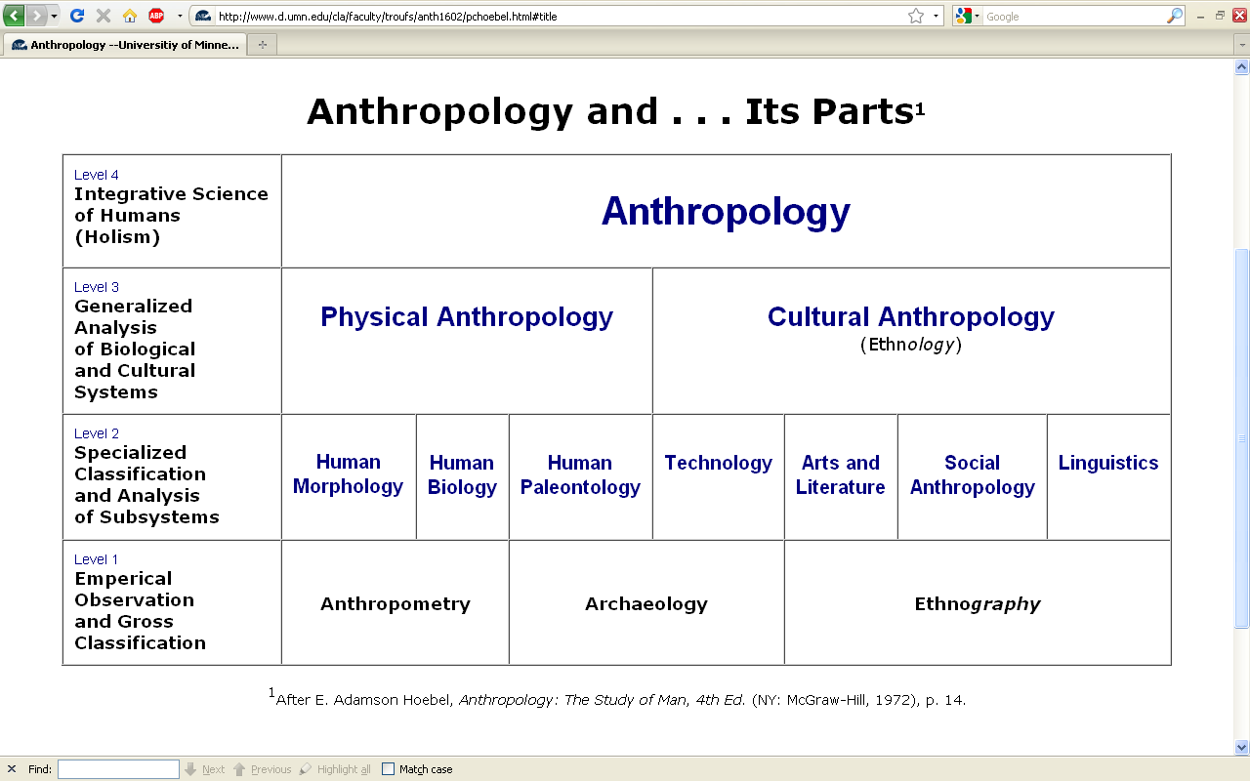
you’ve seen paleontology on the chart earlier . . .

Slide 7
Diet and Human Evolution
Diet and Human Evolution
Exploring the Diets of Extinct Humans Through Paleontology
Teeth
Skulls and Jaws
The Postcranial Skeleton
What Is Adaptation?
Using Chemistry to Infer the Diets of Extinct Hominids
Our Place in Nature
A Brief Who's Who of the Early Hominids
What Did Early Hominids Eat?
What Can We Say About the Diets of Fossil Homo?
Summary
Highlight: Lactose Intolerance

Slide 8
hominids
“We are what they ate.”
The Cultural Feast, 2nd ed., p. 17

Slide 9
now
“hominins” / hominini
hominids
“We are what they ate.”
The Cultural Feast, 2nd ed., p. 17

Slide 10
Diet and Human Evolution
Diet and Human Evolution
Exploring the Diets of Extinct Humans Through Paleontology
Teeth
Skulls and Jaws
The Postcranial Skeleton
What Is Adaptation?
Using Chemistry to Infer the Diets of Extinct Hominids
Our Place in Nature
A Brief Who's Who of the Early Hominids
What Did Early Hominids Eat?
What Can We Say About the Diets of Fossil Homo?
Summary
Highlight: Lactose Intolerance
Exploring the Diets of Extinct Humans Through Paleontology

Slide 11
Diet and Human Evolution
Diet and Human Evolution
Exploring the Diets of Extinct Humans Through Paleontology
Teeth
Skulls and Jaws
The Postcranial Skeleton
What Is Adaptation?
Using Chemistry to Infer the Diets of Extinct Hominids
Our Place in Nature
A Brief Who's Who of the Early Hominids
What Did Early Hominids Eat?
What Can We Say About the Diets of Fossil Homo?
Summary
Highlight: Lactose Intolerance
Exploring the Diets of Extinct Humans Through Paleontology
paleontology
paleobotanists
paleontologists
primates
prosimians

Slide 12
REM
paleontologists study fossilized remains
of extinct animals and plants
paleobotanists specialize in the study of fossilized remains of plants

Slide 14
Diet and Human Evolution
Exploring the Diets of Extinct Humans Through Paleontology
Teeth
Skulls and Jaws
The Postcranial Skeleton
What Is Adaptation?
Using Chemistry to Infer the Diets of Extinct Hominini
Our Place in Nature
A Brief Who's Who of the Early Hominini
What Did Early Hominini Eat?
What Can We Say About the Diets of Fossil Homo?
Summary
Highlight: Lactose Intolerance
Exploring the Diets of Extinct Humans Through Paleontology
paleontology
paleobotanists
paleontologists
primates
prosimians (“pre-monkeys”)

Slide 15
^{“Primates”}
a biological “Order” comprised of
^{prosimians}
^{(“pre-monkeys”)}
^{monkeys}
^{apes}
^{humans}

Slide 16
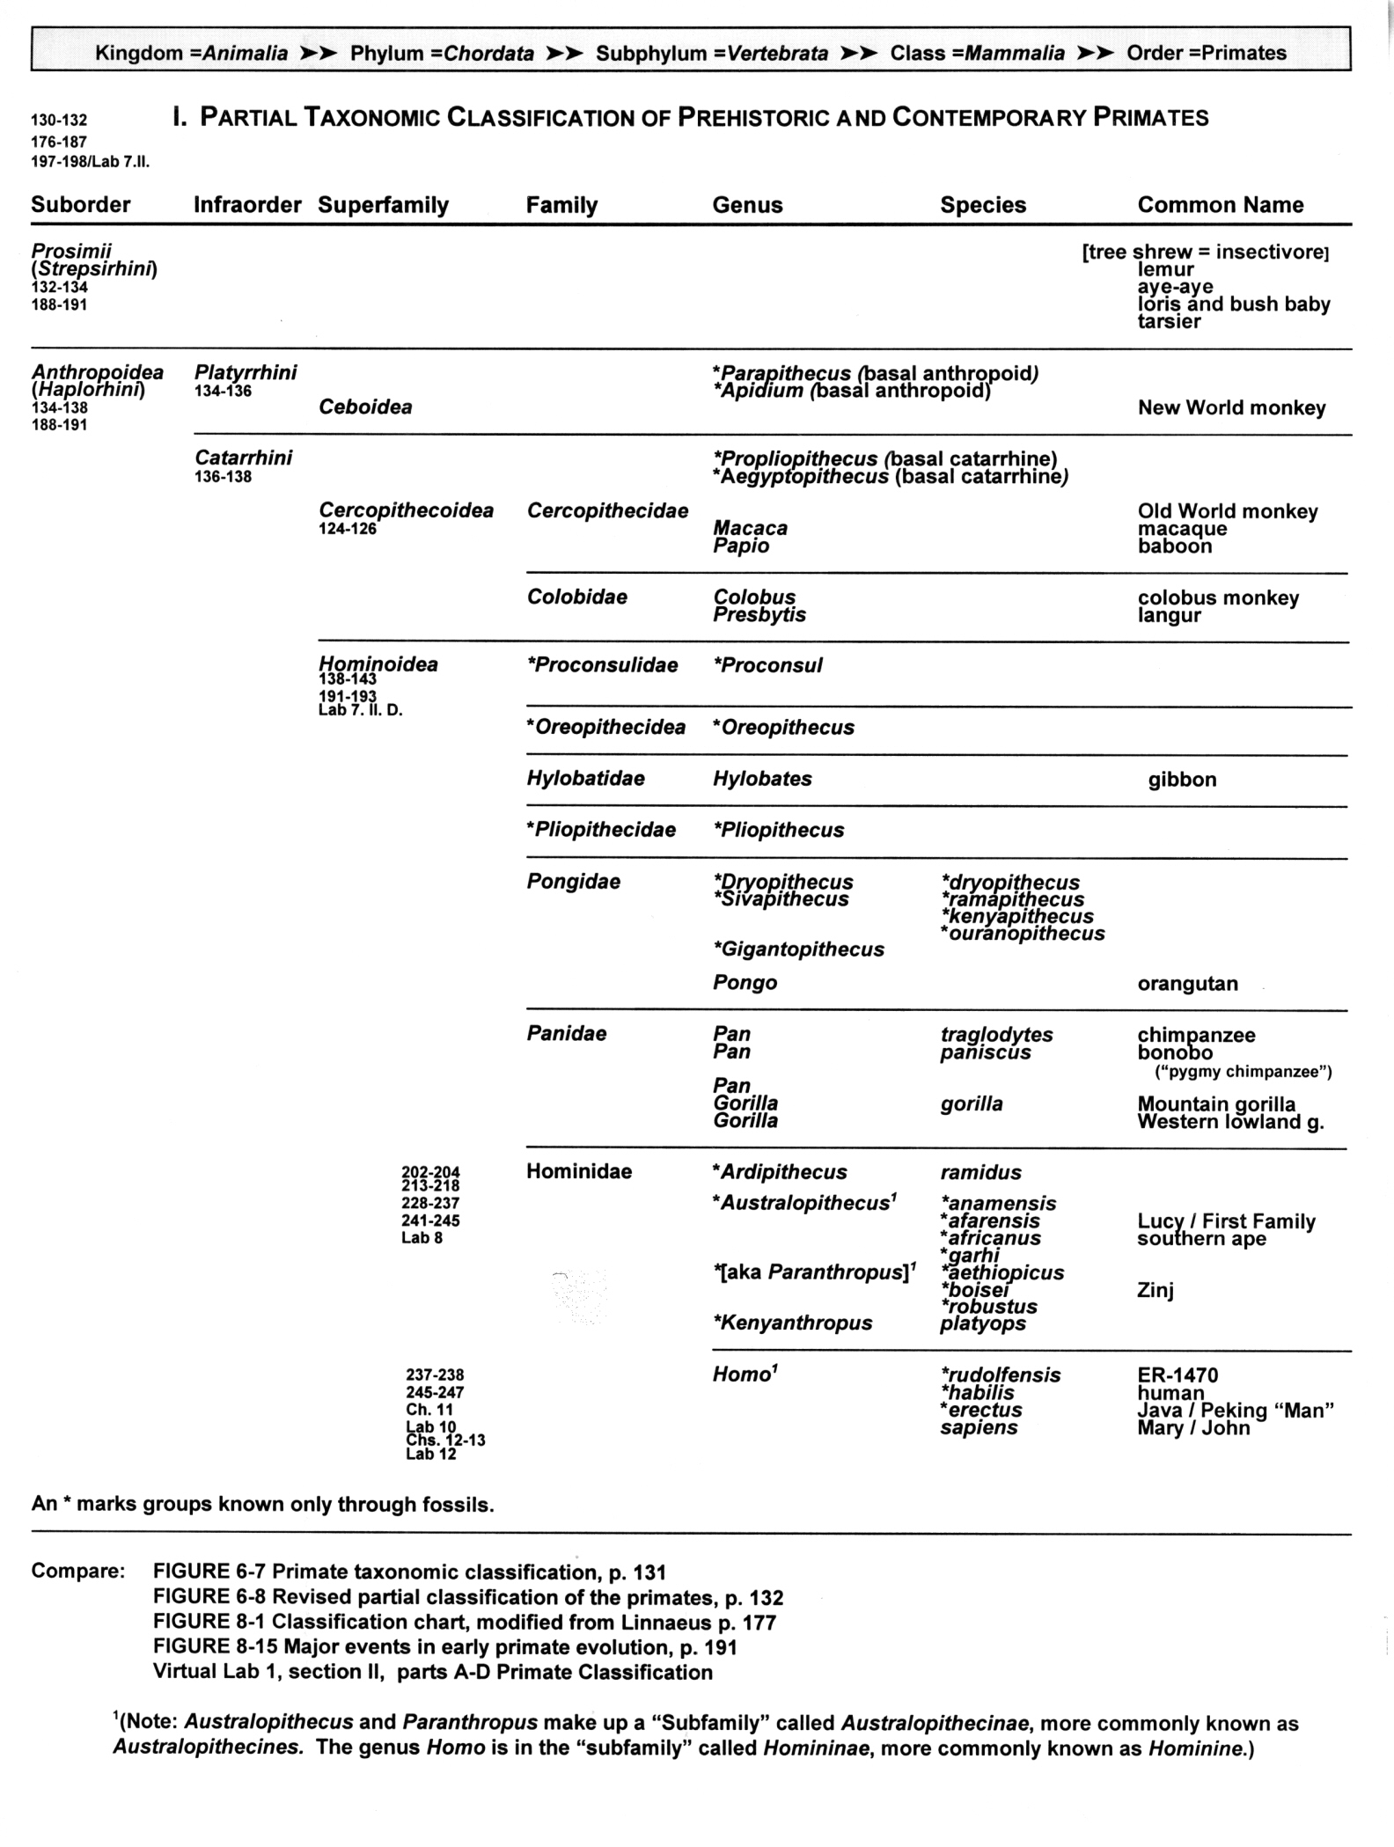
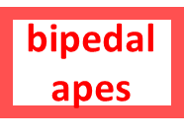
pre-monkeys
prosimians
monkeys
monkeys
apes
apes
humans
humans

Slide 17
^{“Hominoids”}
^{= all living and extinct}
^{apes and humans}
^{aka Hominoidea}
The Cultural Feast, 2nd ed., p. 20

Slide 18

prosimians
Hominoids
monkeys
apes
humans

Slide 19
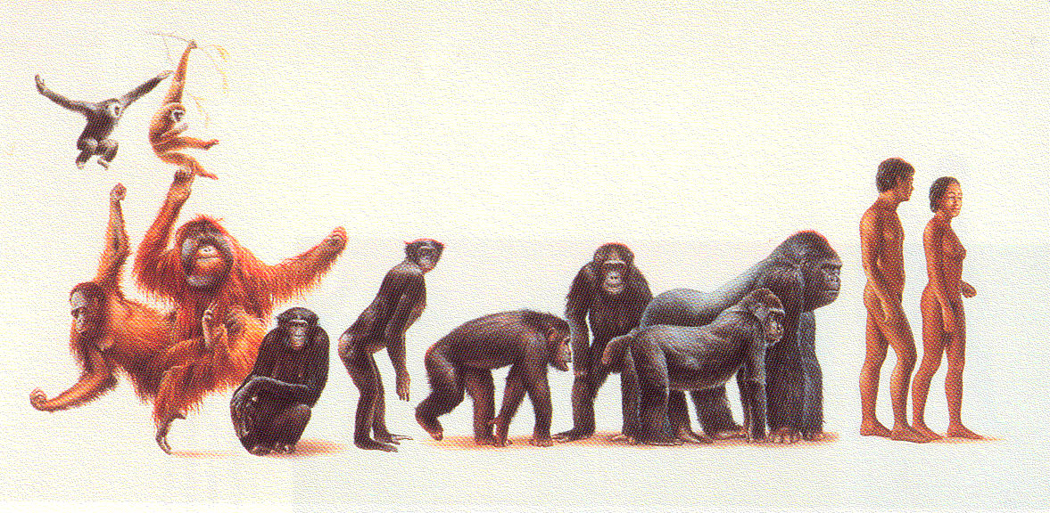
Hominoids
gibbons
humans
bonobos
chimps
orangutans
gorillas
Campbell and Loy, Humankind Emerging, 8th ed., p. 138 ff.

Slide 20
^{“Hominini”}
= modern humans and their nearest predecessors
^{aka Hominidae}
The Cultural Feast, 2nd ed., p. 20.

Slide 21
^{TRADITIONAL}
^{CLASSIFICATION}

Slide 22
prosimians
pre-monkeys

Slide 23
prosimians
monkeys

Slide 24
prosimians
monkeys
apes

Slide 25
prosimians
monkeys
apes
bipedal
apes

Slide 26
prosimians
monkeys
apes
bipedal
apes
humans

Slide 27
prosimians
monkeys
and these were
“hominids”
(until 1980)
apes
bipedal
apes
humans

Slide 28
^{TRADITIONAL}
^{CLASSIFICATION}
prosimians
monkeys
and these were
“hominids”
(until 1980)
apes
bipedal
apes
humans

Slide 29
pre-monkeys
prosimians
monkeys
monkeys
apes
apes
humans
humans

Slide 30
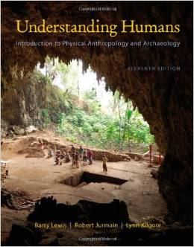
Cf.,
Understanding Humans: Introduction to Physical Anthropology and Archaeology,
11th ed.
Barry Lewis, Robert Jurmain, and Lynn Kilgore
Belmont, CA: Wadsworth Publishing
©2012

Slide 31
^{NEW CLASSIFICATION}
^{“Hominini”}
= “colloquial term for members of the “tribe” Hominini, the evolutionary group that includes modern human and now-extinct bipedal relatives”

Slide 32
^{TRADITIONAL}
^{CLASSIFICATION}
prosimians
monkeys
these were
“hominids”
(until 1980)
apes
bipedal
apes
humans

Slide 33
^{NEW}
^{CLASSIFICATION}
prosimians
monkeys
now these are
”hominins”
apes
Hominins
bipedal
apes
humans

Slide 34
^{NEW}
^{CLASSIFICATION}
prosimians
monkeys
now these are
”hominins”
apes
the
bipeds
are in one “tribe”
(ape AND human)
Hominins
bipedal
apes
”hominins”
humans

Slide 35
meet “Lucy”,
the most famous of the prehistoric hominini . . .

Slide 36
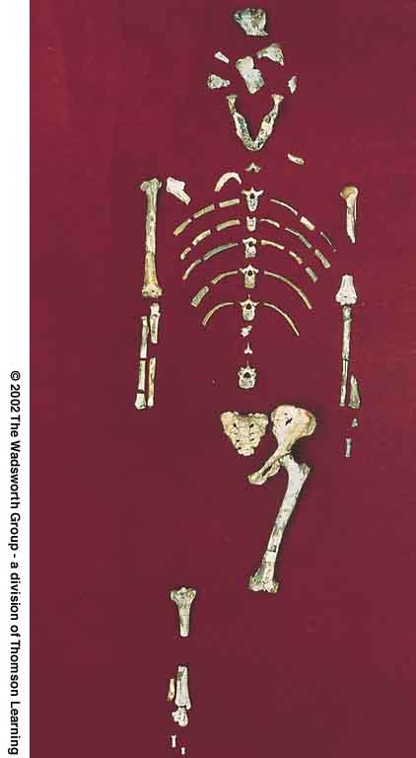
^{for e.g.,}
^{Lucy}
^{and}
^{“The First Family”}
Understanding Physical Anthropology and Archaeology, 9th ed., p. 206

Slide 37
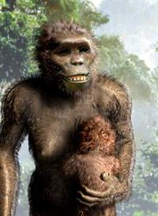
^{for e.g.,}
^{Lucy}
^{and}
^{“The First Family”}
Understanding Physical Anthropology and Archaeology, 9th ed., p. 206

Slide 38
“Lucy" and "The First Family"
from: Hadar, Ethiopia (“Site 333” on the Awash River)
aka: Australopithecus afarensis
age: 3.9 – 2.9 mya
discovered: 1975-1976

Slide 39
we’ll meet more hominini later . . .
first, some of their characteristics . . .

Slide 41
Diet and Human Evolution
Exploring the Diets of Extinct Humans Through Paleontology
Teeth
Skulls and Jaws
The Postcranial Skeleton
What Is Adaptation?
Using Chemistry to Infer the Diets of Extinct Hominini
Our Place in Nature
A Brief Who's Who of the Early Hominini
What Did Early Hominini Eat?
What Can We Say About the Diets of Fossil Homo?
Summary
Highlight: Lactose Intolerance
Exploring the Diets of Extinct Humans Through Paleontology
Teeth
Skulls and Jaws
The Postcranial Skeleton

Slide 43
teeth

Slide 44
Diet and Human Evolution
Exploring the Diets of Extinct Humans Through Paleontology
Teeth
Skulls and Jaws
The Postcranial Skeleton
What Is Adaptation?
Using Chemistry to Infer the Diets of Extinct Hominini
Our Place in Nature
A Brief Who's Who of the Early Hominini
What Did Early Hominini Eat?
What Can We Say About the Diets of Fossil Homo?
Summary
Highlight: Lactose Intolerance
Exploring the Diets of Extinct Humans Through Paleontology
Teeth
Skulls and Jaws
The Postcranial Skeleton

Slide 45
Diet and Human Evolution
Exploring the Diets of Extinct Humans Through Paleontology
Teeth
Skulls and Jaws
The Postcranial Skeleton
What Is Adaptation?
Using Chemistry to Infer the Diets of Extinct Hominini
Our Place in Nature
A Brief Who's Who of the Early Hominini
Highlight: Lactose Intolerance
Exploring the Diets of Extinct Humans Through Paleontology
Teeth are obviously related to food and food gathering

Slide 46
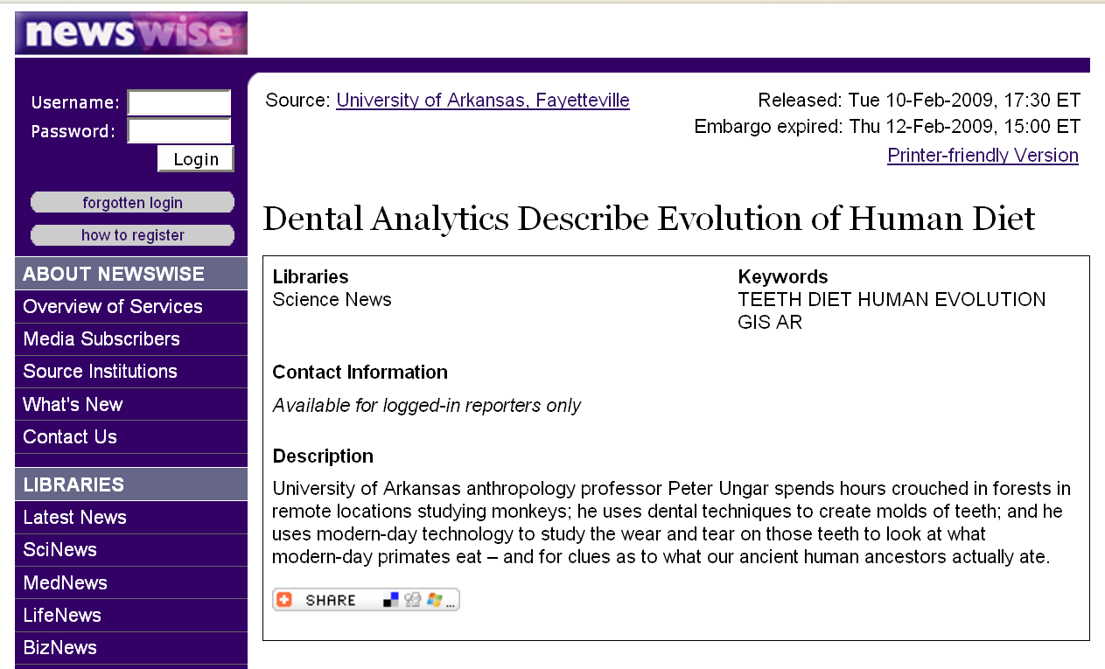
www.newswise.com/articles/view/549004/?sc=rssn

Slide 47
useful markers of the earliest
hominids / hominini:
adaptations for bipedalism …
reduced canine length …
and this is though mostly
to relate to a change in diet

Slide 48
apes (and monkeys)
still possess conical, daggerish canines which project well beyond the surface of the opposite teeth . . .

Slide 49
apes (and monkeys)
still possess conical, daggerish canines which project well beyond the surface of the opposite teeth . . .
so they can’t easily grind sideways with their peaked molar teeth . . .

Slide 50
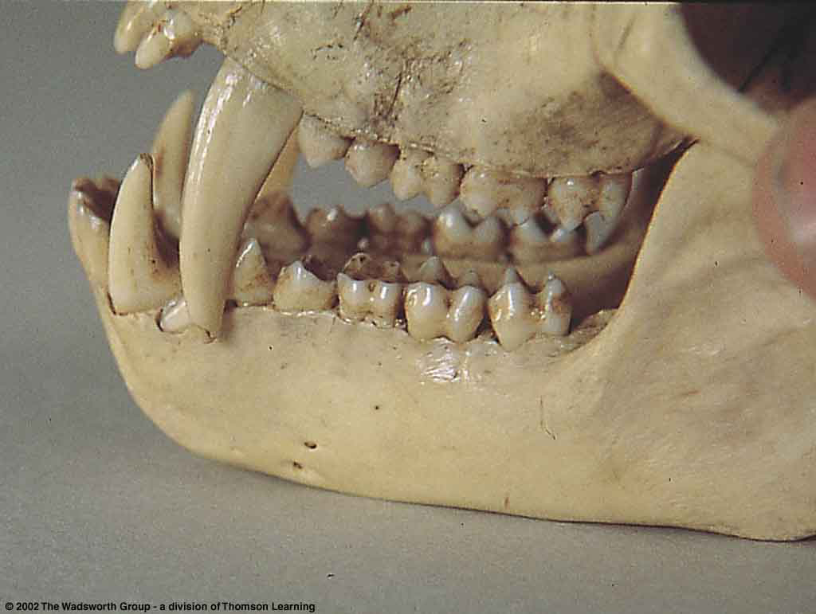
their canines lock, and they cannot easily grind sideways with their peaked molars . . .
Teeth of a male patas monkey
Understanding Physical Anthropology and Archaeology, 9th ed., p. 205

Slide 51
because of the overlap they have diastema . . .

Slide 52
diastema =
a space in the tooth row that accommodates one or more teeth from the opposite jaw

Slide 53
Teeth of a male patas monkey
Understanding Physical Anthropology and Archaeology, 9th ed., p. 205

Slide 54
diastema
Teeth of a male patas monkey
Understanding Physical Anthropology and Archaeology, 9th ed., p. 205

Slide 55
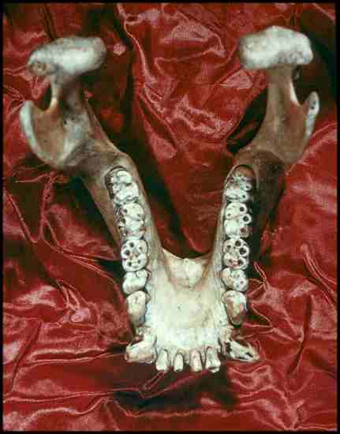
diastema

Slide 56
these big canine teeth are reduced in the
hominids / hominini . . .
and this is though mostly
to relate to a change in diet

Slide 57
there are also some related changes in the
skull and jaw . . .
you can see these by comparing the skull and jaw of a modern human to those of a gorilla . . .

Slide 58
there are also some related changes in the
skull and jaw . . .
you can see these by comparing the skull and jaw of a modern human to those of a gorilla . . .

Slide 59
add molars
grinding

Slide 60
skull and jaws

Slide 61
Diet and Human Evolution
Exploring the Diets of Extinct Humans Through Paleontology
Teeth
Skulls and Jaws
The Postcranial Skeleton
What Is Adaptation?
Using Chemistry to Infer the Diets of Extinct Hominini
Our Place in Nature
A Brief Who's Who of the Early Hominini
What Did Early Hominini Eat?
What Can We Say About the Diets of Fossil Homo?
Summary
Highlight: Lactose Intolerance
Exploring the Diets of Extinct Humans Through Paleontology
Teeth
Skulls and Jaws
The Postcranial Skeleton

Slide 62
Diet and Human Evolution
Exploring the Diets of Extinct Humans Through Paleontology
Teeth
Skulls and Jaws
The Postcranial Skeleton
What Is Adaptation?
Using Chemistry to Infer the Diets of Extinct Hominini
Our Place in Nature
A Brief Who's Who of the Early Hominini
What Did Early Hominini Eat?
What Can We Say About the Diets of Fossil Homo?
Summary
Highlight: Lactose Intolerance
Exploring the Diets of Extinct Humans Through Paleontology
Teeth
Skull and Jaws
The Postcranial Skeleton
= cranium

Slide 63
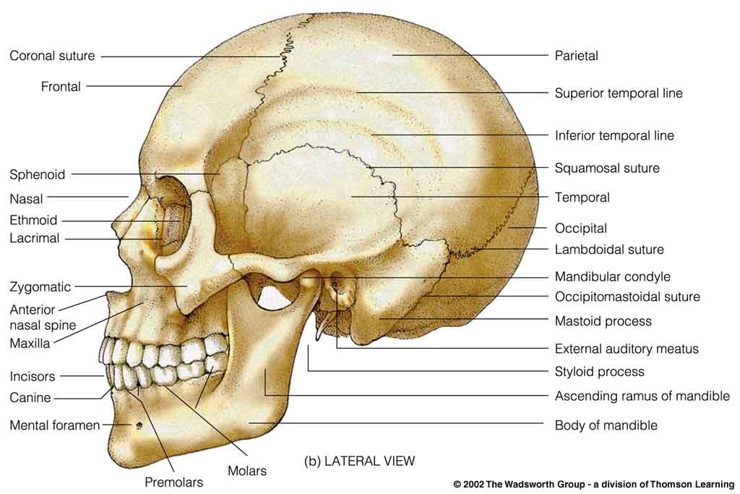
Modern human cranium
Understanding Physical Anthropology and Archaeology, 9th ed., p. 432

Slide 64
the lower jaw =
mandible
see also the related
“mandibular torus”

Slide 65
Modern mandible on a human cranium
Understanding Physical Anthropology and Archaeology, 9th ed., p. 432

Slide 66
in apes mandibles slant outward and downward, without a chin
(“prognathism”)

Slide 67
Diet and Human Evolution
Exploring the Diets of Extinct Humans Through Paleontology
Teeth
Skulls and Jaws
The Postcranial Skeleton
What Is Adaptation?
Using Chemistry to Infer the Diets of Extinct Hominini
Our Place in Nature
A Brief Who's Who of the Early Hominini
What Did Early Hominini Eat?
What Can We Say About the Diets of Fossil Homo?
Summary
Highlight: Lactose Intolerance
Exploring the Diets of Extinct Humans Through Paleontology
Teeth
Skulls and Jaws
Saggital crest
The Postcranial Skeleton

Slide 68
apes have a ridge running down the top of their skulls that’s called a
saggital crest . . .
that is where the jaw muscles attach . . .
and that feature is related to powerful chewing . . .

Slide 69
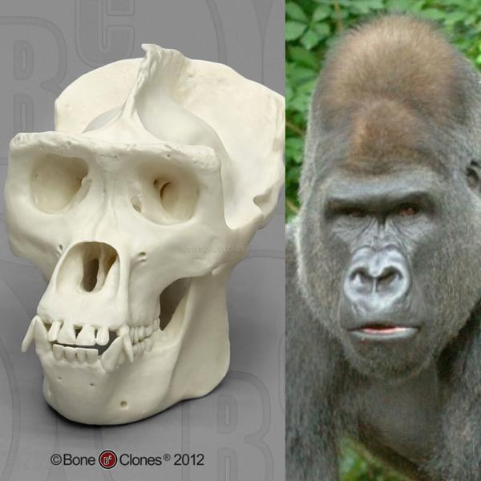
saggital crest
Western Lowland Gorilla (male)
source

Slide 70
and apes have a ridge running down the top of their skulls that’s called a
saggital crest . . .
that is where the jaw muscles attach . . .
and that feature is related to powerful chewing . . .

Slide 71
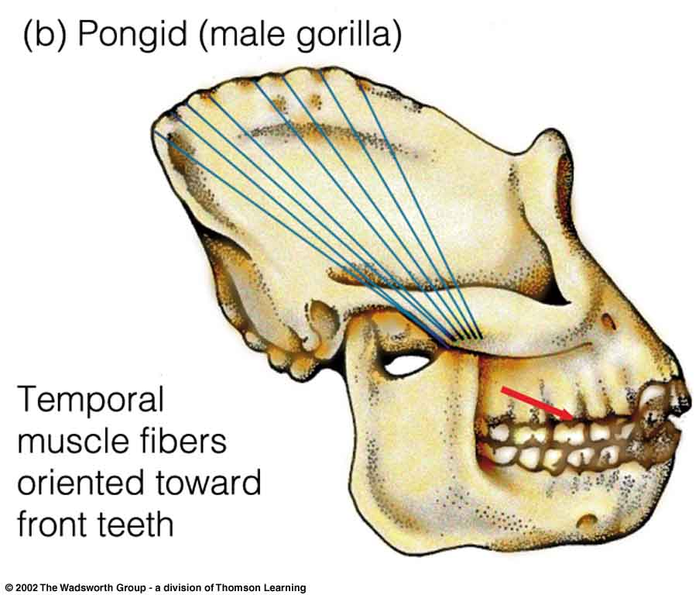
Pongid Prognathism
(Line of greatest muscle force is shown in red)
Understanding Physical Anthropology and Archaeology, 8th ed., p. 245

Slide 72
and apes have a ridge running down the top of their skulls that’s called a
saggital crest . . .
that is where the jaw muscles attach . . .
and that feature is related to powerful chewing . . .

Slide 73
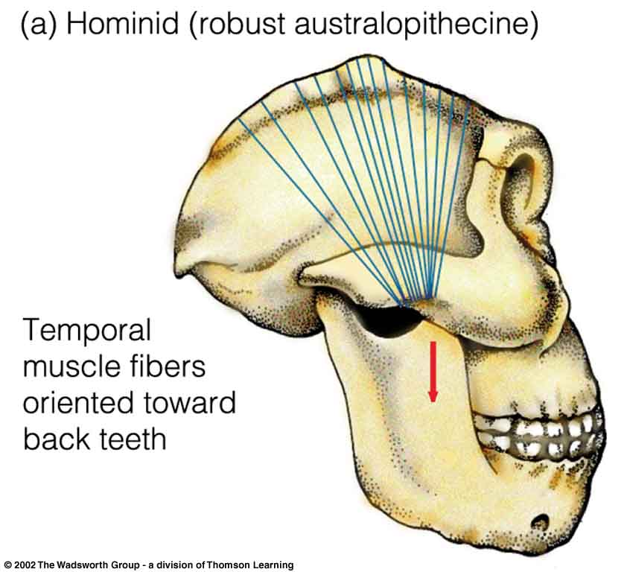
Satittal crests and temporal muscle orientations
^{Hominid compared to pongid}
(Line of greatest muscle force is shown in red)
Understanding Physical Anthropology and Archaeology, 8th ed., p. 245

Slide 74
apes have a “simian shelf” rather than a chin . . .
in humans lower jaw is comparatively small, but always has a distinct chin . . .

Slide 75
Note: no chin
Pongid Prognathism
(Line of greatest muscle force is shown in red)
Understanding Physical Anthropology and Archaeology, 8th ed., p. 245

Slide 76
apes have a “simian shelf” rather than a chin . . .
in humans the lower jaw is comparatively small, but they always have a distinct chin . . .

Slide 77
distinct chin
Modern human cranium
Understanding Physical Anthropology and Archaeology, 9th ed., p. 432

Slide 78


source
source

Slide 79
post-cranial

Slide 80
useful markers of the earliest
hominines:
adaptations for bipedalism . . .
reduced canine length (teeth) . . .
and these relate to food . . .

Slide 81
Diet and Human Evolution
Exploring the Diets of Extinct Humans Through Paleontology
Teeth
Skulls and Jaws
The Postcranial Skeleton
What Is Adaptation?
Using Chemistry to Infer the Diets of Extinct Hominini
Our Place in Nature
A Brief Who's Who of the Early Hominini
What Did Early Hominini Eat?
What Can We Say About the Diets of Fossil Homo?
Summary
Highlight: Lactose Intolerance
Exploring the Diets of Extinct Humans Through Paleontology
Teeth
Skulls and Jaws
The Postcranial Skeleton

Slide 82
postcranial =
below the head (with bipeds)
behind the head (with quadrupeds)

Slide 83
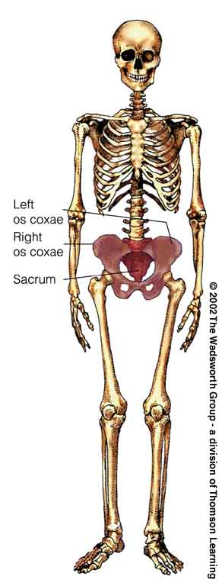
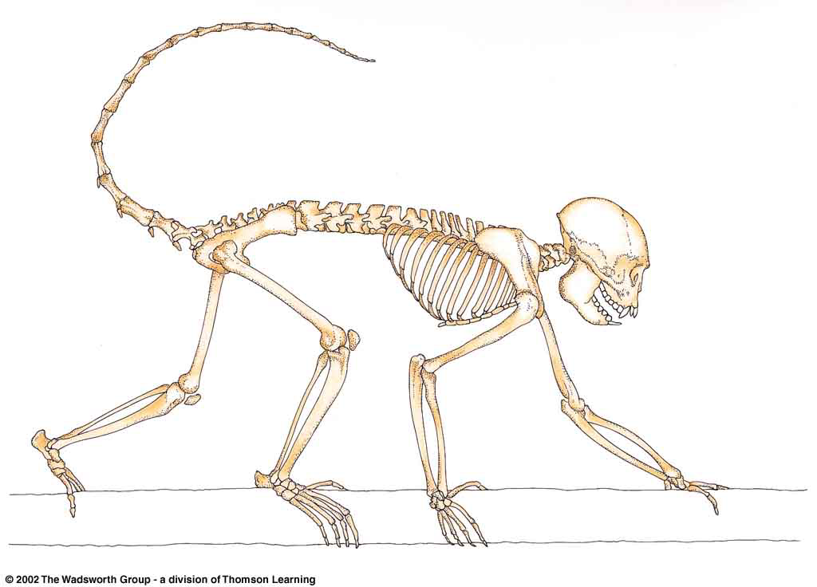
^{Postcrania}
New World monkey
modern human
Understanding Physical Anthropology and Archaeology, 8th ed., pp. 223, 128

Slide 84
NOTE:
anything called
-pithecus
is an ape
e.g.,
Homo sapiens
Moderns (Cro-magnon …)
Premoderns (Neandertal …)
165,000 ybp-present
500,000-28,000 ybp
Homo erectus
1.8 mya–25,000 ybp
Homo habilis
2.4-1.6 mya
Paranthropus
2. 5-1 mya
Australopithecus
4.25-2 mya
Sivapithecus
15-7 mya
dates are approximate
and follow Understanding Humans 2009

Slide 85
Homo sapiens
Moderns (Cro-magnon …)
Premoderns (Neandertal …)
165,000 ybp-present
500,000-28,000 ybp
Homo erectus
1.8 mya–25,000 ybp
Homo habilis
2.4-1.6 mya
Paranthropus
2. 5-1 mya
Australopithecus
4.25-2 mya
Sivapithecus
15-7 mya
dates are approximate
and follow Understanding Humans 2009

Slide 86
Homo sapiens
Moderns (Cro-magnon …)
Premoderns (Neandertal …)
165,000 ybp-present
modern-day apes are not bipeds
they’re brachiators
500,000-28,000 ybp
Homo erectus
1.8 mya–25,000 ybp
Homo habilis
2.4-1.6 mya
Paranthropus
2. 5-1 mya
Australopithecus
4.25-2 mya
as were the prehistoric –pithecines, like . . .
Sivapithecus
15-7 mya
dates are approximate
and follow Understanding Humans 2009

Slide 87
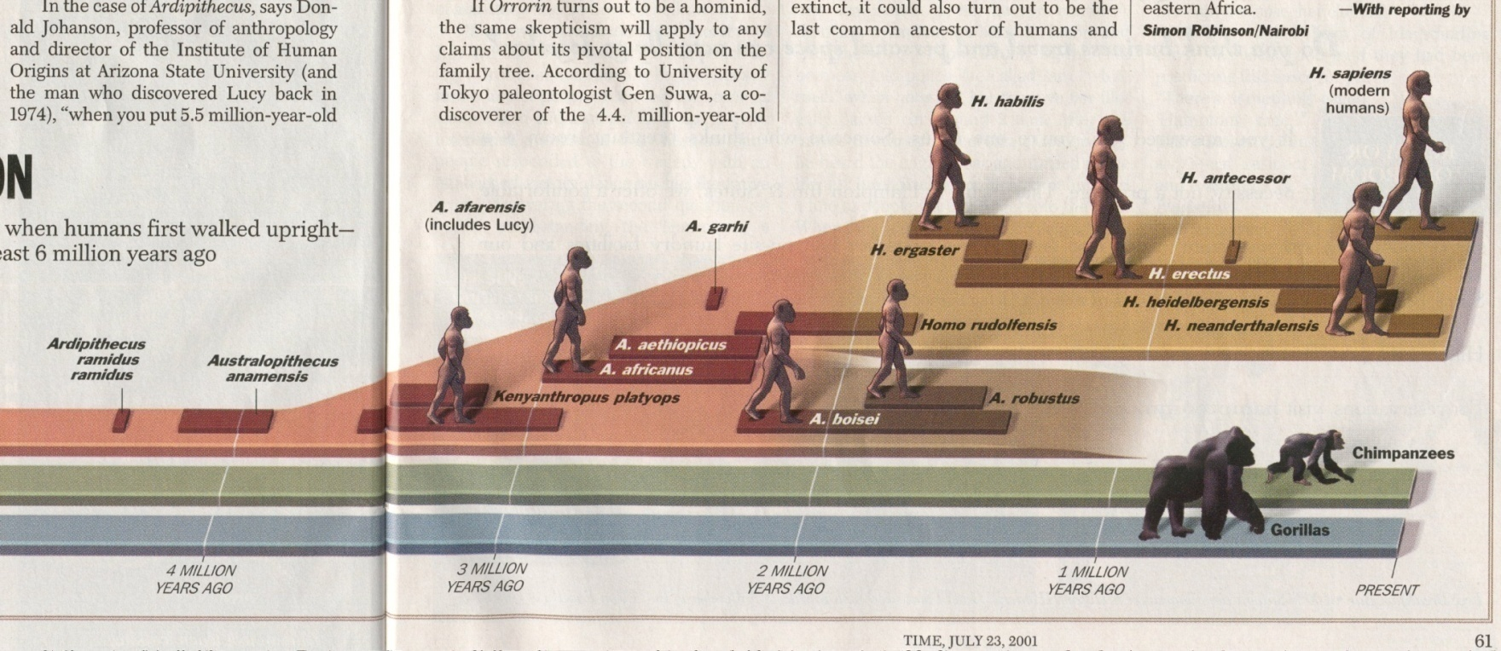
The first “real” ape
Sivapithecus
15-7 mya
Time 23 July 2001

Slide 88
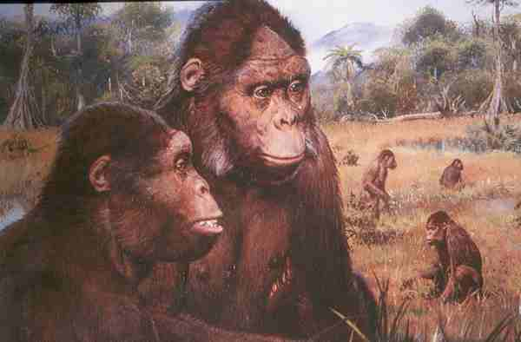
Sivapithecines

Slide 89
note activities . . .
Sivapithecines

Slide 90
Bipedal Locomotion
Sivapithecus
was not a biped . . .

Slide 91
Bipedal Locomotion
Why did bipedalism develop?
there are a lot of theories … several of them related to food procurement and use …

Slide 92
Bipedal Locomotion
Why bipedalism?
there are a lot of theories . . .
and several of them
relate to
food procurement and use . . .

Slide 93

Bipedal Locomotion
Why bipedalism?
Owen Lovejoy
for example, thinks it’s
ALL about food . . .
“provisioning hypothesis”

Slide 94
Bipedal Locomotion
Why bipedalism?
Owen Lovejoy
for example, thinks it’s
ALL about food . . .
and that’s his “provisioning hypothesis”

Slide 95
Lovejoy’s ideas on
bipedalism
specifically relate to
male help in carrying food
back to the “home base” . . .
a feature known as
“provisioning”

Slide 96
Lovejoy’s ideas on
bipedalism
specifically relate to
male help in carrying food
back to the “home base” . . .
a feature known as
“provisioning”

Slide 97
. . . male help
in
“provisioning”
this is Owen Lovejoy’s
“provisioning hypothesis”

Slide 98
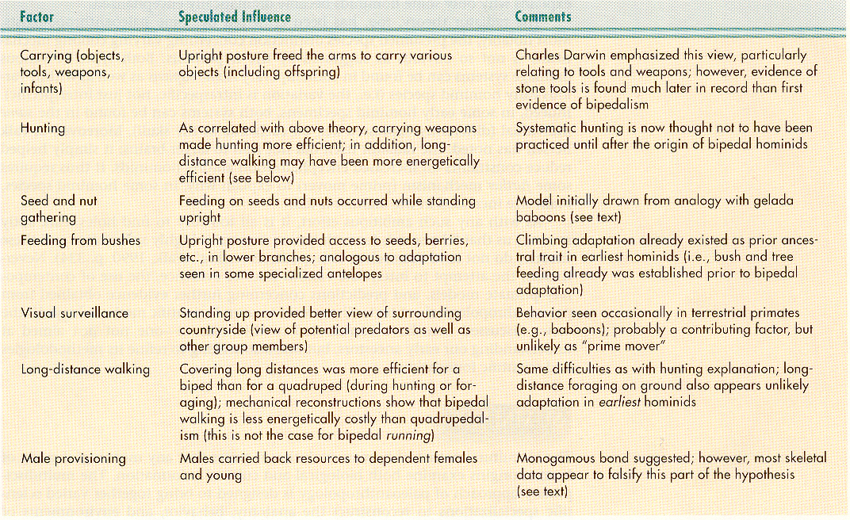
Possible Factors Influencing the
Initial Evolution of Bipedal Locomotion in Hominini
Understanding Physical Anthropology and Archaeology, 8th ed., p. 217

Slide 99
Possible Factors Influencing the
Initial Evolution of Bipedal Locomotion in Hominini
Understanding Physical Anthropology and Archaeology, 8th ed., p. 217

Slide 100
Owen Lovejoy notes that
bipedalism relates to
long-distance walking . . .
including carrying food
while provisioning

Slide 101
Possible Factors Influencing the
Initial Evolution of Bipedal Locomotion in Hominini
Understanding Physical Anthropology and Archaeology, 8th ed., p. 217

Slide 102
. . . and even non-bipeds
carry food . . .

Slide 103
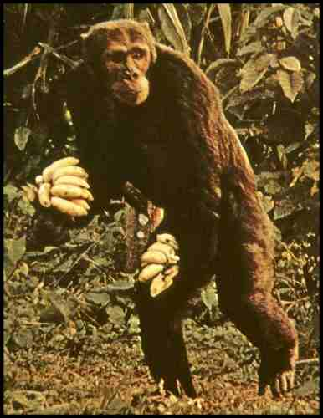
Chimpanzee
The Primates, Time-Life (1974) p. 71

Slide 104
Possible Factors Influencing the
Initial Evolution of Bipedal Locomotion in Hominini
Understanding Physical Anthropology and Archaeology, 8th ed., p. 217

Slide 105
and
bipedalism and vision
(visual surveillance) are related to the quest for food . . .

Slide 106
Possible Factors Influencing the
Initial Evolution of Bipedal Locomotion in Hominini
Understanding Physical Anthropology and Archaeology, 8th ed., p. 217

Slide 107
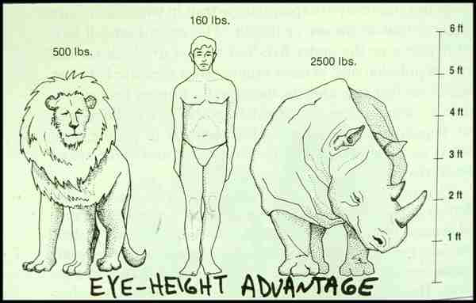
Eye-Height advantage of Bipedal Locomotion in Hunting . . .

Slide 108
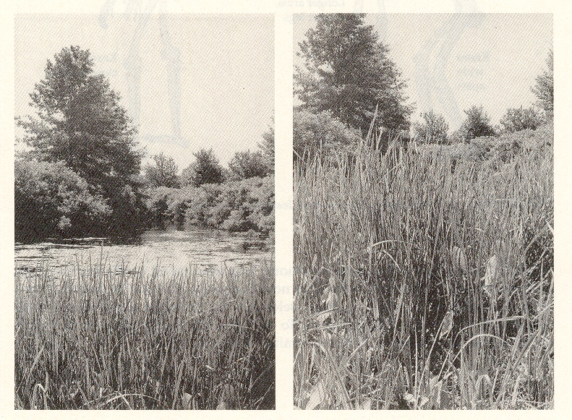
Eye-Height advantage of Bipedal Locomotion in Hunting . . .

Slide 109
Eye Level and Sight.
Humankind Emerging, 7th ed., p. 114

Slide 110
bipedalism is related to
seed and nut gathering
and
feeding from bushes . . .

Slide 111
Possible Factors Influencing the
Initial Evolution of Bipedal Locomotion in Hominini
Understanding Physical Anthropology and Archaeology, 8th ed., p. 217

Slide 112
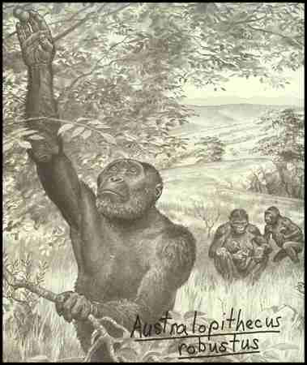

Slide 113
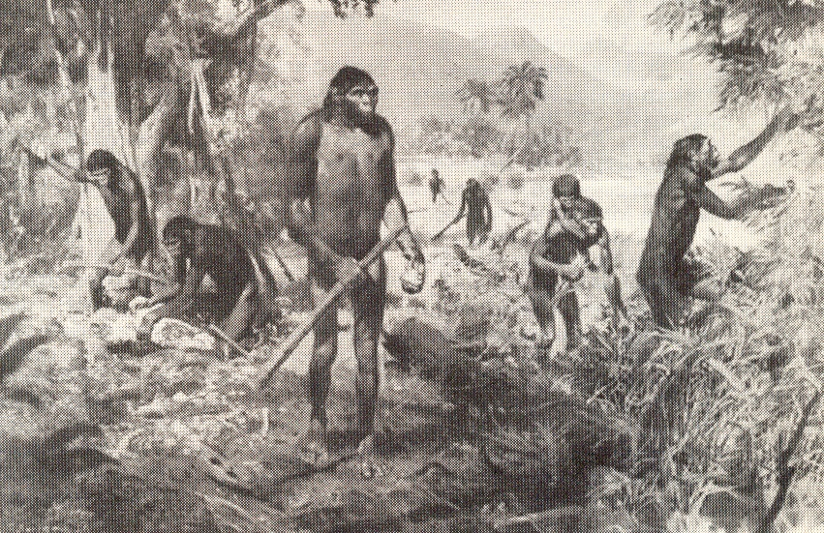
The Emergence of Humankind 4th Ed., p. 105

Slide 114
bipedalism is also related
to tool use . . .
including such simple tools as
a digging stick . . .
(aka a “dibble” or “coa”)

Slide 115
bipedalism is also related to hunting . . .

Slide 116
Possible Factors Influencing the
Initial Evolution of Bipedal Locomotion in Hominini
Understanding Physical Anthropology and Archaeology, 8th ed., p. 217

Slide 117
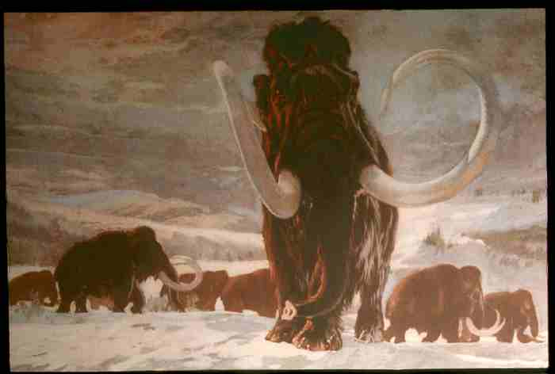
Hunting / Gathering /
Collecting
(foraging)

Slide 118
Possible Factors Influencing the
Initial Evolution of Bipedal Locomotion in Hominini
Understanding Physical Anthropology and Archaeology, 8th ed., p. 217

Slide 119

much of this
is summarized
in . . .
New York University Press 2005

Slide 120
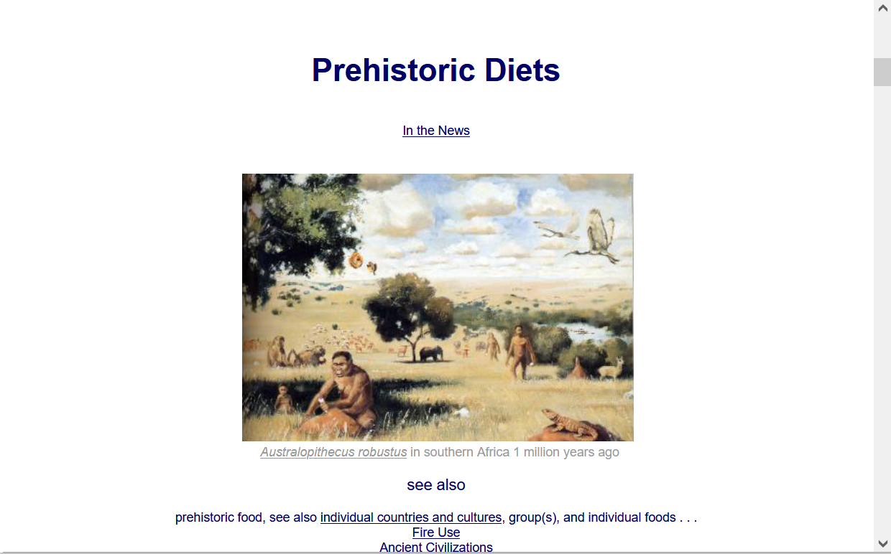
For more information see the class Prehisoric Diets Web Page . . .
https://www.d.umn.edu/cla/faculty/troufs/anth1602/pcdiet.html#title

Slide 121
Diet and Evolution:
Paleontology
Tim Roufs
© 2010-2024

Slide 122
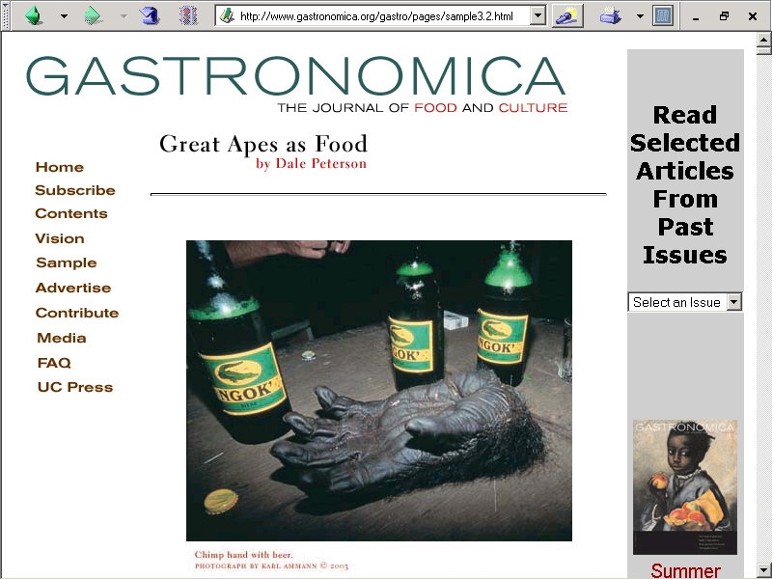
Spring
2003
http://www.gastronomica.org/gastro/pages/sample3.2.html

