Slide 1

The USDA
Food Guide Pyramid
(1992-2011; 2026)
and
MyPlate
(2011-2026)
Anthropology of Food
University of Minnesota Duluth
Tim Roufs ©2014-2026

Slide 2

The 1992 USDA food pyramid

Slide 3

the food pyramid of
The United States
Department of Agriculture
is one of the most widely recognized logos in the world . . .
. . . right next to

Slide 4
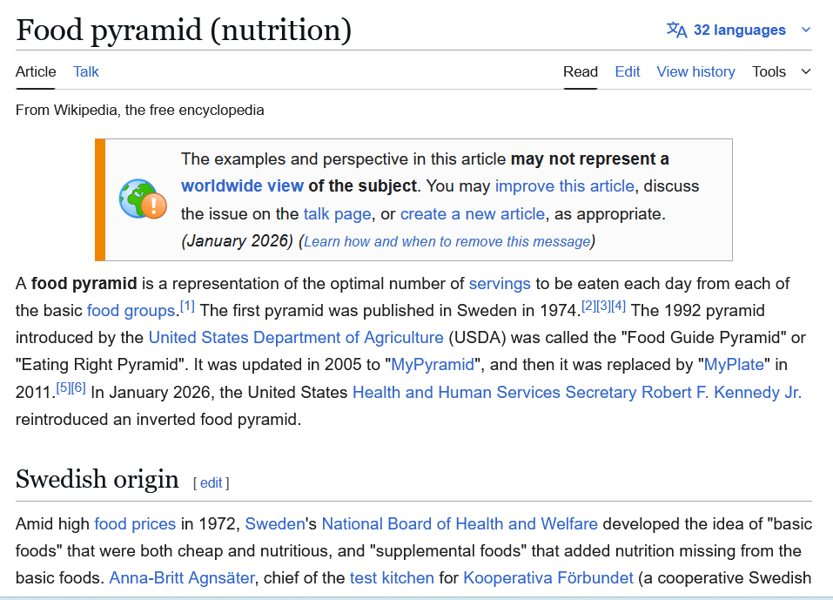
http://en.wikipedia.org/wiki/Food_guide_pyramid

Slide 5
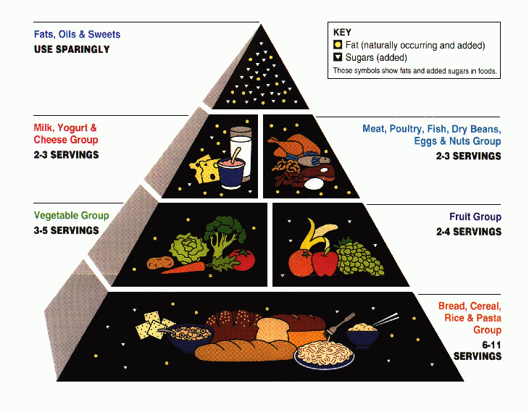
the 1992 “Food Guide Pyramid”
The USDA's original food pyramid, from 1992 to 2005

Slide 6
this is the old (1992) version
the 1992 “Food Guide Pyramid”

Slide 7
the 1992 Food Guide Pyramid
was replaced by
MyPyramid
on 19 April 2005

Slide 8
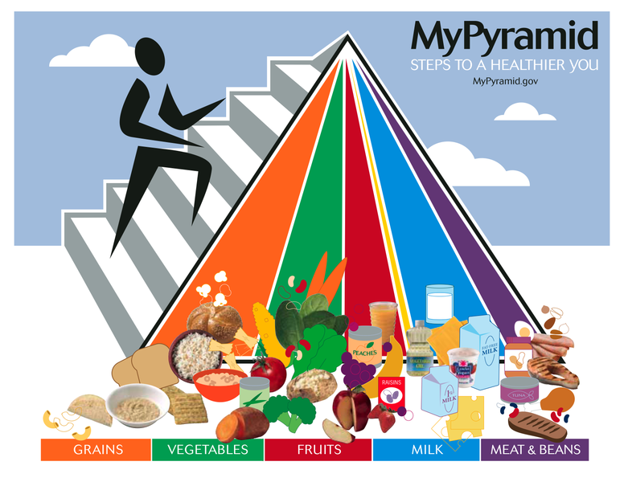
The 2005 USDA food guide pyramid

Slide 9
the 2005 MyPyramid
was in turn replaced by
MyPlate
on 2 June 2011

Slide 10

MyPyramid was replaced by MyPlate on 2 June 2011

Slide 11
the 2011 MyPlate
was in turn replaced by
the 2026 Food Pyramid
on 7 January 2026

Slide 12
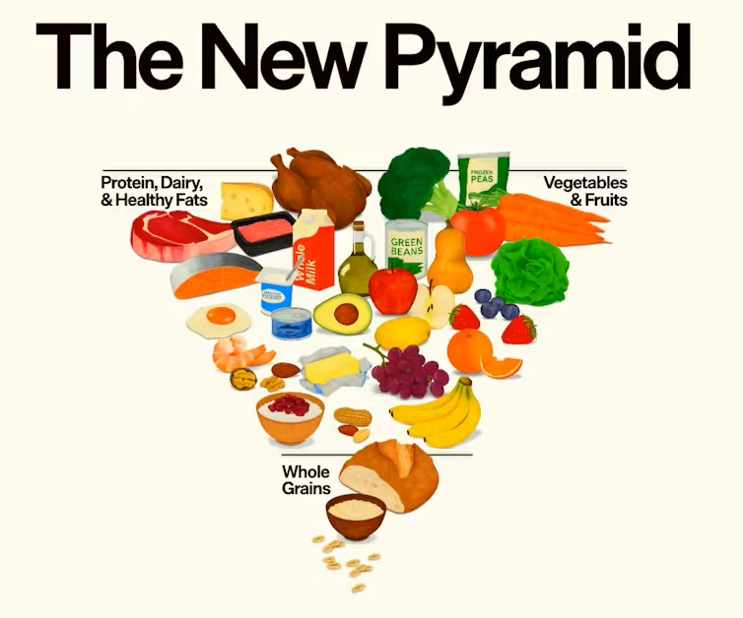
MyPlate was replaced on 7 June 2026

Slide 13
Worldwide, food guide “pyramids” come in
versions for
all countries and cuisines
and in all sizes and shapes . . .

Slide 14
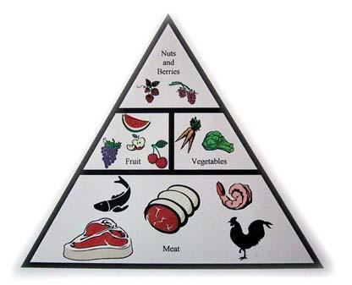
Paleolithic Diet Food Pyramid
http://www.wineinyourdiet.com/My_own_popular_diet_articles/paleolithic_diet.php

Slide 15
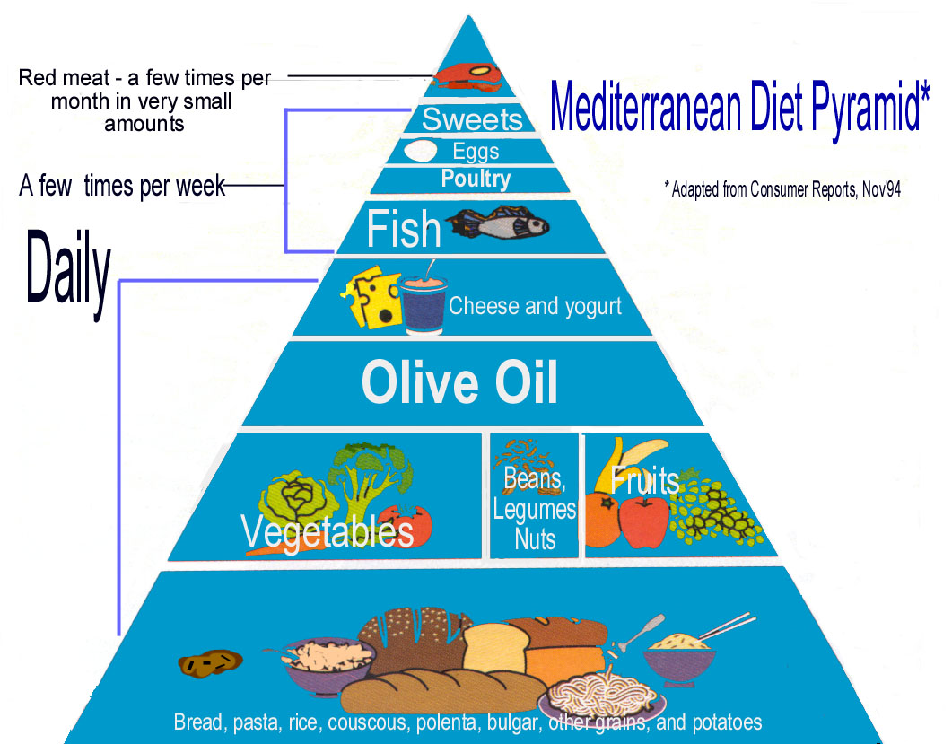
Notes:
15

Slide 16
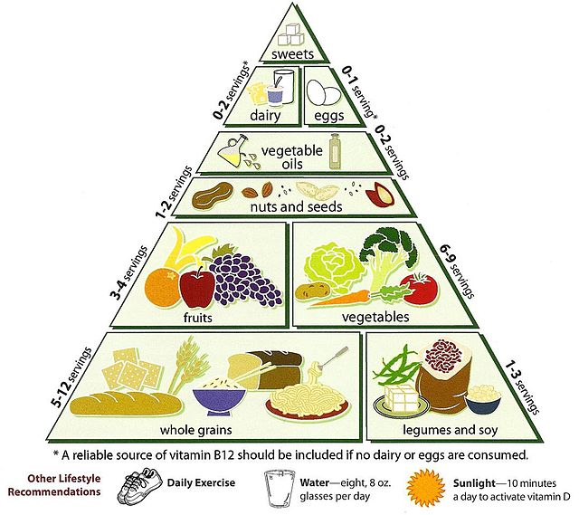
Vegetarian Food Pyramid
http://en.wikipedia.org/wiki/Vegetarian_Diet_Pyramid

Slide 17
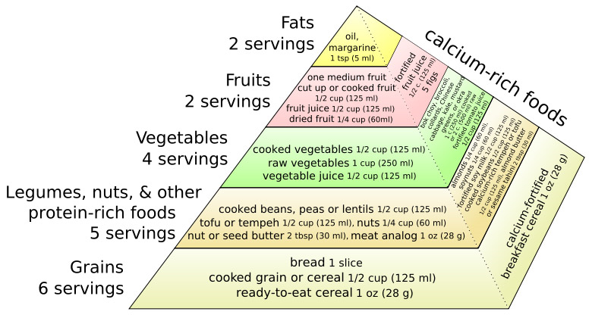
A vegan version of the food guide pyramid
http://en.wikipedia.org/wiki/Vegetarian_Diet_Pyramid

Slide 18
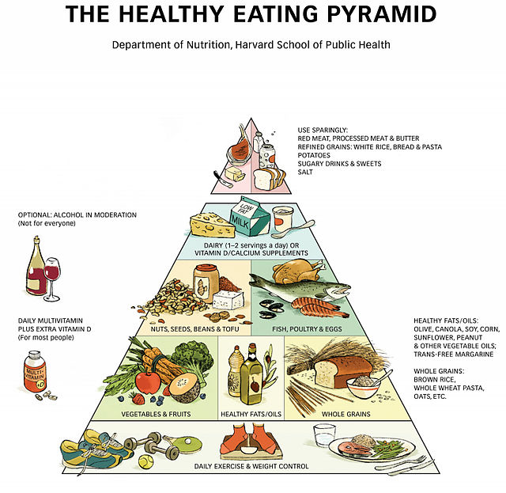
http://en.wikipedia.org/wiki/Healthy_eating_pyramid

Slide 19
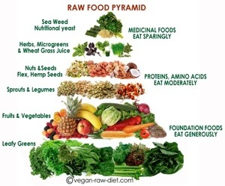
http://tierragoesgreen.com/2014-2024/04/a-real-food-pyramid/

Slide 20
Some examples of
food “pyramids”
around the world. . .

Slide 21
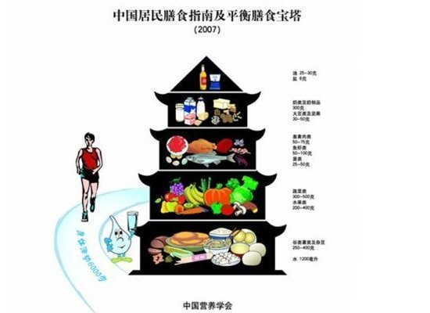
China's Food Pagoda
http://www.huffingtonpost.com/food-republic/food-pyramids-around-the-world_b_874409.html

Slide 22
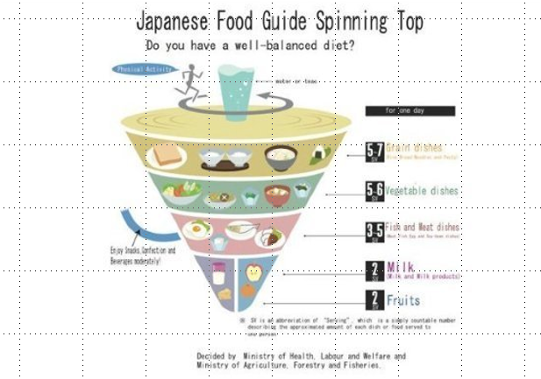
Japan's Spinning Top
http://www.huffingtonpost.com/food-republic/food-pyramids-around-the-world_b_874409.html

Slide 23
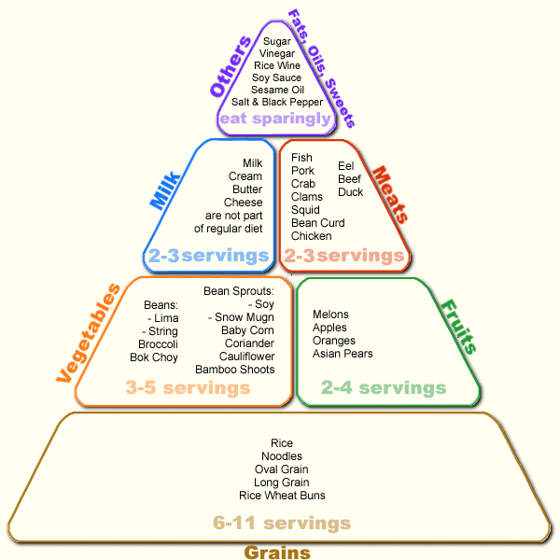
Japanese Food Guide Pyramid
www.ethnicfoodsco.com/Japan/JapaneseFoodPyramid.htm

Slide 24
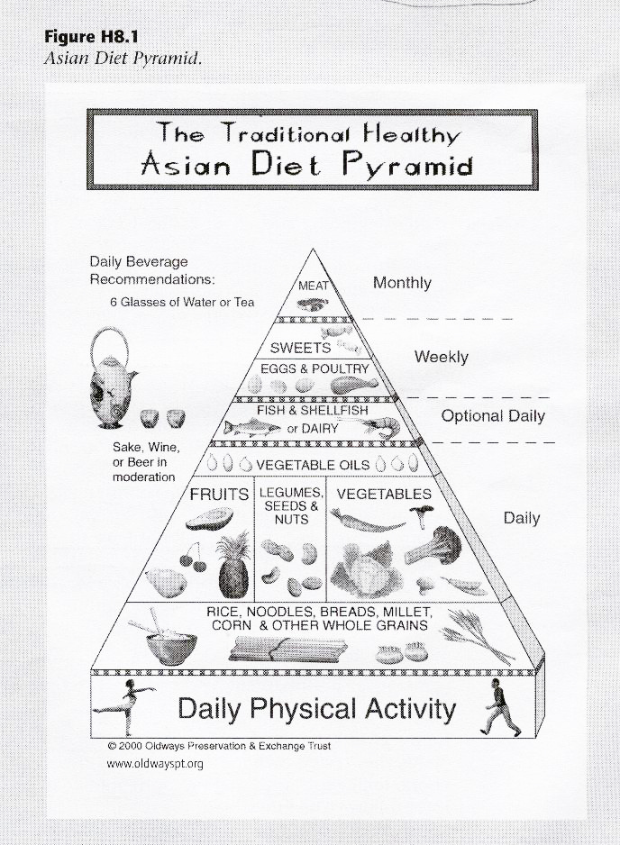
Asian Diet Food Guide Pyramid

Slide 25

Australia
https://www.treehugger.com/what-food-pyramids-around-world-4868722

Slide 26
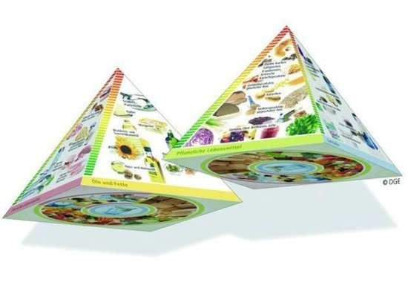
Germany's 3D Pyramid
http://www.huffingtonpost.com/food-republic/food-pyramids-around-the-world_b_874409.html

Slide 27
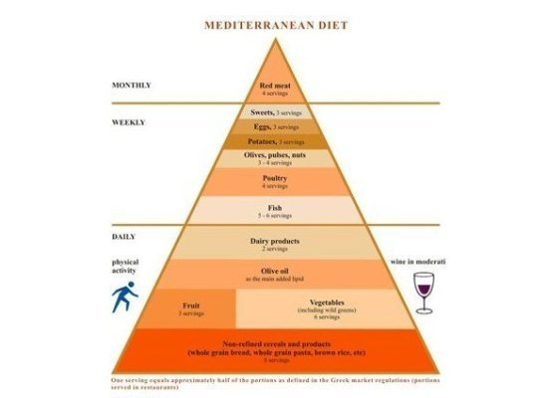
Greece's Food Pyramid
http://www.huffingtonpost.com/food-republic/food-pyramids-around-the-world_b_874409.html

Slide 28

Poland's Food Pyramid
http://www.huffingtonpost.com/food-republic/food-pyramids-around-the-world_b_874409.html

Slide 29
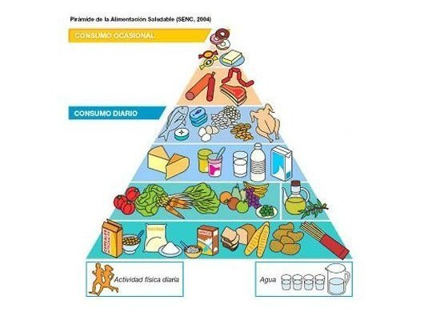
Spain's Food Pyramid
http://www.huffingtonpost.com/food-republic/food-pyramids-around-the-world_b_874409.html

Slide 30
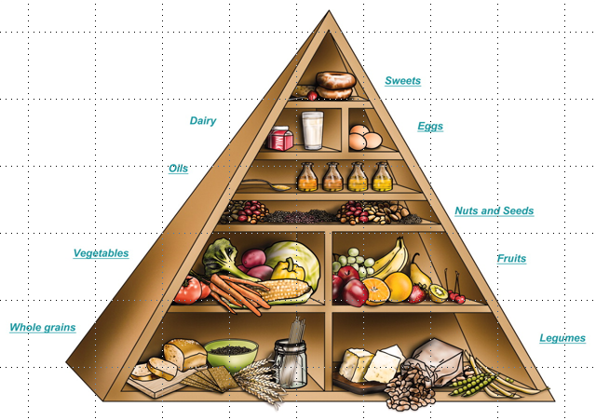
Spain's Food Pyramid
http://www.chiefdelphi.com/media/photos/22549

Slide 31
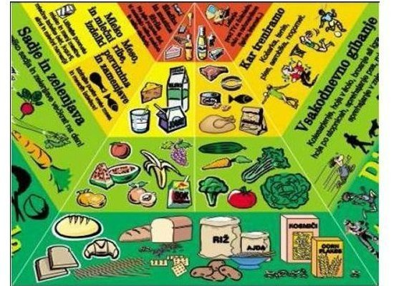
Slovenia's Food Pyramid
http://www.huffingtonpost.com/food-republic/food-pyramids-around-the-world_b_874409.html

Slide 32
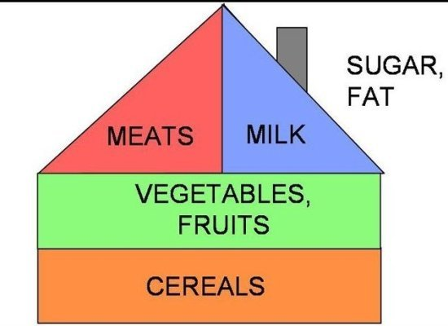
Hungary's Food House
http://www.huffingtonpost.com/food-republic/food-pyramids-around-the-world_b_874409.html

Slide 33

UK's Eatwell Plate
https://www.huffpost.com/entry/food-pyramids-around-the-world_b_874409

Slide 34

France's Food Stairs
https://www.huffpost.com/entry/food-pyramids-around-the-world_b_874409

Slide 35

Belgium
https://www.treehugger.com/what-food-pyramids-around-world-4868722

Slide 36
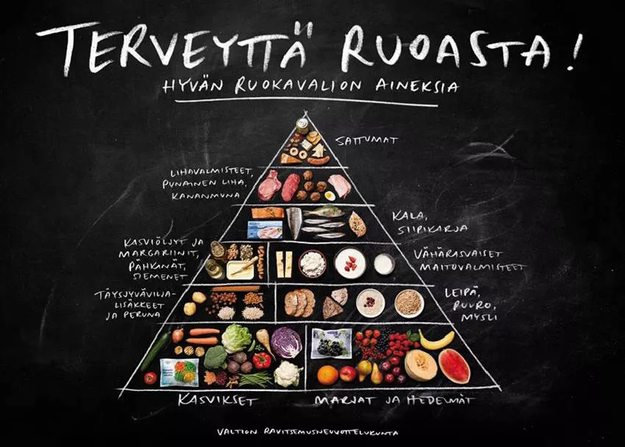
Finland
https://www.treehugger.com/what-food-pyramids-around-world-4868722

Slide 37

Canada’s guide does away with food groups entirely, and instead encourages people to eat a variety of unprocessed foods.
Missing, for e.g., is a daily dose of dairy.
Canada
https://www.bbc.com/news/world-us-canada-46964549

Slide 38
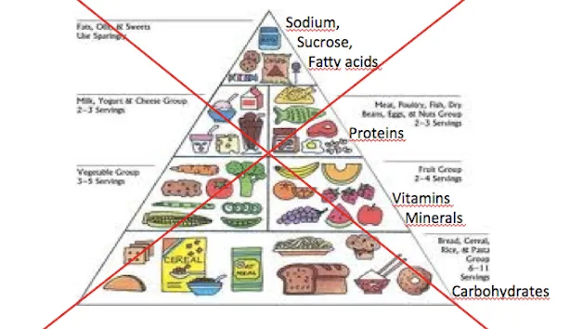
So does Brazil, where "eating is a natural part of social life"
Brazil
https://www.vox.com/2015/2/20/8076961/brazil-food-guide

Slide 39

Brazil, where "eating is a natural part of social life"
https://www.vox.com/2015/2/20/8076961/brazil-food-guide

Slide 40
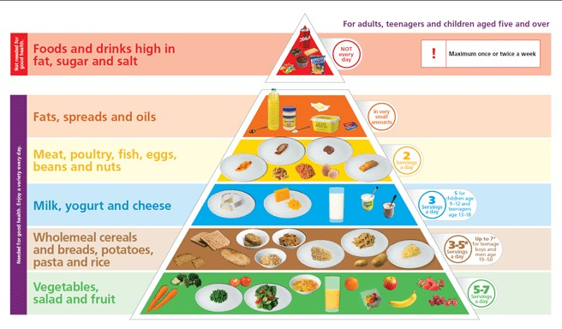
Ireland
https://www.image.ie/editorial/did-you-know-that-ireland-has-revamped-the-food-pyramid-74533

Slide 41
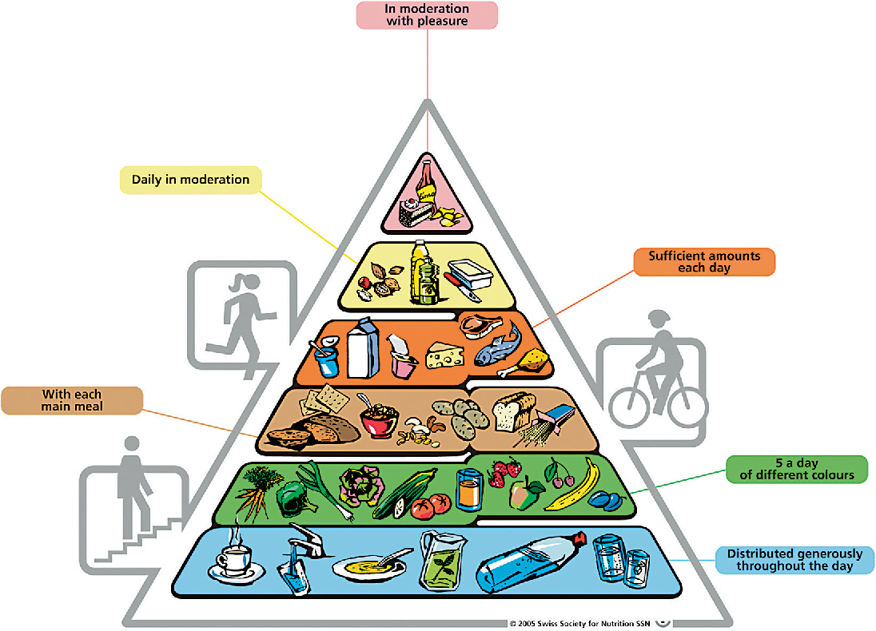
Switzerland
https://www.semanticscholar.org/paper/Food-Pyramid-of-the-Swiss-Society-for-Nutrition-Walter-Infanger/72c830ba5567b5eb8b429b50ff7df8e11c47adc3

Slide 42
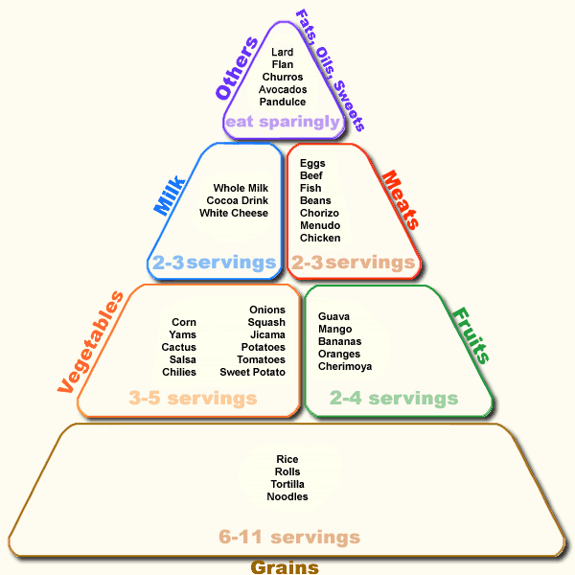
Mexican Food Guide Pyramid
www.semda.org/info/images/July99_new.gif

Slide 43
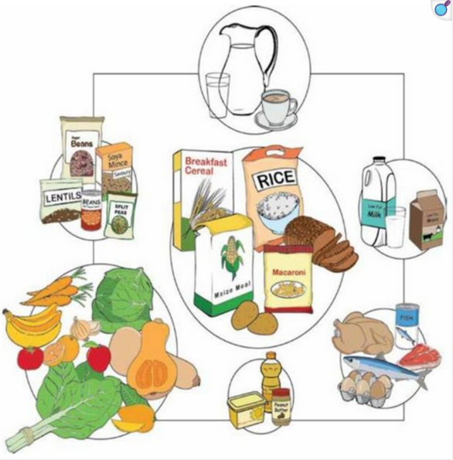
South African Food Guide
https://pmc.ncbi.nlm.nih.gov/articles/PMC8001548/

Slide 44
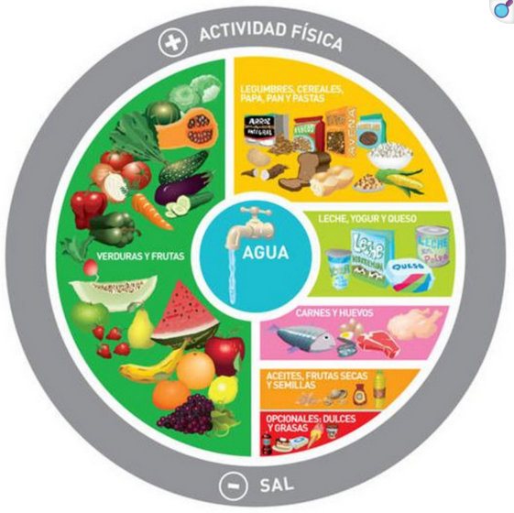
Argentina
https://pmc.ncbi.nlm.nih.gov/articles/PMC8001548/

Slide 45
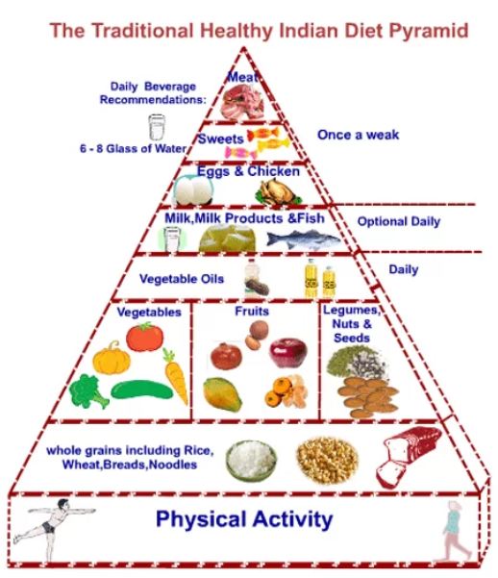
India
https://www.adityabirlacapital.com/healthinsurance/active-together/2017/06/16/understanding-the-indian-food-pyramid/

Slide 46
and lots of places continue to have alternate food guide pyramids that they follow in daily life . . .

Slide 47
and lots of places continue to have alternate food guide pyramids that they follow . . .
The current USDA food pyramid

Slide 48
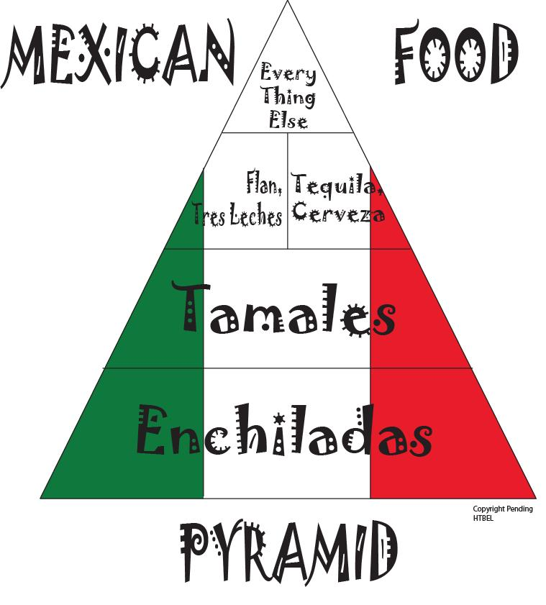
Notes:
48

Slide 49
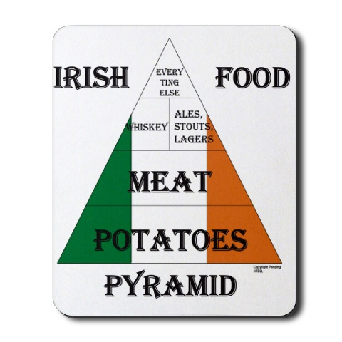
Notes:
49

Slide 50

Notes:
50

Slide 51
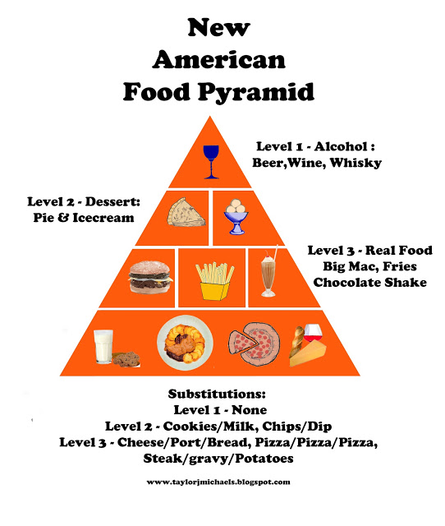
Spain's Food Pyramid
http://taylorjmichaels.blogspot.com/2013/03/new-american-food-pyramid.html

Slide 52
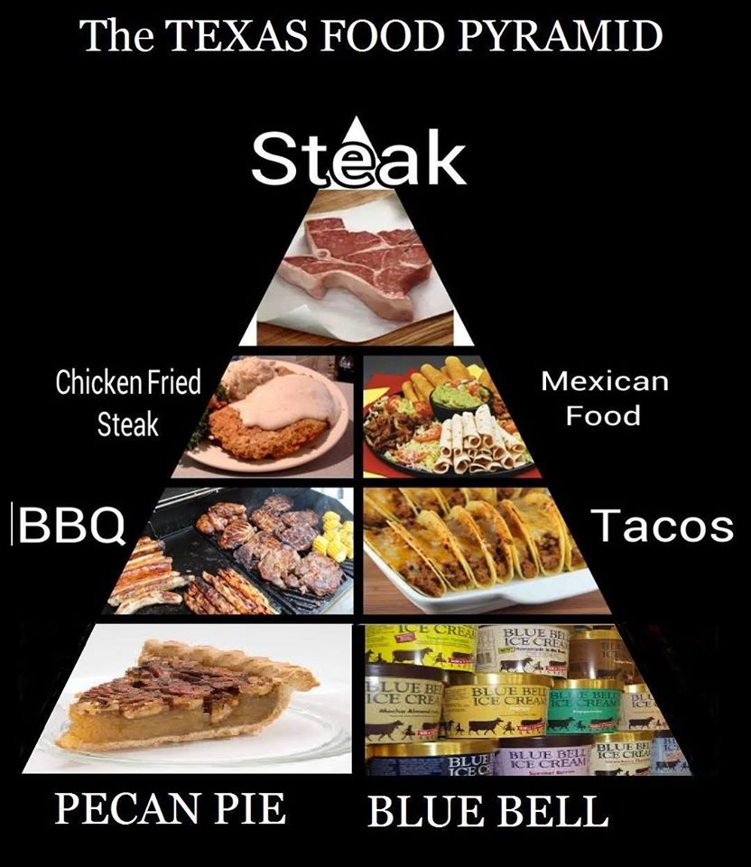
http://ktemnews.com/texas-food-pyramid/

Slide 53
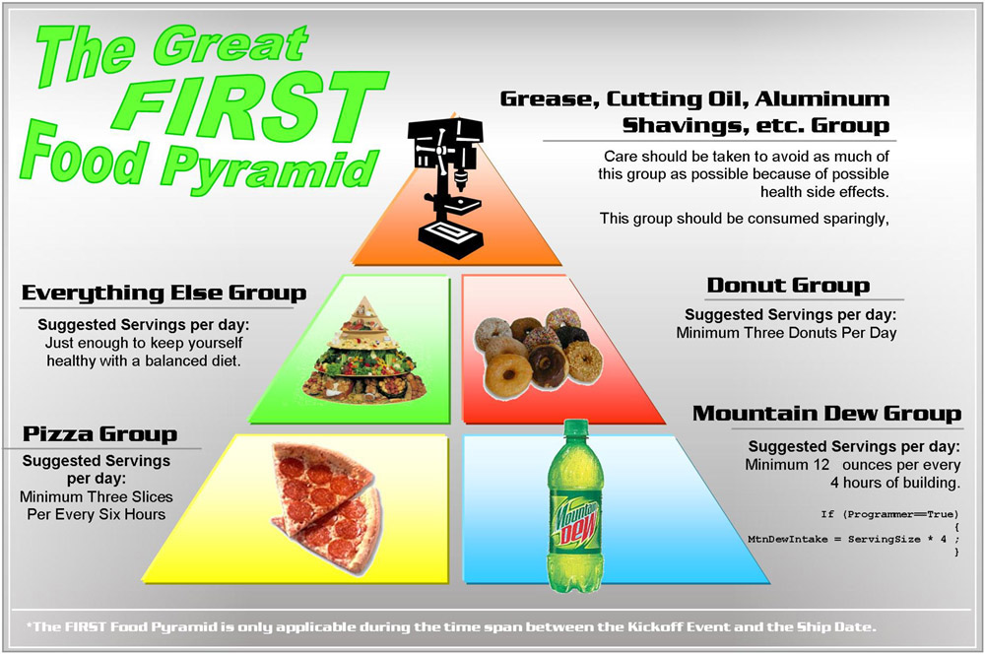
http://www.chiefdelphi.com/media/photos/22549

Slide 54
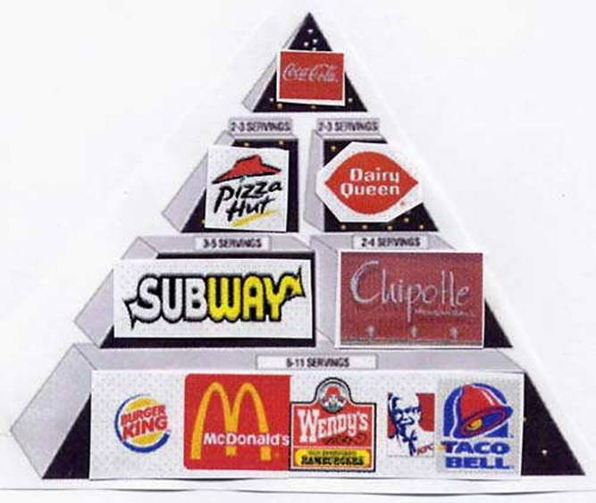
http://fatboydiet.tumblr.com/post/34577921658/follow-this-food-pyramid-and-youll-be-massive-in

Slide 55
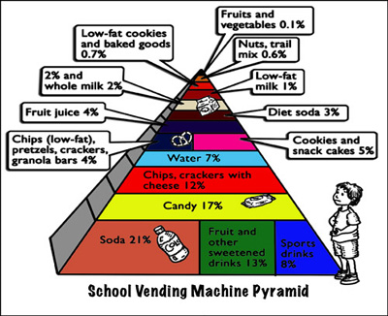
July 19, 2009
http://www.ceche.org/mol/Spring-05/inside.html
Notes:
55

Slide 56
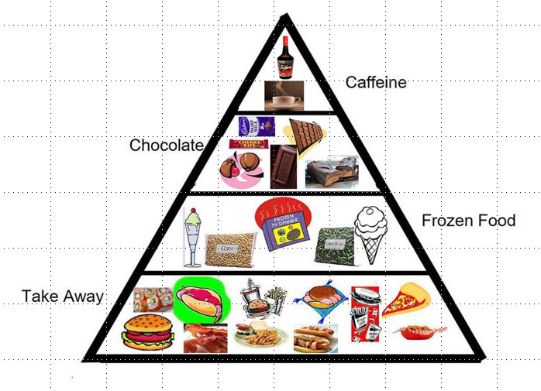
Notes:
56

Slide 57
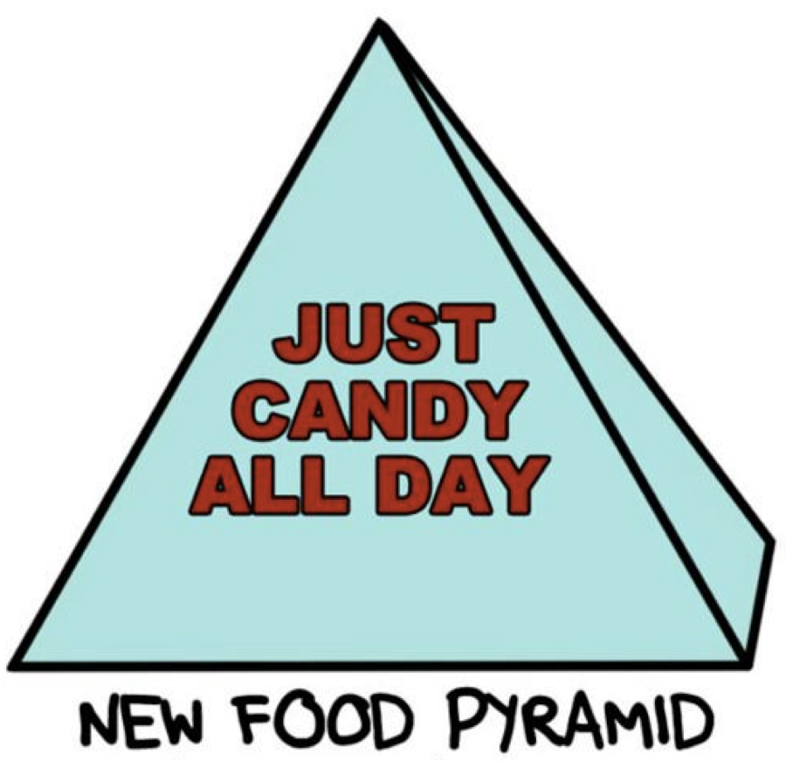
https://www.pinterest.com/pin/465981892667133701/

Slide 58
and there are many speciality
food “pyramids” . . .

Slide 59
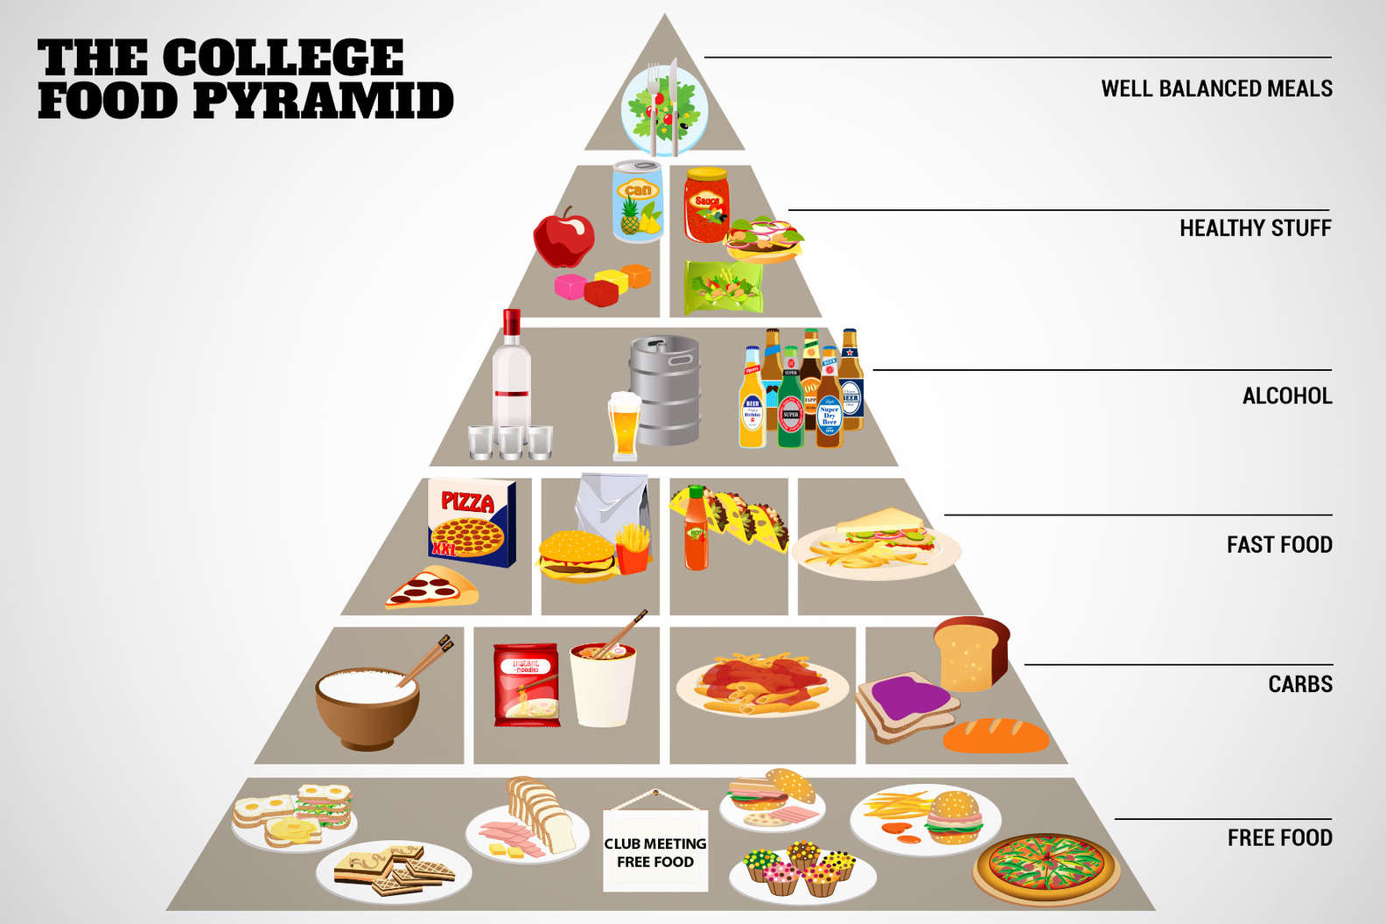
source

Slide 60
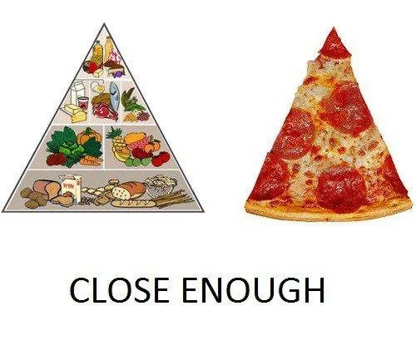
source

Slide 61
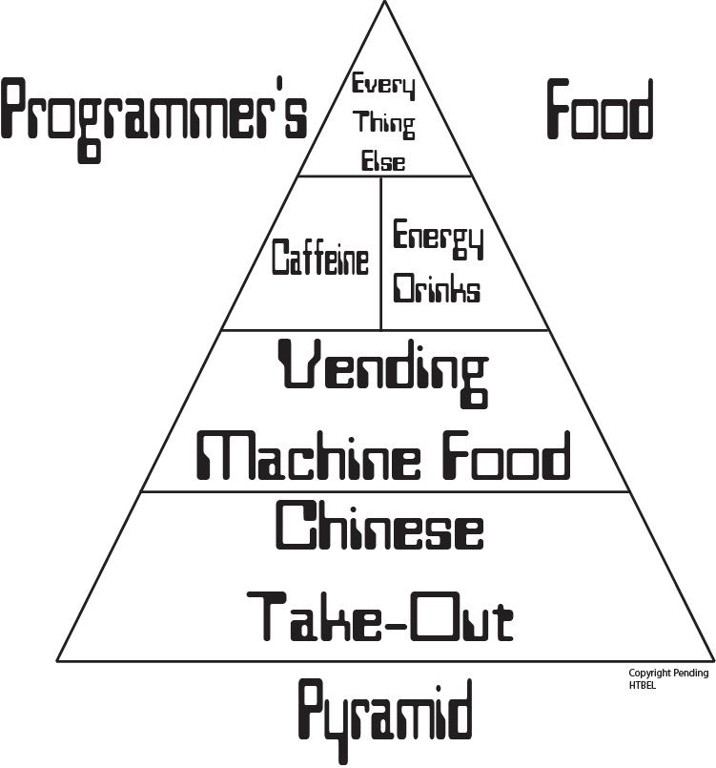
Notes:
61

Slide 62

Notes:
62

Slide 63
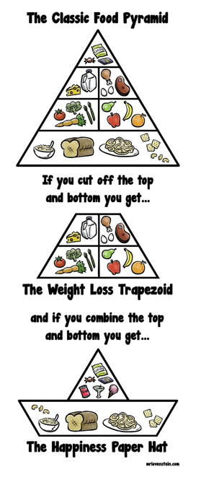
source

Slide 64
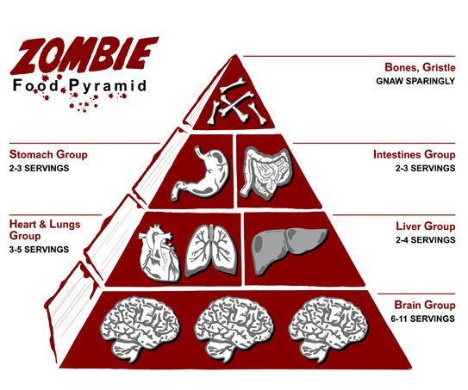
source

Slide 65
and special
food “pyramids”
for COVID lockdowns . . .

Slide 66
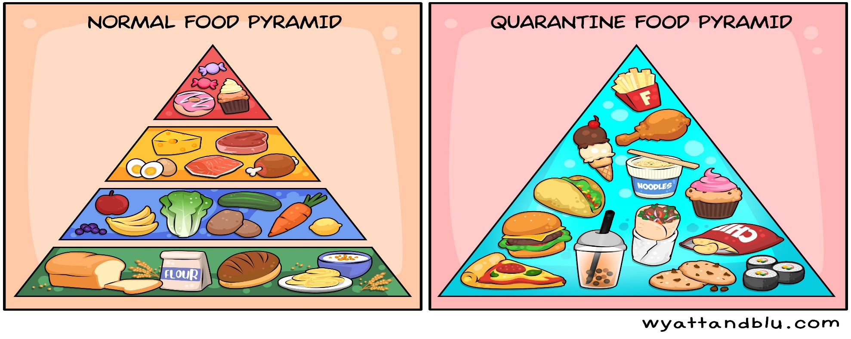
source

Slide 67
And, of course,
there is lots of
food “pyramid” merchandise . . .

Slide 68
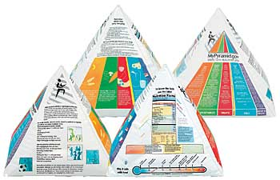
Inflatable USDA Food Guide Pyramid
www.ethnicfoodsco.com/Japan/JapaneseFoodPyramid.htm

Slide 69


Slide 70


Slide 71


Slide 72


Slide 73


Slide 74


Slide 75

Health Beet Portion Control Plate

Slide 76
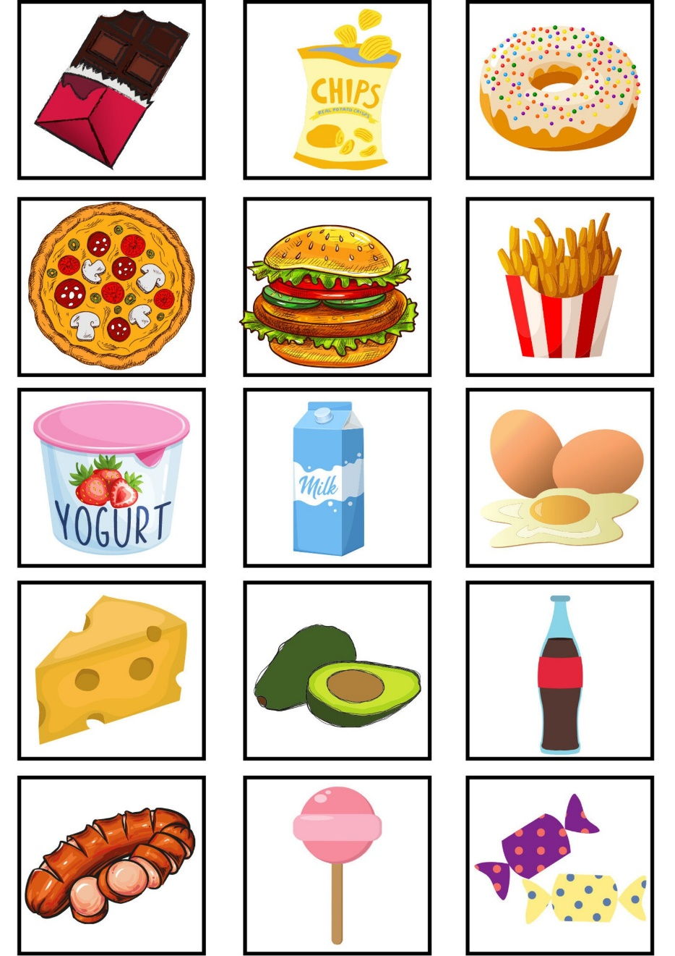
Memory game - Food (card game also known as Concentration or Pairs)

Slide 77

Healthy Helpings MyPlate Game

Slide 78
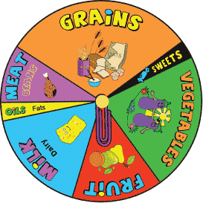

Slide 79
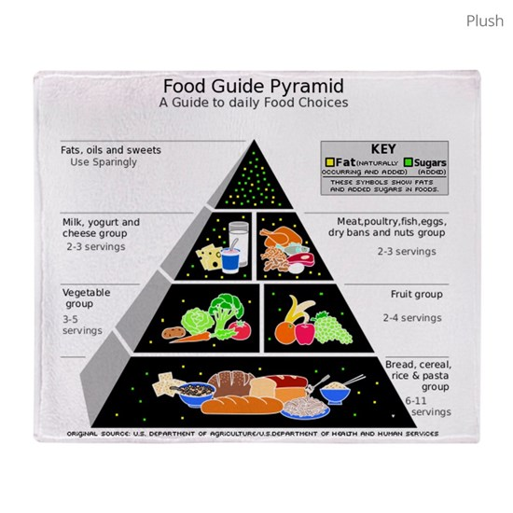
50x60 Plush Fleece Blankets ($48.74)

Slide 80
And, of course . . .

Slide 81
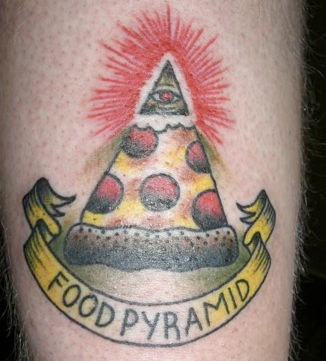
Food Pyramid Tattoos . . .

Slide 82
They are all basically associated with . . .

Slide 83
. . . in one way or another . . .
Inflatable USDA Food Guide Pyramid
www.ethnicfoodsco.com/Japan/JapaneseFoodPyramid.htm

Slide 84
. . . with The USDA
whose job it is
to promote
U.S.
Agriculture . . .

Slide 85
. . . The United States Department of Agriculture . . .

Slide 86
. . .
whose job it is
to promote
U.S.
Agriculture . . .

Slide 87
. . . with The USDA
whose job it is
to promote
U.S.
Agriculture . . .
Being that it is established by law as
“The United States Department of Agriculture”

Slide 88

not to be confused with
United States
Food and Drug Administration

Slide 89
the
United States
Food and Drug Administration
is responsible for regulating and supervising the safety of foods, dietary supplements, etc.

Slide 90
promotes
U.S.A.
agriculture
regulates
U.S.A.
food safety
Inflatable USDA Food Pyramid
www.ethnicfoodsco.com/Japan/JapaneseFoodPyramid.htm

Slide 91
. . . and, in addition, . . .

Slide 92

EPA
. . . The EPA is charged with related things like . . .
http://en.wikipedia.org/wiki/Epa

Slide 93
protecting U.S.A.
human health
and the
environment
EPA
http://en.wikipedia.org/wiki/Epa

Slide 94
promotes
U.S.A.
agriculture
regulates
U.S.A.
food safety

Slide 95
is charged to
protect U.S.A.
human health
and the
environment
promotes
U.S.A.
agriculture
regulates
U.S.A.
food safety

Slide 96
e.g., Factory Farming
(CAFOs)
has environmental impacts
and health risks . . .
EPA
http://en.wikipedia.org/wiki/CAFO

Slide 97
e.g., Factory Farming
(CAFOs) and decisions affect
animal welfare,
food ethics . . .
EPA
http://en.wikipedia.org/wiki/CAFO

Slide 98
And, in addition, there’s . . .

Slide 99

and to the
federal regulators
you must also add

Slide 100
is charged to
protect U.S.A.
human health
and the
environment
promotes
U.S.A.
agriculture
regulates
U.S.A.
food safety
and to the
federal regulators
you must also add

Slide 101
is charged to
protect U.S.A.
human health
and the
environment
promotes
U.S.A.
agriculture
regulates
U.S.A.
food safety
Centers for Disease Control and Prevention
“works to protect public health and safety by providing information to enhance health decisions”

Slide 102

is charged to
protect U.S.A.
human health
and the
environment
an excellent work that sorts all of this out is Marion Nestle’s . . .
promotes
U.S.A.
agriculture
regulates
U.S.A.
food safety
Centers for Disease Control and Prevention
“works to protect public health and safety by providing information to enhance health decisions”

Slide 103
is charged to
protect U.S.A.
human health
and the
environment
and, of course,
The United States
Supreme Court
overrides everybody . . .
promotes
U.S.A.
agriculture
regulates
U.S.A.
food safety
Centers for Disease Control and Prevention
“works to protect public health and safety by providing information to enhance health decisions”

Slide 104
So as is usually [always?]
the case . . .
the Food “Pyramid” and related matters
are rife
with politics . . .

Slide 105
an excellent treatment of this question can be found in . . .
Marion Nestle
Food Politics: How the Food Industry Influences Nutrition and Health
University of California Press 2007

Slide 106
Marion Nestle
Food Politics: How the Food Industry Influences Nutrition and Health
University of California Press 2007
Marion Nestle provides one of the best discussions
— perhaps THE best discussion—
of the Food Guide Pyramid, and of the USDA
(including the politics of the pyramid)

Slide 107

Marion Nestle
Unsavory Truth: How Food Companies Skew the Science of What We Eat
Basic Books 2018
“America's leading nutritionist exposes how the food industry corrupts scientific research for profit”

Slide 108

and . . .
Marion Nestle
What to Eat
North Point Press
2007

Slide 109

Marion [No Relation to the Company] Nestle

Slide 110
While the inverted pyramid “is the latest in over 120 years of nutrition guides from the USDA”, many version of The Food Pyramid remain in use around the world

Slide 111
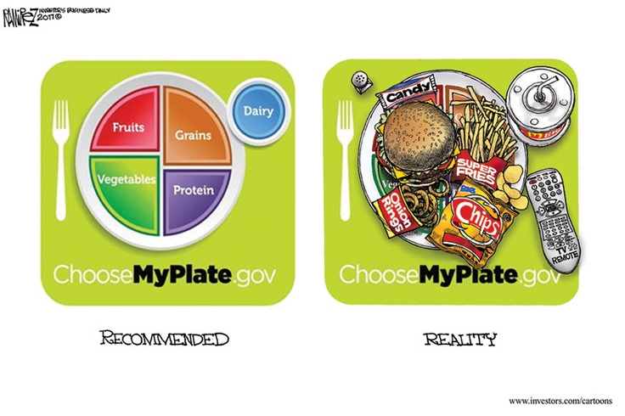
http://www.pinterest.com/pin/118641771407221944/

Slide 112

http://www.cartoonaday.com/new-usda-food-plate-pyramid-replacement/

Slide 113
The USDA
Food Guide Pyramid
(1992-2011; 2026)
and
MyPlate
(2011-2026)
Anthropology of Food
University of Minnesota Duluth
Tim Roufs ©2014-2026

