Slide 1
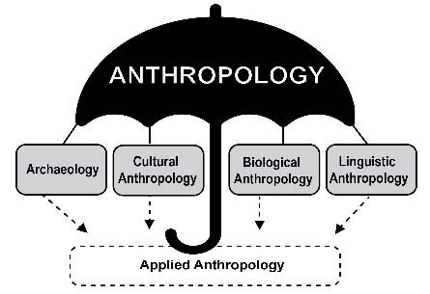
Use your up/down arrow keys and/or your space bar to see the slides
Tim Roufs
© 2021-2026
https://perspectives.pressbooks.com/chapter/introduction-to-anthropology/

Slide 2
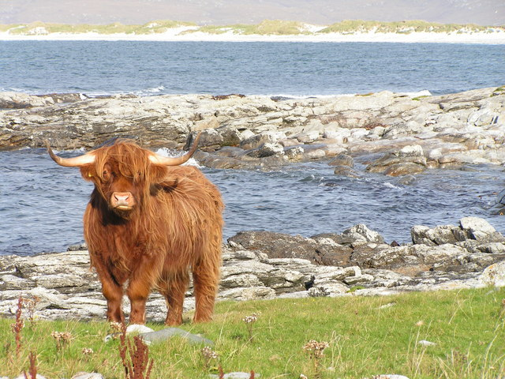
Holism
in
Anthropology
Anthropology of Food
University of Minnesota Duluth
Tim Roufs
© 2010-2026
http://en.wikipedia.org/wiki/Highland_cattle

Slide 3
American
Main Characteristics of Anthropology
˄
1. the four fields of general anthropology
culture as a primary concept
comparative method as major approach
holism as a primary theoretical goal
fieldwork as a primary research technique

Slide 4
American
Main Characteristics of˄Anthropology
1. the four fields of general anthropology
culture as a primary concept
comparative method as major approach
holism as a primary theoretical goal
fieldwork as a primary research technique

Slide 5
First let’s have a brief look at the other
Main Characteristics of Anthropology
1. the four fields of general anthropology
culture as a primary concept
comparative method as major approach
holism as a primary theoretical goal
fieldwork as a primary research technique

Slide 6
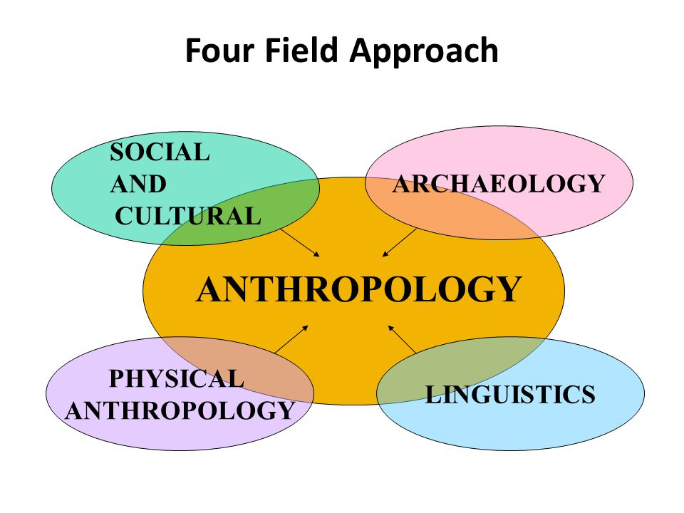
https://slideplayer.com/slide/2407456/9/images/66/Four+Field+Approach+SOCIAL+ARCHAEOLOGY+AND+CULTURAL+PHYSICAL.jpg

Slide 7
You’ll see the four field approach
in American Anthropology . . .
American Anthropology
cultural / social
physical
archaeology
linguistics

Slide 8
These are also
commonly known as . . .
sociocultural
biophysical
archaeological
linguistical

Slide 9
These are also
commonly known as . . .
sociocultural
biophysical
archaeological
linguistical

Slide 10
Main Characteristics of Anthropology
1. the four fields of general anthropology
culture as a primary concept
comparative method as major approach
holism as a primary theoretical goal
fieldwork as a primary research technique

Slide 11
Main Characteristics
“culture” is
  learned
  shared
  transmitted from generation to generation
  based on symbols
  integrated

Slide 12
The Concept of Culture
microculture
  are smaller groups with distinct pattern of learned and shared behavior and thinking found within larger cultures such as ethnic groups in localized regions
  some people like to think of these as
  “local cultures”

Slide 13
The Concept of Culture
microcultures can include ethnic groups within nations
  e.g., Greek-Americans
  e.g., Anishinabe (Chippewa; Ojibwa)
  e.g., Irish “Travellers”
    sometimes incorrectly called “Gypsies”
  e.g., Australian Aboriginals
  e.g., Cajun
  e.g., Rom (Gypsies)
  e.g., Basques
  e.g., Kurds

Slide 14
The Concept of Culture
local groups (microcultures)
generally strive to preserve their cultural identity with . . .
food
clothing
religion
ritual
music, dance, and other arts
language
cultural symbols . . .

Slide 15
The Concept of Culture
local groups (microcultures)
generally strive to preserve their cultural identity . . . for e.g., . . .
  Greek-Americans in Duluth
. . .

Slide 16
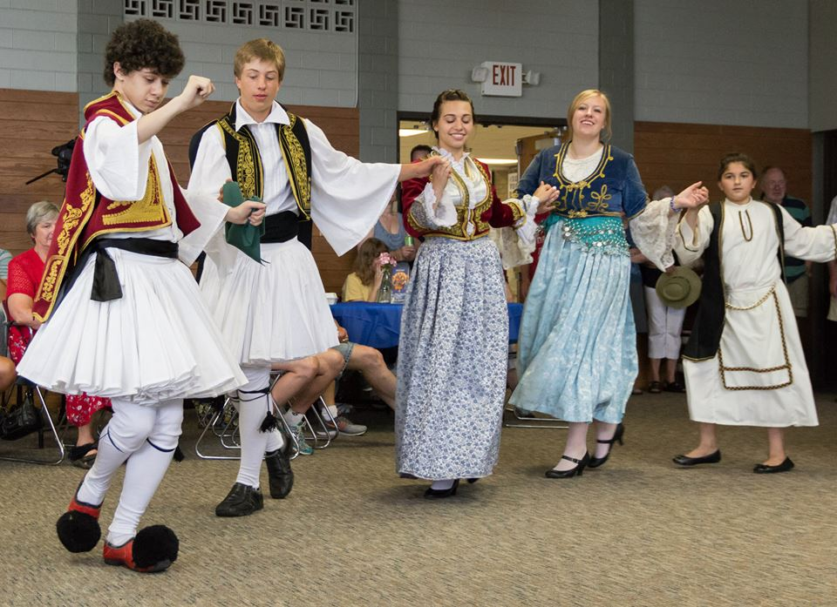
  Greek-Americans in Duluth
www.facebook.com/alexganeevphotography/photos/

Slide 17
Main Characteristics of Anthropology
1. the four fields of general anthropology
culture as a primary concept
comparative method as major approach
holism as a primary theoretical goal
fieldwork as a primary research technique

Slide 18
Compare . . .
Main Characteristics
comparative method
  as a major approach to the study of human behavior
  the comparative method compares things (what else would a “comparative” method do?)

Slide 19
Compare . . .
Main Characteristics
comparative method
  One form of comparative method was pioneered by Fred Eggan
  (University of Chicago)
“Social anthropology and
the method of controlled comparison”
  American Anthropologist, 56:743-61 (1954)

Slide 20
Compare . . .
Main Characteristics
comparative method
  One form of comparative method was pioneered by Fred Eggan
  (University of Chicago)
“Social anthropology and
the method of controlled comparison”
  American Anthropologist, 56:743-61 (1954)

Slide 21
Main Characteristics
comparative method
often, for e.g.,
folks compare things regionally in an attempt
to understand process

Slide 22
Compare . . .
Main Characteristics
comparative method
  Other methods . . .
process
essentially refers to
how things change
or
how things came to be
the way they are now
compare things regionally
in an attempt to understand process

Slide 23
Compare . . .
Main Characteristics
the comparative method compares things
for e.g. . . .
David Montgomery compares what happens when great civilizations around the world ignore problems they are having with top soil . . .
Spoiler: All failed

Slide 24
Compare . . .
Main Characteristics
the comparative method compares things
for e.g. . .
David Montgomery compares what happens when great civilizations around the world ignore problems they are having with top soil . . .
Spoiler: All failed

Slide 25
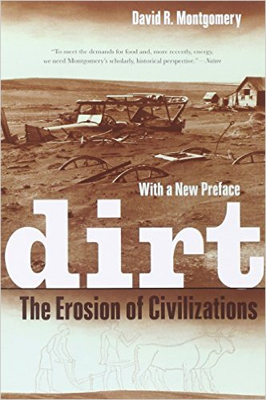
Mesopotamia
China
North America
South America
Europe
Asia
Africa
Pacific Islands
Berkeley: University of California, 2012
http://www.amazon.com/Empires-Food-Feast-Famine-Civilizations/dp/1582437939/ref=sr_1_1?ie=UTF8&qid=1452654498&sr=8-1&keywords=empires+of+food

Slide 26
Compare . . .
Main Characteristics
the comparative method compares things
for e.g. . . .
David Montgomery compares what happens when great civilizations around the world ignore problems they are having with top soil . . .
Spoiler: All failed

Slide 27
Compare . . .
Main Characteristics
the comparative method compares things
for e.g. . . .
In a similar manner Evan D. Fraser and Andrew Rimas compare
Feast, Famine, and the Rise and Fall of Civilizations
around the world. . .

Slide 28
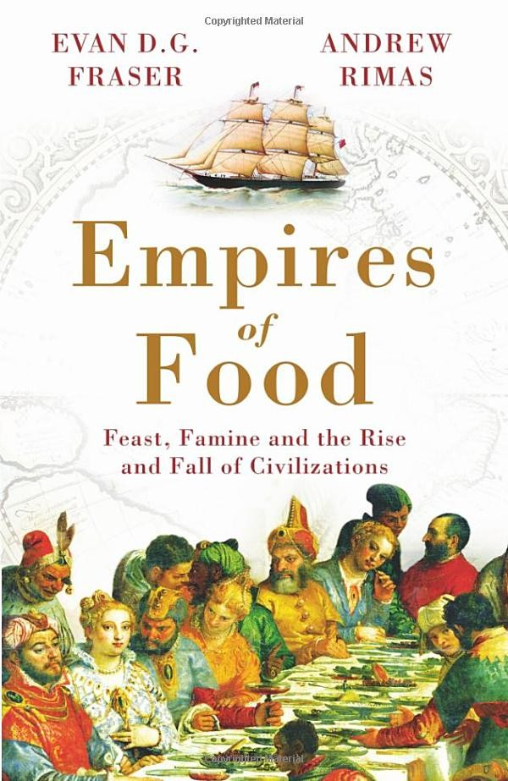
Mesopotamia
China
North America
South America
Europe
Asia
Africa
Pacific Islands
Berkeley: Counterpoint, 2012:
http://www.amazon.com/Empires-Food-Feast-Famine-Civilizations/dp/1582437939/ref=sr_1_1?ie=UTF8&qid=1452654498&sr=8-1&keywords=empires+of+food

Slide 29
American
Main Characteristics of˄Anthropology
1. the four fields of general anthropology
culture as a primary concept
comparative method as major approach
holism as a primary theoretical goal
fieldwork as a primary research technique

Slide 30
Main Characteristics of Anthropology
1. the four fields of general anthropology
culture as a primary concept
comparative method as major approach
holism
or the study of "humankind" as a whole, as a primary theoretical goal
fieldwork as a primary research technique

Slide 31
holism tries to put all of the pieces together . . .
American Anthropology
cultural / social
physical (bio-physical)
archaeology
linguistics

Slide 32
An excellent example of trying to understand things holistically comes from Finland . . .

Slide 33

Finland is switching their
entire school curriculum to
holistic studies . . .
https://brightside.me/wonder-curiosities/finland-will-become-the-first-country-in-the-world-to-get-rid-of-all-school-subjects-259910/

Slide 34
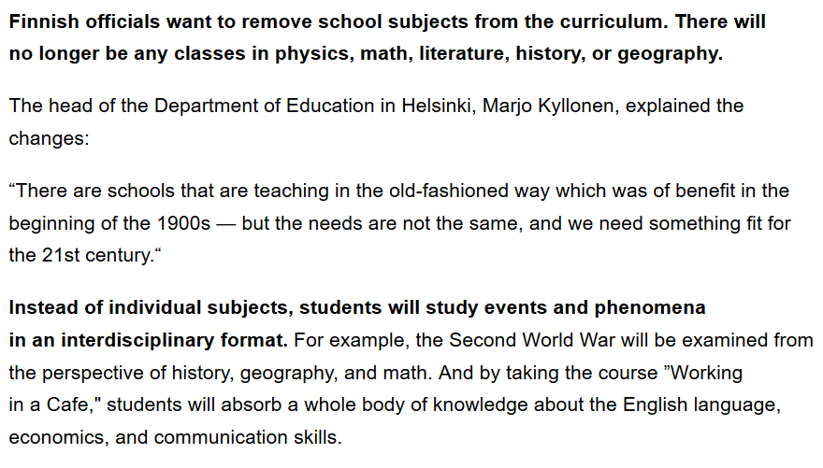
https://brightside.me/wonder-curiosities/finland-will-become-the-first-country-in-the-world-to-get-rid-of-all-school-subjects-259910/

Slide 35
In Anthropology
HOLISM
involves all four levels
and all
of the physical and
cultural (or behavioral)
components combined . . .

Slide 36
A simple example . . .

Slide 37
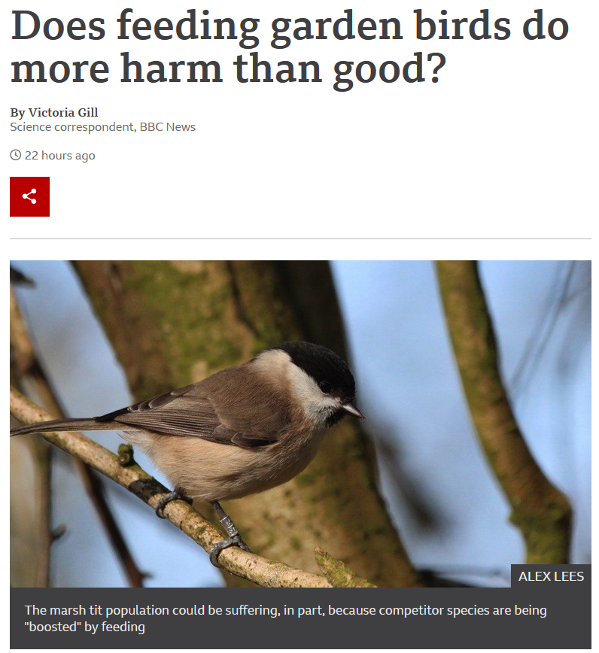

27 August 2021
https://www.bbc.com/news/science-environment-58346043

Slide 38
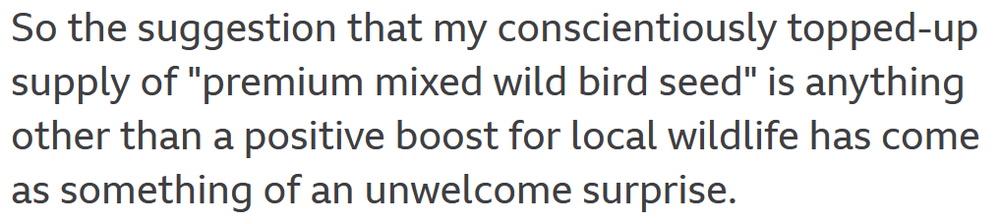
27 August 2021
https://www.bbc.com/news/science-environment-58346043

Slide 39
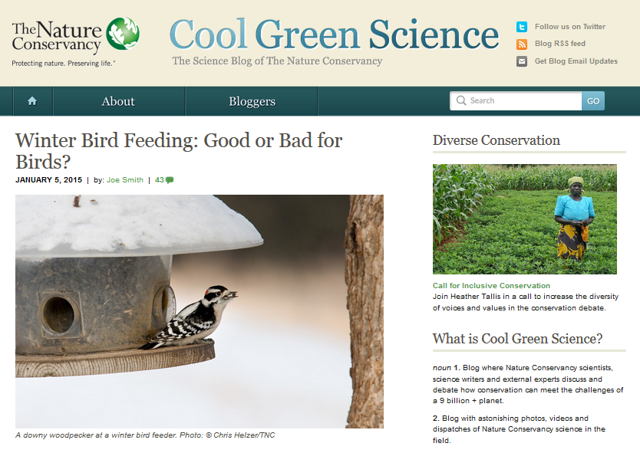
http://blog.nature.org/science/2015/01/05/winter-bird-feeding-good-or-bad-for-birds/

Slide 40
Is it good to feed the winter birds?
Yes . . .
for the reasons one might suspect . . .
http://blog.nature.org/science/2015/01/05/winter-bird-feeding-good-or-bad-for-birds/

Slide 41
Is it good to feed the winter birds?
Yes . . .
for the reasons one might suspect . . .
A simple answer . . .
http://blog.nature.org/science/2015/01/05/winter-bird-feeding-good-or-bad-for-birds/

Slide 42
Is it good to feed the winter birds?
Yes . . .
for the reasons one might suspect . . .
http://blog.nature.org/science/2015/01/05/winter-bird-feeding-good-or-bad-for-birds/

Slide 43
Is it good to feed the winter birds?
More than 40 percent of U.S. households feed their backyard birds, and in the United Kingdom, the rate is as high as 75 percent.
A study conducted during winter in Wisconsin showed that black-capped chickadees with access to bird seed had a much higher overwinter survival rate (69 percent) as compared to those without access to human-provided seed (37 percent survival
Furthermore, some studies have shown that birds making it through the winter in better physical condition see those benefits carry over into the nesting season
Bird feeding produces significantly earlier egg laying dates, larger clutches of eggs, higher chick weights and higher overall breeding success across a wide range of bird species
http://blog.nature.org/science/2015/01/05/winter-bird-feeding-good-or-bad-for-birds/

Slide 44
Is it good to feed the winter birds?
Yes . . .
for the reasons one might suspect . . .
BUT . . .
let’s look at the question from the anthropological
holistic
point of view . . .
http://blog.nature.org/science/2015/01/05/winter-bird-feeding-good-or-bad-for-birds/

Slide 45
Is it good to feed the winter birds?
Yes . . .
for the reasons one might suspect . . .
BUT . . .
let’s look at the question from the anthropological
holistic
point of view . . .
http://blog.nature.org/science/2015/01/05/winter-bird-feeding-good-or-bad-for-birds/

Slide 46
Is it good to feed the winter birds?
Yes . . .
for the one might suspect . . .
A holistic view would also consider . . .
http://blog.nature.org/science/2015/01/05/winter-bird-feeding-good-or-bad-for-birds/

Slide 47
Is it good to feed the winter birds?
feeding can promote the survival and reproduction of the not-quite-fittest
one research group found that birds fed during winter subsequently laid a smaller number of eggs that had lower hatching success and ultimately fledged fewer young than birds that weren’t fed at all
the offspring that did fledge weighed less and had a lower survival rate than the young of unfed birds
http://blog.nature.org/science/2015/01/05/winter-bird-feeding-good-or-bad-for-birds/

Slide 48
Is it good to feed the winter birds?
both species [in two U.K. studies], when they had access to bird food, laid fewer eggs, had lower hatching success, and ultimately had fewer chicks fledged
feeding an irresistible diet that was unbalanced – too high in fat to produce high-quality eggs
http://blog.nature.org/science/2015/01/05/winter-bird-feeding-good-or-bad-for-birds/

Slide 49
Is it good to feed the winter birds?
bird feeding allowed individuals with a lower reproductive capacity which ordinarily would not survive the winter the chance to nest
the feeders may be in poor quality nesting habitat – leading the birds to choose these suboptimal sites as nesting areas in the spring
http://blog.nature.org/science/2015/01/05/winter-bird-feeding-good-or-bad-for-birds/

Slide 50
Is it good to feed the winter birds?
So from the holistic view, one must look at things like the impacts of bird feeding not only on the survival
of the birds fed,
but also on things like . . .
http://blog.nature.org/science/2015/01/05/winter-bird-feeding-good-or-bad-for-birds/

Slide 51
Is it good to feed the winter birds?
  overall reproductive success
  other factors such as disease transmission
  species range expansion
  population trajectories
  and the long-range evolutionary effects on the species
http://blog.nature.org/science/2015/01/05/winter-bird-feeding-good-or-bad-for-birds/

Slide 52
So what to do . . . ?

Slide 53
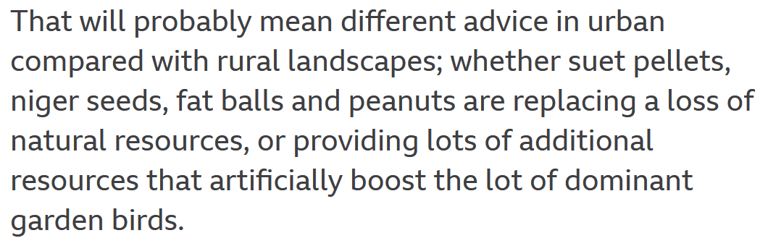
27 August 2021
https://www.bbc.com/news/science-environment-58346043

Slide 54
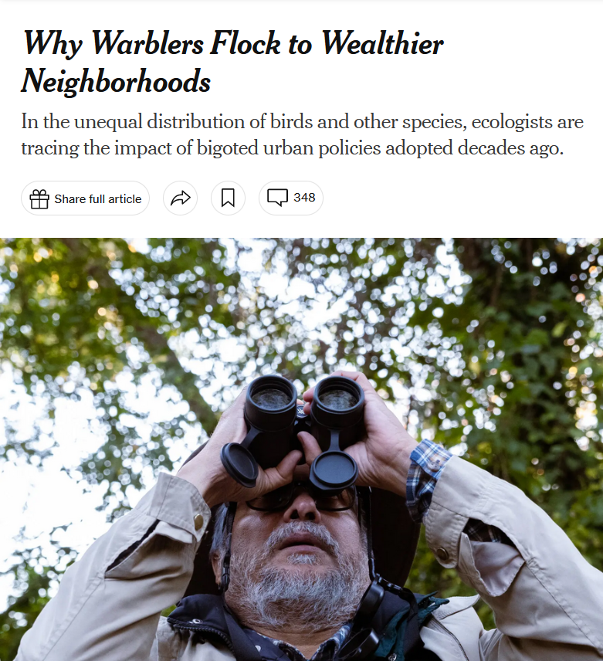
*Why Warblers Flock to Wealthier Neighborhoods (21 November 2023)

Slide 55
Looking at the bird situation even more holistically, other studies show that urban birds are also better off (genetically and otherwise) living in wealthier neighborhoods than living in poorer neighborhoods . . . .
*Why Warblers Flock to Wealthier Neighborhoods (21 November 2023)

Slide 56
Urban birds, like people, are better off in more prosperous neighborhoods than in poor and marginal areas as “patterns of income inequality . . . carry over to influence urban biodiversity” as human inequality creates barriers to wildlife movement.
*Why Warblers Flock to Wealthier Neighborhoods (21 November 2023)

Slide 57
“. . . Like a wall or a highway, systemic racism creates a barrier to wildlife movement.”*
In many communities, “The birds were ‘an indicator of these broader conditions that are effectively bad for people.’”*
*Why Warblers Flock to Wealthier Neighborhoods (21 November 2023)

Slide 58
another simple,
but important,
example . . .

Slide 59
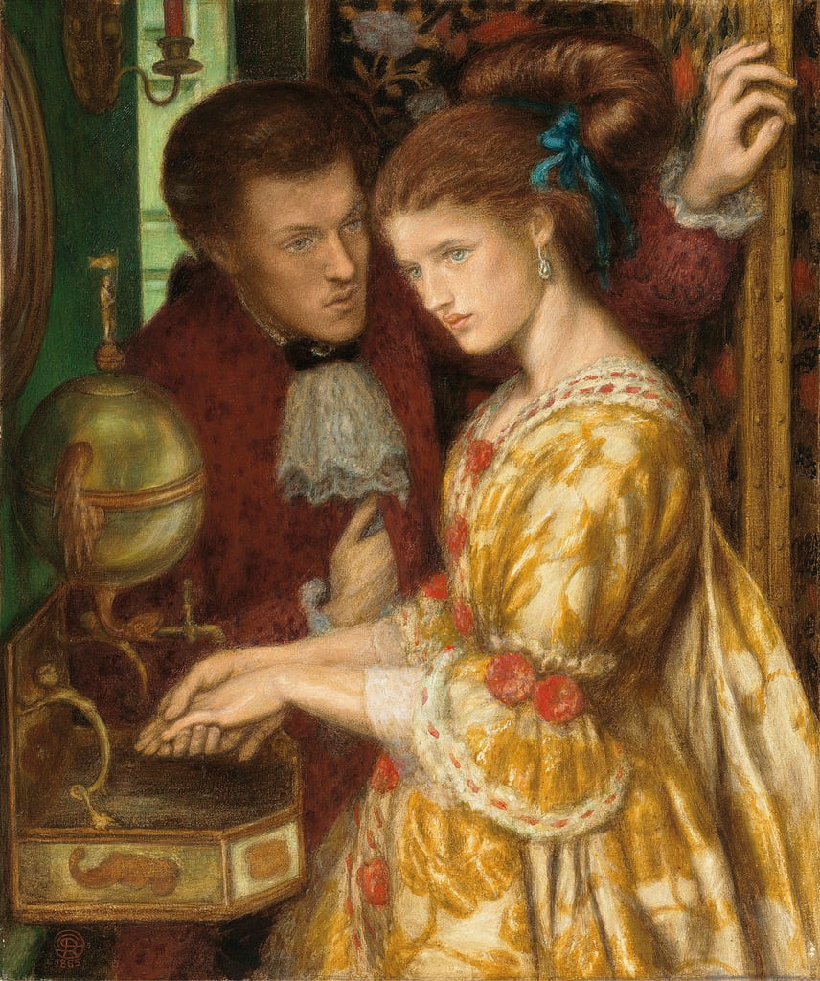
Washing Hands, 1865
Dante Gabriel Rossetti (1828–1882)
https://commons.wikimedia.org/wiki/File:Dante_Gabriel_Rossetti_-_Washing_Hands.jpg

Slide 60
With COVID-19 handwashing became a focused feature of life and most now recognize that handwashing in general is of tremendous importance for both the individual and for society in general . . .
http://www.bbc.com/news/health-40118539

Slide 61
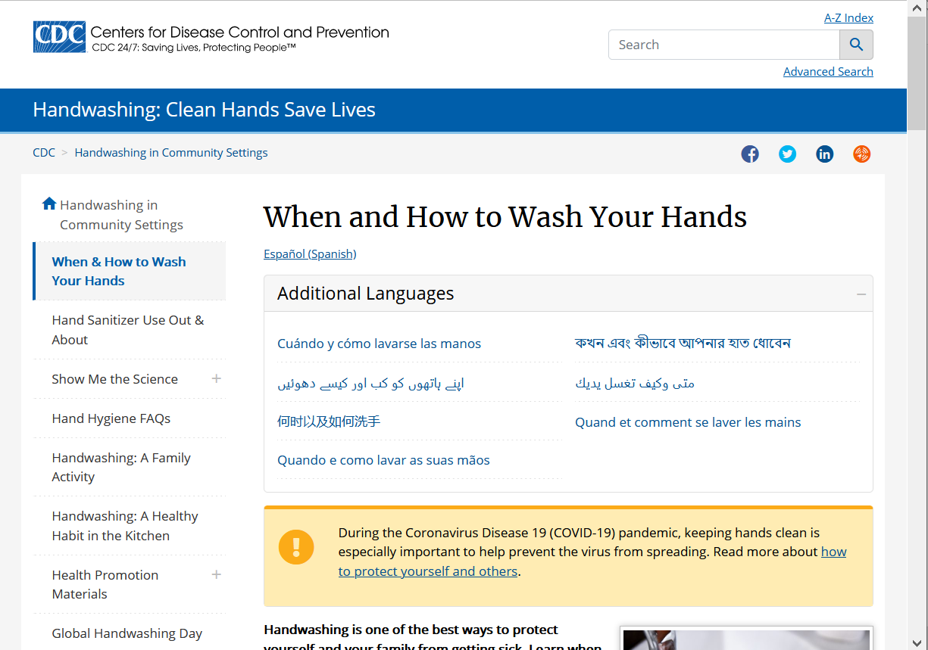
The U.S. CDC issues lots of instructions . . .
https://www.cdc.gov/handwashing/when-how-handwashing.html

Slide 62
Question:
Does it make any difference if you wash your hands with cold water or warm water?
http://www.bbc.com/news/health-40118539

Slide 63
Answer from Scientists:
?
Answer from Anthropologists:
?
(REM: Anthropologists look at things holistically)
http://www.bbc.com/news/health-40118539

Slide 64
Answer from Scientists:
No
Answer from Anthropologists:
Yes
(REM: Anthropologists look at things holistically)
http://www.bbc.com/news/health-40118539

Slide 65
Answer from Scientists:
No
Answer from Anthropologists:
Yes
(REM: Anthropologists look at things holistically)
http://www.bbc.com/news/health-40118539

Slide 66
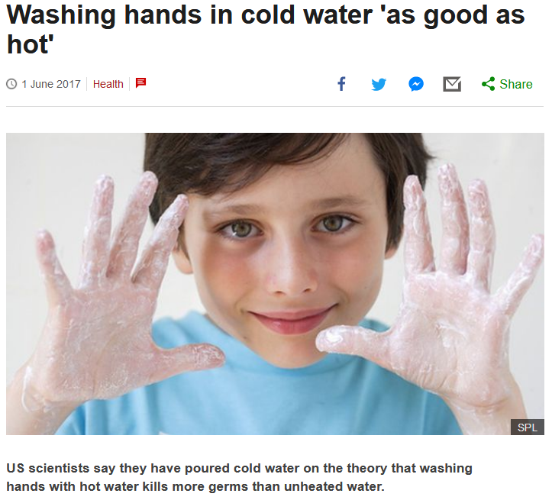


http://www.bbc.com/news/health-40118539

Slide 67
US scientists say they have poured cold water on the theory that washing hands with hot water kills more germs than unheated water.
http://www.bbc.com/news/health-40118539

Slide 68
Article:
“Quantifying the Effects of Water Temperature, Soap Volume, Lather Time, and Antimicrobial Soap as Variables in the Removal of Escherichia coli ATCC 11229 from Hands”
Dane A. Jensen, David R. Macinga, David J. Shumaker, Roberto Bellino, James W. Arbogast and Donald W. Schaffner
Journal of Food Protection, Volume 80, Issue 6 (June 2017), pp. 1022-1031.
http://jfoodprotection.org/doi/pdf/10.4315/0362-028X.JFP-16-370http://jfoodprotection.org/doi/pdf/10.4315/0362-028X.JFP-16-370

Slide 69
an anthropologist would look at the problem of water temperature holistically, and conclude that the water temperature DOES make a difference . . .
http://www.bbc.com/news/health-40118539

Slide 70
because length of time of washing hands
(like length of time
brushing one’s teeth)
is a key variable to overall effectiveness
. . .
http://www.bbc.com/news/health-40118539

Slide 71
because length of time of washing hands
(like length of time
brushing one’s teeth)
is a key variable to overall effectiveness
. . .
http://www.bbc.com/news/health-40118539

Slide 72
because length of time of washing hands
(like length of time
brushing one’s teeth)
is a key variable to overall effectiveness
. . .
http://www.bbc.com/news/health-40118539

Slide 73

Dentists knew that all along . . .
Brusheez® Kid's Electric Toothbrush Set

Slide 74
. . . in other words, HUMAN BEHAVIOR
is a most-important
key variable
http://www.bbc.com/news/health-40118539

Slide 75
. . . and people tend to wash their hands longer if the water temperature is comfortably warm
http://www.bbc.com/news/health-40118539

Slide 76
even the scientists focusing on water temperature in the experiments note more or less in passing that human behavior is an important issue . . .
http://www.bbc.com/news/health-40118539

Slide 77
“A large part of the variability in the data was associated with the behaviors of the volunteers. Understanding what behaviors and human factors most influence hand washing may help researchers find techniques to optimize the effectiveness of hand washing.”
Dane A. Jensen, David R. Macinga, David J. Shumaker, Roberto Bellino, James W. Arbogast and Donald W. Schaffner
Journal of Food Protection, Volume 80, Issue 6 (June 2017), pp. 1022-1031.
http://jfoodprotection.org/doi/abs/10.4315/0362-028X.JFP-16-370http://jfoodprotection.org/doi/abs/10.4315/0362-028X.JFP-16-370

Slide 78
One more example . . .

Slide 79
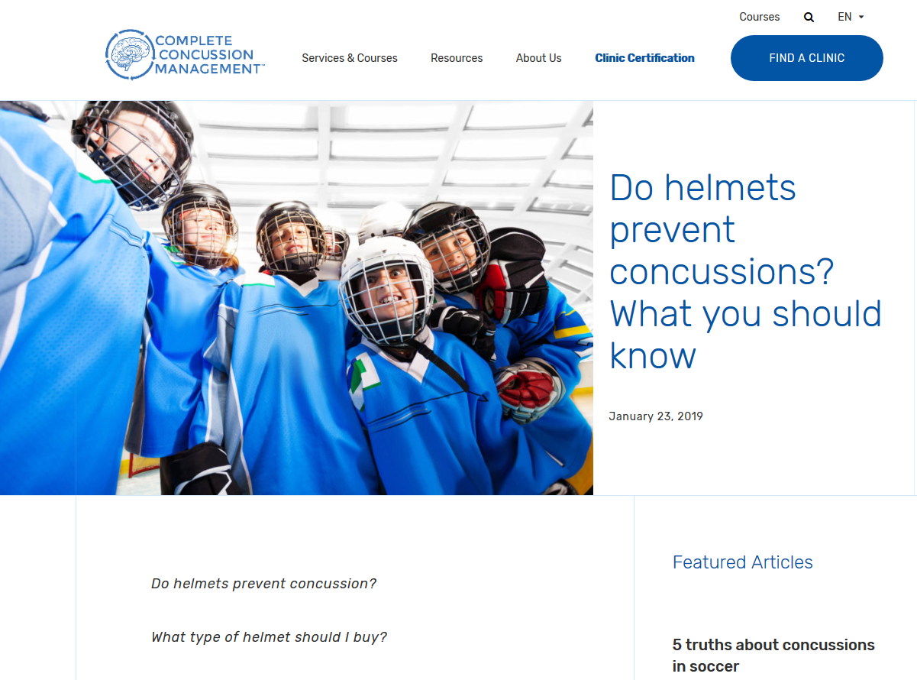

Slide 80
No . . .
Wearing helmets may actually result in more concussions because players assume that helmets help prevent concussions and thus take less care to prevent them . . .

Slide 81
Concussions are caused by acceleration or deceleration of the brain inside the skull . . .
Helmets on the outside of the skull do not mitigate that . . . and athletes think they can hit harder with the helmet on, and that can only increase the chances of a concussion . . .

Slide 82
It is more likely that if athletes were to
wear no helmets that the actual number of concussions would be reduced . . .

Slide 83
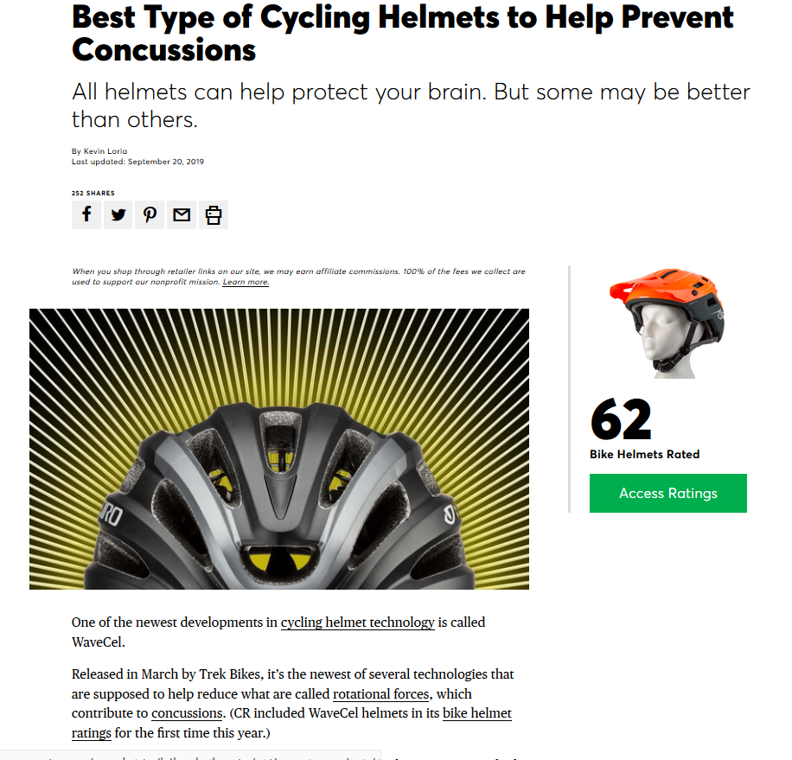
But wear a bike helmet to protect your head.
Wearing a bike helmet reduces the risk of serious head injury (to your skull) by about 70 percent.

Slide 84
with humans,
in anthropology,
holism looks at an item including the many subdisciplines in the areas of . . .

Slide 85
Holism tries to put all of the pieces together . . .
Anthropology of Food
and its . . .
cultural / social
physical
archaeology
linguistics
(bio-physical)

Slide 86
let’s have a look at that on the
“Anthropology and . . . Its Parts” chart . . .

Slide 87
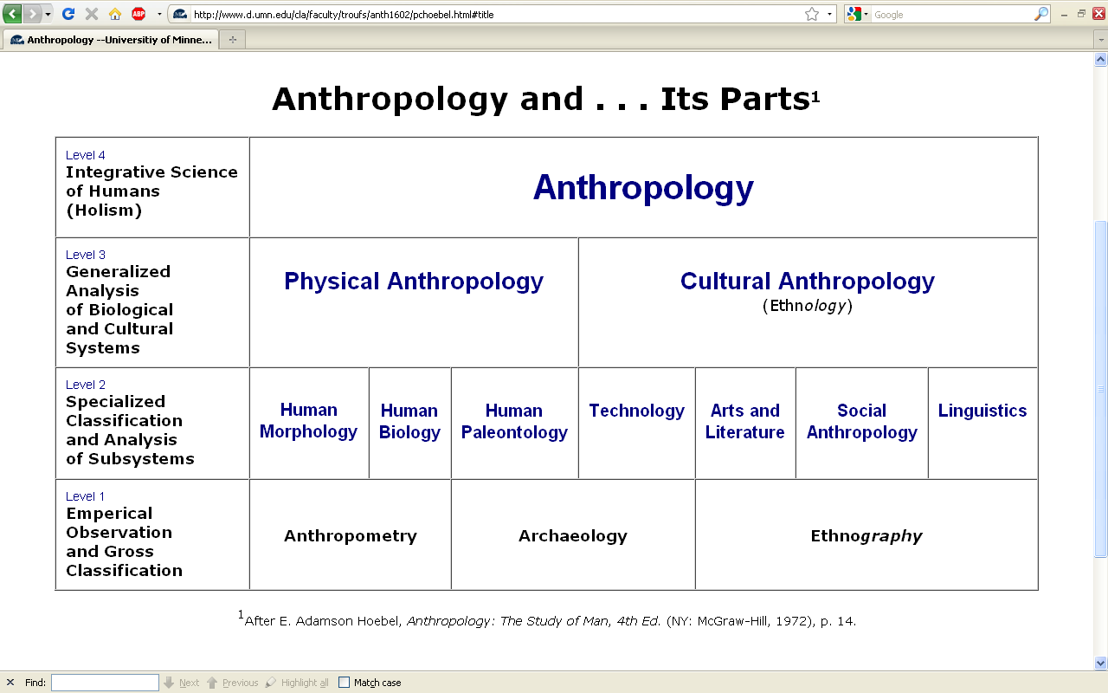
URL link to print: https://www.d.umn.edu/cla/faculty/troufs/anth1602/pchoebel.html#title

Slide 88
REM: We’re having a look at . . .
Food
and its . . .
cultural / social
physical
archaeology
linguistics
and that would appear on the chart as . . .

Slide 89
NOTE:
usually anthropologists read charts from the bottom up
that has to do with the fact that in archaeology the oldest layers are at the bottom of a site and the newer ones are on top

Slide 90
. . . but first note that the two main divisions
of Anthropology are
bio-physical and cultural . . .

Slide 91
Understanding Global Cultures
Anthropology
URL link to print: https://www.d.umn.edu/cla/faculty/troufs/anth1602/pchoebel.html#title

Slide 92
URL link to print: https://www.d.umn.edu/cla/faculty/troufs/anth1602/pchoebel.html#title

Slide 93
Understanding Global Cultures
Anthropology
Bio-physical
URL link to print: https://www.d.umn.edu/cla/faculty/troufs/anth1602/pchoebel.html#title

Slide 94
. . . biophysical involves
things like . . .

Slide 95
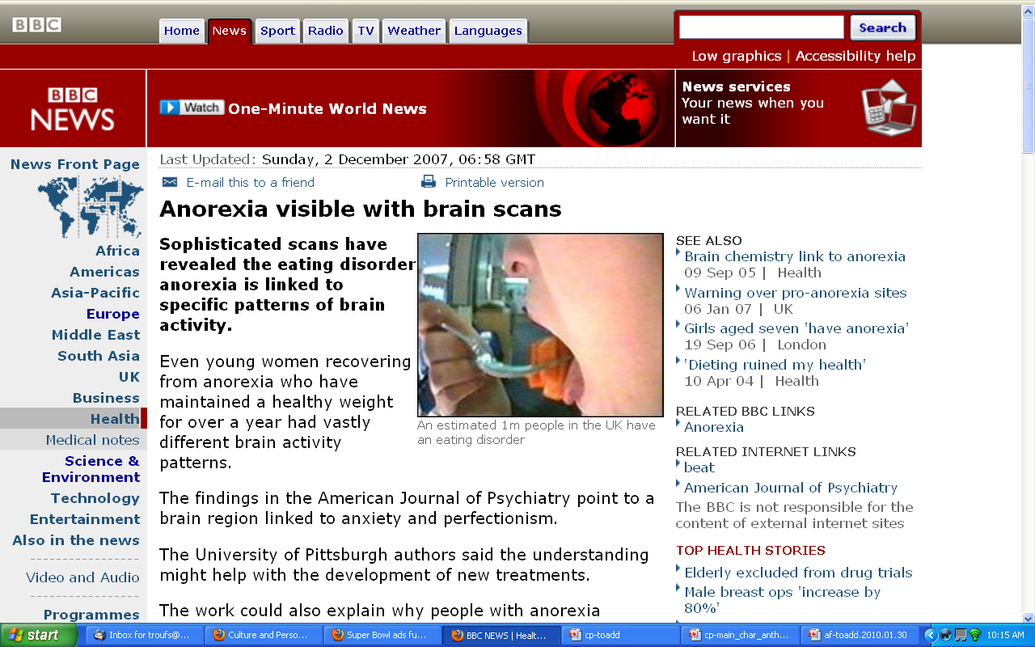
http://news.bbc.co.uk/2/hi/health/7120564.stm

Slide 96
. . . but ultimately anthropologists seek to study phenomena in terms of both physical and cultural aspects
. . .

Slide 97
Understanding Global Cultures
Anthropology
Bio-physical
Cultural
URL link to print: https://www.d.umn.edu/cla/faculty/troufs/anth1602/pchoebel.html#title

Slide 98
  for example, numerous studies have shown that exposure to images [cultural] of ultrathin models can lead to body dissatisfaction and eventually to unhealthy eating behaviors and physical illness [physical] . . .
The Cultural Feast, 2nd ed., p. 115

Slide 99
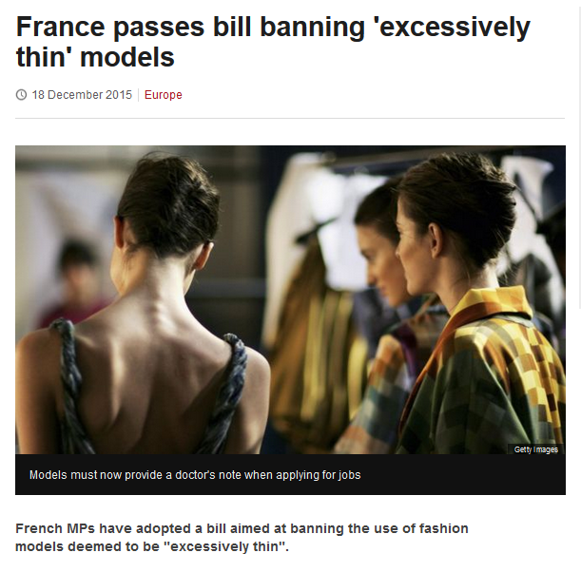
http://www.bbc.com/news/world-europe-35130792

Slide 100
Understanding Global Cultures
. . . and to understand a phenomena in terms of both physical and cultural aspects
. . .
. . . ultimately involves lots of subdisciplines . . .

Slide 101
. . . and that ultimately involves lots of subdisciplines . . .

Slide 102
NOTE:
There are four levels . . .
(REM: read from the bottom up)

Slide 103
URL link to print: https://www.d.umn.edu/cla/faculty/troufs/anth1602/pchoebel.html#title

Slide 104
URL link to print: https://www.d.umn.edu/cla/faculty/troufs/anth1602/pchoebel.html#title

Slide 105
URL link to print: https://www.d.umn.edu/cla/faculty/troufs/anth1602/pchoebel.html#title

Slide 106
URL link to print: https://www.d.umn.edu/cla/faculty/troufs/anth1602/pchoebel.html#title

Slide 107
HOLISM
Involves all four levels
and all
of the physical and cultural
components combined

Slide 108
holism
URL link to print: https://www.d.umn.edu/cla/faculty/troufs/anth1602/pchoebel.html#title

Slide 109
holism
holism
URL link to print: https://www.d.umn.edu/cla/faculty/troufs/anth1602/pchoebel.html#title

Slide 110
Anthropology
URL link to print: https://www.d.umn.edu/cla/faculty/troufs/anth1602/pchoebel.html#title

Slide 111

source

Slide 112
REM
. . . the two main divisions
of Anthropology are
bio-physical and cultural . . .

Slide 113
Understanding Global Cultures
Anthropology
URL link to print: https://www.d.umn.edu/cla/faculty/troufs/anth1602/pchoebel.html#title

Slide 114
Anthropology
Bio-physical
URL link to print: https://www.d.umn.edu/cla/faculty/troufs/anth1602/pchoebel.html#title

Slide 115
Anthropology
Bio-physical
Food and Culture
URL link to print: https://www.d.umn.edu/cla/faculty/troufs/anth1602/pchoebel.html#title

Slide 116
Bio-physical
Food and Culture
URL link to print: https://www.d.umn.edu/cla/faculty/troufs/anth1602/pchoebel.html#title

Slide 117
here is what that would look like
on the Biocultural Framework diagram from The Cultural Feast . . .

Slide 118
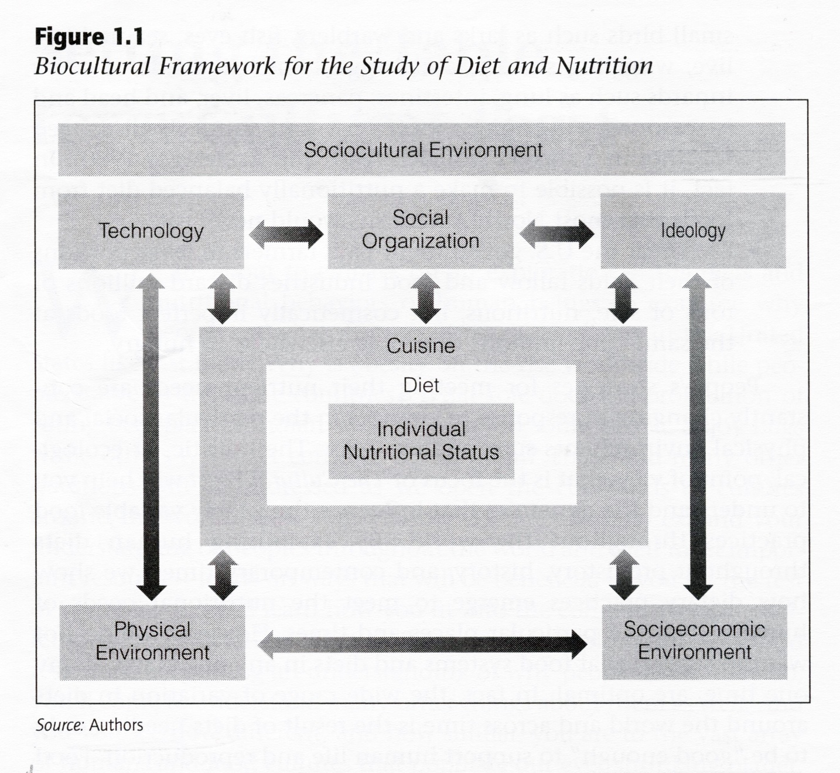
The Cultural Feast, 2nd ed., p. 4

Slide 119
Food and Culture
The Cultural Feast, 2nd ed., p. 4

Slide 120
Food and Culture
Physical Anthropology
The Cultural Feast, 2nd ed., p. 4

Slide 121
. . . biophysical involves
things like . . .

Slide 122
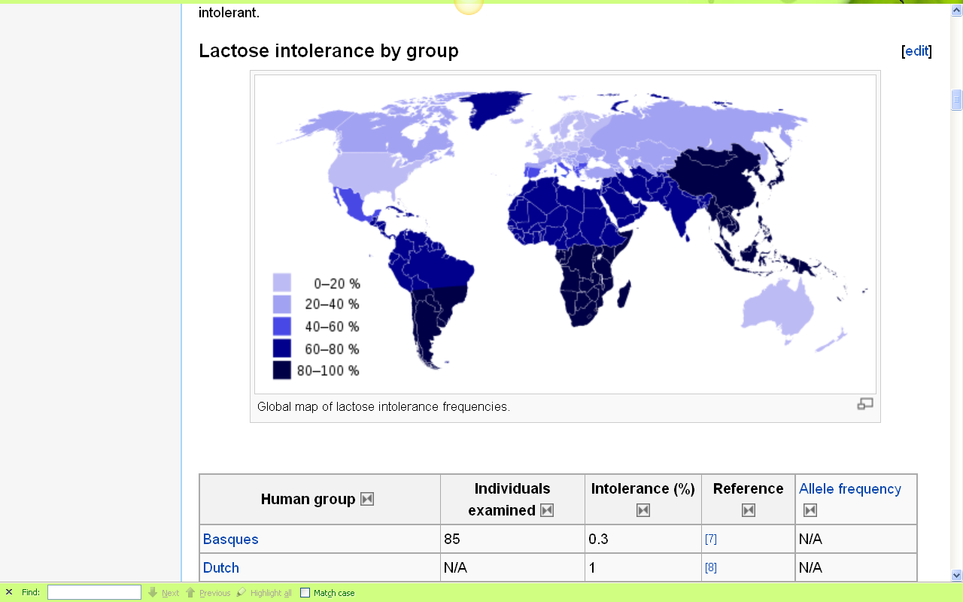
Europeans are some of the few peoples of the world that can drink milk without getting sick
http://en.wikipedia.org/wiki/Lactose_intolerance

Slide 123

BROOKINGS
07 August 2020
https://www.brookings.edu/blog/up-front/2020/08/07/black-and-hispanic-americans-at-higher-risk-of-hypertension-diabetes-obesity-time-to-fix-our-broken-food-system/

Slide 124
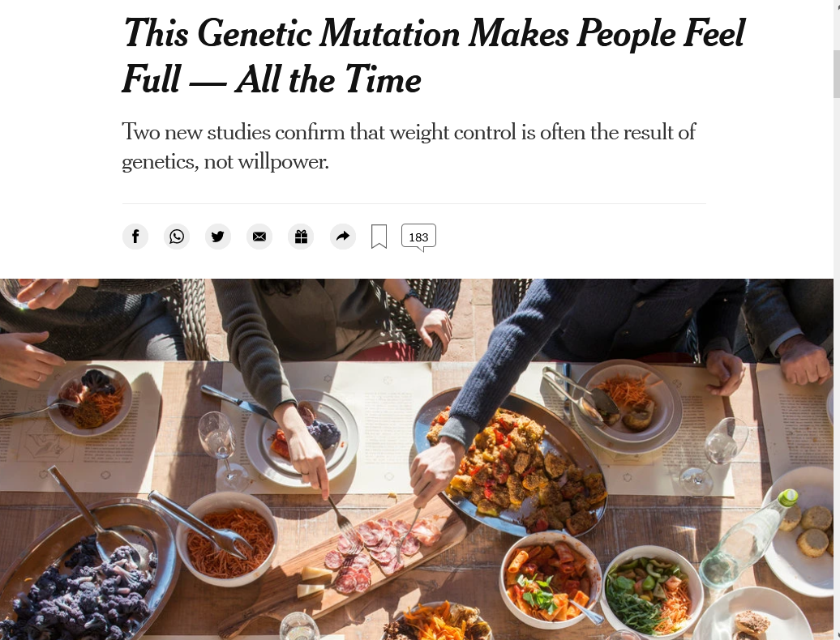
18 April 2019
https://www.nytimes.com/2019/04/18/health/genetics-weight-obesity.html

Slide 125
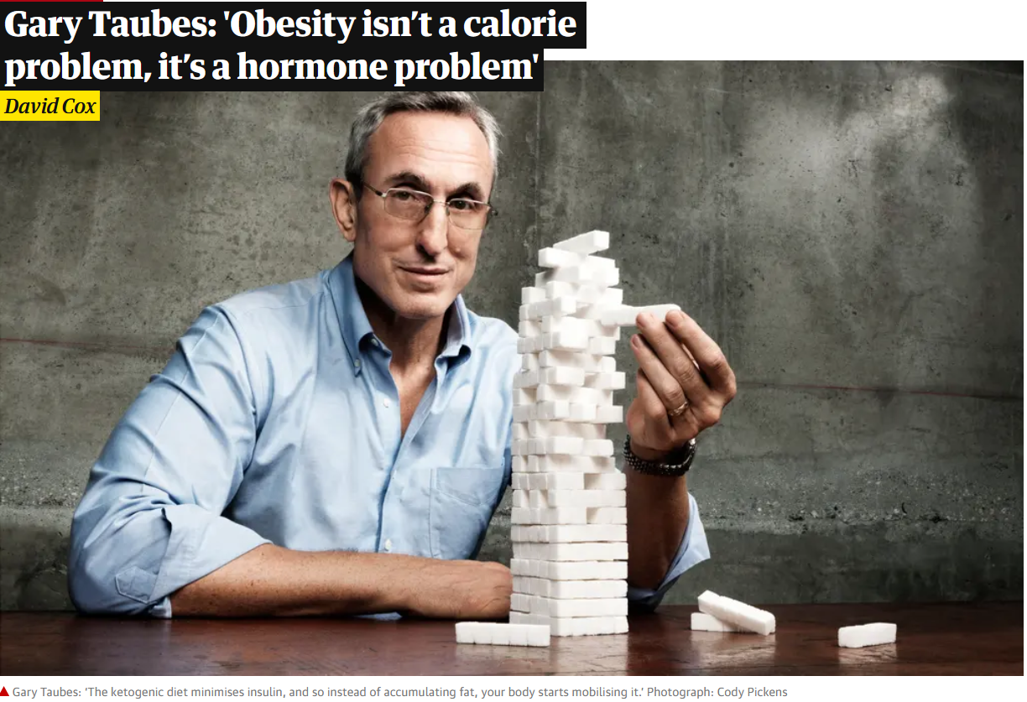

17 Jan 2021
https://www.theguardian.com/society/2021/jan/17/gary-taubes-interview-obesity-calories-hormones-case-for-keto?CMP=Share_iOSApp_Other

Slide 126
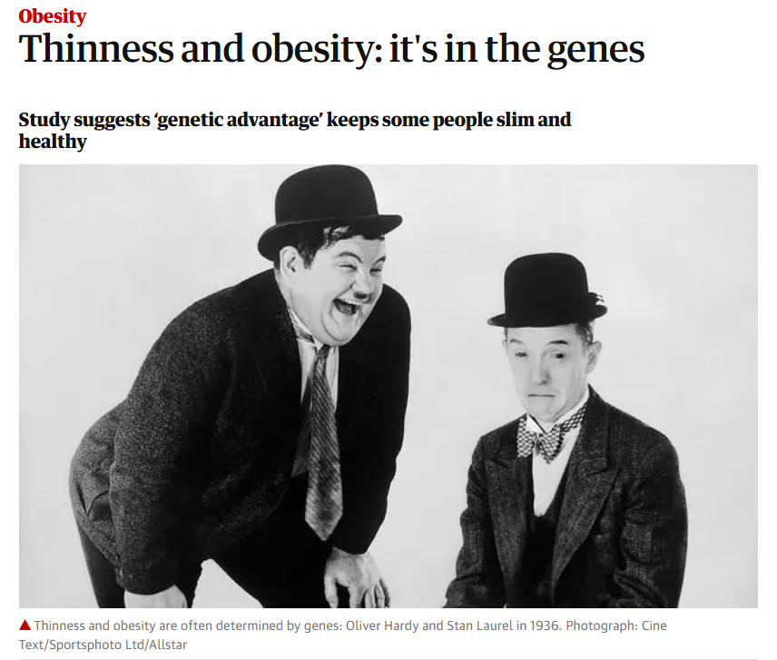
24 Jan 2019
https://www.theguardian.com/society/2019/jan/24/thinness-and-obesity-its-in-the-genes?CMP=Share_iOSApp_Other

Slide 127
. . . but, as mentioned above, ultimately anthropologists seek to study phenomena in terms of both physical and cultural aspects
. . .

Slide 128
Anthropology
Bio-physical
Food and Culture
URL link to print: https://www.d.umn.edu/cla/faculty/troufs/anth1602/pchoebel.html#title

Slide 129
  as in the example mentioned above, numerous studies have shown that exposure to images [cultural] of ultrathin models can lead to body dissatisfaction and eventually to unhealthy eating behaviors and physical illness [physical] . . .
The Cultural Feast, 2nd ed., p. 115

Slide 130

http://news.bbc.co.uk/2/hi/europe/7053725.stm

Slide 131
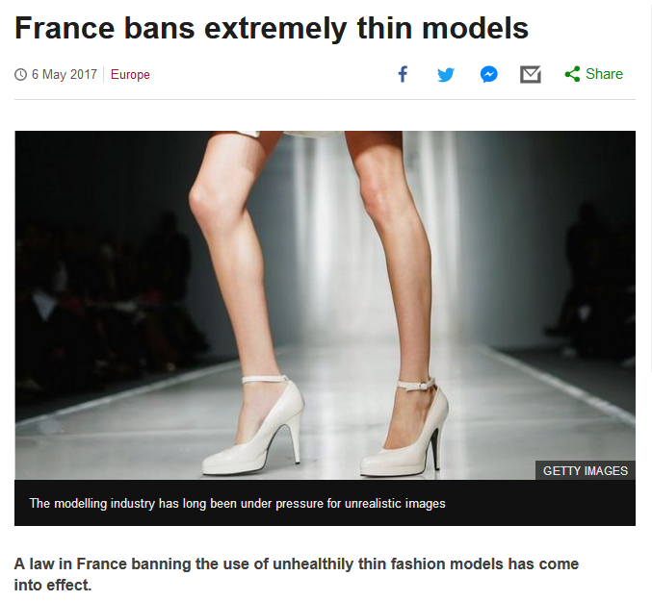
http://www.bbc.com/news/world-europe-39821036http://www.bbc.com/news/world-europe-39821036

Slide 132
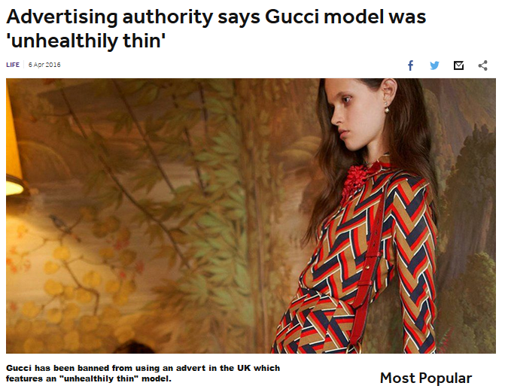
http://www.bbc.co.uk/newsround/35979565

Slide 133

25 May 2018
https://www.theguardian.com/society/2018/may/25/food-firms-may-face-litigation-over-neuromarketing-to-hijack-brains?CMP=Share_iOSApp_Other

Slide 134
Understanding Global Cultures
. . . and to understand a phenomena in terms of both physical and cultural aspects
. . .
. . . ultimately involves lots of disciplines and subdisciplines . . .

Slide 135
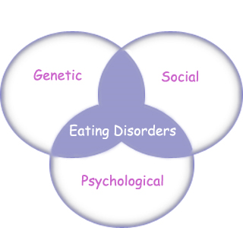
“Eating Disorders are about feelings, not food.”
The Eating Disorder Foundation
www.eatingdisorderfoundation.org/EatingDisorders.htm

Slide 136
. . . and that ultimately involves lots of subdisciplines . . .

Slide 137
Anthropology
Bio-physical |
Food and Culture
measuring
excavating
participant /
observation
URL link to print: https://www.d.umn.edu/cla/faculty/troufs/anth1602/pchoebel.html#title

Slide 138
Anthropology
Bio-physical |
Food and Culture
body
size/shape,
etc.
measuring
excavating
participant /
observation
URL link to print: https://www.d.umn.edu/cla/faculty/troufs/anth1602/pchoebel.html#title

Slide 139
Anthropology
Bio-physical |
Food and Culture
body
size/shape,
etc.
nutrition,
etc.
measuring
excavating
participant /
observation
URL link to print: https://www.d.umn.edu/cla/faculty/troufs/anth1602/pchoebel.html#title

Slide 140
Anthropology
Bio-physical |
Food and Culture
body
size/shape,
etc.
nutrition,
etc.
hunting /
meat eating
measuring
excavating
participant /
observation
URL link to print: https://www.d.umn.edu/cla/faculty/troufs/anth1602/pchoebel.html#title

Slide 141
Anthropology
Bio-physical |
Food and Culture
body
size/shape,
etc.
nutrition,
etc.
hunting /
meat eating
the
“Agricultural
Revolution”
measuring
excavating
participant /
observation
URL link to print: https://www.d.umn.edu/cla/faculty/troufs/anth1602/pchoebel.html#title

Slide 142
Anthropology
Bio-physical |
Food and Culture
body
size/shape,
etc.
nutrition,
etc.
hunting /
meat eating
the
“Agricultural
Revolution”
food in
art
literature
measuring
excavating
participant /
observation
URL link to print: https://www.d.umn.edu/cla/faculty/troufs/anth1602/pchoebel.html#title

Slide 143
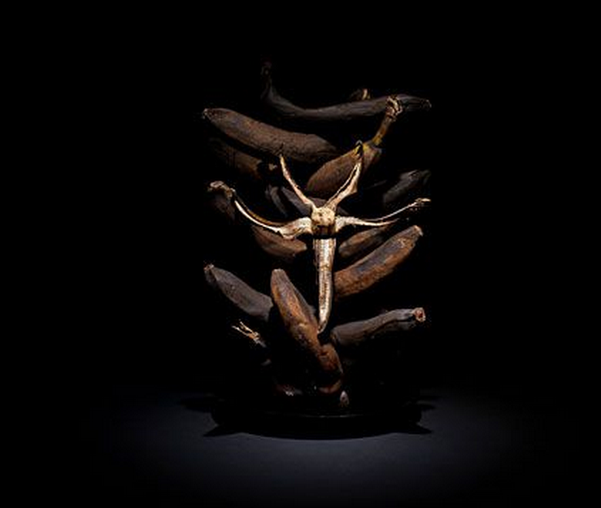
Forum discussion topic

Slide 144
Anthropology
Bio-physical |
Food and Culture
body
size/shape,
etc.
nutrition,
etc.
hunting /
meat eating
the
“Agricultural
Revolution”
food in
art
literature
food and
society and
belief, etc.
measuring
excavating
participant /
observation
URL link to print: https://www.d.umn.edu/cla/faculty/troufs/anth1602/pchoebel.html#title

Slide 145
Anthropology
Bio-physical |
Food and Culture
body
size/shape,
etc.
nutrition,
etc.
hunting /
meat eating
the
“Agricultural
Revolution”
food in
art
literature
food and
society and
belief, etc.
food
and
language
measuring
excavating
participant /
observation
URL link to print: https://www.d.umn.edu/cla/faculty/troufs/anth1602/pchoebel.html#title

Slide 146
some examples of holistic comparative work include . . .

Slide 147
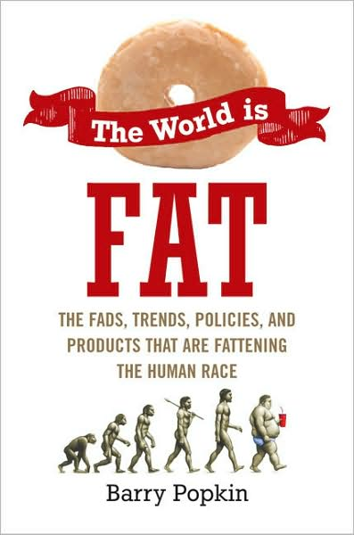
Penguin Avery, 2009

Slide 148
“I’m one of the few experts—if not the only expert—to have conducted large-scale, longitudinal surveys following obesity on a global scale.” (p. 2)
Penguin Avery, 2009

Slide 149
Barry Popkin’s work looks at . . .
(Trivia: Barry is from Superior, WI, and includes Superior in his comparisons in this book)

Slide 150
Anthropology
Bio-physical |
Food and Culture
body
size/shape,
etc.
nutrition,
etc.
hunting /
meat eating
the
“Agricultural
Revolution”
food in
art
literature
food and
society and
belief, etc.
food
and
language
measuring
excavating
participant /
observation
URL link to print: https://www.d.umn.edu/cla/faculty/troufs/anth1602/pchoebel.html#title

Slide 151
In some ways this chart business is all about
Theory
but key theory that is important to the understanding of the Anthropology of Food

Slide 152
theory
holism
URL link to print: https://www.d.umn.edu/cla/faculty/troufs/anth1602/pchoebel.html#title

Slide 153
theory
holism
and the theory ultimately also includes the
results of interdisciplinary study,
esp. with food history, nutrition studies, and the business of producing, distributing and marketing food . . .
URL link to print: https://www.d.umn.edu/cla/faculty/troufs/anth1602/pchoebel.html#title

Slide 154
theory
One excellent example of holism in action is
Nassim Nicholas Taleb’s
INCERTO. . .

Slide 155
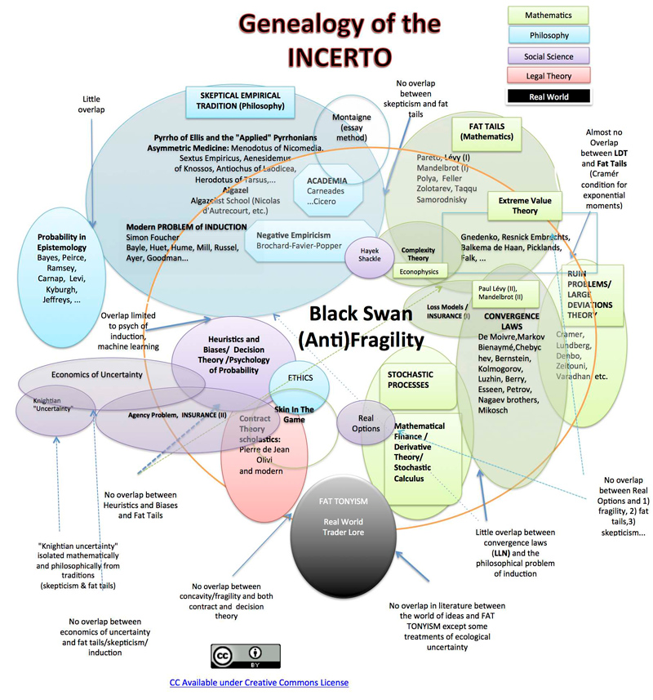

Slide 156
And finally,
we have the last
main characteristic of anthropology . . .

Slide 157
Main Characteristics of Anthropology
1. the four fields of general anthropology
culture as a primary concept
comparative method as major approach
holism as a primary theoretical goal
fieldwork as a primary research technique

Slide 158
Most of all (generally)
Anthropologists
LOVE . . .

Slide 159
Main Characteristics of Anthropology
1. the four fields of general anthropology
culture as a primary concept
comparative method as major approach
holism as a primary theoretical goal
fieldwork
as a primary research technique --
involving “participant observation”

Slide 160
The End
Holism
in
Anthropology
Anthropology of Food
University of Minnesota Duluth
Tim Roufs
© 2021-2026
http://en.wikipedia.org/wiki/Highland_cattle

