Slide 1
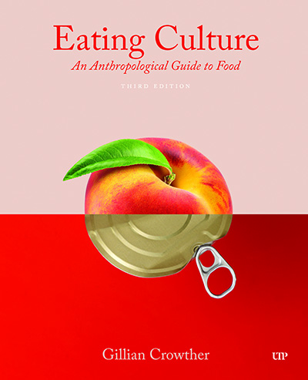
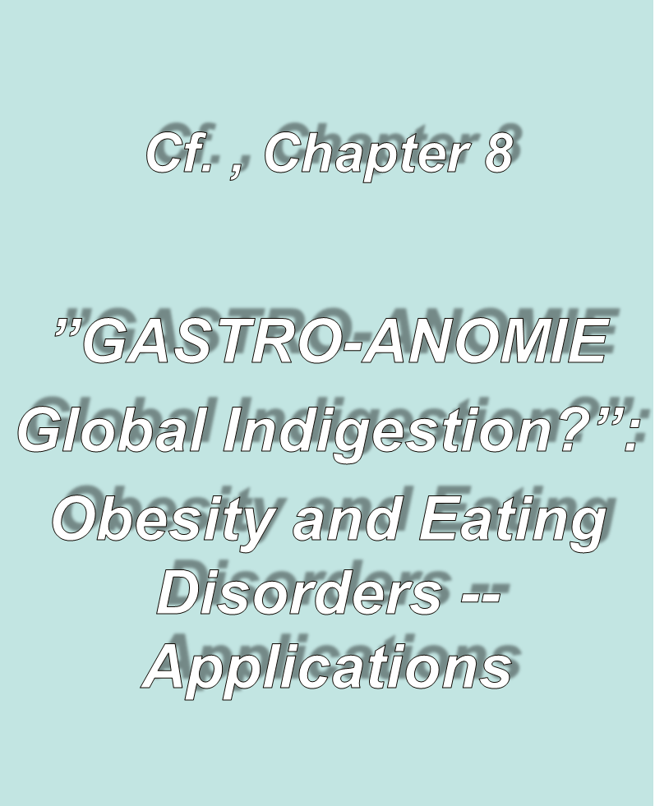
Use your up / down arrow keys and / or
your space bar to advance the slides
Tim Roufs
© 2010-2026
Tim Roufs
© 2010-2026

Slide 2
Tim Roufs
© 2010-2026
Tim Roufs
© 2010-2026

Slide 3
Tim Roufs
© 2010-2026
Tim Roufs
© 2010-2026

Slide 4
“Eating is a Cultural Affair” — Body Image and Health
The Obesity Epidemic
Disordered Body Image and Eating Behaviors
Eating Disorders
Anorexia nervosa
Bulimia nervosa
Binge eating
Orthorexia nervosa
Selective Eating Disorder (SED)
Pica
Others
What Causes Eating Disorders?
Applications

Slide 5
“Eating is a Cultural Affair” — Body Image and Health
success in assisting people in achieving their ideal weight requires an understanding of both the medical and cultural definitions of the term “ideal weight,” as well as the ability to reconcile the differences between them . . .
The Cultural Feast, 2nd ed., pp. 116-117

Slide 6
“Eating is a Cultural Affair” — Body Image and Health
medically, ideal weight is usually determined in terms of height, as given in the body mass index, Metropolitan Life Insurance tables,
or other indexes . . .
The Cultural Feast, 2nd ed., p. 117

Slide 7

“Eating is a Cultural Affair” — Body Image and Health
or use a calculator
or a BMI table . . .
The Cultural Feast, 2nd ed., p. 107

Slide 8
it’s easier to figure out
by looking at
a BMI height/weight table . . .

Slide 9
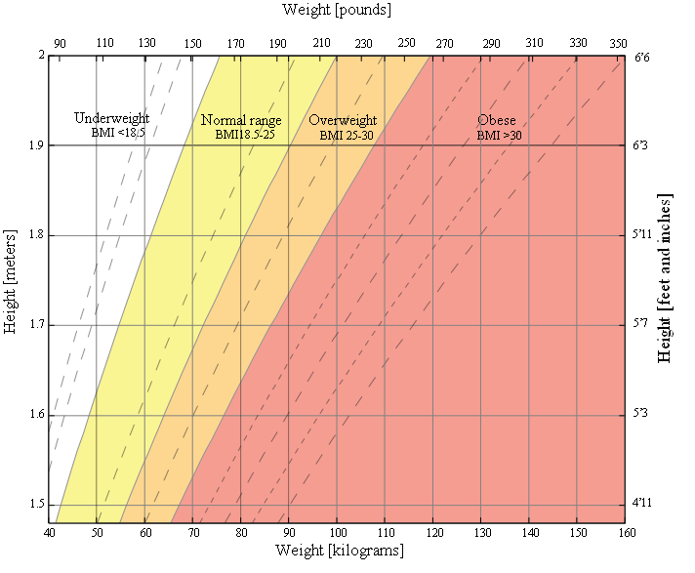
http://en.wikipedia.org/wiki/Body_mass_index

Slide 10
“Eating is a Cultural Affair” — Body Image and Health
if your BMI is equal to or above 25, you are considered overweight
if it is equal to or above 30,
you are considered obese
(unless you are extremely muscular)
underweight is defined as having a BMI below 19
The Cultural Feast, 2nd ed., p. 107

Slide 11
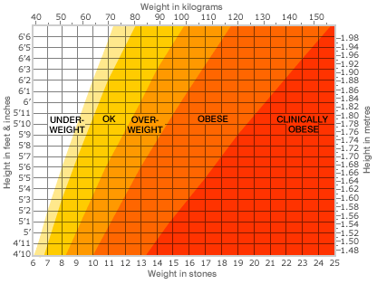
http://news.bbc.co.uk/2/hi/health/5297790.stm

Slide 12
“Eating is a Cultural Affair” — Body Image and Health
because the relative amounts of fat and muscle tissue and bone size vary greatly from person to person, ideal weights are given as ranges . . .
The Cultural Feast, 2nd ed., p. 117

Slide 13
“Eating is a Cultural Affair” — Body Image and Health
many experts argue
that these ranges should be made even more flexible . . .
and point out that the health hazards are associated only with extreme overweight and underweight
(that is, 20% over or under the ideal range)
The Cultural Feast, 2nd ed., p. 117

Slide 14
“Eating is a Cultural Affair” — Body Image and Health
recommendations to diet, therefore, should be directed
only to those who are extremely
over- or underweight . . .
(that is, 20% over or under the ideal range)
The Cultural Feast, 2nd ed., p. 117

Slide 15
“Eating is a Cultural Affair” — Body Image and Health
flexibility allows one to adapt to cultural notions of body size . . .
working at the upper end of the range in cultures that value fatness
working with the lower end of the range in cultures that value thinness
The Cultural Feast, 2nd ed., p. 117

Slide 16
“Eating is a Cultural Affair” — Body Image and Health
efforts reinforcing unrealistic standards of beauty and thinness may do as much harm as good . . .
one must avoid “contributing to the barrage of media messages portraying an ultrathin figure as the only way to be attractive and healthy”
The Cultural Feast, 2nd ed., p. 117

Slide 17
“Eating is a Cultural Affair” — Body Image and Health
proactive behaviors include . . .
increased fruit and vegetable consumption
physical activity, rather than dieting
focusing on a wide variety of benefits rather than solely on weight loss
e.g., ethnic pride with Native American youth
The Cultural Feast, 2nd ed., p. 117

Slide 18
“Eating is a Cultural Affair” — Body Image and Health
avoid blaming the victim . . .
focus on environmental factors rather than just individual knowledge and attitudes
support lowering the fat content of school cafeteria food
support offering phy ed programs during or after school
building walking trails in safe neighborhoods
The Cultural Feast, 2nd ed., p. 117

Slide 19
“Eating is a Cultural Affair” — Body Image and Health
avoid blaming the victim . . .
reframe weight-loss goals so that even small weight losses are considered successful and cause for celebration
The Cultural Feast, 2nd ed., p. 117

Slide 20
“Eating is a Cultural Affair” — Body Image and Health
debate continues on the feasibility of significant, long-term weight loss for severely overweight people, and some medical professionals have change their approach radically, recommending a “nondiet” approach to eating moderately . . .
(Parham1999)
The Cultural Feast, 2nd ed., p. 118

Slide 21
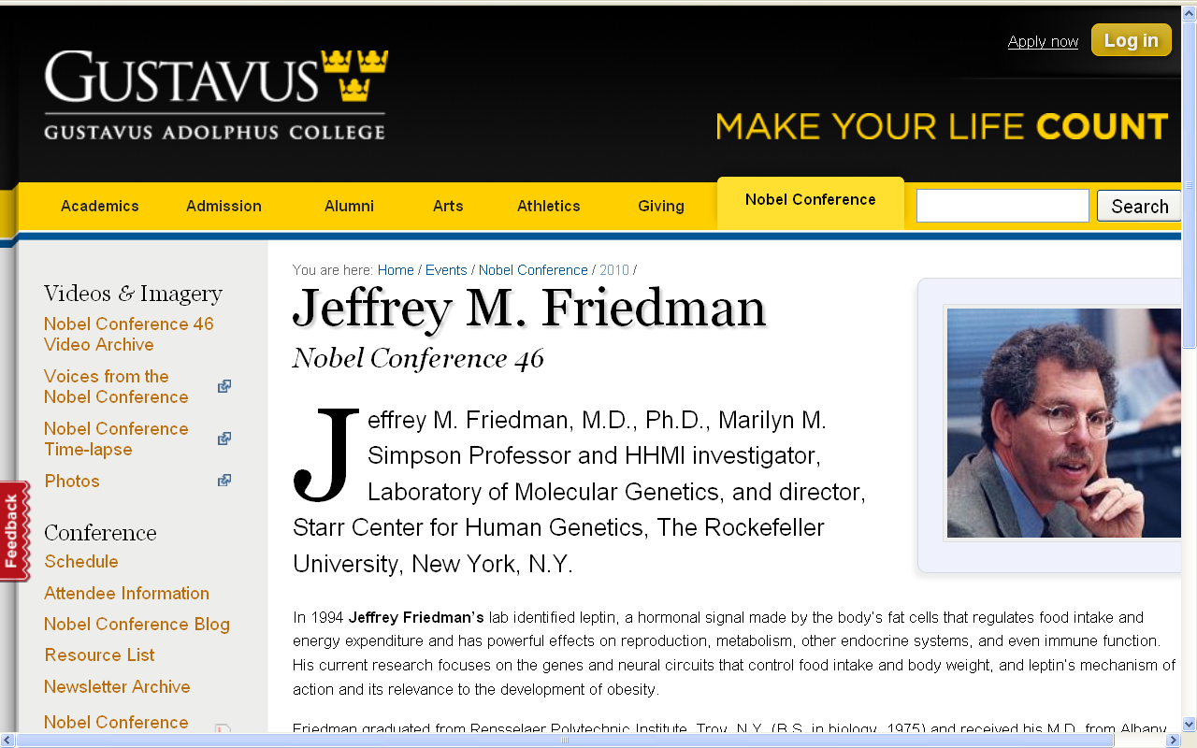
Friedman essentially said diets do not work in the long run, that people eventually level off at a weight that for them is more or less genetically determined and “natural” . . .

Slide 22
“Eating is a Cultural Affair” — Body Image and Health
others focus their efforts on prevention of obesity rather than weight loss . . .
(Parham1999)
The Cultural Feast, 2nd ed., p. 118

Slide 23
“Eating is a Cultural Affair” — Body Image and Health
anorexia nervosa, bulimia, and other severe forms of eating disorders are not nutritional problems . . .
and may require assistance from other professionals . . .
(Parham1999)
The Cultural Feast, 2nd ed., p. 118

Slide 24

“Eating is a Cultural Affair” — Body Image and Health
And sometimes even the physicians specializing in relevant medial complications, the other medical personnel skilled in treating eating disorders, the psychologists, nutritionists, and the prayers of all of the good sisters at the
St. Scholastica Monastery
can’t help . . .

Slide 25
“Eating is a Cultural Affair” — Body Image and Health
for further study consider . . .
ANTH 3080 - Cultural Constructions of the Body (4.0 cr; Prereq-Min 30 cr or #; A-F or Aud, fall, spring, offered periodically) Contemporary cultural constructions of the human body. How biology and culture intersect in body building, menstruation, childbirth, and tattooing. Students gain skills in reading the body as social text and learn core theoretical approaches to cultural studies of the body.
PSY 3540 - Psychology of Food Abuse (3.0 cr; Prereq-1003 or #; A-F or Aud, fall, spring, summer, every year) Basic understanding of eating disorders: obesity, binge eating, anorexia, bulimia, and social, psychological, and physical influences on normal and abnormal eating. Social evaluation of obesity.

Slide 26
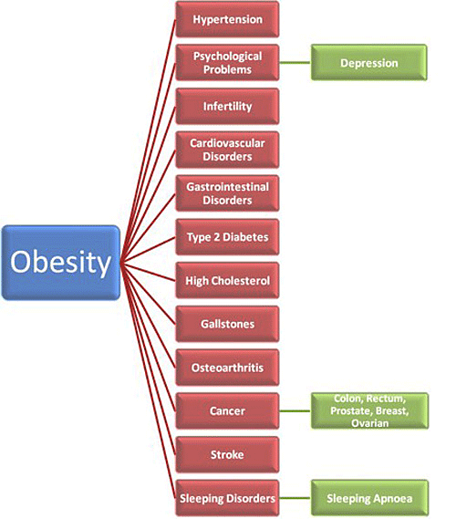
DARWINS NIGHTMARE
DARWINS NIGHTMARE
http://www.redefiningthefaceofbeauty.com/2012/07/o-b-e-si-t-y-new-form-of-child-neglect.html
Notes:
26

Slide 27
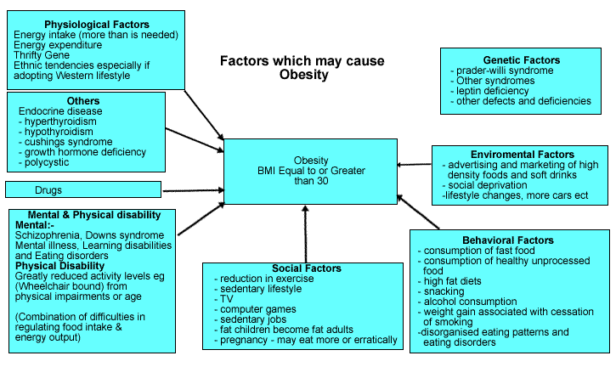
http://www.dwp.gov.uk/publications/specialist-guides/medical-conditions/a-z-of-medical-conditions/obesity/causes-obesity.shtml
Notes:
27

Slide 28
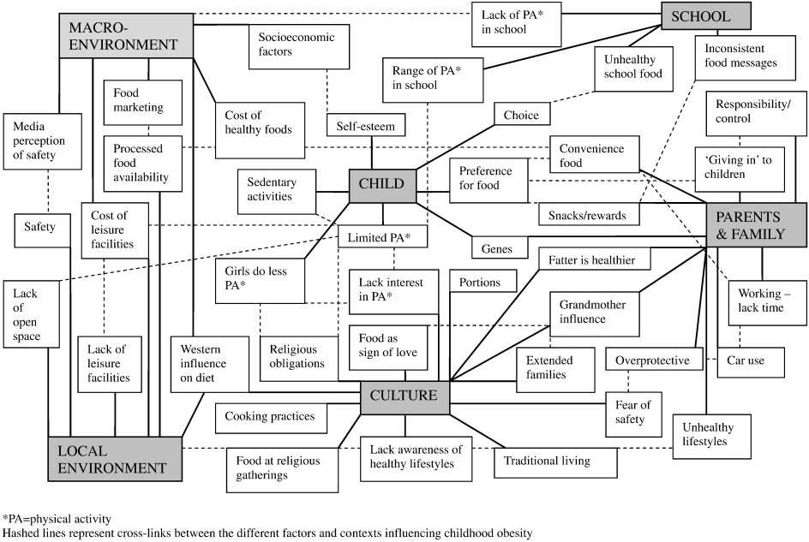
A “holistic” approach
http://www.sciencedirect.com/science/article/pii/S0091743512000394
Notes:
28

Slide 29
Tim Roufs
© 2010-2026
Tim Roufs
© 2010-2026

