Slide 1
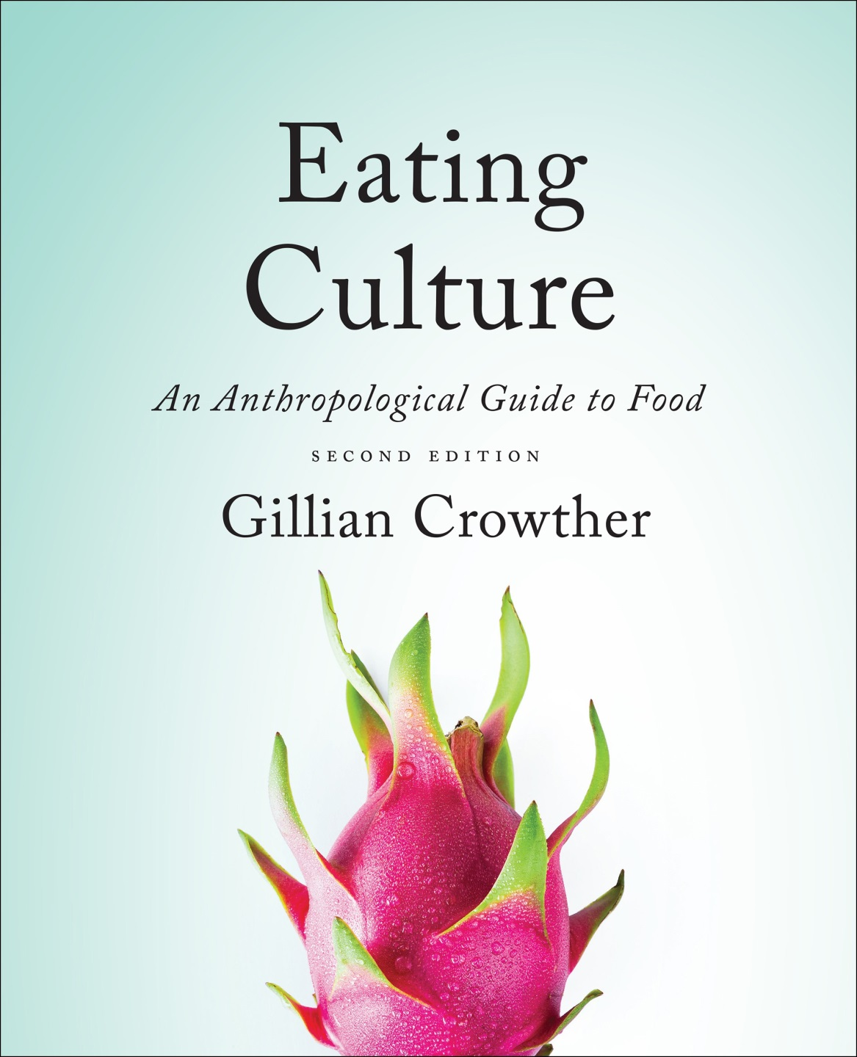
Cf. , Chapter 8
”GASTRO-ANOMIE
Global Indigestion?”:
The Obesity Epidemic
Use your up / down arrow keys and / or
your space bar to advance the slides
Tim Roufs
© 2010-2024
www.d.umn.edu/cla/faculty/troufs/anthfood/aftexts.html#title

Slide 2
Cf. , Chapter 8
”GASTRO-ANOMIE
Global Indigestion?”:
The Obesity Epidemic
Tim Roufs
© 2010-2024
www.d.umn.edu/cla/faculty/troufs/anthfood/aftexts.html#title

Slide 3
Tim Roufs
© 2010-2024
www.d.umn.edu/cla/faculty/troufs/anthfood/aftexts.html#title

Slide 4

Chapter 4
”Eating is a
Cultural Affair” —
The “Obesity Epidemic”
pp.105-118
©Timothy G. Roufs 2010-2024

Slide 5
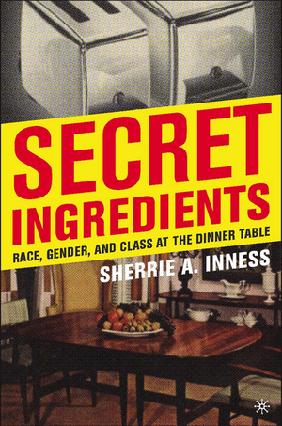
        “The Fat Ladies rebelled against a society that despises fatness.”
Sherrie A. Inness, Secret Ingredients, Palgrave Macmillan, 2006, p. 171

Slide 6
        “It’s the last taboo, isn’t it—fat?”
        —Jennifer Patterson
        of The Two Fat Ladies fame
Sherrie A. Inness, Secret Ingredients, Palgrave Macmillan, 2006, p. 177

Slide 7
        “It’s all the fault
        of the Duchess of Windsor.
        She came up with that stupid line,
        ‘You can never be too rich nor too thin.’
        And America took it to their heart.”
        —Jennifer Patterson
Sherrie A. Inness, Secret Ingredients, Palgrave Macmillan, 2006, p. 177

Slide 8
        “The Fat Ladies rebelled against a society that despises fatness.”
          American culture scapegoats fat people in much the same way that it scapegoats white trash.”
            Redneck jokes reassure the middle class that they have not fallen that low
            Similarly, jokes about fat people reassure less-fat individuals that they have not gained as much as heavier people
Sherrie A. Inness, Secret Ingredients, Palgrave Macmillan, 2006, p. 171

Slide 9
        “The Fat Ladies rebelled against a society that despises fatness.”
          “The American Mainstream hates fat people and seems to feel little or no need to hide that emotion.”
          “U.S. society belittles fat people of
          all genders, socioeconomic
          backgrounds, races, ethnicities, and ages.”
Sherrie A. Inness, Secret Ingredients, Palgrave Macmillan, 2006, p. 171

Slide 10
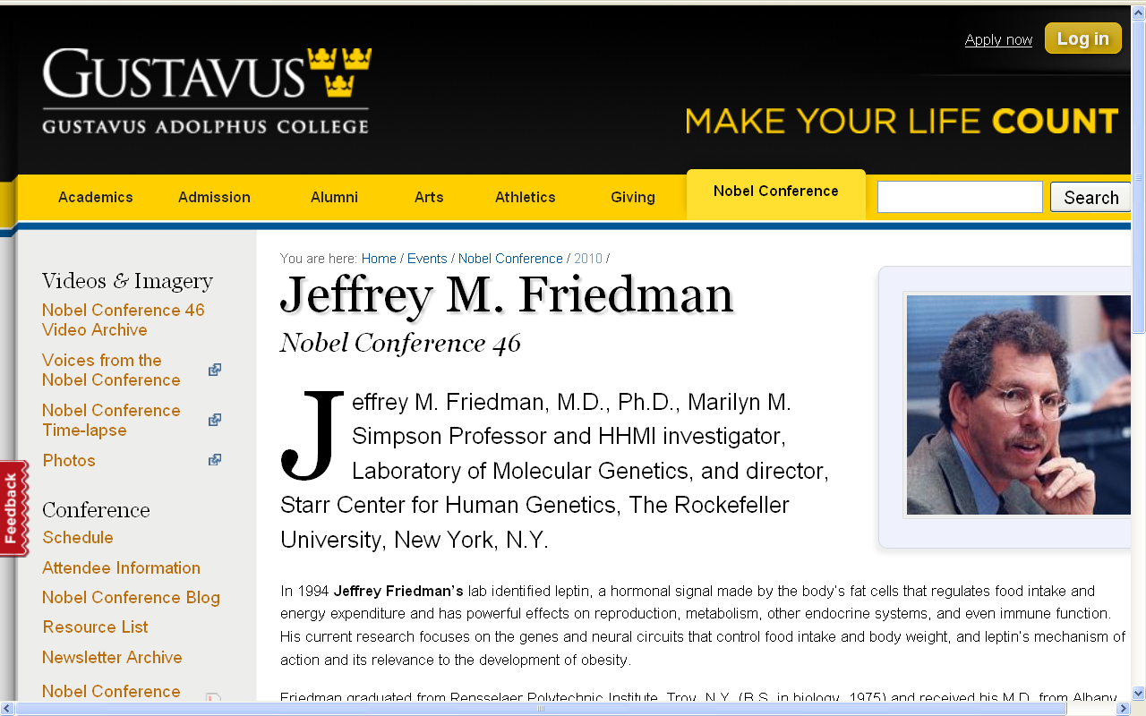
Friedman noted this prejudice in his address to the 2010 Nobel “Making Food Good” Conference . . .

Slide 11
He pointed out that that prejudice against fat people is one of the few prejudices still openly tolerated in America

Slide 12
        “The Fat Ladies rebelled against a society that despises fatness.”
          “The American Mainstream hates fat people and seems to feel little or not need to hide that emotion.”
          “U.S. society belittles fat people of
          all genders, socioeconomic
          backgrounds, races, ethnicities, and ages.”
Sherrie A. Inness, Secret Ingredients, Palgrave Macmillan, 2006, p. 171

Slide 13
for example . . .

Slide 14
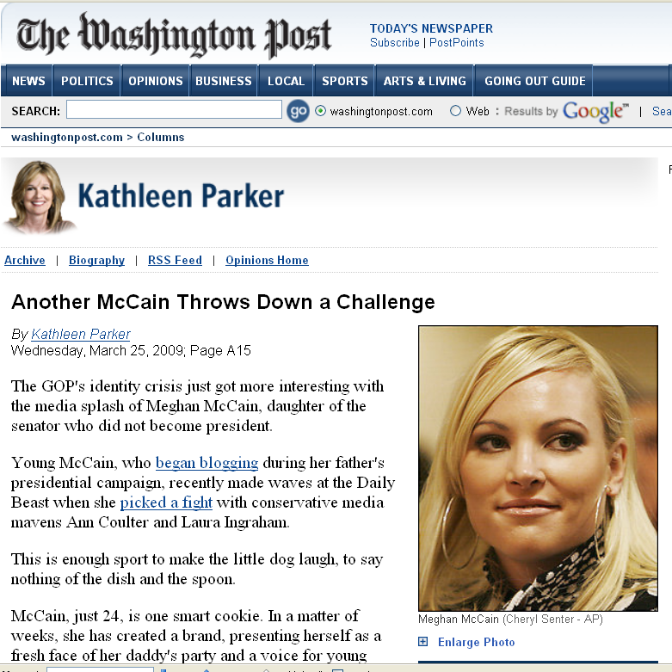
www.washingtonpost.com/wp-dyn/content/article/2009/03/24/AR2009032402465.html

Slide 15
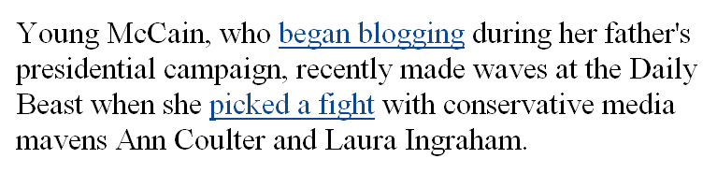
www.washingtonpost.com/wp-dyn/content/article/2009/03/24/AR2009032402465.html

Slide 16
and what immediately became the issue
in the fight?
www.washingtonpost.com/wp-dyn/content/article/2009/03/24/AR2009032402465.html

Slide 17
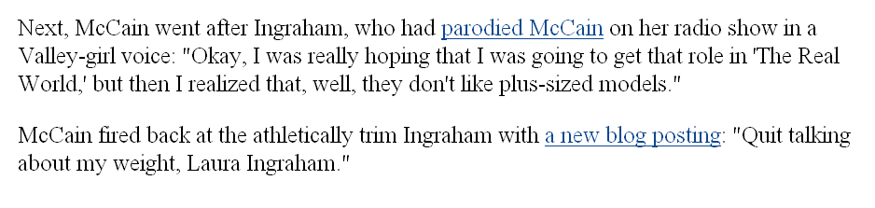
www.washingtonpost.com/wp-dyn/content/article/2009/03/24/AR2009032402465.html

Slide 18
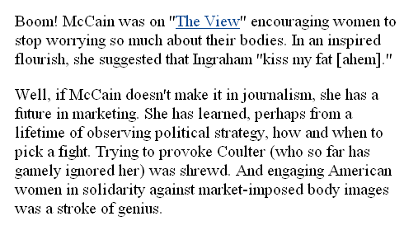
www.washingtonpost.com/wp-dyn/content/article/2009/03/24/AR2009032402465.html

Slide 19
beauty is, of course, relative . . .
but I think it’s fair to say, all politics aside,
that Ms. McCain is not ugly . . .

Slide 20
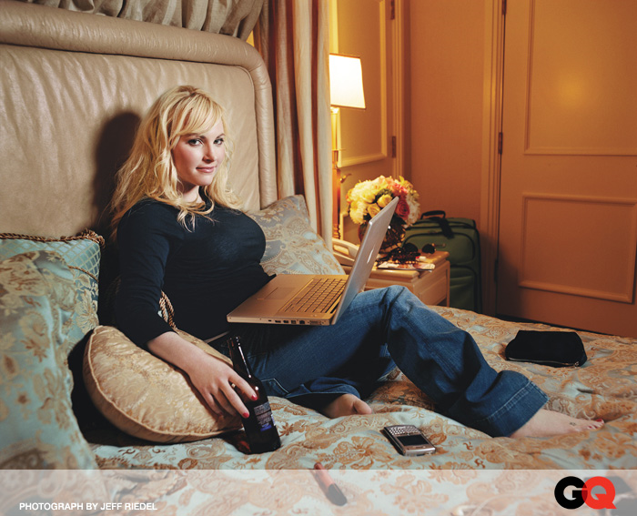
www.washingtonpost.com/wp-dyn/content/article/2009/03/24/AR2009032402465.html

Slide 21
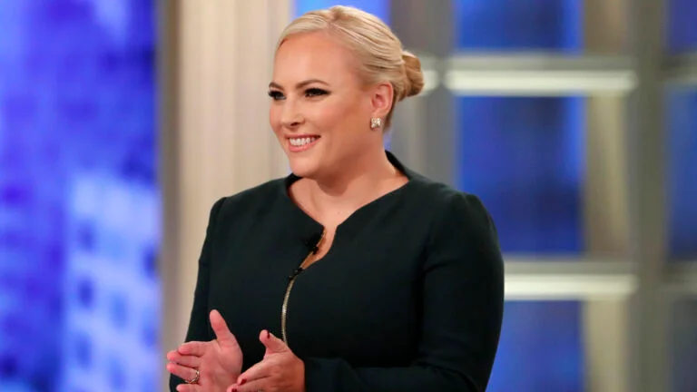
The Associated Press, Associated Press
06 August 2021
https://www.boston.com/culture/tv/2021/08/06/meghan-mccain-the-view-exit-video/

Slide 22
“Eating is a Cultural Affair” — Body Image and Health
  different cultures have different ideals for beauty
  and for body size . . .
The Cultural Feast, 2nd ed., p. 105

Slide 23
“Eating is a Cultural Affair” — Body Image and Health
  In some—maybe even many—a culture’s fatness is valued as a sign of wealth,
  and thinness as evidence that women are poor and undernourished
The Cultural Feast, 2nd ed., p. 105

Slide 24
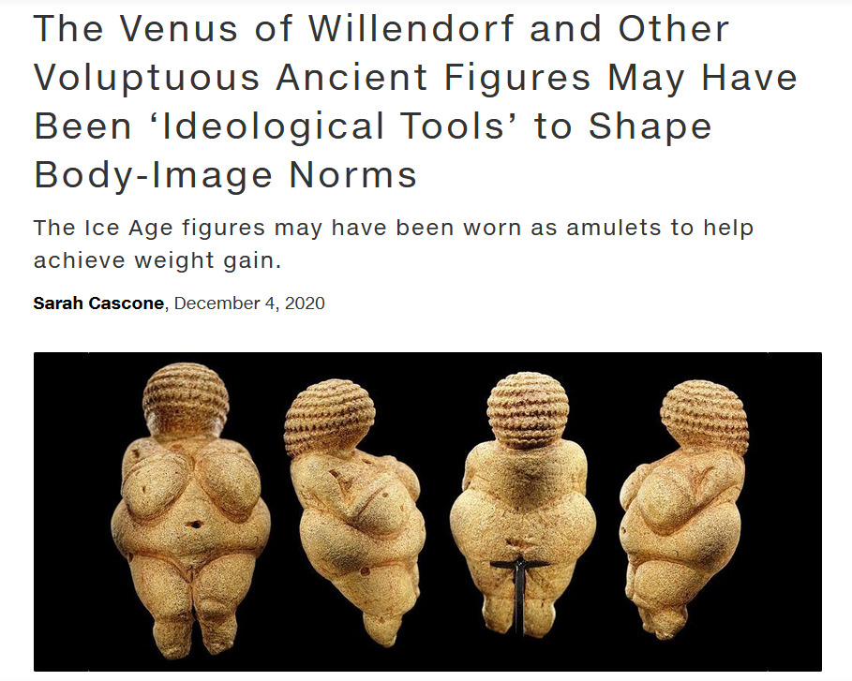
https://news.artnet.com/art-world/venus-figurines-obesity-1928873

Slide 25
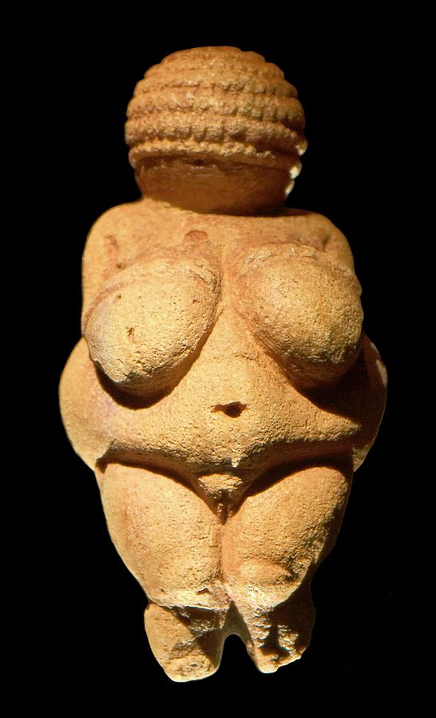
Venus of Willendorf
https://en.wikipedia.org/wiki/Venus_of_Willendorf

Slide 26
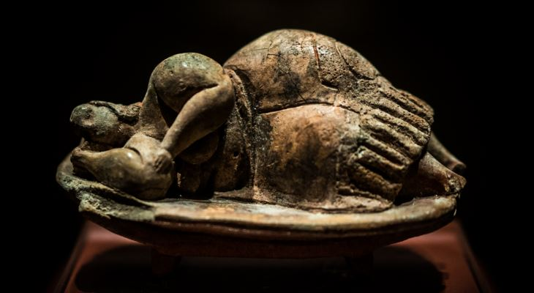
The Dreaming Goddess of Malta
https://www.guidememalta.com/en/5-things-you-didn-t-know-about-malta-gozo-s-prehistoric-temples

Slide 27
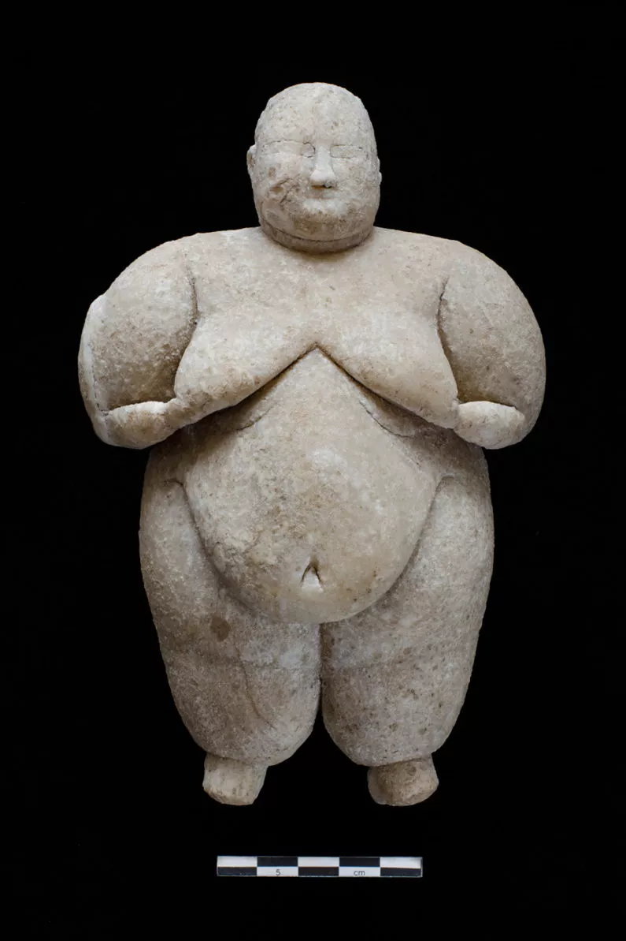
Neolithic Goddess, Çatalhöyük, Turkey
Turkeyhttps://www.livescience.com/56515-neolithic-goddess-figurine-uncovered.html

Slide 28
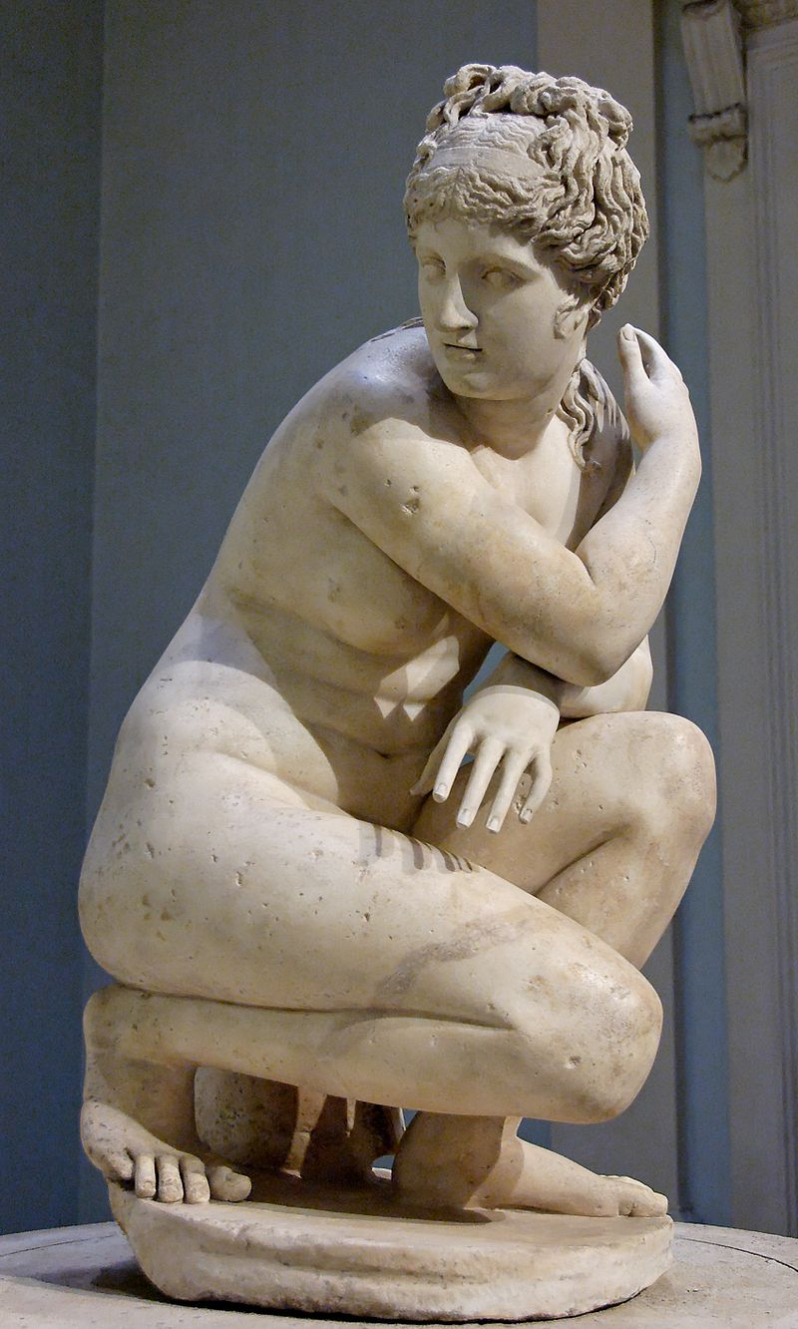
The Lely's Venus, copy of Hellenistic statue
https://en.wikipedia.org/wiki/Lely_Venus

Slide 29
Chapter 4: “Eating is a Cultural Affair” — Body Image and Health
  In some—maybe even many—a culture’s fatness is valued as a sign of wealth, and thinness as evidence that women are poor and undernourished
The Cultural Feast, 2nd ed., p. 105

Slide 30
Leblouh
(Arabic: البلوح‎, romanized: lə-blūḥ)

Slide 31

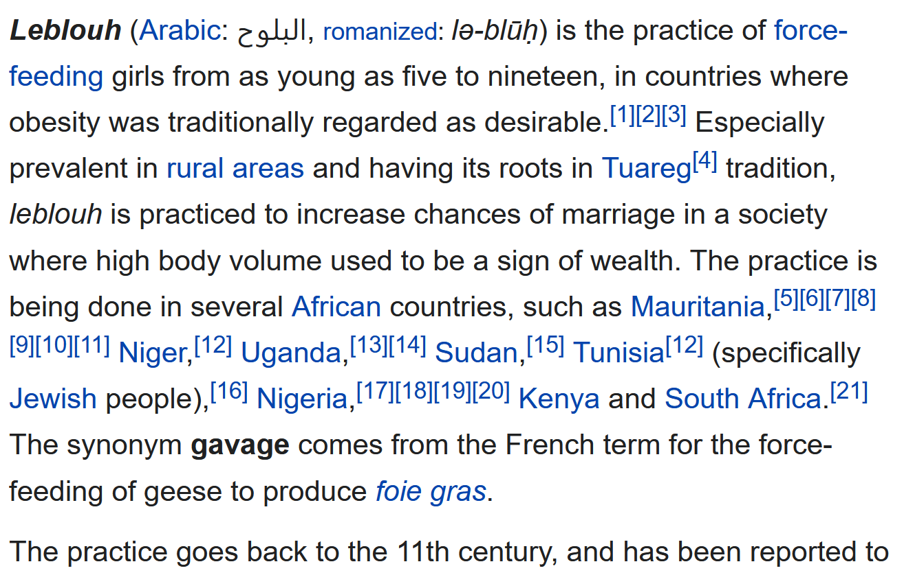


Leblouh
https://en.wikipedia.org/wiki/Leblouh

Slide 32
“Eating is a Cultural Affair” — Body Image and Health
  cultural notions about
  ideal body size and shape have important implications for the publics’ health
The Cultural Feast, 2nd ed., p. 105

Slide 33
let’s have a look at what
The Cultural Feast
has to say . . .

Slide 34
  The Obesity Epidemic
  Disordered Body Image and Eating Behaviors
  Eating Disorders
    Anorexia nervosa
    Bulimia nervosa
    Binge eating
    Orthorexia nervosa
    Selective Eating Disorder (SED)
    Pica
    Others
  What Causes Eating Disorders?
  Applications

Slide 35
“Eating is a Cultural Affair” — Body Image and Health
  The Obesity Epidemic
  Disordered Body Image and Eating Behaviors
  Eating Disorders
    Anorexia nervosa
    Bulimia nervosa
    Binge eating
    Orthorexia nervosa
    Selective Eating Disorder (SED)
    Pica
    Others
  What Causes Eating Disorders?
  Applications

Slide 36
“Eating is a Cultural Affair” — Body Image and Health
  Despite their idealization of thinness,
  increasing numbers
  of North Americans
  have become overweight,
  and in the last three decades the problem has reached epidemic proportions
The Cultural Feast, 2nd ed., p. 105

Slide 37
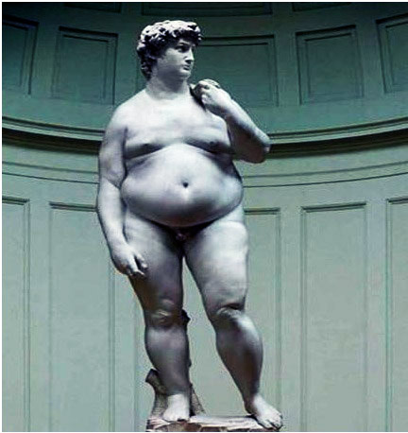
"After a short stay in America,
Michelangelo's David
has been returned to Europe"
www.wsoctv.com/news/17262427/detail.html

Slide 38
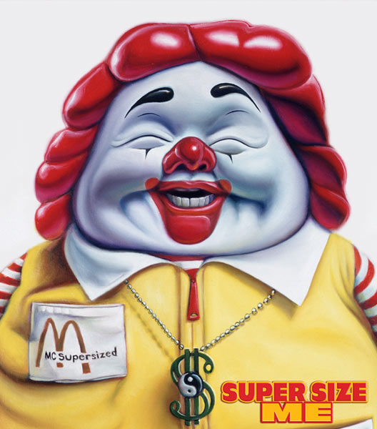
http://francisanderson.files.wordpress.com/2007/08/supersize_me.jpg

Slide 39
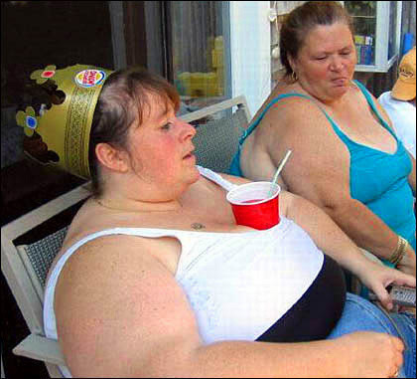
http://www.thorninpaw.com/mt/archives/cat_food.html

Slide 40
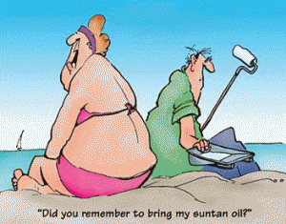
https://cjnotebook.com/obesity-facts-people-suffer-obesity-hunger/obesity-cartoon//

Slide 41
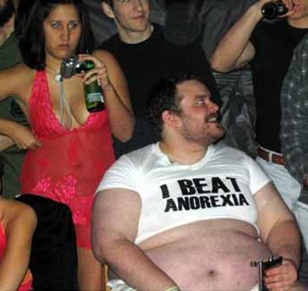
http://funnycoolvideos.wordpress.com/2007/11/08/how-to-beat-anorexia/

Slide 42
remember the
“Three Major Debates”

Slide 43
the three major perennial debates . . .
Biological Determinism vs. Cultural Constructionism
(“nature vs. nurture”)
(“learned vs. inherited”)
Ideationism vs. Cultural Materialism
Individual Agency vs. Structuralism
(“free will” vs. “power structures”)

Slide 44
all three of the classic debates surface during discussions
of the obesity epidemic . . .

Slide 45
Friedman in his talk “Leptin and the Biologic Basis of Obesity” said the obesity problem is genetic based . . .

Slide 46
Jeffrey M. Friedman says the obesity problem is genetic . . .
Biological Determinism vs. Cultural Constructionism
(“nature vs. nurture”)
(“inherited vs. learned”)
Ideationism vs. Cultural Materialism
Individual Agency vs. Structuralism
(“free will” vs. “power structures”)

Slide 47
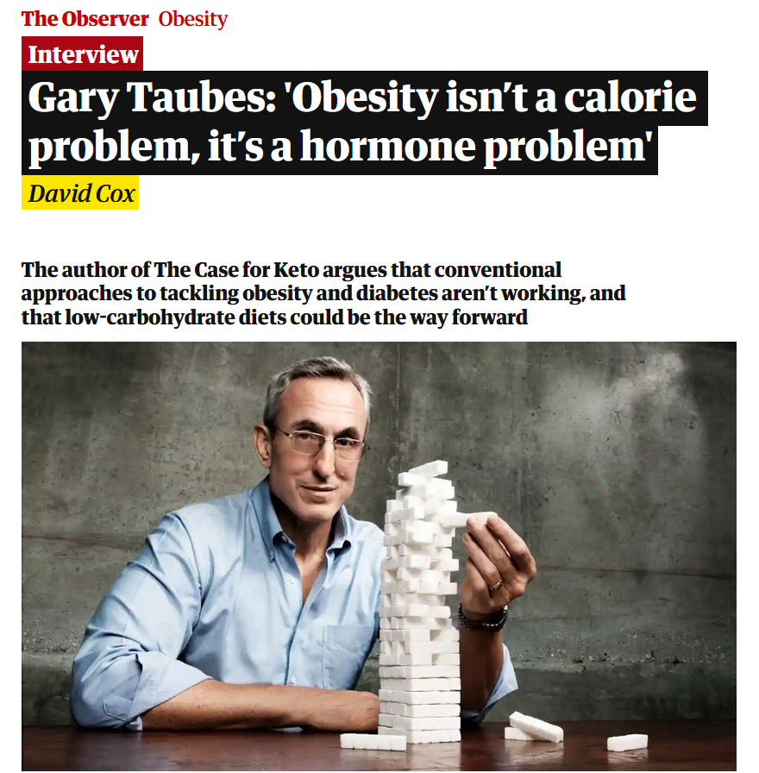
Sun 17 Jan 2021
https://www.theguardian.com/society/2021/jan/17/gary-taubes-interview-obesity-calories-hormones-case-for-keto?CMP=Share_iOSApp_Other

Slide 48
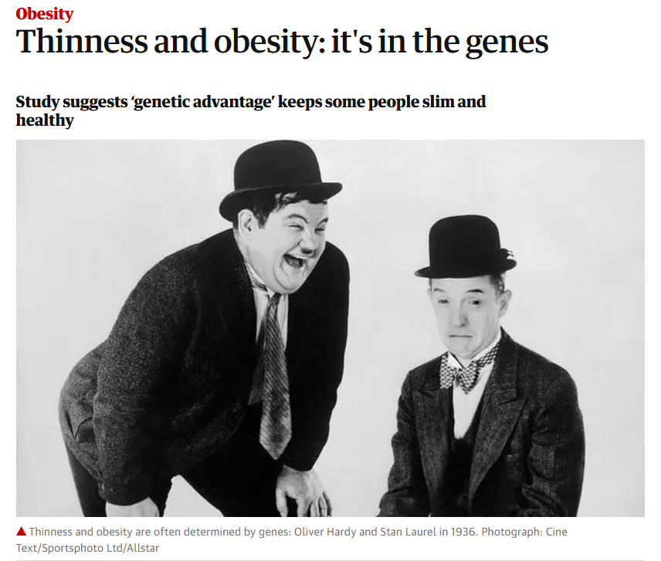

24 Jan 2019
https://www.theguardian.com/society/2019/jan/24/thinness-and-obesity-its-in-the-genes?CMP=Share_iOSApp_Other

Slide 49
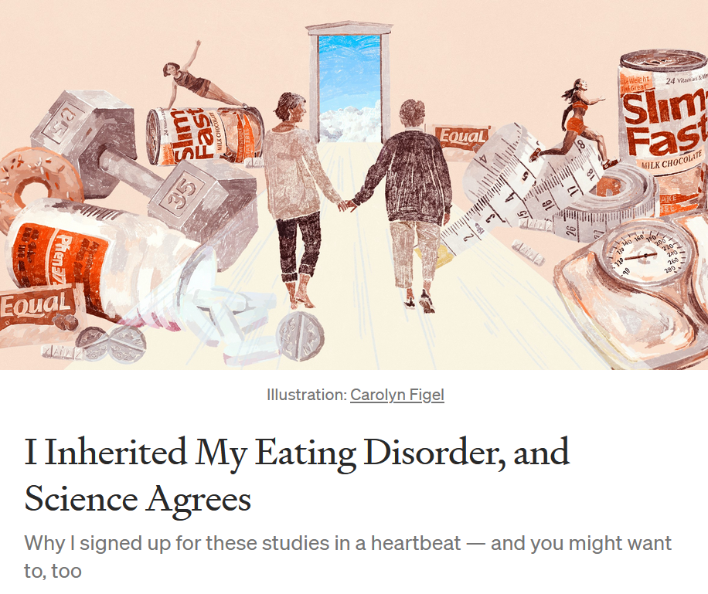

20 October 2021
https://news.illinoisstate.edu/2021/04/social-media-effects-on-body-image-and-eating-disorders/

Slide 50
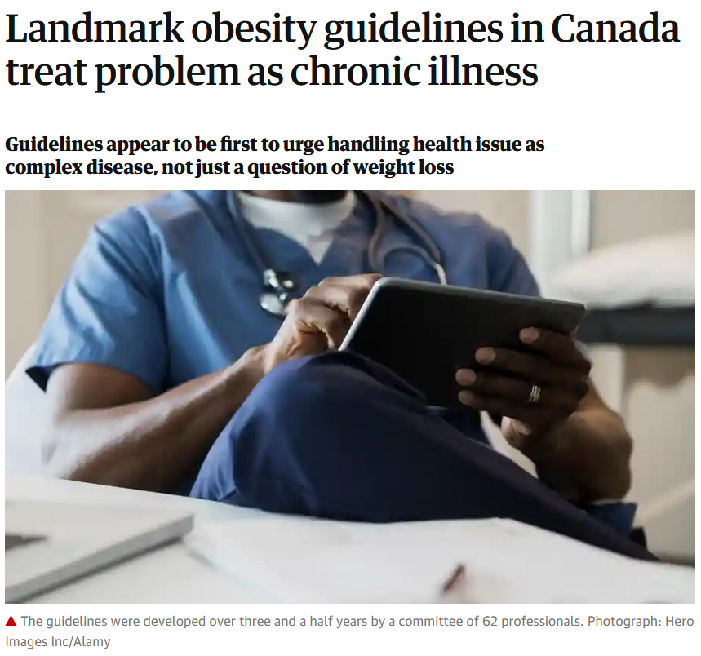
4 Aug 2020
https://www.theguardian.com/society/2020/aug/04/obesity-chronic-illness-guidelines-canada?CMP=share_btn_link

Slide 51
and many blame
the fast-food industry . . .

Slide 52

BROOKINGS
07 August 2020
https://www.brookings.edu/blog/up-front/2020/08/07/black-and-hispanic-americans-at-higher-risk-of-hypertension-diabetes-obesity-time-to-fix-our-broken-food-system/

Slide 53
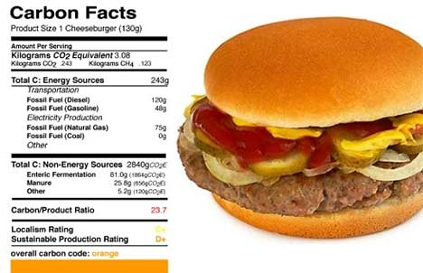
http://feeds.treehugger.com/TreehuggerRadio

Slide 54
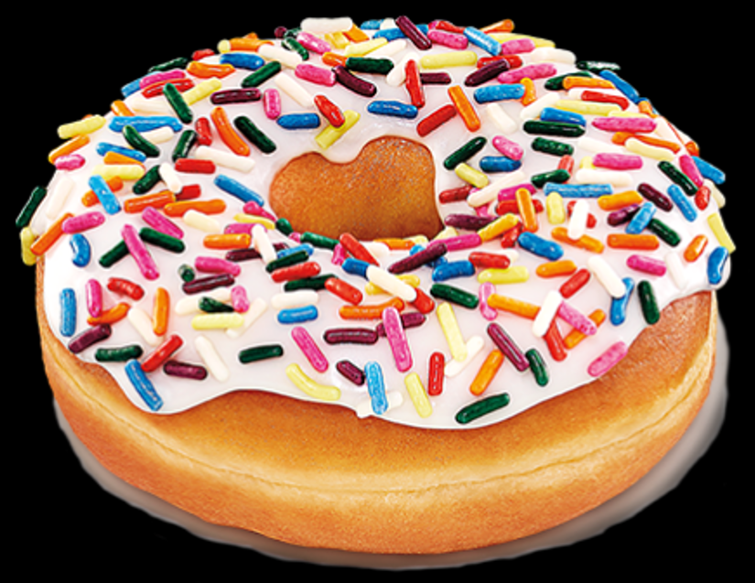
https://www.dunkindonuts.com/en/

Slide 55
which is popular
anywhere and everywhere
you find Americans . . .

Slide 56
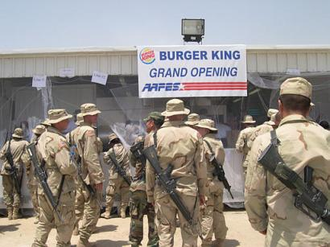
http://www.thorninpaw.com/mt/archives/cat_food.html

Slide 57
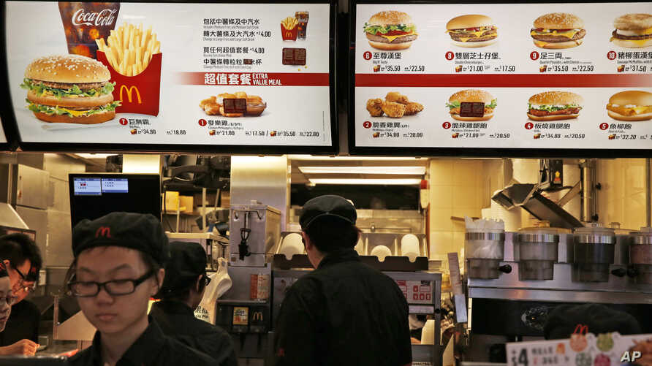
https://www.voanews.com/east-asia-pacific/mcdonalds-meat-supplier-overhauls-china-operations

Slide 58
the question of corporate
“bottom line” “profit motives” regularly surfaces as a main “cause” of the American obesity epidemic during the discussions . . .

Slide 59
“profit motives” are archetypal examples of . . .
Biological Determinism vs. Cultural Constructionism
(“nature vs. nurture”)
(“learned vs. inherited”)
Ideationism vs. Cultural Materialism
Individual Agency vs. Structuralism
(“free will” vs. “power structures”)

Slide 60
the question of “free will” also surfaces during the discussions
of the obesity epidemic, and even in the courts of law . . .

Slide 61
the three major contemporary debates
Biological Determinism vs. Cultural Constructionism
(“nature vs. nurture”)
(“learned vs. inherited”)
Ideationism vs. Cultural Materialism
Individual Agency vs. Structuralism
(“free will” vs. “power structures”)

Slide 62
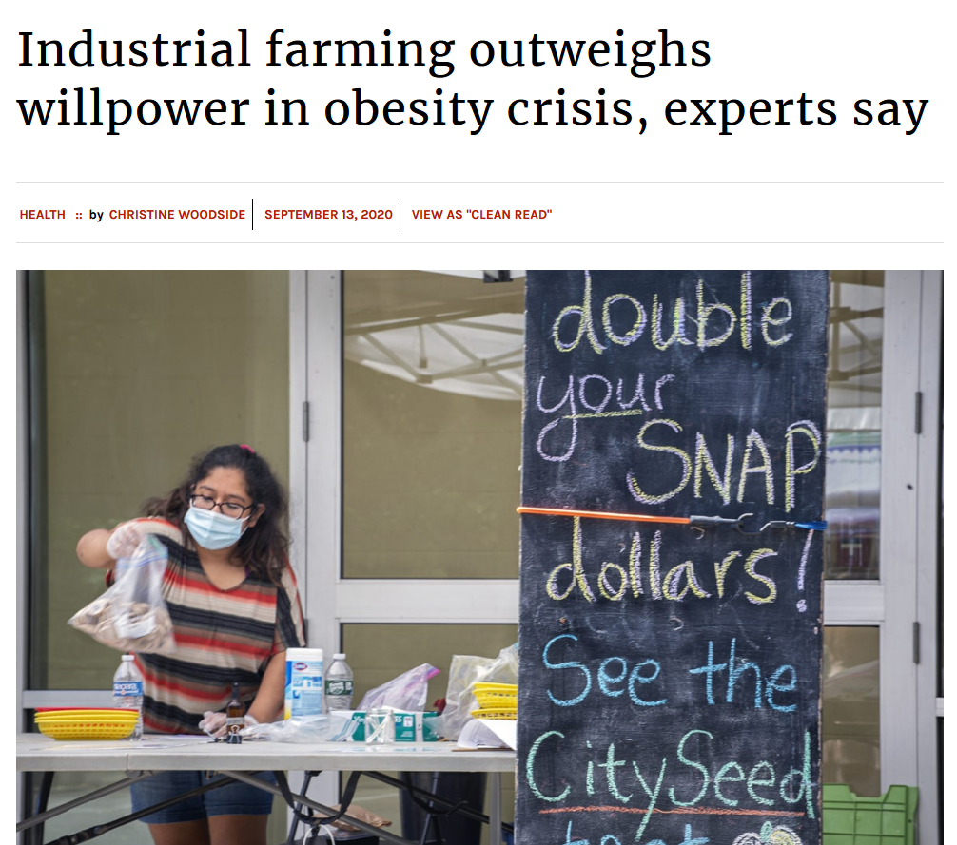
https://ctmirror.org/2020/09/13/industrial-farming-outweighs-willpower-in-obesity-crisis-experts-say/
Notes:
62

Slide 63
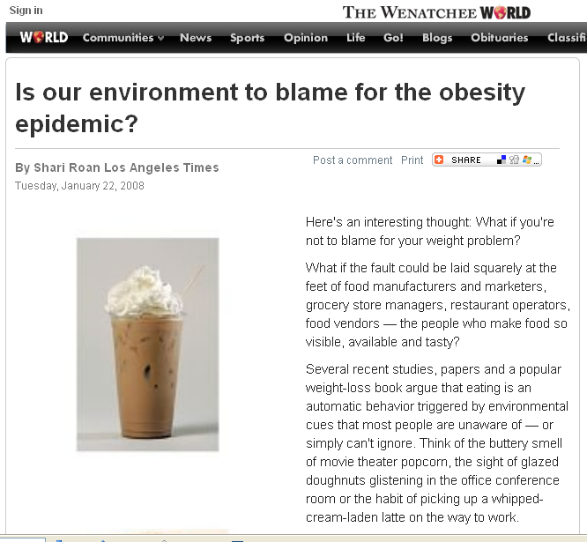
http://www.wenatcheeworld.com/news/2008/jan/22/is-our-environment-to-blame-for-the-obesity/
Notes:
63

Slide 64
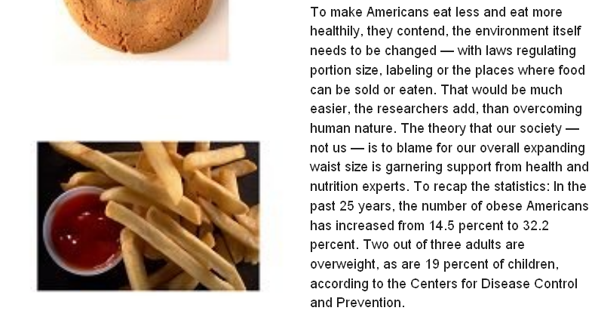
http://www.wenatcheeworld.com/news/2008/jan/22/is-our-environment-to-blame-for-the-obesity/
Notes:
64

Slide 65
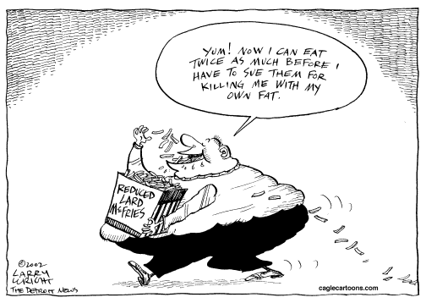
Larry Wright, The Detroit News
9/7/2002
Notes:
65

Slide 66
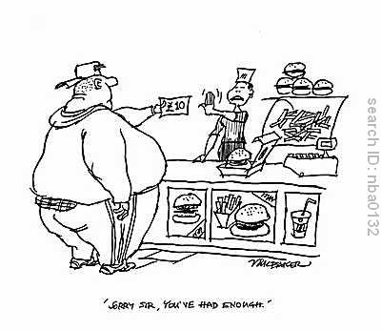
www.cartoonstock.com/directory/s/supersize_me_gifts.asp

Slide 67
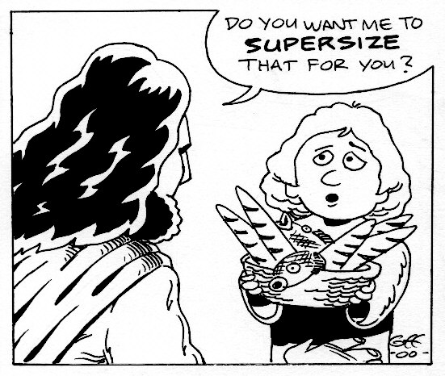
http://www.giffmex.org/blog/?p=119

Slide 68
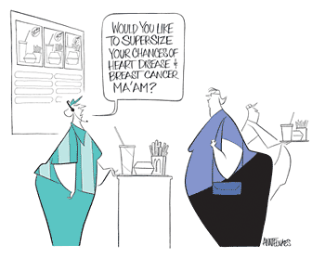
http://www.loc.gov/exhibits/telnaes/telnaes-checklist.html

Slide 69
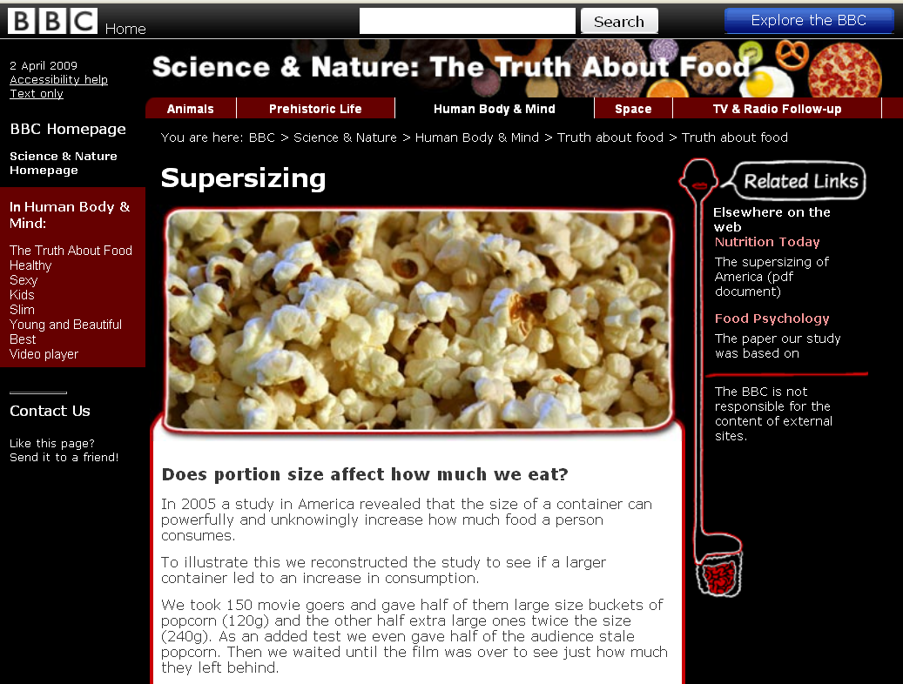
http://www.bbc.co.uk/sn/humanbody/truthaboutfood/slim/popcorn.shtml

Slide 70
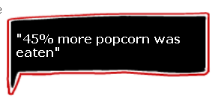
http://www.bbc.co.uk/sn/humanbody/truthaboutfood/slim/popcorn.shtml

Slide 71
does “branding” affect what we eat?

Slide 72
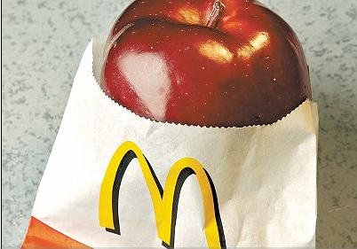
“Study author Dr. Tom Robinson said the kids’ perception of taste was ‘physically altered by the branding.’ The Stanford University researcher said it was remarkable how children so young were already so influenced by advertising. Even carrots, milk and apple juice tasted better to the kids when they were wrapped in the familiar packaging of the Golden Arches.”
http://francisanderson.files.wordpress.com/2007/08/supersize_me.jpg

Slide 73
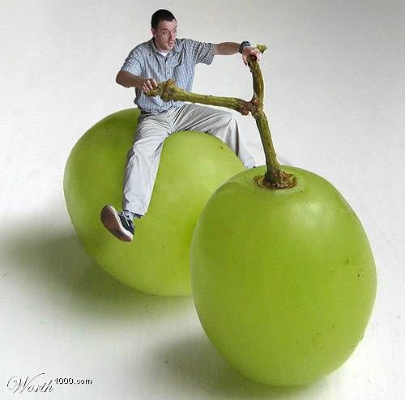
http://www.ursispaltenstein.ch/blog/weblog.php?/weblog/2007/06/04/

Slide 74
“Eating is a Cultural Affair” — Body Image and Health
  The Obesity Epidemic
  Disordered Body Image and Eating Behaviors
  Eating Disorders
    Anorexia nervosa
    Bulimia nervosa
    Binge eating
    Orthorexia nervosa
    Selective Eating Disorder (SED)
    Pica
    Others
  What Causes Eating Disorders?
  Applications
back to the “obesity epidemic” . . .

Slide 75
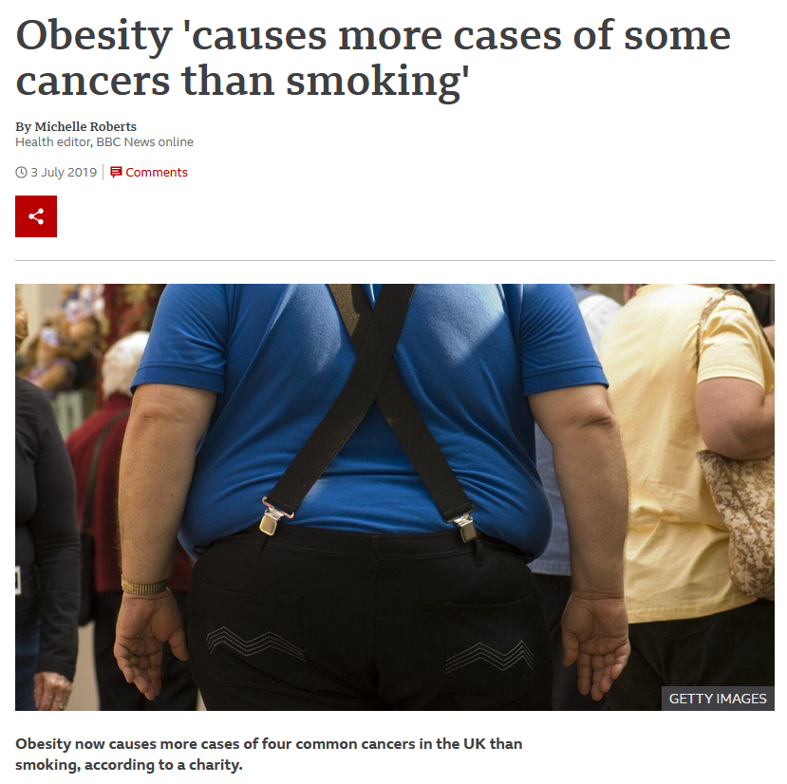

3 July 2019
https://www.bbc.com/news/health-48826850

Slide 76
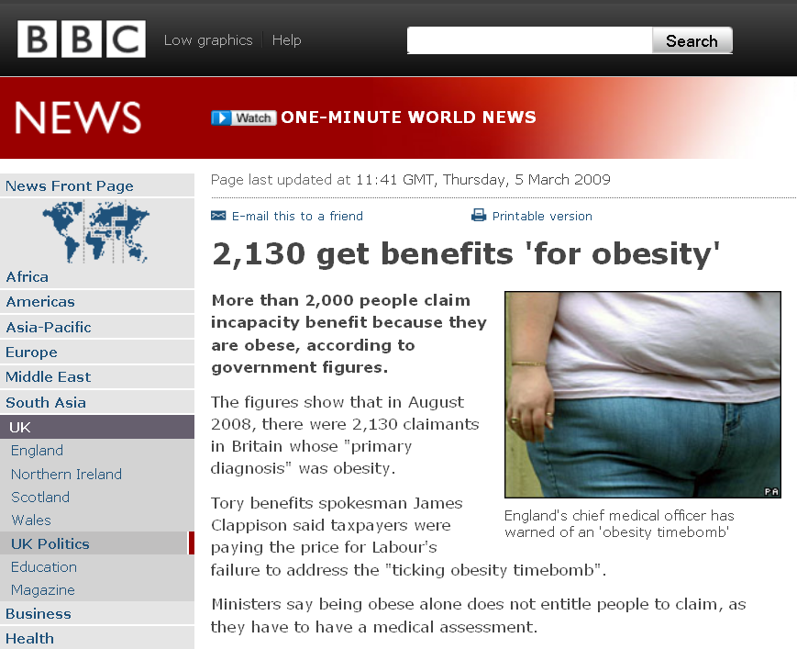
already by 2009, in the UK
http://news.bbc.co.uk/2/hi/uk_news/politics/7925448.stm

Slide 77
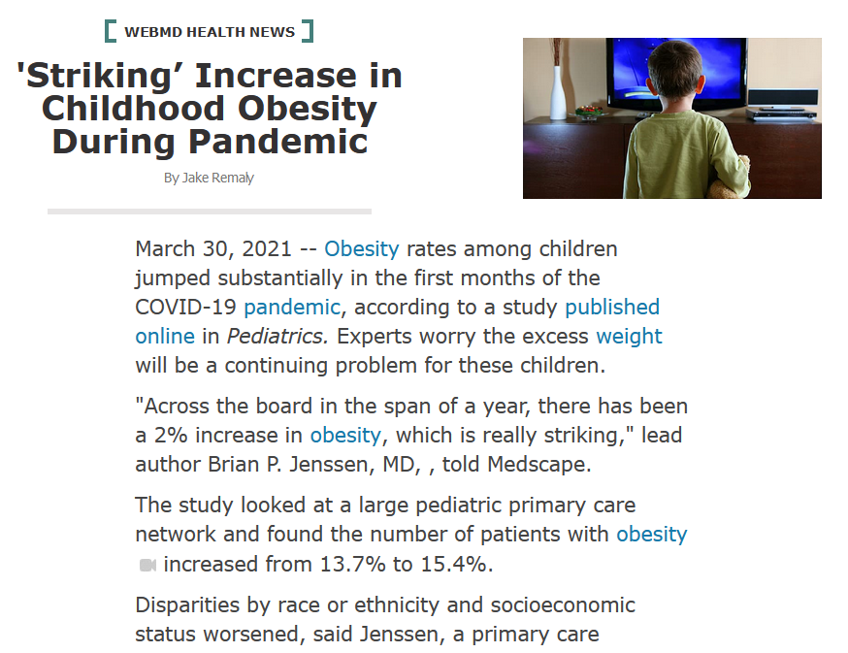

30 March 2021
https://www.webmd.com/lung/news/20210330/striking-increase-in-childhoood-obesity-during-pandemic

Slide 78

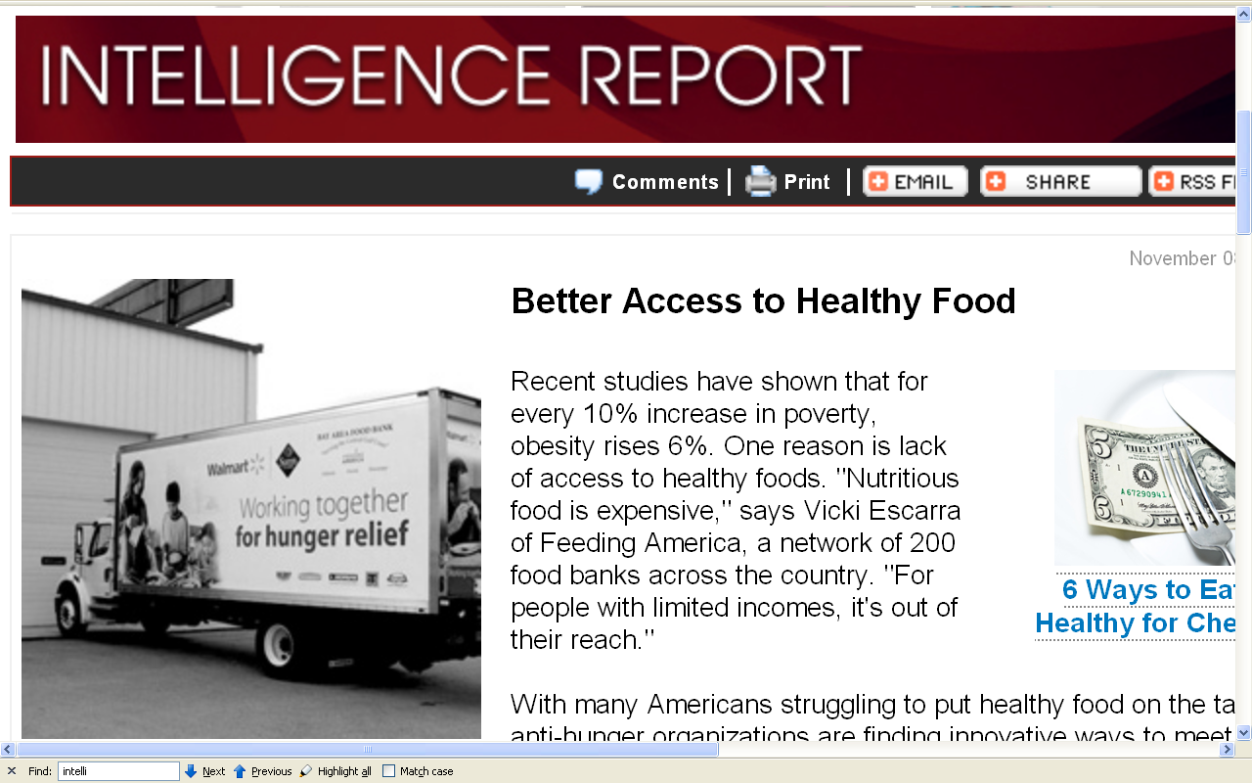
July 19, 2009
12 November 2009
DARWINS NIGHTMARE
DARWINS NIGHTMARE
Watch for new figures as information becomes available from the 2020 U.S. Census
http://www.parade.com/news/intelligence-report/archive/091108-better-access-to-healthy-food.html
Notes:
78

Slide 79
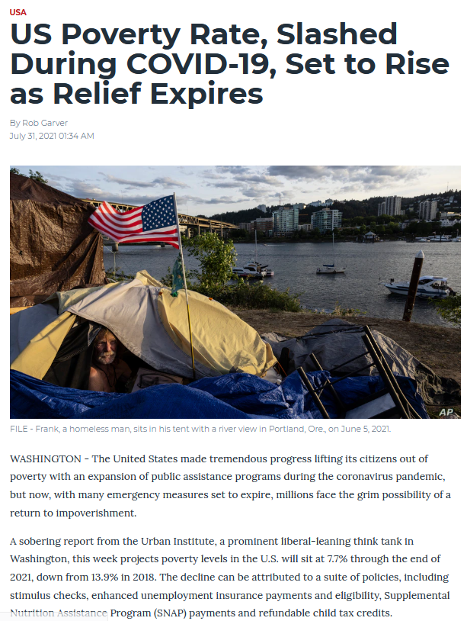

31 July 2021
DARWINS NIGHTMARE
DARWINS NIGHTMARE
http://www.parade.com/news/intelligence-report/archive/091108-better-access-to-healthy-food.html
Notes:
79

Slide 80
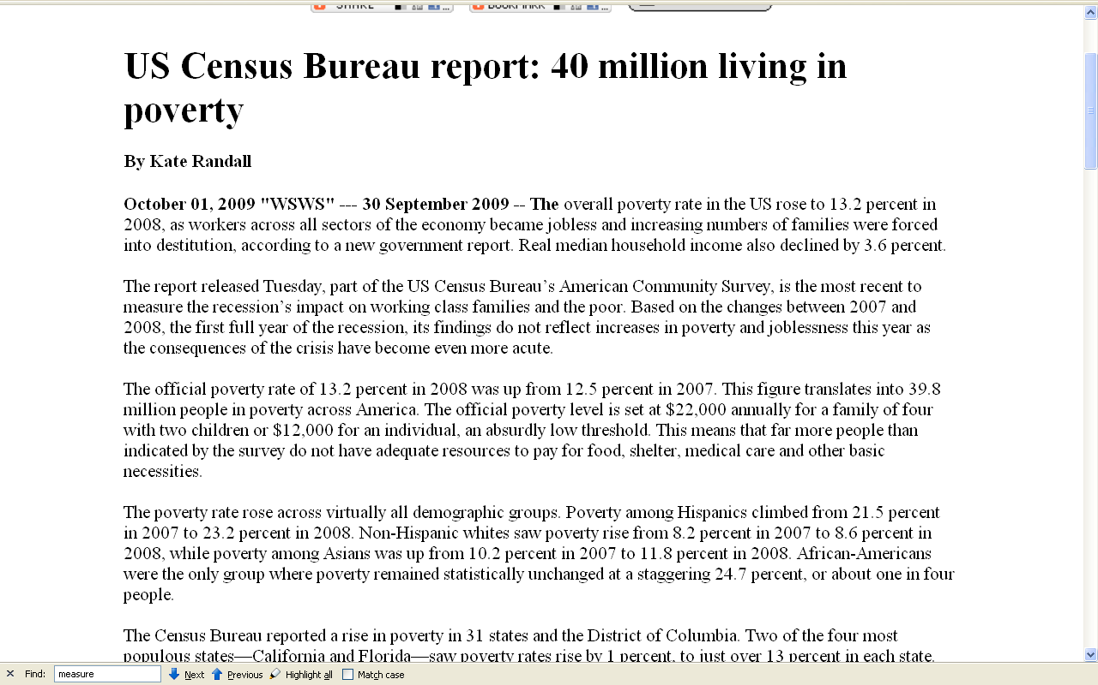
Watch for new figures as information becomes available from the 2020 U.S. Census
http://www.informationclearinghouse.info/article23604.htm

Slide 81
The official poverty rate of 13.2 percent in 2008 was up from 12.5 percent in 2007. This figure translates into 39.8 million people in poverty across America. The official poverty level is set at $22,000 annually for a family of four with two children or $12,000 for an individual, an absurdly low threshold. This means that far more people than indicated by the survey do not have adequate resources to pay for food, shelter, medical care and other basic necessities.
Watch for new figures as information becomes available from the 2020 U.S. Census
http://www.informationclearinghouse.info/article23604.htm

Slide 82
The poverty rate rose across virtually all demographic groups. Poverty among Hispanics climbed from 21.5 percent in 2007 to 23.2 percent in 2008. Non-Hispanic whites saw poverty rise from 8.2 percent in 2007 to 8.6 percent in 2008, while poverty among Asians was up from 10.2 percent in 2007 to 11.8 percent in 2008. African-Americans were the only group where poverty remained statistically unchanged at a staggering 24.7 percent, or about one in four people.
Watch for new figures as information becomes available from the 2020 U.S. Census
http://www.informationclearinghouse.info/article23604.htm

Slide 83
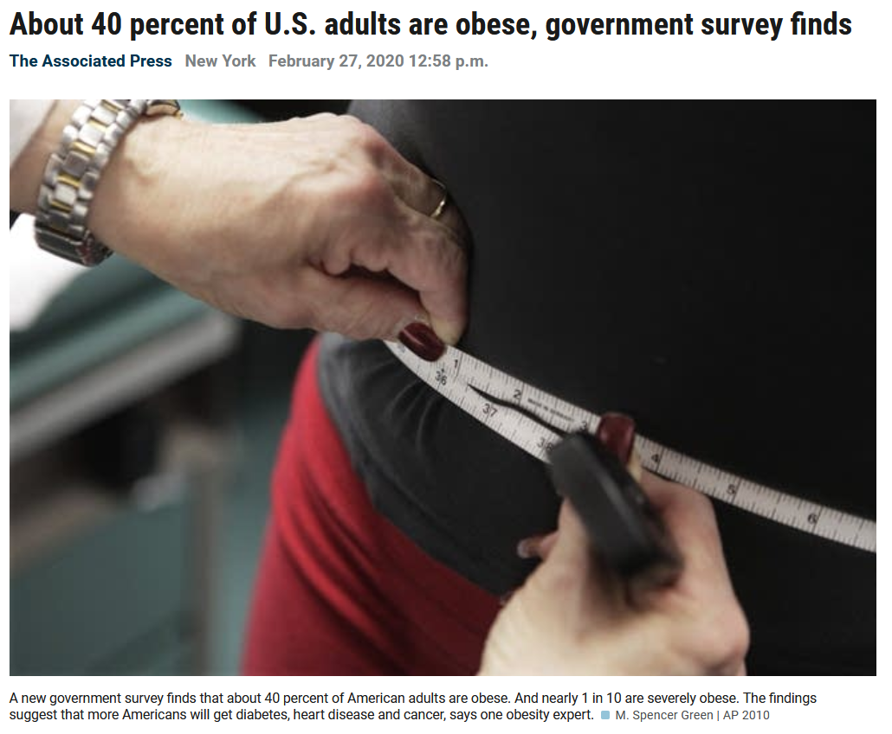
https://www.mprnews.org/story/2020/02/27/about-40-percent-of-us-adults-are-obese-government-survey-finds

Slide 84
the Centers for Disease Control and Prevention
(CDC)
2007 obesity map the United States
looks like this . . .

Slide 85
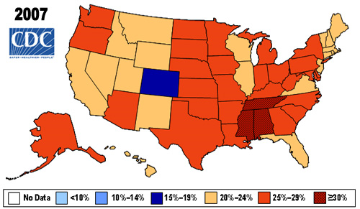
Colorado
18.4%
Tennessee
Alabama
Mississippi
31.7%
% obese
www.cdc.gov/nccdphp/dnpa/obesity/trend/maps/

Slide 86
And it has only become much worse since the original report in 2007 see 2019 map that follows
Colorado
18.4%
Tennessee
Alabama
Mississippi
31.7%
% obese
www.cdc.gov/nccdphp/dnpa/obesity/trend/maps/

Slide 87
Colorado
18.4%
Tennessee
Alabama
Mississippi
31.7%
and the population of every state but Colorado is considered obese—
and Colorado just barely sneaks under the wire of the CDC definition
www.cdc.gov/nccdphp/dnpa/obesity/trend/maps/

Slide 88

the Centers for Disease Control and Prevention
(CDC)
obesity 2019 map the United States . . .
(not strictly comparable to the 2007 map)

Slide 89

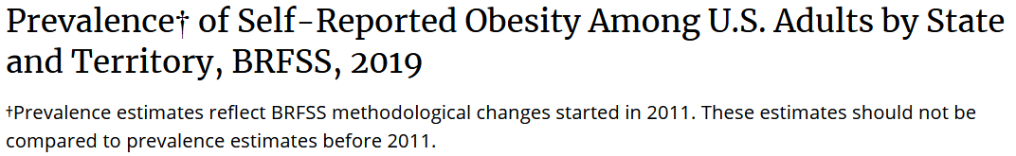
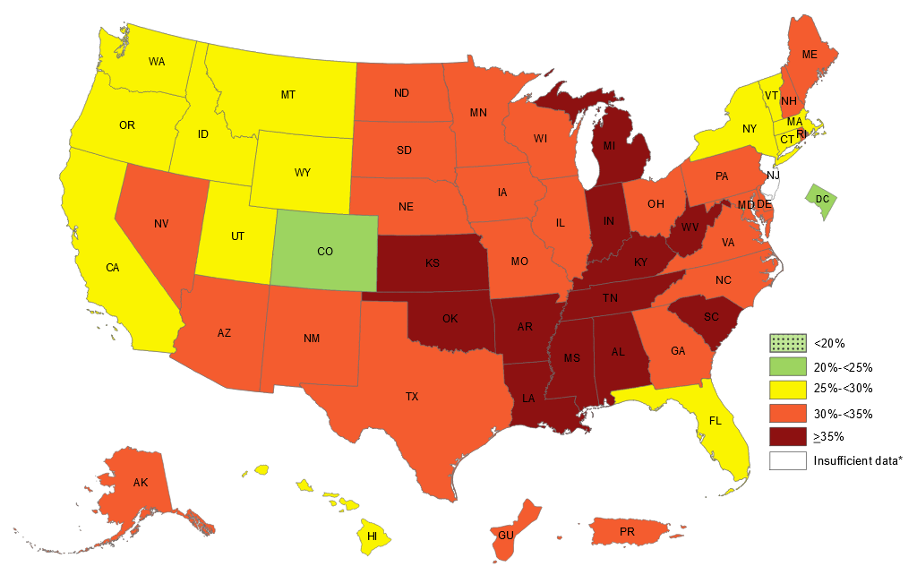



2019
Minnesota
30.1%
Colorado
18.4%
Colorado
23.8%
Mississippi
31.7%
Mississippi
40.8%
https://www.cdc.gov/obesity/data/prevalence-maps.html

Slide 90
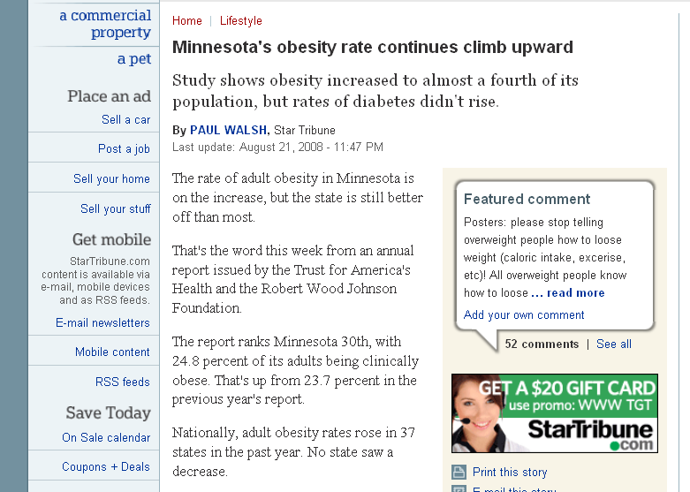
2008
www.startribune.com/lifestyle/27224664.html

Slide 91
2008
www.startribune.com/lifestyle/27224664.html

Slide 92

2008
www.startribune.com/lifestyle/27224664.html

Slide 93
2019
Minnesota
30.1%
Colorado
18.4%
Colorado
23.8%
Mississippi
31.7%
Mississippi
40.8%
https://www.cdc.gov/obesity/data/prevalence-maps.html

Slide 94


2019
Minnesota
30.1%
Colorado
18.4%
Colorado
23.8%
Mississippi
31.7%
Mississippi
40.8%
Colorado remains lowest . . .
https://www.cdc.gov/obesity/data/prevalence-maps.html

Slide 95
2019
Minnesota
30.1%
Colorado
18.4%
Colorado
23.8%
Mississippi
31.7%
Mississippi
40.8%
Colorado remains lowest . . .
https://www.cdc.gov/obesity/data/prevalence-maps.html

Slide 96
Alabama was second highest . . .
Colorado
18.4%
Tennessee
Alabama
31.0
www.cdc.gov/nccdphp/dnpa/obesity/trend/maps/

Slide 97
Alabama has tried new measures to address the problem . . .
Colorado
18.4%
Tennessee
Alabama
31.0
www.cdc.gov/nccdphp/dnpa/obesity/trend/maps/

Slide 98

Alabama set up a program to fine state employees who are overweight . . .
($25 per month)
www.wsoctv.com/news/17262427/detail.html

Slide 99
The University of Minnesota, by contrast, uses the carrot rather than the stick approach.
It pays participating faculty and staff
$65 to agree to try to live a healthier lifestyle.

Slide 100
Alabama was the first state to propose “to charge overweight state workers who don’t work on slimming down . . .”
www.wsoctv.com/news/17262427/detail.html

Slide 101
Alabama already charges workers that smoke . . .
www.wsoctv.com/news/17262427/detail.html

Slide 102

Alabama proposed to fine “. . . anyone with a body mass index of 35 or higher who is not making progress.”
www.wsoctv.com/news/17262427/detail.html

Slide 103
2019
Minnesota
30.1%
Colorado
18.4%
Colorado
23.8%
Mississippi
31.7%
Alabama
36.1%
Mississippi
40.8%
Alabama is now at 36.1% . . .
https://www.cdc.gov/obesity/data/prevalence-maps.html

Slide 104
the CDC defines obesity as having a body mass index (BMI) of 30 or above
www.startribune.com/lifestyle/27224664.html

Slide 105
BMI
Body Mass Index

Slide 106
  note
  body mass index (BMI)
  information
www.wsoctv.com/news/17262427/detail.html

Slide 107
“Eating is a Cultural Affair” — Body Image and Health
  The most accurate method for determining if one is overweight or obese is to calculate
  body mass index (BMI)
  using the following formula:
  BMI = [Weight in pounds ÷ Height in inches ÷ Height in inches] X 703
The Cultural Feast, 2nd ed., p. 107

Slide 108
“Eating is a Cultural Affair” — Body Image and Health
  The most accurate method for determining if one is overweight or obese is to calculate
  body mass index (BMI)
  using the following formula:
  or one’s body weight divided
  by the square of one’s height
The Cultural Feast, 2nd ed., p. 107

Slide 109

“Eating is a Cultural Affair” — Body Image and Health
  or use a calculator
  or a BMI table . . .
The Cultural Feast, 2nd ed., p. 107

Slide 110
it’s easier to figure out
by looking at
a BMI height/weight table . . .

Slide 111

http://en.wikipedia.org/wiki/Body_mass_index

Slide 112
“Eating is a Cultural Affair” — Body Image and Health
  If your BMI is equal to or above 25, you are considered overweight
  If it is equal to or above 30,
  you are considered obese
  (unless you are extremely muscular)
  Underweight is defined as having a BMI below 19
The Cultural Feast, 2nd ed., p. 107

Slide 113

http://news.bbc.co.uk/2/hi/health/5297790.stm

Slide 114
“Eating is a Cultural Affair” — Body Image and Health
  Because the relative amounts of fat and muscle tissue and bone size vary greatly from person to person, ideal weights are given as ranges . . .
The Cultural Feast, 2nd ed., p. 117

Slide 115
“Eating is a Cultural Affair” — Body Image and Health
  Many experts argue that these ranges should be made
  even more flexible . . .
  and point out that the health hazards are associated only with extreme overweight and underweight
  (that is, 20% over or under the ideal range)
The Cultural Feast, 2nd ed., p. 117

Slide 116
“Eating is a Cultural Affair” — Body Image and Health
  Recommendations to diet, therefore, should be directed
  only to those who are
  extremely over- or underweight . . .
  (that is, 20% over or under the ideal range)
The Cultural Feast, 2nd ed., p. 117

Slide 117
“Eating is a Cultural Affair” — Body Image and Health
  Rise in excess weight gain is accompanied by the increased risk in . . .
  coronary heart disease
  hypertension
  stroke
  gallbladder disease
  type 2 diabetes
  osteoarthritis
  some forms of cancer
  emotional problems
The Cultural Feast, 2nd ed., p. 107

Slide 118

https://www.bbc.com/news/health-53921141

Slide 119
“Eating is a Cultural Affair” — Body Image and Health
  Rise in excess weight gain is also accompanied by the increased risk in . . .
  coronary heart disease
  hypertension
  stroke
  gallbladder disease
  type 2 diabetes
  osteoarthritis
  some forms of cancer
  emotional problems
The Cultural Feast, 2nd ed., p. 107

Slide 120
“Eating is a Cultural Affair” — Body Image and Health
  Rise in excess weight gain is accompanied by the increased risk in . . .
  coronary heart disease
  hypertension
  stroke
  gallbladder disease
  type 2 diabetes
  osteoarthritis
  some forms of cancer
  emotional problems
The Cultural Feast, 2nd ed., p. 105

Slide 121
“Eating is a Cultural Affair” — Body Image and Health
  Rise in excess weight gain is accompanied by the increased risk in . . .
  a degenerative joint disease in which the connective tissue (cartilage) is lost
  coronary heart disease
  hypertension
  stroke
  gallbladder disease
  type 2 diabetes
  osteoarthritis
  some forms of cancer
  emotional problems
The Cultural Feast, 2nd ed., p. 105

Slide 122
“Eating is a Cultural Affair” — Body Image and Health
  The Centers for Disease Control and Prevention have launched a major initiative to prevent and control obesity
The Cultural Feast, 2nd ed., p. 107

Slide 123
“Eating is a Cultural Affair” — Body Image and Health
  Obesity is especially problematic
  for children . . .
The Cultural Feast, 2nd ed., p. 107

Slide 124

July 19, 2009
DARWINS NIGHTMARE
DARWINS NIGHTMARE
http://news.bbc.co.uk/2/hi/health/8512102.stm
Notes:
124

Slide 125


as mentioned above . . .
2009
www.washingtonpost.com/wp-dyn/content/article/2009/04/07/AR2009040701202_pf.html

Slide 126
as mentioned above . . .
2009
www.washingtonpost.com/wp-dyn/content/article/2009/04/07/AR2009040701202_pf.html

Slide 127
“Eating is a Cultural Affair” — Body Image and Health
  Metabolic changes that accompany excess weight gain during childhood make it more difficult for them to lose weight later in life . . .
The Cultural Feast, 2nd ed., p. 107

Slide 128
“Eating is a Cultural Affair” — Body Image and Health
  “About one-third or overweight preschoolers and one-half of overweight school-aged children will become overweight adults. . . .
The Cultural Feast, 2nd ed., p. 107

Slide 129

http://news.bbc.co.uk/2/hi/uk_news/northern_ireland/7965315.stm

Slide 130
http://news.bbc.co.uk/2/hi/uk_news/northern_ireland/7965315.stm

Slide 131
and the obesity epidemic is spreading throughout the world . . .

Slide 132

13 Nov 2019
https://www.theguardian.com/society/2019/nov/14/obesity-almost-doubles-in-20-years-to-affect-13-million-people?CMP=Share_iOSApp_Other

Slide 133


Slide 134

2009
http://news.bbc.co.uk/2/hi/uk_news/england/staffordshire/7977283.stm

Slide 135
“Eating is a Cultural Affair” — Body Image and Health
  Many factors contribute to the obesity epidemic . . .
  easy access to an abundant food supply
  sedentary lifestyle
  environmental factors encouraging soft-drink and calorie-rich food product consumption
  growth of the fast-food industry
  a growing tendency to socialize with food and drink
  “supersize” me-ing
  school lunch meals
  easy access to an abundant food supply
  sedentary lifestyle
  environmental factors encouraging soft-drink and calorie-rich food product consumption
  growth of the fast-food industry
  a growing tendency to socialize with food and drink
  “supersize” me-ing
  school lunch meals
The Cultural Feast, 2nd ed., p. 107

Slide 136
“Eating is a Cultural Affair” — Body Image and Health
  Many factors contribute to the obesity epidemic . . .
  “Although school breakfasts and lunches must meet federal nutrition requirements, including guidelines restricting the amount of fat they contain, students who participate in the National School Breakfast and Lunch Program have been shown to have higher intakes or energy, fat, and saturated fat than those who bring their lunches.” (USDA 2001)
The Cultural Feast, 2nd ed., p. 107

Slide 137
“Eating is a Cultural Affair” — Body Image and Health
  Many factors contribute to the obesity epidemic . . .
  “A la carte foods and vending machines that sell soft drinks, cookies, and candies are not subject to these nutritional restrictions and give students mixed messages, as well as excess calories.”
The Cultural Feast, 2nd ed., p. 108

Slide 138
“Eating is a Cultural Affair” — Body Image and Health
  At the same time food consumption has increased, physical activity levels have declined . . .
The Cultural Feast, 2nd ed., p. 108

Slide 139

F MINUS
28 February 2010
http://www.fminus.net/

Slide 140
“Eating is a Cultural Affair” — Body Image and Health
  Also contributing to sedentary lifestyles among adults one finds . . .
  automation of workplaces
  use of labor-saving machinery for household chores
  reliance on automobile travel instead of walking and cycling
The Cultural Feast, 2nd ed., p. 108

Slide 141
“Eating is a Cultural Affair” — Body Image and Health
  Children have become more sedentary . . .
  little to no vigorous regular physical activity
  TV
  computers
  electronic games
The Cultural Feast, 2nd ed., p. 108

Slide 142
“Eating is a Cultural Affair” — Body Image and Health
  The more time children spend watching TV, the less time they spend burning calories on more active forms of recreation . . .
The Cultural Feast, 2nd ed., p. 108

Slide 143
“Eating is a Cultural Affair” — Body Image and Health
  The more time children spend watching TV, the less time they spend burning calories on more active forms of recreation . . .
  . . . and children consume more energy during and after watching TV advertisements for food . . .
The Cultural Feast, 2nd ed., p. 108

Slide 144
“Eating is a Cultural Affair” — Body Image and Health
  It is also difficult to exercise in unsafe neighborhoods and play areas . . .
  . . . or communities that lack sidewalks and trails for safe walking . . .
The Cultural Feast, 2nd ed., p. 108

Slide 145
“Eating is a Cultural Affair” — Body Image and Health
  Children are also less likely to exercise today because many schools have eliminated or greatly reduced physical education in an attempt to save money and increase time for other activities . . .
The Cultural Feast, 2nd ed., p. 108

Slide 146
“Eating is a Cultural Affair” — Body Image and Health
schools have eliminated or greatly reduced physical education
  . . . even though increasing physical activity during a school day actually increases students’ ability to learn . . .
The Cultural Feast, 2nd ed., p. 109

Slide 147
The bottom line?

Slide 148
“Eating is a Cultural Affair” — Body Image and Health
  The Surgeon General of the United States has declared obesity as a national epidemic
The Cultural Feast, 2nd ed., p. 107

Slide 149

DARWINS NIGHTMARE
DARWINS NIGHTMARE
http://www.redefiningthefaceofbeauty.com/2012/07/o-b-e-si-t-y-new-form-of-child-neglect.html
Notes:
149

Slide 150

http://www.dwp.gov.uk/publications/specialist-guides/medical-conditions/a-z-of-medical-conditions/obesity/causes-obesity.shtml
Notes:
150

Slide 151

A “holistic” approach
http://www.sciencedirect.com/science/article/pii/S0091743512000394
Notes:
151

Slide 152
and various government representatives and agencies
have started
to address the problem . . .

Slide 153

July 19, 2009
DARWINS NIGHTMARE
DARWINS NIGHTMARE
http://www.fifa.com/newscentre/news/newsid=1178618.html?cid=rssfeed&att=
Notes:
153

Slide 154

23 Dec 2020
https://www.theguardian.com/world/2020/dec/23/china-to-bring-in-law-against-food-waste-with-fines-for-promoting-overeating?CMP=Share_iOSApp_Other
Notes:
154

Slide 155

Thu 6 Aug 2020
July 19, 2009
DARWINS NIGHTMARE
DARWINS NIGHTMARE
https://www.theguardian.com/food/2020/aug/06/mexico-oaxaca-sugary-drinks-junk-food-ban-children?CMP=Share_iOSApp_Other
Notes:
155

Slide 156

21 Dec 2018
DARWINS NIGHTMARE
DARWINS NIGHTMARE
https://www.bbc.com/news/health-46636422
Notes:
156

Slide 157

July 19, 2009
2010
DARWINS NIGHTMARE
DARWINS NIGHTMARE
source
Notes:
157

Slide 158

July 19, 2009
2010
DARWINS NIGHTMARE
DARWINS NIGHTMARE
source
Notes:
158

Slide 159
fighting the obesity epidemic
has become a worldwide effort . . .

Slide 160

July 19, 2009
DARWINS NIGHTMARE
DARWINS NIGHTMARE
http://www.d.umn.edu/cla/faculty/troufs/anth3635/ceweek08.html
Notes:
160

Slide 161

July 19, 2009
DARWINS NIGHTMARE
DARWINS NIGHTMARE
http://www.reuters.com/article/idUSTRE6364O420100407
Notes:
161

Slide 162

http://win.niddk.nih.gov/statistics/index.htm#econ

Slide 163

$147 billion per year
http://abcnews.go.com/Health/Healthday/story?id=8184975&page=1

Slide 164

31 Mar 2021
2021
source

Slide 165

http://247wallst.com/2010/08/05/the-obesity-index-the-cost-of-obesity-by-state/

Slide 166

http://247wallst.com/2010/08/05/the-obesity-index-the-cost-of-obesity-by-state/

Slide 167
and most expect
the problem to get worse . . .

Slide 168

https://www.theguardian.com/society/2019/oct/02/250-million-children-worldwide-forecast-to-be-obese-by-2030?CMP=Share_iOSApp_Other

Slide 169

10 Feb. 2020
source

Slide 170
more information is available on the class on-line site . . .

Slide 171

http://www.d.umn.edu/cla/faculty/troufs/anthfood/afobesity.html

Slide 172
Cf. , Chapter 8
”GASTRO-ANOMIE
Global Indigestion?”:
The Obesity Epidemic
Tim Roufs
© 2010-2024
www.d.umn.edu/cla/faculty/troufs/anthfood/aftexts.html#title

Slide 173
Chapter 4
”Eating is a
Cultural Affair” —
The “Obesity Epidemic”
pp.105-118
©Timothy G. Roufs 2010-2024

