Slide 1

Start deck in “Slide Show” mode,
and use your up/down arrow keys and/or
your space bar to advance the slides
University of Minnesota Duluth
Tim Roufs
© 2010-2024

Slide 2
REM
indicates that the materials
are a REMinder
and are thus being repeated . . .
REMinder

Slide 3
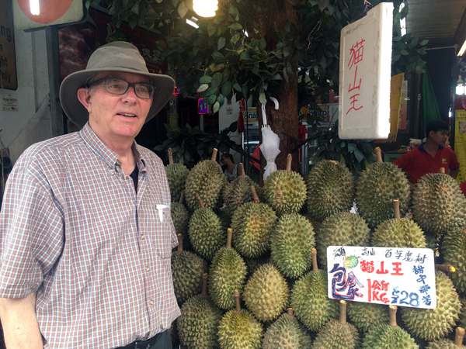
Welcome to
Anthropology of Food
University of Minnesota Duluth
Tim Roufs
© 2010-2024

Slide 4
This will be a great course . . .
you will see

Slide 5
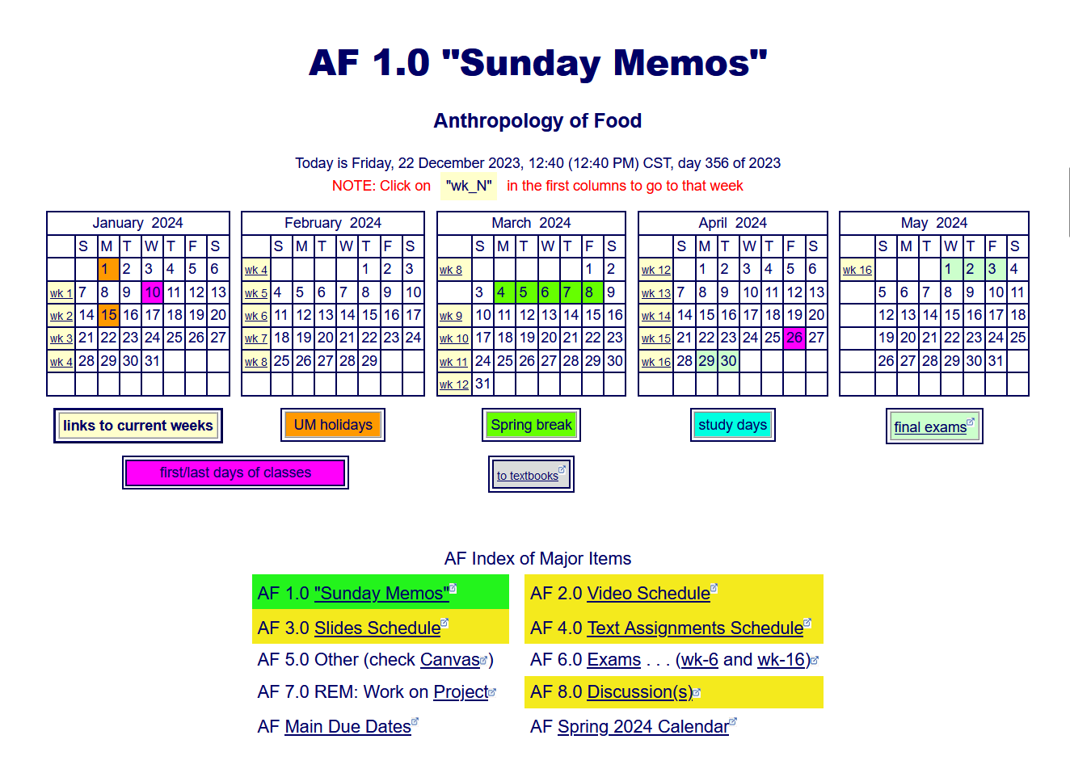
First thing . . .
go to your Week 1
“Sunday Memo”
and check it out . . .

Slide 6
How do you find
the “Sunday Memos”
in the first place?

Slide 7
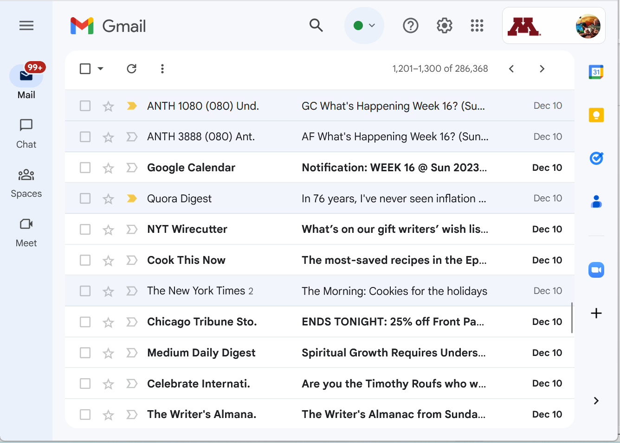


Your “Sunday Memos”
will appear in your
UM Gmail account . . .

Slide 8
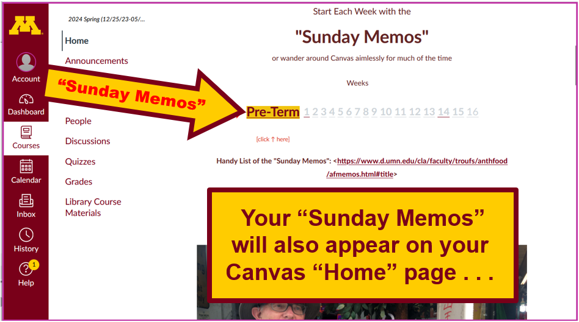

Slide 9
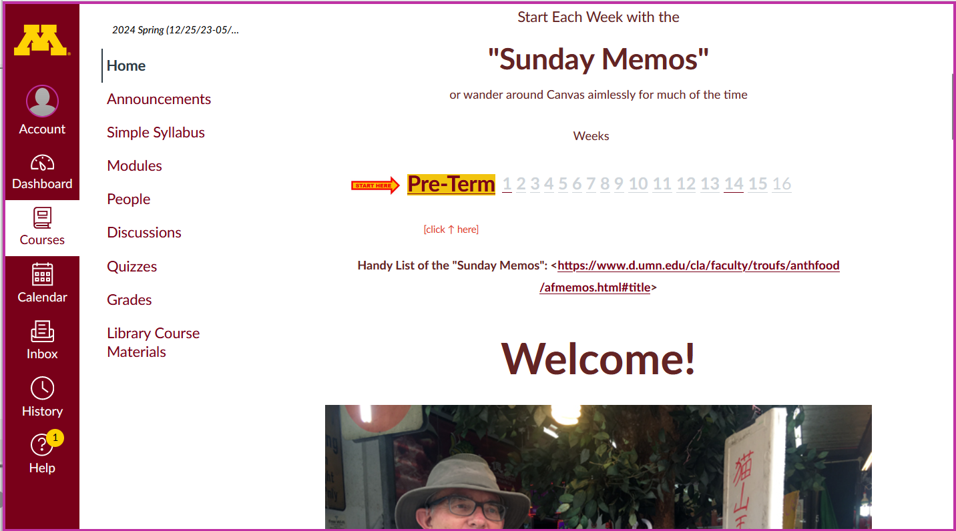
“Sunday Memo” Week 1
1

Slide 10
scroll up
“Sunday Memo” Week 1
1

Slide 11
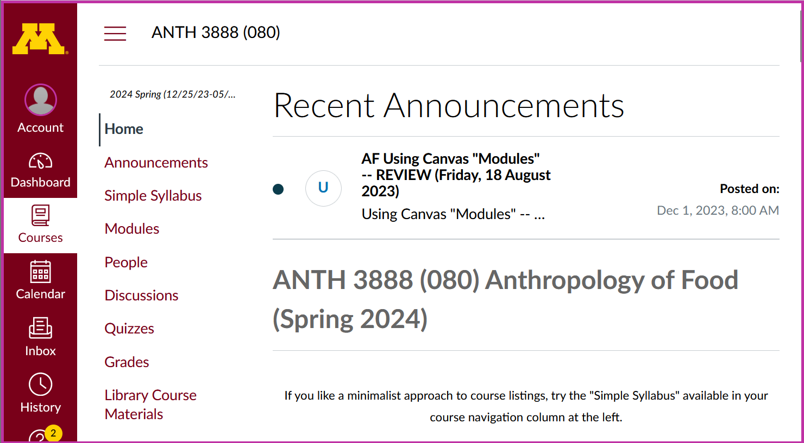

And in your “Announcements” Folder
“Sunday Memos”
Recent Announcements Window.
. . . your “Sunday Memos”
will also appear on your
Canvas “Home” page at the top . . .

Slide 12
. . . and on a WebPage index

Slide 13
scroll down

Slide 14
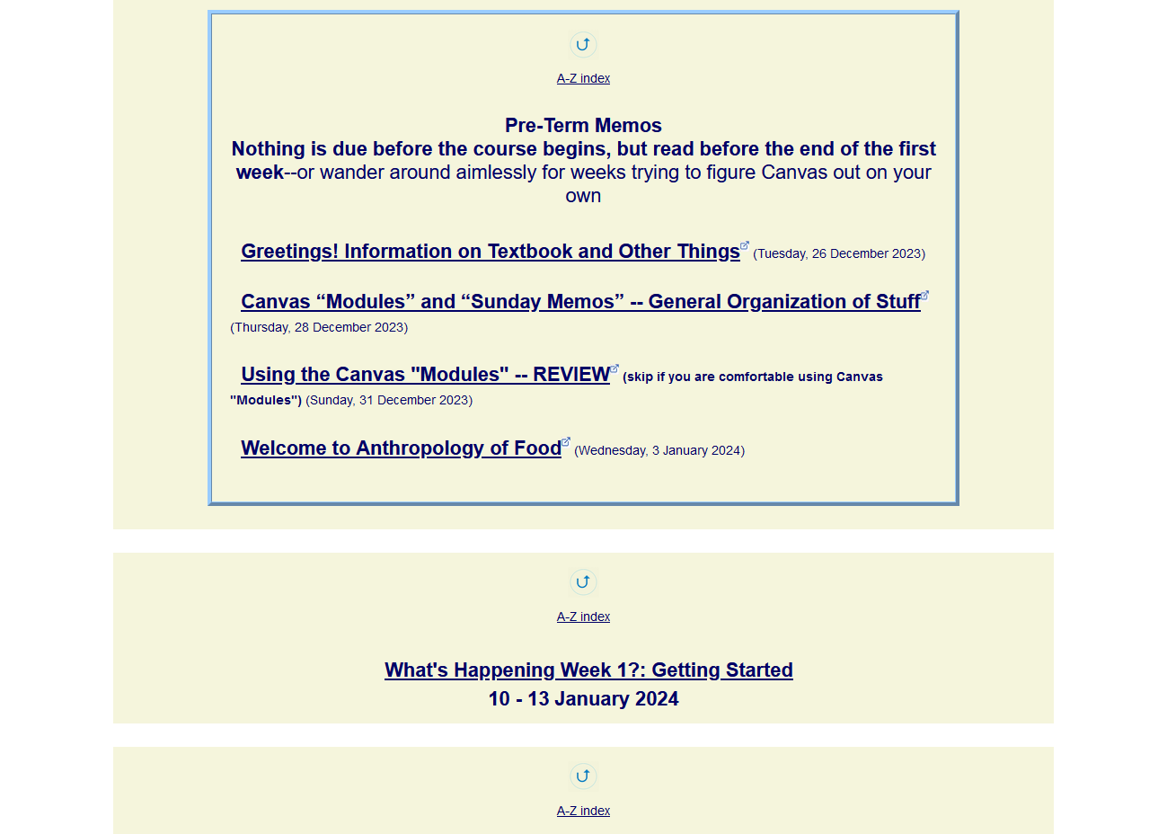

open the
Week 1 “Sunday Memo”

Slide 15
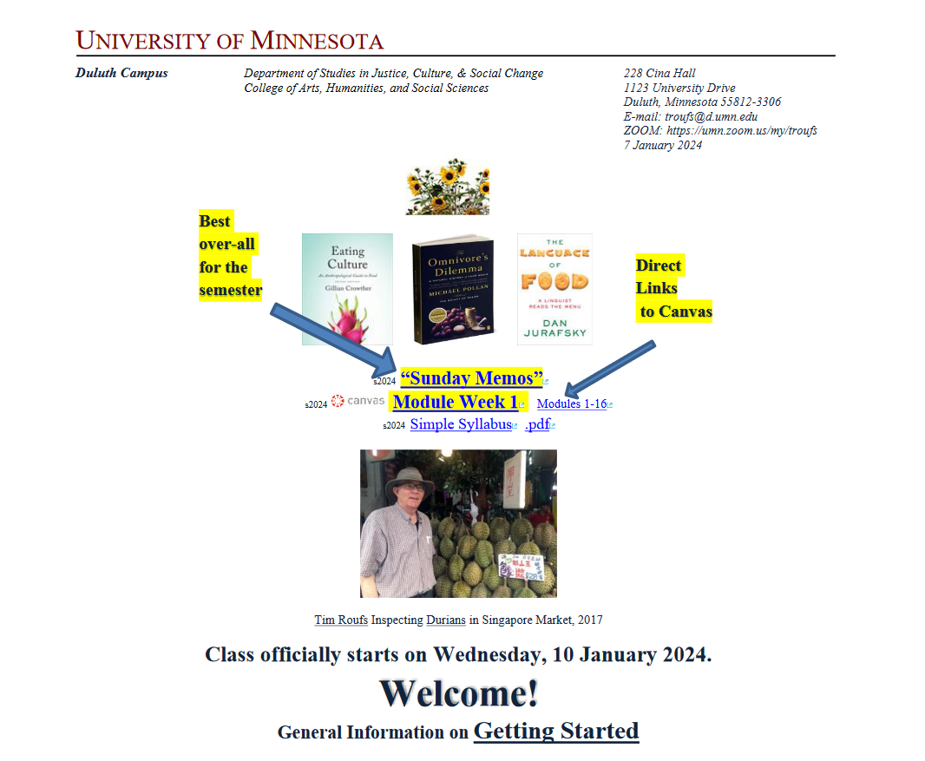
it looks like this . . .

Slide 16
check out the memo
Generally speaking,
the “Sunday Memos”
are the best place to find out
“What’s Happening”
for the week

Slide 18

(if you are not already in Canvas)
Go to your
course management site
and check it out . . .

Slide 19
How do you find your
folder?

Slide 20
Further instructions follow,
but if you want,
and your browser permits,
clicking on the URL that follows
in the next slide
will take you to your Canvas home . . .
(your browser may require that you double-click)
There is another link at the end of this program

Slide 21
https://canvas.umn.edu
(your browser may require that you double-click)
If your browser does not allow you to click on the above URL just enter it in your browser window . . .
Continue on here for further instructions . . .
There is another link at the end of this program

Slide 22
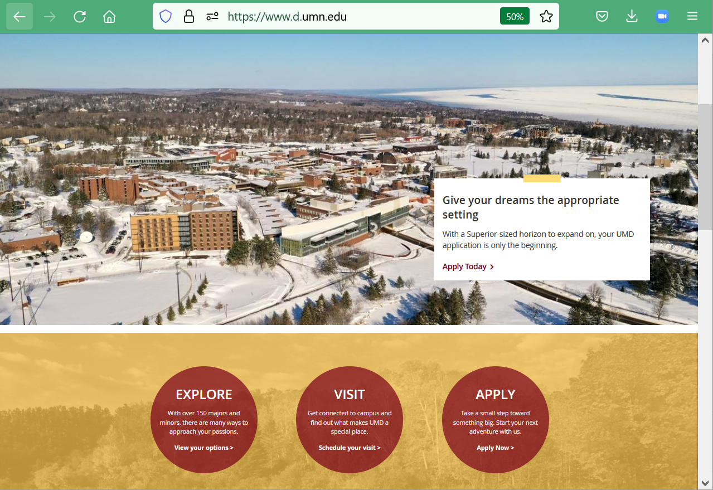
or enter:
canvas.umn.edu
here

Slide 23
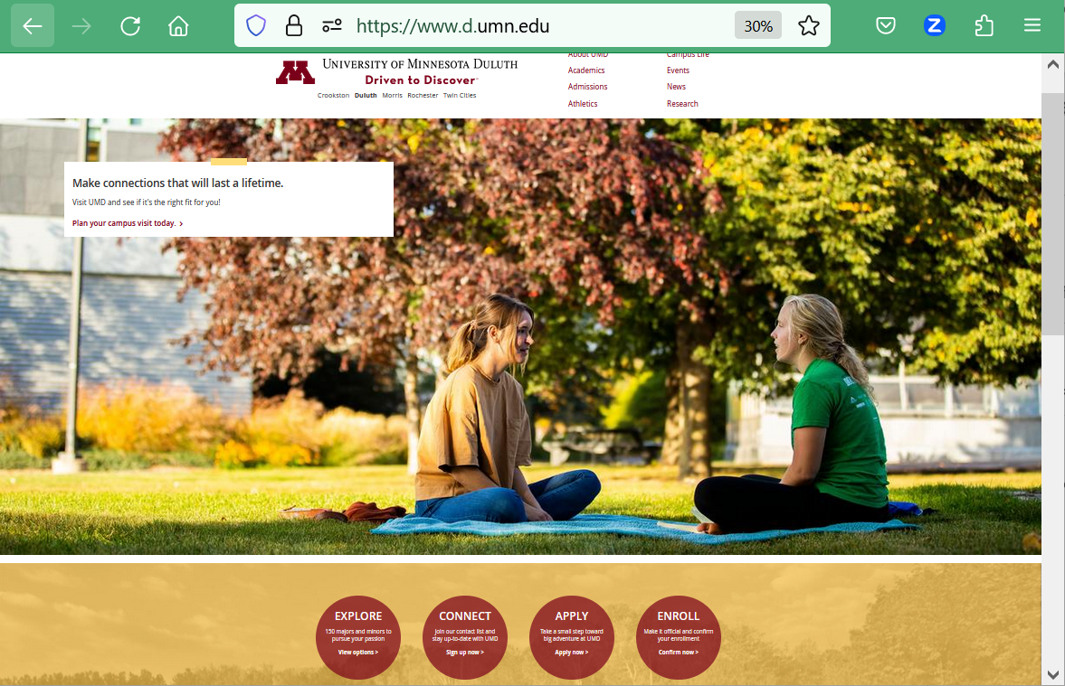
or enter:
canvas.umn.edu
here

Slide 24
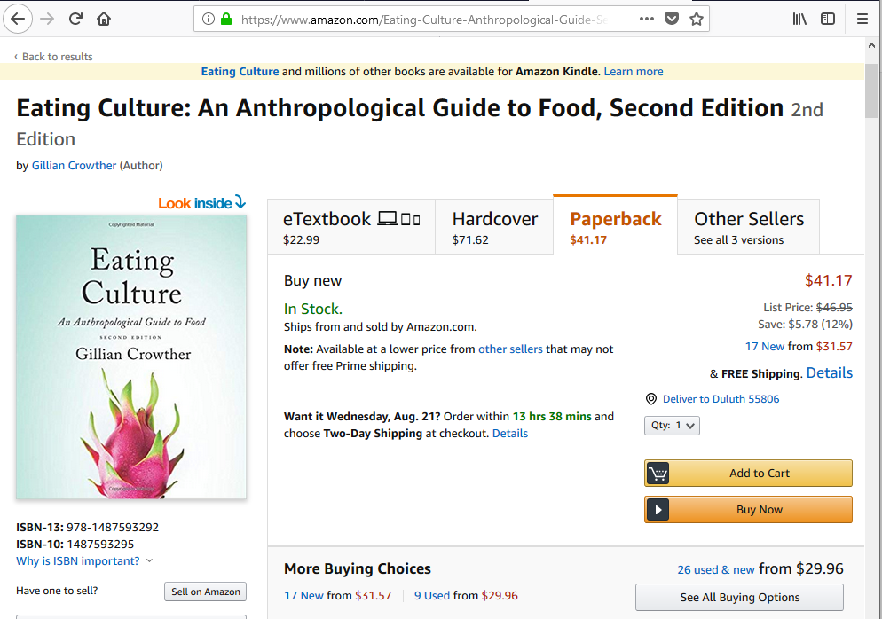
or enter:
canvas.umn.edu
here

Slide 25
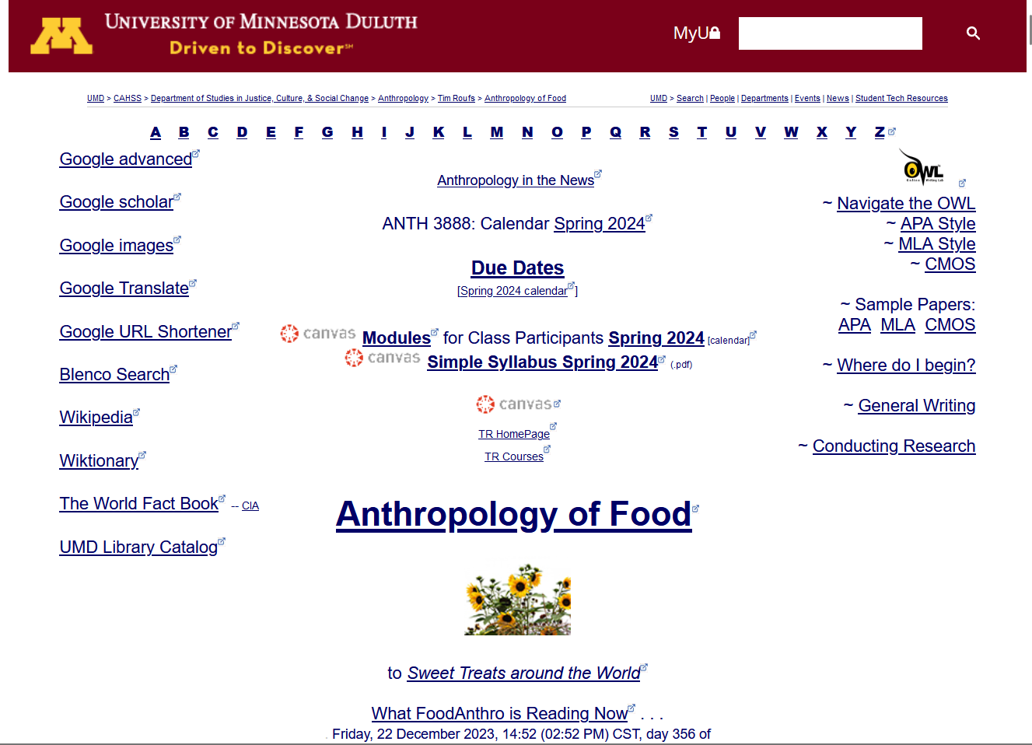
or click links like this

Slide 26
You may also access your Canvas folder from any of the many
course index and content
web pages . . .

Slide 27
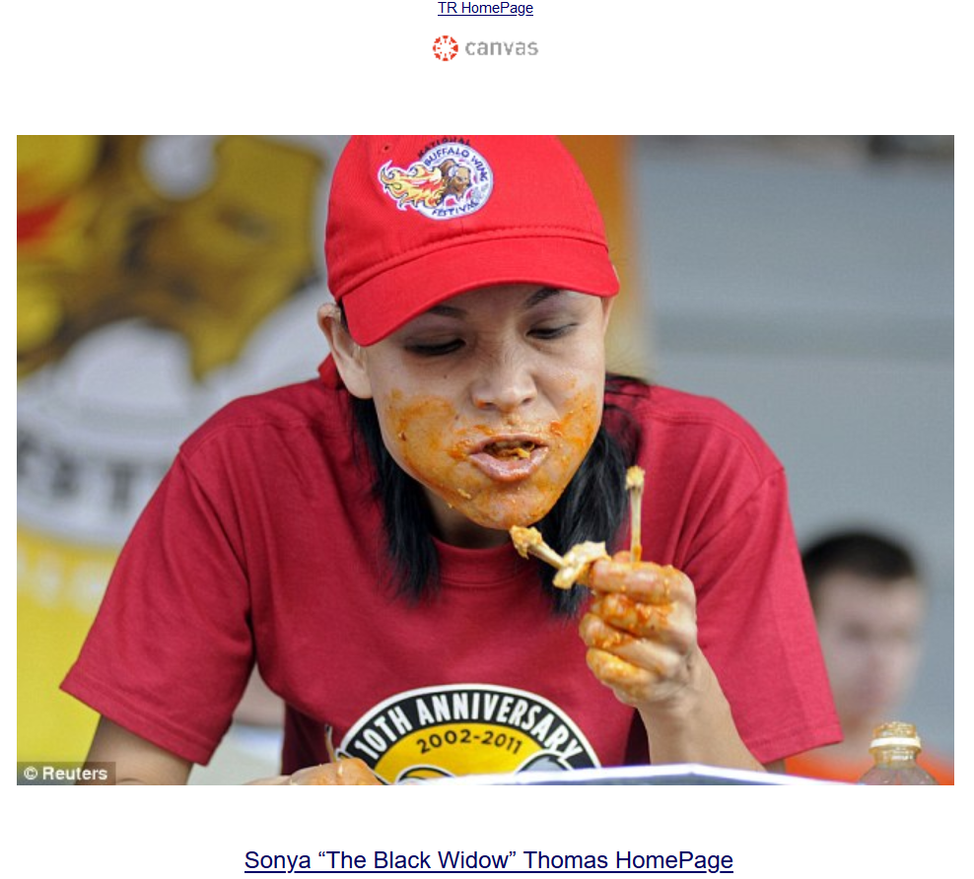

Click Here

Slide 28
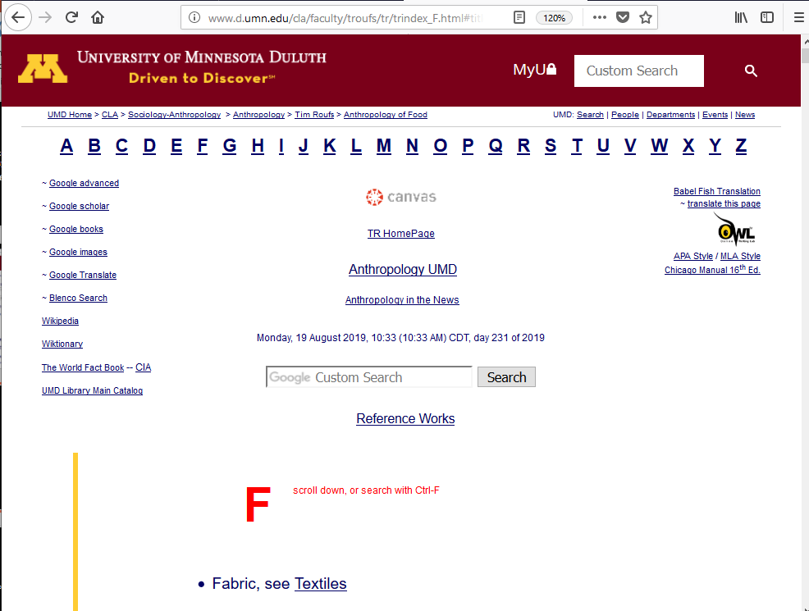
Click Here

Slide 29
Your log-in page
will then present
the UM Canvas Sign-in prompt . . .

Slide 30
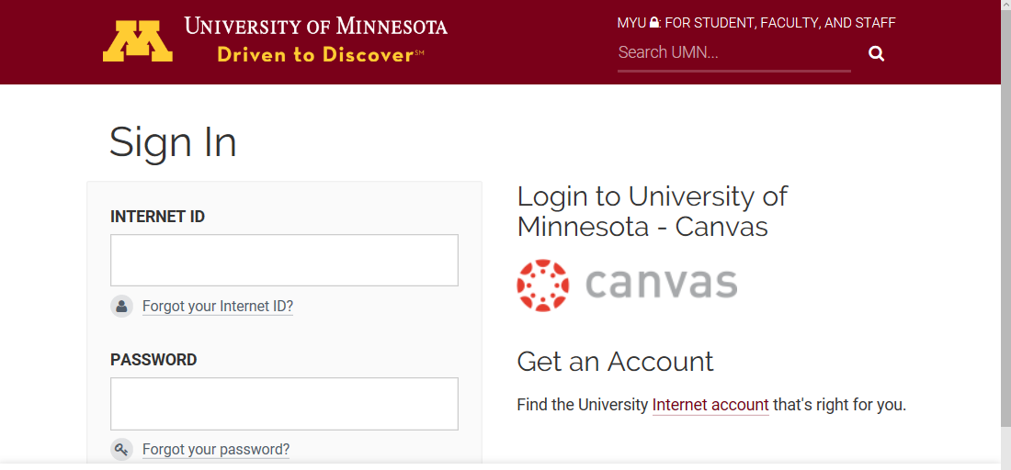
Log in using your “x.500” information . . .
(that’s the log-in information you use for your e-mail)

Slide 31
Log in using your “x.500” information . . .
(that’s the log-in information you use for your e-mail)
Log in using your “x.500” information . . .

Slide 32
Your Sign In will then bring
you to the “Duo Push” screen . . .

Slide 33
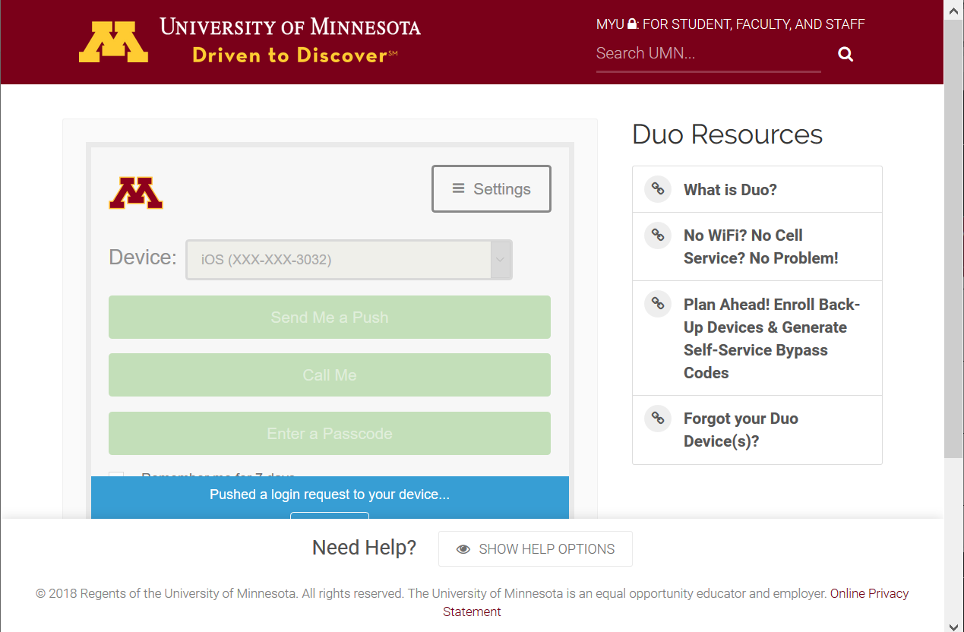

Slide 34
And the “Duo Push” will send
a Login Request
(generally) to your phone . . .

Slide 35
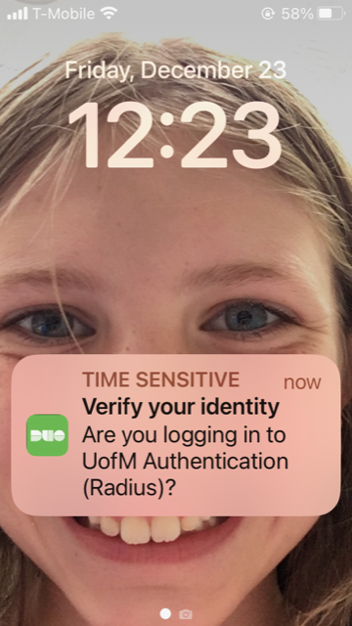
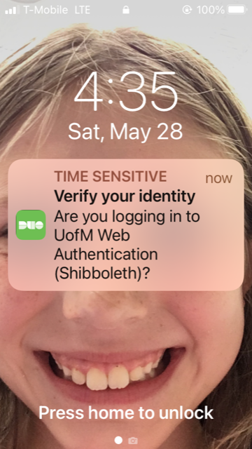
Duo Login Request Alert

Slide 36
Approve the
Login Request
and “Bob’s your uncle” . . .
1887 Lord Salisbury?

Slide 37
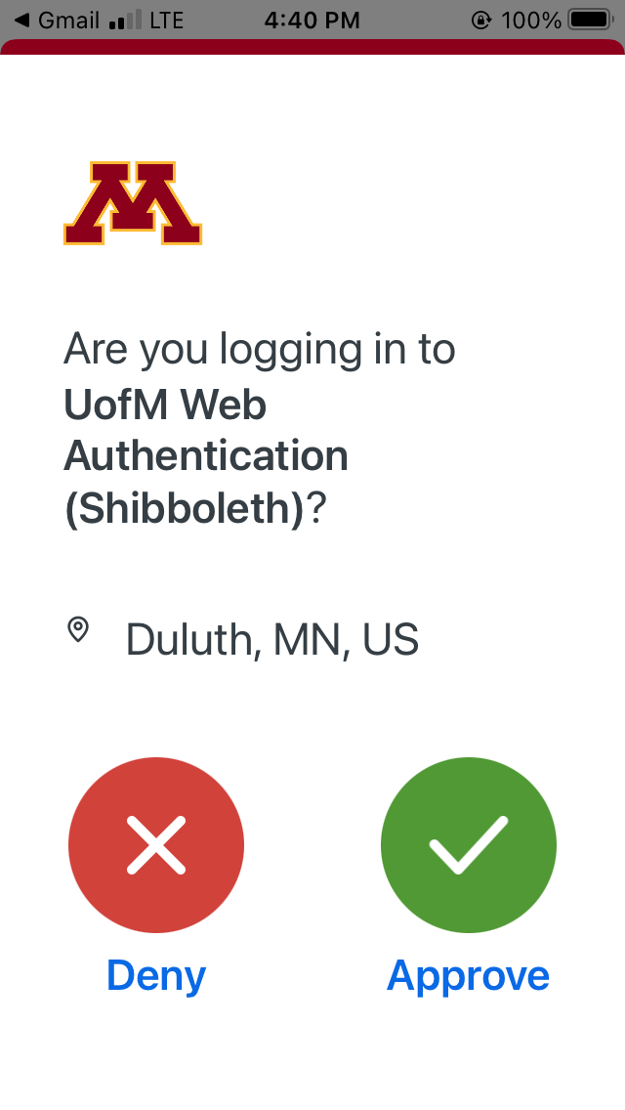
verify here in your UM e-mail

Slide 38
Your Canvas “Dashboard” on your laptop
will look something like the following . . .
https://canvas.umn.edu/

Slide 39
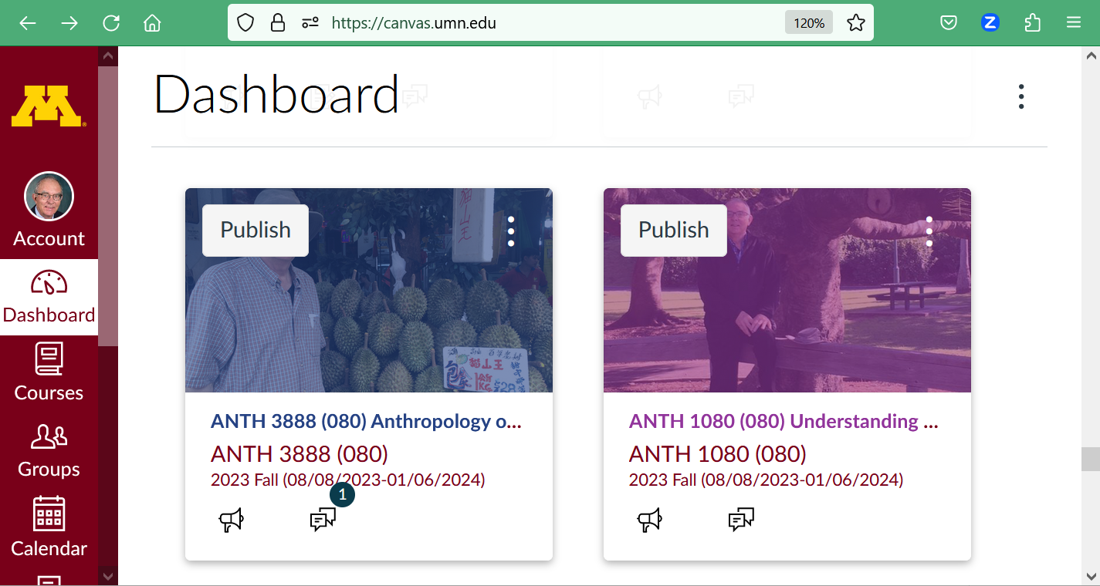
REM
Select ANTH 3888
Dashboard
Your laptop Canvas “Dashboard” will look something like this . . .

Slide 40
Your Canvas “Dashboard” on your phone
will look something like the following . . .
https://canvas.umn.edu/

Slide 41
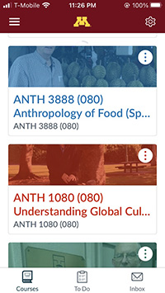
Your Canvas phone app
Dashboard screen
will look
something like this . . .

Slide 42
click on
ANTH 3888

Slide 43
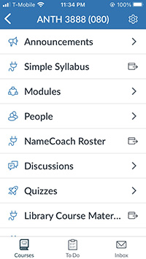
Your Canvas phone app
“Home” screen
will look
something like this . . .

Slide 44
Your Canvas “Home” screen
on your phone
will look something like the following . . .

Slide 45
Your Canvas phone app
“Home” screen
will look
something like this . . .
the weekly “What’s Happening?” memo is available here on your phone

Slide 46
NOTE: Not all Canvas features work on phone apps . . .
And different phone models work differently . . .

Slide 47
Your Canvas “Home” screen
on your laptop
will look something like the following . . .

Slide 48
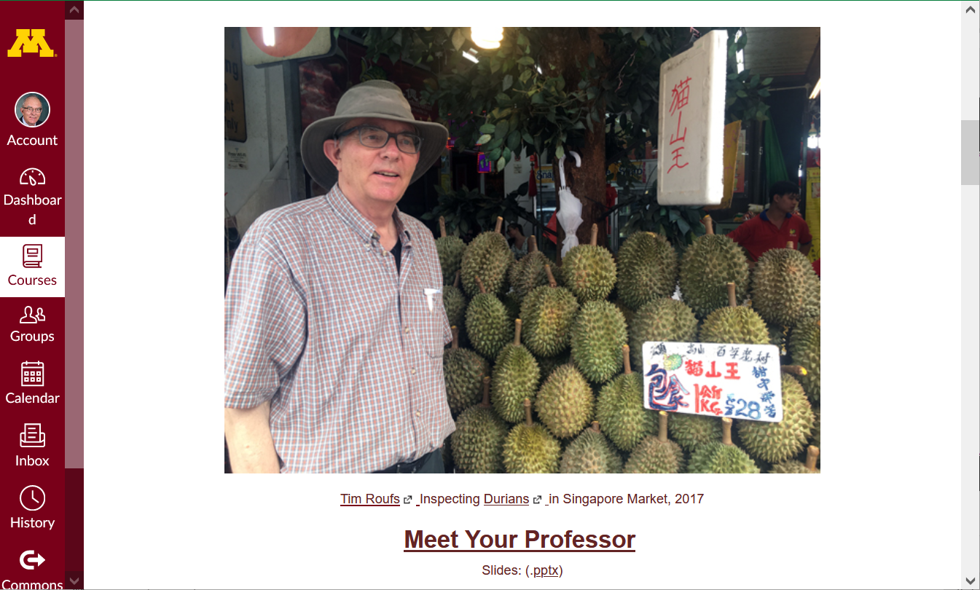

Home page
Your laptop Canvas “Home” screen will look something like this

Slide 49
your laptop
Canvas folder has
two important
navigation panels . . .

Slide 50
GLOBAL navigation . . .
COURSE navigation . . .

Slide 51
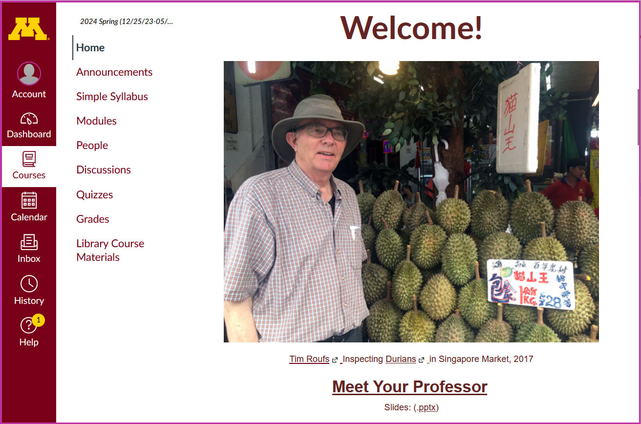
global navigation

Slide 52
GLOBAL navigation . . .
and
COURSE navigation . . .

Slide 53
course navigation

Slide 54
How to hide the
“course Navigation”
panel . . .

Slide 55
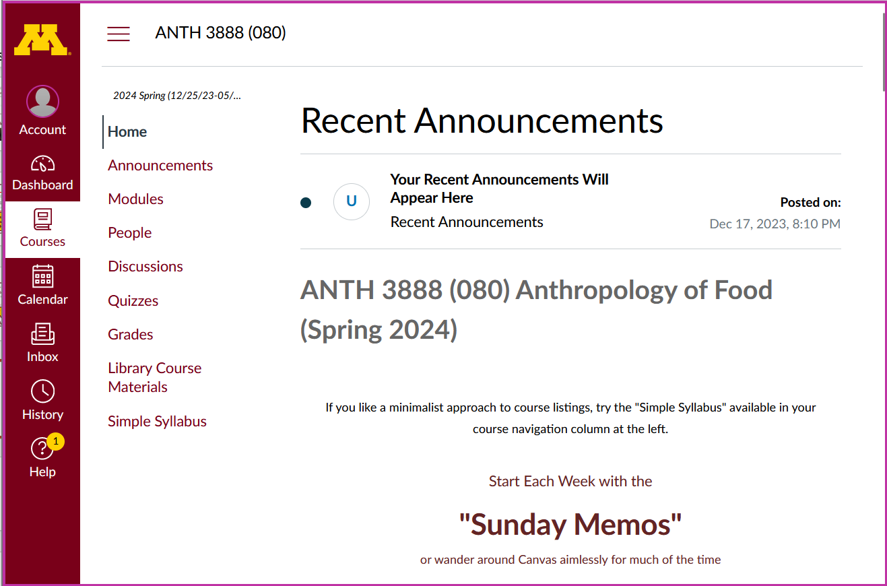
use the “hamburger” button
to turn panel on/off
(the border is turned off when panel is on)

Slide 56
course navigation

Slide 57
hide course navigation panel here
use the “hamburger” button

Slide 58
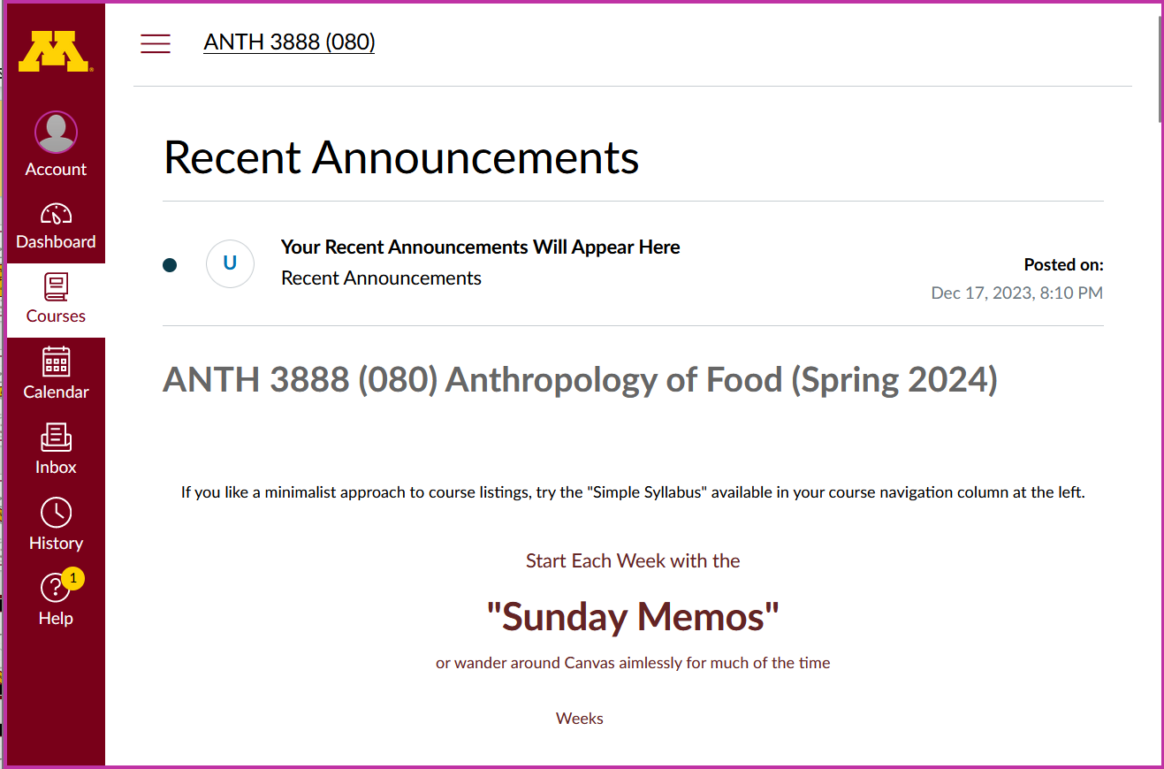
course navigation panel disappears

Slide 59
global navigation remains

Slide 60
to unhide course navigation panel
use the “hamburger” button

Slide 61
course navigation returns

Slide 62
course navigation returns
Scroll down for basic information on Home Page . . .

Slide 63
Home page

Slide 64

Home page
Scroll down for basic information on Home Page . . .

Slide 65
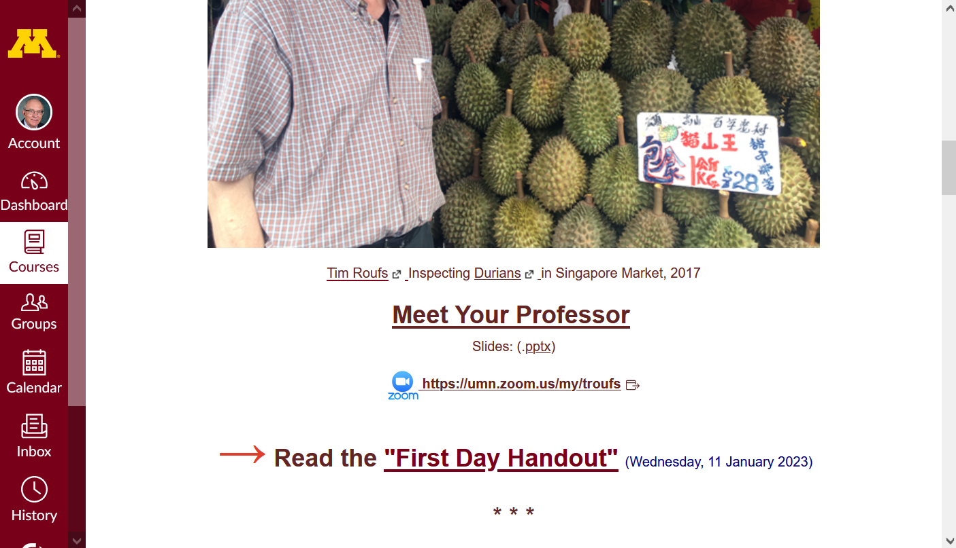
Home page

Slide 66
Home page
Have a look at the
“First Day Handout” . . .

Slide 67
The “First-Day” Handout information contains the basic course information . . .
It’s the syllabus
It look something like the following . . .
https://canvas.umn.edu/

Slide 68
The “First-Day” Handout information contains the basic course information . . .
It’s the syllabus
It look something like the following . . .
https://canvas.umn.edu/

Slide 69
Where to Begin?

Slide 70
Where to Begin?
Read the Week 1 “Sunday Memo”
Open your Canvas folder,
select ANTH 3635,
and have a look around . . .
    Check out your Week 1 Canvas “Module”
    Read the “First-Day” handout
Have fun

Slide 71
Where to Begin?
Read the Week 1 “Sunday Memo”
Open your Canvas folder,
select ANTH 3888,
and have a look around . . .
    Check out your Week 1 Canvas “Module”
    Read the “First-Day” handout
Have fun

Slide 72
Where to Begin?
Read the Week 1 “Sunday Memo”
Open your Canvas folder,
select ANTH 3888,
and have a look around . . .
    Check out your Week 1 Canvas “Module”
    Read the “First-Day” handout
Have fun

Slide 73
Where to Begin?
Read the Week 1 “Sunday Memo”
Open your Canvas folder,
select ANTH 3888,
and have a look around . . .
    Check out your Week 1 Canvas “Module”
    Read the “First-Day” handout
Have fun

Slide 74
Where to Begin?
Read the Week 1 “Sunday Memo”
Open your Canvas folder,
select ANTH 3888,
and have a look around . . .
    Check out your Week 1 Canvas “Module”
    Read the “First-Day” handout
Have fun

Slide 75
Where to Begin?
Read the Week 1 “Sunday Memo”
Open your Canvas folder,
select ANTH 3888,
and have a look around . . .
    Check out your Week 1 Canvas “Module”
    Read the “First-Day” handout
Have fun

Slide 77
REM
Select ANTH 3888
Dashboard
Your laptop Canvas “Dashboard” will look something like this . . .

Slide 78
AVISO!
One of the main complaints regarding Canvas is that it is difficult to find assignments.
Right now, before you do anything else,
do this to fix that problem . . .
Go to the "Modules" Section
(using the Course Navigation Panel)

Slide 79
AVISO!
One of the main complaints regarding Canvas is that it is difficult to find assignments.
Right now, before you do anything else,
do this to fix that problem . . .
Go to the "Modules" Section
(using the Course Navigation Panel)

Slide 80
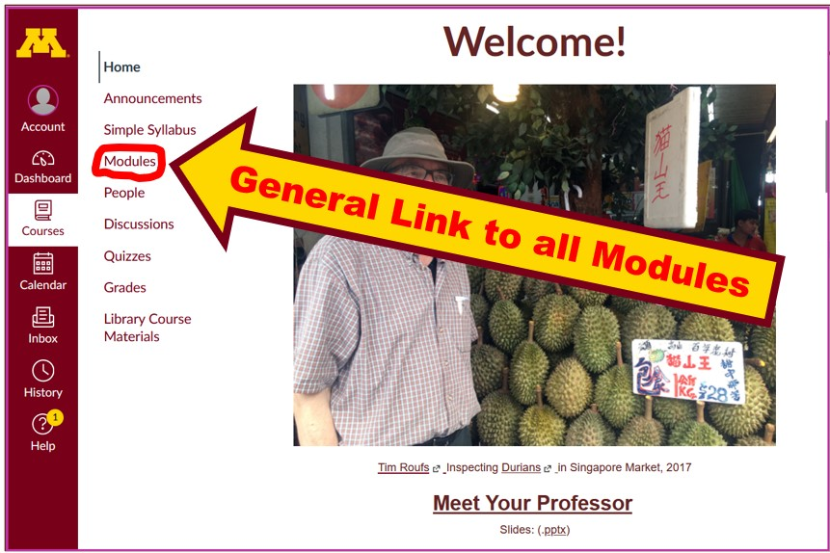


Slide 81
. . . and that will take you
to the Modules folder,
which looks
something like this . . .

Slide 82
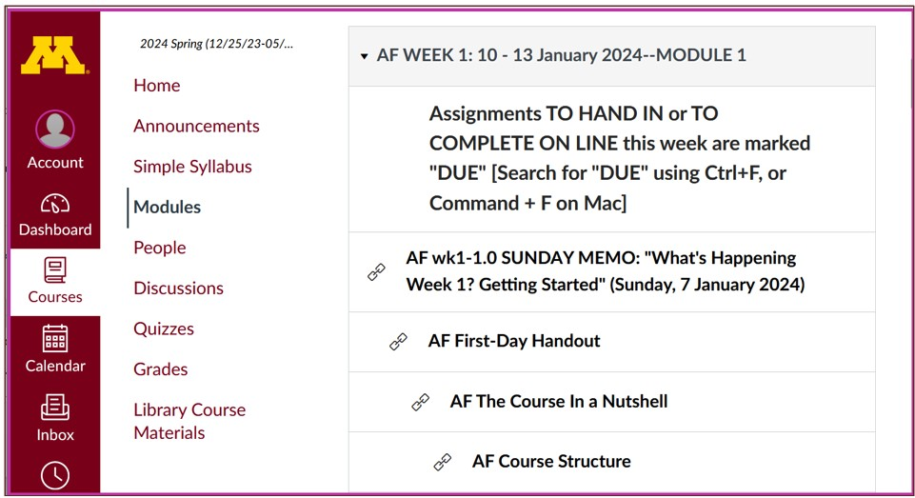


Modules

Slide 83
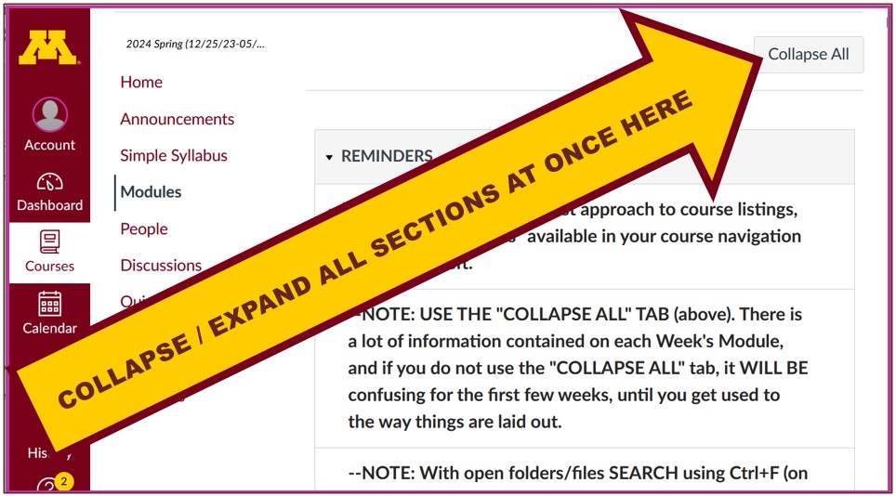



Modules

Slide 84
Then open each Module
one-by-one
as you need it / them . . .

Slide 85
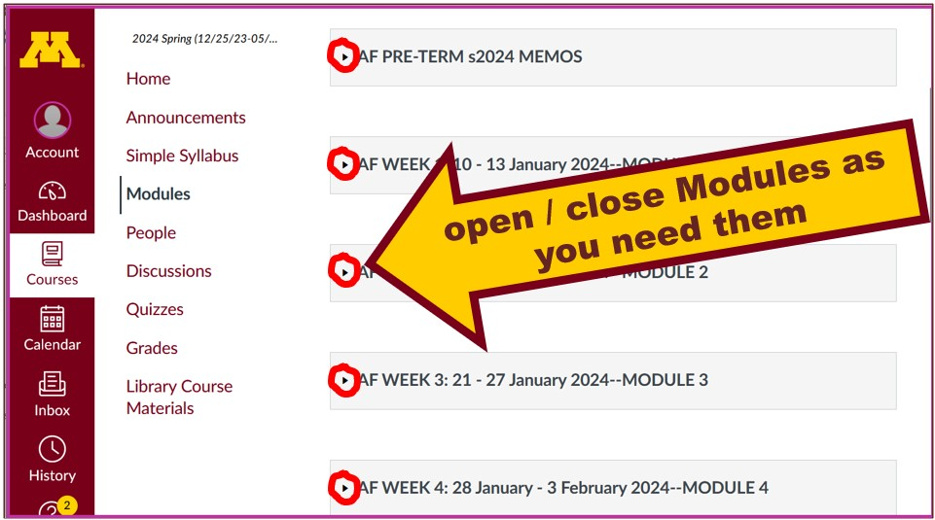

Modules

Slide 86
The expanded
Week 1 Module
will look like this . . .

Slide 87

Modules

Slide 88
To get started
with the basics of the course,
check out the Week 1 “Sunday Memo”
"What's Happening Week 1?
-- Getting Started" . . .

Slide 89


Modules
Getting Started

Slide 90
After you are done with that check out
the "First Day Handout” . . .
(the class syllabus) . . .

Slide 91


Modules
First-Day Handout

Slide 92
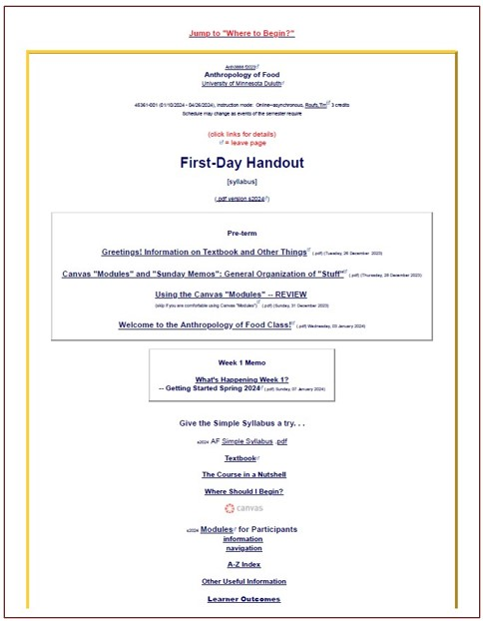


Slide 93
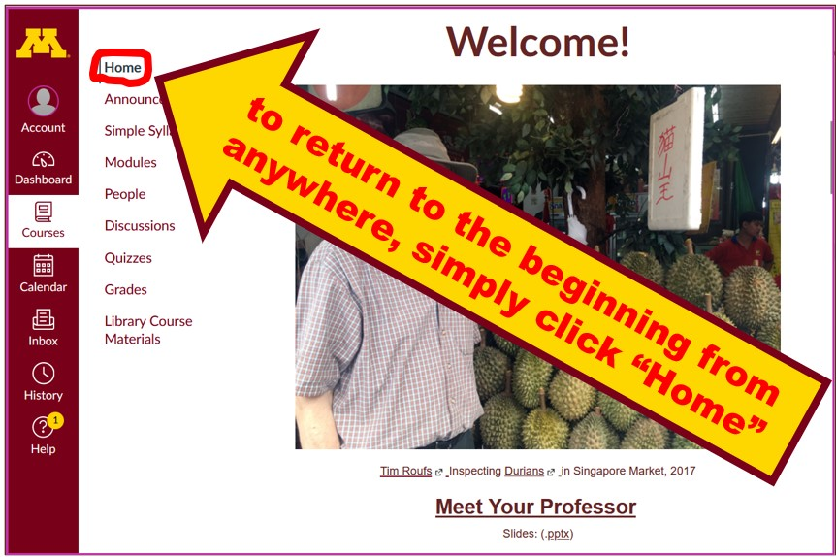


Slide 94
Other useful information . . .

Slide 95
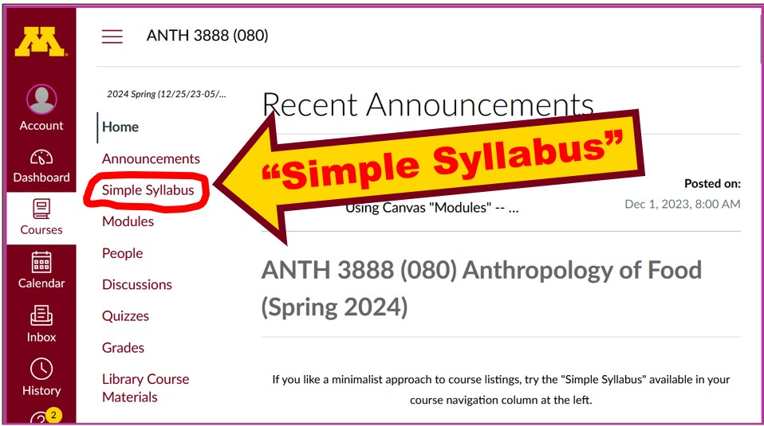
Try the Simple Syllabus . . .

Slide 96
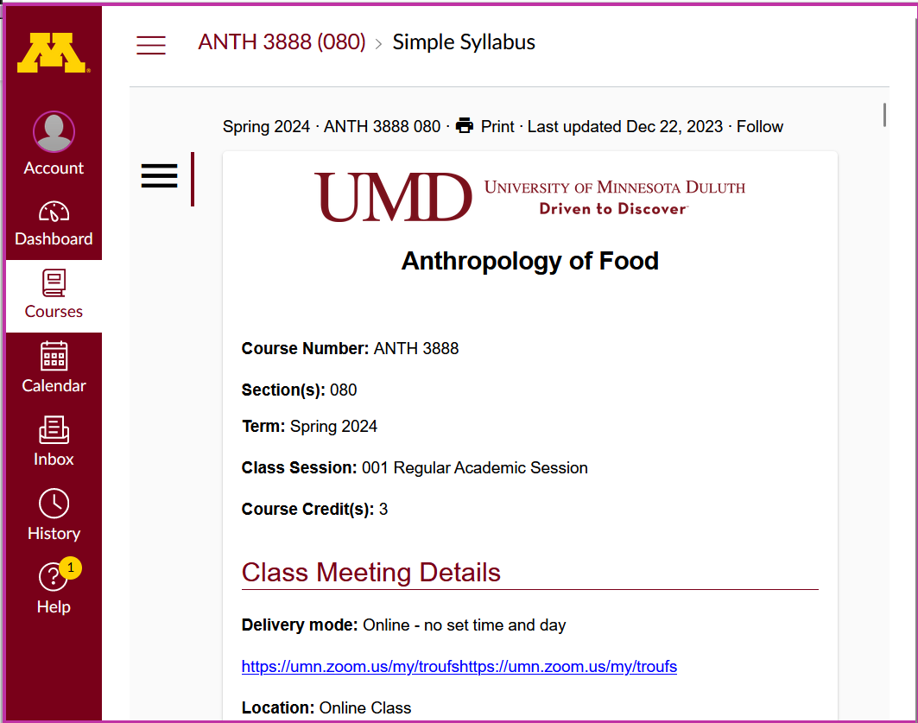

Slide 97
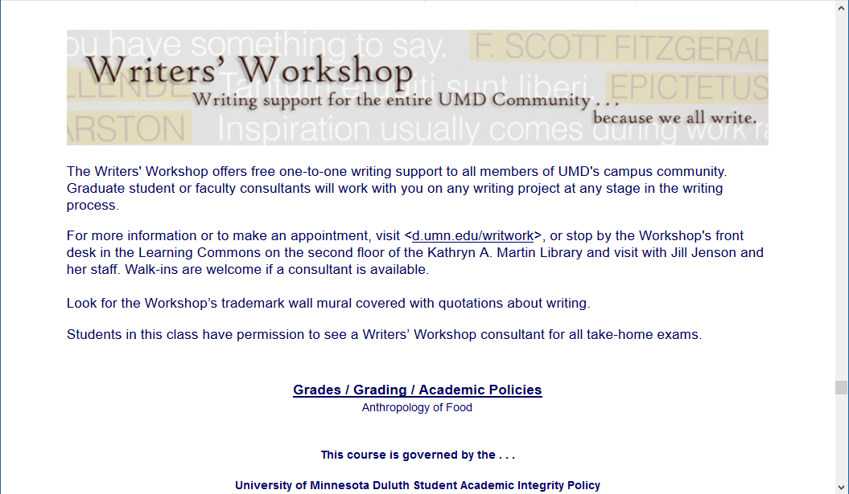
Other Useful Information . . .
Writers’ Workshop
is an excellent resource for
Everyone!
Second Floor UMD Library

Slide 98
Other Useful Information . . .

Slide 99
Governing Procedures
pay attention . . .

Slide 100
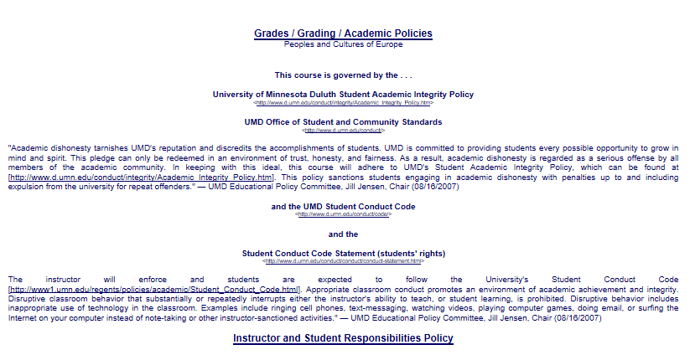

Slide 101
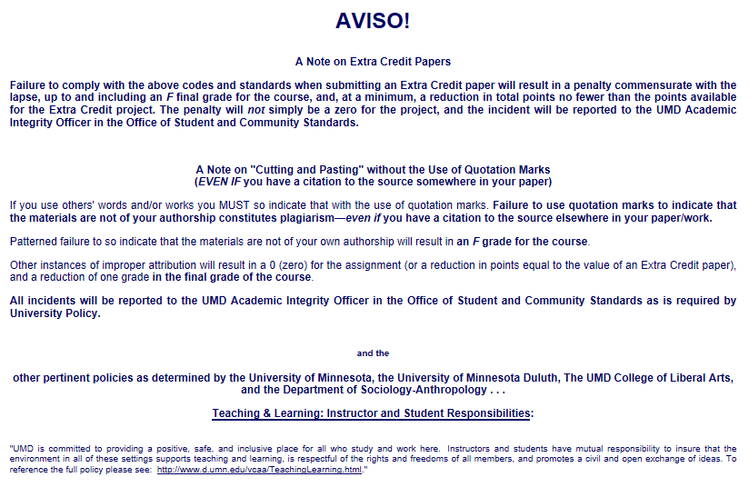

Slide 102
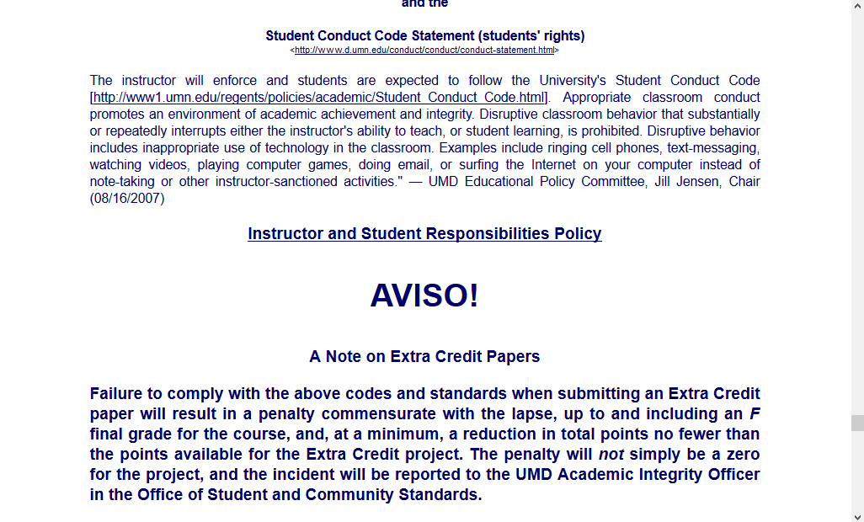
NB: Governing Procedures
note on Extra Credit Papers

Slide 104
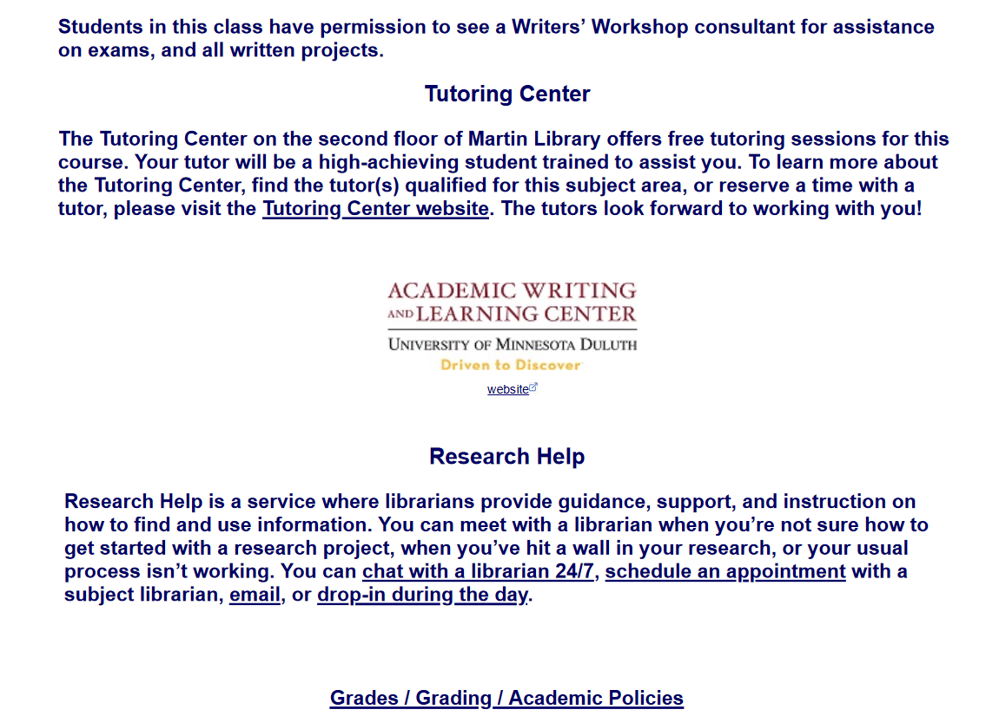

Slide 105
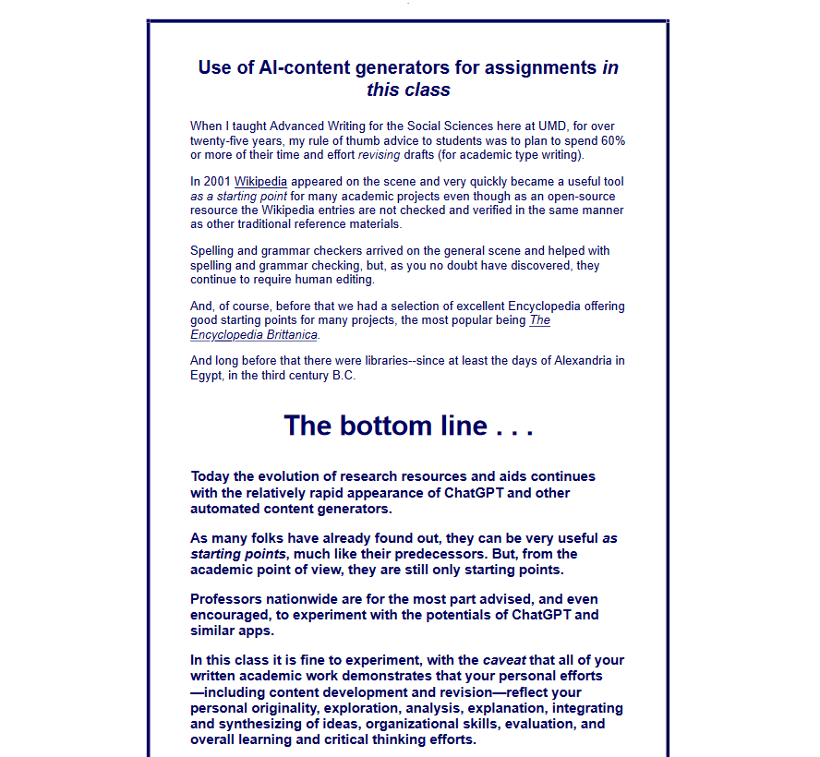

Slide 106
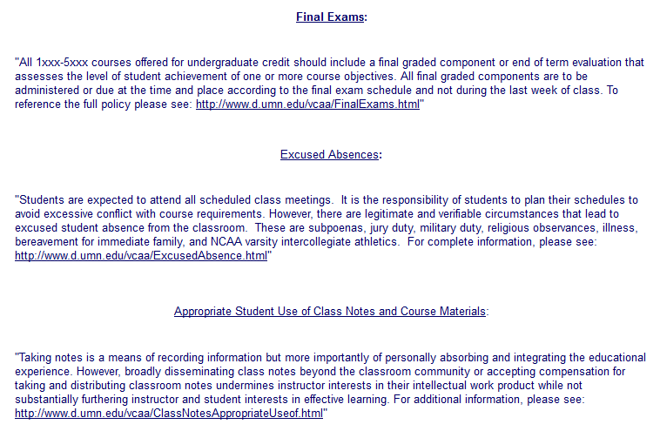

Slide 107
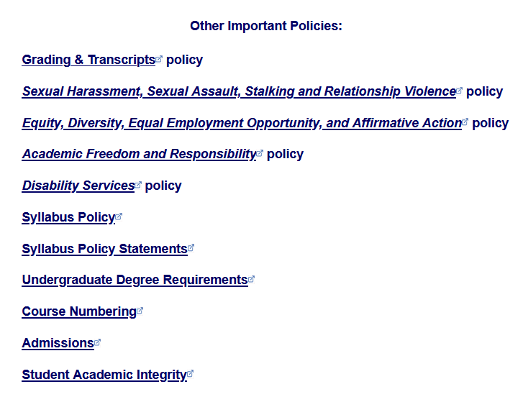

Slide 108
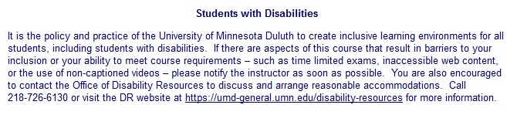
Special Facilities Information

Slide 109
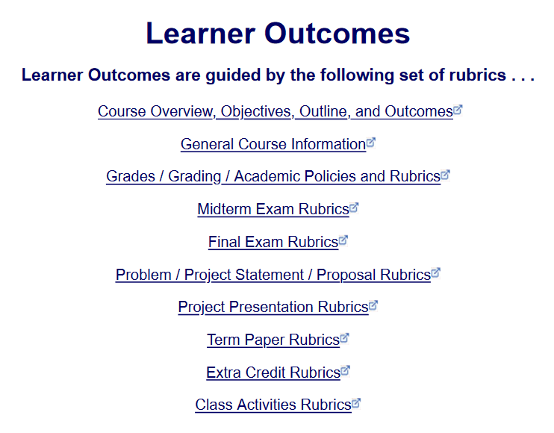




Slide 110
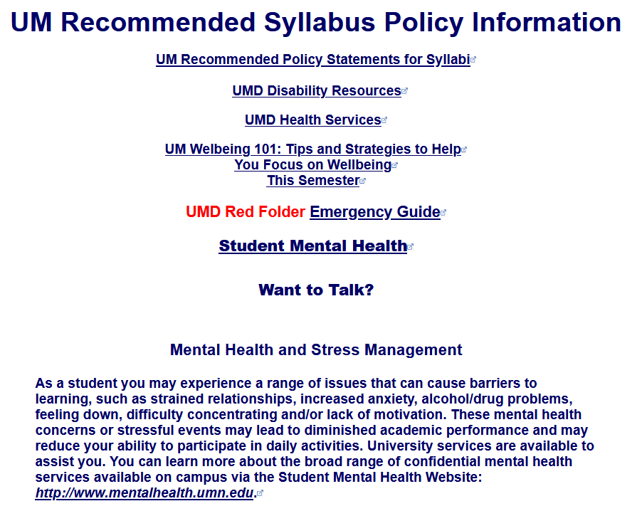

Slide 111
Once again . . .
Welcome to
Anthropology of Food
University of Minnesota Duluth
Tim Roufs

Slide 112
Once again . . .
Welcome to
Anthropology of Food
Enjoy your stay!
University of Minnesota Duluth
Tim Roufs

Slide 113
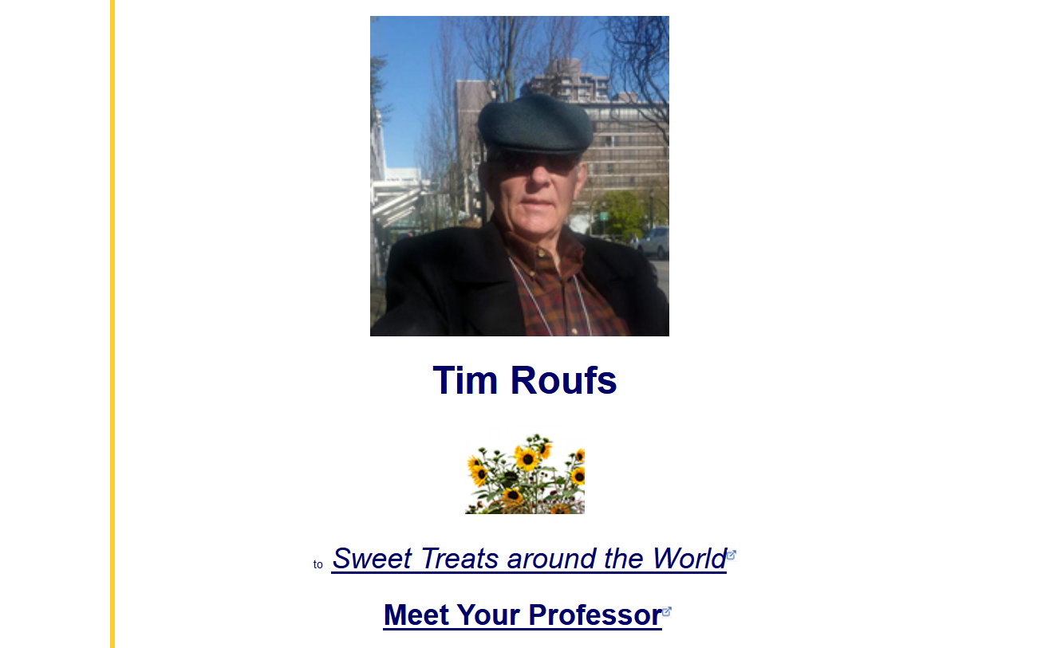
http://www.d.umn.edu/cla/faculty/troufs/index.html
0

